Slide 1
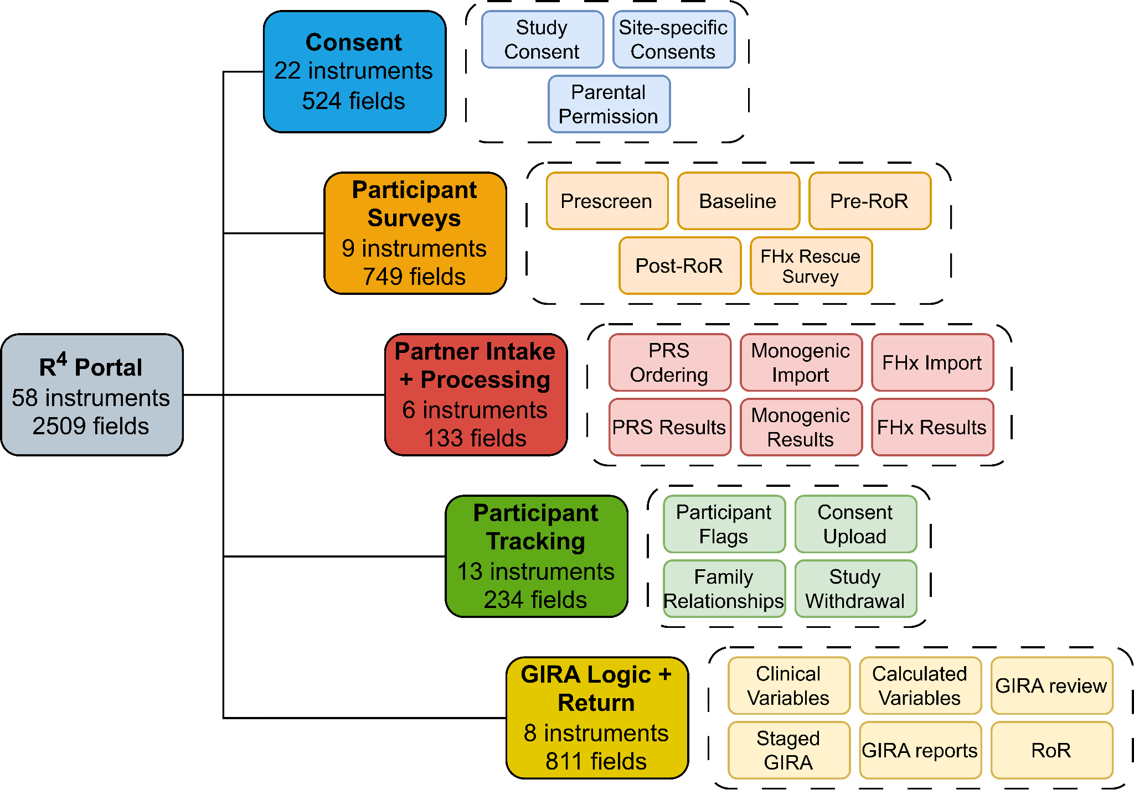
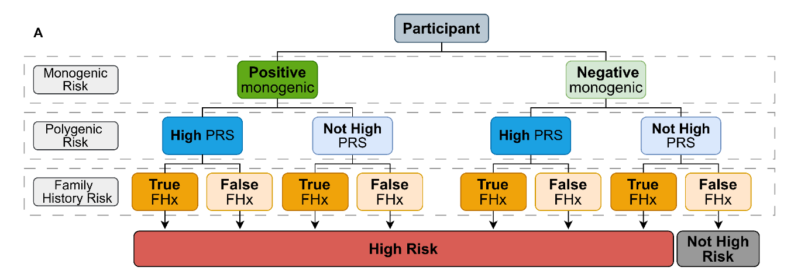









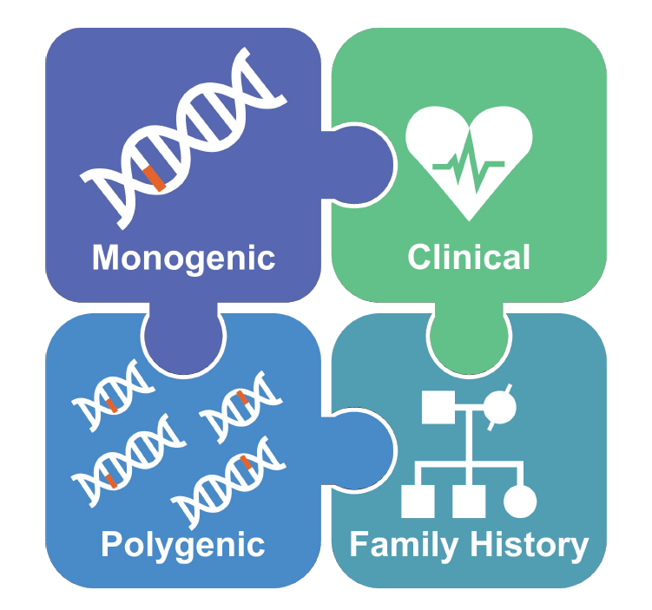










Color guidelines:
Using the REDCap platform to Integrate Risks from Diverse Sources for a Clinical-grade Genome Informed Risk Assessment
Jennifer Morse, MS; Megan He, PhD; Jodell E. Linder, PhD; Adam Lewis; Travis Wilson; Ellis Thomas; Kyle McGuffin; Sophie Forman; Dawn Moore; Paul Harris, PhD; Josh F Peterson, MD, MPH
#D8AB4C
eMERGE Research Study Goals
Conditions Assessed
The eMERGE research study assesses monogenic and polygenic risk (PRS) for 25,000 participants with a goal of understanding the impact of integrated genetic risk on clinical actionability and outcomes.
We developed a data capture, analytic, and reporting infrastructure system using the REDCap platform to combine monogenic and polygenic risk, family history risk, and clinical risk factors to influence preventative care for 11 complex diseases.
Asthma | Coronary Heart Disease | Obesity
Atrial Fibrillation | Colorectal Cancer | Type I Diabetes
Breast Cancer | Prostate Cancer | Type II Diabetes
Chronic Kidney Disease | Hypercholesterolemia
#F7EEDB
Overview of REDCap Instruments
Description of R⁴ System
Processing Risk
Figure 1: REDCap infrastructure of R⁴ Portal used to house, organize, and access study data. The R⁴ Portal was the centralized platform used in the eMERGE study to collect data via participant-facing surveys, track administrative data, intake and process partner data, generate the GIRA, and track return of results. PRS = polygenic risk score, FHx = family health history, RoR = return of results.
R⁴ (Recruitment, Results, and Risk Reduction) receives, stores, and manipulates incoming data streams from electronic health records (EHRs) across 10 health systems, genetic results from two laboratories, and study survey results from participants.
REDCap: well-established modules and features to support clinical research
Features: Electronic consent, direct entry of patient provided survey data, and multisite operational access features allow individual participant records to be assigned to individual sites.
Figure 2: Condition specific high risk was calculated based on a combination of triggers. For each condition assessed, high risk was defined based on a combination of monogenic risk, polygenic risk, family history, and integrated risk. An estimated 1 - 5% of participants are predicted to be at high risk for each assessed condition
#333333
#DDDDDD
Integration with Partner Data
#000000
Custom APIs: APIs with the Broad Institute, Invitae, and MeTree (Duke University) ingested reports in JSON, PNG, and PDF formats. An additional API securely accessed a clinical decision support tool hosted by the University of Cambridge (BOADICEA score) to calculate a lifetime breast cancer risk.
Risk Logic: Collected data were parsed and stored in REDCap and calculated fields were created with custom logic incorporating network-guided recommendations for a combined report, the GIRA.
Conclusions and Implications
As of August 2024, all sites have completed enrollment (n=26,859). Risk reports have been created and results returned for 17,334 participants.
A highly customized REDCap implementation enabled a large-scale genomic risk implementation project. The infrastructure translated patient data and practice guidelines into a clinical report used at point of care to individualize preventive care and potentially mitigate 11 complex diseases. Health services outcomes analysis comparing risk groups is currently ongoing.
Font guidelines:
Contributing Sites
Learn More
Linder, J.E. et al. 2023. Returning Integrated genomic risk and clinical
recommendations: the eMERGE study. Genetics in Medicine.
Impact
Tahoma
Titles:
Impact, Loose Spacing, All Caps
Body Copy:
Tahoma, Regular, 1.5 Extended Spacing
The eMERGE Genomic Risk Assessment Network is funded by the National Human Genome Research Institute (NHGRI) through the following grants: U01HG011172,U01HG011175, U01HG008680, U01HG011176, U01HG008685, U01HG006379, U01HG011169, U01HG011167, U01HG008657, U01HG011181, and U01HG011166.
Please contact the corresponding author at Jennifer.morse@vumc.org

