Slide 1
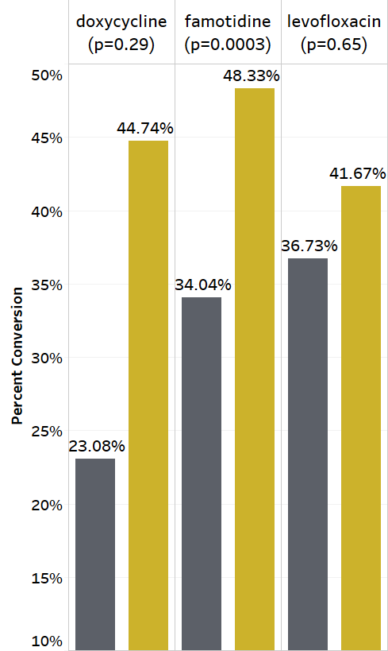
Using Clinical Decision Support to Reduce Cost via Intravenous-to-Oral Medication Conversion:
A Pilot Study and Cost Analysis
Robert W. Turer, MD, MS¹, Claude J. Pirtle, MD, MS¹, David Mulherin PharmD²,
Shane P. Stenner, MD¹, MS, Scott D. Nelson, PharmD, MS¹, Allison B. McCoy, PhD¹,
Mhd W. Alrifai, MD, MS¹, Christoph U. Lehmann, MD, MS^{1,3}
¹Department of Biomedical Informatics, Vanderbilt University, Nashville, TN, USA
²HealthIT, Vanderbilt University Medical Center, Nashville, TN, USA
³Department of Pediatrics, UT Southwestern Medical Center, Dallas, TX, USA
INTRODUCTION
IV medications are frequently used when oral equivalent medications have similar efficacy, improved safety, and reduced cost. EHR-based clinical decision support provides an opportunity to achieve improved safety and cost-savings through IV-to-oral conversion.
METHODS AND RESULTS
CDS Intervention
IV-to-PO Conversion Rates
Drug | Conversion Cost-savings (per dose)
doxycycline | $17.11
famotidine | $0.62
lacosamide | $14.21
levofloxacin | $1.64
levothyroxine | $107.05
linezolid | $42.60
methocarbamol | $54.10
rifampin | $67.67
Wholesale cost analysis of medications at VUMC to find eligible medications.
Targeted alert recommending PO-conversion for non-critically ill adults receiving eligible IV medications.
CDS Analysis
Evaluated 1-month pre and 2-months post. Compared percentage-increase in IV-to-PO conversion using 2x2 Pearson χ2 tests for homogeneity with α=0.05.
Extrapolated actual and potential cost-savings from wholesale cost analysis.
Extrapolated Cost Savings
For All Drugs
$13,948 at current
conversion rate
$118,125 annual
potential savings
CONCLUSIONS
There is great potential for cost-savings and improved safety by converting IV medications to oral equivalents. A more rigorous longitudinal study is required, and a user-centered approach is critical for capturing these potential savings.

