Slide 1

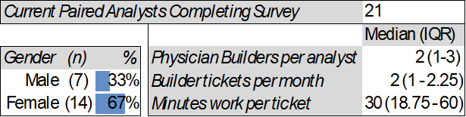
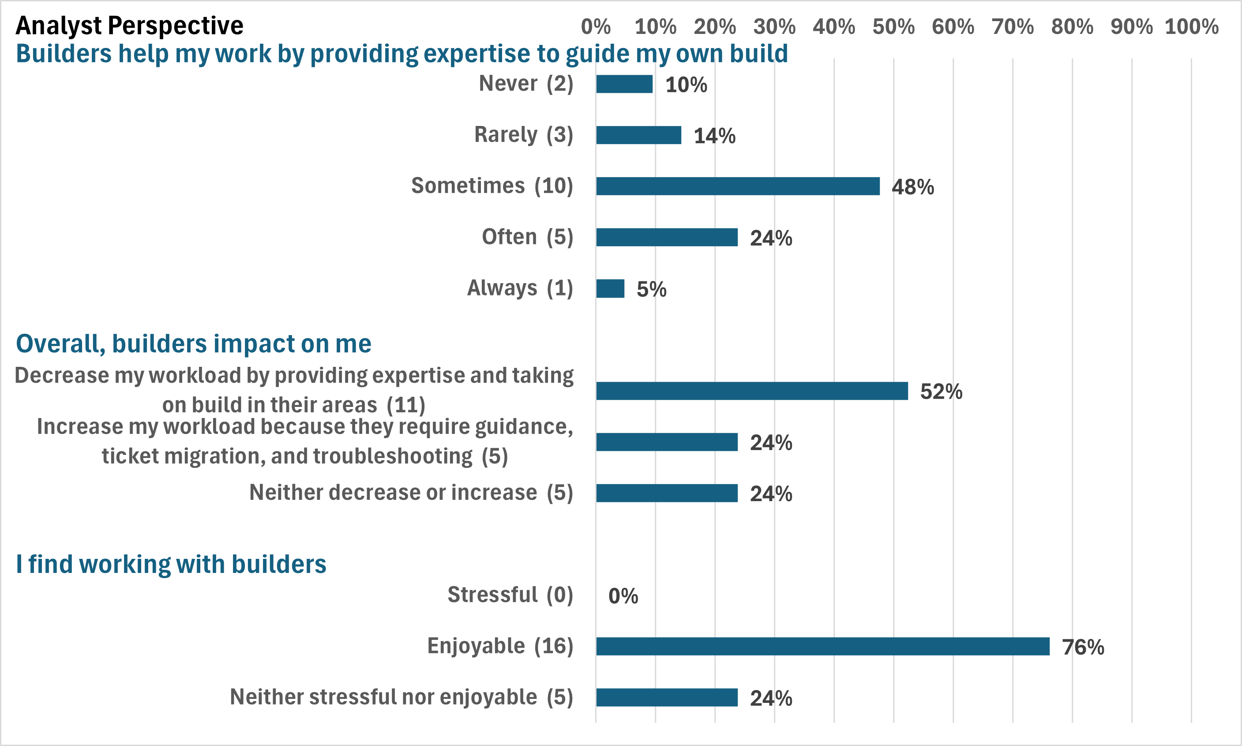


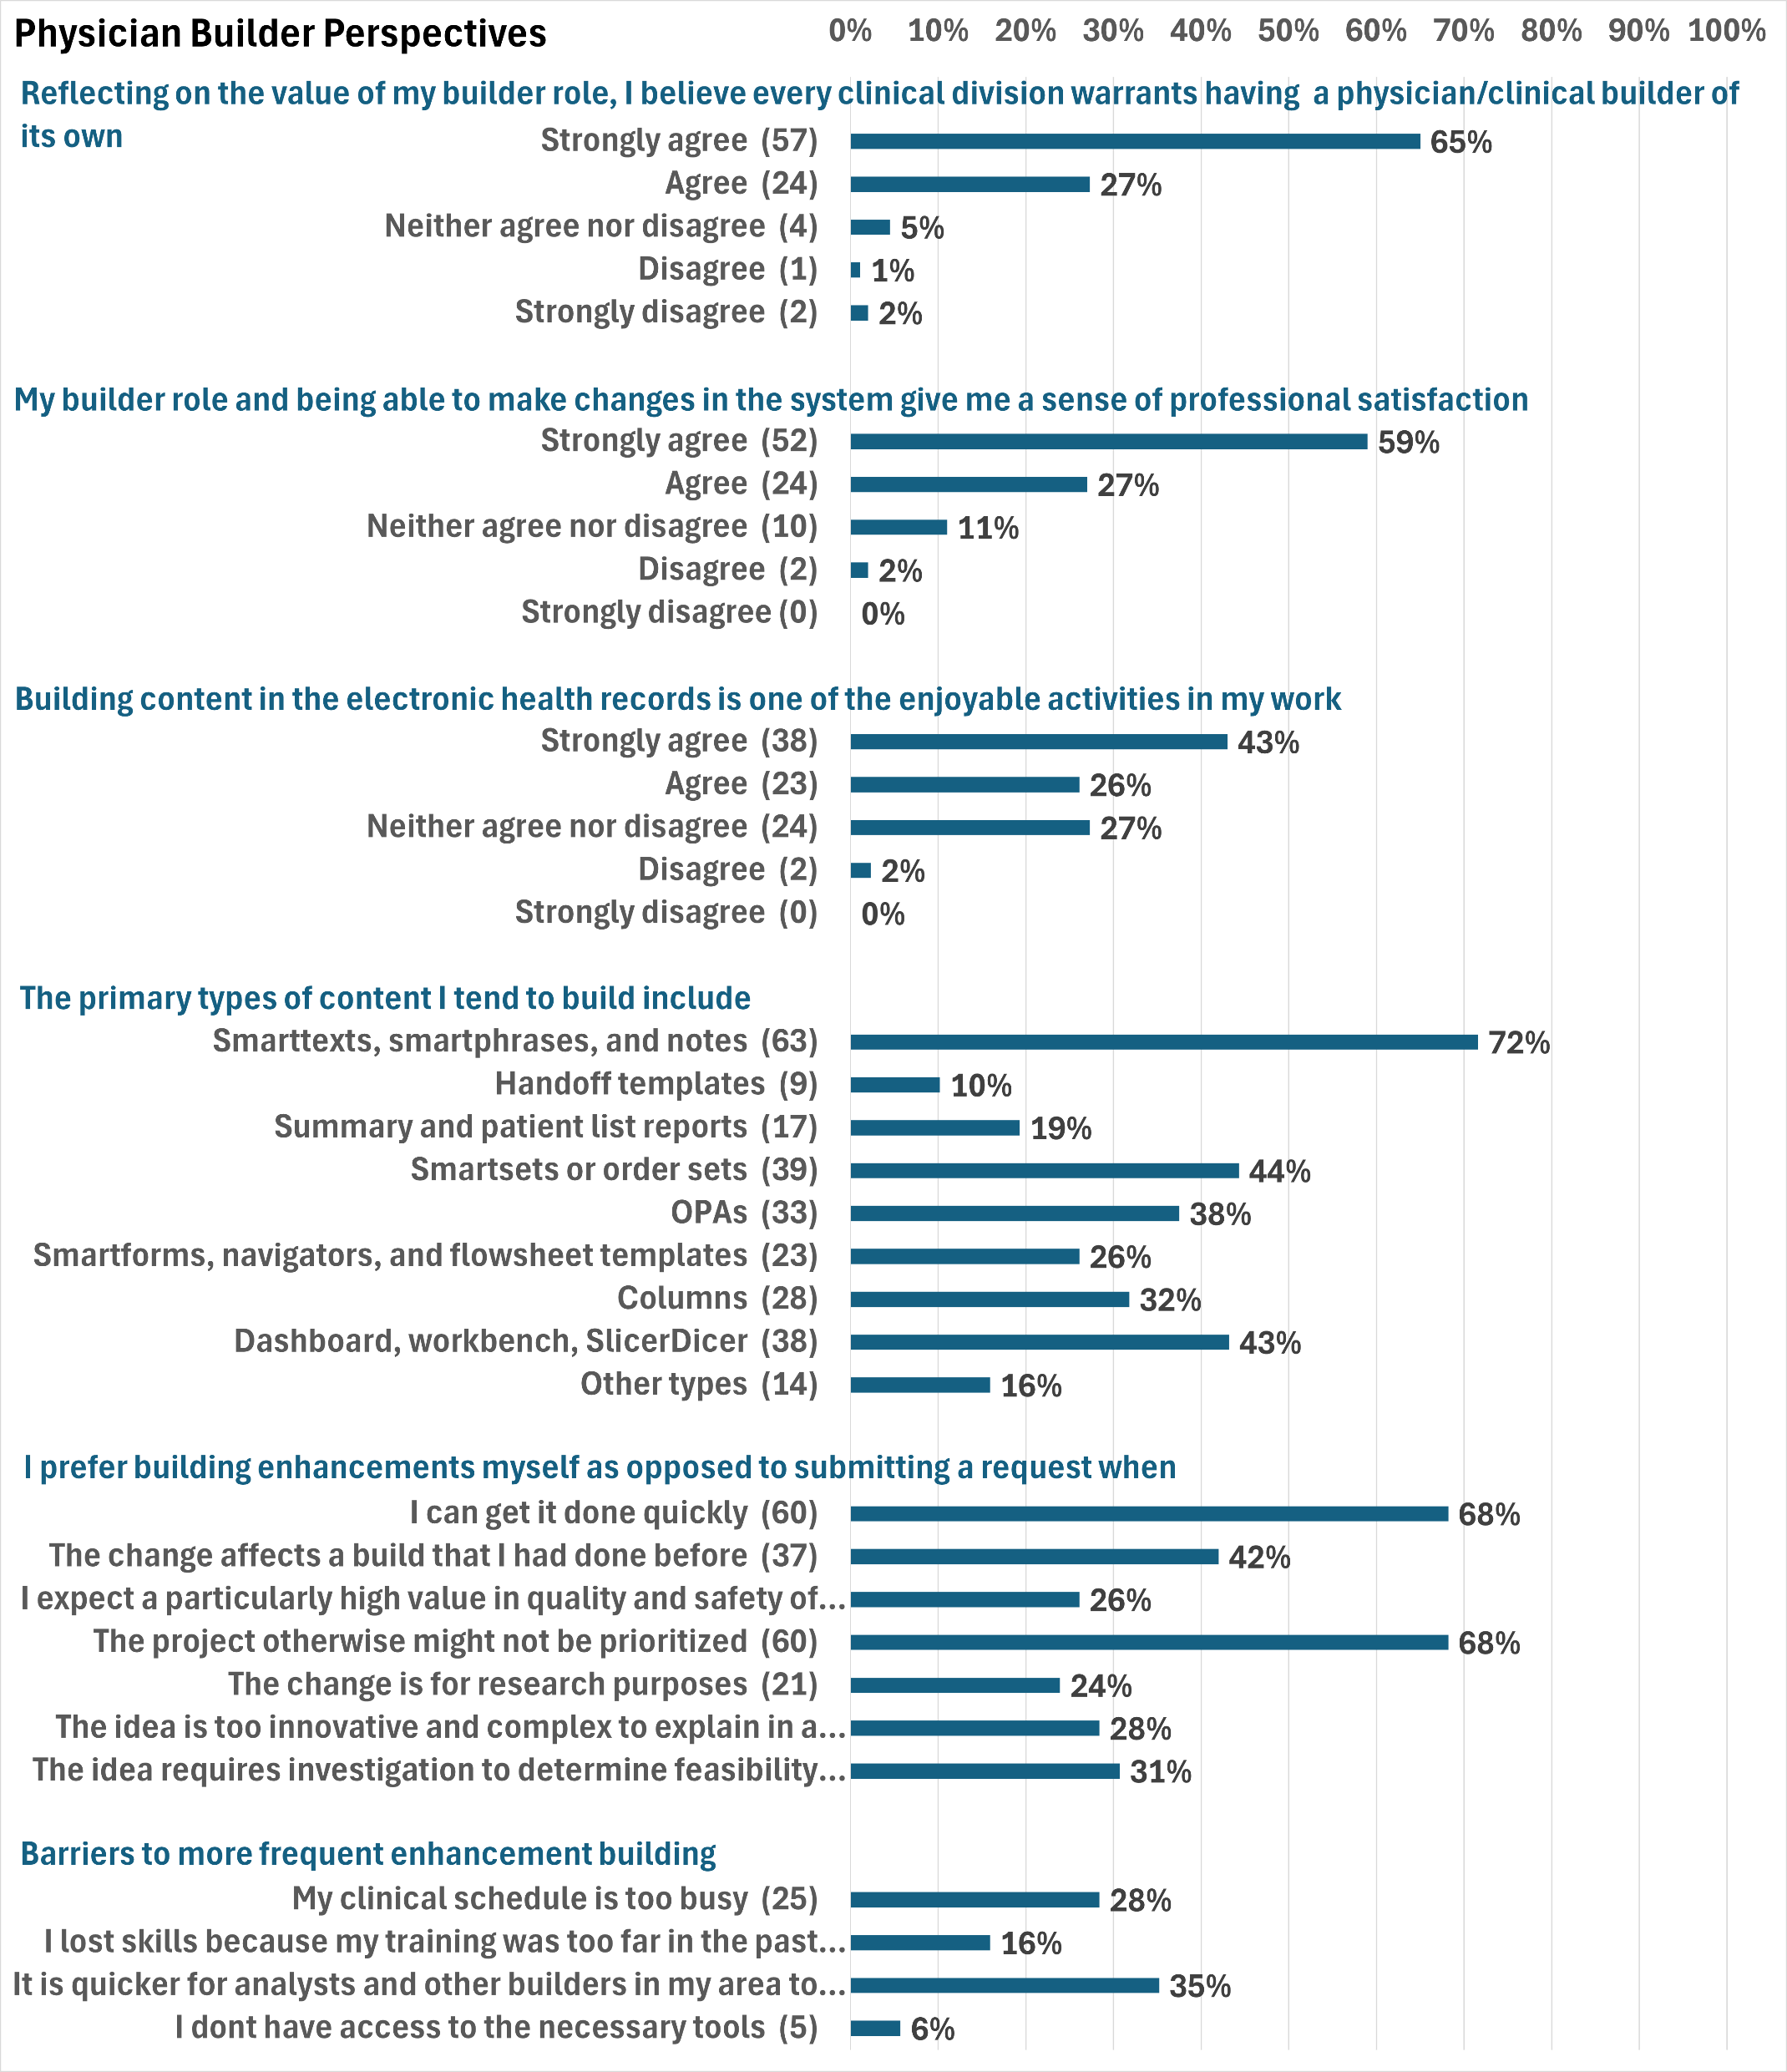
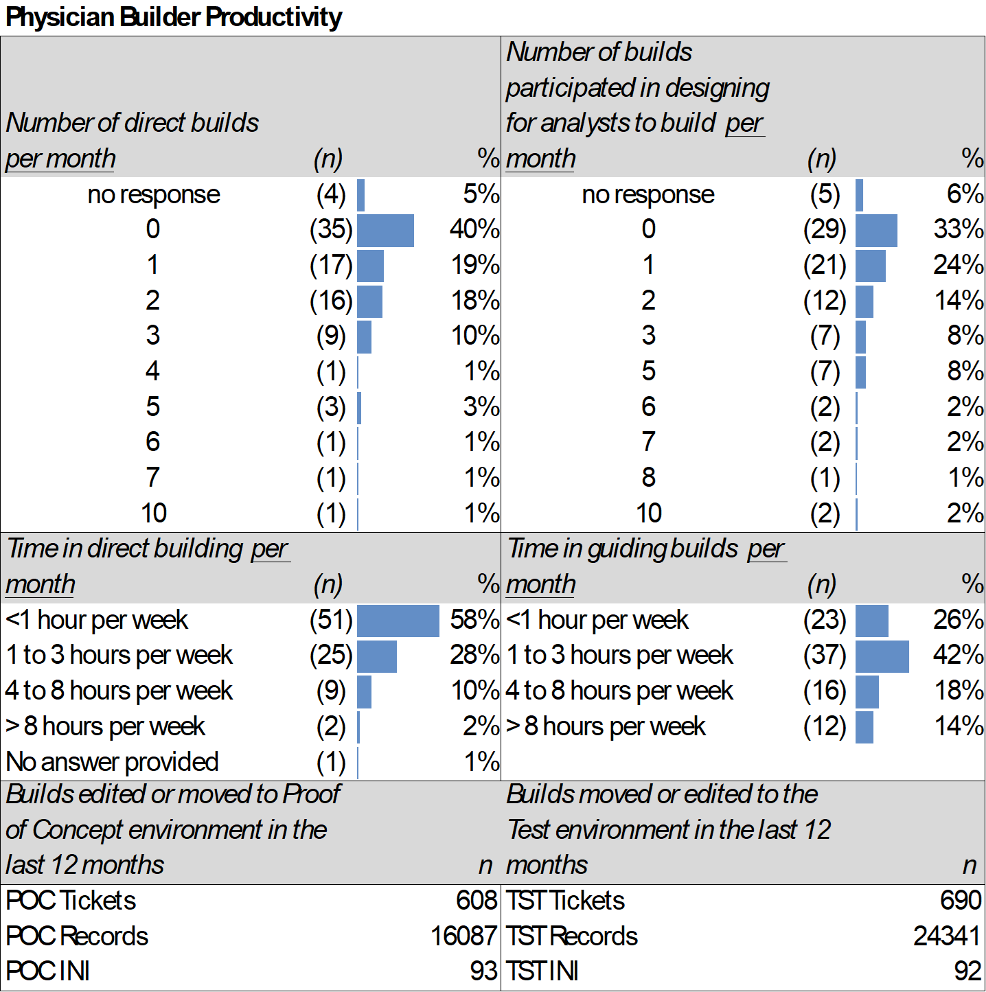
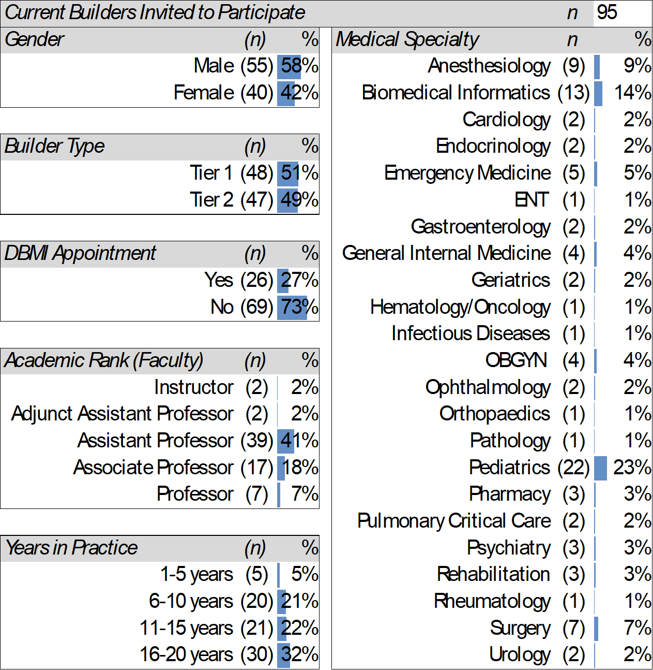

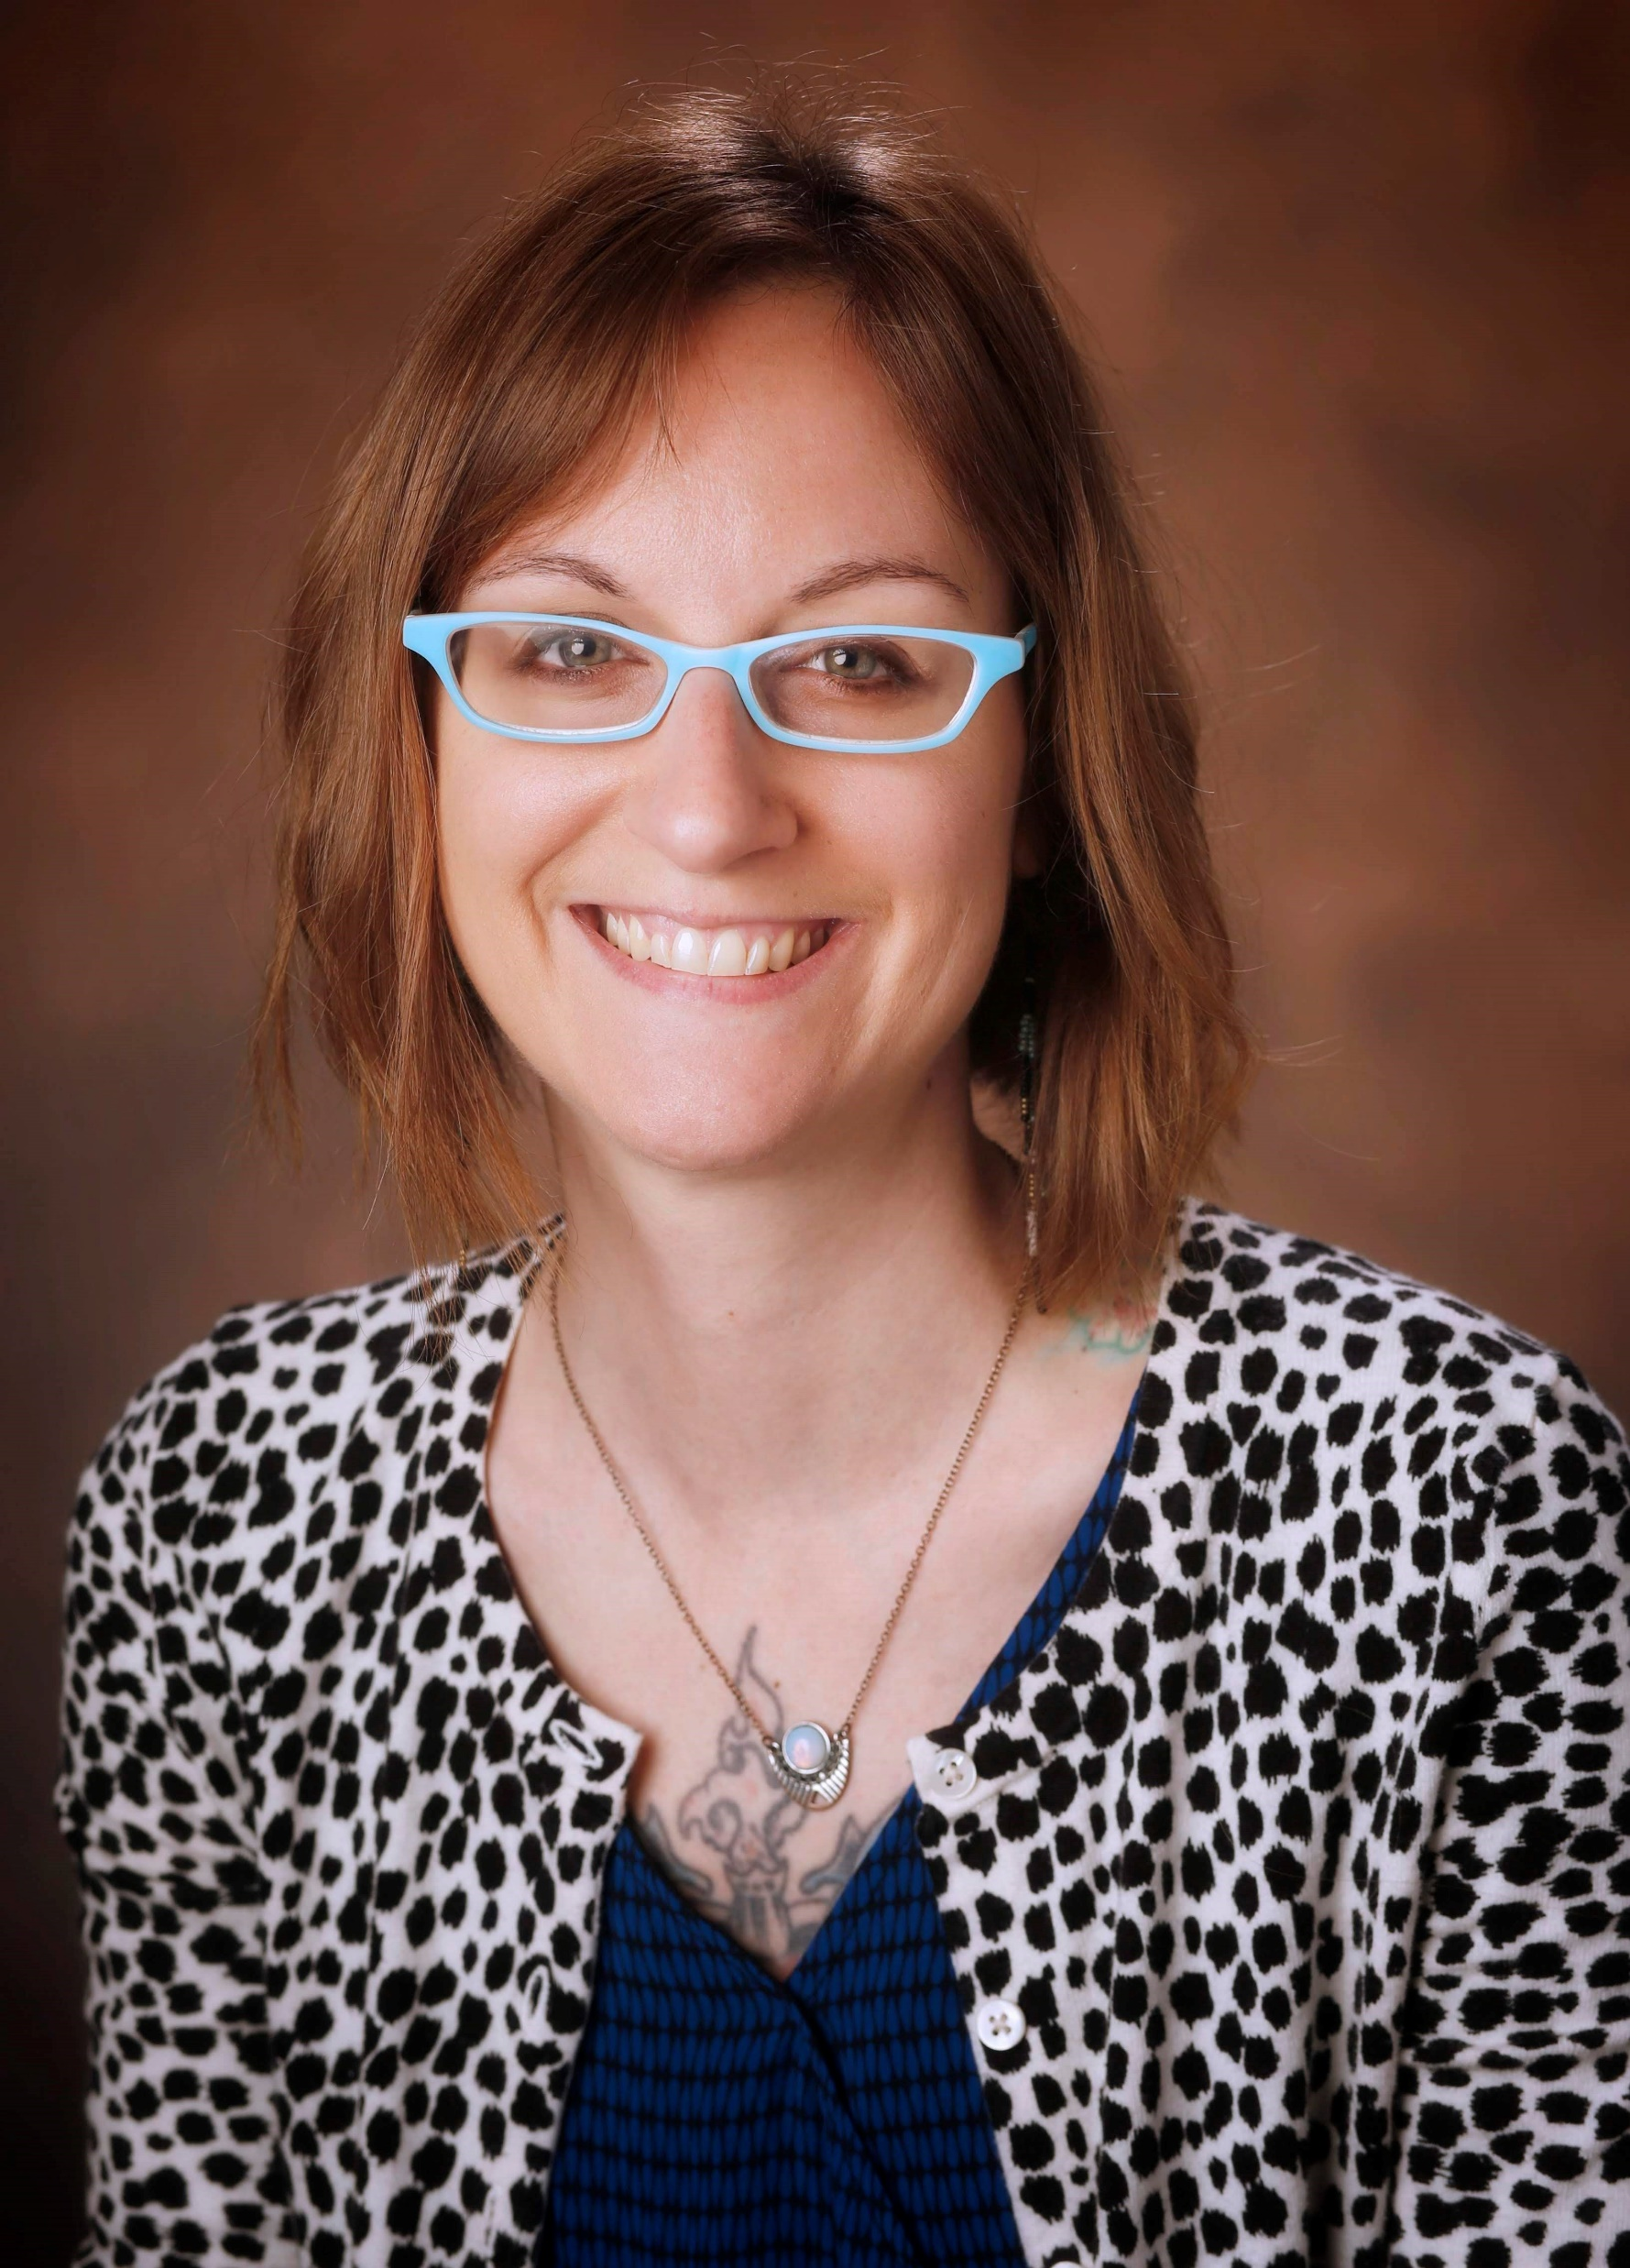


The Physician Builder Model—A Survey and Productivity Analysis
Laura Zahn¹, Mhd Wael Alrifai^{1,2}, Adam Wright^{1,3}, Allison McCoy², Dara Mize^{1,3,4}, Brandon Reese⁴, Jon Wanderer^{1,4,5}
Departments of Biomedical Informatics¹, Pediatrics², Medicine³, HealthIT⁴, Anesthesiology⁵
Vanderbilt University Medical Center
PB is just a name
PBs reported roles
Nurse
Resident
Fellow
Instructor
Assistant Professor
Associate Professor
Professor
Adjunct faculty
Business Intelligence Analyst
Application analyst/developer
Pharmacist
Athletic trainer
Graduate student
Advanced practitioner
Customer care specialist
Project manager
PB is just a name
PBs reported roles:
Nurse
Resident
Fellow
Instructor
Assistant Professor
Associate Professor
Professor
Adjunct Faculty
Business Intelligence Analyst
Application Analyst/Developer
Pharmacist
Athletic Trainer
Graduate Student
Advanced Practitioner
Custom Care Specialist
Project Manager
PB builds are diverse
Content types:
Smarttexts, smartphrases, and notes
Handoff templates
Summary and patient list reports
Smartsets or order sets
OPAs
Smartforms, navigators, and flowsheet templates
Columns
Dashboards, workbench reports, Slicer Dicer
and more!
Through the Physician Builder program, trained members can customize and configure our local instance of Epic to improve clinical workflows.
86%
of PBs find professional satisfaction in their builder role.
92%
of PBs believe every clinical area must have an active PB.
Most paired analysts feel builders’ expertise helps guide their own builds at least sometimes (76%) and decreases their workload (62%).
PURPOSE
To assess the builders’ and supporting analysts’ opinions about the Physician Builder program and perceived added value.
On average, PBs reported
1.4
Project go-lives per month
56%
of PBs had no prior programming experience.
METHODS
N = 88 Physician Builders
22-item REDCap survey
N = 21 HealthIT Analysts
7-item REDCap survey
NEXT STEPS
Analysis of qualitative interviews with 12 clinical leaders and 4 HealthIT leaders about the PB program and manuscript writing!
Presenter: Laura Zahn
Laura.a.zahn@vumc.org
Notes:
Notes:
In Powerpoint, click View > Guides
Keep text within gutter guides.
Author list: Don’t split names onto two lines (e.g., “Jimmy [break] Smith”). If that happens, use a new line, unless you need the space. Bold the first names of anybody who’s presenting in person.
Intro/methods/result: Do not drop below font size 28, but if you have extra space, jack up the font size until the space is full.
Do not use color in the sidebars except in graphs/figures. It’ll pull attention from the center and slow interpretation for passersby.

