Slide 1
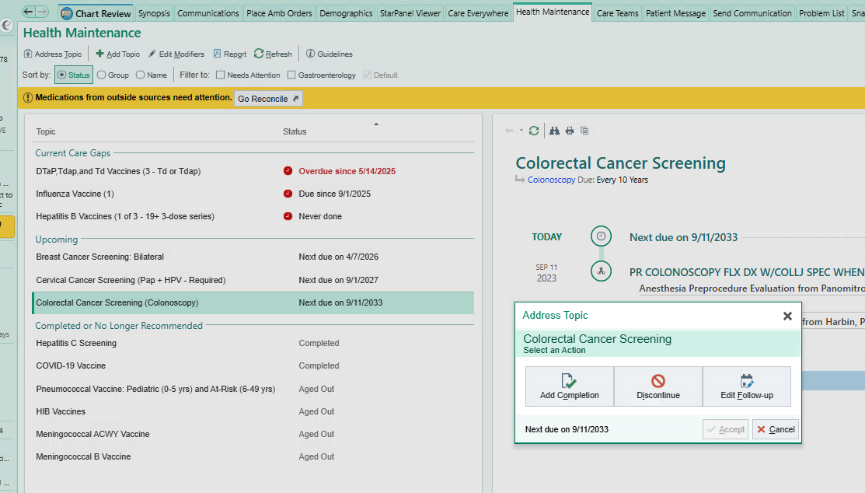
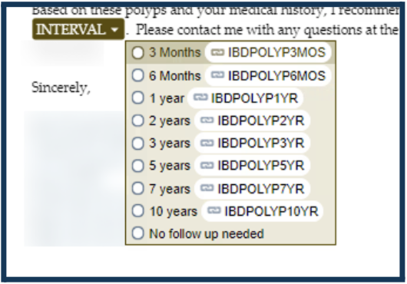

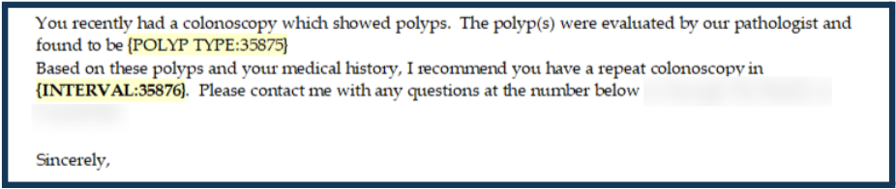


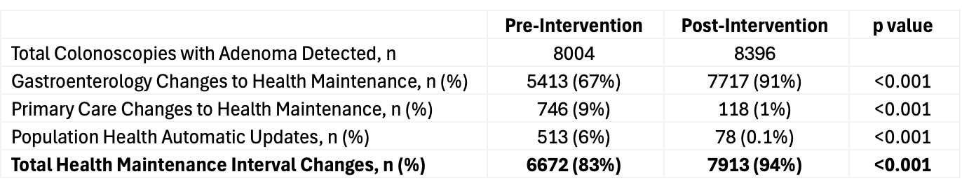

Automated Clinical Decision Support Enhances Post-Adenoma Surveillance Tracking in the Electronic Medical Record
Michael O’Brien, MD, Ashley Spann, MD, Laura Zahn, MS, Allison McCoy, PhD, Sara Horst, MD
Vanderbilt University Medical Center
Background
Surveillance colonoscopy following adenoma detection is essential for colon cancer prevention. Current health maintenance modules frequently depend on manual data entry, placing additional demands on busy primary care physicians.
Clinical decision support tools have the potential to improve efficacy in tracking colonoscopy follow-up intervals in the health maintenance tab.
Methods and Population
35,802 patients undergoing colonoscopy ≥50-75 years were included, and adenomas were detected in 44% (8004/18027) in the pre-intervention and 47% (8396/17775) in the post-intervention period.
Rates of change to health maintenance tab in total and by gastroenterology vs. primary care team were analyzed and compared.
Pre-Intervention
Healthcare maintenance tab edited manually following colonoscopy
Conclusions
For patients with adenoma detected by colonoscopy, our decision support tool significantly increased health maintenance interval changes in general, and by gastroenterology vs. primary care in particular.
This has the potential to increase surveillance colonoscopies for cancer prevention.
Future Directions
Increased follow-up automation for other gastrointestinal screening (Barrett’s esophagus, esophageal varices, etc.)
Integration of non-invasive stool testing data into the healthcare maintenance tab
Post-Intervention
Healthcare maintenance updated automatically after gastroenterologist completes polyp letter
Presenter: Michael O’Brien, MD
Results
Michael.obrien@vumc.org
Notes:
Notes:
In Powerpoint, click View > Guides
Keep text within gutter guides.
Author list: Don’t split names onto two lines (e.g., “Jimmy [break] Smith”). If that happens, use a new line, unless you need the space. Bold the first names of anybody who’s presenting in person.
Intro/methods/result: Do not drop below font size 28, but if you have extra space, jack up the font size until the space is full.
Do not use color in the sidebars except in graphs/figures. It’ll pull attention from the center and slow interpretation for passersby.

