Slide 1
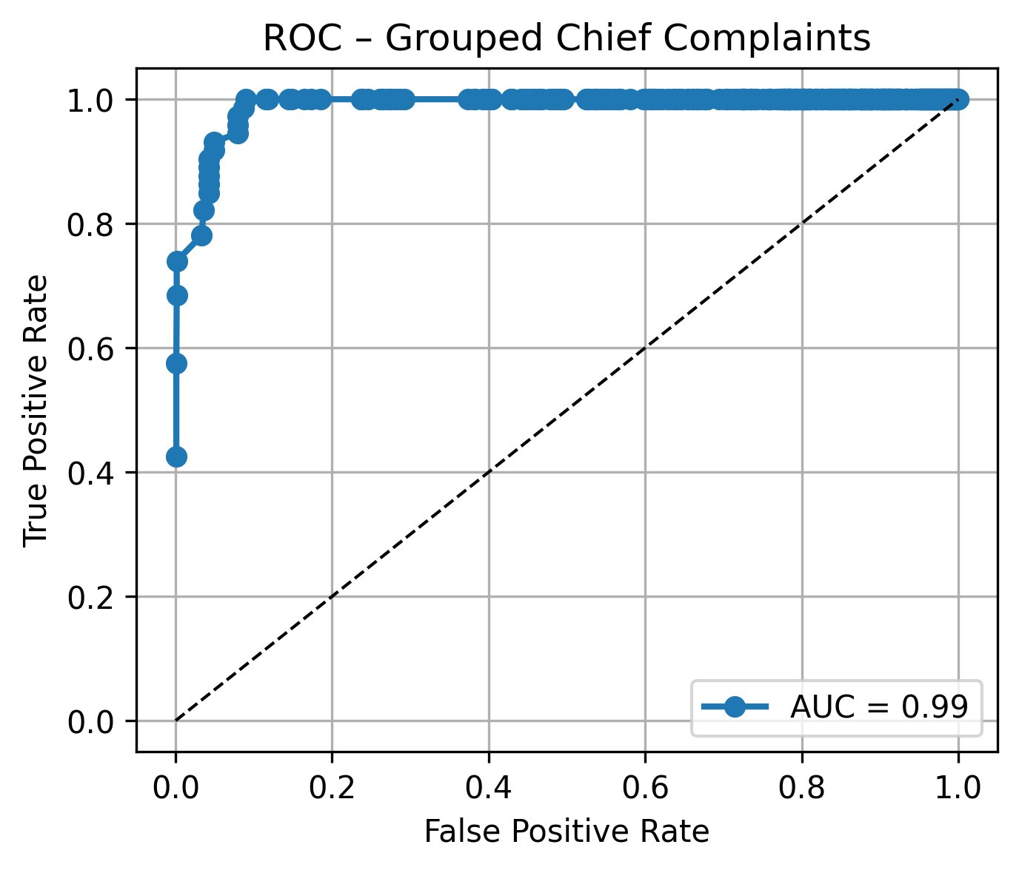
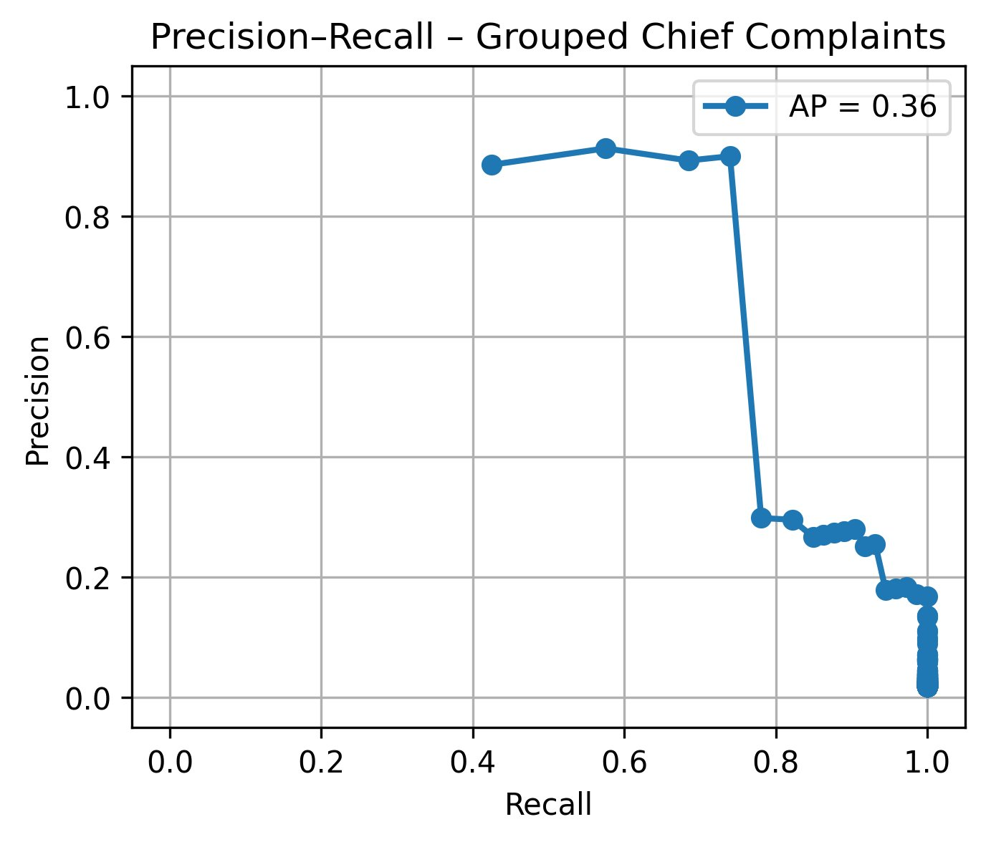
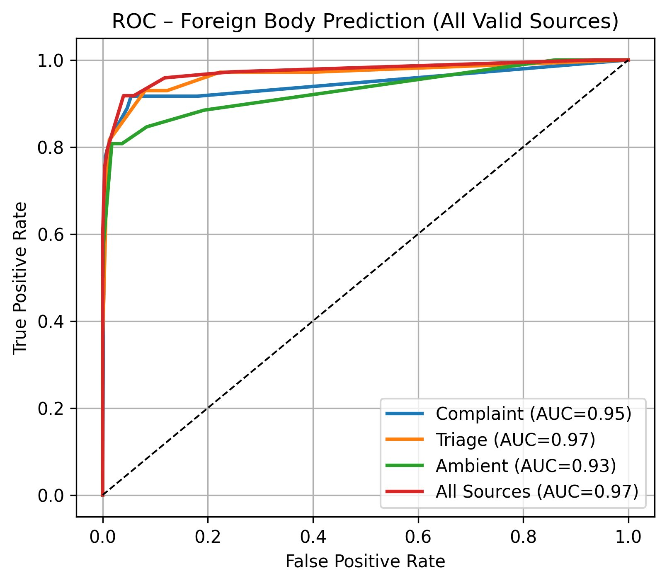
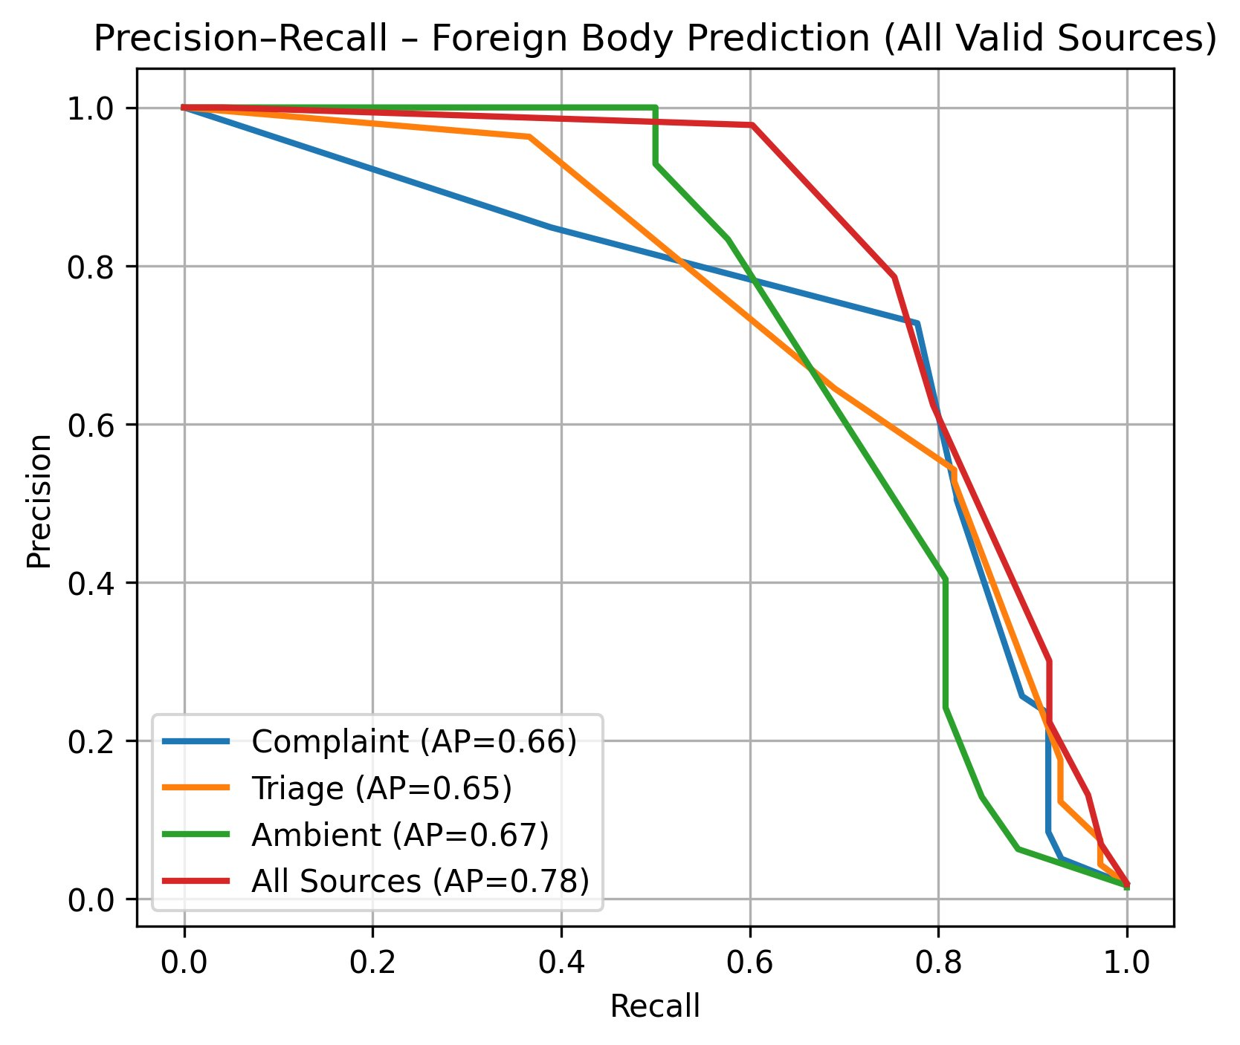

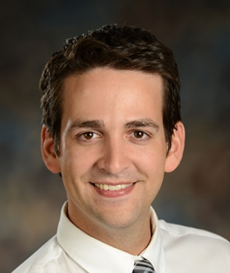


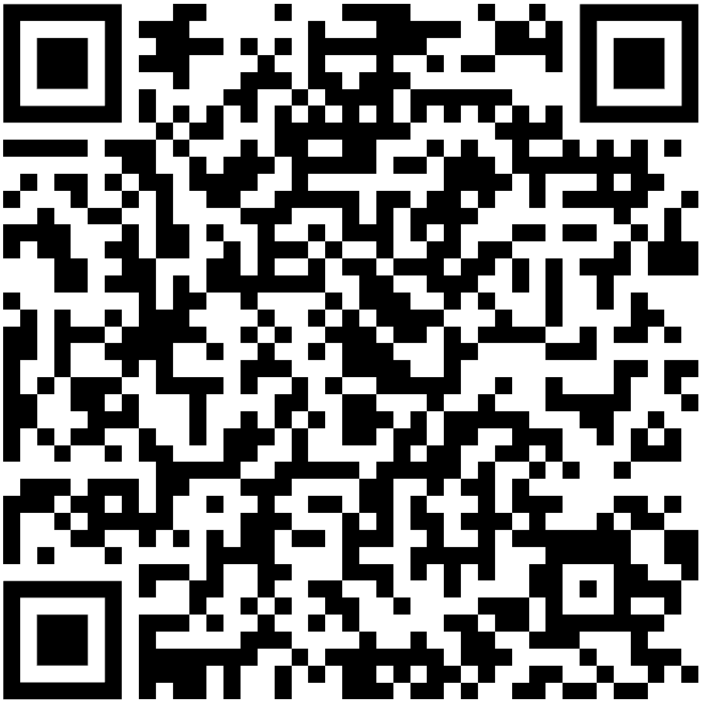
Using a Large Language Model (LLM) to Improve CDS Accuracy for Pediatric ED Foreign-Body (FB) Ingestion/Aspiration Screening
Stephen Gradwohl, MD, MS, Adam Wright, PhD Department of Biomedical Informatics, Vanderbilt University
PURPOSE
Swallowed or inhaled objects can be dangerous; screening helps avoid misses and guides timely x-rays.
Can an LLM using EHR data flag ED visits needing foreign-body x-rays?
METHODS
Retrospective cohort: 4,083 Peds ED visits (May/Jun 2025); outcome: FB present.
Inputs: structured EHR + unstructured notes
LLM: GPT-4o-mini risk 0–1
Eval: sens/spec/PPV/NPV for structured vs +unstructured.
RESULTS
Performance: Structured rules showed acceptable sensitivity/precision; adding unstructured data improved performance
Cost: $0.08/1K Patients
LLM improves screening accuracy at minimal cost.
Data sources
Structured: ED chief complaints
Unstructured: complaint statement, triage note, ED provider note (DAX)
LLM-as-a-Judge
LLM analyzes unstructured text and outputs a 0–1 risk score
CDS Strategy (Next Steps)
Use sensitivity analysis to set the operating threshold
Trigger CDS recommending an FB x-ray series
Presenter: Stephen Gradwohl
Stephen.Gradwohl@vumc.org
Scan for full presentation
Notes:
Notes:
In Powerpoint, click View > Guides
Keep text within gutter guides.
Author list: Don’t split names onto two lines (e.g., “Jimmy [break] Smith”). If that happens, use a new line, unless you need the space. Bold the first names of anybody who’s presenting in person.
Intro/methods/result: Do not drop below font size 28, but if you have extra space, jack up the font size until the space is full.
Do not use color in the sidebars except in graphs/figures. It’ll pull attention from the center and slow interpretation for passersby.

