Slide 1
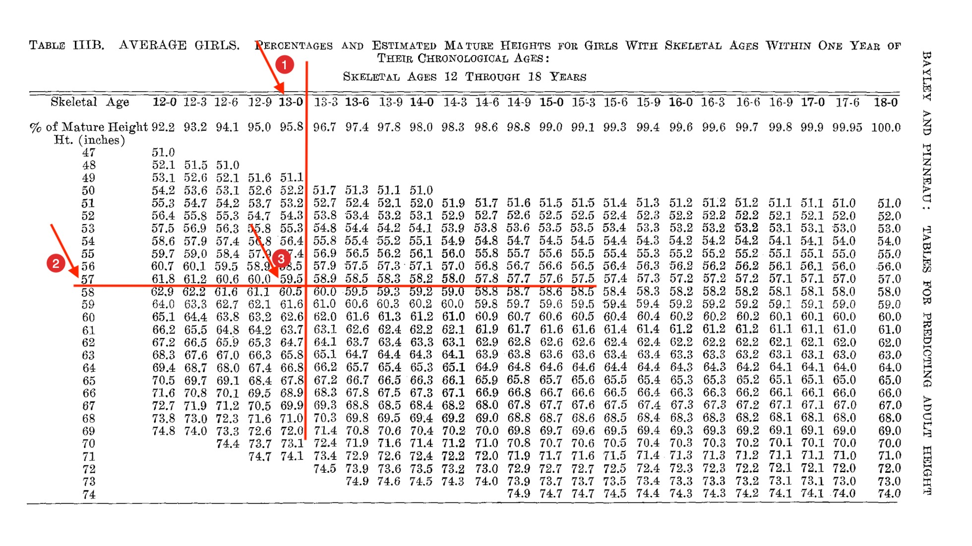
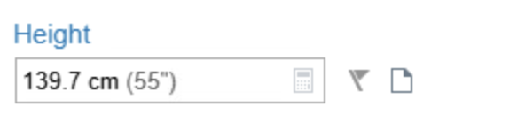

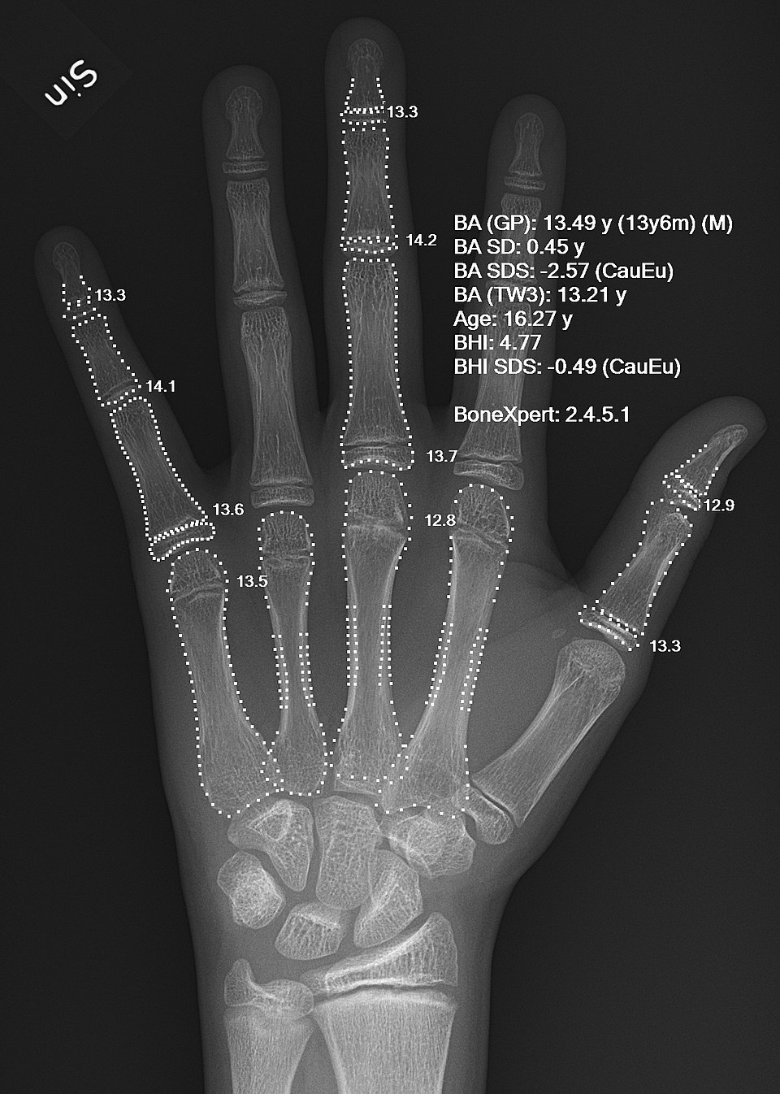
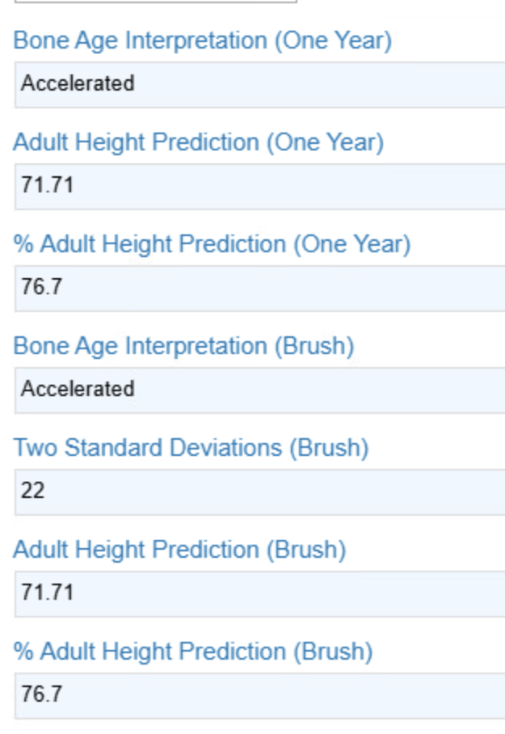


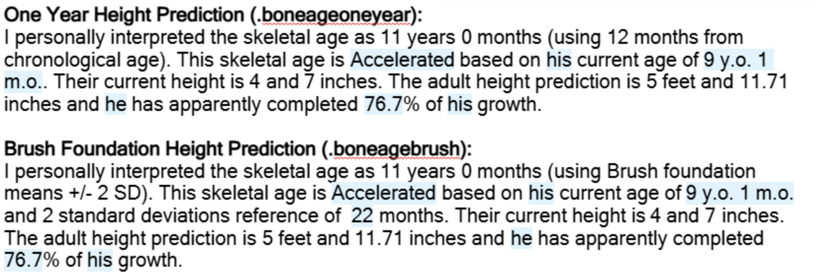



Integrated Bone Age Height Prediction Calculation in Epic
Brandon Buxton MS, Rachael Knight Miller PharmD, Yaa Kumah-Crystal MD, MPH Department of Biomedical Informatics, Vanderbilt University
PURPOSE
Bone age is commonly used by pediatric endocrinologists to assess growth trajectory.
Calculation of height prediction & growth delay requires manual reference to printed books or the use of external tools.
Goal to create an integrated within the Epic workflow.
METHODS
Greulich-Pyle bone age standards were used for height prediction formulas.
One-year and Brush Foundation methods were used to determine growth trajectory.
Complex custom formulas developed in Flowsheet rows.
RESULTS
Height prediction values are calculated for providers by entering X-ray determined bone age and height without requirement of manual reference material
Bone age calculator in Epic flowsheets improves workflow efficiency.
Clinician Feedback
“omg. Amazing”
“Oh my goodness, This is so cool.”
“Very very cool.”
“This will help me immensely.”
“We don’t deserve you. This is awesome.”
Previous calculation workflow
“It’s letting the computers compute while allowing the humans to human.”
-Pediatric Endocrinologist
Presenters: Brandon Buxton
Growth chart event entry & calculation rows
Rachael Knight Miller
Brandon.buxton.1@vumc.org
SmartPhrases for inclusion in notes
Notes:
Notes:
In Powerpoint, click View > Guides
Keep text within gutter guides.
Author list: Don’t split names onto two lines (e.g., “Jimmy [break] Smith”). If that happens, use a new line, unless you need the space. Bold the first names of anybody who’s presenting in person.
Intro/methods/result: Do not drop below font size 28, but if you have extra space, jack up the font size until the space is full.
Do not use color in the sidebars except in graphs/figures. It’ll pull attention from the center and slow interpretation for passersby.

