Slide 1
VWCH Clinical Instructor Orientation
Nursing Education and Professional Development

Slide 2
Objectives
Identify Orientation Requirements
Discuss Group Placement Guidelines
Identify Instructor Responsibilities
Discuss Student Expectations
Discuss Performance/Incidences Process

Slide 3
About VWCH
Two-campus facility licensed for 245 beds is the sole provider of inpatient and outpatient medical services in Wilson County.
Accreditations
  Chest Pain
  Joint
  Bariatric
  Primary Stroke

Slide 4
About VWCH
1411 Baddour Pkwy
Main Campus
500 Park Avenue
McFarland Campus
1N – Med/Surg
2N – Med/ Surg
ICU
Stepdown
1W - Observational
Emergency Department
Obstetrics
Surgical Areas
Inpatient Rehab
Behavioral Health

Slide 5
Overhead Alerts
Red Alert = Fire
Yellow Alert = Prepare to activate Emergency Plan
Orange Alert = Activate Emergency Plan
Code Pink = Missing infant (younger than 12 months old)
Code Purple = Missing child (ages 1to 12 years)
Code Walker Adolescent = Missing adolescent (ages 13 to17)
Code Walker Adult = Missing adult (17+)
Code Silver = active shooter
Code Green = Aggressive Behavior
Code Black = Bomb Threat
STAT = Life threatening emergency

Slide 6
Group Placements
Placement reserved in SharePoint
Submission of Student Data Grid (by school coordinator)
Group of 6 students max (up to 18/semester)
Assigned to one clinical area
  Students should not rotate off unit
  Few exceptions allowed

Slide 7
Observational Experiences
Students in clinical groups should not observe/shadow in areas outside of their assigned clinical unit
Students in clinical groups may, however, follow an assigned patient along the continuum of care in an observational status when approved by the clinical instructor and the procedural contact person
Students should not accompany patients to MRI

Slide 8
Observational Experiences
All requests for Observation / Shadow Experiences are handled through VOE – Vanderbilt Observation Experiences (voe@vumc.org)
Nursing students currently in clinical rotation are not eligible

Slide 9
Thinking Point…
Student is assigned to a patient who is scheduled for an interventional radiology procedure and asks you if they can go with their patient. Which response is the most appropriate?
  A: No, absolutely not. You are never allowed to leave this unit during your rotation
  B: Yes, feel free to go with them. Have a wonderful experience!
  C: Let’s see if we can make that work, I’ll discuss with the shift leader on our unit and down at interventional radiology.
Notes:
Rationale- students are expected to be under supervision at all times while in clinical rotations. Generally, we ask that they remain on the unit to which they are assigned. In the special exceptions where students are following their patient throughout care (i.e. to interventional radiology, speech, PT/OT, etc), permission must be obtained from both the unit CSL/RSL and the receiving charge nurse in the department. While they are off the unit they are in a strictly observation role only. Students are NOT allowed to follow patients into MRI, OR or when transferring patients to a different unit. Students are not allowed to transport patients independently.

Slide 10
Instructor Orientation Requirements
Experience in specialty area of clinical rotation
Clinical Instructors New to VUMC:
  1 – 12 hour shadowing shifts with a staff nurse
  Completion of Orientation Checklist
Returning Clinical Instructors (to same unit):
  Shadowing shift - as needed (none required)
Returning Clinical Instructors (to new unit):
  1 – 12 hour shadowing shifts with a staff nurse (if you have not taught on the unit > 12 months)
  Completion of Orientation Checklist

Slide 11
Instructor Orientation Requirements
VUMC Employees assigned unit other than home unit:
  1 – 12 hour shadowing shift with a staff nurse
  Completion of Orientation Checklist
VUMC Employees working on home unit:
  Completion of Orientation Checklist

Slide 12
Instructor Orientation Requirements
Vanderbilt issued ID badge with school name
  Indicating you are a visiting instructor
  Applies to VUMC employees (should NOT wear their VUMC employee badge during rotations)

Slide 13
Clinical Instructor Responsibilities
Clinical instructor MUST:
  Be present on unit
  Determine student assignments in collaboration with the charge nurse, CSL, and/or delegate
  Review and co-sign all student documentation
  Accompany the student in performance of assessments, skills, procedures and medication administration to assess and verify his/her performance

Slide 14
Clinical Instructor Responsibilities
Instructors and students will be on the floor ready to get report at the designated time
Assignments will be documented on the Assignment form by the clinical instructor and given to the charge nurse/CSL
Objectives and goals of the clinical experience should be communicated to the unit

Slide 15
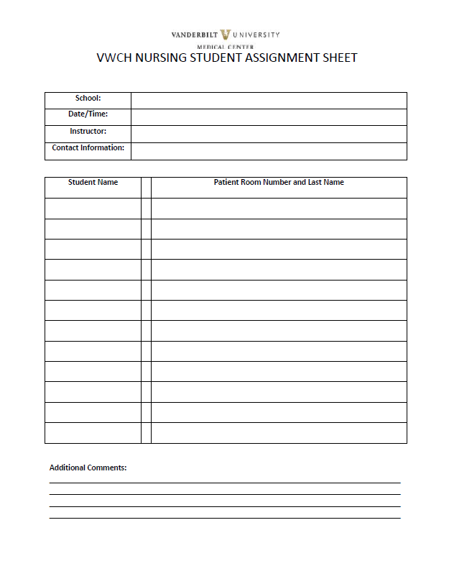
Nursing Student Assignment Sheet

Slide 16
Thinking Point…
You are prepping your students assignments the night before clinical. What is the most appropriate process for determining how best to place them?
  A: Call the night shift leader and ask which nurses to assign your students to
  B: Go in prior to students arrival and communicate with shift leader to determine appropriate patients for students
  C: Write down student assignments on assignment sheet and leave at the medical receptionist desk
Notes:
B is the best answer (C is appropriate after competing B). You will need to communicate with the shift leader to determine the appropriate patient assignment for the students to meet both patient care needs, staffing requirements as well as student experience expectations. After determining assignments, they should be recorded on the appropriate sheet.

Slide 17
Educational Guidance
Instructor / Student will receive a handover communication from the assigned nurse
Student performs care under the supervision of the Clinical Instructor or Licensed Care Provider
Before leaving the clinical area, the student will provide a handover communication to the assigned nurse
Policy # CL 30-08.04 – Clinical Handover Communication

Slide 18
Friendly Reminders
Please do not hold pre and/or post conference in public areas
Please be cognizant of congregating and/or clustering on the units especially at the nurses station
If allowing students to pre-plan the evening before clinical day, ensure no more than 3 students are present on unit at a time
Please do not contact the unit or unit leadership for questions about Student Placement.
  Use student.placement@vumc.org for all Student Placement inquiries

Slide 19
Student Expectations
  Dress Code in the Clinical Setting:
  Students will arrive in the clinical area with a school lab coat and/or school badge on their scrubs
  Injuries incurred that require support (i.e casts, boots, crutches etc.) are outside of the dress code policy, and clinical rotations must be paused in this instance
  Hair should be worn in such a manner it does not come into contact with patients or visitors
  Artificial nails, perfume/cologne or open-toed shoes are not permitted
  No revealing attire, bandanas or hats are permitted
  Visible body piercings are restricted to the ears
  Visible tattoos must be concealed
  Policy # CL 20-06.05– Dress Code and Personal Appearance

Slide 20
Student Expectations
Student ID Badges
    Vanderbilt ID badges must be visible above the waist and worn at all times
Students are not to independently transport any patient unless approved by the instructor and/or charge nurse
Students are not to independently transport monitored and/or unstable patients at any time
Policy # CL 30-03.05 – Transport of Patients

Slide 21
ID Badges Photos*
Once you have created a valid VUMC ID, and have waited 2 hours for it to process, you may follow the steps below to upload a “selfie” for your badge photo.
Go To: https://csgoldwm.app.vumc.org/login/ldap.php
-Enter Vanderbilt VUMC ID (all lower case)
-Enter Password
-Select “Submit ID Photo” from the menu
Make sure the photo follows the proceeding specifications:
* For Instructors/Students who do not have a school issued badge with their photo included on it

Slide 22
ID Badges*
* For Instructors/Students who do not have a school issued badge with their photo included on it
The Photo Must:
· Be in color
· Clearly identify YOU from head to shoulders only
· Have no noticeable reflections or glares, especially from glasses
· Have a solid white or off-white background
· Have normal contrast and lighting
You Must:
· Be the only person in your photo
· Face forward, looking directly into the camera (no side profiles)
· Have no red eye
· Have nothing touching your face such as hands, props or other distractions
· Not make any gestures or inappropriate facial expressions
· Not wear a hat or sunglasses
· Not wear jewelry or garments that obstruct the view of your face
· Look happy!
If the photo DOES NOT meet these requirements- it will not be accepted

Slide 23
Thinking Point…
One of your students comes to clinical with only their school student ID badge and a VUMC t-shirt. They state “I forgot my badge at home, but the staff nurse told me I could wear this shirt.” The best response is:
  A: “You are not allowed to be in clinical out of appropriate dress code and without a VUMC ID badge”
  B: “Go home for the day- you haven’t met the appropriate requirements”
  C: “As long as you have your school ID badge you will be good”
  D: “Dress code specifies that you must be in your school uniform with your school ID badge”
Notes:
A- students must be in a school lab coat or scrubs with the school badge on it. They must also have their VUMC badge clearly displayed above the waist.

Slide 24
Parking
No parking pass needed for VWCH parking.
The first 2 rows are reserved for our visitors, all other spaces are open.

Slide 25
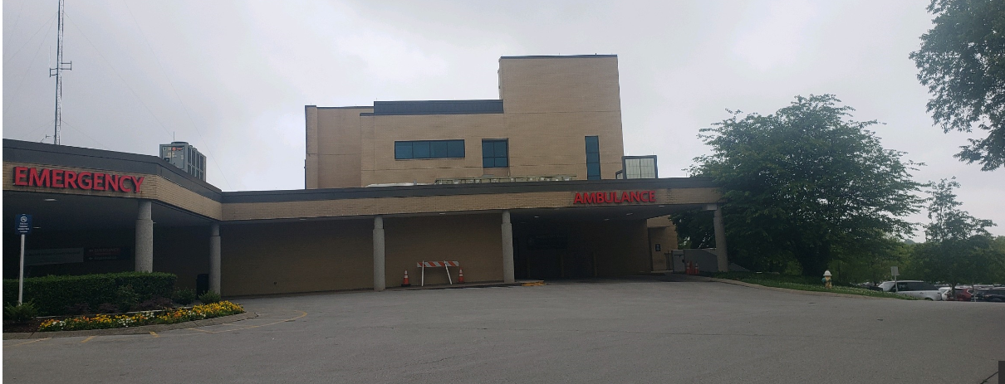
VWCH
1411 Baddour Pkwy Parking
Park in the Rear Parking Lot Behind Emergency Department
Park in the Rear Lot
Behind ED

Slide 26
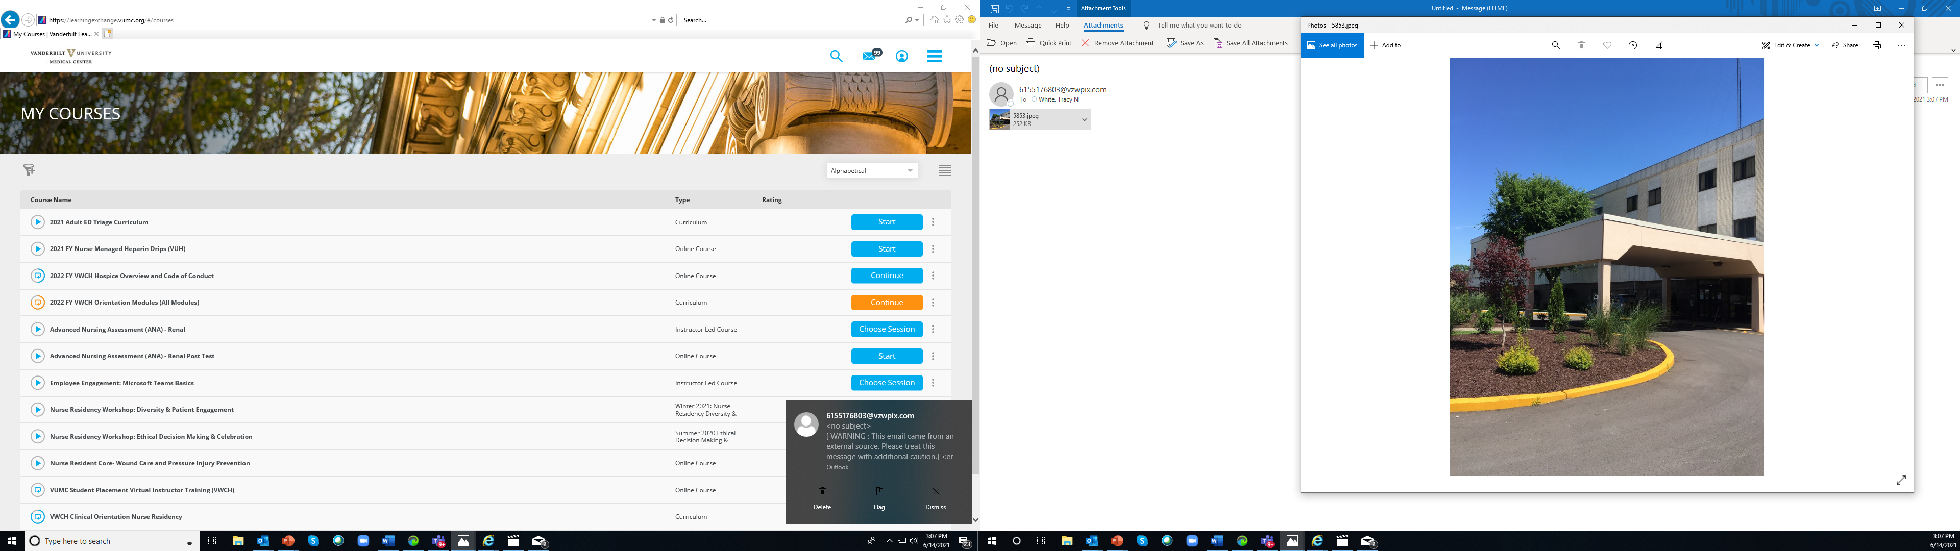
VWCH
500 Park Avenue Parking
Park in the Parking Lot in the front

Slide 27
Student Expectations
Social Media Policy – OP 10.10-30
  Communications through personal media during clinical time is prohibited (Facebook, Twitter, personal phone calls, texting etc.)
  Personal phone calls should not be taken in the clinical area
  Students who need to provide their families with emergency numbers should provide them with the unit number
  Pictures should not be taken in any clinical area

Slide 28
Thinking Point…
You have a student that claims they are using their cell phone to look up medications while in a patient room. Which of the following is NOT true?
  A: Per VUMC policy, you are allowed to utilize your phone to look up information
  B: Per VUMC policy, you are not allowed to communicate via social media during clinical time or in clinical care areas
  C: It is ideal to avoid using a personal cell phone in patient care areas due to perception from patients of lack of quality care
  D: No cell phones are allowed in patient care areas
Notes:
D: VUMC does not restrict cell phones being on the unit. We do prohibit photographs of any sort as well as any personal communication or social media use during clinical time. Many schools have their own policies on cell phone use during clinicals. Please refer to your school policy which may be more restrictive.

Slide 29
Performance Feedback
Rounding on units
  Completed by Student Placement Team
  Done throughout the semester
  Instructors / Students / Staff
Questions or Issues to:
  student.placement@vumc.org

Slide 30
Chain of Inquiry
Conflict resolution is best done with immediate feedback in the moment. If, however, practice or concerns are beyond immediate resolution between 2 or more individuals, please follow the below steps for follow-up
STUDENT HAS A CONCERN
Student TO Clinical Instructor
Clinical Instructor TO School Coordinator
School Coordinator TO student.placement@vumc.org
Associate Program Manager will elevate to entity-specific lead
Lead will communicate with unit leadership
UNIT STAFF HAS A CONCERN
Unit Staff TO Unit Leadership
Unit leadership TO Student Placement Lead
Student Placement Lead TO School Coordinator
School Coordinator TO Clinical Instructor
Clinical Instructor TO Student

Slide 31
Chain of Inquiry
  Please do not contact unit educators or managers regarding questions
  Students should never speak with anyone except their school coordinator/instructor about their concerns and then those can be communicated to student placement via the school coordinator
  Student placement will communicate with unit educators/managers

Slide 32
Occurrences / Incidences
Faculty / Instructor Performance Issue
  Unit educator/manager will report to NEPD via phone/email; Lead will report to school coordinator and request school coordinator respond with an action plan
  Depending on the severity of the performance issue, student placement lead may request removal from clinical site
Student Performance Issue
  Faculty / instructor will address per school policy

Slide 33
Thinking Point…
You have a student that is struggling with time management and is not ready to administer medications by the scheduled time. They are now 2 hours overdue and the student has not communicated this to you. A staff nurse comes to you complaining “the students are slowing me down, I can’t complete my morning work appropriately.” What would you anticipate as the appropriate conflict resolution?
  A: The students have no idea what they are doing. They should just give the medications and we can document them later
  B: I am sorry that this was missed- would it be more helpful for you to give the morning medications and let me talk with the student to determine if we can manage the noon meds?
  C: Give me a break! You are responsible for your patients- you should have known better than to wait until 2 hours past when meds are due.
  D: We do not give medications as part of this clinical rotation. The students should have told you that at the beginning of the shift.
Notes:
B: Best conflict resolution- use the HEARD model of communication (Hear, empathize, acknowledge, resolve and document). Good communication of goals and expectations of the students for the day at the beginning of the shift will go a long way in preventing these types of miscommunications.

Slide 34
Thinking Point…
After the previous conversation you overhear the nurse negatively discussing yourself and your clinical group at the nurse’s station. The following week, this same nurse is working with students and refusing to let them provide any care and telling them “you are not safe to practice- I don’t think any of you will make it as nurses” Given that you have appropriately communicated the shift’s plans and goals for the day with the staff, what are your next steps? (check all that apply)
  A: Pull the nurse aside at a down moment and discuss the situation with him/her
  B: Document the incident
  C: Send documentation of the incident to your school coordinator
  D: Report the nurse to the unit manager
  E: Remove the students from the clinical setting for the remainder of the day
  F: Use this situation as a learning example for your students of workplace conflict

Slide 35
Needle sticks & Splashes
Wash needle sticks with soap/water
Flush splashes to nose, mouth, skin with water
Irrigate eyes with clean water, saline, or sterile irrigates (Eye wash stations available in many areas)
Get the name, Medical Record #, and location of the exposure source
Notify preceptor and Charge Nurse/CSL
Fill out Tennessee First Report of Work Injury
Go to Emergency Department (if after hours) for an evaluation
Contact your faculty for any school specific procedures

Slide 36
Personal Injury
Complete TN 1st Report of Work Injury
Report to Adult ED for emergency care
Report to personal PCP or School’s student health department

Slide 37

Questions? Contact Student Placement @
student.placement@vumc.org

