Slide 1
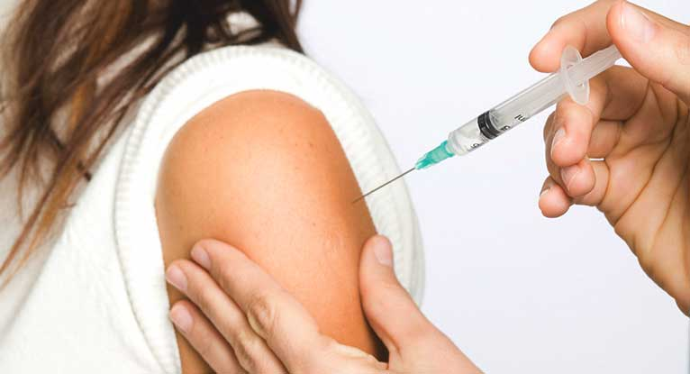
Vaccinations and Transplantation (with an update on COVID-19 vaccines)
Lora Thomas MD MPH

Slide 2
Transplantation and Vaccines
Transplant recipients are more susceptible to infections due to antirejection medications and comorbidities
Vaccination is a tool to reduce risk of infection/reactivation after transplantation
Issues related to reduced protective immune response to vaccines
Live virus vaccines pose risk

Slide 3

Topics to Discuss
What vaccinations should be considered prior to transplantation?
What vaccines should be given after transplantation and how immunogenic are they?
Issues related to COVID-19 vaccinations?
Can a family member get a live vaccine?
Can vaccines induce rejection?
I have a patient that will be traveling to …

Slide 4
Basic vaccine definitions
Inactivated: virus or bacteria are killed/dead
Live/attenuated: contain version of living microbe that is weakened
Toxoid: contain inactivated bacterial toxin
Conjugated: link antigens/toxoids to the bacterial polysaccharide coating

Slide 5
Vaccine definitions continued
Adjuvant: ingredient added to boost immune response
Recombinant: DNA of desired antigen inserted into cell/bacteria
mRNA: transformed into viral proteins
Viral Vector: modified vector virus (i.e. adenovirus) delivers genetic material that is transformed into viral proteins

Slide 6
Vaccinating the solid organ candidate
Pre transplant evaluation ideal time to review vaccination history
Pre transplant candidates more likely to develop vaccine-induced immunity than after transplantation
Some immunizations are guided by screening serologies

Slide 7
Vaccinations guided by serology results
Vaccine | Recommendation
Hepatitis A | 2 doses 0,6 months
Hepatitis B | HBsAb 2 doses (Heplisav) 3 doses (Recombivax)
Varicella (VZV) | 2 doses, 4-8 weeks apart
MMR* | Negative for >1 of the 3 viruses 1 dose

Slide 8
Vaccinations by indication
Vaccine | Indication | Recommendation
HPV | Ages 9-26y | Dose 0,2,6 months
PPSV-23 | All candidates if <2 doses in past | 2 doses 5y apart, separate from PCV-13 by > 8weeks
PCV-13 | All candidates if not yet received | 1 dose, separate from PPSV-23 by > 1 year (8 weeks for peds)
COVID-19 | All candidates if not yet received | 1-2 doses
Tdap | All candidates if not yet received | 1 dose
Zoster | Age > 50 | 1 dose
HIB | Splenectomy or if eculizumab will be needed | 1 dose
Meningococcus (quadrivalent) | Splenectomy or if eculizumab will be needed | 1 dose

Slide 9
Vaccination in ESRD/Cirrhosis
Seroconversion Rates
 | ESRD | Cirrhosis | Normal Hosts
Hepatitis B | 50-70% | 28-62% | >90%
Pneumococcal (PS) | 80% | 63-100% | 84-90%
Influenza | >80% | 75-85% | >90%
COVID-19 | 90% | 76% | 100%

Slide 10
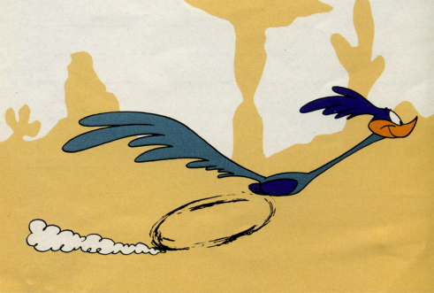
Accelerated schedules
Hepatitis B or Hepatitis A/B vaccine can be administered using accelerated schedule
Day 0, 7, 21 (12 month booster)
Response rate in liver candidates poor (36%)

Slide 11
Vaccination in chronic organ failure
Vaccinate early in disease progression
Live vaccines can be administered if not immunosuppressed
Must wait at least 4 weeks from live vaccine to transplant

Slide 12
Timeline for vaccinations after transplant
Not clearly defined how long to wait after transplant to start immunizations
Most centers wait 1-6 months
Mycophenolate may reduce seroresponse to vaccines
Study in renal transplant: no difference in response to vaccines between ATG and basiliximab induction

Slide 13
Post transplant vaccinations
Vaccine | If not previously received, administer…
Influenza | Yearly
Hepatitis A/B | 2-3 doses
HPV | Ages 9-26
PPSV-23 | 2 doses 5 y apart
PCV-13 | 1 lifetime dose
Tdap | 1 dose
COVID-19 | Vaccine series + booster
MMR/Varicella/Zoster | Live vaccines contraindicated

Slide 14

Influenza vaccine
Transplant recipients suffer higher morbidity and mortality related to flu
Standard dose currently recommended
Wait 1-6 months after transplant
If vaccine given within 2 months of transplant, consider a booster dose later in season
Should be administered annually

Slide 15
Flu complications in SOT
 | Adults | Children | P value
Gastrointestinal symptoms | 66/154 (43%) | 39/83 (47%) | 0·636
Pneumonia on chest radiograph or CT scan | 60/149 (40%) | 13/81 (16%) | <0·001
Admission to hospital | 112/154 (73%) | 55/83 (66%) | 0·373
Admission to the intensive care unit | 27/154 (17·5%) | 10/83 (12·0%) | 0·357
Mechanical ventilation | 18/153 (12%) | 3/83 (4%) | 0·063
Antiviral treatment within 48 h | 43/138 (31%) | 47/77 (61%) | <0·001
Antiviral treatment after 48 h | 95/138 (69%) | 30/77 (39%) | <0·001
Death | 10/154 (7%) | 0/83 (0%) | 0·016

Slide 16
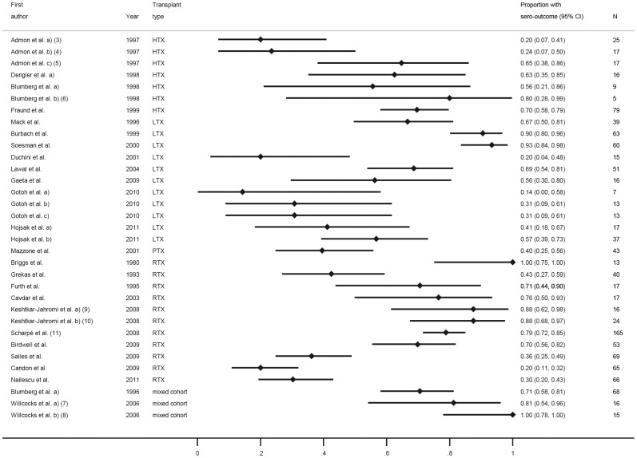


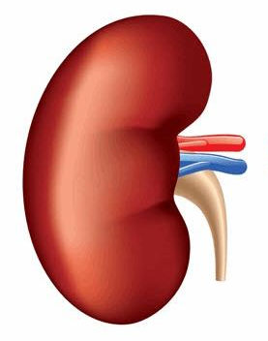
Response to flu vaccine in SOT

Slide 17
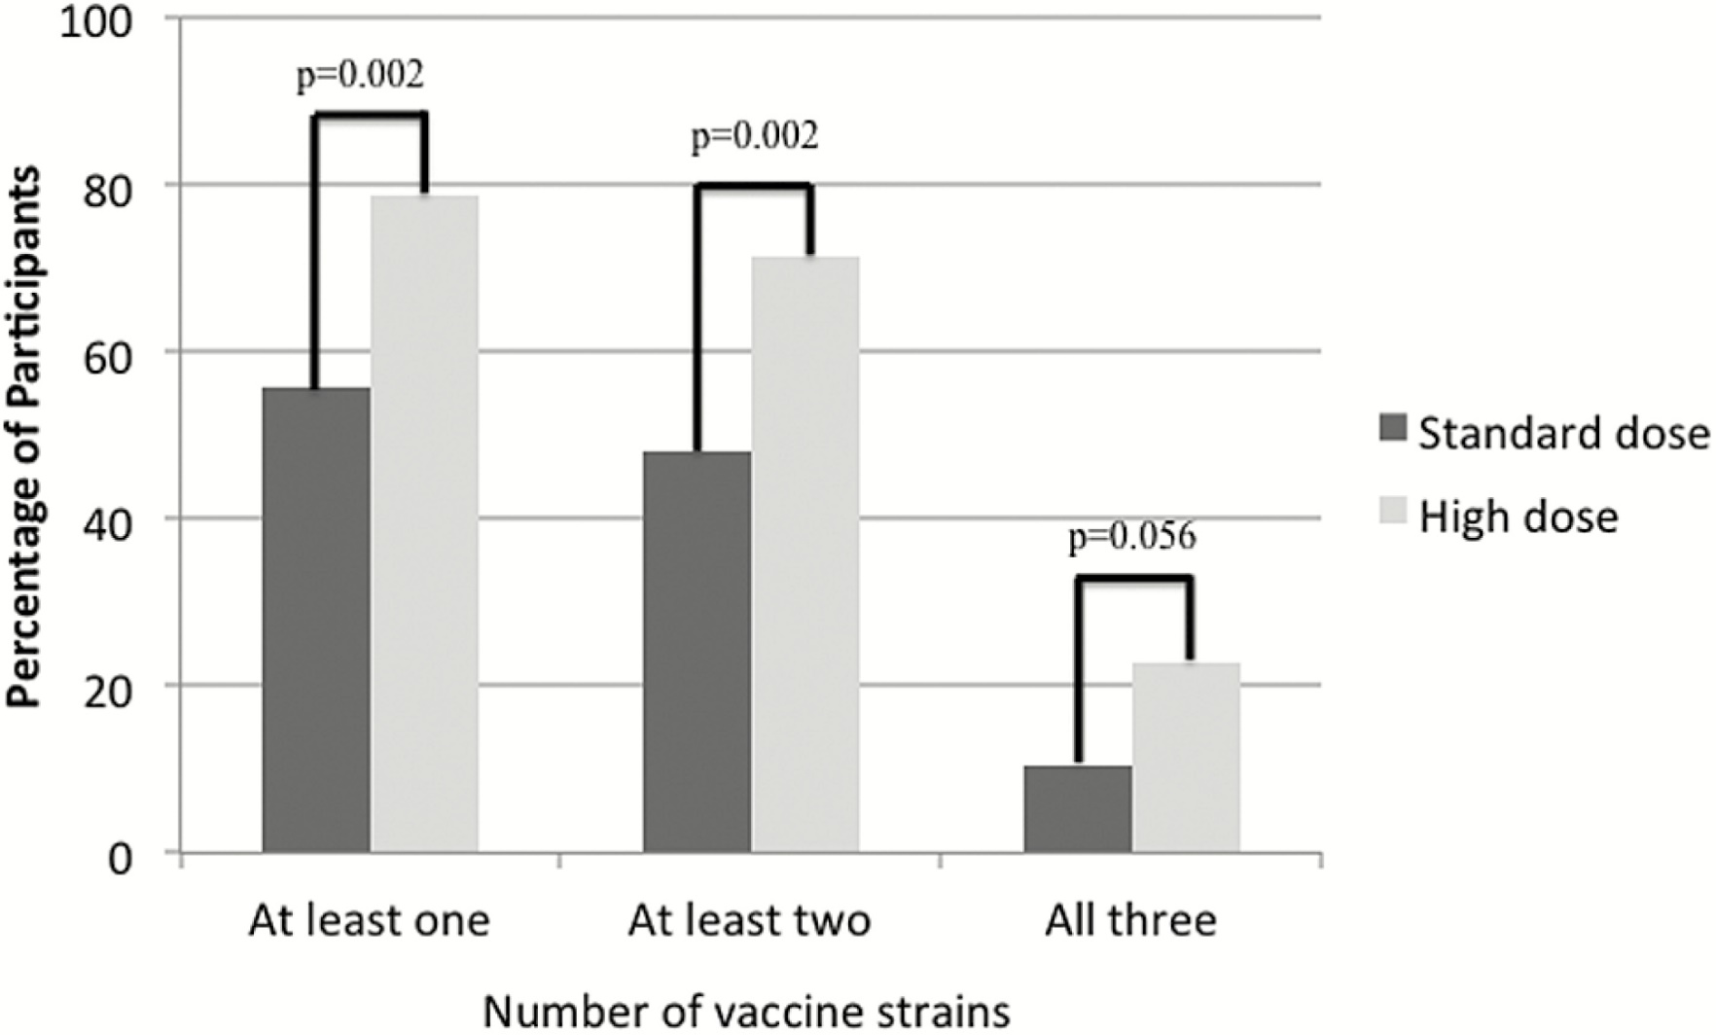
HD vs SD influenza vaccine

Slide 18
HD vs SD influenza vaccine
 | Standard Dose (n = 77) | High Dose (n=84) | P Value
Seroconversion (%)
A/H1N1 | 16 (20.8) | 34 (40.5) | .007
A/H3N2 | 25 (32.5) | 48 (57.1) | .002
B/Brisbane | 32 (41.6) | 49 (58.3) | .033
B/Phuketª | 11 (14.3) | 28 (33.3) | .005
Geometric mean fold rise
A/H1N1 | 14.0 | 20.3 | .001
A/H3N2 | 28.5 | 31.7 | .005
B/Brisbane | 5.4 | 20.4 | .002
B/Phuketª | 3.1 | 24.7 | .011

Slide 19
COVID-19 Vaccination Post Transplant: AST Recommendations
SARS-CoV-2 vaccination in all SOT recipients
Vaccination of their household members and caregivers
Continuation of a stable immunosuppression regimen at the time of vaccination to avoid the risk of organ rejection until more comprehensive data are available
Continued adherence of all transplant recipients to protective measures including masking and social distancing regardless of vaccination status.

Slide 20
658 Transplant Patients 2 Doses mRNA vaccine
 | Seropositivity after 2 doses
Overall | 54%
Kidney Liver Heart Lung | 48% 80% 57% 39%
< 3 years since transplant | 37%
Moderna Pfizer | 60% 49%
Antimetabolite | 43%

Slide 21
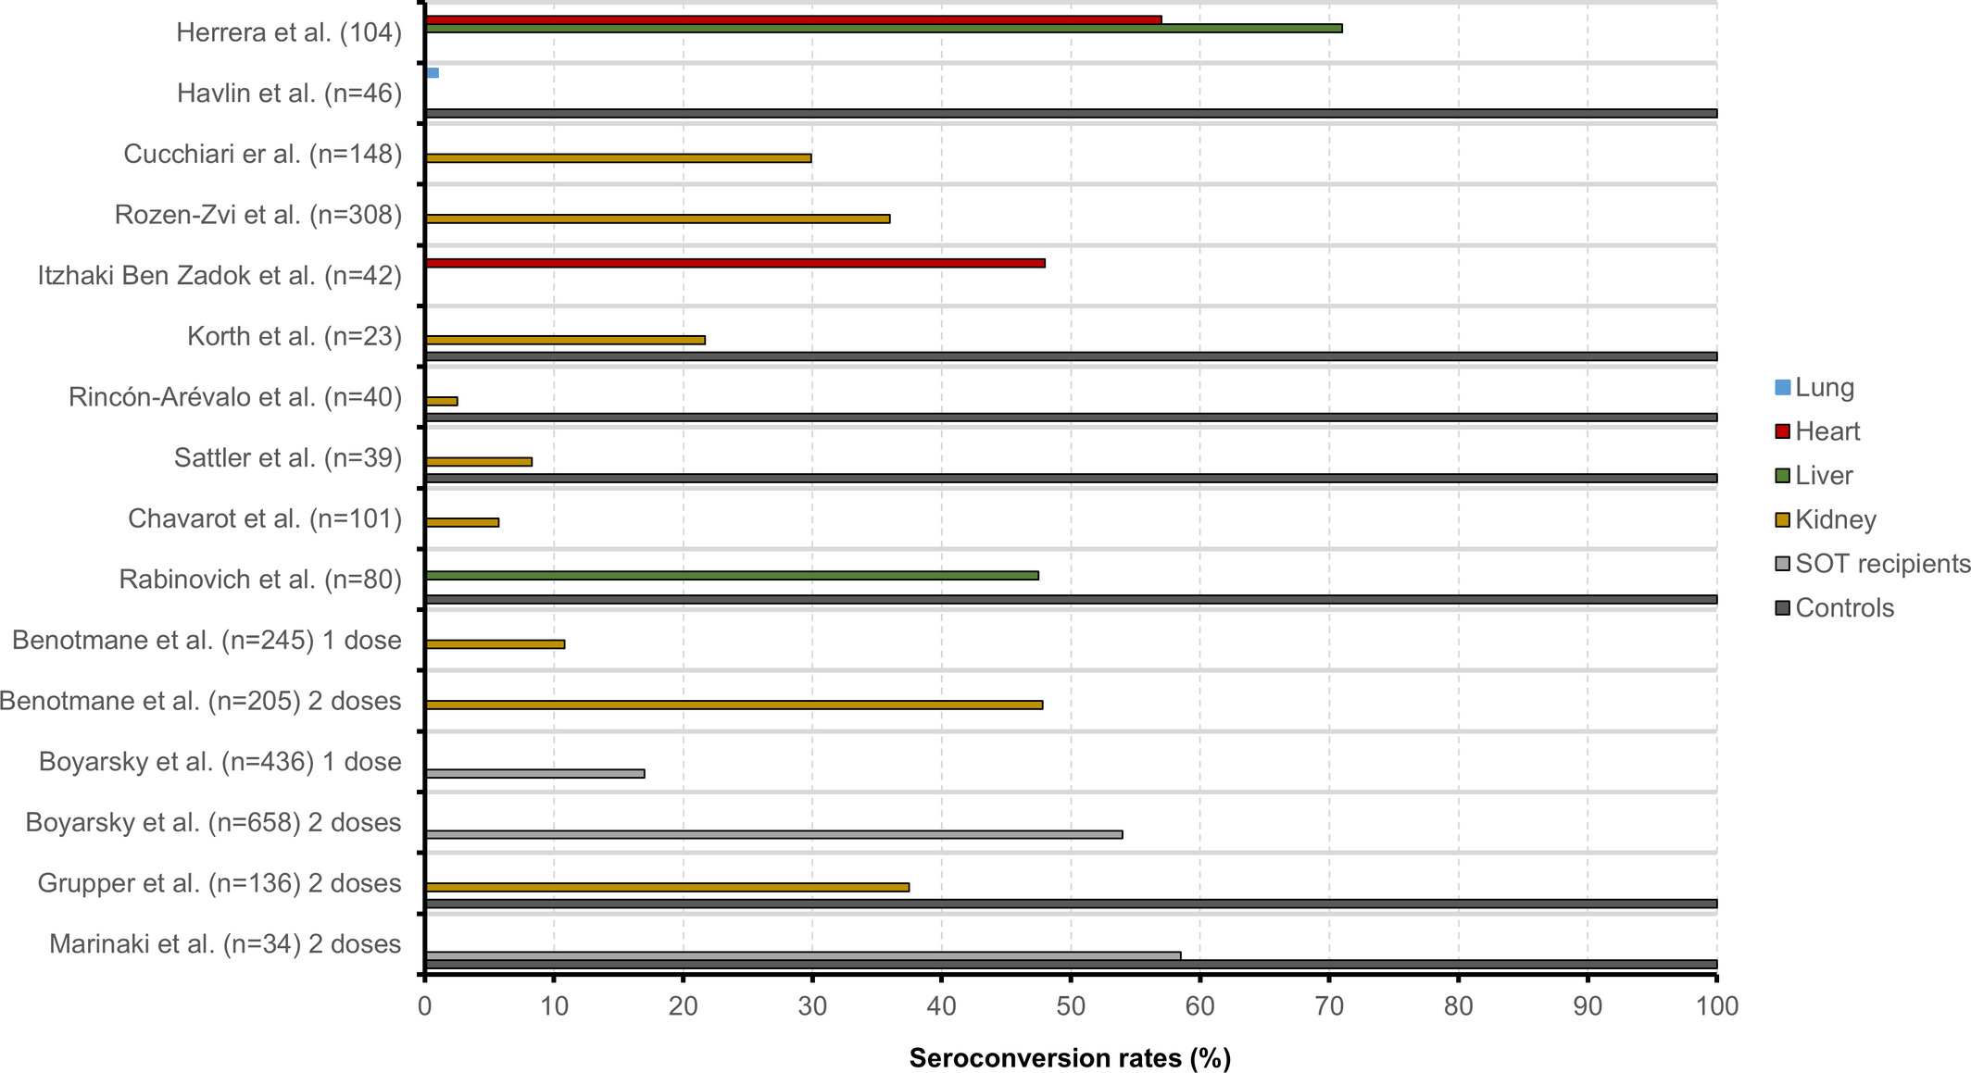
COVID-19 Vaccines in SOT
M
P
M
P
P
P
P
P
P
P
M
M
M/P
M/P
P
P

Slide 22
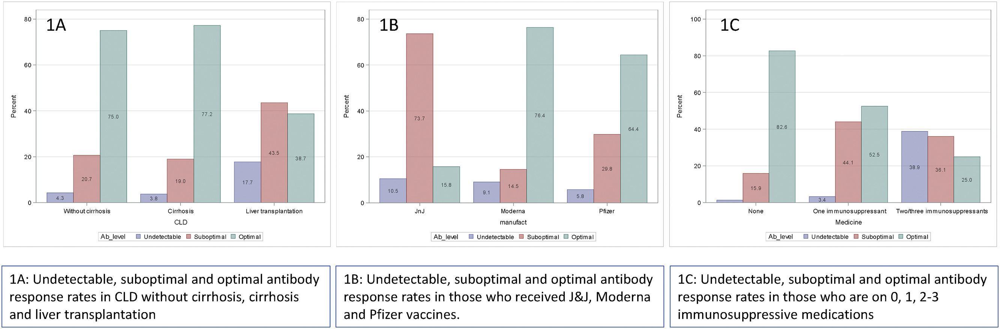
Liver Disease

Slide 23
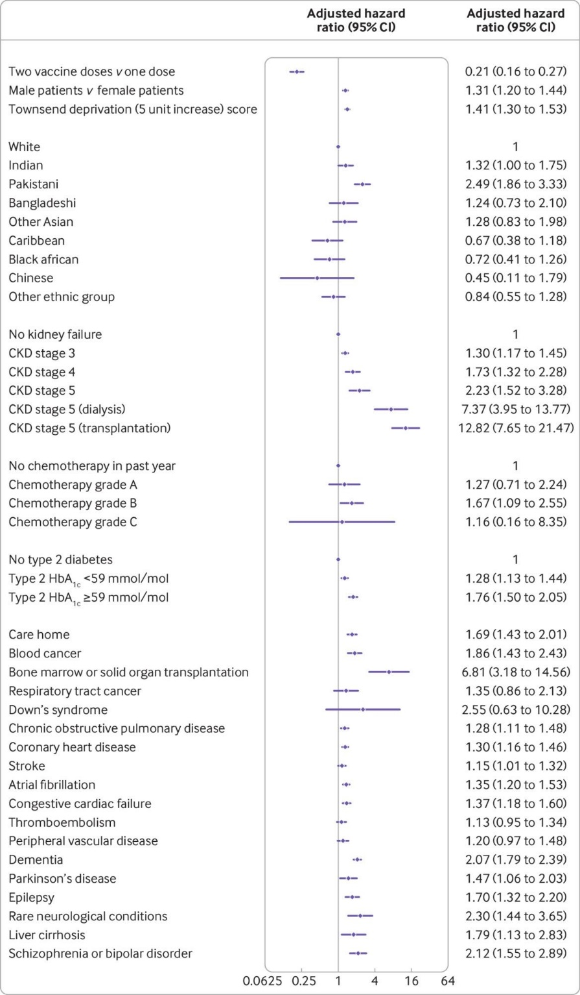
Risk of hospitalization after COVID 19 vaccination
AztraZeneca and Pfizer vaccine
BMJ 2021 Sep 17:374

Slide 24
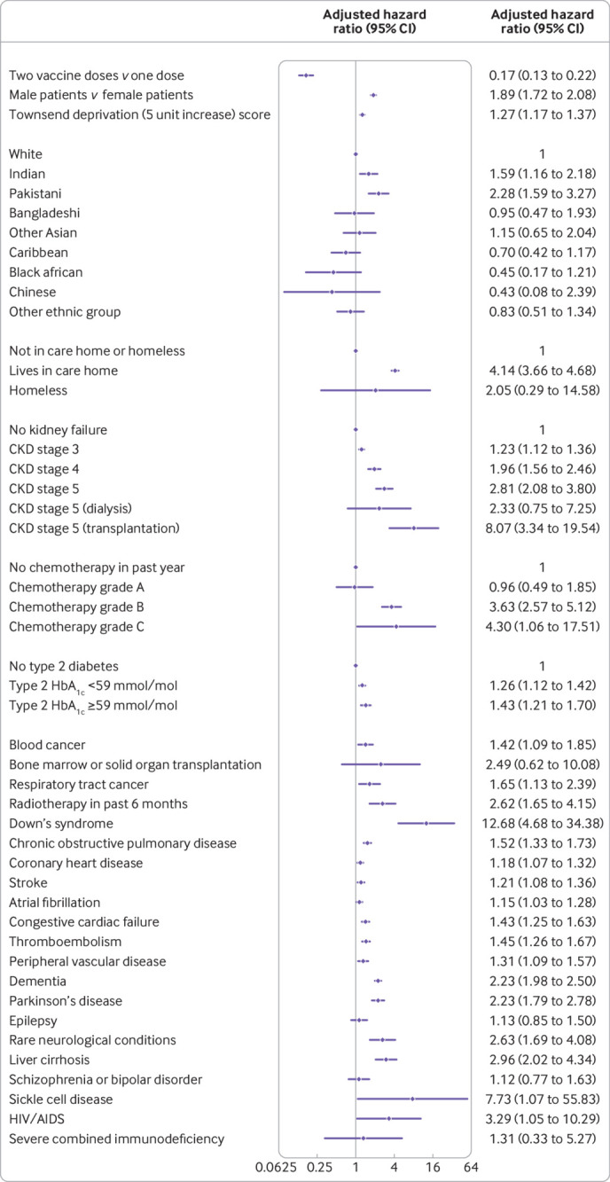
Risk of death after COVID 19 vaccination
BMJ 2021 Sep 17:374

Slide 25
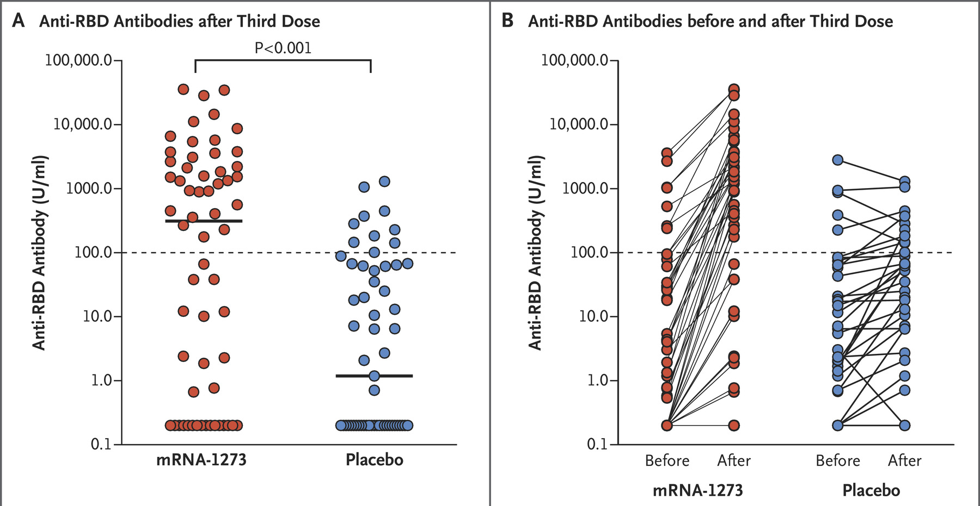
COVID-19 Booster Vaccine
. 2021 Aug 27.
120 SOT recipients
Moderna: 2 doses + 3rd dose/placebo
(schedule 0, 1, 3 months)

Slide 26
Booster Recommendations
ACIP recommends additional (3rd) dose of mRNA (Pfizer or Moderna) vaccine after completion of 2 dose primary series to immunocompromised people
Ideally, same mRNA vaccine dose should be used, but heterologous additional dose is permitted if only option available
Additional dose should be administered >28 days from completion of primary series

Slide 27
COVID-19 Vaccine: Safety
741 SOT (kidney, liver, heart, pancreas)
400 Pfizer, 341 Moderna
77 (dose1) - 81%(dose 2) local reactions
49% (dose 1) – 69% (dose 2) systemic reactions
Severe reactions rare
1 case of ACR

Slide 28
Contacts
Healthcare workers and family members should be immunized fully (including yearly flu vaccination)
Avoidance of recently immunized household contact is not necessary
No need to delay childhood immunizations for household member

Slide 29
Live vaccines & close contacts
Vaccine | Comments
MMR | Give on schedule to household contact
Rotavirus | Avoid handling diapers 4 weeks
Varicella | If transplant recipient seronegative and vaccine recipient develops rash; avoid direct contact or antiviral trx 21 days
Zoster | If transplant recipient seronegative and vaccine recipient develops rash; avoid direct contact or antiviral trx 21 days
LAIV | Not if severely immunocompromised HSCT
Oral polio | Avoid, no longer available in US

Slide 30
Concern for rejection
Case reports of vaccination inducing allograft rejection
Larger studies show no clinical association between vaccinations and rejection/allograft dysfunction
Multicenter heart transplant study showed no difference in ACR rates between flu vaccination at 2, 3, or 6 months after transplant and no vaccination at all.

Slide 31
Alloimmune response after flu vaccine
169 SOT recipients had anti-HLA abs drawn pre and post flu vaccine
5/136 KT recipients (3.7%) developed de novo anti-HLA abs
1/5 developed donor specific ab (DSA) and AMR 8 months post vaccine
5/136 KT recipients had rejection <12 months of vaccine (2 ACR, 1 mixed ACR/AMR from noncompliance, 1chronic AMR after acute AMR episode pre vaccine): 4/5 had no de novo anti-HLA abs

Slide 32
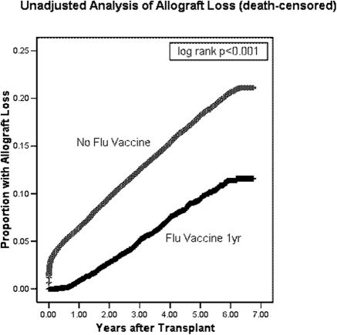
Flu vaccine and renal transplant

Slide 33

For the world travelers…
Refer to American Society of Transplantation Infectious Diseases Guidelines for Travel
cdc.gov- provides vaccination information for each country
Preferable to wait 1 year after transplant before foreign travel (longer if rejection)

Slide 34

Travel vaccinations
Transplant patients should be evaluated at a designated travel clinic at least several months in advance
Avoid live vaccines: Yellow fever, oral typhoid (IM typhoid recommended, ok for family to receive live vaccines)
Malaria prophylaxis drugs: beware of drug interactions (QTc)

Slide 35
Conclusions
No evidence that vaccines lead to allograft rejection
Vaccinations remain an important (and in some cases underutilized) tool in preventing infection in transplantation
While response to vaccines after transplant is suboptimal, partial protection preferred to no protection
Household contacts should be up to date on vaccinations (even live ones)

Slide 36
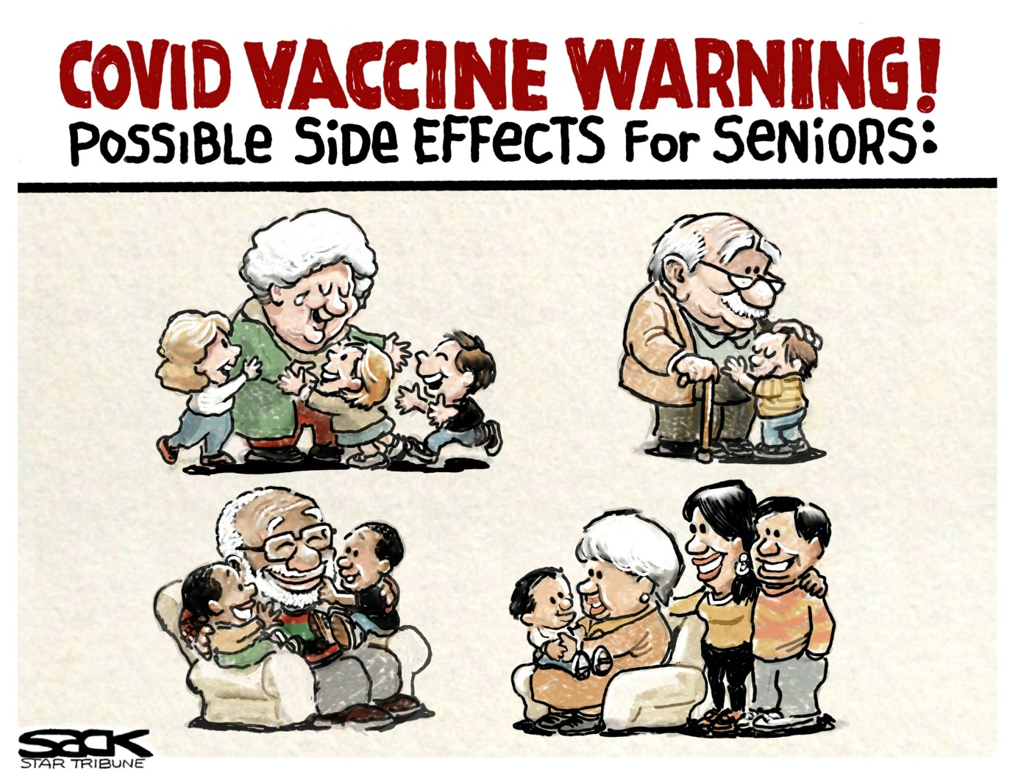
Questions?

