Slide 1


Telehealth in Transplantation: Regulation and Opportunities for APRNs
Presented by:
Amber Humphrey, MBA
Senior Director | Telehealth

Slide 2

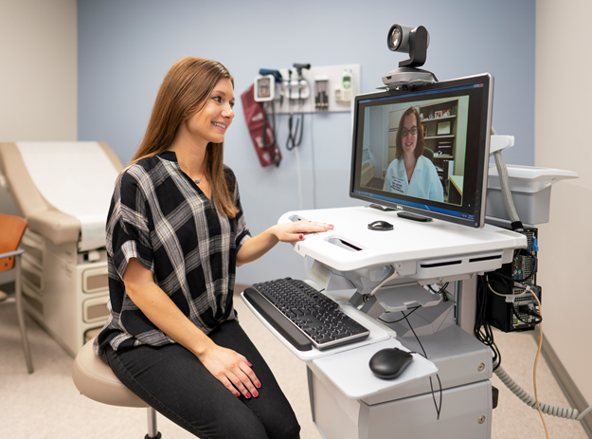

Telehealth Program Overview
4 Categories of Telehealth
System to System: Teleneurology, TeleID, remote diagnostic review
Ambulatory: clinic-to-clinic and direct-to-patient
Store and Forward: also called “asynchronous”; includes eConsult and remote diagnostic review
Remote Patient Monitoring: device checks and continuous glucose monitoring
Pre-Pandemic Engagement
30,000 telehealth visits per year including System to System, Ambulatory and RPM encounters
Less than 10 direct-to-patient visits per day
Approximately 100 providers using telehealth

Slide 3


Telehealth Tipping Point: COVID-19
Scaling telehealth during the pandemic
Activation of telehealth visit types for all providers
On-demand and live training modules for providers, nursing staff, and schedulers
Enhanced patient resources for telehealth readiness
Engaged Interpreter Services
Revenue Cycle monitoring to determine payors’ requirements; prepared claims accordingly
Impact
2,500 telehealth visits per day during the Stay-at-Home order
70% of clinicians using telehealth
370,000 visits since March 2020

Slide 4
Regulatory Landscape: Pre-COVID
CMS’s Telehealth Eligibility Requirements
Originating Sites: healthcare facilities in rural professional shortage areas
Distant Site Practitioners: MD, NP, PA, Midwives, CRNAs, Psychologists, Social Workers, and Dieticians
Specific CPT Codes
Applicable to Medicare Part B and other federally-insured patients.
Exceptions: services covered by Medicare Part A, i.e., Transplant Services
Commercial Payors
Limited coverage for telehealth services
Varied based on state regulations
Originating site requirements: no rural restriction, but most payors required patient to be in a healthcare facility
Notes:
Facilities: Physician and practitioner offices ● Hospitals ● Critical Access Hospitals (CAHs) ● Rural Health Clinics (RHCs) ● Federally Qualified Health Centers (FQHCs) ● Hospital-based or CAH-based Renal Dialysis Centers (including satellites) ● Skilled Nursing Facilities (SNFs) ● Community Mental Health Centers (CMHCs) ● Renal Dialysis Facilities ● Patients with End-Stage Renal Disease (ESRD) getting home dialys

Slide 5
During the Public Health Emergency
What is a Public Health Emergency period?
A 90-day period during which federal waivers are in place provide emergency support . The Department of Health and Human Services can renew/extend at any time during that 90-day period.
How did the PHE enable telehealth?
Expanded approved technology platform options
Eliminated originating site restrictions
Additional distant site providers: allows therapists, audiologists, genetic counselors, etc. to provide billable telehealth services
Includes reimbursement for ‘phone only’ visits
Does the current PHE period expire? January 13, 2022
Notes:
Amber/Bob

Slide 6


Regulatory Landscape: Post-COVID
Commercial Payors
All major payors have confirmed their intent to cover direct to patient telehealth beyond the pandemic.
Proposed CMS 2022 Medicare Physician Fee Schedule
Most continued flexibility is focused on behavioral health services
Removal of geographic restrictions and originating site requirements for behavioral health services
Continued ‘phone visit’ coverage for behavioral health services
Extends coverage of some services added during the PHE through 2023
Final rule is not available until late November
Notes:
Clinicians who wish to pursue out of state licensure must:
Obtain approval from his/her Department Chair, the Office of Risk and Insurance Management, and the Office of the Chief of the Clinical Staff
Confirm the patient’s planned location and that you (the clinician) have appropriate licensure before scheduling a telehealth visit

Slide 7
State Licensure Guidelines
All temporary licensure in surrounding states has expired.
Clinicians must be licensed in the state where the patient is physically located at the time the telehealth visit is conducted, state licensure applies to New and Established patients.
Examples
If a patient lives in Alabama and will be in Alabama during the telehealth visit, the clinician must be licensed in Alabama.
If a patient lives in Tennessee will be vacationing in Florida during the telehealth visit, the clinician must be licensed in Florida.
Reminders
Clinicians who obtain out of state licensure are subject to professional licensure requirements and all other laws and regulations including those pertaining to scope of practice, confidentiality, etc.
Residents or fellows providing care under VUMC’s institutional medical license are only permitted to see patients via telehealth when the patient is physically in the State of Tennessee.
Notes:
Clinicians who wish to pursue out of state licensure must:
Obtain approval from his/her Department Chair, the Office of Risk and Insurance Management, and the Office of the Chief of the Clinical Staff
Confirm the patient’s planned location and that you (the clinician) have appropriate licensure before scheduling a telehealth visit

Slide 8


Telehealth Use Cases for Transplant Patients
New and Return Visits
Global Period Visits
Non-Billable/Bundled Visits: Social Work & Care Coordination
Research and Grants
Photo credit: apaservices.org
Reminder: after the PHE period, patients’ transplant coverage – Medicare A vs. Medicare B – may determine which services can be offered via telehealth.
Notes:
Clinicians who wish to pursue out of state licensure must:
Obtain approval from his/her Department Chair, the Office of Risk and Insurance Management, and the Office of the Chief of the Clinical Staff
Confirm the patient’s planned location and that you (the clinician) have appropriate licensure before scheduling a telehealth visit

Slide 9
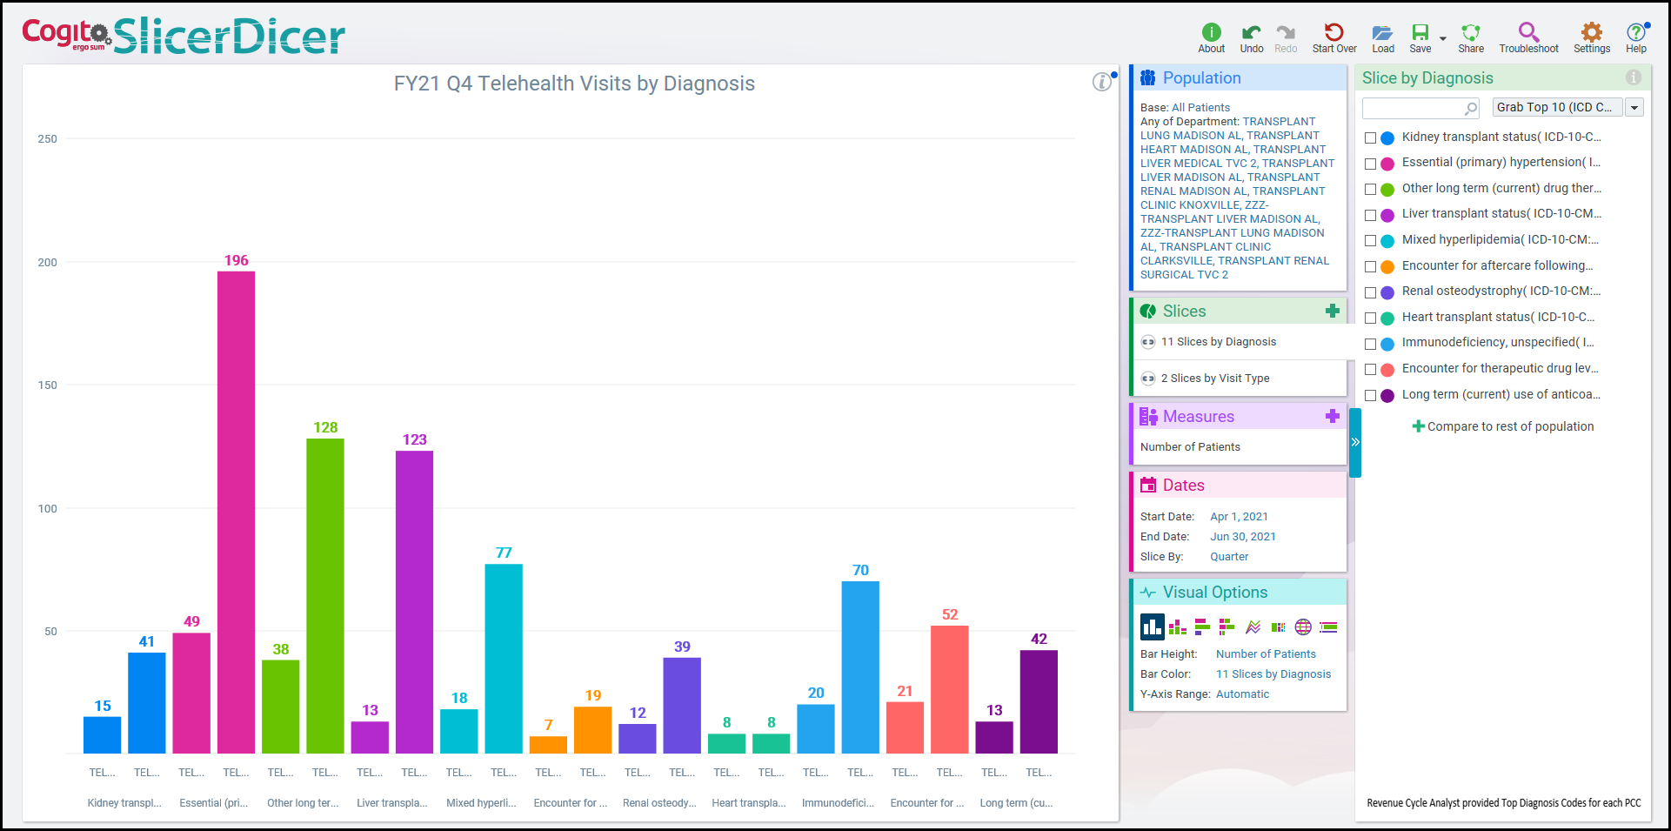
Telehealth Utilization by Diagnosis
Notes:
eStar’s Slicer Dicer feature provides PCC-specific telehealth utilization by diagnosis.
This tool is a great way to determine which diagnosis or visit types are clinically appropriate for telehealth.

Slide 10
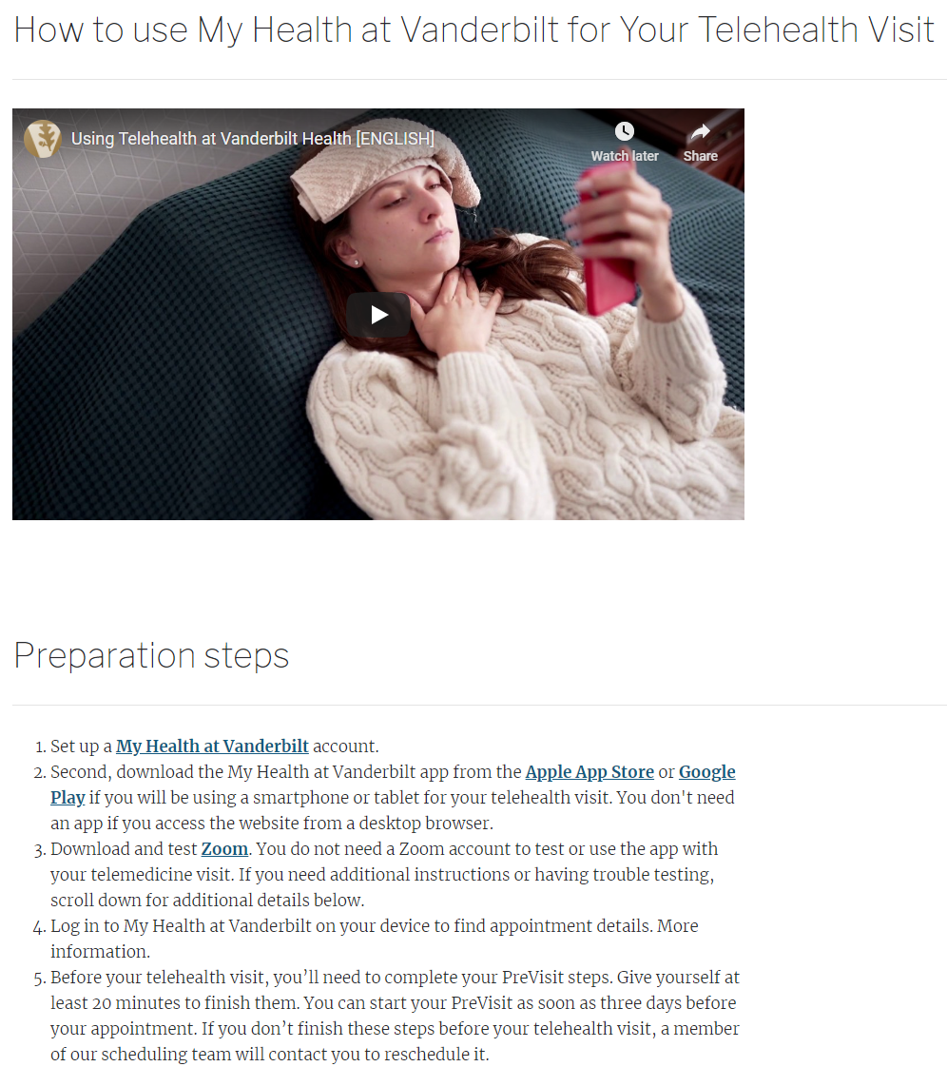
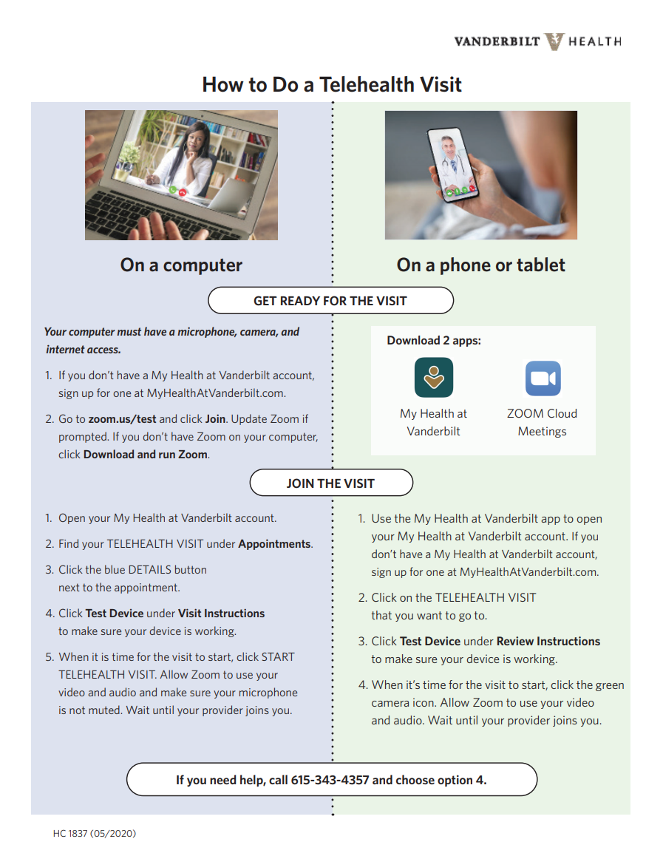



Patient Education and Marketing

Slide 11
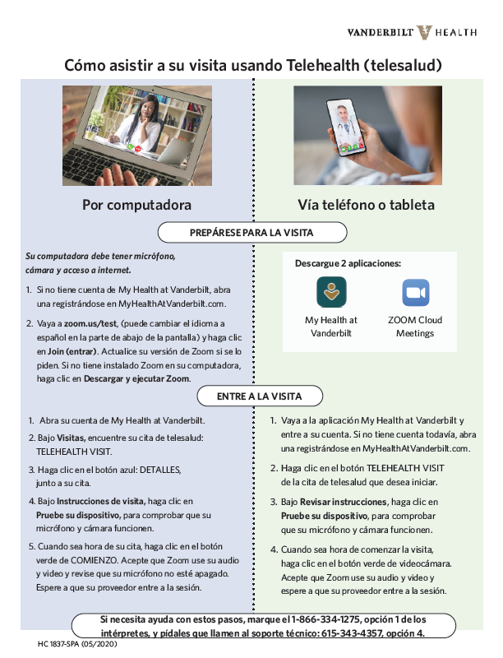
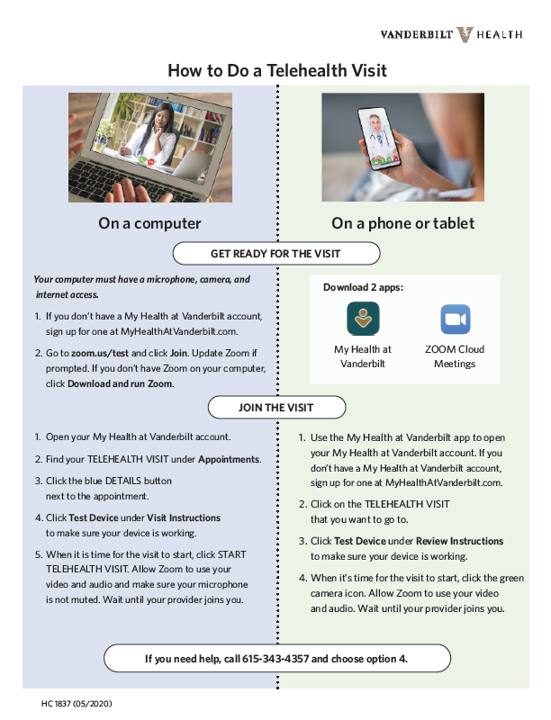

Addressing Health Equity
“At VUMC, where making diversity and inclusion is intentional with values and objectives that guide strategic direction, we integrated health equity into our health system’s COVID-19 operations to make it a priority, not an isolated stream of work.”
- Consuelo H. Wilkins, MD, MSCI, Senior Vice President for Health Equity and Inclusive Excellence, VUMC
Notes:
See C. Wilkins’ journal article / Office of Health Equity / Developed COVID Health Equity Workstream to ensure that patients who face social, cultural, and economic barriers have access to healthcare.
With so many patients trying to telehealth for first time, it was important to create instructions for accessing telehealth visits that were written to reflect various health literacy levels.
We also recognize that many of our patients have limited English proficiency. Our two largest non-English speaking populations are Spanish and Arabic-speaking patients, so with the help of our Interpreter Services department, all telehealth materials were translated to Spanish and Arabic.
We also partnered with that group to ensure that adding an interpreter into the visit was a seamless as possible.
Vanderbilt will continue make health equity a priority for all patients we serve.

Slide 12
amber.humphrey@vumc.org
Thank you!

