Slide 1
New drug Updates from the transplant pharmacist & Panel discussion

Slide 2
Disclosure
The speakers have nothing to disclose relevant to this presentation.
Presentation will include discussion of off-label uses of medications.
Notes:
For the record today, the speakers have nothing to disclose and we will be discussing off label uses of medications

Slide 3
Panel members
Kimberly Harrison, PharmD, BCPS
Heart Transplant Clinical Pharmacist, Vanderbilt University Medical Center
Nikita Wilson, PharmD, BCPS, MMHC
Kidney/Pancreas Transplant Clinical Pharmacist, Vanderbilt University Medical Center
Carissa Garza, PharmD, MMHC
Liver Transplant Clinical Pharmacist, Vanderbilt University Medical Center
Notes:
First I want to introduce you to our panel members. My name is….

Slide 4
Potassium binders
Notes:
**Poll group to preference for kayexalate, veltassa, lokelma

Slide 5
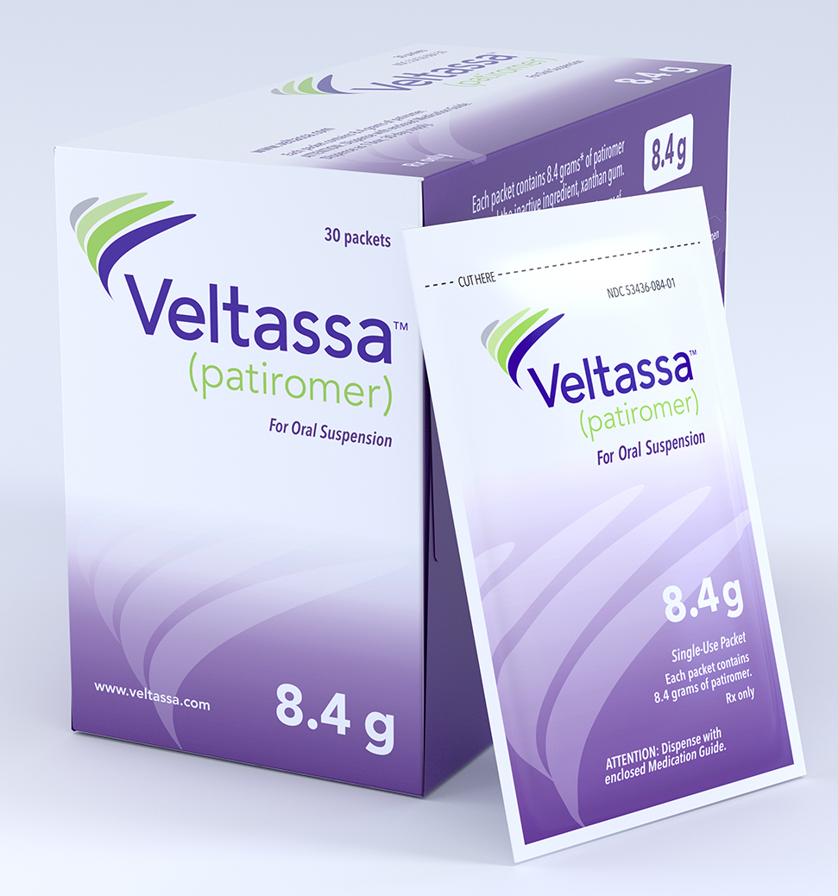
Veltassa® (patiromer)
FDA Approval Date: 2015
Indication: Treatment of hyperkalemia
Mechanism:
Non-absorbed cation exchange polymer that contains a calcium-sorbitol counterion
Most active in colon
Lowers potassium in ~ 7 hours
Notes:
Also binds magnesium
Most active in the colon
Lowers K in 7 hours

Slide 6
Veltassa® (patiromer)
Formulations:
Powder packets for oral suspension: 8.4g, 16.8g, 25.2g
Dissolve in at least 1/3 cup water, apple juice, or cranberry juice and stir (mixture will not dissolve)
Dosing: 8.4g daily
Adjust by 8.4g at one-week intervals to potassium goal (max 25.2g daily)
Adverse Effects:
Hypomagnesemia
Drug Interactions:
Separate other medications at least 3 hours before or after Veltassa

Slide 7
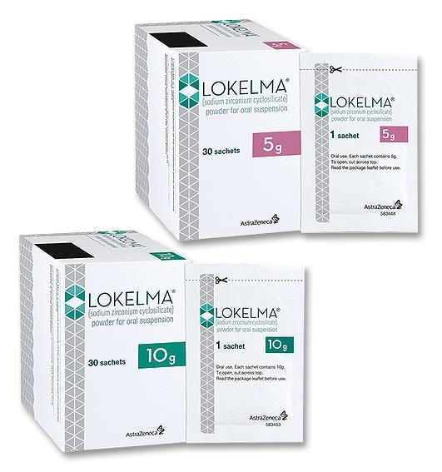
Lokelma® (sodium zirconium cyclosilicate)
FDA Approval Date: 2018
Indication: Treatment of hyperkalemia in adults
Mechanism:
Non-absorbed zirconium silicate that preferentially exchanges potassium for hydrogen and sodium
Lowers potassium in 1 hour
Notes:
MOA: binds throughout GI tract, starting in the small intestine

Slide 8
Lokelma® (sodium zirconium cyclosilicate)
Formulations:
Powder packets for oral suspension: 5g or 10g
Empty contents into at least 3 Tbsps of water
Dosing: 10g TID up to 48hrs, then 10g daily.
Adjust by 5g at one-week intervals to potassium goal
Adverse Effects:
Potential edema
Drug Interactions:
Separate other medications at least 2 hours before or after Lokelma
Notes:
Not studied in bowel mobility disorders
400mg sodium per 5g dose
Transiently change gastric pH and effect absorption of co-administered drugs

Slide 9
biosimilars
Notes:
Anyone heard this term?

Slide 10
biosimilars
Characteristic | Small-Molecule Drug | Biologic Drug
Size | Small molecules/low molecular weight | Large, complex, protein/glycoprotein molecules/high molecular weight
Manufacturing | Produced by chemical synthesis | Produced by living cell cultures
Structure | Simple, well-defined; completely characterized | Complex, heterogeneous with many levels; impossible to fully characterize
Immunogenicity | Mostly non-immunogenic | Potentially immunogenic
Stability | Stable and predictable | Unstable and sensitive to external conditions
Notes:
There a couple new biosimilars on the market so before I discuss those I wanted to talk what a biosimilar even is.
→ What is happening on the market today is that exclusitivity rights for these biologics are starting to expire for the first time (12 years)
Discuss generic approval process
Pharmacist not able to automatically interchange

Slide 11
What’s in a name
Reference Product | Biosimilar Name | Brand Name | FDA Approval Date
Epoetin (Epogen) | epoetin alfa - epbx | Retacrit | 2018
Filgrastim (Neupogen) | filgrastim-sndz | Zarxio | 2015
 | filgrastim-aafi | Nivestym | 2018
Rituximab (Rituxan) | rituximab-aabs | Truxima | 2018
 | rituximab-pvvr | Ruxience | 2019
Notes:
4 letter extension to identify manufacturer for post marketing surveillence
Legalities around these drugs has the potential to change in the coming years as the FDA adopts it’s policies to changing technology
Benefit: decrease treatment cost
Future biologics: Campath, prolia,

Slide 12
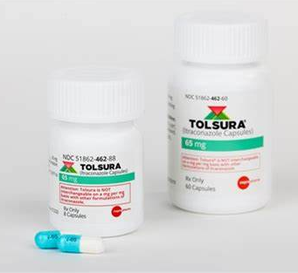
Tolsura® (Itraconazole)
FDA Approval Date: December 2018
Class: Azole Anti-fungal
Uses SUBA® technology: improves drug absorption by decreasing particle size and increases solubility in the small intestine
Clinical Results:
Decreased drug level variability
Improved time to therapeutic itraconazole levels
Absorption not altered in presence of PPI
Notes:
Anyone using itraconazole prophylaxis?
Okay with PPI
FDA approved date:
$$ comparison

Slide 13
Itraconazole formulations
 | Sporanox |  | Tolsura
Dosage forms* | 100mg capsule | 10mg/mL oral solution | 65mg capsules
Typical dosage | 200mg once or twice daily | 200mg once or twice daily | 130mg once or twice daily
Primary Absorption Site | Stomach (requires acidity) | Stomach | Small Intestine
Administration | With food | Empty Stomach | With food
Approx. cost (30 day supply) | $1449 | $2964 | $4952
Drug Interactions | Potent CYP3A4 inhibitor, P-glycoprotein inhibitor, BCRP inhibitor
Common side effects | Hepatotoxicity, QTc prolongation, negative inotropic effects (caution w/ CHF)
*Formulations are NOT interchangeable
Notes:
Previously oral solution preferred for best oral absorption
**formulations are NOT interchangeable

Slide 14
CMV Resistance

Slide 15
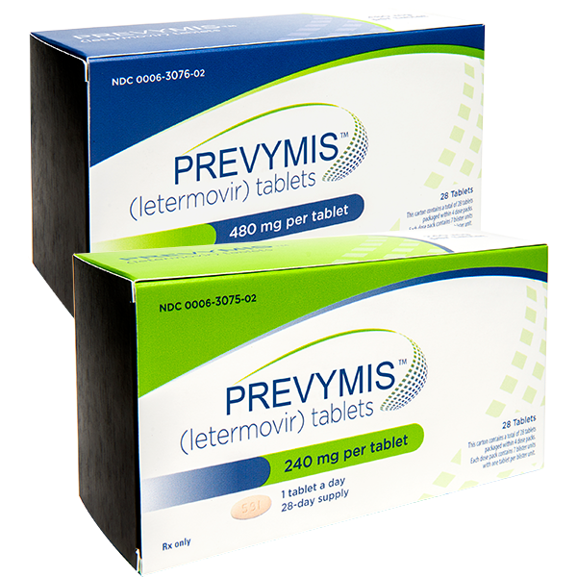
Prevymis™(letermovir)
FDA Approval Date: 2017
Indication:
Prophylaxis of CMV in adult CMV+ recipients of an allogeneic hematopoietic stem cell transplant
Mechanism:
CMV DNA terminase complex inhibitor
NOT active against HSV
Potential for use in UL54 and UL97 mutations
Notes:
preventing viral DNA processing and packaging
Can be considered for CMV strains with UL54 and UL 97 mutations as it works downstream of these sites

Slide 16
Prevymis™(letermovir)
Formulations:
Tablets: 240mg, 480mg
IV injection
Dosing: 480mg daily
Adverse Effects:
GI: nausea, vomiting, diarrhea
Peripheral edema
Drug Interactions:
Substrate: CYP3A4, P-glycoprotein, CYP2D6, OATP1B1
Reduce letermovir dose to 240mg daily when used with cyclosporine
Notes:
No hematologic toxicities
No extensively studied for treatment of CMV but has been reported for cmv resistance
Unfortunately Low barrier to resistance (to UL56)

Slide 17
Panel discussion

