Slide 1
Time for Innovation: Organ Monitoring with Allosure
Jennifer Gray, PharmD
Senior Medical Science Liaison – Cardiothoracic, East Coast Lead
October 19th, 2021

Slide 2
Objectives
AlloSure Kidney Overview
Lung and Heart
Present a Kidney Transplant Patient Case
High Level Synopsis of Ongoing Studies in the Different Organs

Slide 3


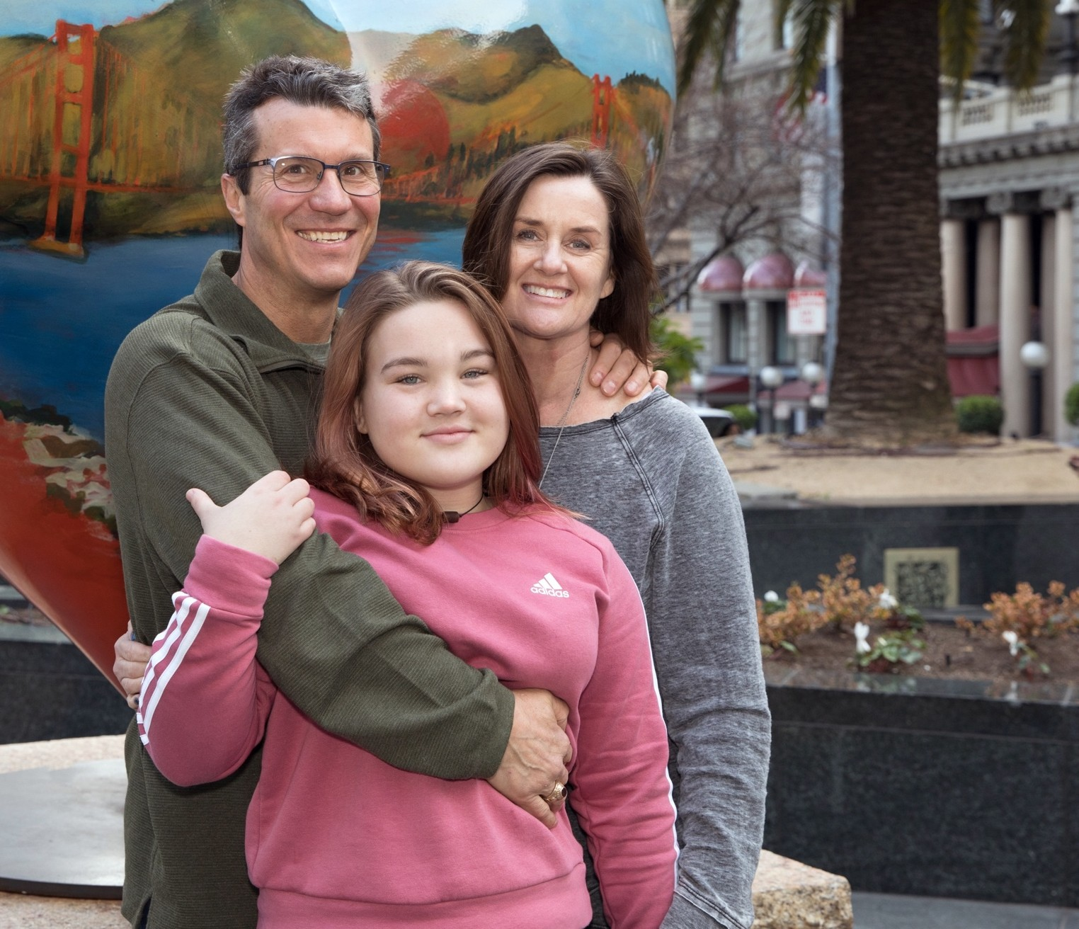


Our Vision
The leading partner for the transplant ecosystem
Our Mission
We are committed to improving long-term outcomes by providing innovative solutions throughout the entire transplant patient journey

Slide 4


Slide 5

Who has heard of cell free DNA?
Who doesn’t care and just wants to eat lunch?

Slide 6

Patient Care Post-Transplantation is a Balance
Patients are on life-long immunosuppressive drug therapy
TOO LITTLE
TOO MUCH
Increased risk of:
Rejection ….leading to failure of the organ
Increased risk of:
Infections
Kidney failure
Malignancy
Onset of Diabetes
Consequences
Transplant Recipients are high value patients in the Health Care System
Median survival: Kidney: 10 years
OBJECTIVE Avoid Rejection…While Minimizing Immunosuppression
Notes:
Key Talking Points: We have a responsibility to our patients to avoid rejection while minimizing immuno- suppression. Transplant recipents have a meticulous balance of therapy to remain on indefinitely, with major consequences either way.

Slide 7
Current Clinical Challenges within Kidney Transplantation
Allograft loss is expensive, resulting in many major adverse outcomes for the patient, family, center, system, and US healthcare
Current immunosuppression has not changed much in over 15 years
Current outcomes have not changed much in over 15 years
Current monitoring modalities have not changed much in over 15 years (Scr, U/A, viral NATs, DSA → DU/S, KBx) despite many attempts to define new invasive or non-invasive markers
Current monitoring is often arduous, expensive, and inaccurate
Notes:
Key Talking Points: There are many challenges within the kidney transplantation space, including lack of innovations in immunosuppression and monitoring modalities. Accordingly, we are still seeing similar outcomes as we did 15 years ago. Current options for monitoring for rejection are arduous, expensive, and inaccurate. There must be a better way.

Slide 8


Guidelines Recommend Monitoring for Rejection
According to KDIGO clinical practice guidelines, early detection of allograft dysfunction is key¹
Monitoring serum creatinine is recommended, but an increase can be due to other conditions¹, eliminating specificity and sensitivity
Current assays to monitor donor-specific antibodies (DSA) are insensitive and have limited specificity²
Protocol biopsies are not practical for frequent surveillance and may not uniformly identify patients who would benefit from therapy²
¹ Bia M, Adey DB, Bloom RD, et al. KDOQI US commentary on the 2009 KDIGO clinical practice guideline for the care of kidney transplant recipients. Am J Kidney Dis. 2010; 56(2):189-218. doi: 10.1053/j.ajkd.2010.04.010.
²Kidney Disease: Improving Global Outcomes (KDIGO) Kidney Transplant Candidate Work Group. KDIGO Clinical Practice Guideline on the Evaluation and Management of Candidates for Kidney Transplantation. Transplantation. 2020;104: S1 – S103.
Notes:
Key Talking Points: Though the KDIGO guidelines recommend early detection of allograft rejection, options for monitoring are limited. Serum creatinine is recommended, but an increase can be due to other conditions, eliminating specificity and sensitivity.
Current assays to monitor DSAs are also insensitive, with limited specificity. In addition, protocol biopsies are not practical for frequent surveillance, and due to the inherent variation in histological observance, may not uniformly identify patients in need of therapy.

Slide 9
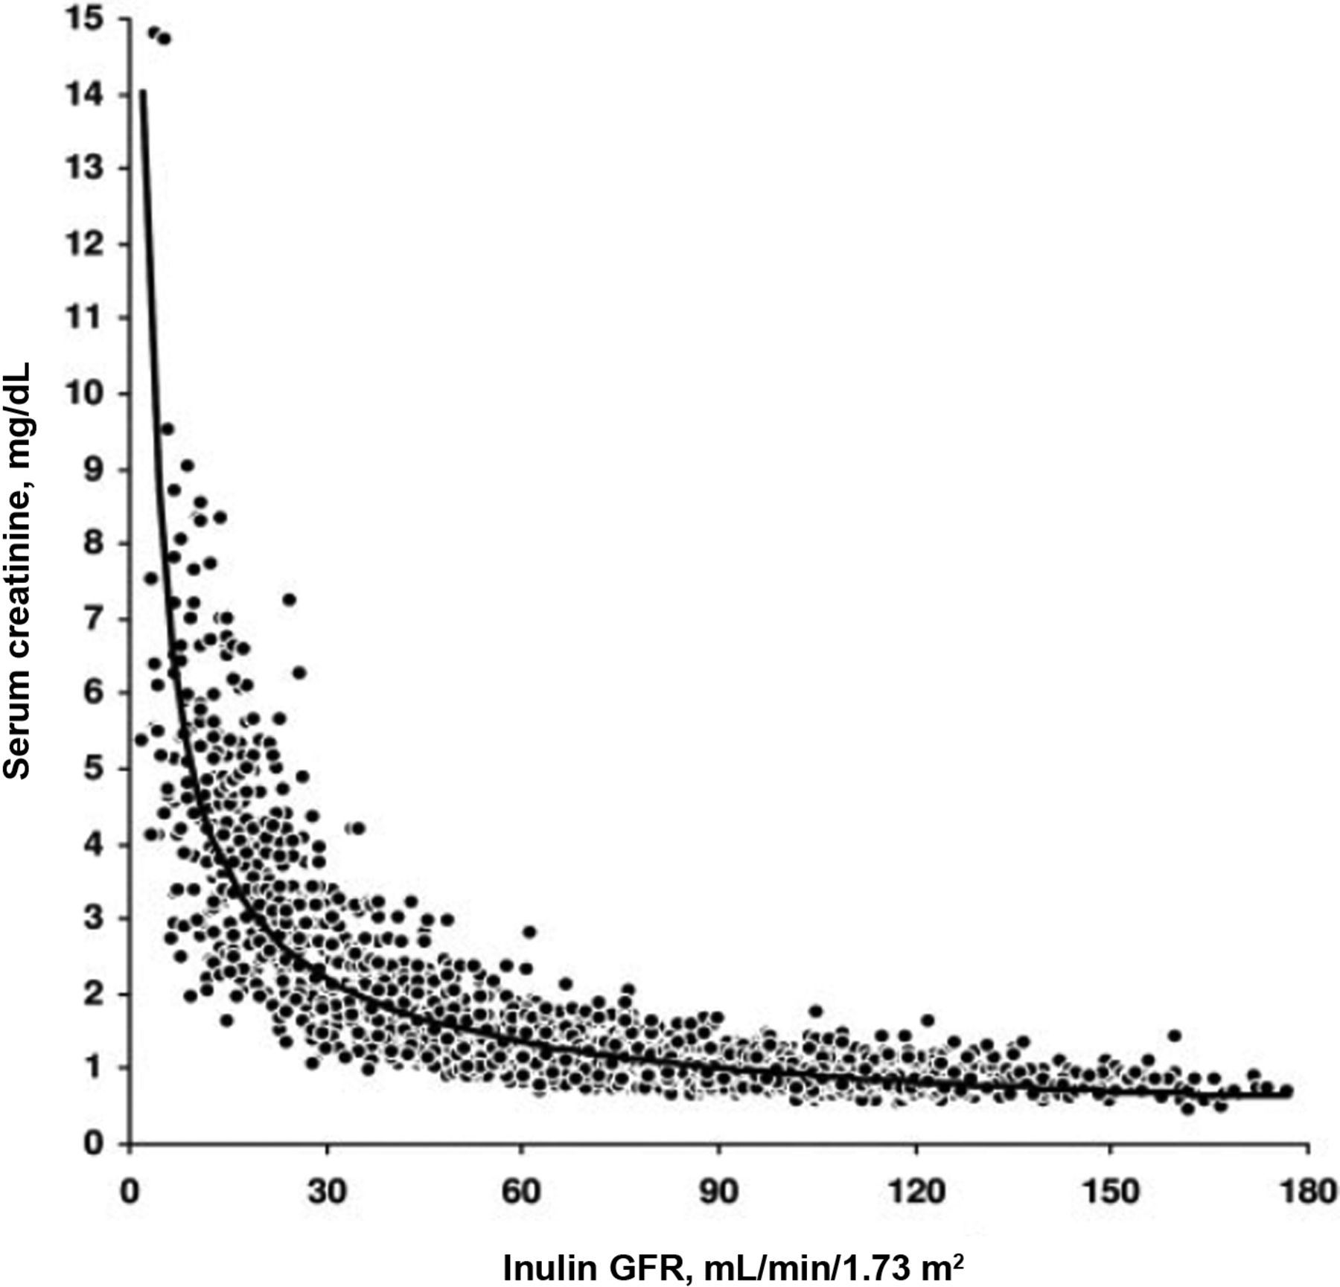
Current Surveillance Options have Limitations
Non-Invasive
Serum
Creatinine
DSA
Less Accurate
in diagnosis of Graft Injury
More Accurate
in diagnosis of Graft Injury
Biopsy
Invasive
Nickerson P. Post-transplant monitoring of renal allografts: are we there yet? Curr Opin Immunol. 2009; 21(5) 563-568
Josephson Monitoring and Managing Graft Health in the Kidney Transplant RecipientClin J AM Soc Nephrol 2011
Notes:
Key Talking Points: We have come a long way in transplant but current surveillance options have limitations. Do you compromise accuracy for invasion?
Serum Creatinine: non-specific, not sensitive, risk of late signal
Kidney Biopsy: sampling errors, inconvenient, potential for complications, interpretation challenges
Not all positive DSA tests equal ABMR

Slide 10
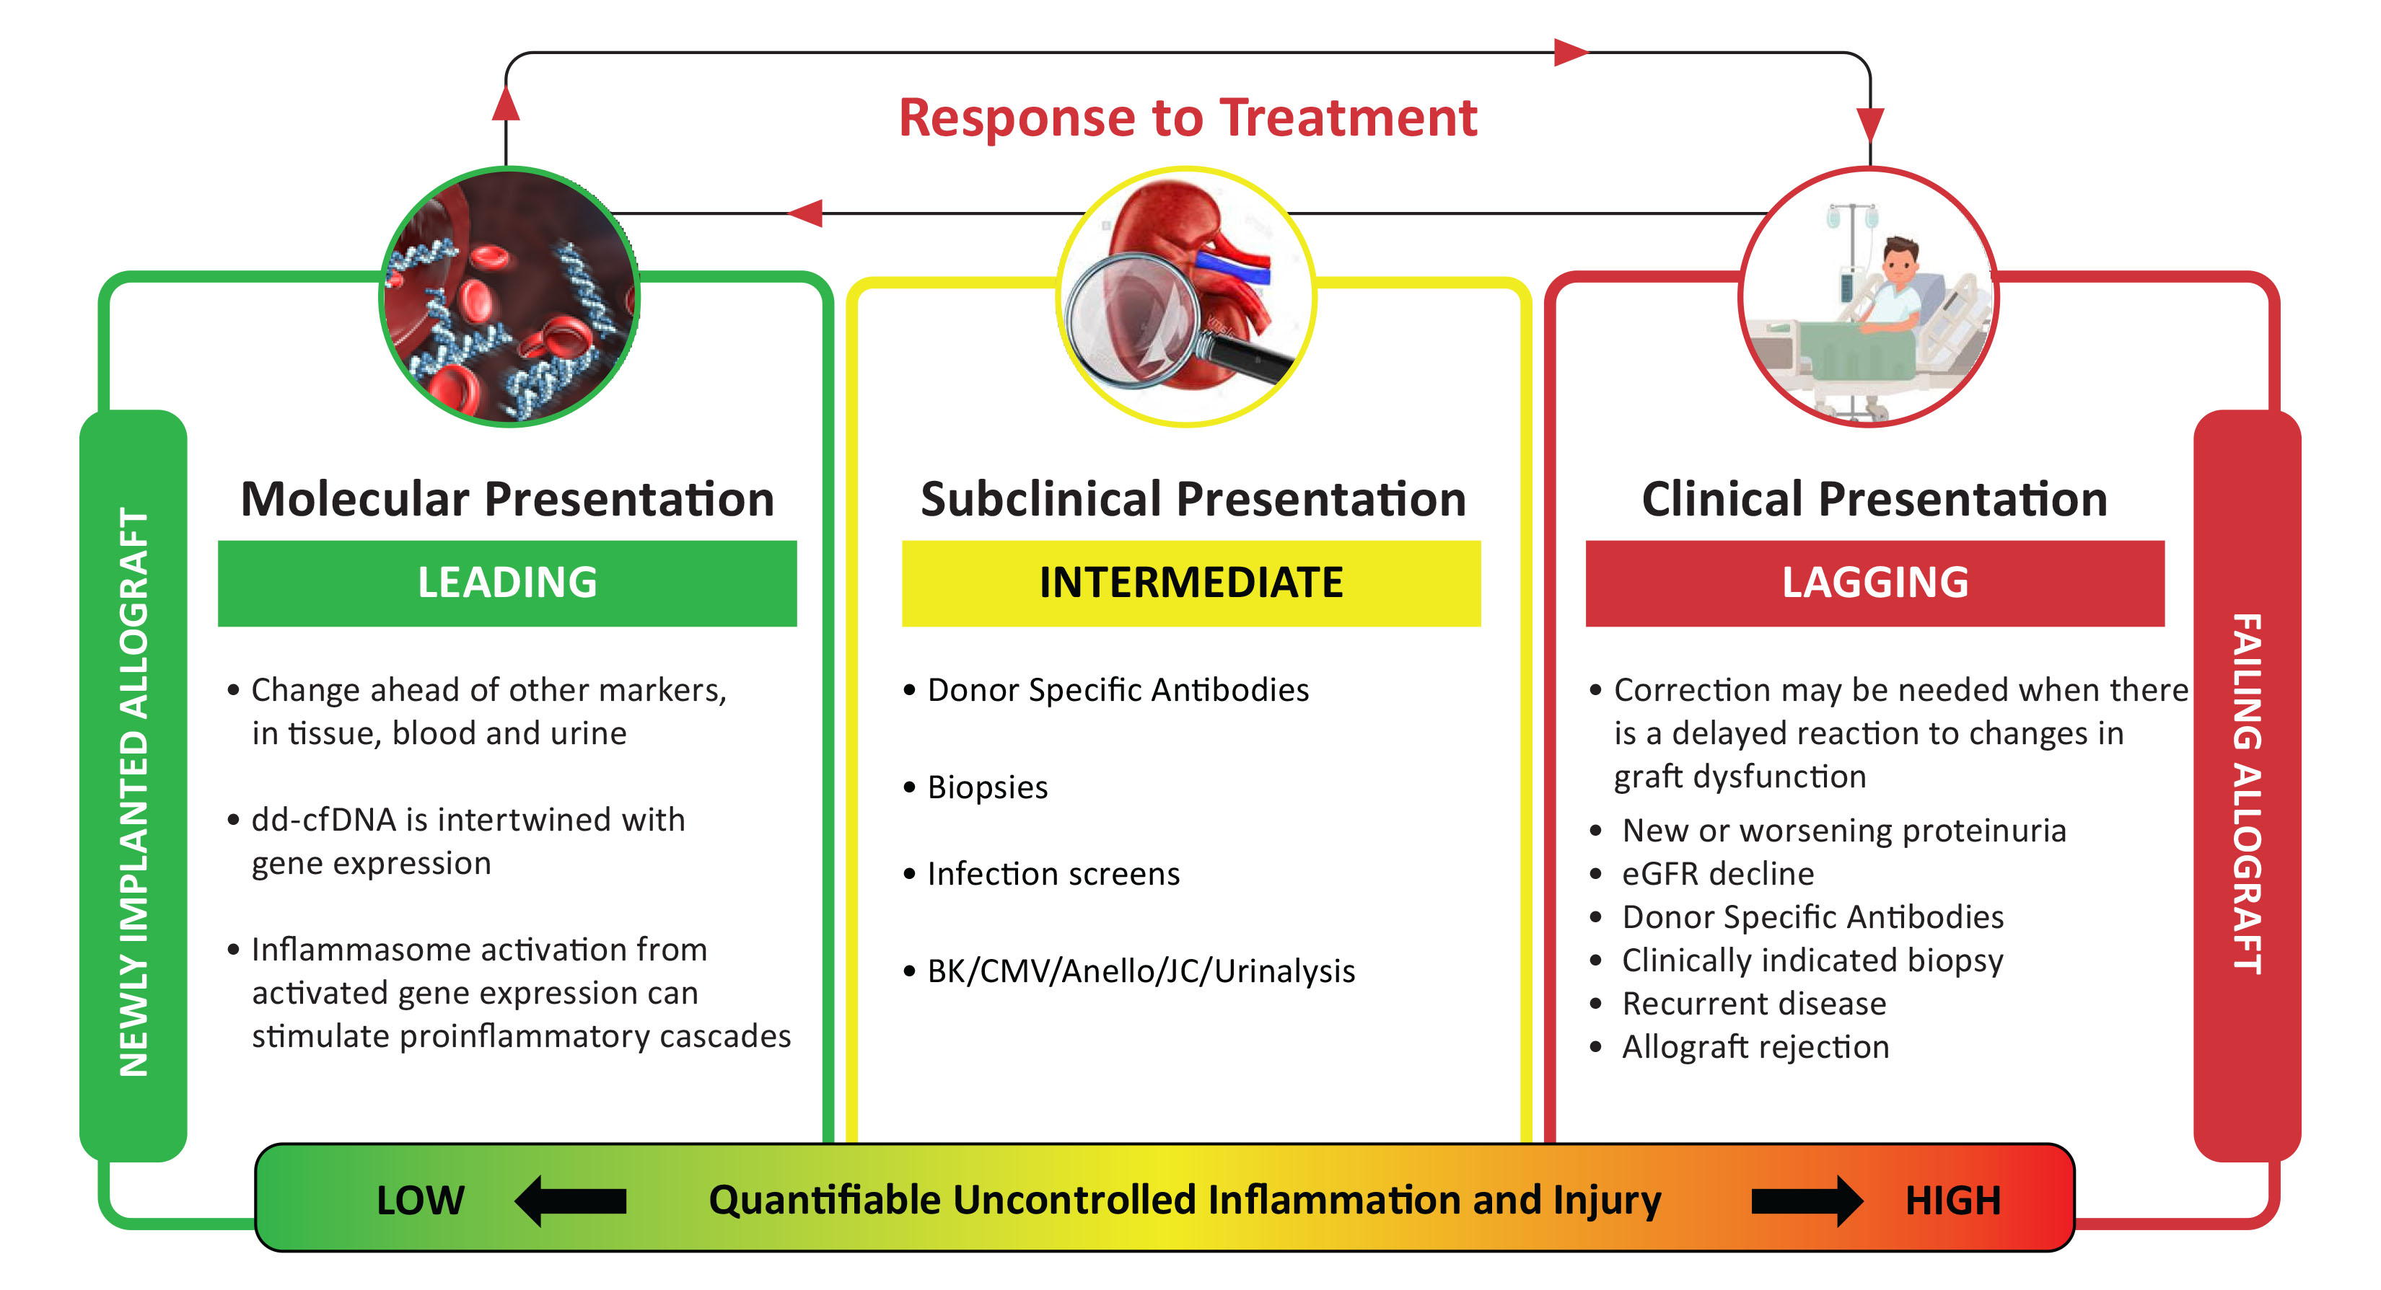
The value of the molecular window provides insights into clinical outcomes
Fehr T et al Kidney Int 2011;80:1254–5
Naesens et al Kidney Int 2011;80:1364–76
Notes:
Key Talking Points: Our current measurements of allograft rejection are delayed util inflammation is intermediate to uncontrolled. Subclinical measures like DSA, BK, and urinanalysis, as well as taking biopsies, occur once inflammation is already intermediate. By the time we have clinical presentation of inflammation and injury, the allograft is already failing. If we unlock the molecular window, we have a key view into a leading marker. We know donor-derived cell free-DNA is a key marker, and an early marker, in addition to inflammasome activity.

Slide 11
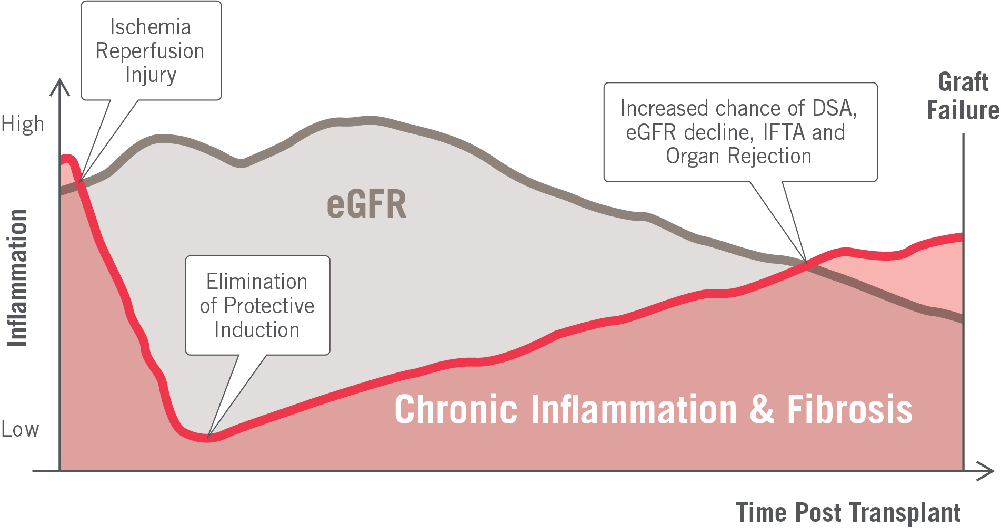
What Biomarker Can Allow for Early Intervention?
Notes:
Key Talking Points: how can we intervene before we hit chronic inflammation?

Slide 12
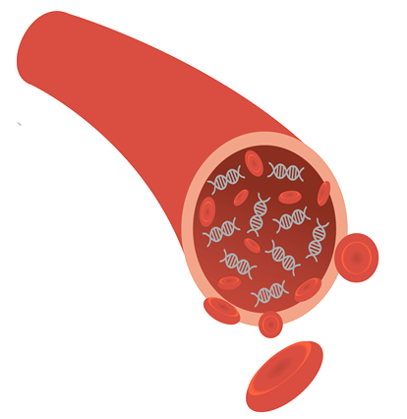
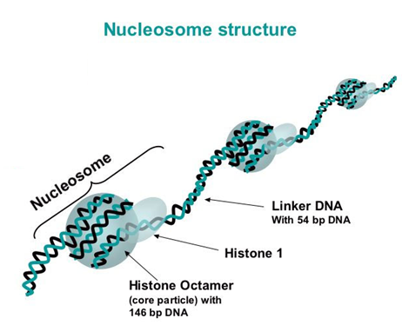
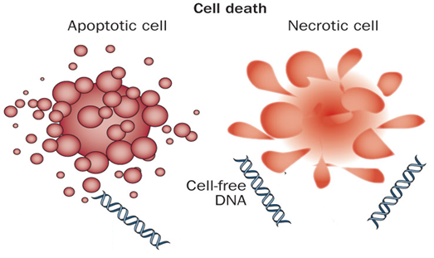
Cell-free DNA as a Biomarker in Transplantation
Found in serum, plasma, urine, saliva, feces, synovial fluid, CSF, and peritoneal fluid
Originates from cells undergoing cell death:
Double-stranded, coding and non-coding genomic DNA
DNA degrades into nucleosomal units
Primarily short size (160-200 bp)
Cleared from blood by the liver and kidney, half-life ~30 min
Donor-Derived Cell-Free DNA (dd-cfDNA) is cell-free DNA released by the allograft
Cell-free DNA
in blood and plasma
Notes:
Key Talking Points: Cell-free DNA, or cf-DNA as we will refer to it, refers to the fragments of DNA found throughout the fluids of the human body, originating from cells undergoing apoptosis. This DNA is degraded into nucleosomal units of short sizes – around 160-200 base pairs. Accordingly, cfDNA is cleared from the blood by the liver and kidney, with a half-life of 30 minutes.
Donor-derived cf-DNA is cell-free DNA released by the donated organ.

Slide 13
AlloSure Introduction

Slide 14

Introduction to AlloSure
Non-invasive
AlloSure is a donor-derived cell-free DNA (dd-cfDNA) test for noninvasive transplant surveillance, providing a direct measure of organ injury
More accurate than serum creatinine or DSA testing
Noninvasive
Serum Creatinine
DSA
(Cell-free DNA)
Less Accurate
in diagnosis of
Graft Injury
More Accurate
in diagnosis of Graft Injury
Biopsy
Invasive
Nickerson P. Post-transplant monitoring of renal allografts: are we there yet? Curr Opin Immunol. 2009; 21(5) 563-568
Josephson Monitoring and Managing Graft Health in the Kidney Transplant Recipient Clin J AM Soc Nephrol 2011
Notes:
Key Talking Points: So what are we all here to talk about, and what are we all here to learn? AlloSure, a dd-cfDNA test that is both non-invasive and accurate in the detection of allograft injury and rejection.

Slide 15
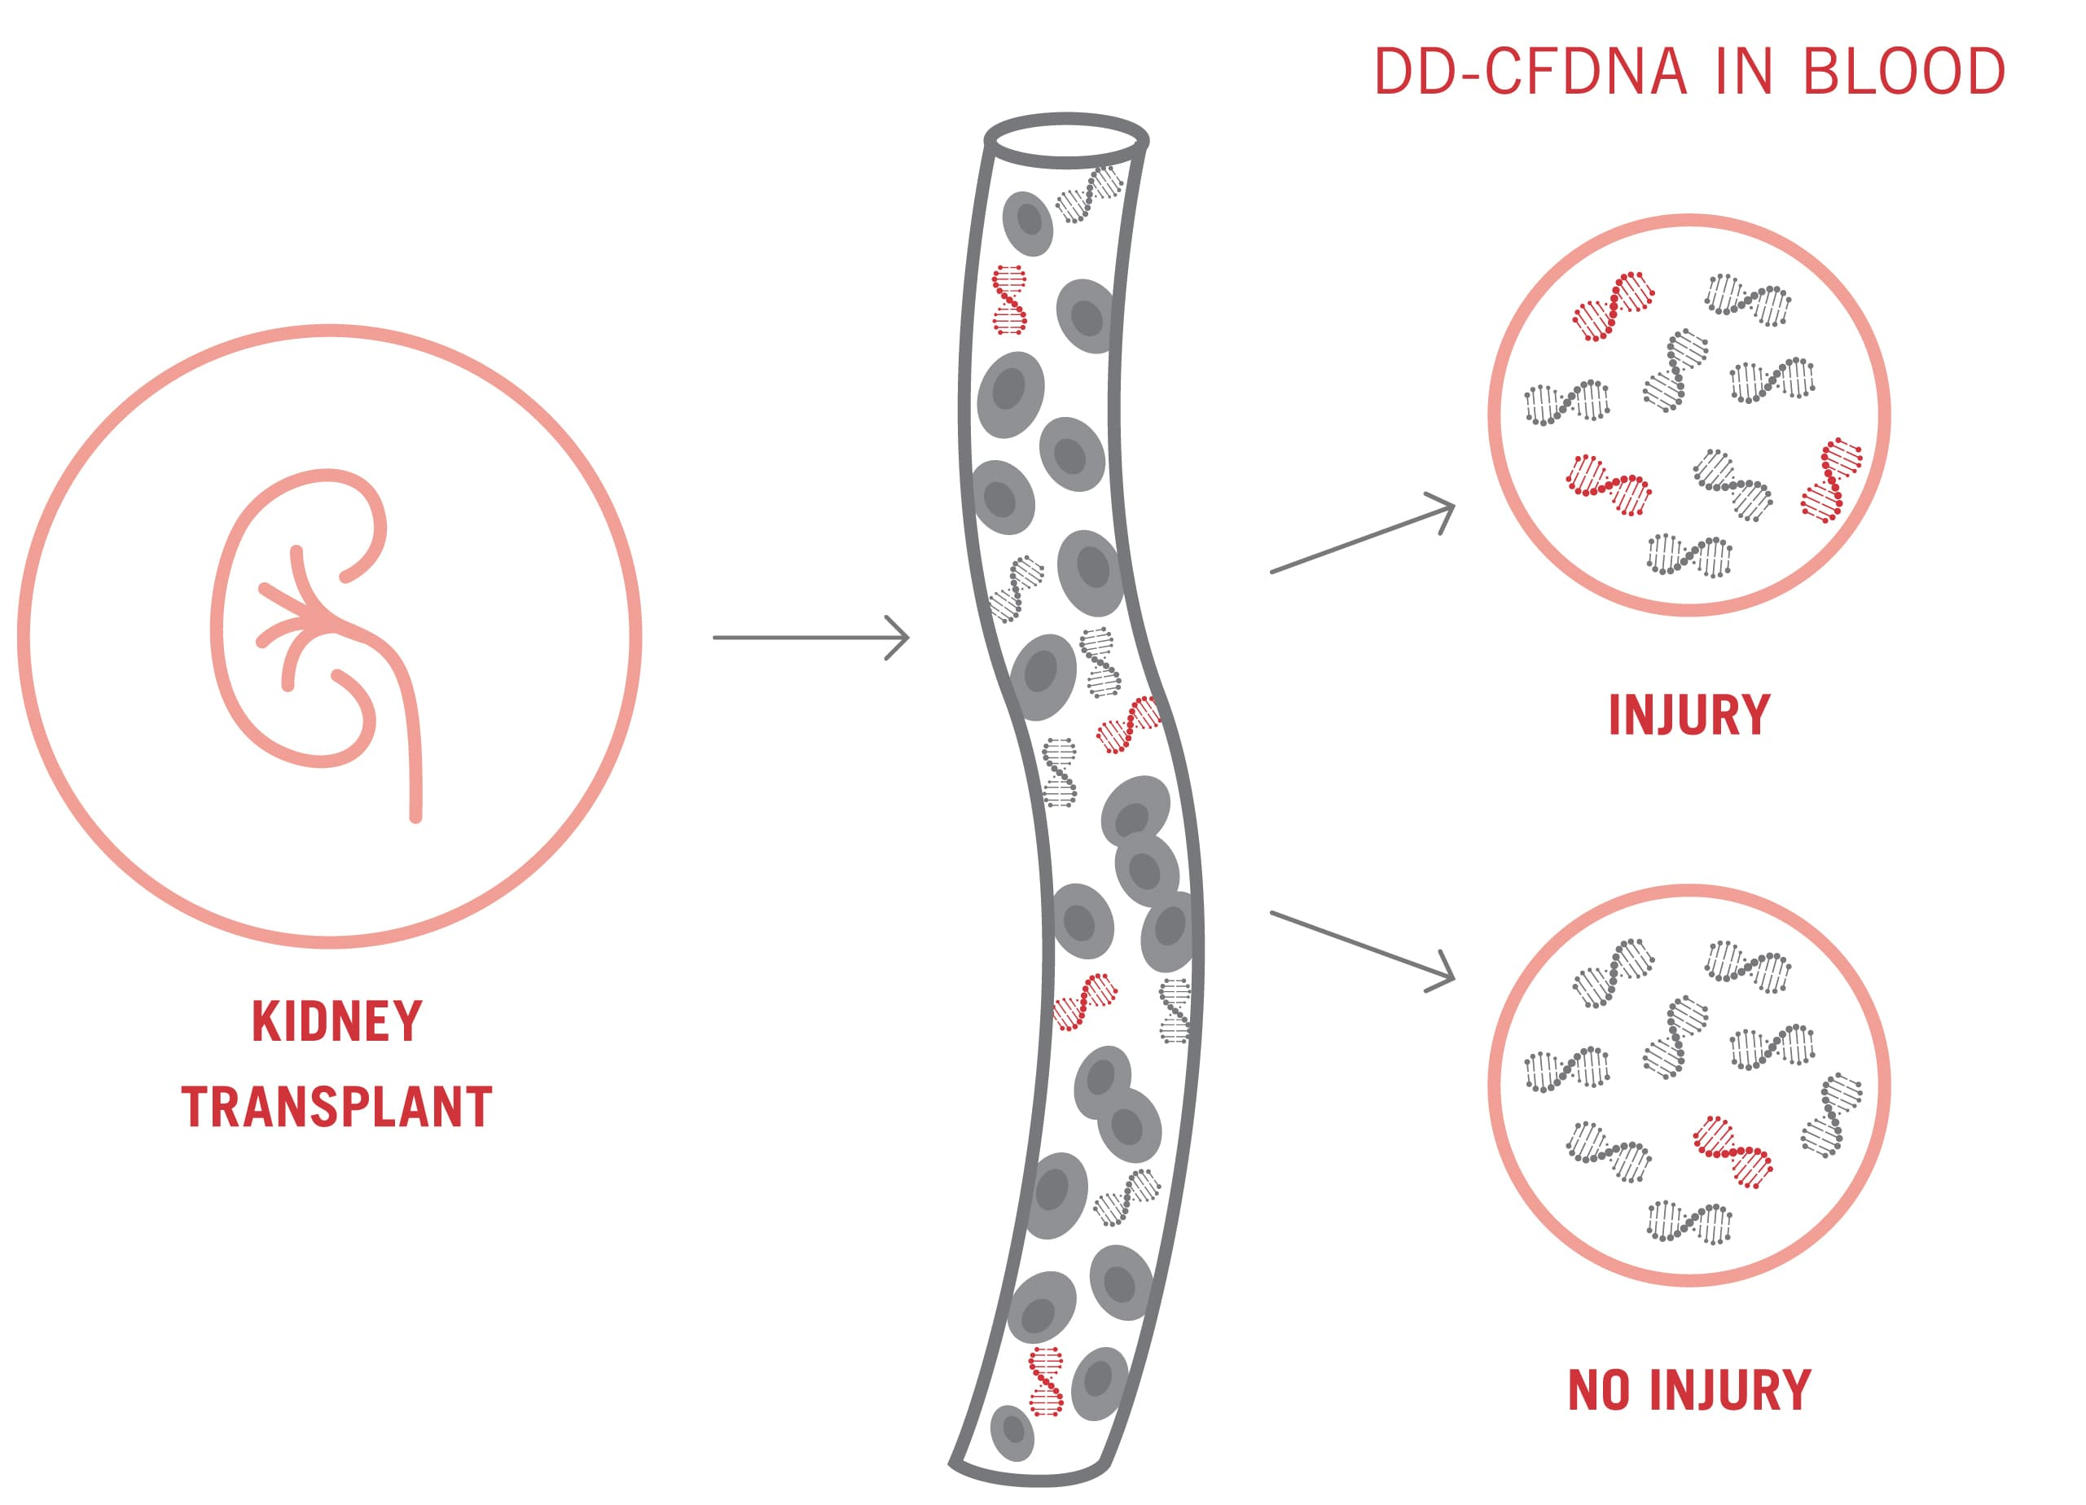
How Does Donor-Derived Cell-Free DNA Work?
Cell-free DNA is fragmented DNA originating from cells and continuously released into the bloodstream
AlloSure measures cfDNA and uses single nucleotide polymorphisms (SNPs) to distinguish between donor and recipient
AlloSure can quantify increasing levels of dd-cfDNA, serving as a leading indicator of graft injury
Notes:
Key Talking Points: As cells are injured or die they release cfDNA, and we can identify which cfDNA is coming from the donor vs the recipient. An elevation in the dd-cfDNA is a sign of injury or rejection. And all of this can be done without genotyping, as AlloSure measures SNPs to distinguish between donor and recipient. AlloSure is a LEADING INDICATOR of graft injury, flagging increasing levels of dd-cfDNA.

Slide 16
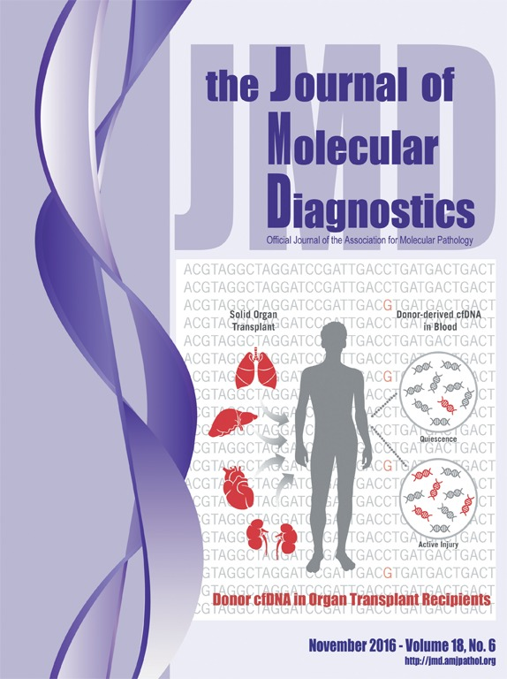

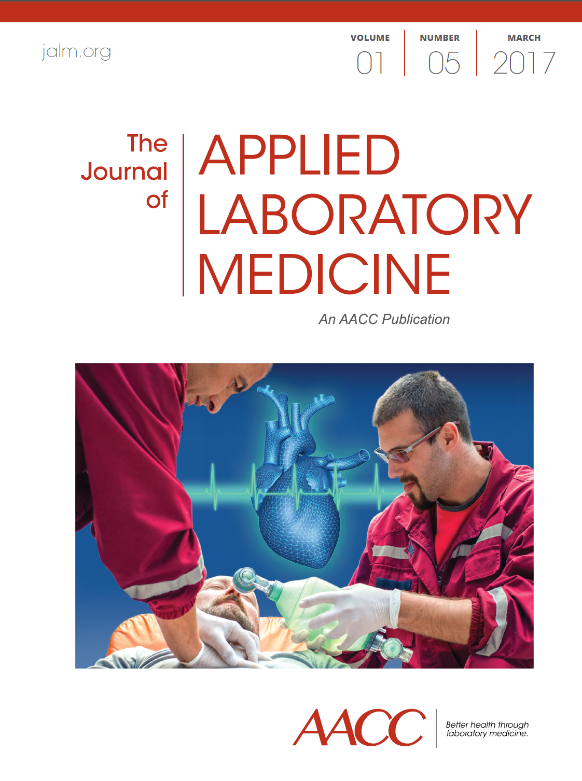
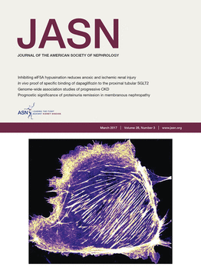
AlloSure is Analytically and Clinically Validated
Analytical Validation
Analytical validity to show AlloSure
Accurately measures dd-cfDNA
Does the test accurately and
robustly measure the biomarker?
PUBLISHED
Clinical Validation
dd-cfDNA variance in a kidney transplant reference population
How does the biomarker vary within the reference population?
PUBLISHED
Clinical validity of AlloSure to measure the probability of kidney transplant rejection
Are there differences in levels of the biomarker with organ rejection?
PUBLISHED
Notes:
Key Talking Points: Why does it matter that AlloSure is analytically validated? We confirm that we are measuring what we say we are measuring.
Clinical validation = is the test medically useful? Are there differences between how the biomarker appears within the reference population? What about differences in levels as organ rejection occurs?
AlloSure has the publications to back all of this up.

Slide 17



Analytical Improvements Implemented in AlloSure 3.0²
Lowered Limit of Qualification 2016 = 0.15%¹ → 2020 = 0.12%²
Expanded Reportable Range 2016 = 0.15% - 16%¹ → 2020 = 0.12% - 16%²
Less Variability (CV) 2016 = 6.8%¹ → 2020 = 2.7%²
1. Grskovic M et al. Validation of a Clinical-Grade Assay to Measure Donor-Derived Cell-Free DNA in Solid Organ Transplant Recipients. J Mol Diagn. 2016;18(6):890-902.
2. Wong L, Scott S, Grskovic M, Dholakia S, Woodward RN (2020) The Evolution and Innovation of Donor-Derived Cell-Free DNA Testing in Transplantation. J Med Diagn Meth. 2020;(9):302
Notes:
Key Talking Points: AlloSure is analytically validate to be sensitive, accurate, and precise, with a LLQ of 0.15% and quantifiable range of 0.15%-16%. The variability from test-result to test-result is only 6.8% of the total score, so a low result has a less than 0.01% variability in repeated AS scores.

Slide 18
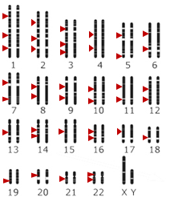
The AlloSure methodology does not require genotyping of the donor or recipient¹
SNP Selection Overview
Highly selected SNPs
High Heterozygosity
Extensive data in support of frequency
F_{ST} value near 0 in support of pan-ancestral heritage
SNPs not in LD
Minimal SNP variation in amplicon
Prioritized high confidence sequence regions
Exclude disease-associated SNPs (no incidental findings)
SNP regions efficiently sequenced
Sufficient number of SNPs
dd-cfDNA is measured by determining the fraction of donor-derived nucleotides at single-nucleotide polymorphism (SNP) location
The method does not require prior genotyping of the donor or recipient:
SNPs are chosen that each have two alleles, distributed equally in the population
The SNP regions are amplified from the low levels of dd-cfDNA found in plasma
Next-Generation Sequencing is used to count each allele
Example: If we detect 99 counts of allele A, and 1 count of allele B:
Infer Recipient is homozygous for allele A
Infer Donor has B allele, estimate dd-cfDNA≈1%
SNPs selected from across the genome:
^{1.}Grskovic M et al. Validation of a Clinical-Grade Assay to Measure Donor-Derived Cell-Free DNA in Solid Organ Transplant Recipients. J Mol Diagn. 2016;18(6):890-902.
Notes:
Key Talking Points: Importantly, AlloSure’s methodology does not require genotyping, as dd-cfDNA measures the fraction of dd-nucleotides at SNP location. This is beneficial, as we have targeted highly selected SNPs that are efficiently sequenced with a sufficient number. The way we calculate our AS score is as follows;
If we detect 99 counts of allele A within the SNP regions, and 1 count of Allele B, we go back to our basic genetics and can infer that the recipient is homozygous for allele A, while the donor has a B allele. Therefore, 1 allele B/100 alleles total = 1% dd-cfDNA.

Slide 19
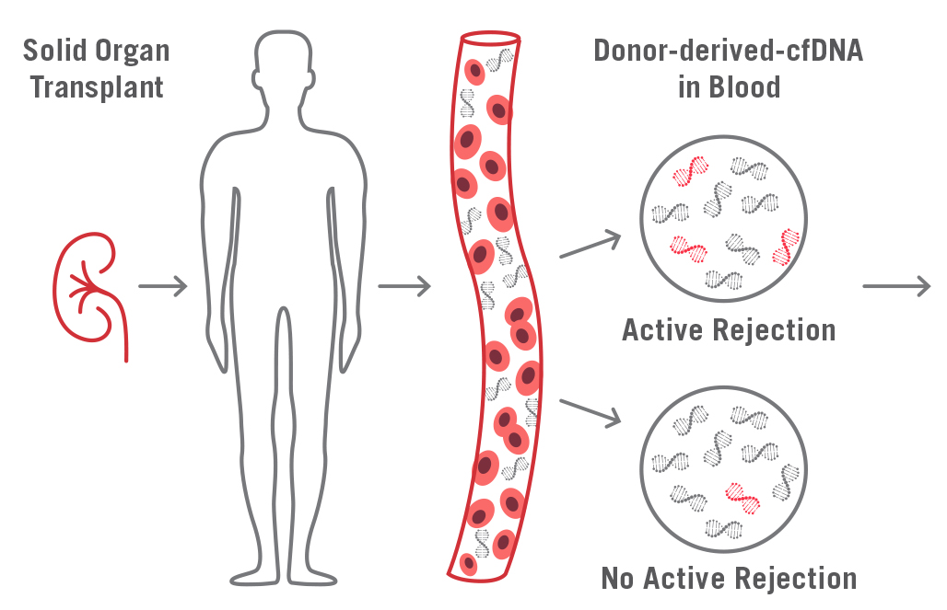
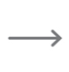
Measuring AlloSure (dd-cfDNA) levels in Transplant Patients
The method measures the small amount of dd-cfDNA from plasma:
Extract cfDNA (plasma collected in Streck BCT tubes)
Amplify SNP loci selected to be sufficient to accurately measure dd-cfDNA. Amplify by concurrent multiplex PCR (Access Array technology, Fluidigm)
Sequence amplified SNP loci (MiSeq next-generation sequencing, Illumina)
Calculate the fraction of donor-specific nucleotides (CareDx)
Amplify SNPs (Amplicons)
Sequence all amplicons
Count Donor-specific alleles
Calculate % dd-cfDNA (AlloSure)
19
Notes:
Key Talking Points: the way we measure AlloSure levels in transplant patients is simple. We extract cdDNA via plasma collected in Streck BCT tubes. In our lab, we amplify SNP loci selected to be sufficient as per the previous slide. Then, we amplify again via multiplex PCR. We sequence the amplified SNPs and calculate the fraction of donor-specific nucleotides.

Slide 20
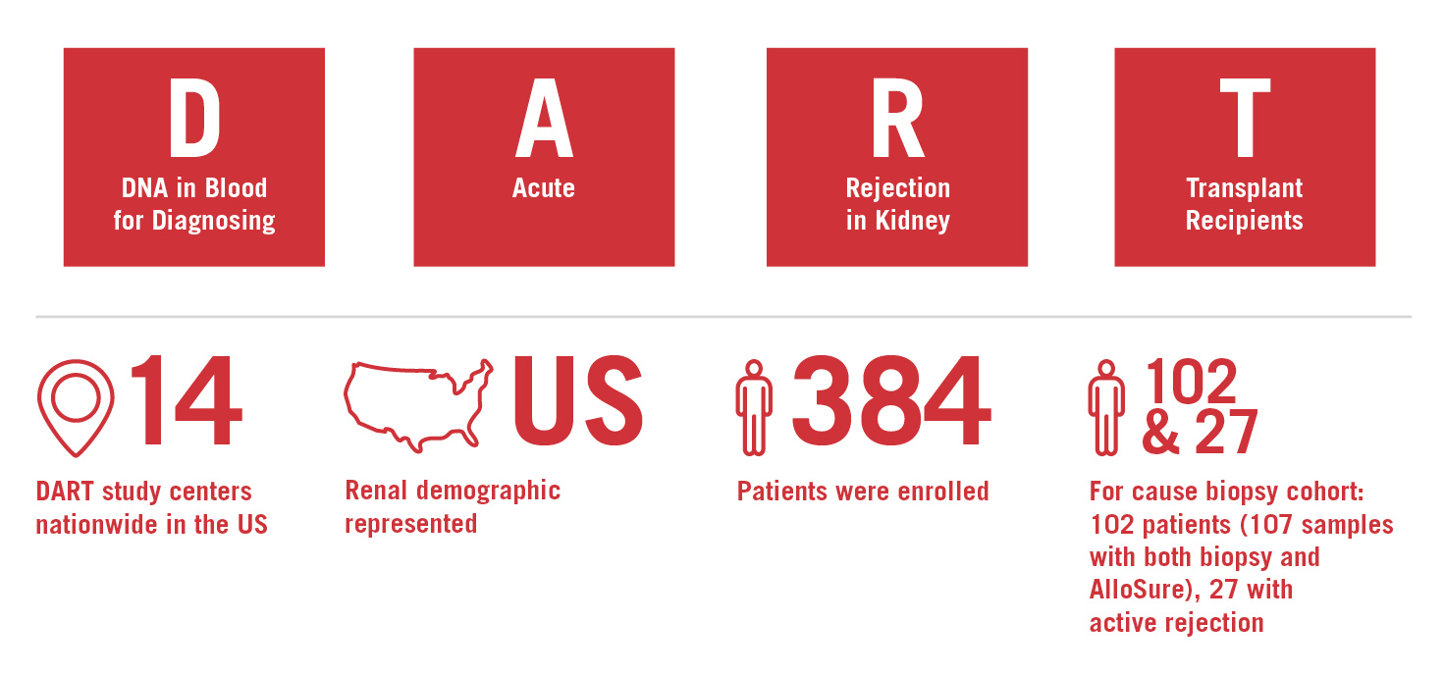
AlloSure is Clinically Validated by a Multi-Center Prospective Trial
The Circulating Donor-Derived Cell-Free DNA in Blood for Diagnosing Acute Rejection in Kidney Transplant Recipients (DART) is the clinical validation study for AlloSure
Bloom RD et al. J Am Soc Nephrol. 2017;28(7): 2221-2232
Notes:
Key Talking Points: Let’s talk about AlloSure’s clinical validation. The DART study was a prospective Multicenter study published in JASN- a leading academic journal
Included 14 centers from across the US, with 384 patients enrolled. 102 had for cause biopsies and 27 patients were found to have rejection.
The Circulating Donor-Derived Cell-Free DNA in Blood for Diagnosing Acute Rejection in Kidney Transplant Recipients (DART) is the clinical validation study for AlloSure
DART is the:
First multicenter (14 in total) study of dd-cfDNA in renal allograft recipients
Largest prospective observational study with 384 patients - resulting in 1272 samples

Slide 21

DART Study Objectives
1
Compare the performance of AlloSure to the performance of serum creatinine
2
Determine the ability of AlloSure to discriminate active rejection
3
Determine the ability of AlloSure to discriminate ABMR from No ABMR
Notes:
Key Talking Points: The DART study was designed to:
Compare AlloSure to creatinine in the detection of rejection
Determine the ability of AlloSure to discriminate active rejection from no active rejection, and ABMR from no ABMR

Slide 22
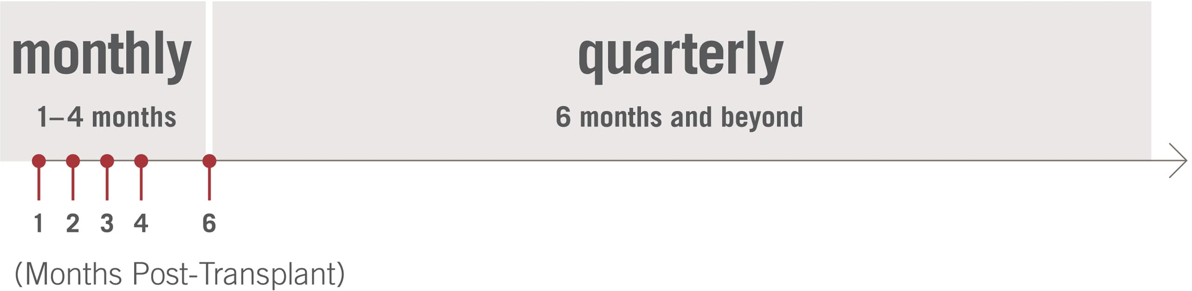
DART Study Established the ARTS Protocol
AlloSure Routine Testing Schedule (ARTS) is used by over 70 centers
The schedule ensures testing at key clinical time points post-transplant and then quarterly surveillance testing
Bloom RD et al. Cell-free DNA and active rejection in kidney allografts. J Am Soc Nephrol. 2017. doi:10.1681/ASN.2016091034.
Notes:
Key Talking Points: What is the usefulness of testing at these timepoints?
Early on months 1-2: establish a baseline
Months 3-4: monitor for continued improvement in allograft health demonstrated by further reduction in AlloSure values, or for a rise from baseline that may guide treatment (induction waning may be happening here)
At months 6,9,12: monitor for subclinical and acute rejection and test along with DSA to aid in the diagnosis of ABMR
12 months and beyond: the risk of ABMR increases, so test along with DSA. AlloSure results may increase before other markers like Cr and may be early indicator of injury and rejection. As patients transition back to the general nephrologist AlloSure testing may aid in the decision whether or not to send patients back to the transplant center

Slide 23
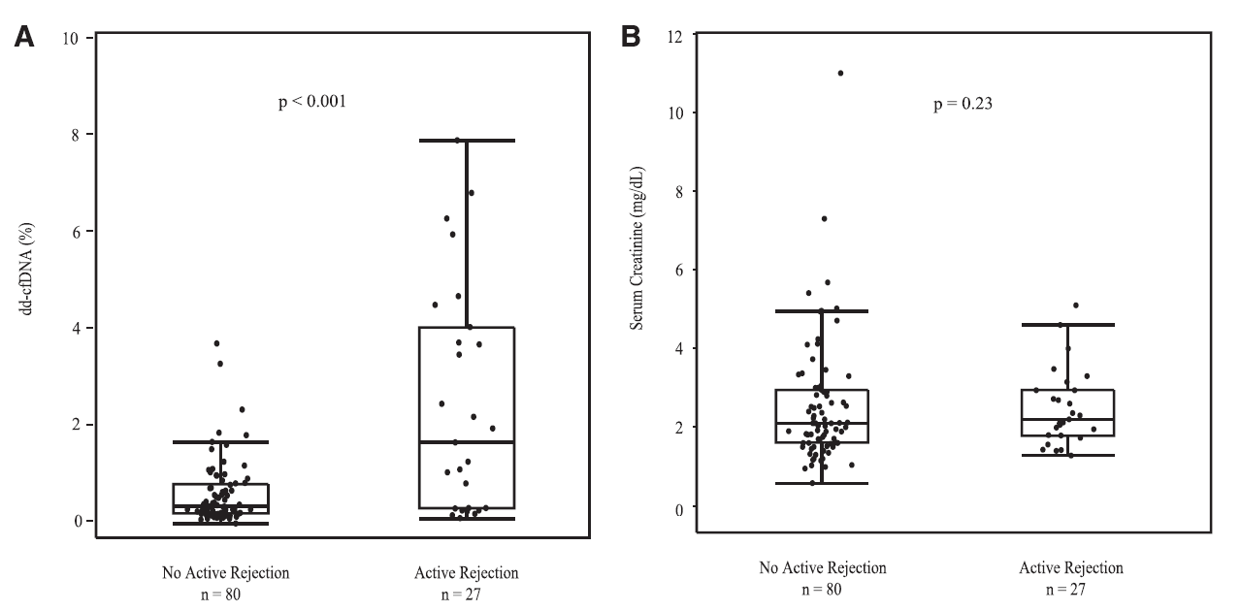
DART Findings: AlloSure Accurately Discriminates Active Rejection from No Active Rejection, and Outperforms Serum Creatinine
* In patients with clinical suspicion of active rejection, the most common cause for the clinical suspicion of active rejection was elevated serum creatinine
Bloom RD et al. Cell-free DNA and active rejection in kidney allografts. J Am Soc Nephrol. 2017. doi:10.1681/ASN.2016091034.
Notes:
Key Talking Points: Here we can clearly see that an elevated creatinine was not a distinguishing feature in patients with rejection versus those without rejection. Creatinine is standard test but often elevated for other reasons, other than injury or rejection.
AlloSure on the other hand, was clearly elevated in patients with rejection versus those without.

Slide 24
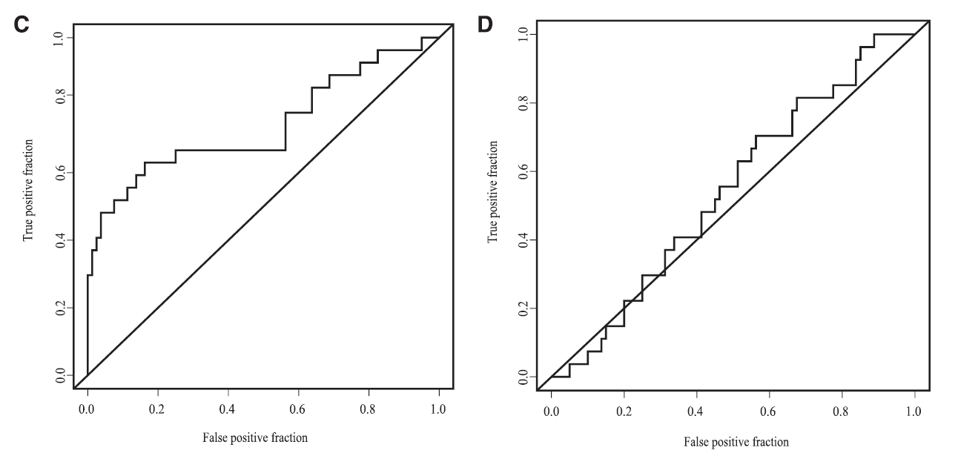
DART Findings: AlloSure Accurately Discriminates Active Rejection from No Active Rejection, and Outperforms Serum Creatinine
AUC 0.74
AUC 0.54
* In patients with clinical suspicion of active rejection, the most common cause for the clinical suspicion of active rejection was elevated serum creatinine
Bloom RD et al. Cell-free DNA and active rejection in kidney allografts. J Am Soc Nephrol. 2017. doi:10.1681/ASN.2016091034.
Notes:
Key Talking Points: Here we can clearly see that an elevated creatinine was not a distinguishing feature in patients with rejection versus those without rejection. Creatinine is standard test but often elevated for other reasons, other than injury or rejection.
AlloSure on the other hand, was clearly elevated in patients with rejection versus those without.

Slide 25
AlloSure is the Most Published dd-cfDNA Test
Detects Active Rejection and Outperforms Serum Creatinine¹
¹Bloom et al. Cell-Free DNA and Active Rejection in Kidney Allografts. American Journal of Transplantation, 2017.
²Bromberg et al. Biological Variation of Donor-Derived Cell-Free DNA in Renal Transplant Recipients: Clinical Implications. Journal of Applied Laboratory Medicine, 2017.
³Mehta et al. Repeat Kidney Transplant Recipients With Active Rejection Have Elevated Donor-Derived Cell-Free DNA. American Journal of Transplantation, 2019.
⁴Jordan et al. Donor-Derived Cell-Free DNA Identifies Antibody-Mediated Rejection in Donor-Specific Antibody-Positive Kidney Transplant Recipients. Transplantation Direct, 2018.
⁵Hinojosa et al. dd-cfDNA May Confirm Real-Time Response to Treatment of Acute Rejection in Renal Transplant Patients. Transplantation, 2019.
⁶Huang et al. Early Clinical Experience Using Donor-Derived Cell-Free DNA to Detect Rejection in Kidney Transplant Recipients. American Journal of Transplantation, 2019.
⁷Stites et al. High levels of dd-cfDNA identify patients with TCMR 1A and borderline allograft rejection at elevated risk of graft injury. American Journal of Transplantation, 2020.
⁸Brennan et al. Donor Derived Cell Free DNA (dd-cfDNA) May Aid in the Diagnosis of BK Virus Nephropathy. American Journal of Transplantation, 2019.
Reference Change Value of 61%²
Utility in Repeat Tx Patients³
Robust Clinical Evidence supporting AlloSure
Improve Non-Invasive Diagnosis of active ABMR⁴
Findings Include:
Helps Verify Resolution of Rejection⁵
Discriminates ABMR⁶
Stratifies Biopsy-Confirmed TCMR1A/Borderline Rejection Patients⁷
Aids in the Diagnosis of BK Virus Nephropathy⁸
+ more
Notes:
Key Talking Points: AlloSure has been intensively studied, and is the most published test. Robust clinical evidence supports AlloSure across the spectrum, including utility in repeat transplant patients and pediatric patients, along with aiding in the diagnosis of BK virus nephropathy, active ABMR, and TCMR.

Slide 26
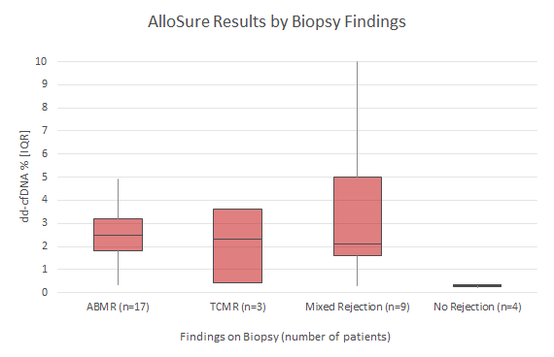
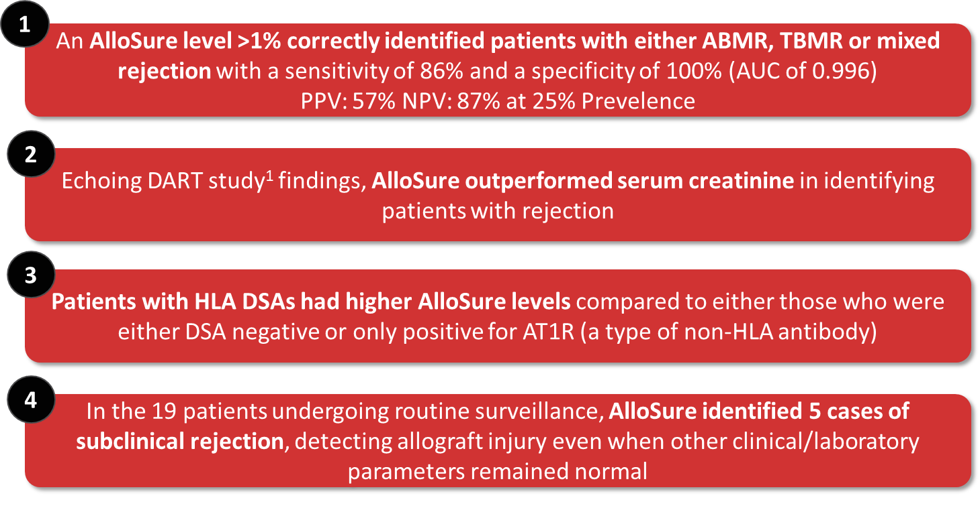
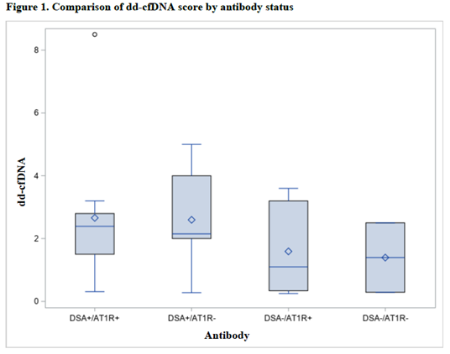
AlloSure Utility with Pediatric Patients
“Donor-derived cell-free DNA (dd-cfDNA) for detection of allograft rejection in pediatric kidney transplants”
Pediatric Transplantation, 2020
Study Summary:
67 patients either receiving AlloSure surveillance or tested for clinical suspicion of rejection from Cedars Sinai & UTHealth
Includes living donor recipients (n=11), highly sensitized recipients (n=10), and patients maintained on steroid-sparing regimens (31%), encompassing a broad spectrum of immunologic risk
Course of AlloSure dd-cfDNA scores
Study Conclusions:
In a cohort of pediatric kidney transplant patients undergoing either routine surveillance or for-cause AlloSure testing, the findings show:
¹Bloom RD et al. J Am Soc Nephrol. 2017;28(7): 2221-2232. The DART Study was a prospective, 14-center study, and is the clinical validation study for AlloSure

Slide 27
Relative Change Guidance for Clinical Care
Bromberg, et al. JASN 2017 publication shows a 61% Relative Change
Anand, et al. ATC 2020 abstract shows a
141% Relative Change
Notes:
Key Talking Points: two recent publications have highlighted the relative change amounts between dd-cfDNA due to biological variations. Bromberg, et. al found a 61% relative change, while Anand, et. al, showed a 141% RC.

Slide 28


What is Relative Change Value (RCV)?
AlloSure is best used as a surveillance test to measure changes in dd-cfDNA over time. By establishing a baseline for AlloSure levels, it is possible to identify clinically meaningful increases/decreases.
To determine the threshold for a clinically meaningful change in AlloSure levels, it is essential to understand the difference between biological variation and pathological variation.
The variation in stable healthy patients serves as a reference – this is called the “relative change value”, or “RCV”.
RCV
Notes:
Key Talking Points: What is RCV, and how do we use this? As we know, Allosure is best utilized for surveillance of graft injury, to measure dd-cfDNA over time. By establishing a baseline, and keeping an eye on trends, you may identify clinically meaningful increases or decreases in the score. To know what is clinically meaningful, we must understand the difference between biological and pathological variation. The variation seen in stable, healthy patients is a reference: the relative change value, or RCV

Slide 29
Utility of Relative Change Value (RCV)
How much is a clinically meaningful change in AlloSure levels?
In the DART Study, Bromberg and colleagues found AlloSure’s RCV to be 61%
Serial increases in AlloSure up to 61% may be attributed to normal biological variation
Serial increases in AlloSure greater than 61% exceeds expected biological variation
How is knowing RCV useful for monitoring kidney transplant patients?
Monitoring RCV enables clinicians to build a better picture of their patient’s graft health
Notes:
Key Talking Points: So, what exactly is a clinically meaningful change in AlloSure? In DART, Bromberg and colleagues found that serial increases in AlloSure up to 61% could be attributed to normal biological variation, while those above 61% exceeded expected biological variation. By monitoring RCV, you can develop a better picture of patient graft health.

Slide 30
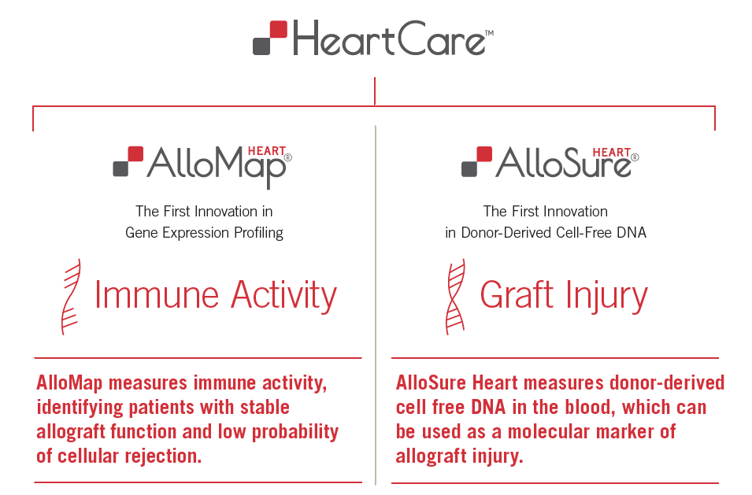

HeartCare Improves Clinical Utility with a New Dimension: Graft Injury
Together, AlloMap and AlloSure Heart are complementary, non-invasive tools for heart transplant surveillance
30
Notes:
Identifies patients at increased risk of ACR
BNP
EMB – influx of t-cells
AS
Echo
AM measures what is happening outside of the heart – host response
Check CARGO paper
AM “assesses” immune activity by identifying patients with stable allograft function with a low probability of cellular rejection

Slide 31
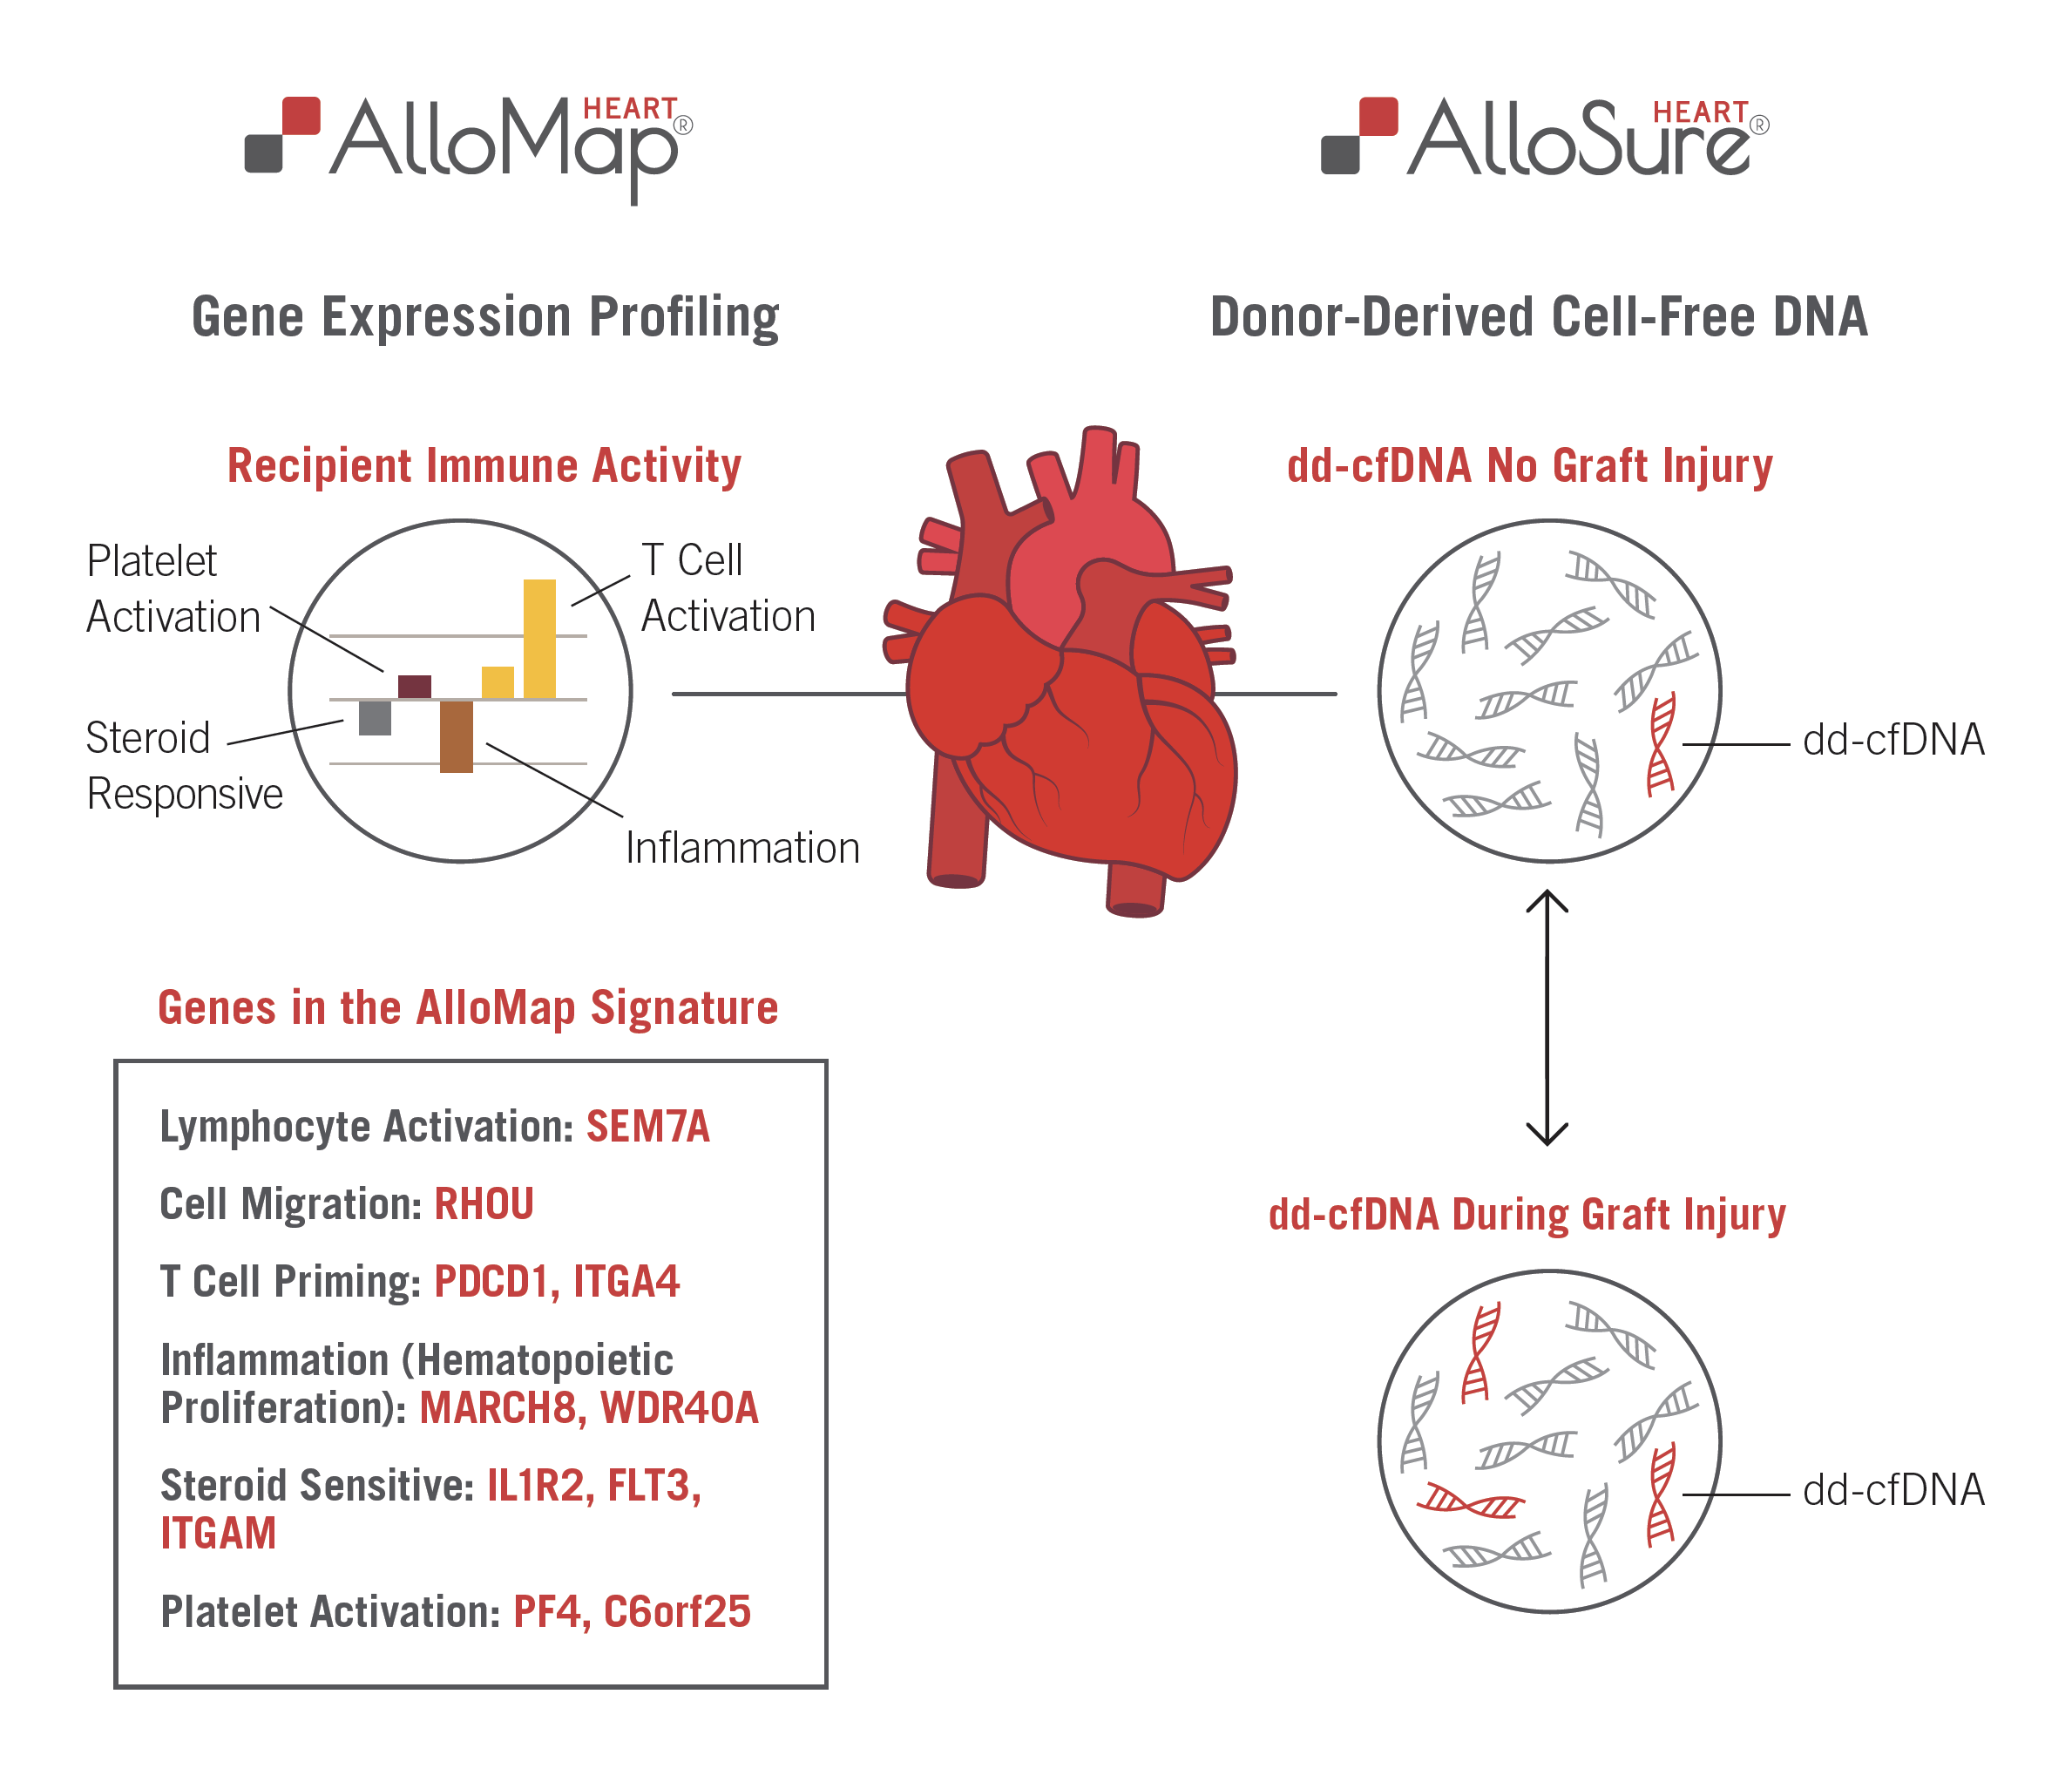
HeartCare Utilizes Two Complementary Technologies to Provide a More Comprehensive Overview of Allograft Health
31

Slide 32
HeartCare Yielded Significant Reduction in Biopsy Volume Without Reduction in AR Detection Compared to GEP Alone
Percentage of Patients Receiving Biopsy
44% Reduction in Biopsies in HeartCare Cohort
Gondi KT, et.al., Clinical Transplantation, February 2021
Notes:
Make optional?

Slide 33
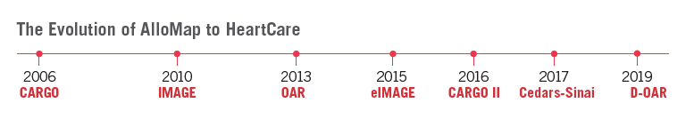
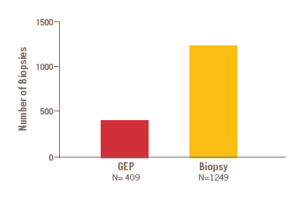
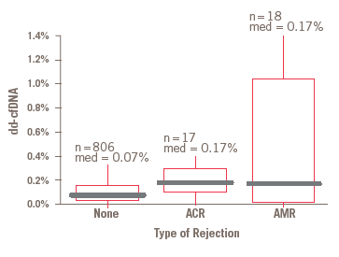
HeartCare Has Been Clinically Validated in Multi-Center Prospective Studies Including >4,500 Patients
AlloMap Reduced the Number of Biopsies While Achieving Non-Inferior Outcomes
AlloSure Heart was Clinically Validated in the Multi-Center Prospective D-OAR Study
Clinical Validations:
• dd-cfDNA levels are over 2X greater in the rejection groups vs the no rejection group
• No rejection vs all rejection, p= 0.005
• ACR = Grade 2R and Grade 3R
• Grades 0R and 1R are in the No Rejection group
• AMR = pAMR1 and pAMR2
Pham MX, et al. N Engl J Med. 2010 May 20;362(20):1890-900
Khush KK, et al. Am J Transplant. 2019 Oct;19(10):2889-2899 D-OAR is a sub-study of the Outcomes AlloMap Registry (OAR)

Slide 34
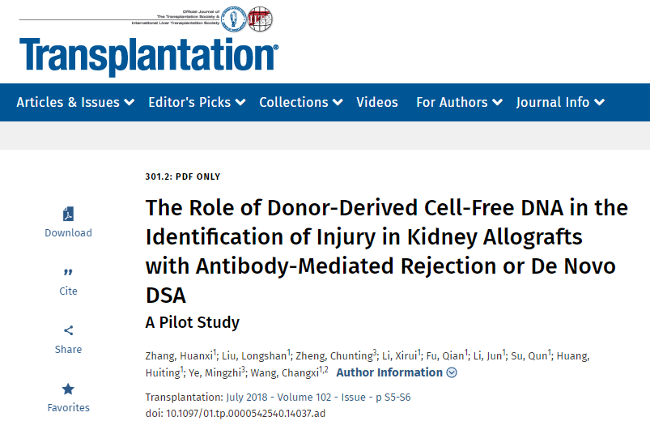
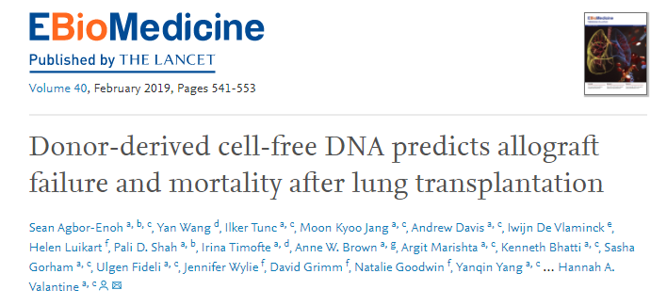
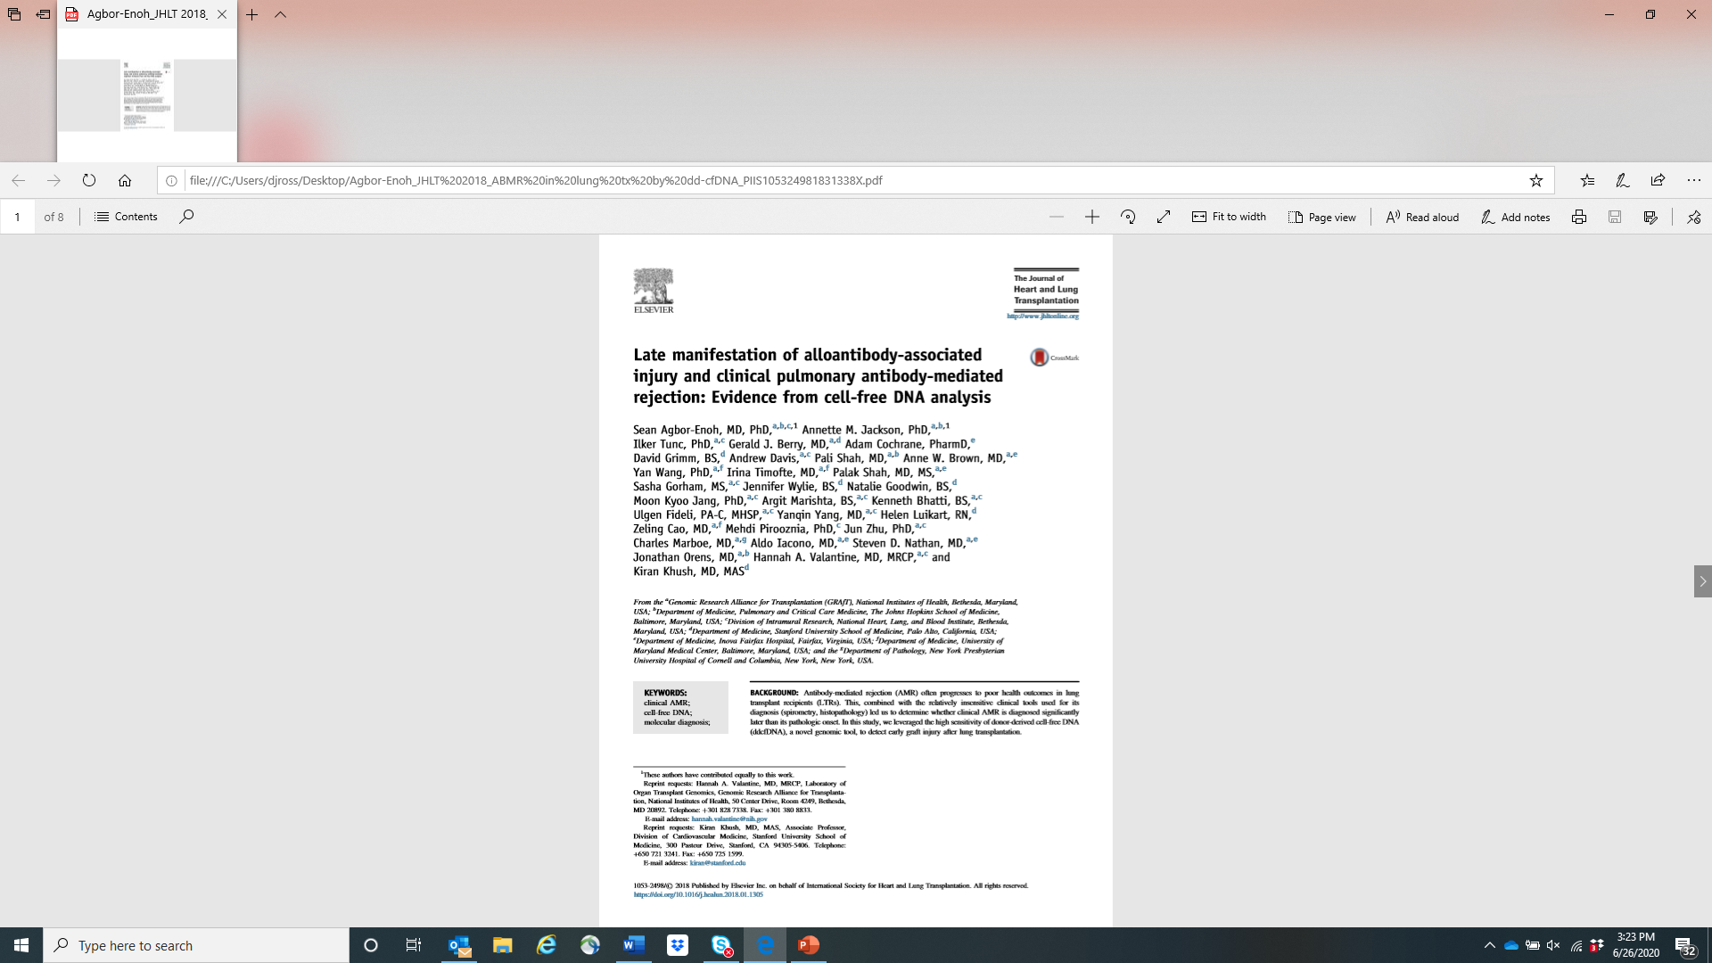
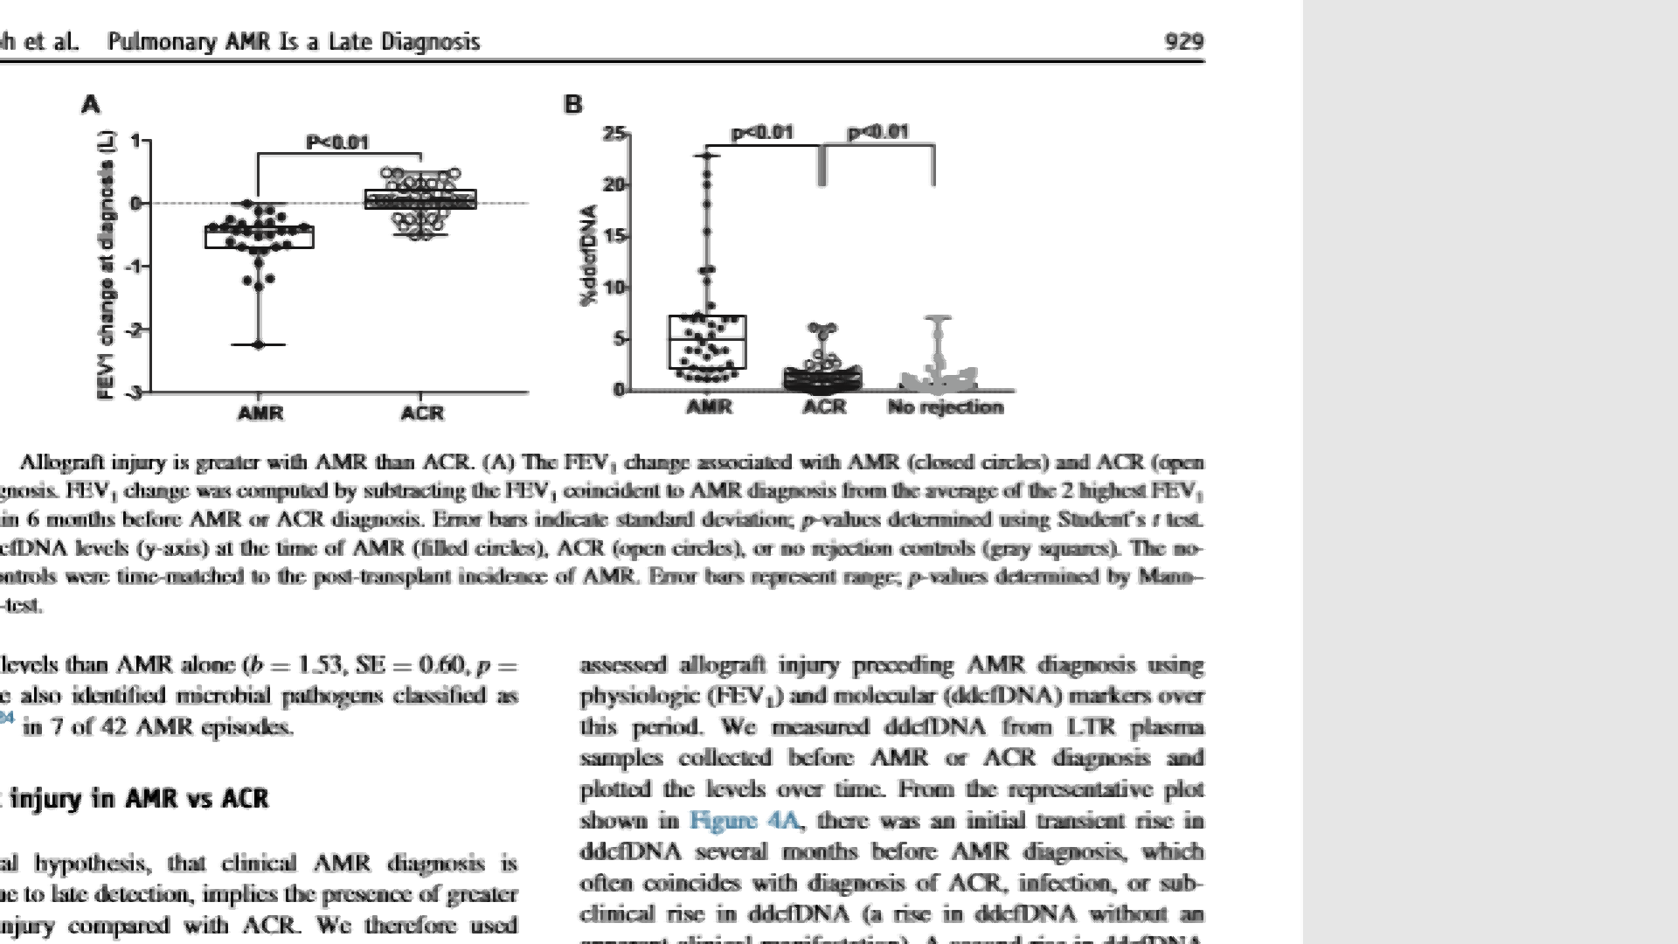
Predictive value of DD-cfDNA may help improve outcomes
Genomic Research Alliance for Transplantation : GRAfT (NiH)

Slide 35
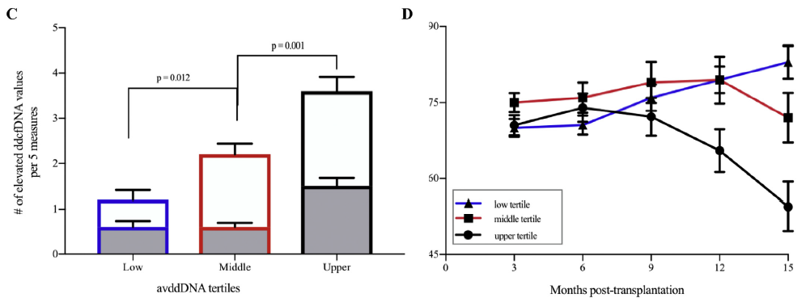
DD-cfDNA Associated with Clinical Complications & FEV decline
Clinical Episodes by dd-cfDNA Tertile
Average FEV Over Time
CONCLUSION
High dd-cfDNA levels during the initial 3 months post-transplant predicted later worsened outcomes with FEV-1 decline and CLAD onset
Agbor-Enoh, S., et al., Donor-derived cell-free DNA predicts allograft failure and mortality after lung transplantation. EBioMedicine, 2019. 40: p. 541-553.

Slide 36
AlloSure Lung Clinical Data
The Most Published dd-cfDNA test in Lung Transplantation
Publication Title | Author | Journal | Year
Donor-derived, Cell-free DNA levels by Next Generation Targeted Sequencing are Elevated in Allograft Rejection after Lung Transplantation | Khush | European Resp J Open Research | 2020
Snapshot dd-cfDNA in Lung Transplant during COVID-19 | Levine | Biomarker Insights | 2020
Plasma dd-cfDNA levels are increased during ACR after Lung Transplant: pilot data (LARGO) | Sayah | Transplant Direct | 2020

Slide 37
AlloSure Has Broad Adoption
AlloSure is used in:
>150 Transplant Centers
>30K
Transplant Patients
1 out of 3
Newly Transplanted Patients
Notes:
Key Talking Points: AlloSure is adopted across the board, being used by over 150 transplant centers, over 30,000 transplant kidney patients. Even more – AlloSure is used in 1 out of 3 newly transplanted kidney patients.

Slide 38
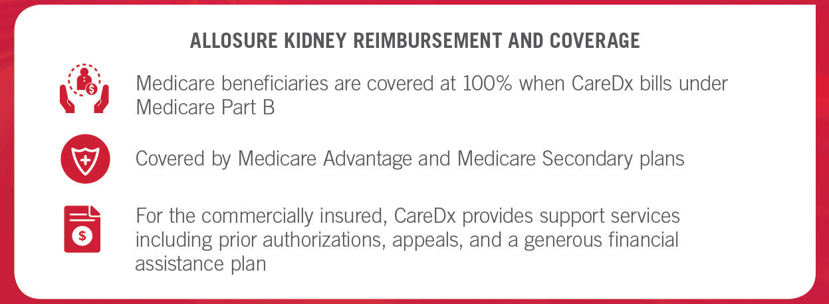
AlloSure is Fully Covered by Medicare
Additionally, CareDx has a billing team to handle all billing and appeals
Notes:
Key Talking Points: Most importantly for you and your patients, is that AlloSure is FULLY COVERED by Medicare. Medicare beneficiaries are covered at 100% when CareDx bills under Medicare Part B, and we’re covered by Medicare Advantage and Medicare Secondary Plans.
If your patient is commercially insured, CareDx is here to help with prior auths, appeals, and assistance. CareDx’s billing team can handle all billing and appeals, so feel free to reach out after the talk to get connected with a billing specialist.

Slide 39






Patient Case Studies

Slide 40
Surveillance: Case 1
Case 1: AlloSure Surveillance with Normal/Stable Creatinine
Patient History
22-year-old Caucasian male
End-stage renal disease
Secondary to renal dysplasia/reflux nephropathy

Slide 41

Surveillance: Case 1
Case 1: AlloSure Surveillance with Normal/Stable Creatinine
Timeline
2003
2013
Living-related kidney transplant from his mother
It was a 1 haplotype match, induction unknown and CMV status unknown
He had antibody mediated rejection.
He received IVIG, Thymoglobulin, rituximab, bortezomib and steroids
Per records has DSA to DQ ?. He also had several sessions of pheresis

Slide 42
Surveillance: Case 1
Case 1: AlloSure Surveillance with Normal/Stable Creatinine
Timeline
2014
2018
Another biopsy showed persistent severe PTC
Underwent a second deceased-donor renal transplant
Post deceased-donor renal transplant
CDC high-risk donor; KDPI 19%; CPRA 84 (2/86); 1A, 2B, 1DR mismatch; CMV positive into negative
CDC and Flow Cross match were negative.
No DSA

Slide 43
Surveillance: Case 1
Case 1: AlloSure Surveillance with Normal/Stable Creatinine
Patient Data
Creatinine stable at 1.5
AlloSure:
1st month 5.2
3rd month 4.7
4th month 5.3, DSA is negative, and creatinine remains stable
What to do Next?

Slide 44
Surveillance: Case 1
Case 1: AlloSure Surveillance with Normal/Stable Creatinine
Patient Data
Kidney biopsy shows severe peritubular capillaritis

Slide 45
Surveillance: Case 1
Case 1: AlloSure Surveillance with Normal/Stable Creatinine
Patient Data
Following the biopsy:
Received IV steroids and IS was augmented (Tac target 10 to 12 for 3 months and tapered dose of steroids). Patient reported adverse reactions to TPE and rituximab and said he “almost coded”
Non-HLA labs came back positive for AT1R (very high titers)
Talking to the pediatric transplant nephrologist that took care of the first kidney reported that AT1R was positive as well in 2013.

Slide 46
Surveillance: Case 1
Case 1: AlloSure Surveillance with Normal/Stable Creatinine
Summary
Most likely would not have initiated biopsy due to stable creatinine
AlloSure identified non-HLA rejection
If this had gone untreated for long period of time, this would lead to significant decrease in the graft survival
By monitoring AlloSure results we were able to detect rejection, despite stable creatinine and no DSA

Slide 47
Other Patient Focused Offerings

Slide 48
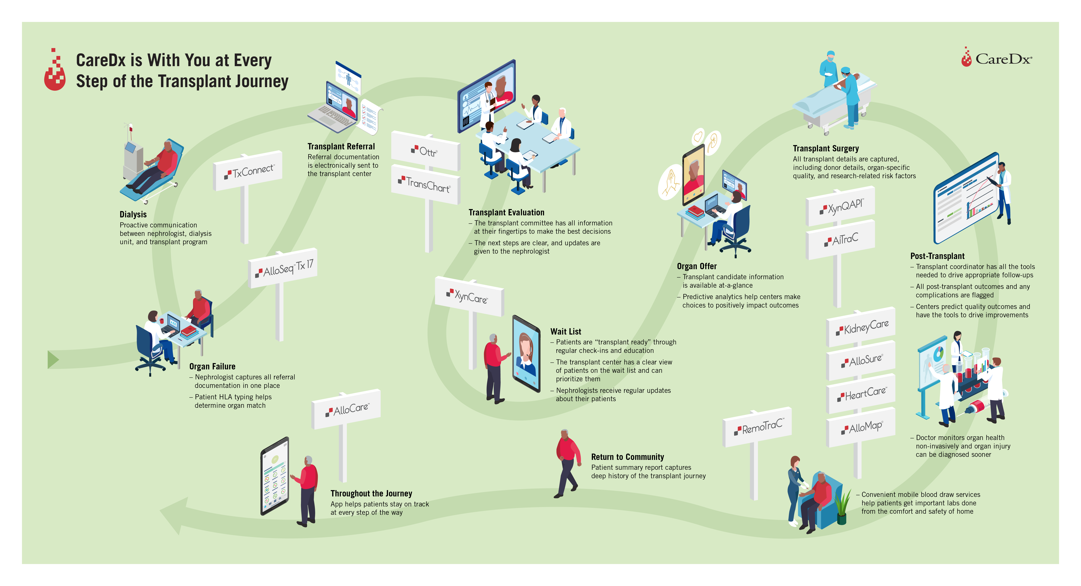

Slide 49
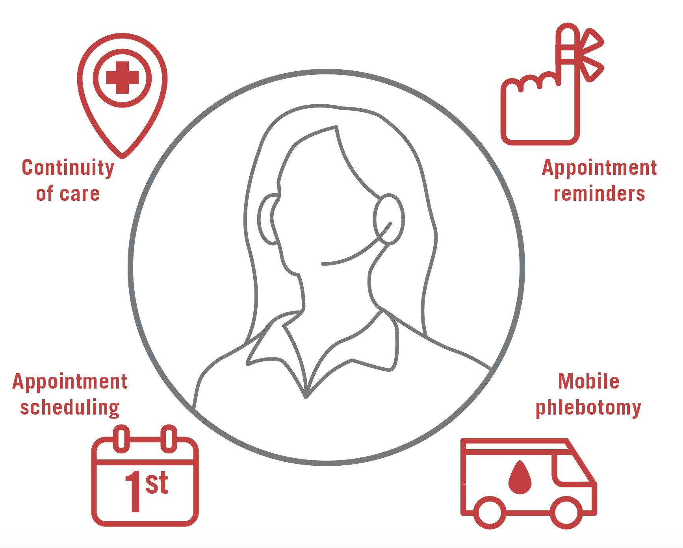
Patient Care Managers to Support AlloSure Patients
Notes:
Key Talking Points: CareDx offers help around the clock, with patient care managers. You and your staff are busy, let PCMs assist by reminding your patients about their appointments, scheduling appointments, organizing mobile phlebotomy, and ensuring continuity of care.

Slide 50


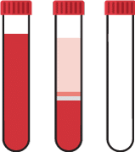

Mobile Phlebotomy to Support AlloSure Patients
At-Home Blood Draws
Complete Testing and Labs
10,000 Phlebotomists
No Additional Cost for Patients
Comprehensive Testing
Highlights
AlloSure or KidneyCare
Complete Blood Count (CBC)
Immunosuppressant level
Tacrolimus, Sirolimus, Cyclosporine, Everolimus
Comprehensive Metabolic Panel + Mg + Phos
Viral PCR (BK/CMV/EBV)
Urinary Protein / Creatinine Ratio
Results integrated into EMR
Results reported within 2 days
Routine Labs reported within 1 day
“Peace of Mind” for Patient and Physician
Notes:
Key Talking Points: CareDx is offering mobile phlebotomy to perform a blood draw at a transplant patient’s home, for AlloSure or KidneyCare surveillance and routine transplant testing at NO ADDITIONAL COST for patients. Results are reported faster, and integrated into EMR, generating peace of mind and convenience for you and your patients.

Slide 51
Molecular Assessment & Profiling of Liver Transplant rEcipients (MAPLE) Study Overview
Jake Miles, MD, BSc
MAPLE Study Lead
Sr Medical Science Liaison - East

Slide 52
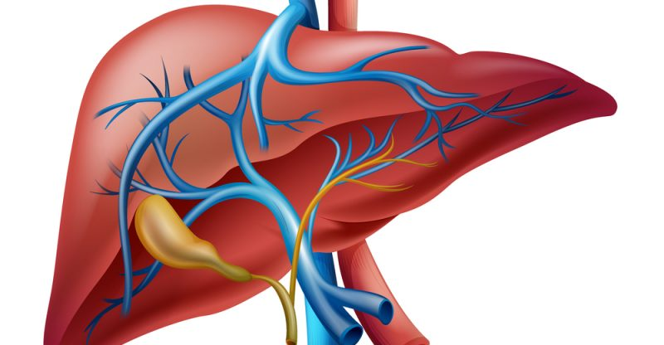
Preventing allograft loss is complex, yet current surveillance tools have limitations
Complications of immunosuppression
Acute or chronic rejection
Biliary complications
Recurrence of primary liver disease
CV Disease
Nephrotoxicity
Infection
Malignancy
Metabolic syndrome
TCMR
ABMR
Mixed pathologies
Strictures
Leaks
Viral hepatitis
Autoimmune hepatitis
Alcoholic liver disease
PBC
PSC
HCC

Slide 53
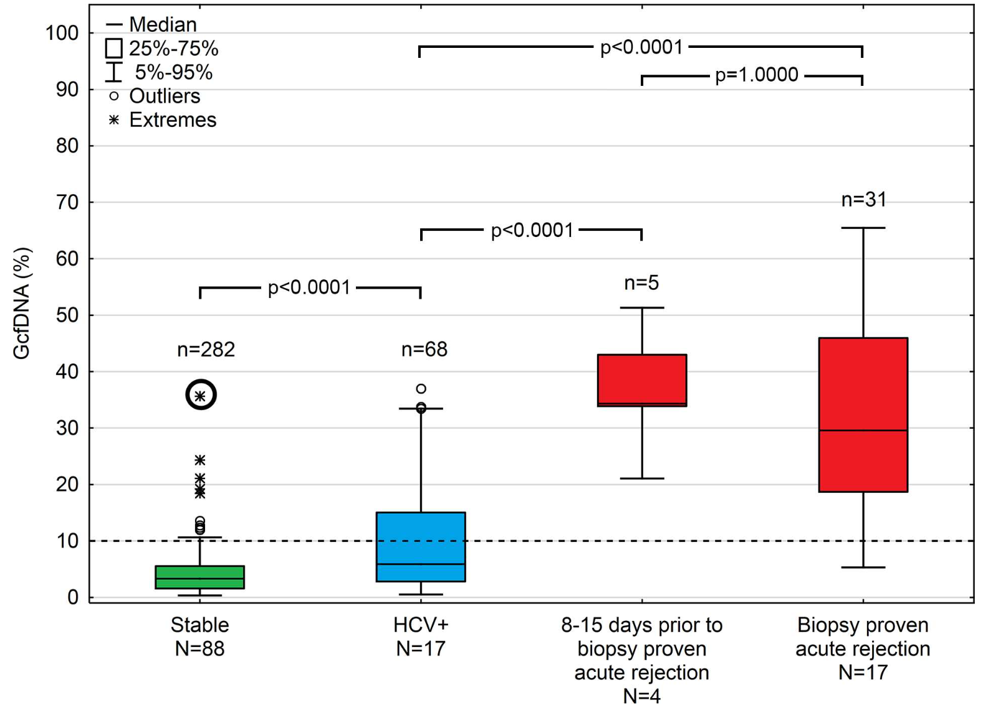
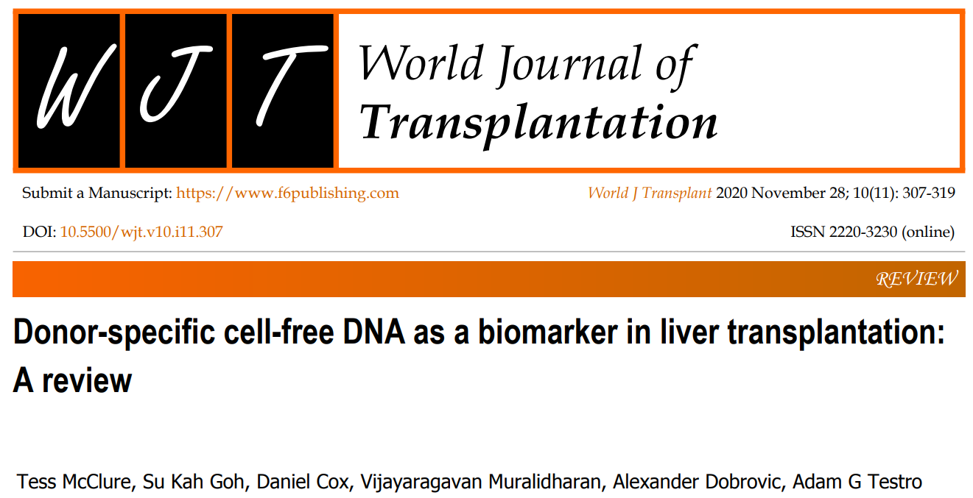
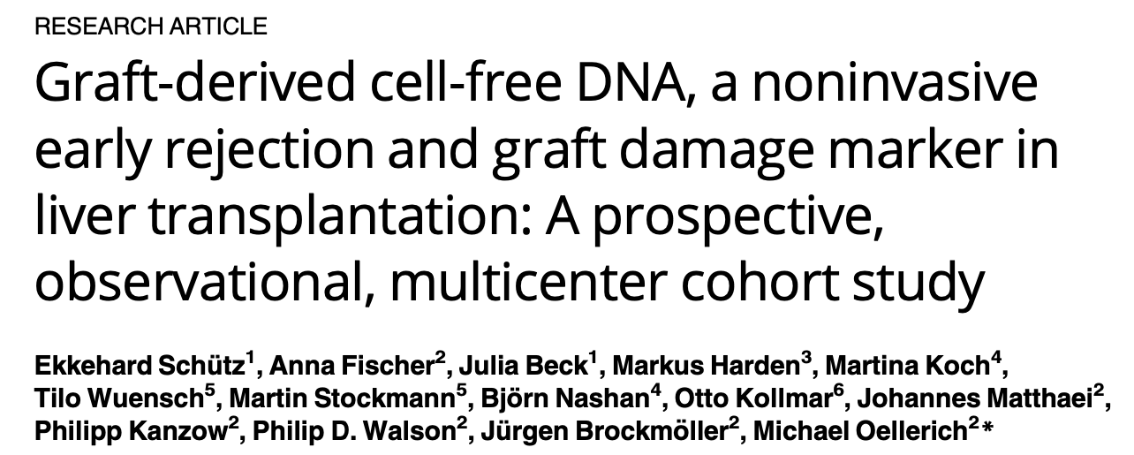
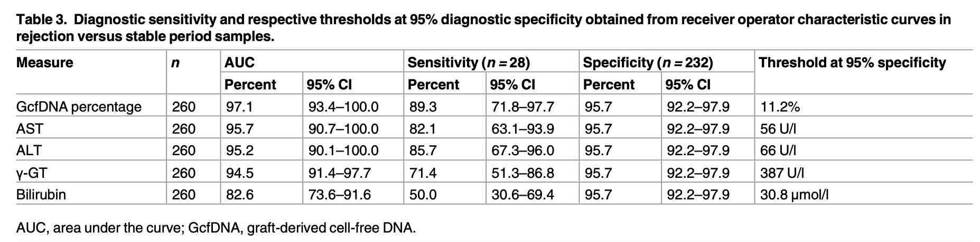
dd-cfDNA is a dynamic marker of injury and outperforms LFTs in identifying BPAR

Slide 54
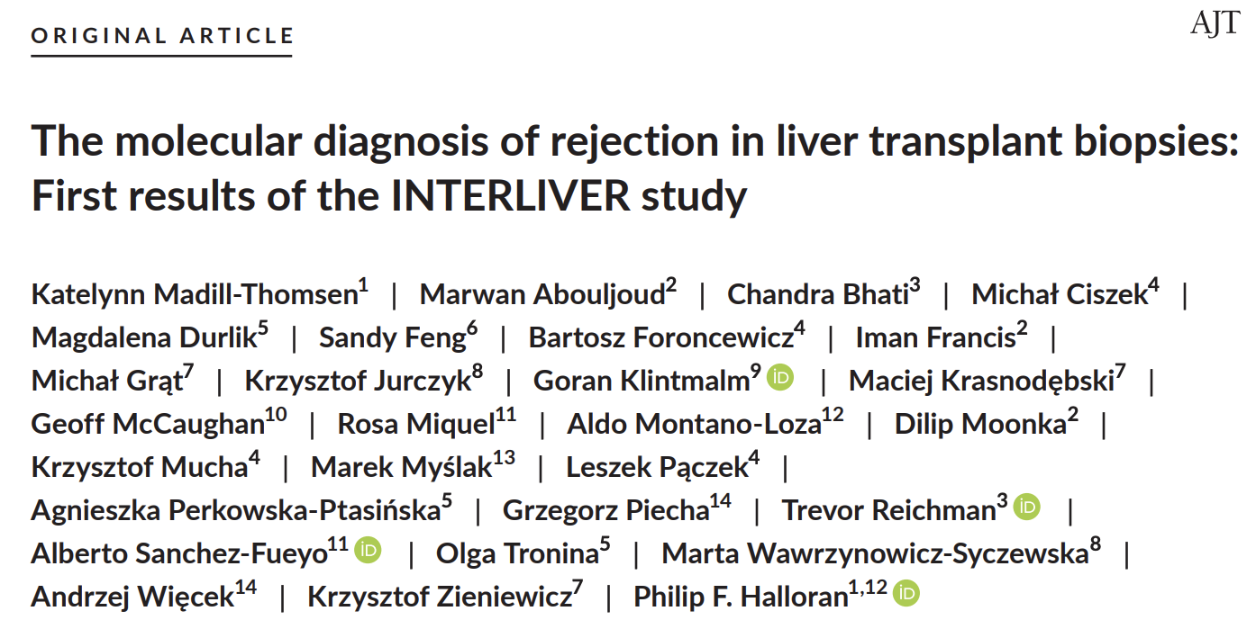
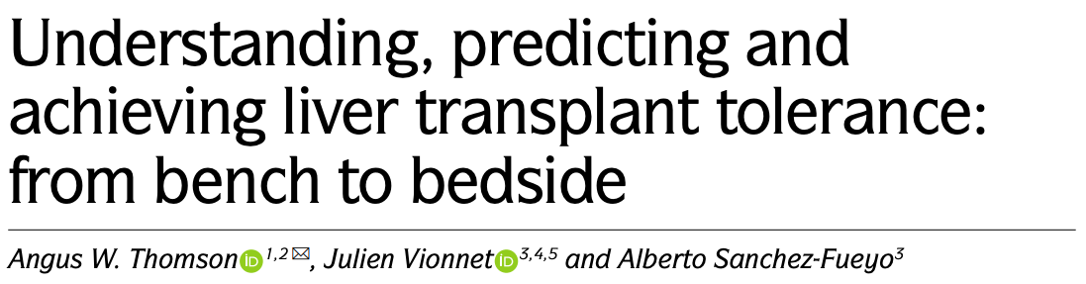
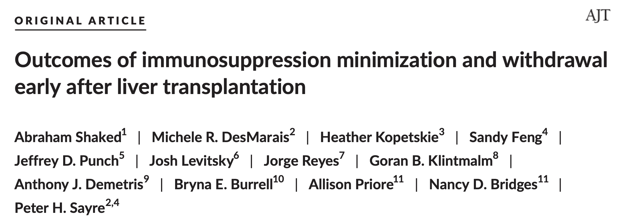
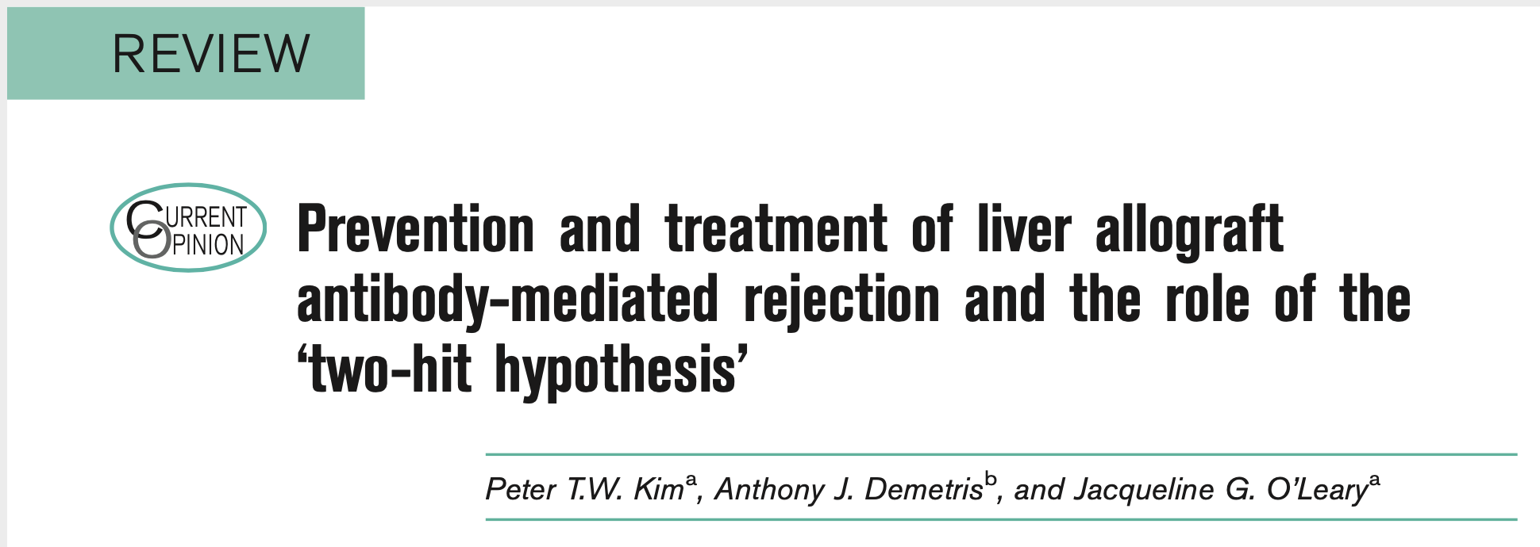
Unlocking insights into alloantibody mediated injury, immune tolerance & immunosuppression optimization

Slide 55





Peripheral blood-based biomarkers
Donor-derived cell free DNA (dd-cfDNA)
Gene expression profiling (GEP)
Micro-chimerism tool
Metagenomics infectious disease screening
Allograft Injury
Immune Activity
Immune Tolerance
Improved infectious disease diagnostics
AlloSure, AlloMap, AlloHeme & AlloID scores are for Research Use Only and are not intended for diagnostic procedures.

Slide 56


Tissue-based biomarkers & artificial intelligence
Tissue-based gene expression profiling
Machine learning transplant analytics
Molecular tissue characterization
Allograft prognosis
HistoMap and iBox scores are for Research Use Only and are not intended for diagnostic procedures.

Slide 57
MAPLE Objectives
Primary objective: assess the feasibility and utility of LiverCare in post-transplant surveillance of liver transplant recipients
Secondary objectives:
Correlate LiverCare with graft dysfunction, prevalence of dnDSA and longitudinal abnormalities in liver function
Correlate LiverCare with histological assessment of tissue biopsy (surveillance and for-cause)

Slide 58
MAPLE Study Design
Multi-center, pilot sample collection study in liver transplant recipients
Target enrolment 1,500 patients (de novo or re-transplant)
Total trial period of three (3) years follow up for enrolled patients
Exploratory study to examine the feasibility and utility of LiverCare surveillance in preparation for larger clinical trials
Standard of care liver biopsies (surveillance and for-cause)

Slide 59
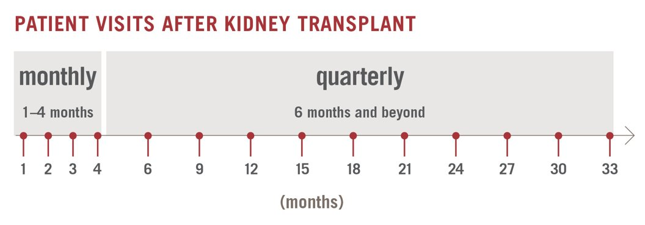
MAPLE Surveillance Testing Schedule
Provides a standardized protocol for LiverCare testing across transplant centers in conjunction with routine clinical assessments
Designed to mirror standard post-transplant surveillance time points
Weeks 0, 1, 2, 3
Months 1, 2, 3, 4, 6 & then quarterly
DSAs will be collected and analyzed retrospectively for research purposes
Research DSA screening: months 3, 6, 9, 12, 18, 24, 30 & 36
DSAs for clinical use will be ordered as per standard of care
PATIENT VISITS AFTER LIVER TRANSPLANT
Weekly
0-3 weeks
Monthly
1-4 months
Quarterly
6 months and beyond
0
1
2
3
1
2
3
4
6
9
12
15
18
21
24
27
30
33

Slide 60
MAPLE Clinically Indicated Biopsy Testing Schedule
LiverCare will be drawn at the time of clinically indicated biopsies
Patients with BPAR will be have peripheral blood biomarkers drawn weekly for 12 weeks before returning the regular surveillance schedule
The serial measurement of LiverCare will be used to assess the response to rejection treatment, where the levels are anticipated to return to baseline in response to appropriate intervention
FFPE tissue samples from all biopsies will be analyzed with HistoMap (tissue-based GEP)
BPAR
Weekly LiverCare for 12 weeks
LiverCare + clinically indicated biopsy
(e.g. abnormal LFTs, abnormal imaging findings, new DSA)
No BPAR
Regular LiverCare surveillance schedule

Slide 61
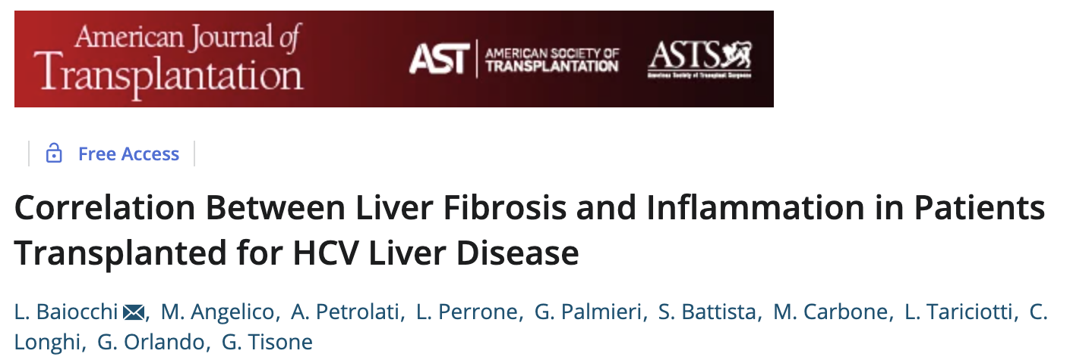
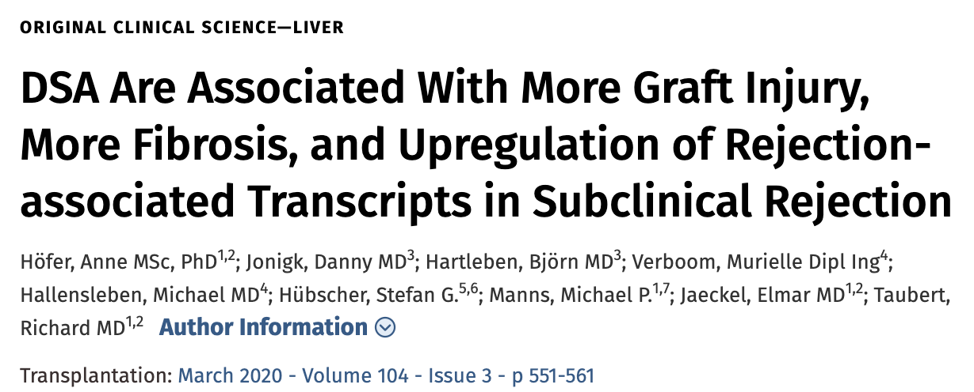
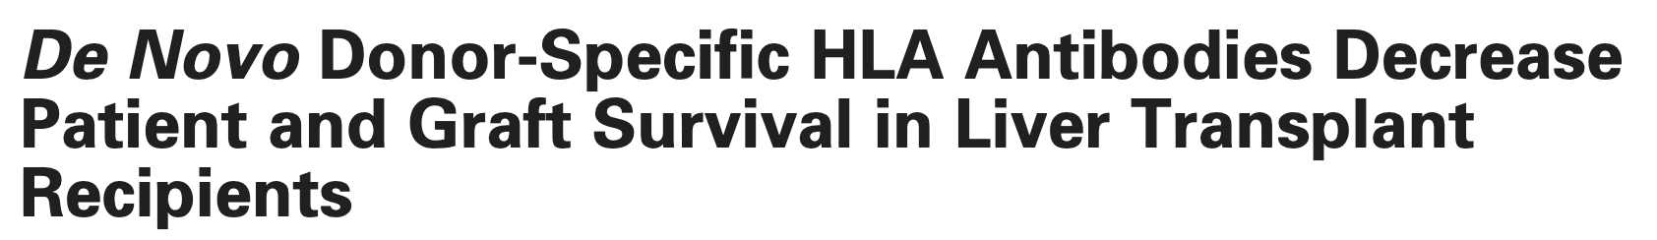
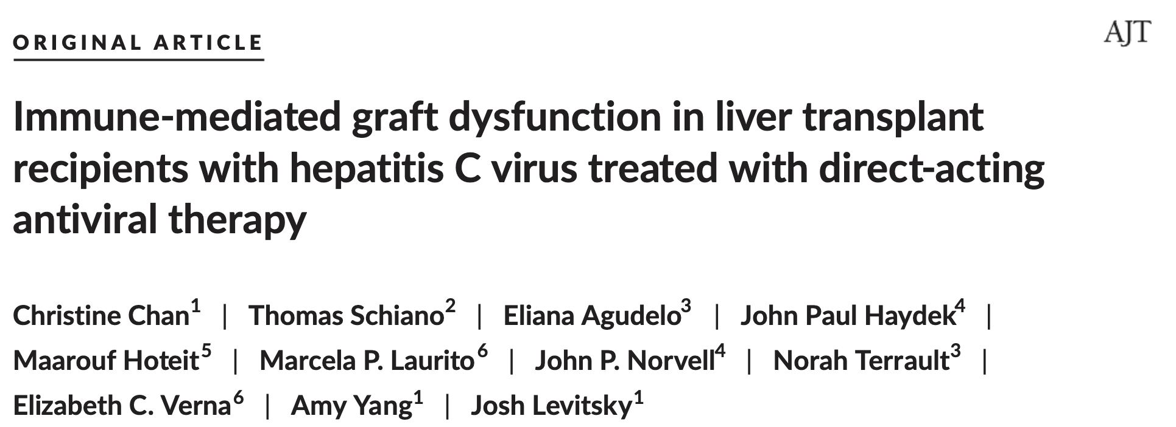
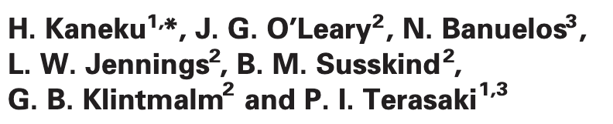
How can we shift the paradigm and utilize molecular tools to safely titrate immunosuppression?

Slide 62

TEAMMATE
Technology Enabled And Molecular Monitoring of the Allograft and Transplant rEcipients
Notes:
What does the next-generation integrated care model look like?
Where is the remote monitoring project at – maybe we can include as well?

Slide 63

mHealth
Definition
Medical and public health practice supported by mobile devices, such as cell phones, patient monitoring devices, personal digital assistants, and other wireless devices.
Goals
To improve delivery of healthcare
Improve quality and access
Care-coordination
Lower rehospitalization
Improve outcomes
Monitor patients in real time
Possibilities are endless!
The Global Observatory for eHealth
Notes:
There over 3.6 billon smart phone users across the globe with numbers projected to increase significantly. United States has the third highest utilization (>260 million) of smartphones in the world.

Slide 64






Utilization of mHealth in various disease states
mHealth in transplant recipients
Notes:
Literature pertaining to utilization of mHealth in various disease states has been reported for decades. Most of the available literature includes small number of patients when assessing impact in outcomes. Additionally, impact on readmission rates has been studied in select patient populations only.
As you can see here, mHealth has been utilized in various transplant patient populations. There are single center studies with small number of patients demonstrating potential for the utility of mHealth in transplant patients. What is lacking here is a comprehensive mHealth tool, such as AlloCare, that encompasses the comprehensive need of post-transplant recipient management, as well as a multi-center, interventional study in large number of patients across all organ groups demonstrating the utility of mHealth.

Slide 65

Readmission Rates after Transplant Remain High
Can mHealth & AlloSure help bring down re-admission rates and improve clinical outcomes?
Liver
30.3% (90-day)¹
18.8% (30-day)²
26.8% (90-day)³
29.8% - 45.4% (30-day)⁴
Heart
Kidney
Lung
1 - Shankar, N., et al., Defining readmission risk factors for liver transplantation recipients. Gastroenterol Hepatol (N Y), 2011. 7(9): p. 585-90.
2 - Darmoch, F., et al., Abstract 15814: 30-Day Readmission Causes and Rates After Heart Transplant: A Nationwide Cohort Study. Circulation, 2019. 140(Suppl_1): p. A15814-A15814.
3 - Famure, O., et al., What Are the Burden, Causes, and Costs of Early Hospital Readmissions After Kidney Transplantation? Prog Transplant, 2021: p. 15269248211003563.
4 - Simanovski, J. and J. Ralph, Readmissions After Lung Transplantation. Prog Transplant, 2020. 30(4): p. 365-367.
Notes:
Working on citations.

Slide 66







An mHealth Device for Solid Organ Transplant Recipients
Generate Reports
To Share with Your Doctors
Manage Medications
Lab Visit Reminders
Track Metrics & Activity
Receive Reminders
Bluetooth Connectivity
Notes:
?Video

Slide 67

TEAMMATE
Hypothesis: The combination of AlloCare and molecular testing with AlloSure will lead to:
Decrease readmissions
Better medication adherence (time in therapeutic range)
Fewer immunosuppression-related complications
Improved patient and provider satisfaction at 90 days
4000 Patients
2000 Controls
Design:
Multi-center, randomized control study
1000 Kidney, Liver, Heart, and Lung Transplant Recipients Each
12-month Study Period
Compatible Device to be Provided for the duration of the Trial
AlloCare
Patient Engagement App
PRIMARY ENDPOINT
Readmission rates at 90 days
Secondary Endpoints:
BPAR at 3,6,12 months
Medication Adherence
Patient satisfaction

Slide 68
Lung Allograft Survival has Not Improved Over Time
CLAD the Predominant Cause
ISHLT 2019 Data

Slide 69


Unmet Needs in Lung Transplantation
Lung transplant recipients experience one of the lowest median survivals (6.7 years) of any solid organ transplants, with a 5-year survival of 53%¹
Lung transplant recipients have an increased incidence of chronic organ rejection, termed “Chronic Lung Allograft Dysfunction” (CLAD)
53%
CLAD
There is an increased frequency of respiratory infectious complications due both to the intimate contact of the lung graft and outside environment, and more intensive immunosuppressive regimens
There are no clinically available biomarkers for noninvasive detection of graft rejection, infection or CLAD; therefore, diagnosis has usually been dependent on invasive procedures
¹ ISHLT data, 2020
Notes:
May have heard of biomarkers in heart and kidney and we are now making our way into lung

Slide 70


Injury as the Common Denominator for Lung Morbidity?
Infection/Pathogens
GERD/Aspiration
Injury
CXC ELR+, CXC ELR-, CC Chemokines, Cytokines
HLA DSA, AT1R, EC, Pro-collagen-V, Ka1 -tubulin

Slide 71
Notes:
Really want to focus on the molecular presentation.
We currently live in the lagging and subclinical presentations, but in order to really be able to intervene early, we need to identify injury early
And allosure can help do that

Slide 72






Bringing Innovation from Benchtop to Clinic to
Improve Transplant Outcomes
Metagenomics Infectious Disease Screening
Gene Expression Profiling
Micro-chimerism tool

Slide 73
ALAMO Study Design
Protocol Number: SN-C-00016
Study Centers: 50 centers across the United States
Duration of Study: 5 years
Projected accrual: 2 years
Longitudinal surveillance: 3 years
Observational Cohort Enrollment Target: 500

Slide 74
LungCare Testing Recommendations
AlloSure Lung Routine Testing Schedule (ALRTS) (12-4-4)
Year 1 Post Transplant:
LungCare Testing monthly
Year 2:
LungCare Quarterly
Year 3:
LungCare Quarterly

Slide 75
AlloSure Lung Assessment and Metagenomics Outcomes Study: ALAMO
500 Historical Control patients
receiving standard of care from
January 1, 2021 – September 30th, 2021
1000 Case Patients
Validation of AlloID, AS-Lung Surveillance Protocol
LungCare
Protocol
Bronchoscopy and
“For Cause” Bronchoscopy Assessments per center protocol
Secondary Endpoints:
dnDSA BOS Grade 1
Infection events RAS
ABMR Hospitalization
ACR ≥ A1
PRIMARY ENDPOINTS
1.) CLAD-free Survival
2.) Severe Infection-free Survival
Notes:
Inclusion Criteria
Age ≥ 18 years
Unilateral or Bilateral, deceased-donor, initial or re-transplant
≤ 3 months post-transplant
Ability to understand and provide informed consent and adhere to laboratory surveillance schedule
Patients who have LungCare initiated within 30 days of signing the informed consent form
Exclusion Criteria
Multi-organ transplants
Thoracotomy or pleural space infection
Pregnancy
“Severe” Primary Graft Dysfunction (PGD Grade 3 at 72-hours post-transplant) requiring either post-transplant mechanical assisted ventilation or extracorporeal membrane oxygenation (ECMO) support
Unresolved systemic infection or sepsis
Non-dermatologic malignancy (melanoma exclusion)

Slide 76
Participant Selection for ALAMO
Inclusion criteria
Lung transplant recipients <90 days post-transplant
De-novo single or double or re-transplant
Participant is willing and able to give informed consent for participation in the trial
In the Investigator’s opinion, is able and willing to comply with all trial requirements

Slide 77
If you want or need any information about these studies – please let me know!

Slide 78

THANK YOU!

