Slide 1
Student Health Center Services
Laura Burkhart MD, MPH
Staff Physician
Zerfoss Student Health Center

Slide 3
Welcome!
Student Health Center (SHC) is here to serve your healthcare needs at Vanderbilt
Spouses and children cannot be seen at SHC
Relationship with a Primary Care Provider (PCP) is important
Schedule appointments---don’t just walk-in

Slide 4
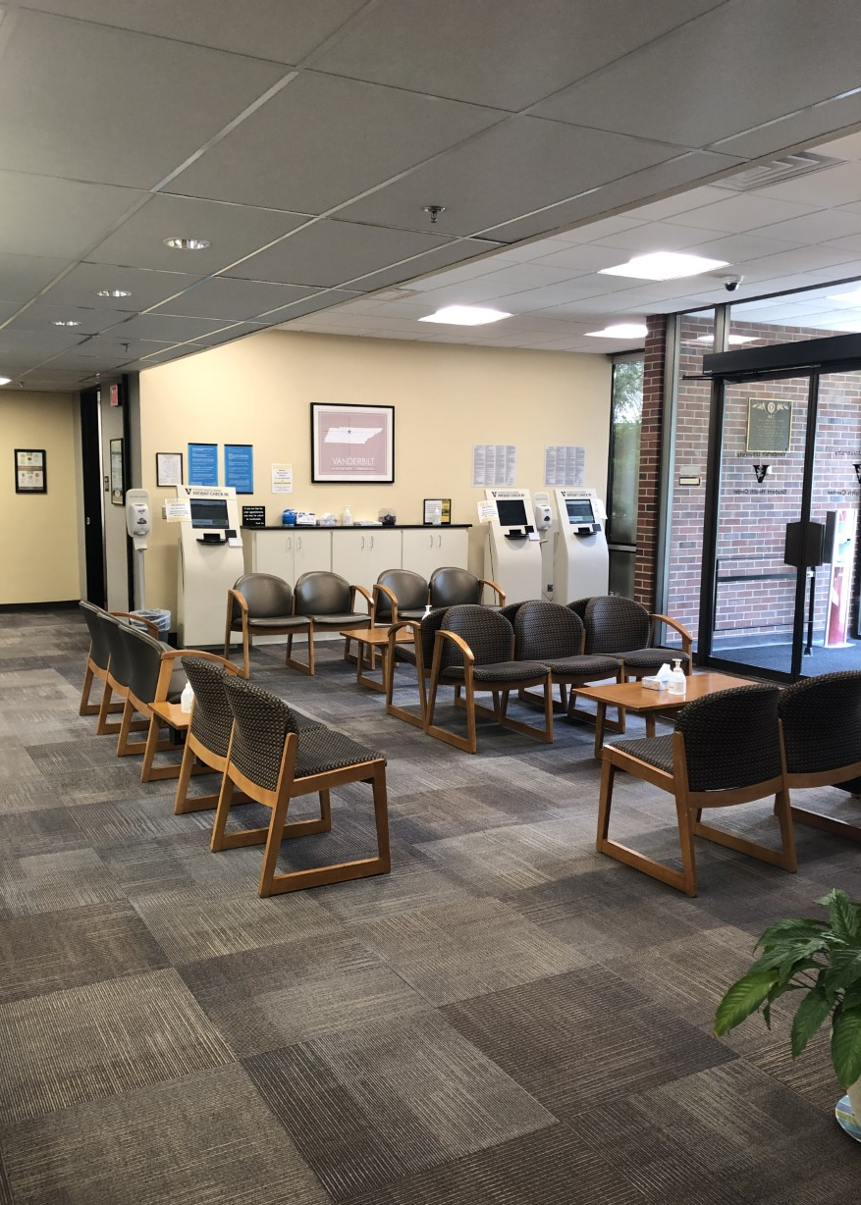
Primary Care Services
Acute care and chronic disease management
Well-woman and office gynecology
Specialty clinics
Sports Medicine
Dieticians
Dispensary on site
Treatment rooms

Slide 5
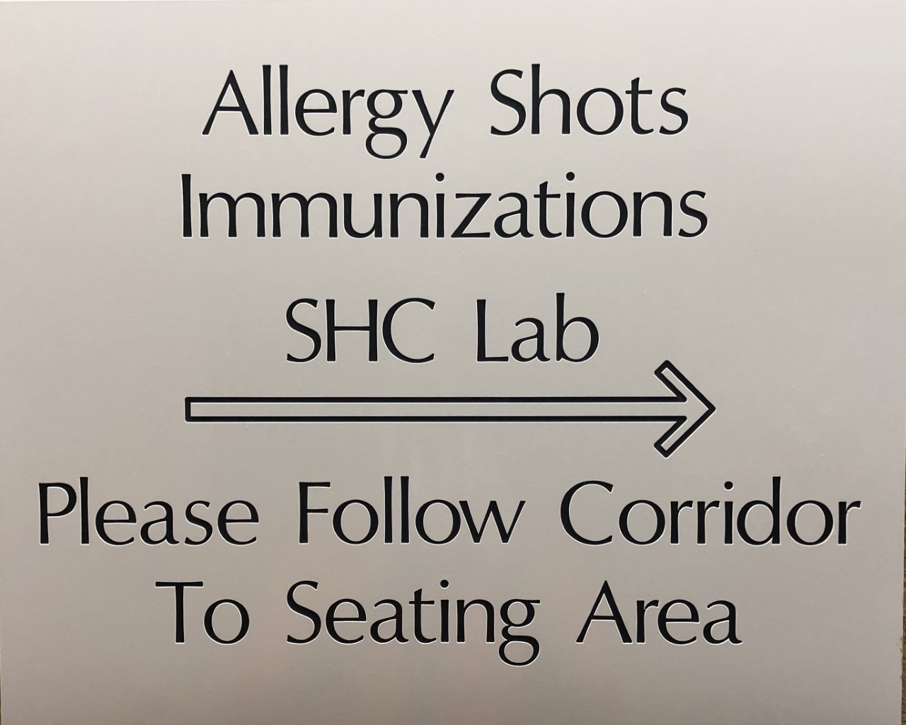
Services
Allergy shot administration
Immunizations

Slide 6
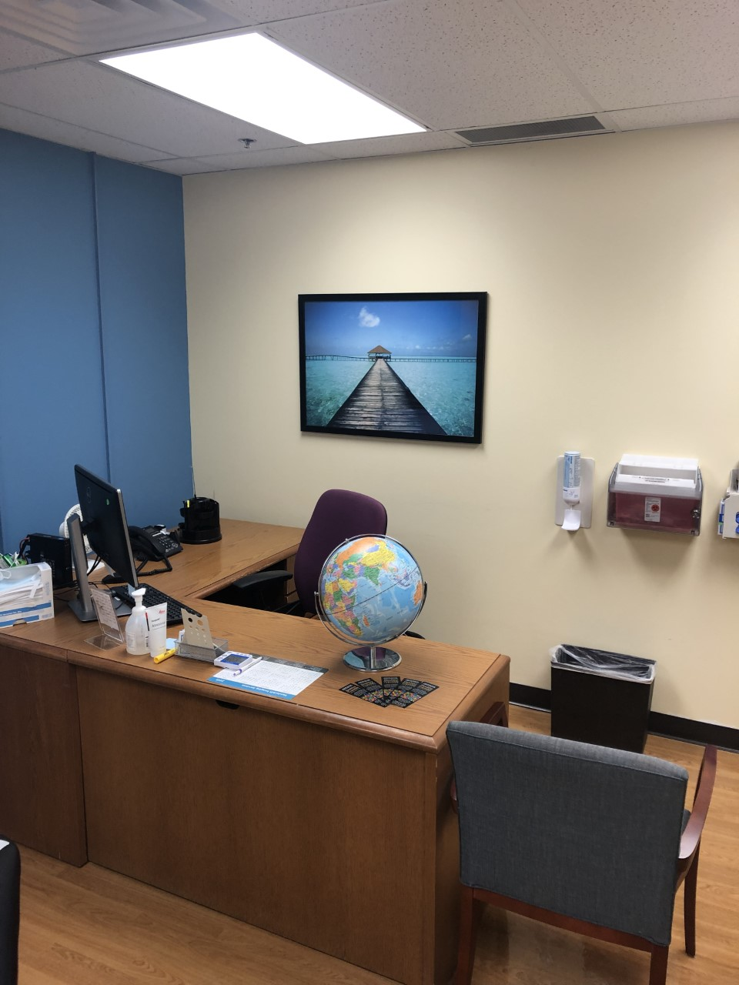
Travel Consultations

Slide 7
Lab On Site

Slide 8
Student Health Hours ALL STUDENTS are eligible for care!
Monday- Friday: 8 am until 4:30 pm
On Call medical provider for after hours assistance-call 615-322-2427
This is for urgent questions that cannot wait until the next business day

Slide 9
Remember that we are here to help you!
Illness or injuries---schedule an appointment
Immunization questions—call our main #

Slide 10
Contact Information
Student Health Center: 615-322-2427
Website: www.vumc.org/student-health/
Email: studenthealth@vanderbilt.edu

