Slide 1
VMG Workplace Violence Prevention Committee: Safety Plan Updates
10/20/2022
VUMC Workplace Violence Steering Committee

Slide 2
VMG Specific Data
In April of 2022, the VMG WPVPC surveyed all ambulatory staff reporting through the Adult Ambulatory entity. More than 780 Reponses were received with excellent representation of all frontline roles and geographic locations.
370 individual selections were made for experiencing or witnessing a workplace violence event in the last year.
From least prevalent to most, the responses were:
2% reported sexual violence- unwelcome sexual advances, requests for sexual favors, or other verbal or physical conduct of a sexual nature
2% reported stalking- harassing, spying
3% reported physical violence- hitting, spitting, shoving, grabbing, restraining
19% reported verbal violence- threats, name calling, blaming
21% reported emotional violence- bullying, manipulation, intimidation

Slide 3
Current VMG Workplace Violence Prevention Efforts
Safety Action Plan Development
Leader Development: Response, Reporting, Tools
Manager responses to situations are a strong contributor to employees’ perceptions of overall safety and security
Standardize response to patient behavior in partnership with the Office of Patient Relations
Education Opportunities:
Resources after events
Policy awareness -WPV, Physical Security, Key and Access Cards
Importance of VERITAS reporting
Encourage safety assessment with VUPD
Awaiting recommendations from organizational assessment
Roadshow for Staff Meetings or Newsletter

Slide 4
Safety Action Planning: A trained response is a quick response
Our clinics have plans for what to do if events that threaten safety occur i.e., chemical spill, fire, and tornado
Like the principles for fire drills or mock codes, the more healthcare workers prepare for workplace violence, the higher the chance they will remain safe during an emergency
A trained response is a quick response

Slide 5
Clinic Specific Safety Action Plan
Over the last year, the WPVPC developed a Safety Action Plan Template and Leader Guide
Safety Action Plan Templates will be incorporated into organizational annual Emergency Preparedness requirements through department sub plans
This will be a line item in 2023 EOC surveys
Goal: clinic leaders use the Safety Action Plan Template and Leader Guide for scenario-based discussion and planning with multidisciplinary clinic teams

Slide 6
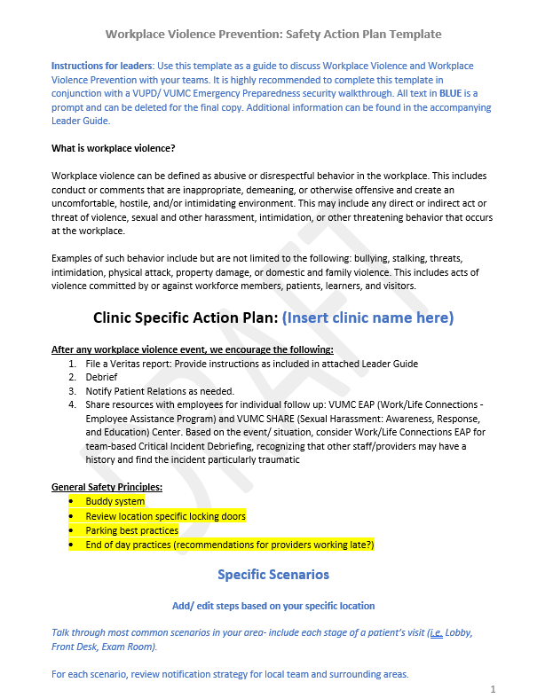
Workplace Violence Prevention: Safety Action Plan Template

Slide 7
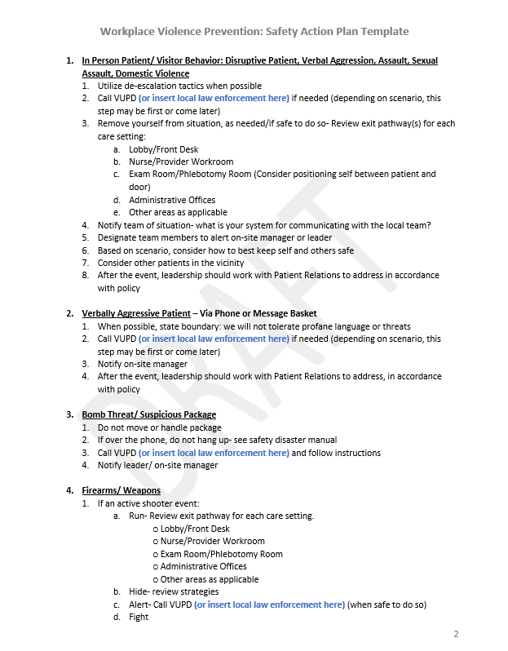
Workplace Violence Prevention: Safety Action Plan Template

Slide 8
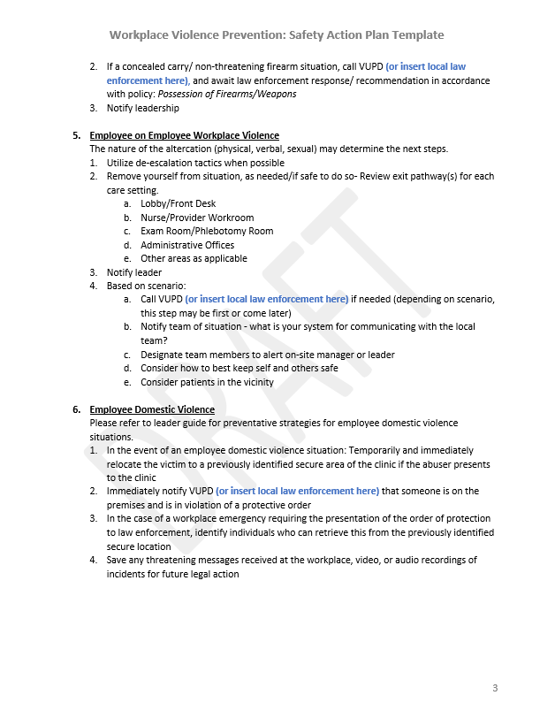
Workplace Violence Prevention: Safety Action Plan Template

Slide 9
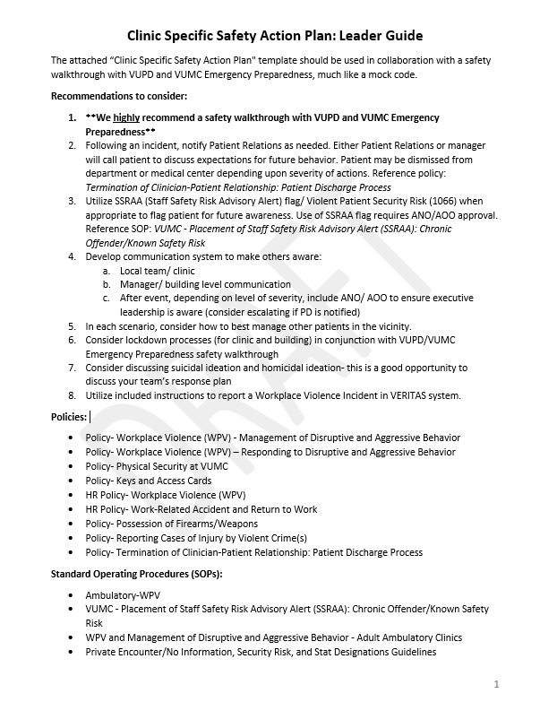
Clinic Specific Safety Action Plan: Leader Guide

Slide 10
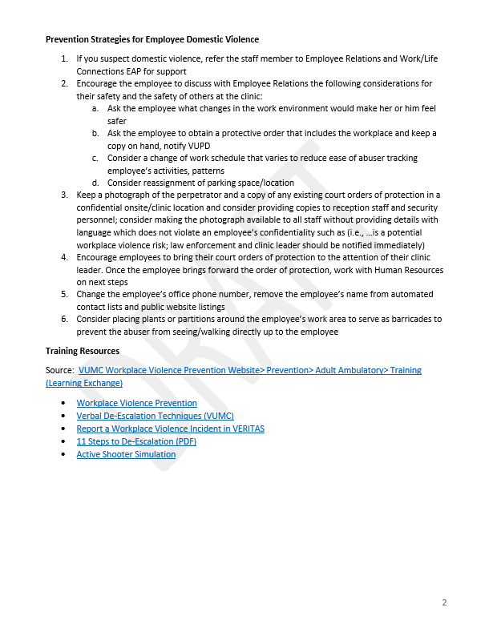
Clinic Specific Safety Action Plan: Leader Guide

Slide 11
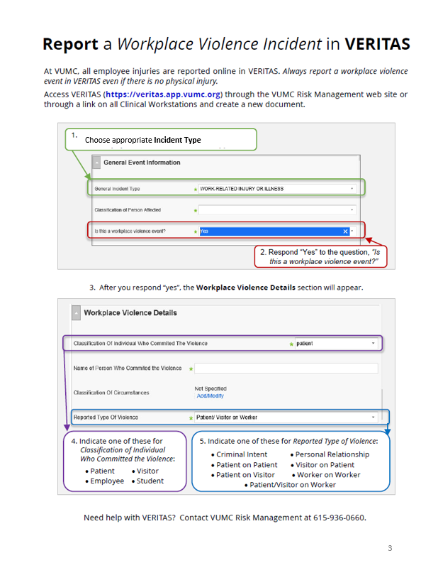
Clinic Specific Safety Action Plan: Leader Guide

Slide 12
Questions/ Feedback

