Slide 1
Department- Specific Epic Training, Student Edition
Updated September Jan 2025

Slide 2
Purpose
To ensure the student’s Epic profile is properly built
To educate and simulate most common workflows within Epic
To start conversation between student and CI regarding charting styles and preferences, and provide opportunity to troubleshoot questions/problems
Not, necessarily, intended to teach the user how to document, but how to use some of the tools at their disposal

Slide 3
Overview
Build Check
Patient lists & List Columns
Chart Review & Associated Tools
Flowsheets & Data Input
End of Day Duties

Slide 4
Check the Build
Log in department should be
VUH Physical Therapy
VUH Occupational Therapy
Tabs across the top should contain
Eval/Treat Navigator
Flowsheets
Chart Review
Summary
Notes
Demographics
If not, please contact Taylor or Bobby to enter Help Desk ticket to modify account build

Slide 5
Patient Lists

Slide 6
“My Lists” vs System Lists
System Lists
Created by the institution
Distinguishes patients by a host of features:
location, diagnosis, procedures, consulting service, admission status, insurance coverage, ice cream preferences
My Lists
Created by the user or shared with the user
Department pre-builds
Shared lists

Slide 7
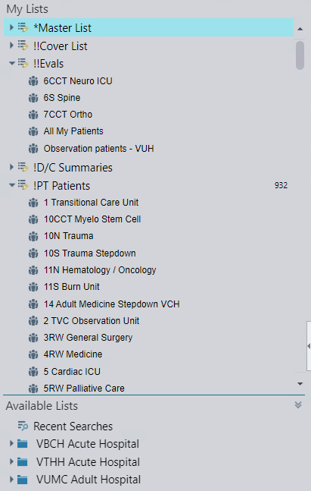
My Lists
Created by the user or shared with the user
Department pre-builds
Shared lists
Customizable
Infinite– as many as you want for whatever purpose needed

Slide 8
System Lists
Includes familiar and personalized lists, such as
“All My Patients”
Team- ortho total joint
Units- 6S
As well as hospital initiatives, such as "Priority Discharges”
Notes:
Found under available lists

Slide 9
Video Demo: Patient Lists and Columns
Patient Lists & Editing My Lists Columns.mp4
Notes:
Add link to video

Slide 10
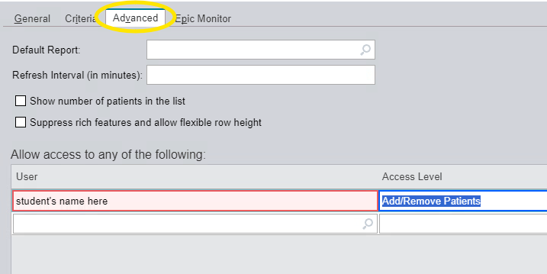
Patient Lists: How to view your CI/FE’s list
CI/FE must share their list with the student:
1. From the far-left sidebar, right-click the list to share.
2. Select Properties and go to the Advanced tab within the pop-up window.
3. Add student to “User” line
4. Select level 3, or “add/remove” patients.
Student can now view the list under the Shared Lists heading of their patient list side bar

Slide 11
List Columns

Slide 12
Patient Lists: Columns to Discuss

Slide 13
PT or OT Priority
- A means of internal communication to designate or prioritize patients for follow-up treatment
- Workflow sequence:
Double-click the dash (-) in priority column to open pop-up
Select the number and/or applicable title
Subsequent providers (therapists or assistants) should remove the number after treatment (titles, such as CVA, total joint, etc. may remain)
This is reviewed at the end with end of day discussion
Notes:
Internal communication to designate or prioritize patients for treatment or tracking

Slide 14
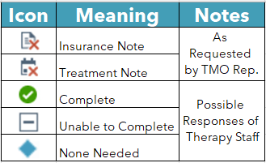
OT/PT Needs Update
Contains icons:
To respond, double click the list icon to pull up the DC Huddle Dashboard:
Or use flowsheet row under the treatment tab:
Notes:
Unable to complete request” is selected (insert symbol” will appear. The symbol appears based upon the selection as opposed to choosing they symbol. Same for When “None Needed” is selected, (insert symbol) appears.

Slide 15
More “Needs Update” Icon Details
Insurance Note – Facility or Insurance is requiring renewed confirmation of need. These are high priority and should be scheduled to be seen and charted on by 11 AM the following day.
Treatment Note – Request made by member of medical team for patient to be treated.
Updated Note Complete – After note is finished, clinician clicks “Complete” in the huddle dashboard to signal request has been satisfied (Icon refreshes after 48 hours).

Slide 16
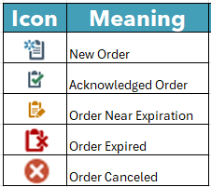
PT/OT “Order Status”
Also, icons-based:
Click for Video Demo: Order Status Icons:
Demo Order Status Icons.mp4
Crtl + click to follow links to video demos
Notes:
Insert video link

Slide 17
Priority Discharge
Notes:
"yes," "no," or" --“
Additional comments should specify if your discipline is needed
If no comments for your discipline, then no special treatment is necessary

Slide 18
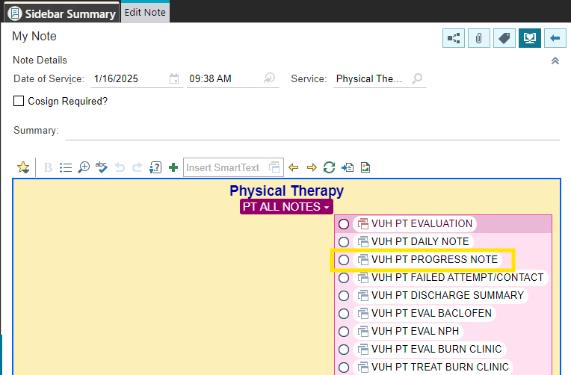
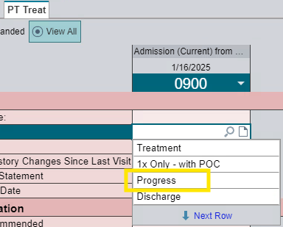
Progress Note Due Date
Calculates from the date entered on evaluation, re-evaluation, or from previous progress note to track when progress note is due
Therapist must update plan of care with a progress note-- begin via treatment tab flowsheet selection (A), followed by use of progress note template in Notewriter (B)-- every 30 days (+/- 7 days) on all patients
You can designate patients in the priority column with “Progress Note”
A.
B.

Slide 19
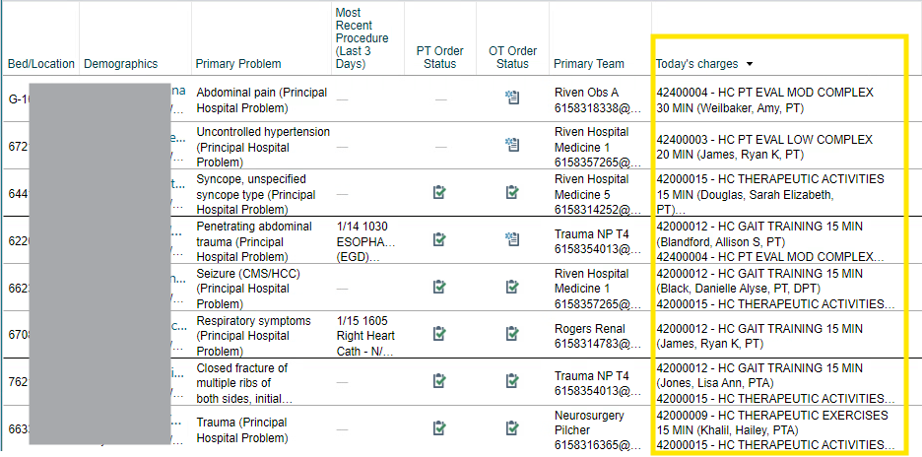
Today’s Charges
Helps you ensure that billed correctly as part of end of day workflow

Slide 20
Other General Column Suggestions
Demographics
Room/patient location
Team with pager number
Assist Level
Most Recent Procedure (Last 3 Days)
OT/PT and COTA/PTA
Discharge recommendations
Last 3 visits
Frequency
PT/OT Sticky Note
Nurse
Patient class
Primary Diagnosis

Slide 21
Other Columns of Interest
VENT modes
RASS score
Isolation
Opposite discipline items

Slide 22
Chart Review & Associated Tools

Slide 23
Chart Review Discussion Topics
Encounters Tab- lists events such as hospital admissions and office visits
Different ways to review: a) “Chart Review” – contains notes from any encounter b) “Notes” – only entries from current encounter
Using the wrench icon to change the default chart review tab and to edit the order
Set-up Chart Review filters
Wrenching in “Active Orders” into summary activity
Utilizing the pasteboard

Slide 24
Video Demo: Tabs, Chart Review vs Notes, Pasteboard
Activity Tabs.mp4
Chart Review Filters & Chart Review v Notes Tab.mp4
Pasteboard.mp4
Crtl + click to follow links to video demos
Notes:
Add link to video

Slide 25
Flowsheets & Data Input

Slide 26
Flowsheets – General Info
Versatile means for data entry and note collection
Includes pick lists and narrative comments
A tool, and not necessarily intended to force a style upon the user
Only some are mandatory for chart review/auditing purposes
If it doesn’t need to be commented on, then resist the compulsion

Slide 27
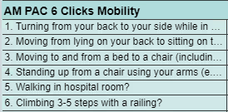
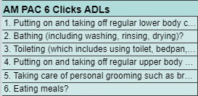
Required Flowsheet Entries
Date of the visit—Eval, treatment, or both
Selections required for Visit type and Charting type
Selecting Discharge Recommendations (instantly seen in patient story report)
Equipment Recommendations (instantly seen in patient story report)
Score AMPAC 6 Clicks– Mobility for PT and ADLs for OT- with every visit

Slide 28
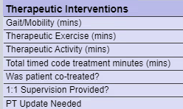
Flowsheets considerations: Billing time, Student and assistant supervision/correspondence, and Co-treatment
Treatment Minutes –
Record approximate times for each billing category
Denote total billable time in Total Timed Code
Remember the 8-minute rule
1:1 supervision (students only)– should select the auto-populated response whenever applicable
Therapist Communication (assistants only)
Co-treatment
Select when patient is Observation Status, and
“Total Timed Code Treatment Minutes” does not match the total time spent with patient
Explain via the comment box for any discrepancy due to splitting between clinicians

Slide 29
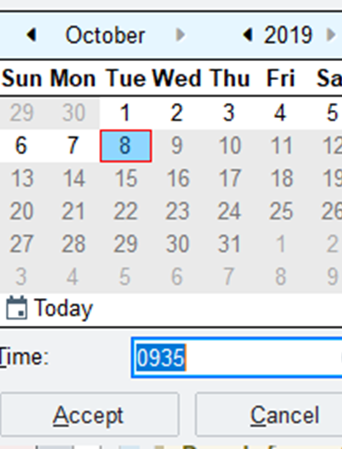
Flowsheet Rows
Wild Cards, symbolized by ***
Allows users to leave a placeholder to return to within the NoteWriter
Must be resolved prior to signing a note
24-hour Rule –
The note must be created within 24 hours of time column for flowsheets.
Caution: flowsheet data will therefore pull in for notes on follow up visits that are within< 24 hours (such as BIDs)

Slide 30
Contact Notes and Failed Attempts
Contact Note –
A. Describes an instance where no attempt was made (i.e. due to medical status, off the unit, etc), or
B. Denotes successful contact/interaction with patient/caregiver but not billable time
Failed Attempt – describes a planned visit was unsuccessful
IMPORTANT: If discharging a patient from therapy services as part of either option above, also select for “Treatment Frequency” as Discharged from Therapy in treatment plan

Slide 31
Charting Demos
Failed Attempt (all users):
Eval Note (therapist students only):
Treatment Note (all users):
Adding Treatment to Eval (therapist students only):
Charting FAs and CNs.mp4
Charting Eval A-- Eval only (Student).mp4
Charting Treatment Note.mp4
Charting Eval B-- Adding Treatment.mp4
Crtl + click to follow links to video demos
Notes:
Add links to videos

Slide 32
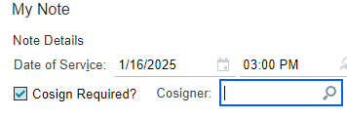
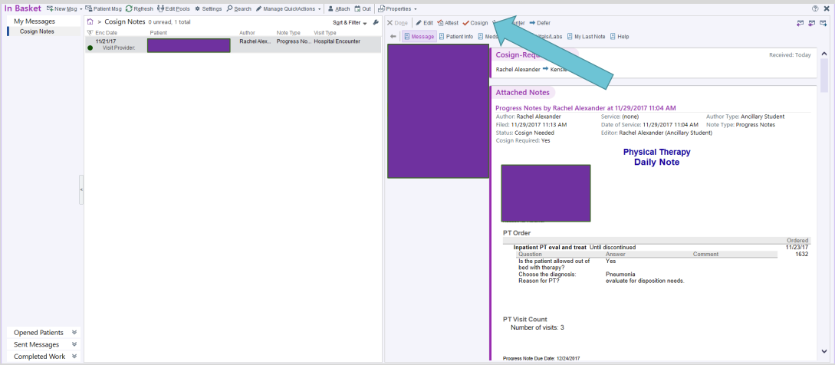
Cosigning Student Notes
Student enters the name of supervising CI/FE as cosigner at the very top of Notewriter sidbar
Make edits per preferences of supervisor– flowsheets vs in note writer, etc
Remind your CI/FE to drop charges
Cosigning ultimately happens from within the “In Basket” tab

Slide 33
End of Day Duties

Slide 34
End of Day Duties
Review and Cosign Notes
Verify Today’s Charges (charges are added by CI/FE)
Indicate Priorities for Tomorrow

Slide 35
Recall the previous slide for Priority Buttons
- Priority Columns represent internal communications to designate or prioritize patients for follow ups
- Workflow sequence:
Double-click the dash (-) in priority column to open pop-up
Select the number and/or applicable title
Subsequent providers (therapists or assistants) should remove the number after treatment (titles, such as CVA, total joint, etc. may remain)
Notes:
Internal communication to designate or prioritize patients for treatment or tracking

Slide 36
Priority Options
Numbers indicates the priority of patients to be seen the next day by the assistant or treating therapist (Lower number indicates higher priority)
Each floor has a designated allotment of treatment slots
Remember: Subsequent providers (therapists or assistants) should remove the number after treatment (titles, such as CVA, total joint, etc. may remain)

Slide 37
Priority Options
Therapist: Indicates follow up should be completed by a therapist, rather than an assistant.
Note: Best practice is to document the reason in PT/OT Sticky note

Slide 38
Priority Options
Titles or Diagnosis indicators: Can be used in conjunction with a number or other priority designations.
Insurance note: needs to be seen next day for insurance or facility approval.
Sunday (Insurance note): Select on Friday when patient will need to be seen on Sunday for Insurance Note.
VSRH 1, 2, 3: indicates treatment was requested on the Stallworth Email (1st, 2nd, and 3rd priority)
Hold: Patient awaiting surgery, not medically appropriate, has new bedrest orders, etc.

Slide 39
Priority Options
Saturday or Sunday Discharge: Used for a patient who will discharge that day and is pending something from therapy.
Study Patients (A to E): Used to identify patients involved in departmental studies.​
Splint: (OT only) Identifies a new splint need
Splint Check: (OT only) Identifies splints needing f/u
Admin: Request identified by CTL/CC/Manager for patient to be seen as soon as possible.
Pager: Designates pager requests needing f/u. Please add a PT/OT Sticky Note with pertinent details.

Slide 40
Thanks for your attention
Consult with your CI or Epic Superuser regarding any questions or concerns, or suggestions for this training material

