Slide 1
A Tale of Two Patients
Rachel Wolf, MD
Assistant Professor of Internal Medicine and Pediatrics
October 22, 2022

Slide 2
Disclosures
None

Slide 3
Learning Objectives
Identify screening and primary care-based medical management of common substance use disorders (SUDs).
Identify common co-occurring primary medical care needs of individuals with addiction.
Understand treatment and preventive options for these primary care needs, including hypertension and diabetes co-management in the setting of buprenorphine treatment.

Slide 4
Patient 1:
29yo male with Crohn’s disease
Prior history of SUD, treated with buprenorphine-naloxone
Difficulty achieving consistent care due to insurance status
Admitted to hospital with Crohn’s flare
Evaluated by gastroenterology service
Treated with steroids with symptom improvement
Planned for outpatient follow-up with gastroenterology

Slide 5
Patient 1: Discharge planning
Prescribed buprenorphine-naloxone from community prescriber but unable to afford
Not receiving regular primary care or psychiatric care
Medicare recipient
Decided to transition to co-located primary care and SUD care within Vanderbilt

Slide 6
Patient 1: Intake additional histories
Initially, prescribed opioids for Crohn’s disease related pain
Use increased over 4-5 years
Went to inpatient rehabilitation and initiated therapy with buprenorphine/naloxone two years prior to presentation
Denies history of intravenous drug use
Denies legal concerns
Smokes hookah daily

Slide 7
Patient 1: Social history
Lives with father
Mother is living abroad
Sister living close by, has other siblings
Completed some college but had to withdraw due to Crohn’s symptoms
Currently unemployed

Slide 8
Patient 1: Psychiatric history
Diagnoses of depression and anxiety
Previously on bupropion and escitalopram
Evaluated by psychiatry on prior admission
Denies suicidal ideation, history of mania or psychosis

Slide 9
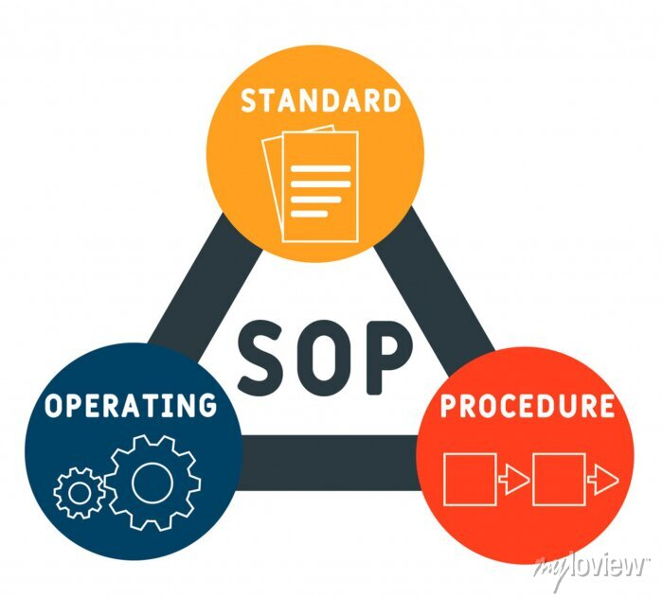
Routine screenings
Alcohol and tobacco use screened on intake for every patient
No additional required standardized screening
Medicare requirements for annual visits
Notes:
Catch things like cannabis hyperemesis

Slide 10
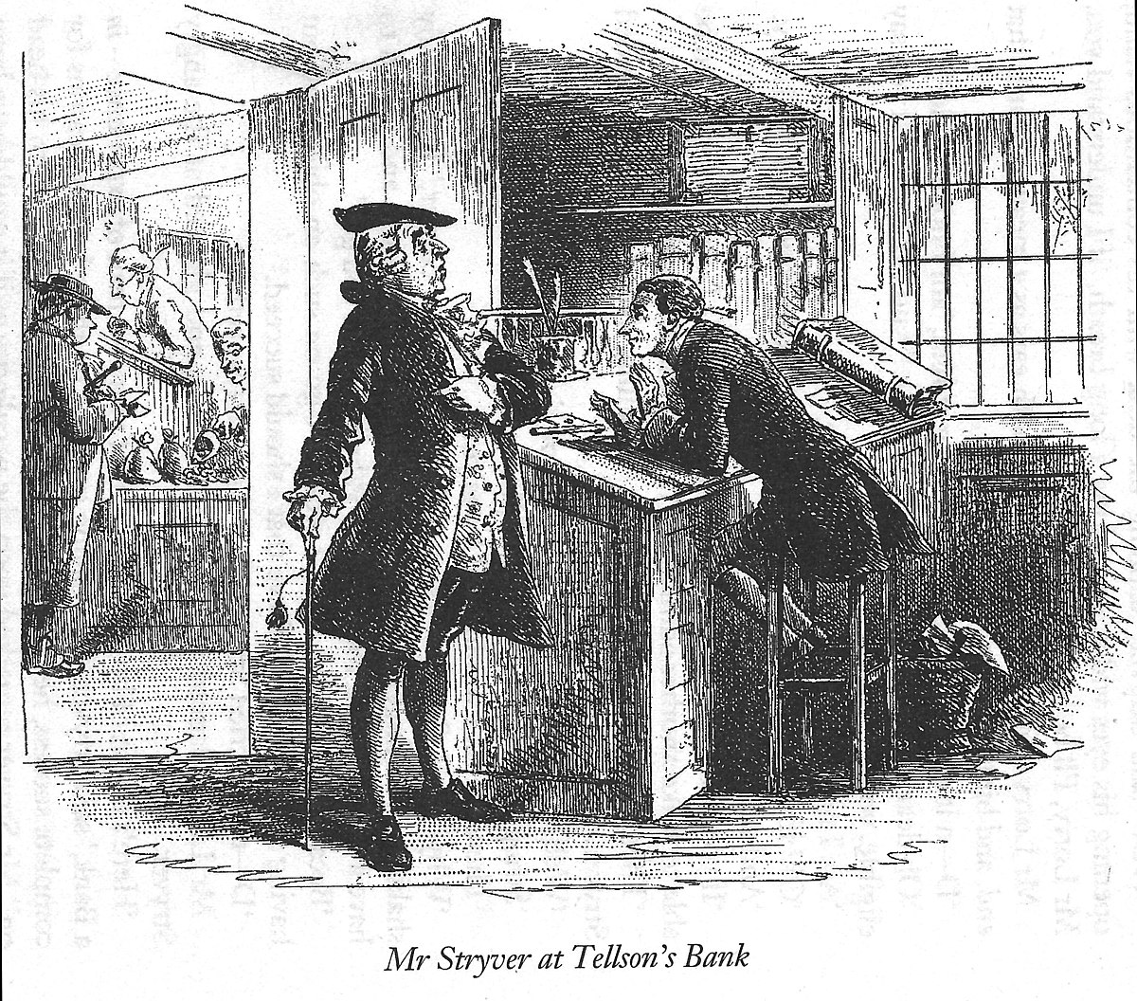
Management options
Initiate medications
Refer to substance use disorder program
Refer to higher level of care
Notes:
MOUD/MAUD/NRT/psychotropic
When to ask for help:
Pregnant women
Adolescents
Significant comorbid psychiatric conditions
Catch things like cannabis hyperemesis

Slide 11
Medications for SUDs
Tobacco use disorder
Nicotine replacement therapy
Varenicline
Bupropion
Alcohol use disorder
Acamprosate
Disulfiram
Naltrexone
Topiramate
Gabapentin
Opioid use disorder
Naltrexone
Buprenorphine
Methadone
Notes:
MOUD/MAUD/NRT/psychotropic
When to ask for help:
Pregnant women
Adolescents
Significant comorbid psychiatric conditions
Catch things like cannabis hyperemesis

Slide 12
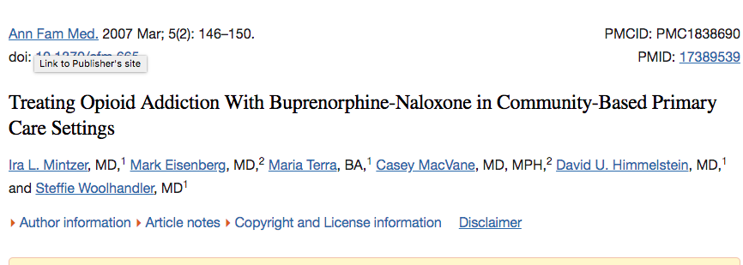
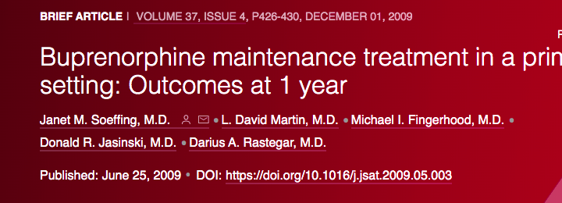
Buprenorphine in the primary care setting
Notes:
99 patients suboxone at 2 urban primary care practices (hospital based) and free standing neighborhood health center 51%/58% (lower number at site with addictions counselor)
8-24mg dosing
Factors predicting sobriety: private insurance, older age, longer treatment, trend towards significance for NA/AA

Slide 13
Buprenorphine in the primary care setting
Cohort study demonstrated successful treatment in primary care setting
Site 1: in clinic induction after 24 hours of abstaining, 3 consecutive visits
Site 2: day 1 given prescription, evaluated days 3, 7, 14, 21 then followed monthly
Recommended counseling and meetings
Overall 54% retention at 6 months
Mintzer IL et al, Treating opioid addiction with buprenorphine-naloxone in community-based primary care settings. Annals of Family Medicine, 2007, 5:2.
Notes:
99 patients suboxone at 2 urban primary care practices (hospital based) and free standing neighborhood health center 51%/58% (lower number at site with addictions counselor)
8-24mg dosing
Factors predicting sobriety: private insurance, older age, longer treatment, trend towards significance for NA/AA

Slide 14
Successful buprenorphine maintenance in federally qualified health centers (FQHC)
Retrospective observational study
Retention: 88.4% at 1 month, 71.8% at 3 months and 56.8% at 6 months
Dosing >50% of patients >16mg
Substance use counseling and psychiatric medications increased retention
Cocaine use decreased retention
Significant gaps in treatment
Haddad MS, Zelenve A Altice FL. Integrating buprenorphine maintenance therapy into federally qualified health centers: Real-world substance abuse treatment outcomes. Drug and Alcohol Dependence, 2013, 131: 127-135
Notes:
Connecticut
~300 patients
136 patients with 1 yr of observation, 60% of those

Slide 15
Outcomes of Buprenorphine maintenance in primary care setting
250 patients at primary care clinic in Baltimore over 1 year
57% in treatment after 1 year
~50% of dropouts in first month
16% opioid negative urine screens for all blocks
~50% opioid negative urine screens for 6 or more negative blocks
485 patients at hospital based primary care in New York City over 7 years
Induction and transfer patients
83% retention at week 1 for induction
Adverse effects: 3% precipitated withdrawal, 5% prolonged withdrawal
Median 57 weeks treatment retention (both groups combined)
Overall opiate positive urine 40%, cocaine 24%, benzodiazepines 17%
Soeffing JM et al. Buprenorphine maintenance treatment in a primary care setting: Outcomes at 1 year. Journal of Substance Abuse Treatment. 2009:37:426-30
Bhatraju EP et al. Public sector low threshold office-based buprenorphine treatment: outcomes at year 7. Addict Sci Clin Pract. 2017: 12:7
Notes:
250 patients
More likely to stay in treatment if: using cocaine, benzos, alcohol
Low barrier-insurance availability, home induction, weekly and then less frequent f/u, no mandated psychosocial treatment
Active heroin users least likely to be retained
No standardized protocol

Slide 16
Notes:
Insurance! Housing instability

Slide 17
Barriers
Access to primary care
Lack of trained or comfortable providers
Time constraints
Psychiatric comorbidities
Social determinants of health
Bowman et al. Reducing the health consequences of opioid addiction in primary care. Am J of Medicine. 126;7, July 2013
Notes:
Insurance! Housing instability

Slide 18
Patient 1: Clinical course
One year later, developed severe Crohn’s complications including multiple intraabdominal abscesses
Required interventional radiology drainage of abscesses, parenteral nutrition, outpatient parenteral antibiotic therapy
Perioperative pain managed by acute pain management
Addiction consult service
Seen in Bridge clinic for two months

Slide 19
Patient 1: Clinical course
Surgical bowel resection performed one month later with complicated post operative course
Pneumonia, poorly controlled pain, depression
Returned to Bridge clinic for one visit and then transitioned back to Primary Care

Slide 20
Patient 1: Current status
Referred multiple times to integrative health center and to psychiatry with no appointments completed
No significant hospitalizations
Notes:
Gaps? Psychiatric care, multidisciplinary team

Slide 21
Notes:
*** add points ***

Slide 22
Patient 2
53yo male with hypertension presented to Psychiatric Assessment Services (PAS)
Receiving medical care in local clinic
Receiving mental health care in local clinic
Requesting buprenorphine, referred to Bridge Clinic
Missed first appointment due to incarceration

Slide 23
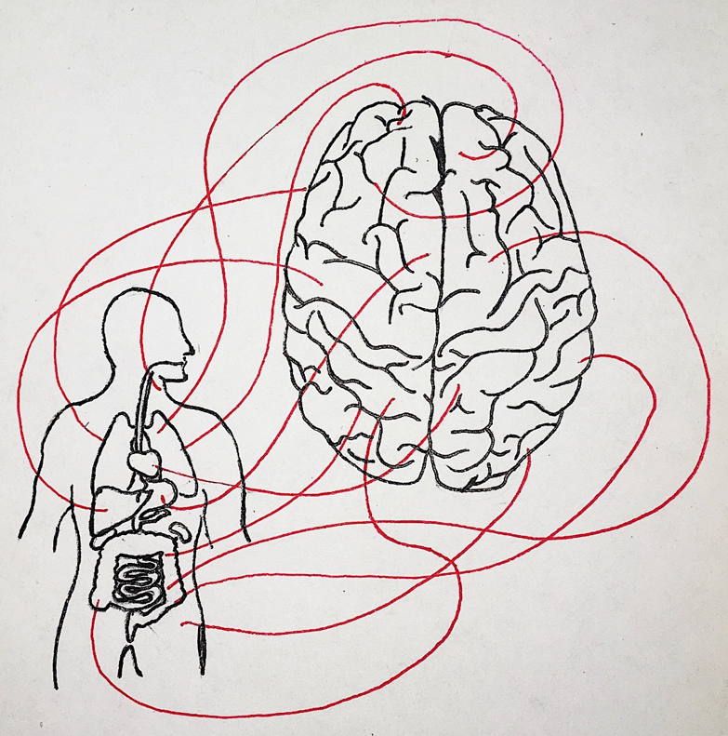
Patient 2:
Comorbid conditions
Hypertension
lisinopril 20mg, amlodipine 5mg
Bipolar disorder
venlafaxine 75mg, olanzapine 5mg, hydroxyzine 25mg as needed
http://hippocratesmedreview.org/a-clinical-approach-to-the-mind-body-connection/

Slide 24
Medical comorbidities in patients with SUD
Cardiovascular disease
Infectious Disease
Primary Care
Hypertension
Hyperlipidemia
Coronary artery disease
Diabetes mellitus
HIV
Hepatitis B
Cirrhosis
Hepatitis C

Slide 25
Comorbidities and treatment retention
Cocaine use associated with higher attrition
Hepatitis C virus (HCV) positive associated with higher attrition
Hypertension present more than other primary care populations
(69% vs 27%)
Sweeney et al, Buprenorphine treatment retention and comorbidities among patients with opioid use disorder in a primary care setting. Am J Addict. 2022; 1-5

Slide 26
Morbidity and mortality in patients with substance use disorder on MOUD
2 year observational study in Norway
1.4% of patients (200) died
Categories
Somatic disease (liver disease, cardiovascular disease, pulmonary disease, cancer, other) (45%)
Drug related death (42%)
Violent death (12%)
Bech et al. Mortality and causes of death among patients with opioid use disorder receiving opioid agonist treatment: a national register study, BMC Health services Research, 19:440, 2019
Notes:
Pulm is copd, pneumonia
Cardiovascular PE, stroke, endocarditis, CAD/MI
Other: kidney, diabetes, GI bleeds, sepsis, epilepsy

Slide 27
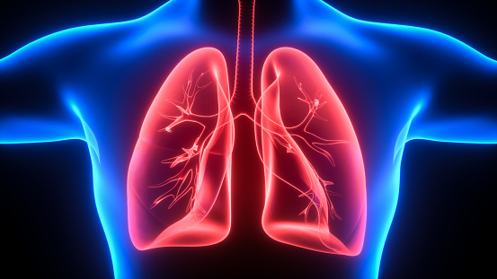
Morbidity and mortality in patients with substance use disorder on MOUD
Retrospective cohort study in Boston
Mortality 12.4 fold higher than similarly aged general population
“Chronic comorbid conditions”
Chronic kidney disease, chronic lung disease, congestive heart failure, HCV, malignancy associated with increased hazard all-cause mortality
25% chronic lung disease
Fine et al. Baseline factors associated with mortality in patients who engaged in buprenorphine treatment for opioid use disorder: a cohort study, J Gen Intern Med 35(8):2375-82
Notes:
(CAD, cerebrovascular disease, CKD, chronic lung disease, CHF, HCV, HIV, liver disease, cancer, infection

Slide 28
Morbidity and mortality in patients with substance use disorder on MOUD
In Western Australia, evaluated rates of hospital admissions, emergency department visits and death in opioid dependent patients after entering pharmacotherapy program compared with non-dependent controls
Kelty E and Hulse G. Morbidity and mortality in opioid dependent patients after entering an opioid pharmacotherapy compared with a cohort of non-dependent controls Journal of Public Health, Vol 40, Issue 2, June 2018, 409–414

Slide 29
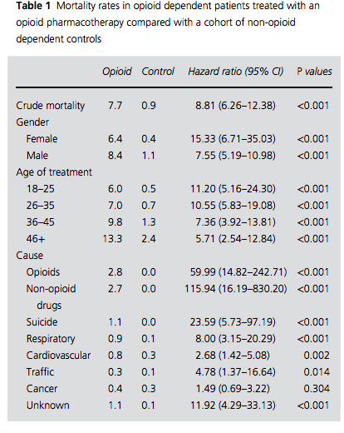
Notes:
Similar for hospital admissions

Slide 30
Substance use and cardiovascular disease
Direct
Tobacco
Alcohol
Stimulant
American Heart Association Presidential Advisory 2021
Chow et al. Opioid use and its relationship to cardiovascular disease and brain health: a presidential advisory from the American Heart Association. Circulation, 144, 13, Sep, 2021 218-232
Notes:
Opioids effect on heart in addiction and also treating patients with heart problems with opioids
Higher arterial stiffness (kelty article, citation 17)
Importance of additional investigation

Slide 31
Patient 2: Risk stratification and intervention
Optimize hypertension treatment
Screening for diabetes mellitus type II
Screening for hyperlipidemia
Atherosclerotic cardiovascular disease risk calculation

Slide 32
Substance use interactions with medical comorbidities
Stimulant use
Withdrawal

Slide 33
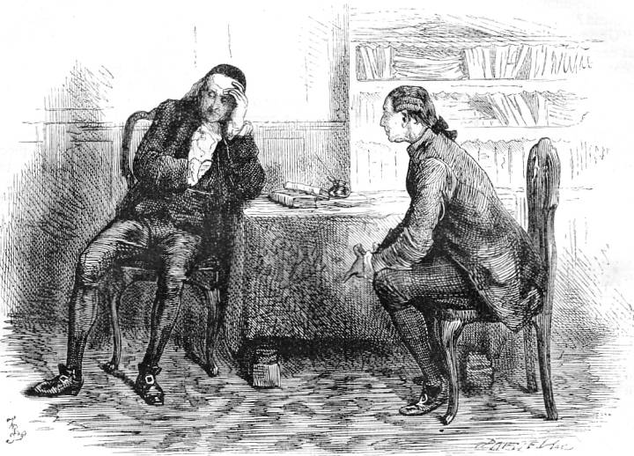
Medical concerns for Patient 2
Hypertension
Chest pain
Lower extremity edema

Slide 34
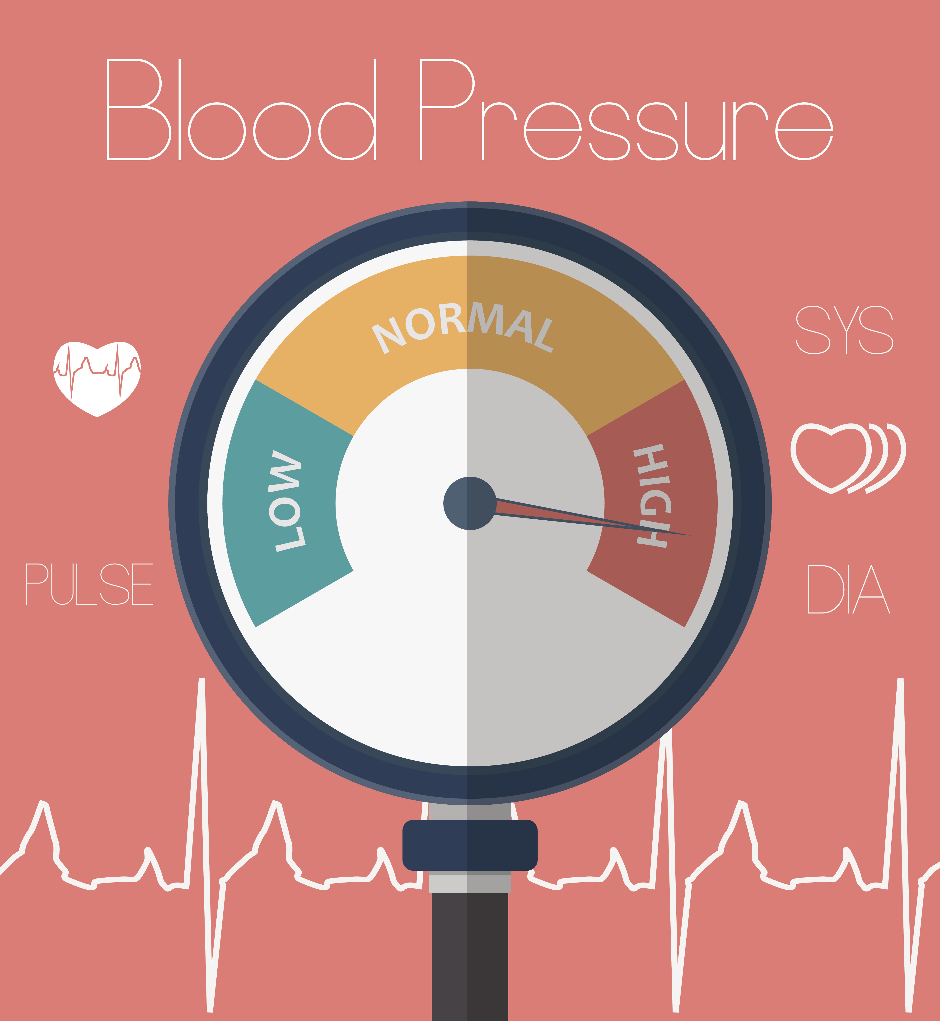
Patient 2: Hypertension
Hypertension
Medication options
Renin-angiotensin-aldosterone system
Calcium channel blockers
Diuretics
Beta blockers
Goal blood pressures
When to ask for help
Notes:
Help if having symptoms
Clonidine, guanfacine, centrally acting alpha agonist
prazosin/doxazosin alpha blocker

Slide 35
Patient 2: Chest pain
Chest pain
Emergency?
Differential diagnosis
Evaluation
Management

Slide 36
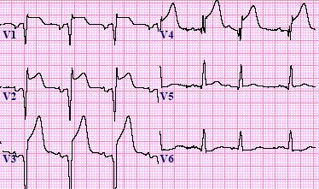
Patient 2: Chest pain
Emergency room counseling
Anginal equivalents
Evaluation: Electrocardiogram, echocardiogram, stress test
Cardiology evaluation

Slide 37
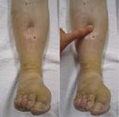
Patient 2: Management of medical comorbidities
Lower extremity edema
Differential diagnosis
Unilateral or bilateral
Acute or chronic
Evaluation
Management
Notes:
Cardiac, renal, hepatic, venous stasis, medications
Ultrasound, diuretic (laboratory monitoring), medication interactions, sulfa allergy

Slide 38
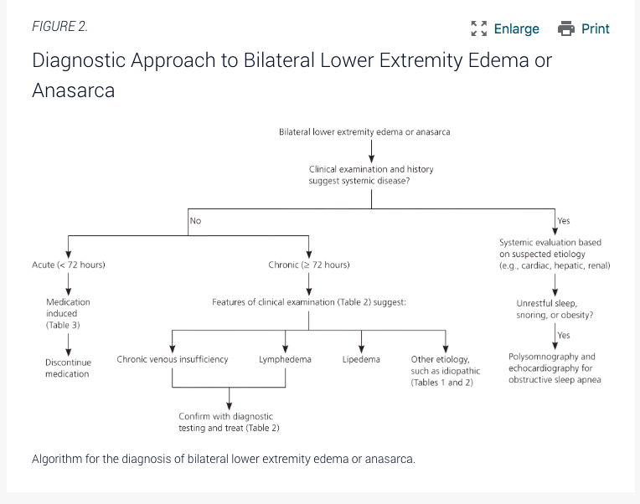
Trayes et al, Edema: Diagnosis and Management
Am Fam Physician. 2013;88(2):102-110
Notes:
Cardiac, renal, hepatic, venous stasis, medications
Ultrasound, diuretic (laboratory monitoring), medication interactions, sulfa allergy

Slide 39
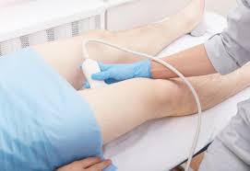
Patient 2: Lower extremity edema management
Obtained lower extremity ultrasound with no deep venous thrombosis
Stopped amlodipine
Lower extremity edema resolved

Slide 40
Patient 2: Additional management
Initiated mirtazapine to treat stimulant use disorder
Multidisciplinary interventions for legal, social concerns

Slide 41
Patient 2: Clinical course
Recommended re-establishing with local mental health and primary care
Transitioned to Vanderbilt recovery clinic

Slide 43
Summary
Primary care and substance use disorder treatment are both vitally important
Important to know basics of common medical concerns when caring for patients with SUD
Opportunity to improve general health and decrease morbidity and mortality with appropriate interventions

Slide 44
References:
Bech et al. Mortality and causes of death among patients with opioid use disorder receiving opioid agonist treatment: a national register study, BMC Health services Research, 19:440, 2019
Chow et al. Opioid use and its relationship to cardiovascular disease and brain health: a presidential advisory from the American Heart Association. Circulation, 144, 13, Sep, 2021 218-232
Fine et al. Baseline factors associated with mortality in patients who engaged in buprenorphine treatment for opioid use disorder: a cohort study, J Gen Intern Med 35(8):2375-82
Haddad MS, Zelenve A Altice FL. Integrating buprenorphine maintenance therapy into federally qualified health centers: Real-world substance abuse treatment outcomes. Drug and Alcohol Dependence, 2013, 131: 127-135
Kelty E and Hulse G. Morbidity and mortality in opioid dependent patients after entering an opioid pharmacotherapy compared with a cohort of non-dependent controls Journal of Public Health, Vol 40, Issue 2, June 2018, 409–414
Larochelle, MR et al. Medication for opioid use disorder after nonfatal opioid overdose and association with mortality. Annals of Internal Medicine, 2018; 169: 137-145
Lee JD et al, Comparative effectiveness of extended-release naltrexone versus buprenorphine-naloxone for opioid relapse prevention (X:BOT): a multicentre, open-label, randomised controlled trial. Lancet, 2018; 391
Mintzer IL et al, Treating opioid addiction with buprenorphine-naloxone in community-based primary care settings. Annals of Family Medicine, 2007, 5:2.
https://www.samhsa.gov/medication-assisted-treatment/medications-counseling-related-conditions/naltrexone
https://www.samhsa.gov/medication-assisted-treatment/medications-counseling-related-conditions/buprenorphine
Soeffing JM et al. Buprenorphine maintenance treatment in a primary care setting: Outcomes at 1 year. Journal of Substance Abuse Treatment. 2009:37:426-30
Bhatraju EP et al. Public sector low threshold office-based buprenorphine treatment: outcomes at year 7. Addict Sci Clin Pract. 2017: 12:7
Andrews RR. Family physicians can manage adults with hepatitis C. Am Fam Physician, 2018; 98(7) 413-416.
Bartholomew TS et al, Integration of hepatitis C treatment in a primary care federal qualified health center; Philadelphia, Pennsylvania, 2015-2017. Infect Dis (Auckl) 2019; 12
Trayes et al, Edema: Diagnosis and Management Am Fam Physician. 2013;88(2):102-110
Lee et al, Home buprenorphine/naloxone induction in primary care. J Gen Intn Med, 2008, 24(2):226-32
Sweeney et al, Buprenorphine treatment retention and comorbidities among patients with opioid use disorder in a primary care setting. Am J Addict. 2022; 1-5

