Slide 1
Substance use disorders and infections
Katie D. White, MD, Phd
Assistant Professor of Medicine, Division of Infectious Diseases
Vanderbilt Addiction medicine fellowship program director
Mid-south addiction conference
October 21, 2022

Slide 2
I have no disclosures

Slide 3
Learning objectives
List the types of infections associated with injection drug use
List the features of infective endocarditis that influence morbidity/risk and describe standard and innovative treatments
Describe recommended testing for viral infections associated with IVDU
Interpret testing results for HCV, HBV, and HAV infections
Describe infection prevention strategies for people who inject drugs

Slide 4
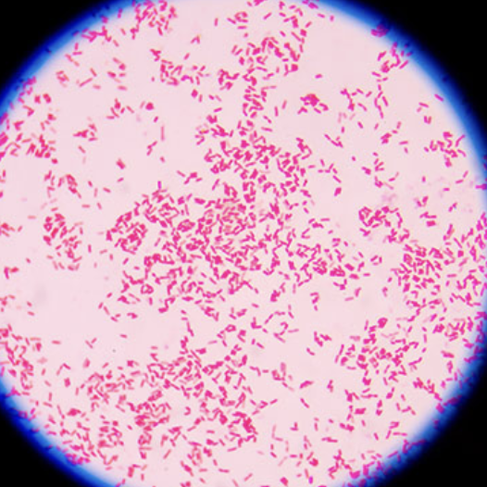
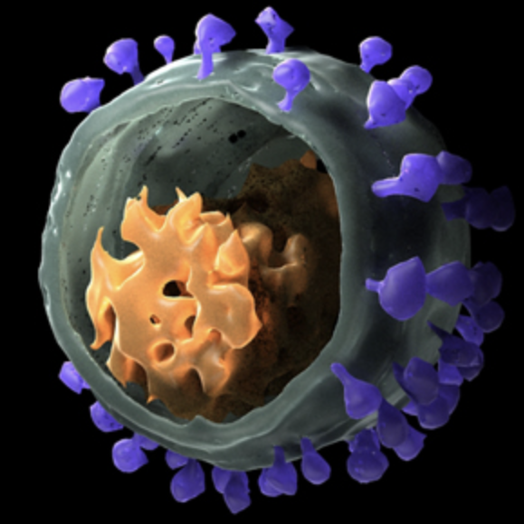
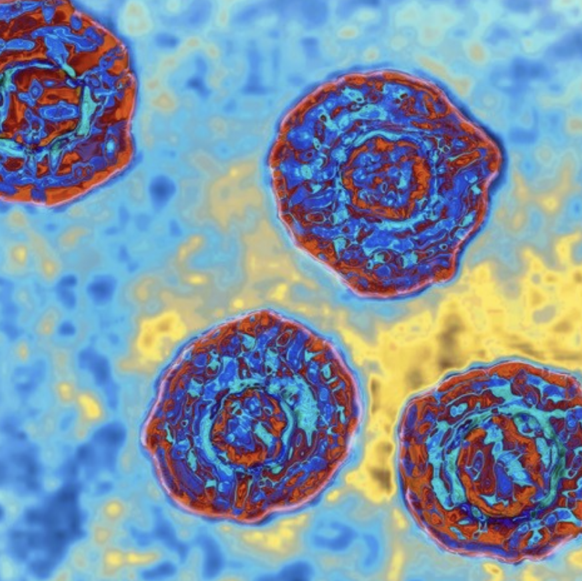
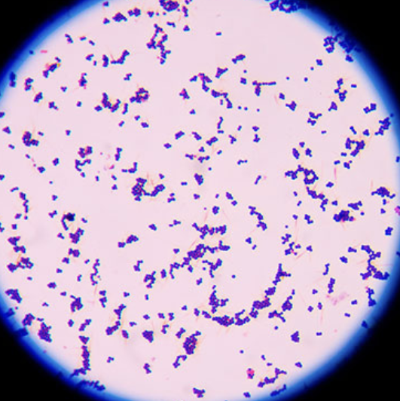
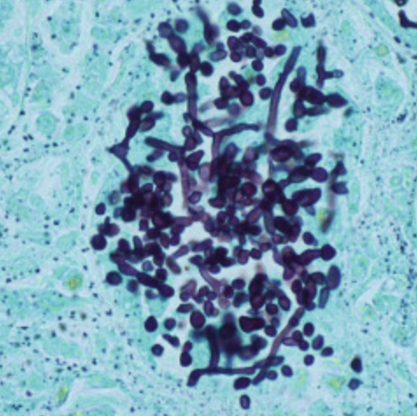
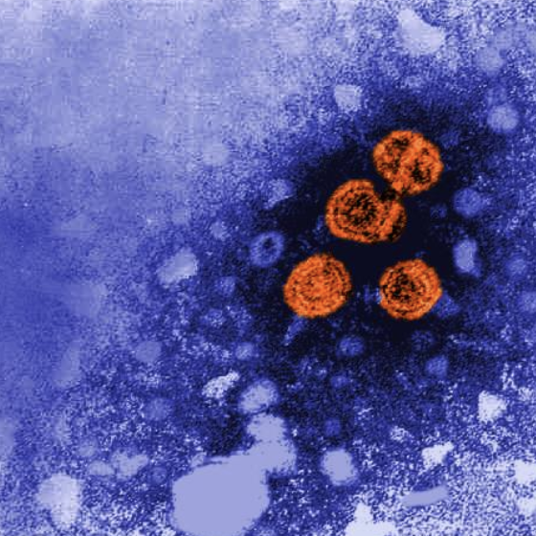
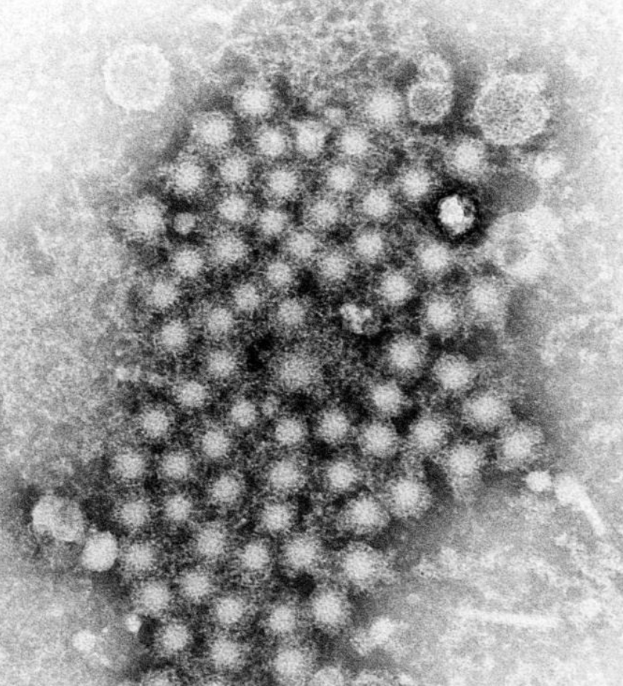
The colorful world of…
BACTERIA
VIRUSES
HIV
FUNGI
HCV
C. glabrata
HBV
HAV
https://www.cell.com/pictureshow/hiv
https://blog.microbiologics.com/9-gram-staining-best-practices/
https://www.sciencedirect.com/topics/agricultural-and-biological-sciences/candida-glabrata
https://www.nature.com/articles/d41586-020-02932-y
https://www.cdc.gov/vaccines/vpd/hepb/public/photos.html
https://www.cdc.gov/vaccines/vpd/hepa/public/photos.html
Notes:
LEFT TO RIGHT:
HIV VIRION (SCANNING EM WITH PSEUDOCOLOR); CELL
HEPATITIS B VIRIONS (TRANSMISSION EM WITH PSEUDOCOLOR); CDC
HEPATITIS A VIRIONS (TEM); CDC
HEPATITIS C VIRIONS (TEM WITH PSEUDOCOLOR); NATURE
C GLABRATA (GMS STAIN)
GRAM NEG BACTERIA
GRAM POS BACTERIA

Slide 5
The colorful world of…
BACTERIA
VIRUSES
HIV
FUNGI
HCV
C. glabrata
HBV
HAV
…INFECTIONS ASSOCIATED WITH INJECTION DRUG USE
Notes:
LEFT TO RIGHT:
HIV VIRION (SCANNING EM); CELL
HEPATITIS B VIRIONS (TRANSMISSION EM WITH PSEUDOCOLOR); CDC
HEPATITIS A VIRIONS (TEM); CDC
HEPATITIS C VIRIONS (TEM WITH PSEUDOCOLOR); NATURE
C GLABRATA (GMS STAIN)
GRAM NEG BACTERIA
GRAM POS BACTERIA

Slide 6
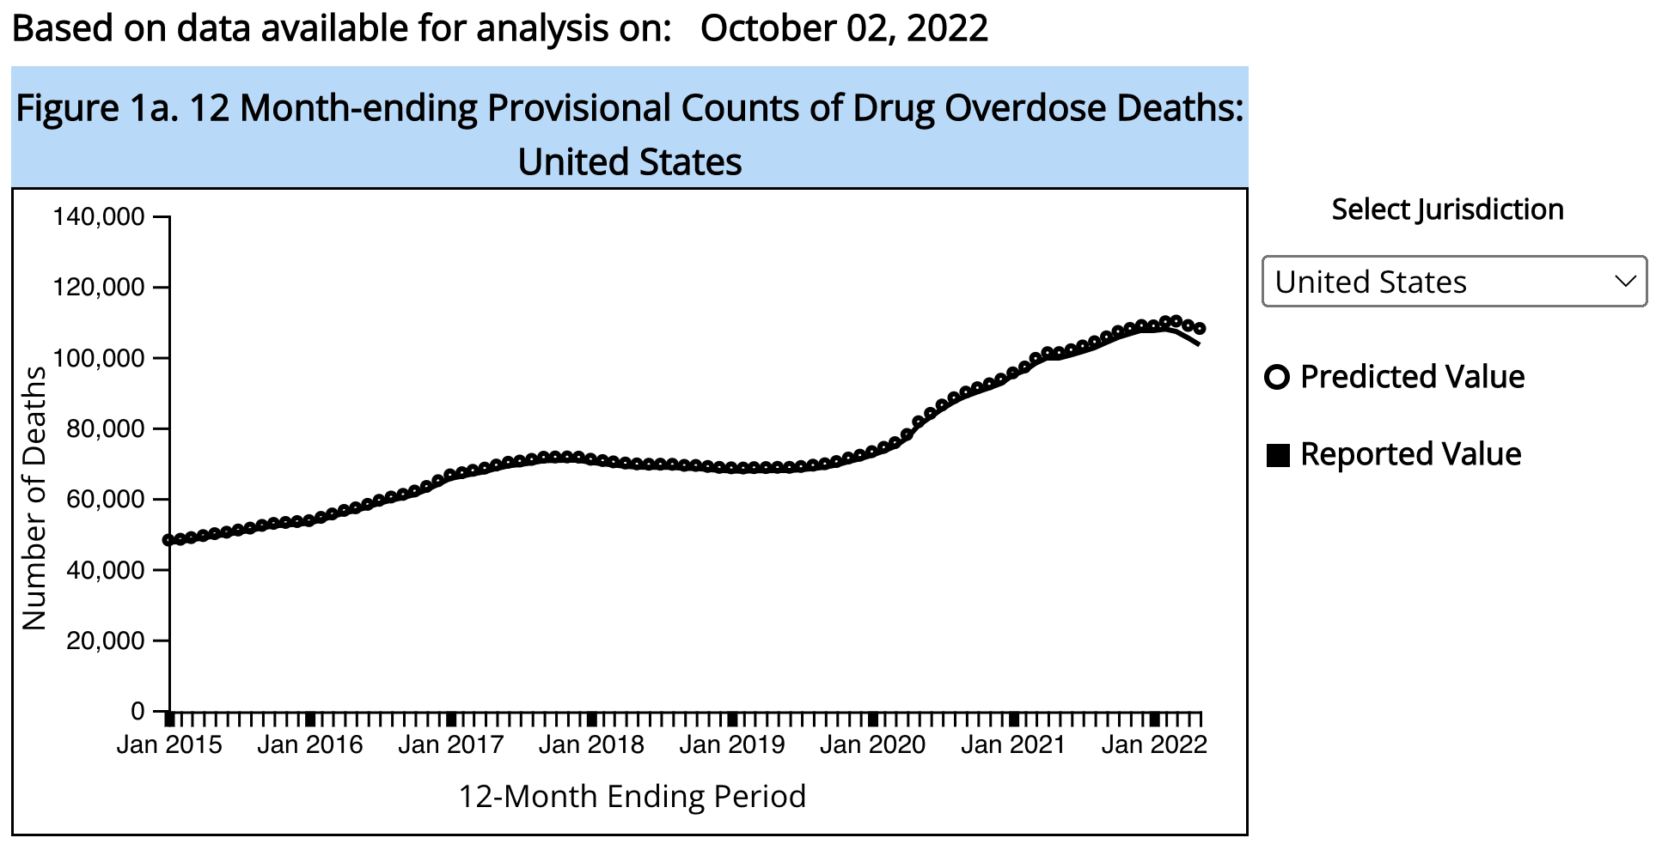
On the rise: overdose
Source: CDC, Vital Statistics
https://www.cdc.gov/nchs/nvss/vsrr/drug-overdose-data.htm
Notes:
I’d like to start by talking about drug overdose—this is a topic that has been heavily covered in the news in recent years because the number of overdose deaths is staggering and the trend over time is very concerning.

Slide 7
On the rise: infections associated with IVDU
Bacterial and fungal infections
Viral infections
HIV
Hepatitis A virus
Hepatitis B virus
Hepatitis C virus
BACTERIAL AND FUNGAL INFECTIONS | VIRAL INFECTIONS
Primary mode of infection: translocation of skin/environmental microbes during injection | Primary mode of infection: transmission of blood-borne viral particles through shared paraphernalia/needles
Present as acute, symptomatic infection | Less frequently present as symptomatic infection
Can cause invasive/complicated disease associated with high morbidity and mortality | Disease process is usually protracted/chronic with late morbidity and mortality
Risk can be mitigated through safe injection practices | Risk can be mitigated through safe injection practices Infection can be prevented through vaccination (HAV, HBV), pre-exposure prophylaxis (HIV)

Slide 8
An illustrative case of a 45 year old female…
Presented to hospital in 2/2020 with fever, malaise, drenching night sweats, and generalized weakness.
PMH: OUD with daily injection heroin use, MDD, pTSD.
Multiple blood cultures grew MRSA.
Echocardiogram demonstrated a large Tricuspid valve mass.
She underwent angiovac® procedure to debulk vegetation from TV and right atrium.
She ultimately left hospital on 3/4/2020 (patient directed).
Presented on 3/5/2020 with primary complaint new, severe back pain.

Slide 9
45 year old female…
BP 119/72 | Pulse 90 | Temp 36.5 °C (97.7 °F) | Resp 19 | SpO2 96% | BMI 26.58 kg/m²
GENERAL: Awake, alert, appears uncomfortable EYES: EOMI, PERRL, no conjunctival injection ENT: Nares clear, MMM, no thrush noted NECK: Supple RESPIRATORY: CTA throughout, breath sounds symmetric CARDIOVASCULAR: Normal rate, regular rhythm, 2/6 systolic murmur at LSB GASTROINTESTINAL: +BS, soft, tender LUQ and RUQ LYMPHATIC: No cervical or supraclavicular LAD MUSCULOSKELETAL: Right hand 4th digit PIP joint with redness, swelling and pain, +TTP over cervical spine EXTREMITIES: No LE edema, pulses 2+ in distal extremities NEUROLOGIC: sensation grossly intact, RLE with ?possible decreased strength to 4/5 though difficult to assess due to back pain
SKIN: Distal LE with numerous petechiae noted

Slide 10
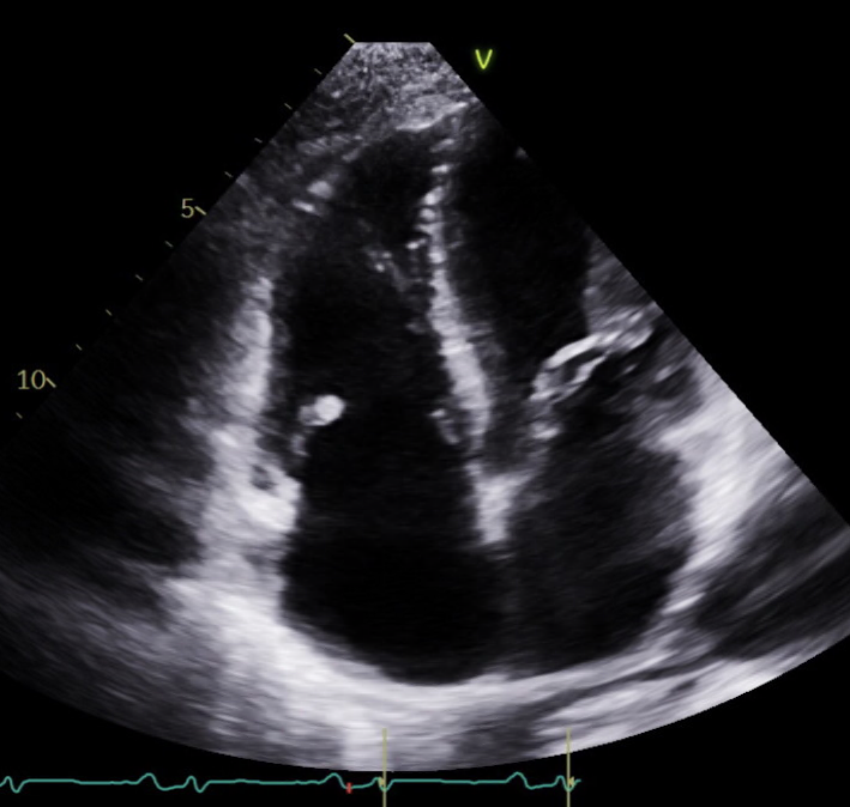
Transthoracic Echocardiogram 3/6/2020
Mobile mass (~1-2 cm) on the anterior leaflet of the tricuspid valve that prolapses back into the RA. Severe tricuspid regurgitation.
RV
Vegetation
Tricuspid valve
RA
Notes:
This is after angiovac

Slide 11
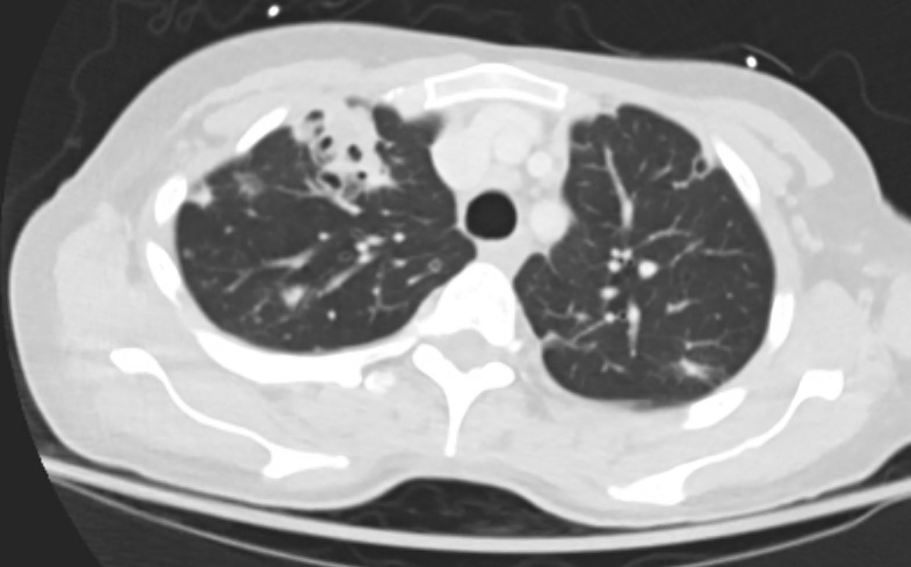
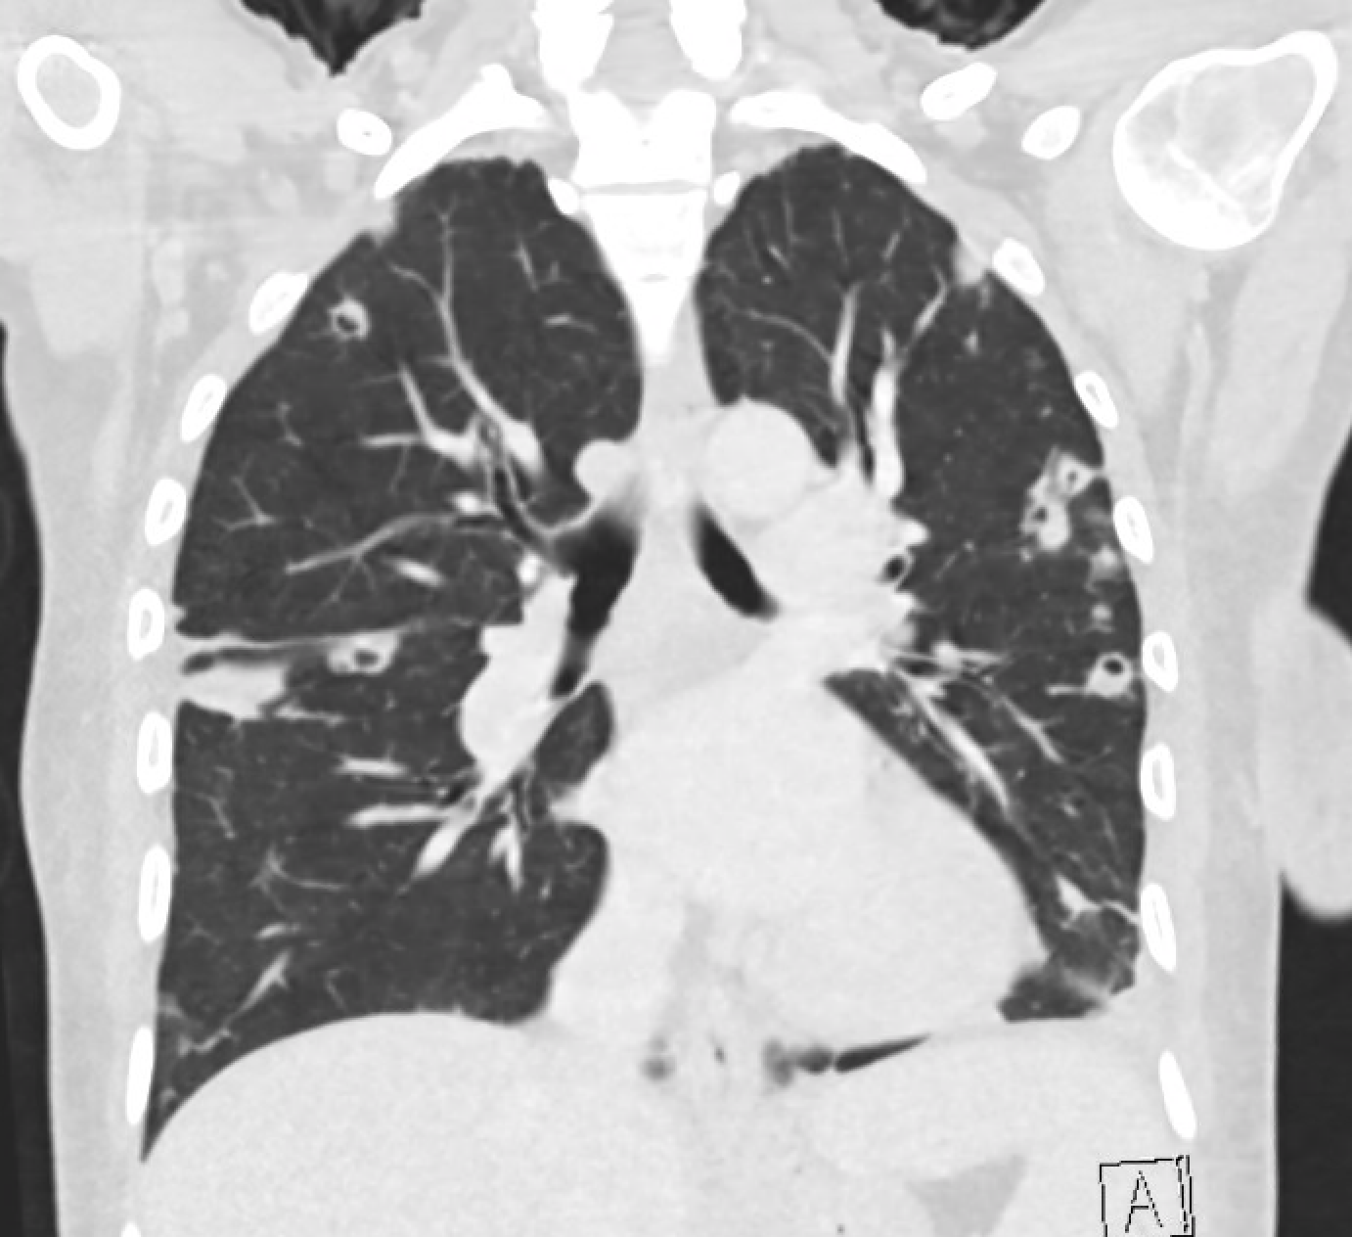
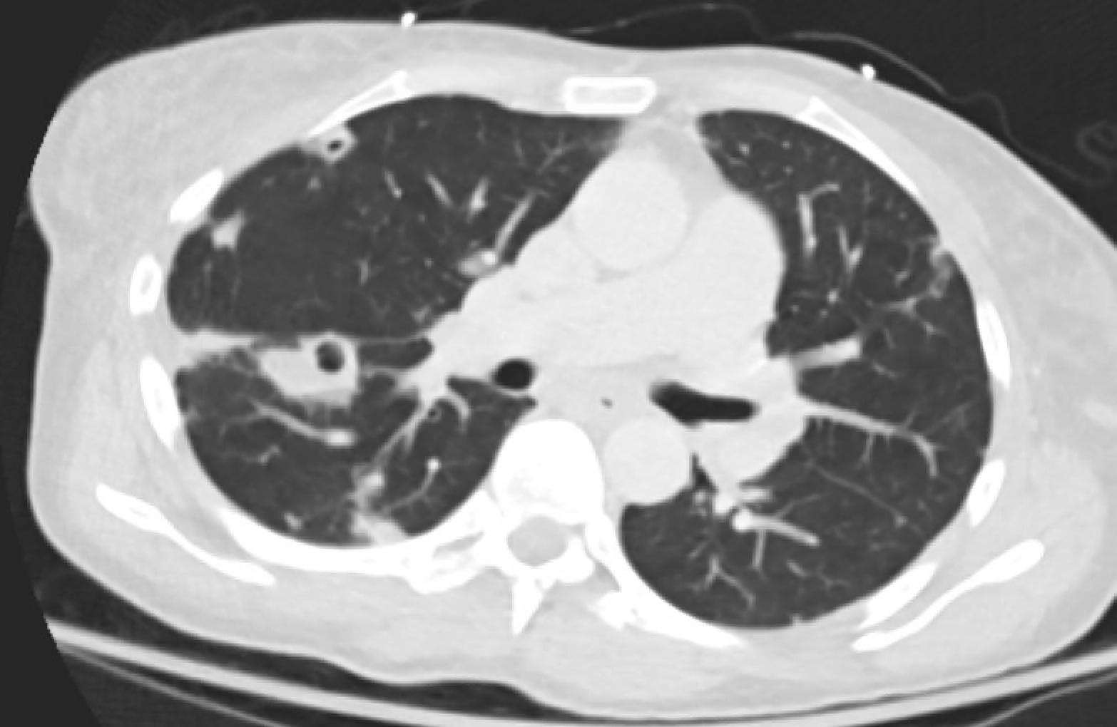
CT chest 3/5/2020

Slide 12
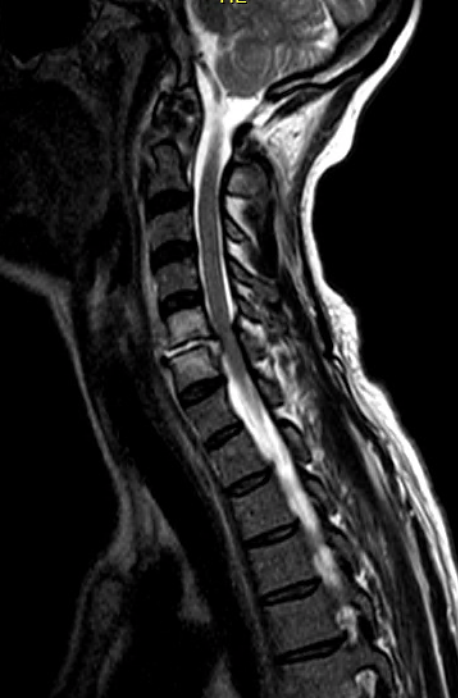
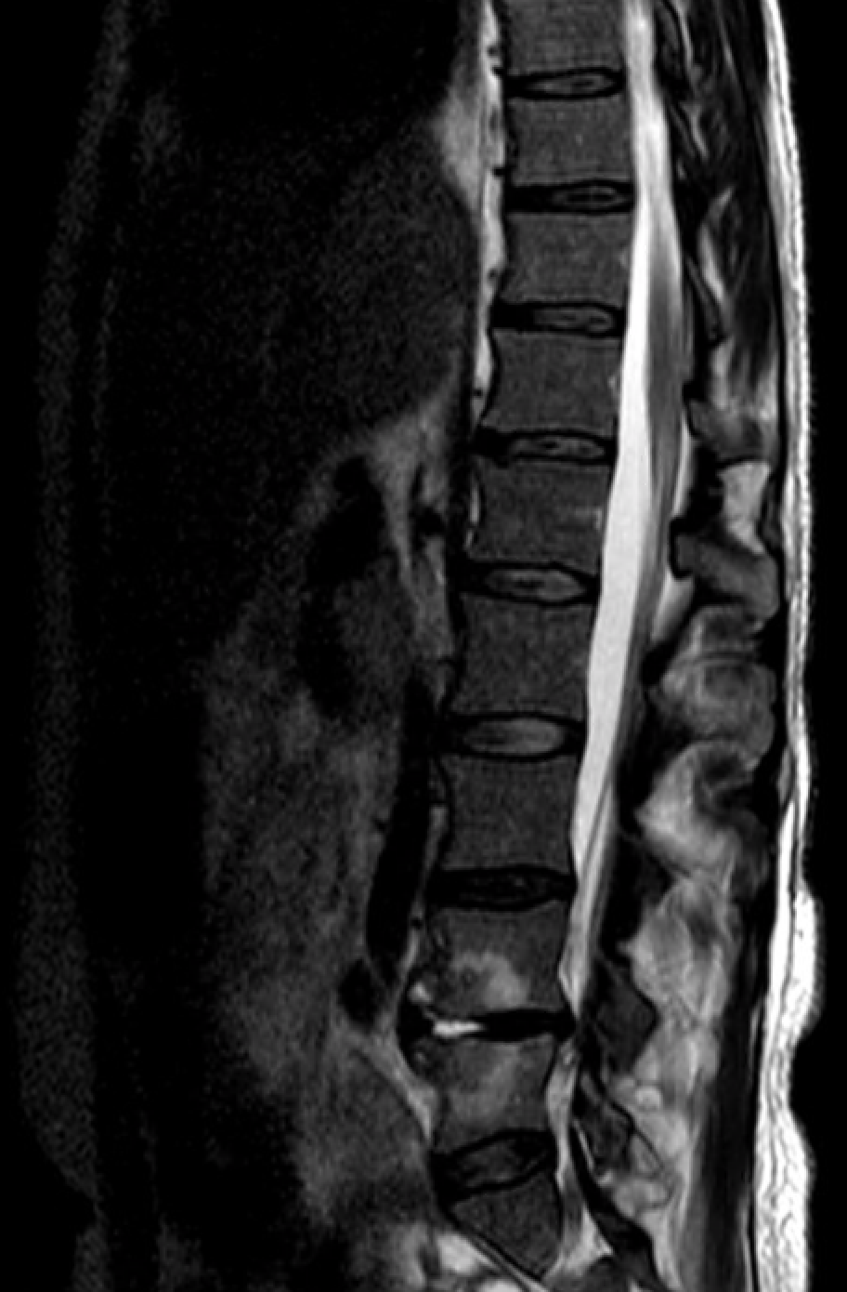
MRI spine 3/5/2020
T2W images
Bone edema of C5, C6 vertebrae
Abnormal C5/6 disc signal with extrusion into anterior epidural space with cord compression
Edema of L4 and L5 vertebral bodies and L4/5 disc

Slide 13
Hospital course
Treated with vancomycin on arrival
3/10/2020 total C5 and C6 corpectomy with anterior spinal fusion (hardware placed)
OR cultures grew MRSA
Rifampin added in setting of new hardware
3/17/2020 Suboxone induction
3/17/2020 AKI (post-infectious glomerulonephritis +/- ATN)
Discharged on 3/26/2020 to complete IV antibiotics in outpatient setting
Addiction clinic intake visit on 3/27/2020

Slide 14
Hospital problem list
OUD, with injection drug use
MRSA native tricuspid valve endocarditis with septic embolic disease to lungs bilaterally (cavitary pneumonia)
MRSA cervical spine osteomyelitis/discitis with epidural abscess and cord compression
MRSA lumbar spine osteomyelitis/discitis
Chronic hepatitis C virus infection
MDD
PTSD

Slide 15
Learning objectives
List the types of infections associated with injection drug use
List the features of infective endocarditis that influence morbidity/risk and describe standard and innovative treatments
Describe recommended testing for viral infections associated with IVDU
Interpret testing results for HCV, HBV, and HAV infections
Describe infection prevention strategies for people who inject drugs

Slide 16
BACTERIAL AND FUNGAL INFECTIONS ASSOCIATED WITH IVDU

Slide 17
Trends: bacterial/fungal infections related to IVDU
National estimates of hospitalizations related to OUD and associated infections, 2002 and 2012
 | 2002 (N = 36,523,831) | 2012 (N = 36,484,846)
 | Number | Number
OUD/dependence | 301,707 | 520,275**
OUD/dependence with infection# | 3,421 | 6,535**
Endocarditis | 2,077 | 3,035*
Osteomyelitis | 458 | 985**
Septic arthritis | 729 | 1,940**
Epidural abscess | 411 | 1,085**
#Infection: endocarditis, osteomyelitis, septic arthritis, or epidural abscess
*p < 0.01; **p < 0.001
Ronan MV, Herzig SJ. Hospitalizations related to opioid abuse/dependence and associated serious infections increased sharply, 2002-12. Health Aff (Millwood) 2016; 35:832–7.
Notes:
This study examined 36 billion discharges over 10 years (spanning 2002-2012) and found a significant increase in the number of patients with OUD as well as concomitant OUD and serious bacterial infection including endocarditis, OM, septic arthritis, and epidural abscess.
Ronan MV, Herzig SJ. Hospitalizations related to opioid abuse/dependence and associated serious infections increased sharply, 2002-12. Health Aff (Millwood) 2016; 35:832–7.
.Emory University Rollins School of Public Health, Gilead Sciences. AIDSVu home page (http://www.aidsvu.org. opens in new tab).
Google Scholar
Peters PJ﻿, Pontones P﻿, Hoover KW﻿, et al; Indiana HIV Outbreak Investigation Team. HIV infection linked to injection use of oxymorphone in Indiana, 2014-2015. ﻿ N Engl J Med. 2016;375(3):229-239. doi:10.1056/NEJMoa1515195
Integration of care for HIV and opioid use disorder
Oldfield, Benjamin J ; Muñoz, Nicolas ; McGovern, Mark P ; Funaro, Melissa ; Villanueva, Merceditas ; Tetrault, Jeanette M ; Edelman, E. Jennifer
England: Ovid Technologies (Wolters Kluwer Health)
AIDS (London), 2019, Vol.33 (5), p.873-884
Opioids and Infectious Diseases: A Converging Public Health Crisis
Schwetz, Tara A ; Calder, Thomas ; Rosenthal, Elana ; Kattakuzhy, Sarah ; Fauci, Anthony S
United States: Oxford University Press (OUP)
The Journal of infectious diseases, 2019, Vol.220 (3), p.346-349

Slide 18
Trends: bacterial/fungal infections related to IVDU
Incidence of SUD-associated infective endocarditis
The incidence of IE among PWID ranges between 2-5% per year.
The proportion of IE admissions attributed to IVDU increased from 15 to 29% between 2010-2015.
Fleischauer AT, Ruhl L, Rhea S, Barnes E. Hospitalizations for Endocarditis and Associated Health Care Costs Among Persons with Diagnosed Drug Dependence — North Carolina, 2010–2015. MMWR Morb Mortal Wkly Rep 2017;66:569–573. DOI: http://dx.doi.org/10.15585/mmwr.mm6622a1
Shmueli et al., Right-Sided Infective Endocarditis 2020: Challenges and Updates in Diagnosis and Treatment, JAHA 2020.
Notes:
Looking at rates of endocarditis associated with substance use, we have seen a marked increase in incidence, particularly among younger patients (age 26-40). Note that this observation period ends in 2015—these curves have no doubt continued on this upward trajectory.

Slide 19
Learning objectives
List the types of infections associated with injection drug use
List the features of infective endocarditis that influence morbidity/risk and describe standard and innovative treatments
Describe recommended testing for viral infections associated with IVDU
Interpret testing results for HCV, HBV, and HAV infections
Describe infection prevention strategies for people who inject drugs

Slide 20
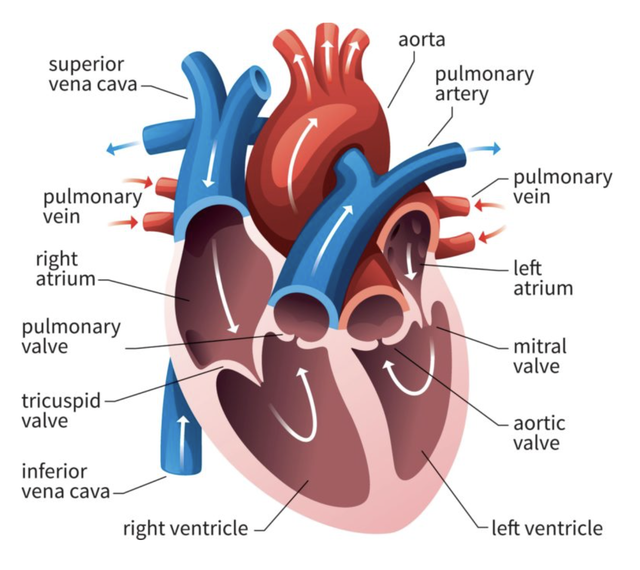
Infective endocarditis (IE): general principles
Risk increased for:
Left-sided (mitral or aortic valve) iE
Prosthetic valve endocarditis
Difficult-to-treat organisms (S. aureus, drug-resistant bacteria, fungi)
Treatment:
4-6 weeks of IV antibiotics
Sometimes surgical management
Valve replacement or repair
Antibiotic prophylaxis for dental procedures (lifelong)
Image credit: https://www.cardofmich.com
Notes:
Risk:
-Lower mordbidity and mortality associated with RIGHT-sided IE
--more easily treated with abx alone
--embolic disease less likely to reach critical structure (i.e., brain)
--TV dysfunction better tolerated than MV or AoV dysfunction [TV regurg: peripheral edema, fatigue; MV or AoV regurg: pulm edema/hypoxia]
--majority of IVDU-associated IE cases involve the tricuspid valve (estimates 70-90%)
--Repeated IVDU can lead to structural abnormalities of the TV including focal thickening, valve prolapse, and regurgitation
PVE: can be complicated by myocardial invasive infection/abscess and valve dehiscence

Slide 21
Infective endocarditis (IE): guidelines
INDICATIONS FOR EARLY VALVE SURGERY:
Symptoms of heart failure
Conduction block
Persistent bacteremia despite appropriate antibiotics
Annular or aortic abscess
Destructive penetrating myocardial lesions
Recurrent septic emboli and persistent vegetations despite appropriate antibiotic therapy
Mobile vegetations that are >1 cm
Left-sided IE caused by S aureus, multidrug-resistant bacteria, or fungi
“Although there is no evidence that indications for valve surgery are different for PWID with IE than for patients who do not inject drugs and have IE, the application of these indications in PWID has been heterogeneous.” [Baddour et al., Circulation 2022]
Baddour et al., Infective Endocarditis in Adults: Diagnosis, Antimicrobial Therapy, and Management of Complications, Circulation 132:1435-1486. 2015.
Otto et al., 2020 ACC/AHA Guideline for the Management of Patients With Valvular Heart Disease: A Report of the American College of Cardiology/American Heart Association Joint Committee on Clinical Practice Guidelines, J Am Coll Cardiol. 77(4):e25-e197. 2021

Slide 22
Infective endocarditis (IE): guidelines
“It is reasonable to avoid surgery when possible in patients who are IDUs…”
2015 guidelines document
“In patients with recurrent endocarditis and continued intravenous drug use, consultation with addiction medicine is recommended to discuss long-term prognosis for the patient’s refraining from actions that risk reinfection before repeat surgical intervention is considered.”
2020 ACC/AHA Guideline for the Management of Patients with Valvular Heart Disease
Baddour et al., Infective Endocarditis in Adults: Diagnosis, Antimicrobial Therapy, and Management of Complications, Circulation 132:1435-1486. 2015.
Otto et al., 2020 ACC/AHA Guideline for the Management of Patients With Valvular Heart Disease: A Report of the American College of Cardiology/American Heart Association Joint Committee on Clinical Practice Guidelines, J Am Coll Cardiol. 77(4):e25-e197. 2021

Slide 23
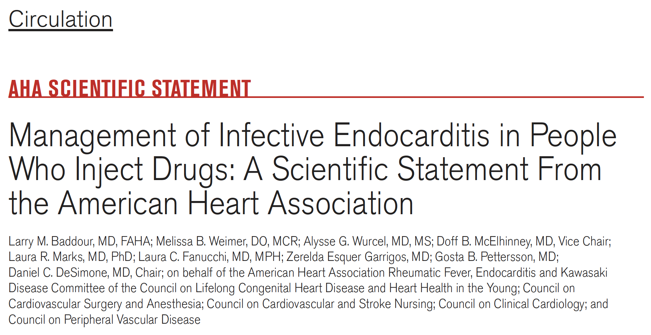
Writing group comprised of experts from ID, Internal Medicine, Addiction Medicine, CV Surgery
Audience: “Frontline clinicians”
Baddour et al., Management of Infective Endocarditis in People Who Inject Drugs: A Scientific Statement From the American Heart Association, Circulation 2022.

Slide 24
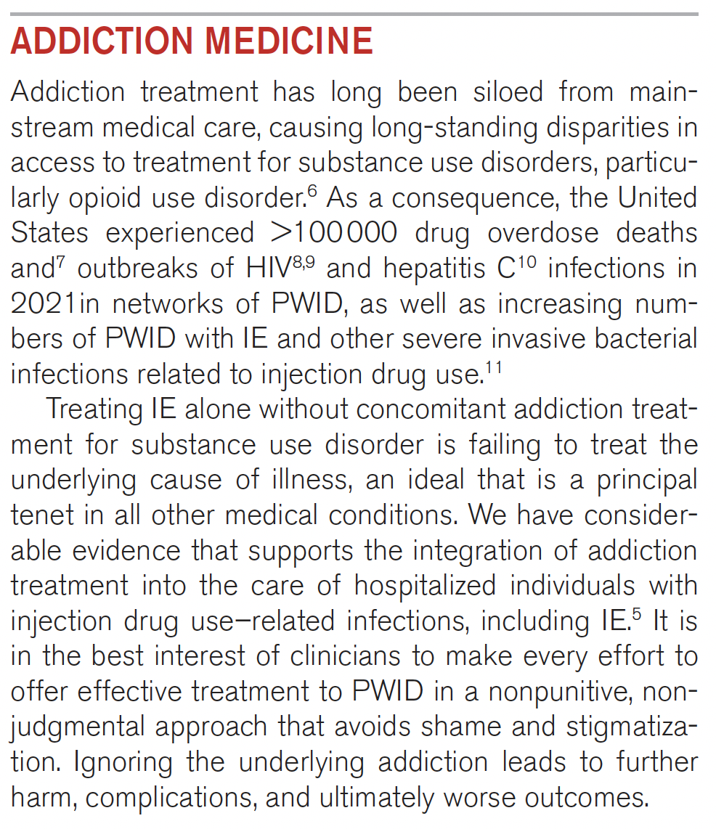
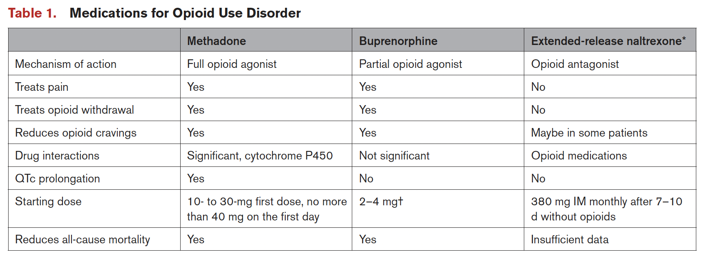
Baddour et al., Management of Infective Endocarditis in People Who Inject Drugs: A Scientific Statement From the American Heart Association, Circulation 2022.

Slide 25
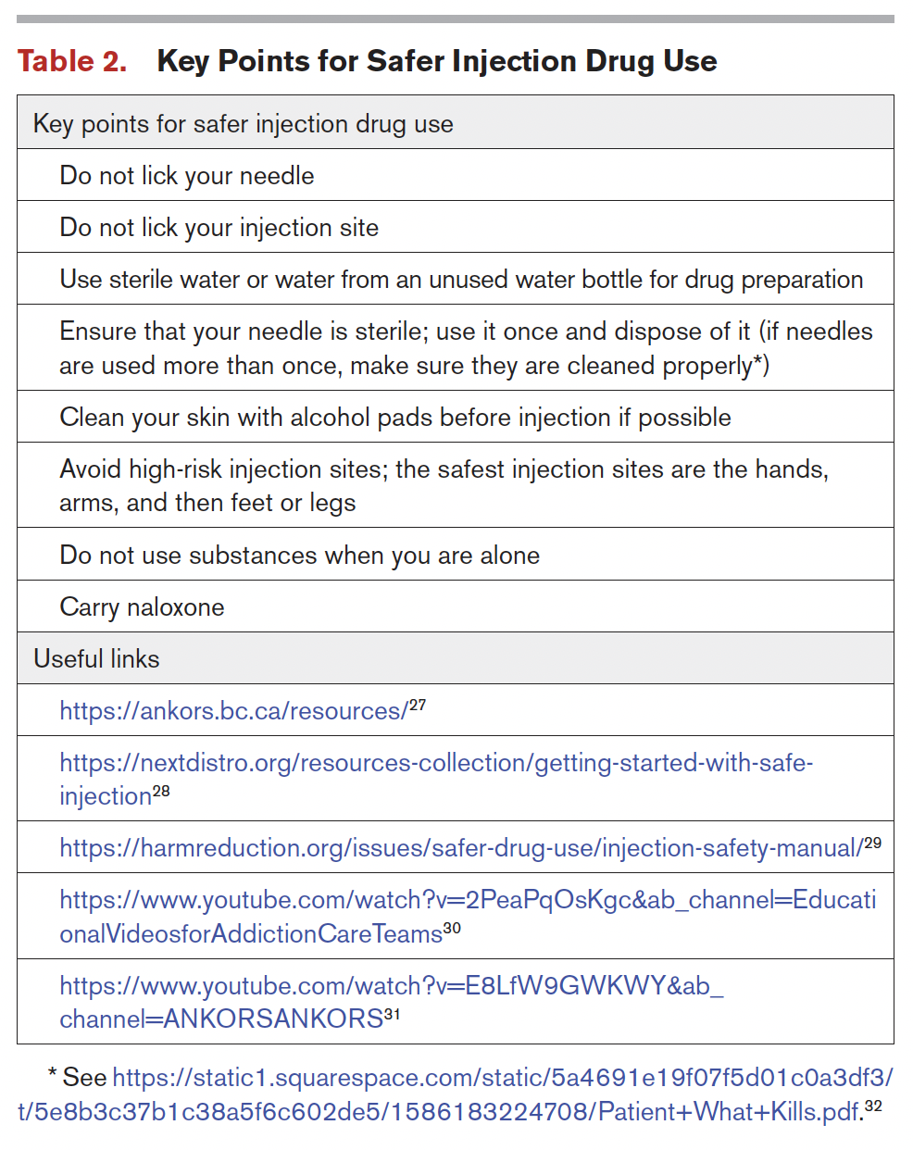
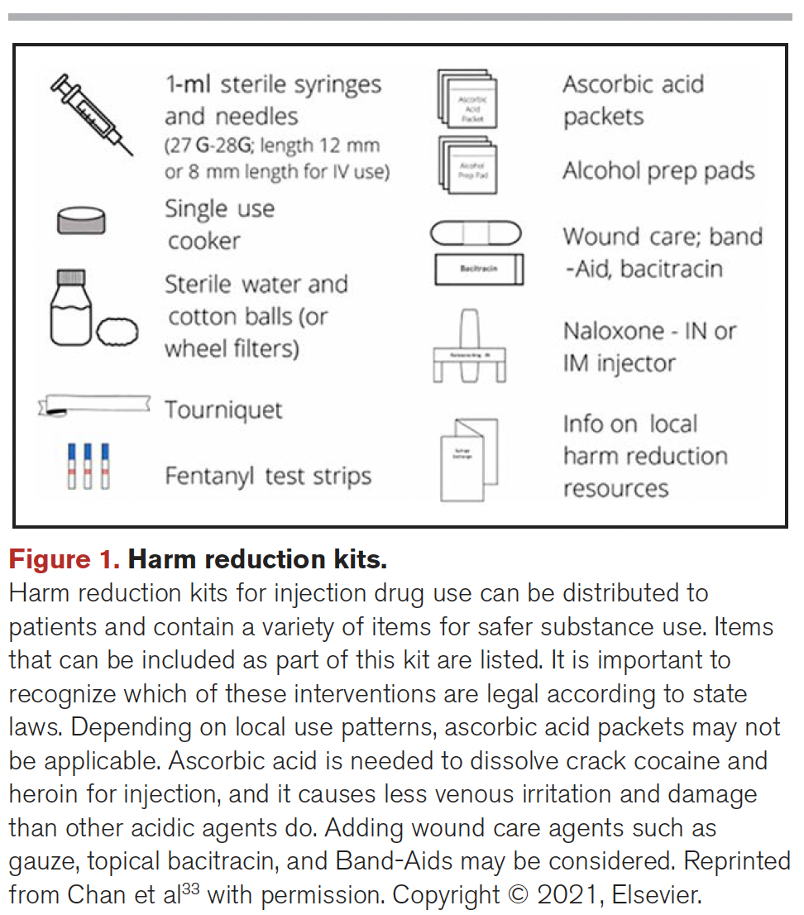
Baddour et al., Management of Infective Endocarditis in People Who Inject Drugs: A Scientific Statement From the American Heart Association, Circulation 2022.

Slide 26
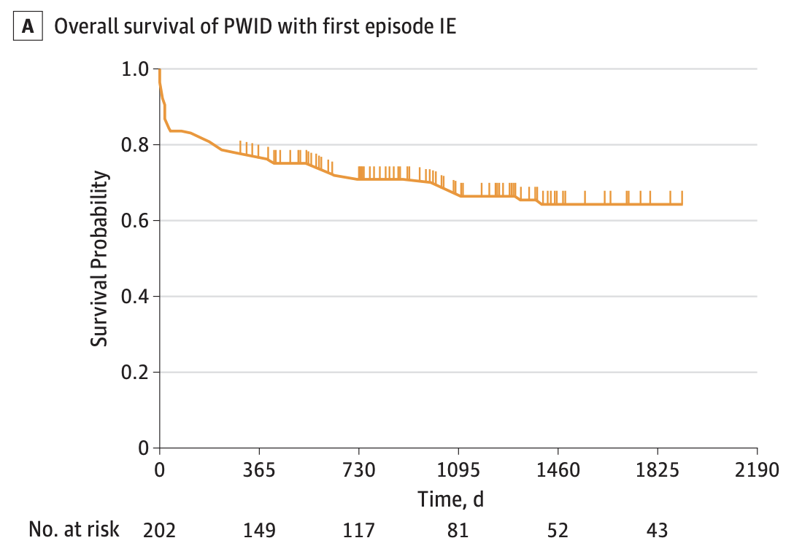
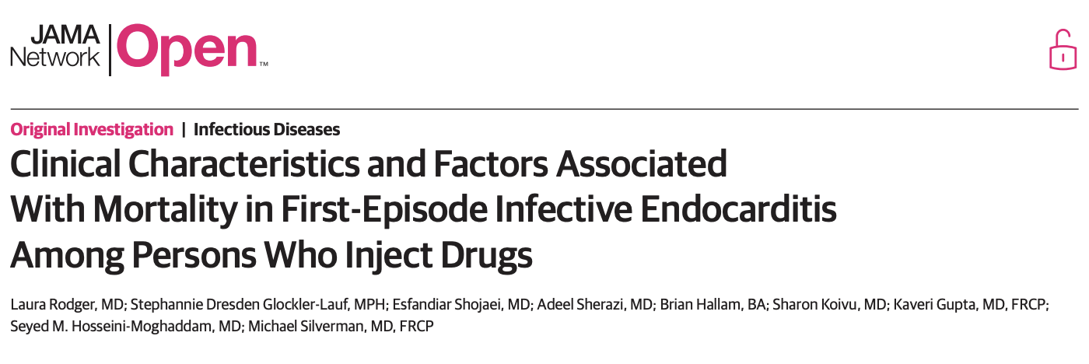
PWID IE: long-term outcomes
Case series of PWID with first-episode IE (Canada)
N = 202
Observation period: 4/1/2007 – 3/30/2016
61.4% of IE was right-sided
Overall mortality rate = 33.7%
1 year
2 years
3 years
4 years
5 years
6 years
Rodger et al., JAMA Open Network. 2018.
Notes:
There are few studies examining longer term outcomes for PWID with endocarditis

Slide 27
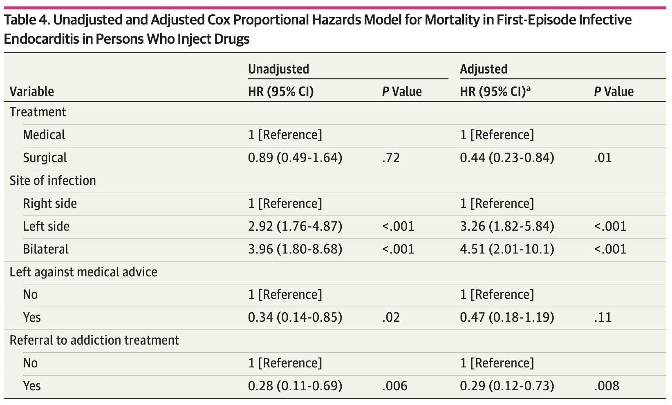
PWID IE: long-term outcomes
SURGERY VS NO SURGERY
Surgery performed in 19.3% of IE
56% of surgeries were for left-sided infection
Survival was not significantly different for surgery vs no surgery at observation up to 1 year
ALL CAUSE MORTALITY
Lower mortality
Surgery
Referral to addiction treatment
Higher mortality
Left-sided infection
Rodger et al., JAMA Open Network. 2018.
Notes:
Adjusted for age and sex

Slide 28
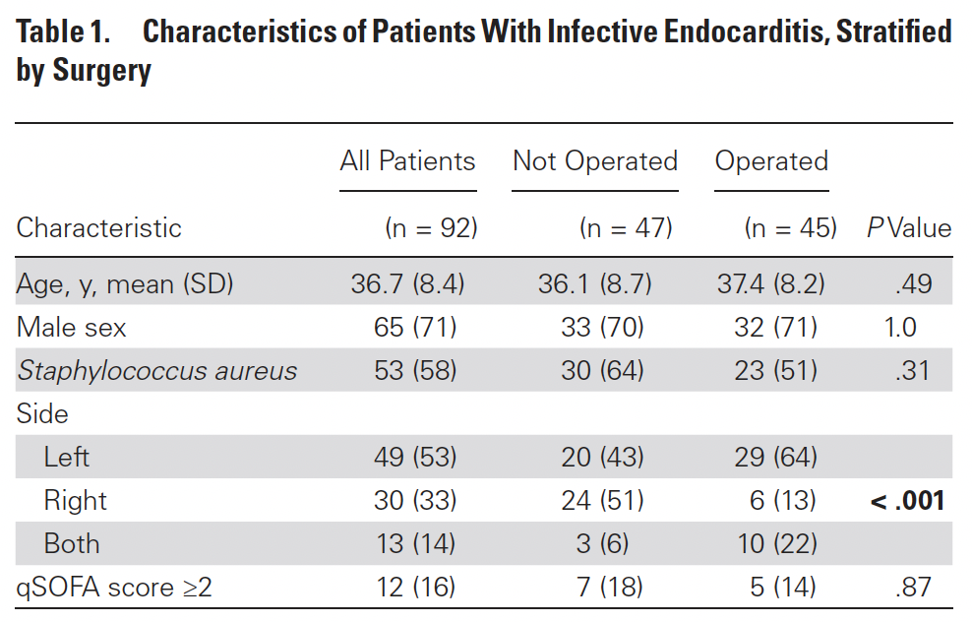
PWID IE: long-term outcomes
Prospective, observational cohort study (UK)
PWID with IE (n = 92)
PWID with other infection (but no IE; n = 107)
Observation period: 1/2006 – 12/2016
Primary outcome:
All-cause mortality at 30d; 1, 3, 5, and 10 years
Focus: Effect of surgery on long-term outcomes
Surgery performed in 47% of IE episodes.
Straw et al., CID. 2019.
Notes:
Few studies have reported long-term outcomes for PWID with IE
First study to report survival rates based on surgery
Note that their cohort had a higher proportion of L-sided IE (not in keeping with other estimates of PWID-IE)
Surgery performed in 45 of 92 IE episodes (47%)

Slide 29
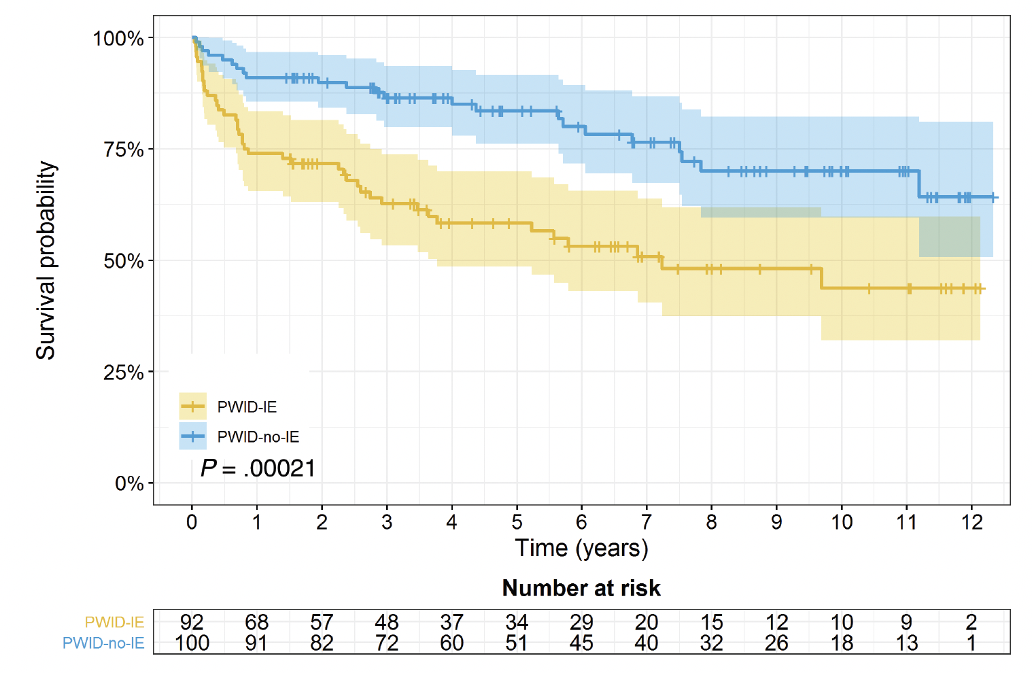
PWID IE: long-term outcomes
SURVIVAL OF PWID WITH IE VS OTHER INFECTIONS
30-day mortality for PWID with IE was 15% (surgical mortality 8.5%)
Long-term survival is significantly reduced following an episode of IE compared to other infections
Less than 50% of PWID with IE were alive at 10-year post infection
Straw et al., CID. 2019.
Notes:
Few studies have reported long-term outcomes for PWID with IE
First study to report survival rates based on surgery
Note that their cohort had a higher proportion of L-sided IE (not in keeping with other estimates of PWID-IE)
Surgery performed in 45 of 92 IE episodes (47%)

Slide 30
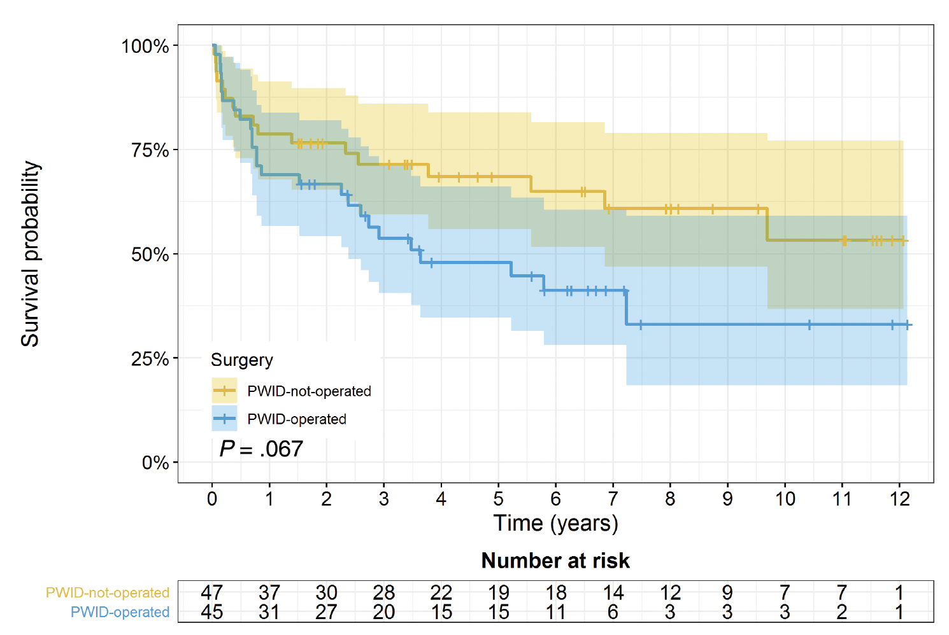
PWID IE: long-term outcomes
SURVIVAL OF PWID WITH IE
Stratified by operated vs not operated
Trend toward reduced survival in the operated group
Of the 42 deaths in the PWID-IE group:
Cause of death identified for 38 patients
21 deaths due to IE
6 deaths due to overdose
4 deaths due to another infection
Straw et al., CID. 2019.
Notes:
Few studies have reported long-term outcomes for PWID with IE
First study to report survival rates based on surgery
Note that their cohort had a higher proportion of L-sided IE (not in keeping with other estimates of PWID-IE)
Surgery performed in 45 of 92 IE episodes (47%)

Slide 31
LIMITATIONS:
Predominance of left-sided heart disease
Disease severity at outset for patients who underwent surgery
DID NOT collect data on specific SUD services provided
Straw et al., CID. 2019.
Notes:
Still, this study does merit discussion and the associated editorial was pointed in noting that the primary findings—less than 50% of patients who inject drugs and have endocarditis survived ten years should serve as a wake-up call across the board as to the extreme threat of injection drug-related endocarditis and should motivate us all to define best practices that incorporate the expertise of addiction medicine, ID, and cardiac surgery to best care for our patients.

Slide 32
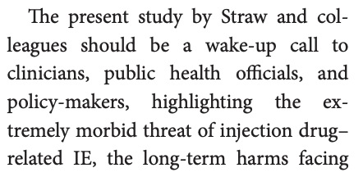
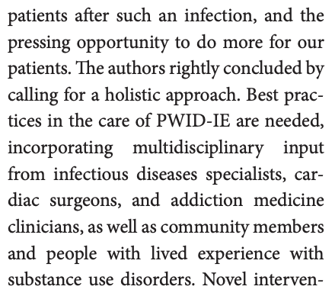
LIMITATIONS:
Predominance of left-sided heart disease
Disease severity at outset for patients who underwent surgery
DID NOT collect data on specific SUD services provided
Straw et al., CID. 2019.
Notes:
Still, this study does merit discussion and the associated editorial was pointed in noting that the primary findings—less than 50% of patients who inject drugs and have endocarditis survived ten years should serve as a wake-up call across the board as to the extreme threat of injection drug-related endocarditis and should motivate us all to define best practices that incorporate the expertise of addiction medicine, ID, and cardiac surgery to best care for our patients.

Slide 33
Learning objectives
List the types of infections associated with injection drug use
List the features of infective endocarditis that influence morbidity/risk and describe standard and innovative treatments
Describe recommended testing for viral infections associated with IVDU
Interpret testing results for HCV, HBV, and HAV infections
Describe infection prevention strategies for people who inject drugs

Slide 34
OPAT: outpatient parenteral antibiotic therapy
WHY CONSIDER OPAT FOR PWID?
Better for some patients
More restorative environment at discharge
Opportunity for treatment for SUD without delay in care
Patients do not receive SUD treatment beyond Medication for Opioid Use Disorder (MOUD) at SNF
Opportunity for the patient to participate in his/her health care, leads to empowerment in early phases of recovery
Hospital/SNF days saved
Decreased risk of health care acquired infection

Slide 35
OPAT: outpatient parenteral antibiotic therapy
OPAT IN PWID VS NON-PWID
PWID = People Who Inject Drugs
Outcomes | PWID | Non-PWID
Experience | N = 800, 10 studies | N = >60,000
Treatment completion | 72-100% (>80% in 9/10 studies) | 80-90%
Deaths | N = 8; 1% of total, 0-10% per study | 0.1 – 0.4%
Readmission | ~20% | 3.6 – 12.6% (but 15.3 – 36% for SSTI, IE, OM)
PICC-related complications | 0.75 – 4.2 per 1,000 line days | 3.2 – 5.3 per 1,000 line days
PICC misuse | Very low rates (2% in 1/10 studies) | unreported
Other observations: OPAT in PWID is increasingly common: 84% of OPAT centers internationally provide to PWID
Cost savings: estimated ~$11,000-25,000 per OPAT episode
Suzuki et al., 2018 meta-analysis

Slide 36
OPAT: outpatient parenteral antibiotic therapy
PWID: OPAT VS SNF
TABLE 2: OUTCOMES OF PATIENTS DISCHARGED TO HOME VERSUS REHABILITATION
 | Discharged to Home (n=21) | Discharged to SNF/IPR (n=31) | P-value (Fisher’s exact test)
Any complication | 4 | 11 | 0.23
Line complication | 1 | 5 | 0.38
Injection drug use relapse | 1 | 5 | 0.38
Loss to follow-up | 1 | 4 | 0.64
Readmission | 3 | 9 | 0.72
Death | 1 | 0 | 0.40
D’Couto et al., 2018
Notes:
No difference across multiple metrics related to discharge disposition

Slide 37
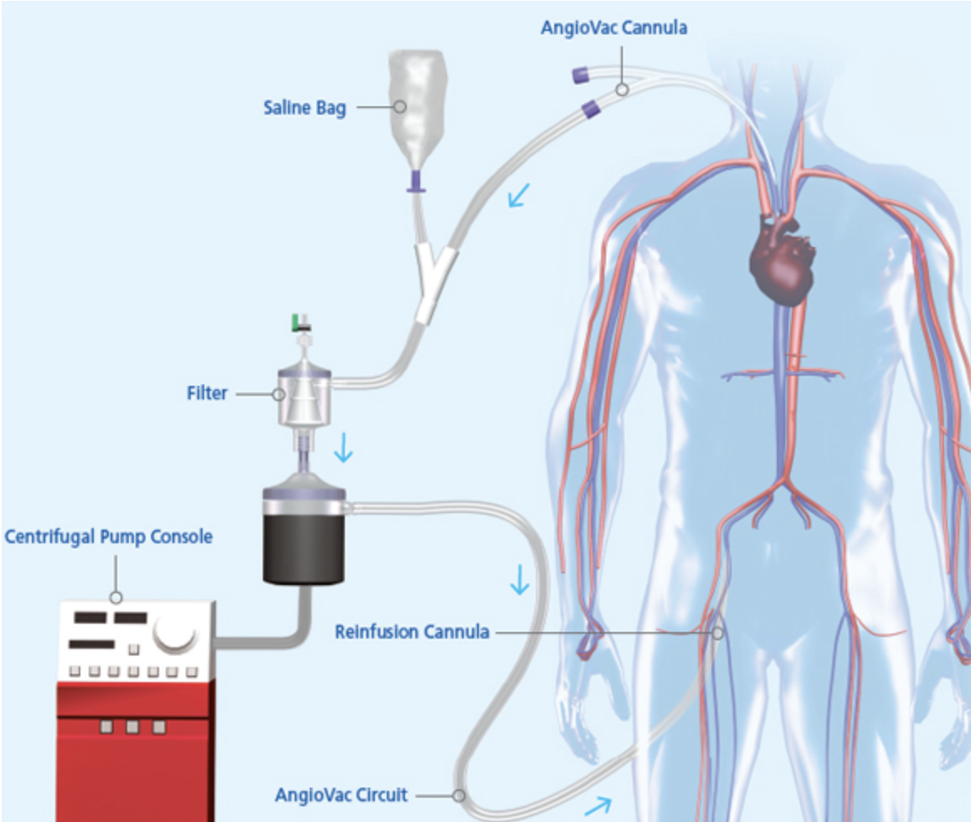
Aspiration vegectomy with veno-venous bypass
ANGIOVAC (Angiodynamics, USA)
FDA approved in 2014 for removal of intravascular thrombi
System:
Venous drainage cannula
Venous return cannula
Connected by vacuum system with bubble filter
Notes:
So we have established that endocarditis in PWID is a hard problem. Are their novel approaches to improve management?
There are a few treatment innovations that I think warrant discussion here—starting with a minimally invasive strategy to “debulk” right-sided vegetations

Slide 38
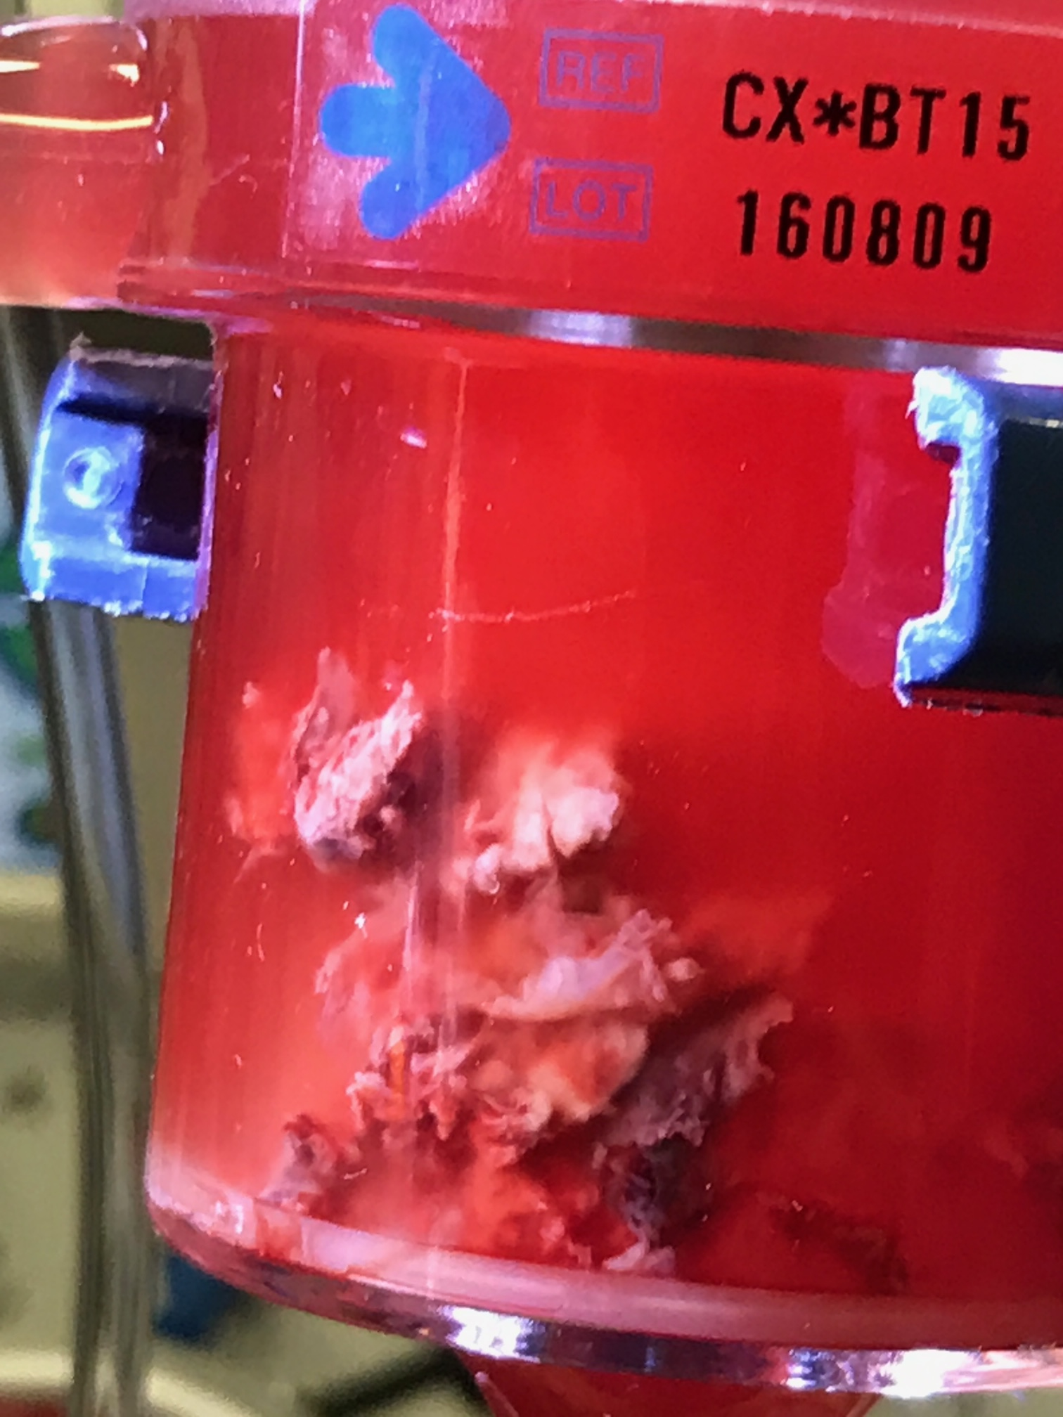
Aspiration vegectomy with veno-venous bypass
ANGIOVAC (Angiodynamics, USA)
FDA approved in 2014 for removal of intravascular thrombi
System:
Venous drainage cannula
Venous return cannula
Connected by vacuum system with bubble filter
Photo courtesy of
Dr. Travis Richardson
Notes:
So we have established that endocarditis in PWID is a hard problem. Are their novel approaches to improve management?
There are a few treatment innovations that I think warrant discussion here—starting with a minimally invasive strategy to “debulk” right-sided vegetations

Slide 39
Aspiration vegectomy with veno-venous bypass
ANGIOVAC FOR RIGHT-SIDED VEGETATIONS AS PART OF SURGICAL-SPARING MANAGEMENT OF RIGHT-SIDED IE:
George et al.: 33 patients with TV IE underwent debulking of large vegetations (2.1 +/- 0.7 cm) with reduction of vegetation size observed in 61% of cases and 91% patients discharged home.
Parmar et al.: case report of a 49-year-old PWID with a 2.5 x 1.2 cm MSSA TV vegetation who underwent Angiovac thrombectomy. Residual vegetation was 0.8 x 0.6 cm vegetation and the patient was successfully treated with antibiotics.
Schaerf et al.: 20 patients with device-related IE treated with Angiovac and antibiotics; all with resolution of infection.
Starck et al.: case report of a 57-year-old patient with ESRD on HD, GI bleed, and a 1.2 x 1.7 cm MSSA TV vegetation who underwent Angiovac thrombectomy. Remained septicemic following procedure and ultimately underwent TVR.
Abubakar et al.: case report of a 33-year-old PWID with a 3 x 1.5 cm S. pyogenes TV vegetation and persistent septicemia who underwent Angiovac thrombectomy with 50-60% reduction in vegetation size. The patient completed six weeks of antibiotics and was without signs/symptoms of infection at one-month follow-up.
Full citations available on request
Notes:
Angiovac has not been formally recommended as part of treatment for right-sided endocarditis, it has been studied in a handful of case reports and case series and the data are promising.
The role of angiovac as a beneficial treatment for TV endocarditis has strong biologic and epidemiologic plausibility: 1) we know that many cases of right-sided can be cured with abx alone and source control is a general predictor of response to success with medical management and 2) TV repair/replacement is associated with significant risks

Slide 40
Aspiration vegectomy with veno-venous bypass
ANGIOVAC FOR RIGHT-SIDED VEGETATIONS AS PART OF SURGICAL-SPARING MANAGEMENT OF RIGHT-SIDED IE:
Risks:
Procedural
Increased incidence of septic pulmonary emboli
Estimated to occur 35-55% of cases with vegetations >1 cm
Does not address valve dysfunction
Can worsen tricuspid regurgitation
Shmueli et al., Right-Sided Infective Endocarditis 2020: Challenges and Updates in Diagnosis and Treatment, JAHA 2020.
Notes:
That said, there are risks and caveats to consider.

Slide 41
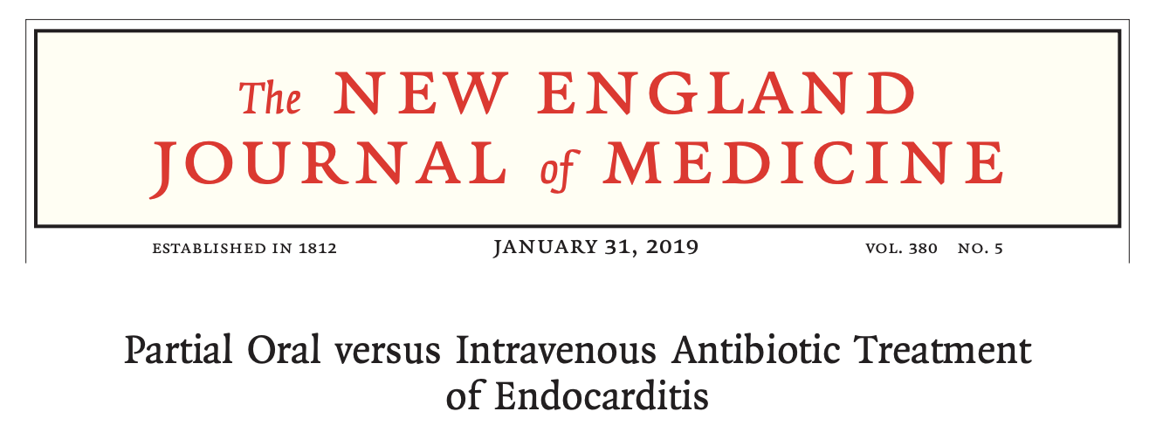
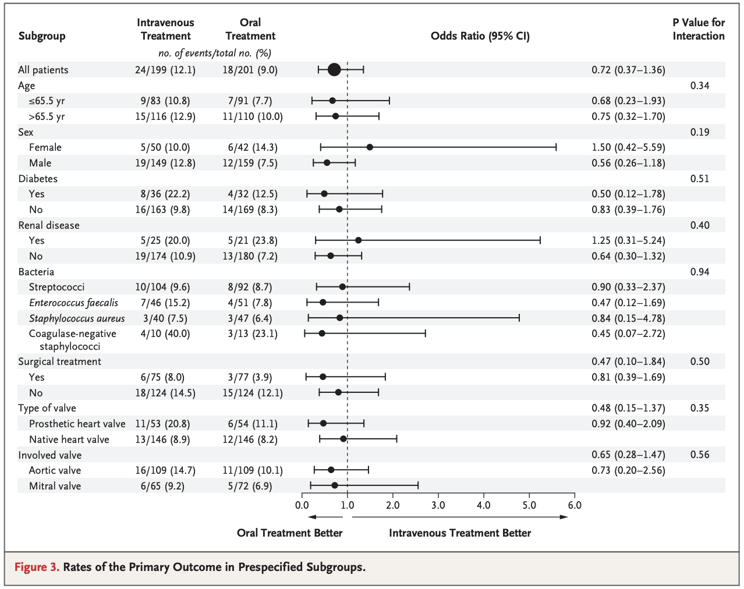
Partial oral antibiotic treatment
POET trial (2019)
Randomized, noninferiority trial
400 adults with left-sided IE in stable condition
Streptococcus, E faecalis, MSSA, CoNS (NO MRSA)
Study arms:
IV antibiotics for six weeks (standard)
IV antibiotics for ~10 days with transition to PO antibiotics to complete six week course
Primary outcome: composite all cause mortality, unplanned cardiac surgery, embolic events, or relapsed bacteremia
Observation period: six months post treatment completion
Notes:
The take-home message was that transition to oral abx in selected patients was non-inferior to standard all-IV treatment. Data even suggested a possible signal toward better outcomes with partial oral treatment (not significant)

Slide 42
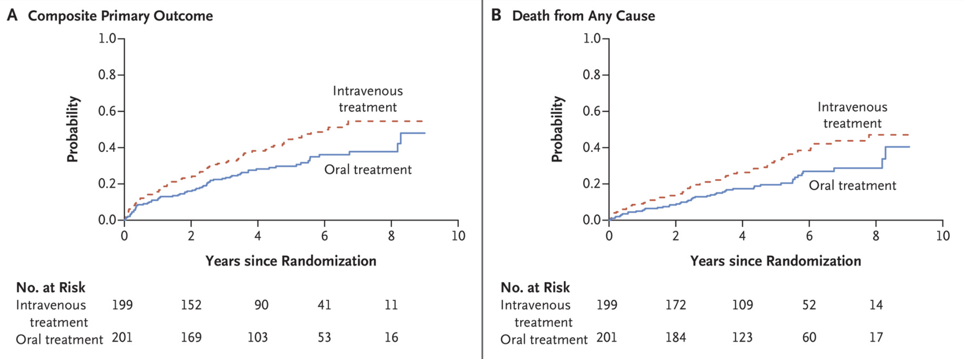
Partial oral antibiotic treatment
Primary outcome: composite all cause mortality, unplanned cardiac surgery, embolic events, or relapsed bacteremia
NEJM February 10, 2022
Notes:
Based on some study limitations that limited generalizability (namely, very stable patients and no MRSA infections included), we have not adopted early transition as a mainstay of care.
However, the POET study team published five-year follow-up data for this cohort last month. Again, the oral abx group is doing pretty well—potentially with a signal toward improved outcomes. Very cool as late relapsed infection was a primary concern early on.
For now, you might see ID recommend transition in selected patients—including patients with barriers to full IV treatment. We will see if these latest updated data influence practice more broadly.

Slide 43
Bacterial and Fungal Infections in Pwid
Blood stream infection: S. aureus, Streptococcal, gram negative bacteria, Candida spp., *polymicrobial
Septic arthritis, osteomyelitis
Epidural Abscess
Skin and Soft Tissue: abscesses, necrotizing fasciitis, tenosynovitis
Antimicrobial duration depends on site/type of infection
Often requires combined medical/surgical approach
Always more complicated when Hardware is involved or placed

Slide 44
Learning objectives
List the types of infections associated with injection drug use
List the features of infective endocarditis that influence morbidity/risk and describe standard and innovative treatments
Describe recommended testing for viral infections associated with IVDU
Interpret testing results for HCV, HBV, and HAV infections
Describe infection prevention strategies for people who inject drugs

Slide 45
VIRAL
INFECTIONS ASSOCIATED WITH IVDU

Slide 46
Viral Infections associated with injection drug use
Hepatitis C virus
Hepatitis A virus
Hepatitis B virus
HIV

Slide 47
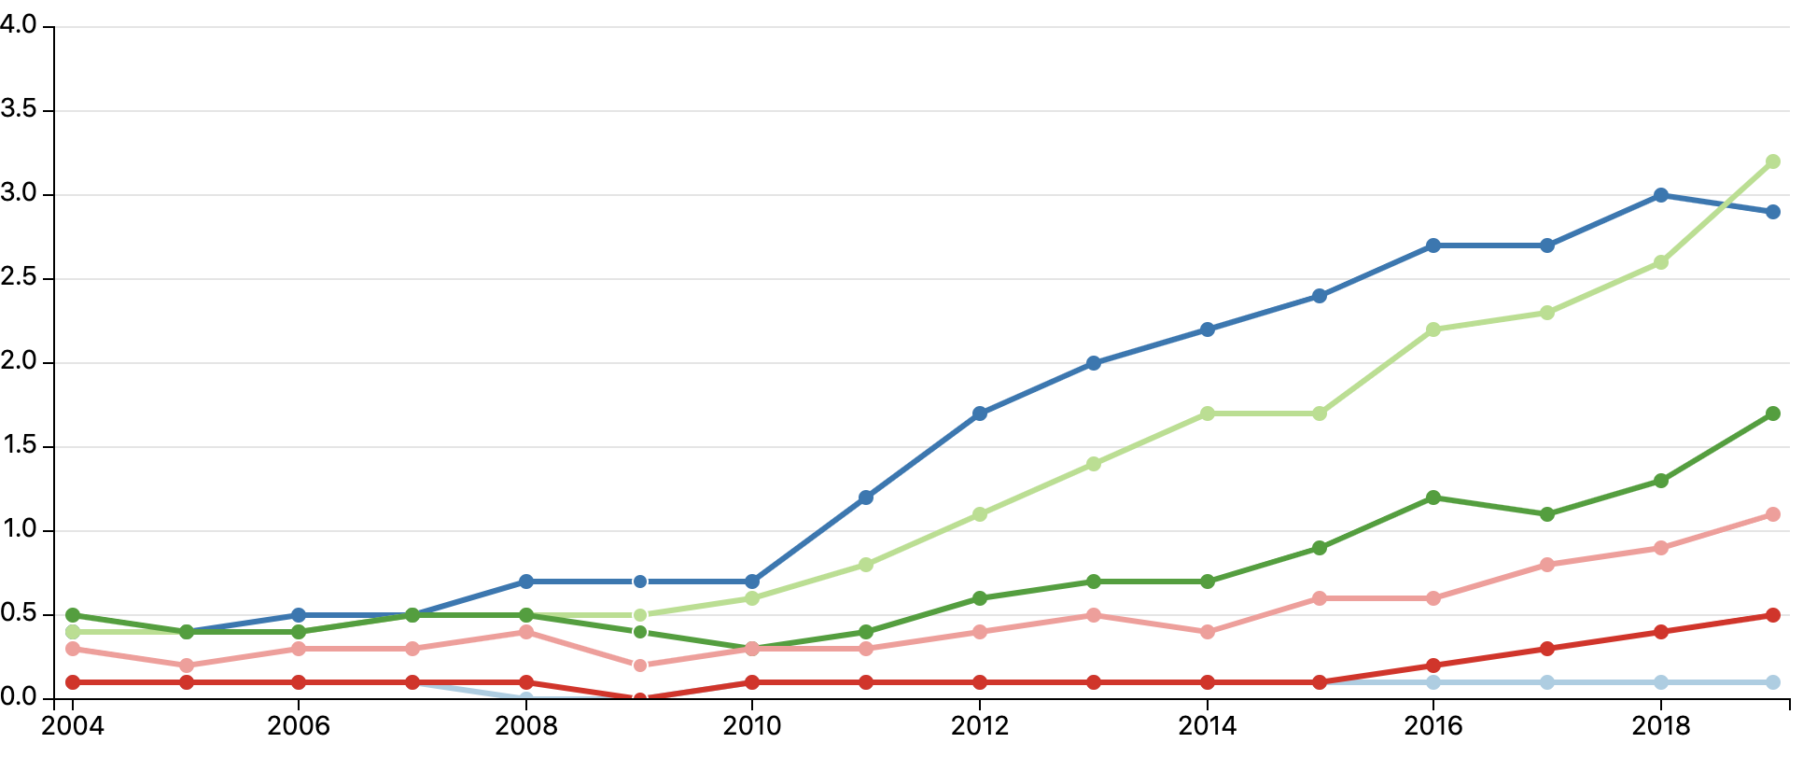
Hepatitis C
Rates of reported acute hepatitis C virus infection, by age group, 2004-2019
Injection drug use is the most commonly reported risk factor among patients with acute HCV infection
Seroprevalence of HCV infection among PWID estimated to be ~53% in the US
Reported cases per 100,000 population
Year
https://www.cdc.gov/hepatitis/statistics/2019surveillance/HepC.htm
Degenhardt L, et al., Lancet Global Health. 2017;5(12):e1192-1207.
Notes:
-We have seen an increase in reported cases of acute HCV infections, again, particularly among patients age 20-39.
-And note that according to these CDC data, injection drug use is the most commonly reported risk factor among patients with acute HCV infection.

Slide 48
Hepatitis c
HCV
Transmission | Blood-borne, sexual, perinatal, possibly non-injected cocaine
Symptoms | Asymptomatic Fever, fatigue, dark urine, clay-colored stools, abdominal pain, anorexia, N/V, jaundice
Disease | 20-50% clear initial infection 50-80% develop chronic, active infection 5-25% of chronic infections will evolve to cirrhosis in 10-20 years
Whom to test | All adults >18 years (x1), pregnant women, any history of PWID, HIV+, and other indications
Testing | Screening: HCV IgG Confirmation of active infection: blood quantitative HCV RNA
Treatment | Direct Acting Antivirals Highly effective and well tolerated Expensive, hard to access for many patients
Prevention | Harm reduction for PWID Condoms Treat known infections NO VACCINE
Reinfection | Possible (prior infection does not confer immunity)
Notes:
Seo S, Silverberg MJ, Hurley LB, et al. Prevalence of spontaneous clearance of hepatitis C virus infection doubled from 1998 to 2017. Clin Gastroenterol Hepatol 2020;18:511–3.

Slide 49
Hepatitis c
HEPATITIS C TESTING, INTERPRETATION, AND ACTION STEPS
HCV IgG | HCV RNA | Scenario | Action steps
Negative | N/A | No history of or current HCV infection | Patient education, harm reduction
Positive | N/A | Prior, cleared or active HCV infection | Send HCV RNA quant
Positive | Negative | Prior, cleared or prior, treated HCV infection | Patient education, harm reduction
Positive | Positive | Active HCV infection | Refer for treatment Patient education, harm reduction Give HAV and HBV vaccine Discuss alcohol use (and treat AUD if present)
Notes:
Consuming alcohol is included among factors that increases likelihood of progression to cirrhosis.
From CDC:
Who is more likely to develop cirrhosis after becoming infected with HCV?
Rates of progression to cirrhosis are increased in the presence of a variety of factors, including
Being male
Being age >50 years
Consuming alcohol
Having nonalcoholic fatty liver disease, hepatitis B, or HIV coinfection
Receiving immunosuppressive therapy

Slide 50
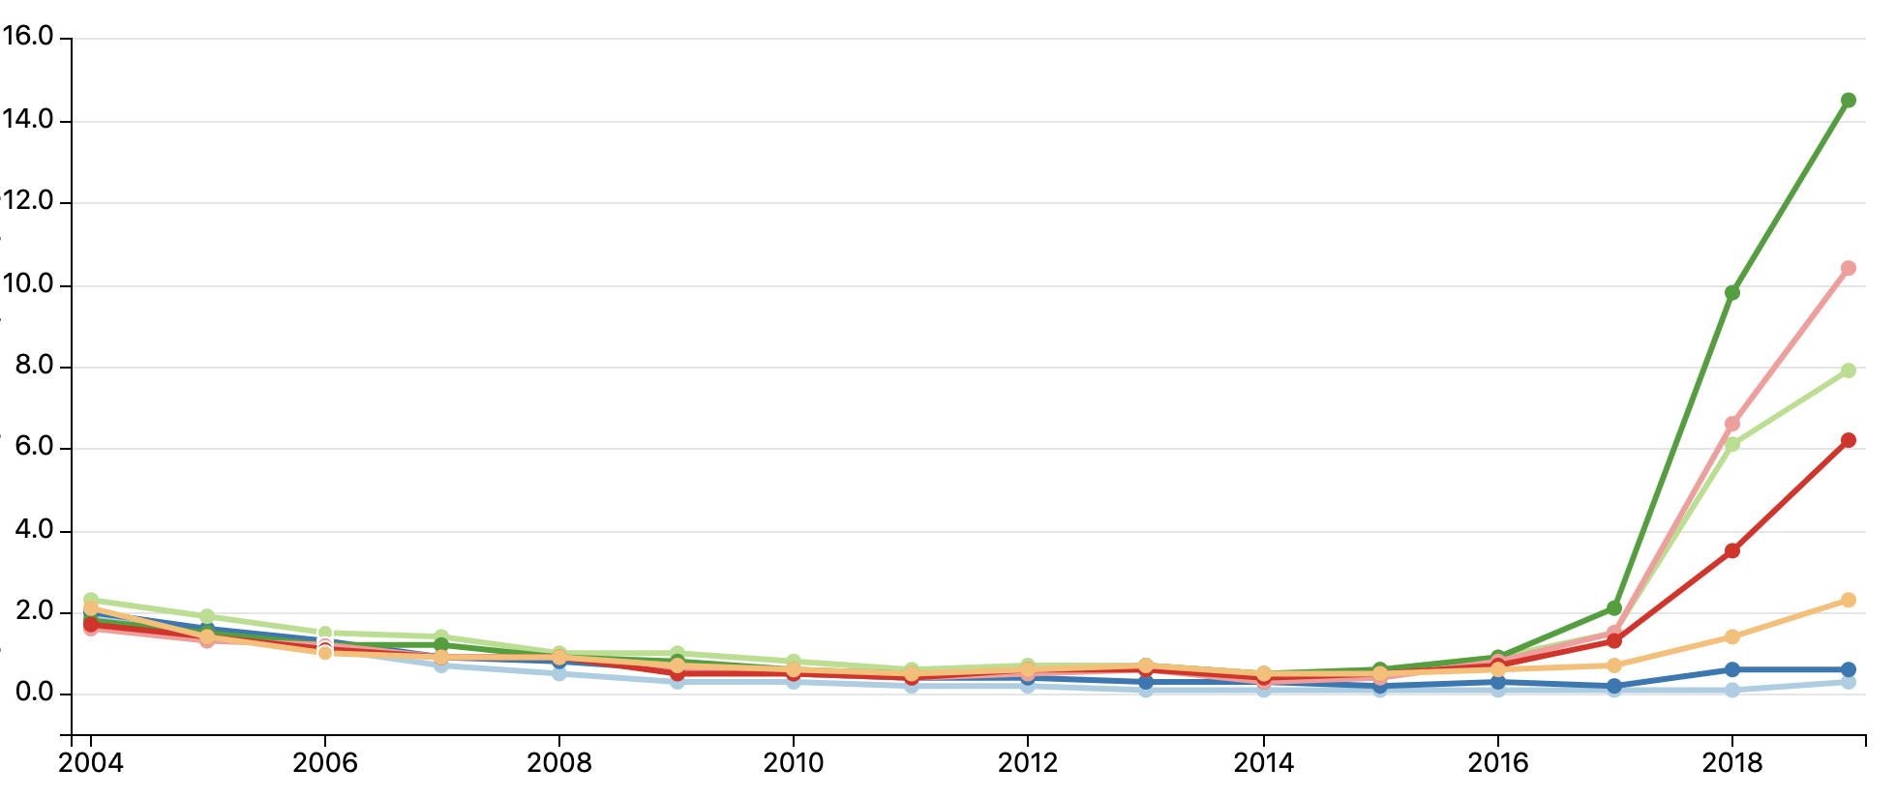
Hepatitis A
Rates of reported acute hepatitis A virus infection, by age group, 2004-2019
Among the 10,991 reported cases with IDU information available, 5,017 (46%) reported IDU
Reported cases per 100,000 population
Year
https://www.cdc.gov/hepatitis/statistics/2019surveillance/HepA.htm
Notes:
-We are all aware of the uptick in cases of acute HAV infection since 2017.
-The incidence of new infections spans a broader age range for this virus, however, among the ~11,000 new infections for which risk factor data were available, IVDU was reported in approximately 46% of cases.

Slide 51
Hepatitis A
HAV
Transmission | Close person-to-person contact, fecal-oral route, bloodborne
Symptoms | Typically symptomatic: fever, fatigue, dark urine, clay-colored stools, abdominal pain, anorexia, N/V, jaundice
Disease | Acute disease only (no chronic infection)
Whom to test | Persons with signs of hepatitis (acute infection); PWID, MSM, occupational risk, homelessness, international travelers, HCV/HBV, liver disease
Testing | Screening for active infection: HAV IgM Screening for immunity: HAV IgG
Treatment | Supportive
Prevention | VACCINE! Harm reduction for PWID
Reinfection | No Prior infection provides lifelong immunity Duration of vaccine-induced immunity is not known (studies suggest at least 20 years)
Notes:
.

Slide 52
Hepatitis A
HEPATITIS A TESTING, INTERPRETATION, AND ACTION STEPS
HAV IgG | HAV IgM | Scenario | Action steps
Negative | Negative | No history of or current HAV infection or vaccination | Vaccinate
Negative | Positive | Acute infection | Supportive care; no need for vaccination
Positive | Positive | Acute infection | Supportive care; no need for vaccination
Positive | Negative | Prior infection or vaccination | No action—all good
Notes:
May want to repeat HAV IgG for IgM+IgG- patients at a later date to confirm immunity (and not spurious IgM result)

Slide 53
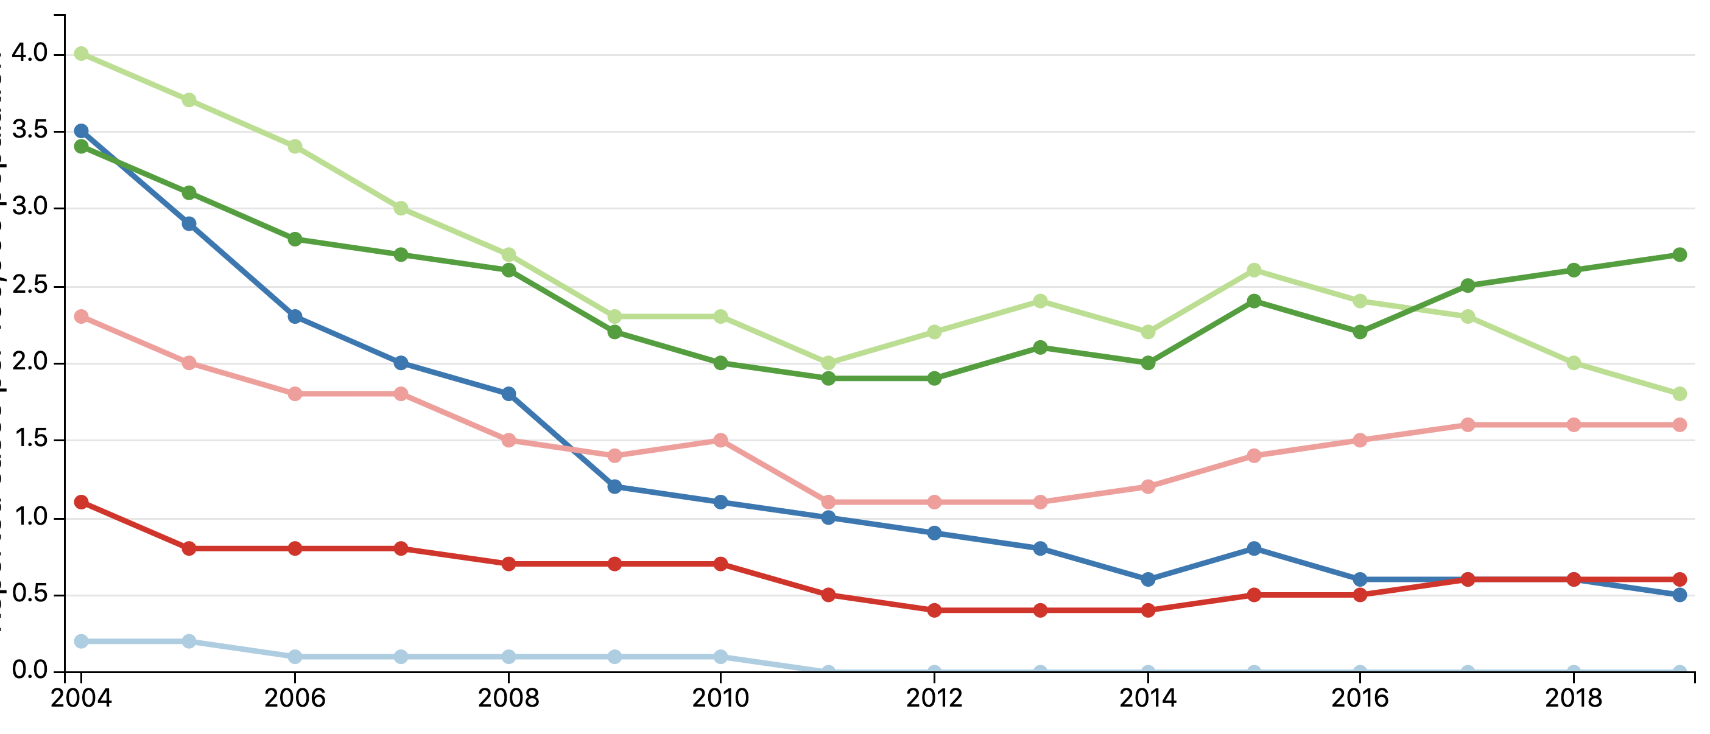
Hepatitis B
Rates of reported acute hepatitis B virus infection, by age group, 2004-2019
Prevalence of chronic HBV infection estimated to be ~860K in US
257 million worldwide
Reported cases per 100,000 population
Year
https://www.cdc.gov/hepatitis/statistics/2019surveillance/HepB.htm

Slide 54
Hepatitis B
HBV
Transmission | Perinatal, blood-borne, sexual
Symptoms | Acute: Asymptomatic; fever, fatigue, dark urine, clay-colored stools, abdominal pain, anorexia, N/V, jaundice Chronic: Asymptomatic; cirrhosis, liver cancer
Disease | Acute infection more likely to clear if infected as an adult Acute infection in childhood more likely to become chronic (1 in 3 for children <6 years at infection)
Whom to test | MSM, PWID, HIV+, household contacts of known HBV+, HCV+, pregnant women, others
Testing | HBV panel: HBV core antibody, HBV surface antibody, HBV surface antigen
Treatment | Antivirals
Prevention | VACCINE! Harm reduction for PWID Condoms
Reinfection | No
Notes:
.

Slide 55
Hepatitis B
HEPATITIS B TESTING, INTERPRETATION, AND ACTION STEPS
HBV core antibody (cAb) | HBV surface antigen (sAg) | HBV surface antibody (sAb) titer | HBV sAb interpretation | Scenario | Action steps
Positive | Negative | <10 mIU/ml | Negative | Prior, cleared HBV infection without immunity | No action (can try double dose vaccine)
Positive | Negative | >= 10 | Positive | Cleared HBV infection with immunity | No action—all good.
Positive/ Negative | Positive | Any value | Positive/ Negative | Active HBV infection | Refer for treatment Patient education; harm reduction
Negative | Negative | >= 10 | Positive | Prior vaccination for HBV with immunity | No action—all good.
Negative | Negative | <10 | Negative | No history of HBV infection or vaccination | Vaccinate!
https://www.cdc.gov/mmwr/volumes/67/rr/rr6701a1.htm

Slide 56
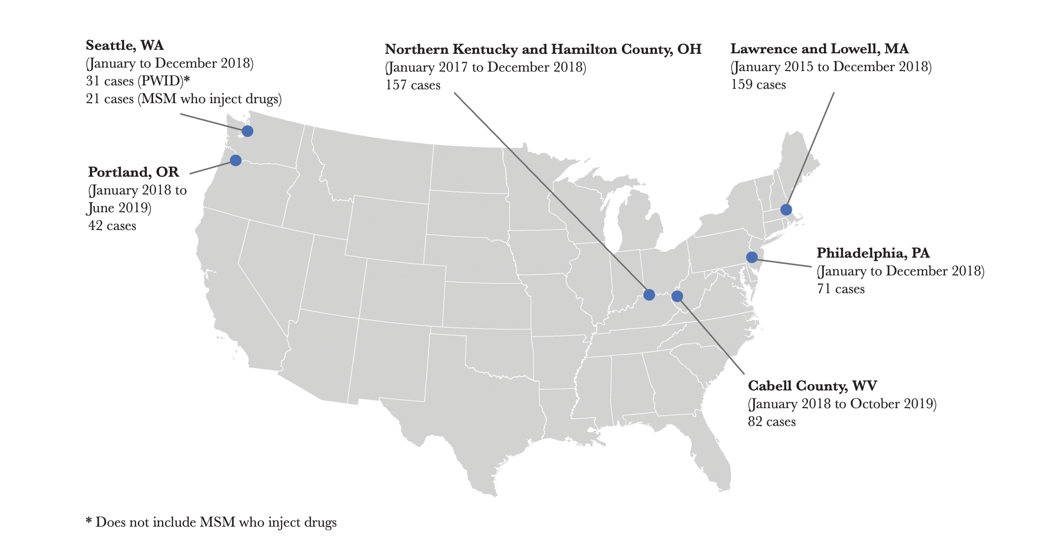
HIV
OUTBREAKS AMONG PERSONS WHO INJECT DRUGS (2016-2019)
Lyss et al, J Infect Dis 2020:222
https://emergency.cdc.gov/han/2020/han00436.asp
Notes:
.

Slide 57
HIV
HBV
Transmission | Sexual, blood-borne, perinatal
Symptoms | Acute: Asymptomatic; fever, fatigue, pharyngitis, lymphadenopathy, rash Chronic: Asymptomatic; weight loss, opportunistic infections
Disease | Chronic
Whom to test | All persons aged 13-64 (x1), MSM, PWID, multiple sex partners, pregnant women, with other STD, others
Testing | Screening: HIV-1/2 antibody/antigen test If screening positive: HIV viral load
Treatment | Antivirals
Prevention | PrEP Harm reduction for PWID Condoms Treat known infections (Treatment as Prevention) NO VACCINE
Reinfection | No*
Notes:
.

Slide 58
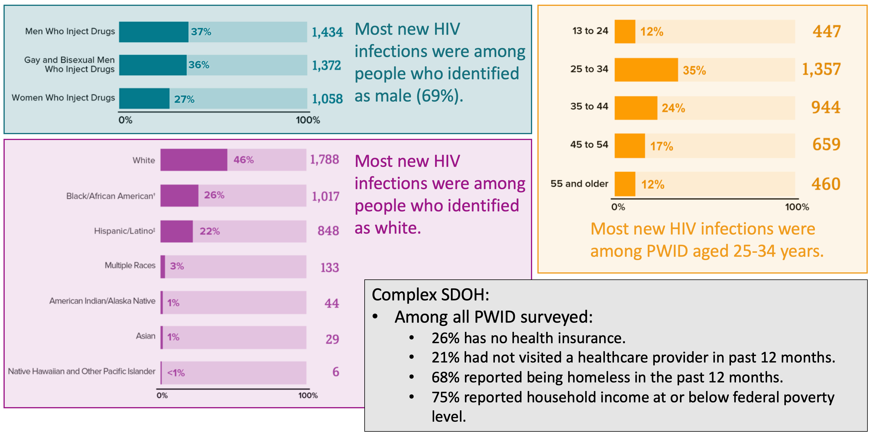
New HIV diagnoses among PWID (2018)
CDC’s National HIV Behavioral Surveillance (NHBS) report on Persons Who Inject Drugs (PWID)
11,437 PWID surveyed in 2018
National HIV Behavioral Surveillance Injection Drug Use (https://www.cdc.gov/hiv/group/hiv-idu.html)
Notes:
.

Slide 59
Risk factors for HIV transmission and testing among PWID (2018)
Participating metropolitan areas:
Atlanta, GA
Baltimore, MD
Boston, MA
Chicago, IL
Dallas, TX
Denver, CO
Detroit, MI
Houston, TX
Los Angeles, CA
Memphis, TN
Miami, FL
Nassau-Suffolk, NY
New Orleans, LA
New York, NY
Newark, NJ
Philadelphia, PA
Portland, OR
San Diego, CA
San Francisco, CA
Sa Juan, Puerto Rico
Seattle, WA
Virginia Beach, VA
Washington, DC
National HIV Behavioral Surveillance Injection Drug Use (https://www.cdc.gov/hiv/group/hiv-idu.html)
Notes:
.

Slide 60
Learning objectives
List the types of infections associated with injection drug use
List the features of infective endocarditis that influence morbidity/risk and describe standard and innovative treatments
Describe recommended testing for viral infections associated with IVDU
Interpret testing results for HCV, HBV, and HAV infections
Describe infection prevention strategies for people who inject drugs

Slide 61
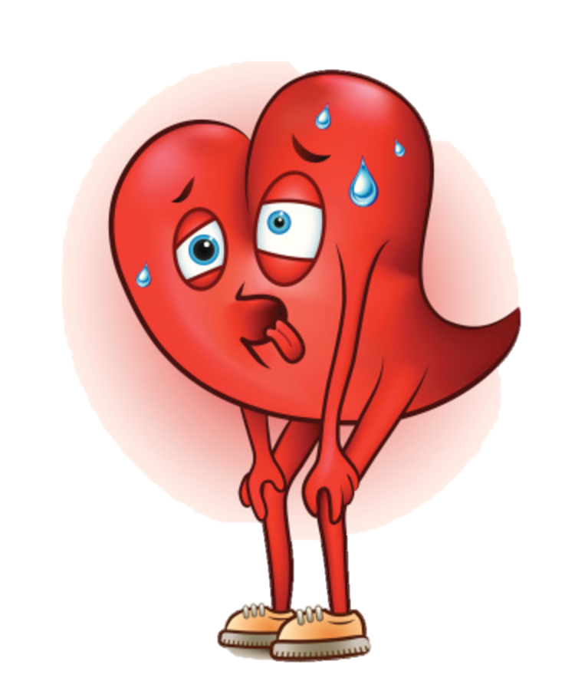
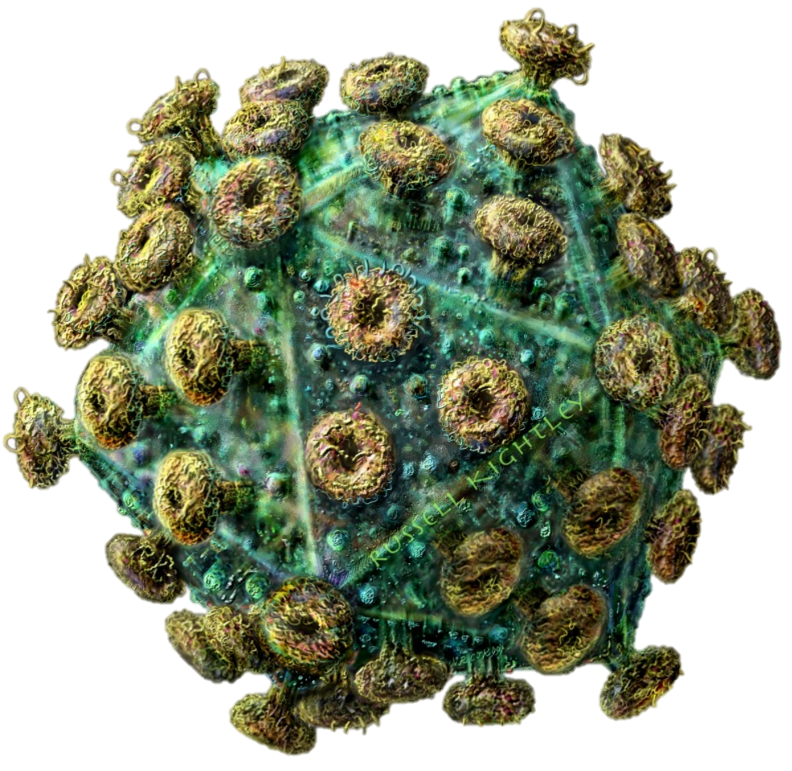
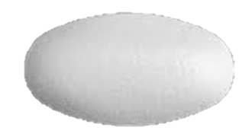
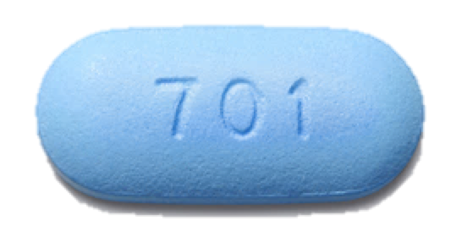
HIV pre-exposure prophylaxis
PREP IS PRIMARY PREVENTION
Intended to PREVENT the onset of a disease in those who are AT RISK
HIV PrEP is a fixed dose combination of two antiviral medications with activity against HIV.
Taken daily with clinician visits and monitoring labs every three months.
Statin
Notes:
Truvada recommended for PrEP in PWID (CDC); assume this is because TAF efficacy has not been studied in this context

Slide 62
HIV pre-exposure prophylaxis
PREP IS PRIMARY PREVENTION
Intended to PREVENT the onset of a disease in those who are AT RISK
 | emtricitabine + tenofovir disoproxil fumarate | emtricitabine + tenofovir alafenamide | cabotegravir
Trade name | Truvada® | Descovy® | Apretude®
Administration | Oral, daily | Oral, daily | Extended release injection, every other month
PrEP indications (risk factors) | Sexual transmission IVDU | Sexual transmission | Sexual transmission
Efficacy estimate | 99% risk reduction for sexual transmission (with ideal adherence) 74% risk reduction for IVDU transmission (with ideal adherence)
Notes:
Truvada recommended for PrEP in PWID (CDC); assume this is because TAF efficacy has not been studied in this context

Slide 63
Need: risk mitigation strategies
Harm Reduction: practical strategies and steps to reduce negative disease outcomes
Coronary Artery Disease | Substance Use Disorder
Decrease tobacco use | Overdose education and prevention
Diet and exercise | Naloxone prescription
Treat hypertension, diabetes, hyperlipidemia | Never use alone
Maybe low-dose aspirin | Safe injection education
Pacemaker or defibrillator placement in advanced disease | Syringe exchange resources
 | Testing for HIV and viral hepatitis
 | PrEP; vaccination for HAV/HBV
Notes:
Speaker Notes:

Slide 64
Need: risk mitigation strategies
Syringe Services Programs:
Studied for decades
Safe, effective, cost saving
DO NOT increase crime or illicit drug use
Reduce transmission of infection
Increase engagement in SUD treatment
SSP participants are 5x more likely to enter treatment and 3x more likely to stop using drugs
Protect the public and first responders by decreasing risk of needle stick exposures
https://www.cdc.gov/ssp/index.html

Slide 65
Need: risk mitigation strategies
SSPS IN TENNESSEE
https://www.tn.gov/health/health-program-areas/std/std/syringe-services-program.html#:~:text=Syringe%20Services%20Programs%20(SSPs)%20provide,referrals%20to%20substance%20use%20disorder
Notes:
SSPs have been studied for decades and a large body of data have shown that SSPs are safe, effective, and cost saving; do not increase drug use or crime; they effectively reduce transmission of viral hepatitis, HIV and other infections;
Participants are five times more likely to enter treatment for their addiction and ~3x more likely to stop using drugs than those that do not access an SSP
Protect the public and first responders by decreasing the number of needle sticks in the community

Slide 66
QUESTIONS?
Katie White, MD, PhD
katie.d.white@vumc.org

