Slide 1
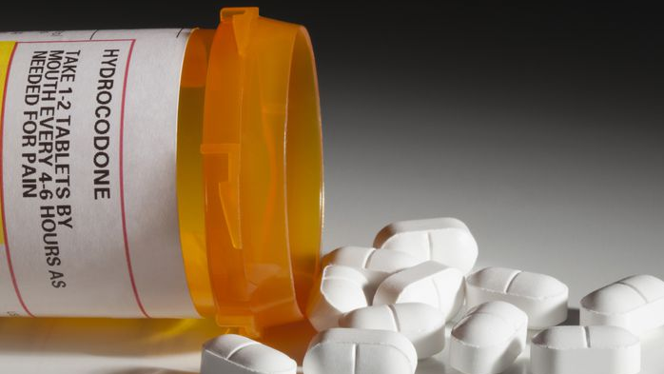
Adverse Childhood Experiences Predict Opioid Relapse During Treatment among Rural Adults
Dr. Dan Sumrok

Slide 2
opioid use disorder
Opioid Use Disorder (OUD) is an epidemic in the US
Currently, 1.5% of all deaths in the US are attributable to opioids*
There are large gaps in our ability to treat individuals with OUD
Those with OUD may not know that medicine exists/have no resources to get care
Not enough physicians are trained and/or waivered to treat OUD
Even for those who reach treatment: Relapse is extremely high
Our goal with this research was to examine treatment outcomes in individuals with OUD
Relapse
Prediction of treatment relapse
Prediction of treatment success
* Gomes T, Tadrous M, Mamdani MM, Paterson JM, Juurlink DN. The Burden of Opioid-Related Mortality in the United States. JAMA Netw Open. Published online June 01, 20181(2):e180217. doi:10.1001/jamanetworkopen.2018.0217

Slide 3
Treatment for opioid use disorder
How do we treat individuals with OUD?
Medication Assisted Treatment (MAT)
Buprenorphine-naloxone = most widely accepted form of MAT*
Reduces cravings but does not make the patient “high”
Very good outcomes in scientific research (↓relapse, ↑quality of life)
Prescribed on outpatient basis
Treatment course: 6 months – indefinitely
Counseling
Federally required practice when a patient receives MAT
Medication reduces cravings
Counseling helps patients make lifestyle changes
* Main, F., & Kelly, L. (2016). Systematic literature review on buprenorphine/naloxone use in outpatient opioid dependence treatment. Canadian Journal of Addiction, 7(1).

Slide 4
Adverse childhood experiences
We considered what factors may be affecting relapse rates in OUD populations
Based upon clinical experiences, identified childhood adverse events as a potential factor
Adverse childhood experiences (ACEs) is the term used to describe all types of abuse, neglect, and other potentially traumatic experiences that occur to people under the age of 18
ACE’s can include:
Abuse
Alcoholism in family systems
Child Abuse
Domestic violence
Dysfunctional family
Effects of domestic violence on children
Neglect
Post-traumatic stress disorder
Psychological abuse
Verbal abuse

Slide 5
IMPACT OF ACE
Opioid Relapse?
https://www.cdc.gov/violenceprevention/childabuseandneglect/acestudy/aboutace.html

Slide 6
METHODS
Study was reviewed and approved by the University of Tennessee Health Science Center Institutional Review Board (IRB)
Data were abstracted from medical charts of patients (N=87) enrolled in buprenorphine-naloxone treatment from 2011 to 2017 at a rural clinic in the southeastern US
Charts included Adverse Childhood Experiences (ACE), number of visits attended, buprenorphine-naloxone prescription data, self-reported opioid use, urine screen results, and prescription drug monitoring database results
Given that patients had multiple office visits, all available visit records (N=2,052) were extracted
Treatment duration ranged from 1 month to 7 years and 10 months
The clinic was open two mornings per week, with group counseling provided first, followed by individual appointments with physicians

Slide 7
Results: Descriptive
Sample was 100% Caucasian and 75% male
Age ranged from 21 to 81 years old (M=39.9, SD=9.5
Number of office treatment visits ranged from 1 to 80 (M=23.6, SD=22
Majority (91%) of patients were prescribed Suboxone (8mg), 7% were prescribed Bunavail (4.2/0.7mg), and 2% were prescribed Zubsolv (5.7/0.7mg)
Mean ACE score was 3.5 (SD=2.9)
18% of participants reported no ACE
46% reported four or more
Most commonly reported ACE included parent separation/divorce (59%), alcohol abuse by adult in the household (53%), verbal abuse (45%), and emotional neglect (40%)

Slide 8
Results: Relapse during treatment
Relapse
Of the 87 patients, 47 (54%) relapsed at least once.
Of the 2,052 visit observations, 145 (7%) indicated a positive result for opioid relapse
The median number of visits to relapse was 1
Highest relapse rate (34%) on the first visit

Slide 9
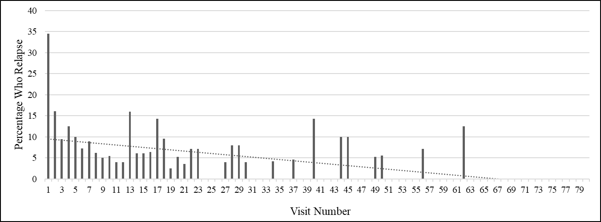
Results: Relapse during Treatment
*Derefinko KJ, Salgado Garcia F, Talley K, Bursac Z, Johnson K, Murphy JG, McDevitt-Murphy M, Andrasik F, & Sumrok DD. (in press). Adverse Childhood Experiences Predict Opioid Relapse During Treatment among Rural Adults. Addictive Behaviors.

Slide 10
Results: ace as a risk factor
GEE repeated measures model allowed us to include patients with different numbers of follow-up visits and make use of all available data while adjusting for number of visits for each patient
Results demonstrated that for every unit increase in ACE score, the odds of opioid relapse were 17% higher
(OR=1.17, 95% CI: 1.05-1.30, p=.005)

Slide 11
Results: benefit of staying in treatment
Odds of opioid relapse were 2% lower for every additional treatment visit
(OR=0.98, 95% CI: 0.97-0.99, p=.008)
Neither gender (OR=1.49, 95% CI: 0.68-3.28, p=.313) nor age (OR=0.99, 95% CI: 0.96-1.02, p=.697) were associated with opioid relapse
DFBETA statistics indicated that no observations (individuals with multiple relapses) influenced findings or were out of bounds of normal expectancy

Slide 12
Results: benefit of staying in treatment
*Derefinko KJ, Salgado Garcia F, Talley K, Bursac Z, Johnson K, Murphy JG, McDevitt-Murphy M, Andrasik F, & Sumrok DD. (in press). Adverse Childhood Experiences Predict Opioid Relapse During Treatment among Rural Adults. Addictive Behaviors.

Slide 13
conclusions
This is the first study to evaluate the association between ACE scores and opioid relapse during combined buprenorphine-naloxone treatment and group counseling
This finding is of concern for rural populations that are at risk for both ACE and opioid use
May also suggest that trauma-informed care may be quite relevant for rural individuals with OUD given the relevance of ACES
Finding that remaining in treatment was related to reduced relapse risk was encouraging
Promoting treatment adherence among those who are newly engaged in buprenorphine-naloxone treatment could be beneficial

