Slide 1
Novel & Emerging
Psychoactive Drugs: Synthetics, designer & beyond
Mariah Smith, MD
Assistant Professor
Dept of Psychiatry and Behavioral Sciences
Vanderbilt University Medical Center
October 22, 2022

Slide 2
Disclosures
No ACCME-defined commercial interest conflicts or disclosures.

Slide 3
Objectives
This activity is designed to help the learner:
Discuss different novel and emerging psychoactive drugs using three distinct patient cases: Cannabinoids, benzodiazepines and opioids.
Describe clinical presentations, associated risks, and treatment for different novel and emerging psychoactive drugs
Explain availability and methods of screening for synthetic substances
Notes:
I am going to discuss novel drugs in the framework of three distinct patient cases

Slide 4
Audience Question 1:
Notes:
I am going to discuss novel drugs in the framework of three distinct patient cases

Slide 5
You see a patient in a clinic who states they have been using Spice. What substance are they referring to?
ⓘ Start presenting to display the poll results on this slide.

Slide 6
Audience Answer 1:
C-Synthetic Cannabinoids
Notes:
I am going to discuss novel drugs in the framework of three distinct patient cases

Slide 7
Audience Question 2:
Notes:
I am going to discuss novel drugs in the framework of three distinct patient cases

Slide 8
The United Nations Office on Drug and Crime (UNODC) Early Warning Advisory for Nov 2021 reported which novel psychoactive substance is the most associated with fatalities?
ⓘ Start presenting to display the poll results on this slide.

Slide 9
Audience Answer 2:
B- Synthetic benzodiazepines
Notes:
I am going to discuss novel drugs in the framework of three distinct patient cases

Slide 10
Audience Question 3:
Notes:
I am going to discuss novel drugs in the framework of three distinct patient cases

Slide 11
Which of the following is true?
ⓘ Start presenting to display the poll results on this slide.

Slide 12
Audience Answer 2:
D- Fentanyl is lipophilic
Notes:
I am going to discuss novel drugs in the framework of three distinct patient cases

Slide 13
What are novel psychoactive drugs?
Novel psychoactive substances (NPS) are a range of drugs that have been designed to mimic established recreational illicit drugs
Other names include “synthetic drugs” or “legal highs”
Categorized into stimulant, cannabinoid receptor agonist, sedative/hypnotic, hallucinogen, dissociative, synthetic opioid and herb/plant
1-2

Slide 14
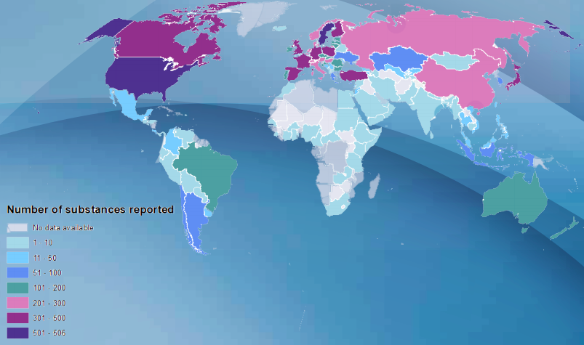
Global emergence of NPS
November 2021: 1,100 individual NPS have been reported to the United Nations Office on Drug and Crime Early Warning Advisory (UNODC EWA) by 133 countries and territories.
2

Slide 15
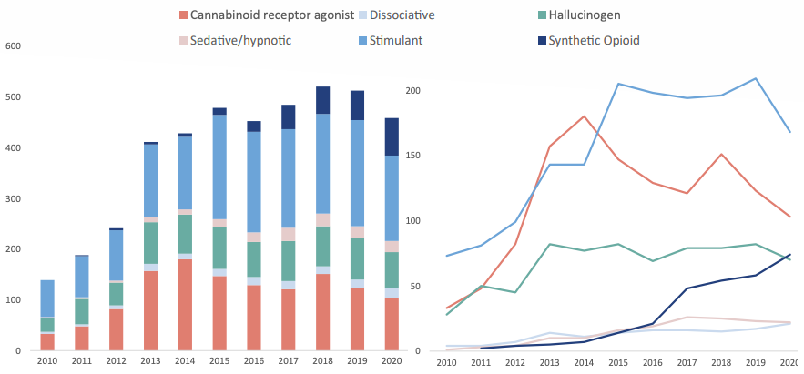
Emergence of NPS reported to the UNODC EWA 2010-2020
2
Notes:
United nations office on drug and crime early warning advisory
Although the most popular of these have been cannabinoids and designer cathinones (stimulants), recent years have seen the appearance of novel synthetic opioids on the recreational drug market

Slide 16
Case #1
ID: 33 M seen at Meharry addiction clinic for opioid use disorder (OUD) and treatment with Suboxone as MOUD
Consult: Bipolar diagnostic clarification and medication management
HPI: Previous dx of BPAD but hesitant towards medications; stable on suboxone for OUD, reports smoking “spice” multiple times during the day with some insight into worsening mental health symptoms with use (paranoia, racing thoughts, mood); contemplative stage regarding cessation

Slide 17
Case #1
PPH: OUD, ADD, GAD, BPAD by history; no inpatient admissions or current outpatient care; denies SA; no current medications
PMH: Denies
SH: Works as a tutor, single, lives with mother, family is supportive
Substance Hx: Opioid use, in remission on suboxone and cannabis per HPI; past sedative and stimulant use; smokes 1 PPD; numerous overdoses and residential treatment programs

Slide 18
Case #1
MSE: Significant for distractibility, rapid speech, grandiose delusions, circumstantial thought process, irritability, expansive affect, judgement- fair, insight- limited, treatment seeking
Recommendations: Meets criteria for bipolar II disorder; continue Suboxone for MOUD; provided education re: synthetics and risks with cannabis on mental health; encouraged BPAD medications; did not meet criteria for involuntary commitment; RTC in 2 weeks

Slide 19
Synthetic Cannabinoids (SCB)
Names: Spice, K2, herbal incense, Cloud 9, Mojo
Many types of synthetic cannabinoids (SCB) each having a unique binding affinity for receptors CB₁ and CB₂
SCBs act as full agonist of CB₁ and CB₂, whereas THC is a partial agonist at CB₁
3, 5, 10
Notes:
Although both Δ⁹-tetrahydrocannabinol (THC) and SCBs stimulate the same receptors, cannabinoid receptor 1 (CB₁) and cannabinoid receptor 2 (CB₂)
studies have shown that SCBs are associated with higher rates of toxicity and hospital admissions than is natural cannabis. This is due to… direct agonist
Add stuff about CYP450??
https://scholar.google.com/scholar?q=Cytochrome%20P450-mediated%20oxidative%20metabolism%20of%20abused%20synthetic%20cannabinoids%20found%20in%20K2Spice:%20identification%20of%20novel%20cannabinoid%20receptor%20ligands
https://scholar.google.com/scholar?q=Distinct%20pharmacology%20and%20metabolism%20of%20K2%20synthetic%20cannabinoids%20compared%20to%20delta-THC:%20mechanism%20underlying%20greater%20toxicity

Slide 20
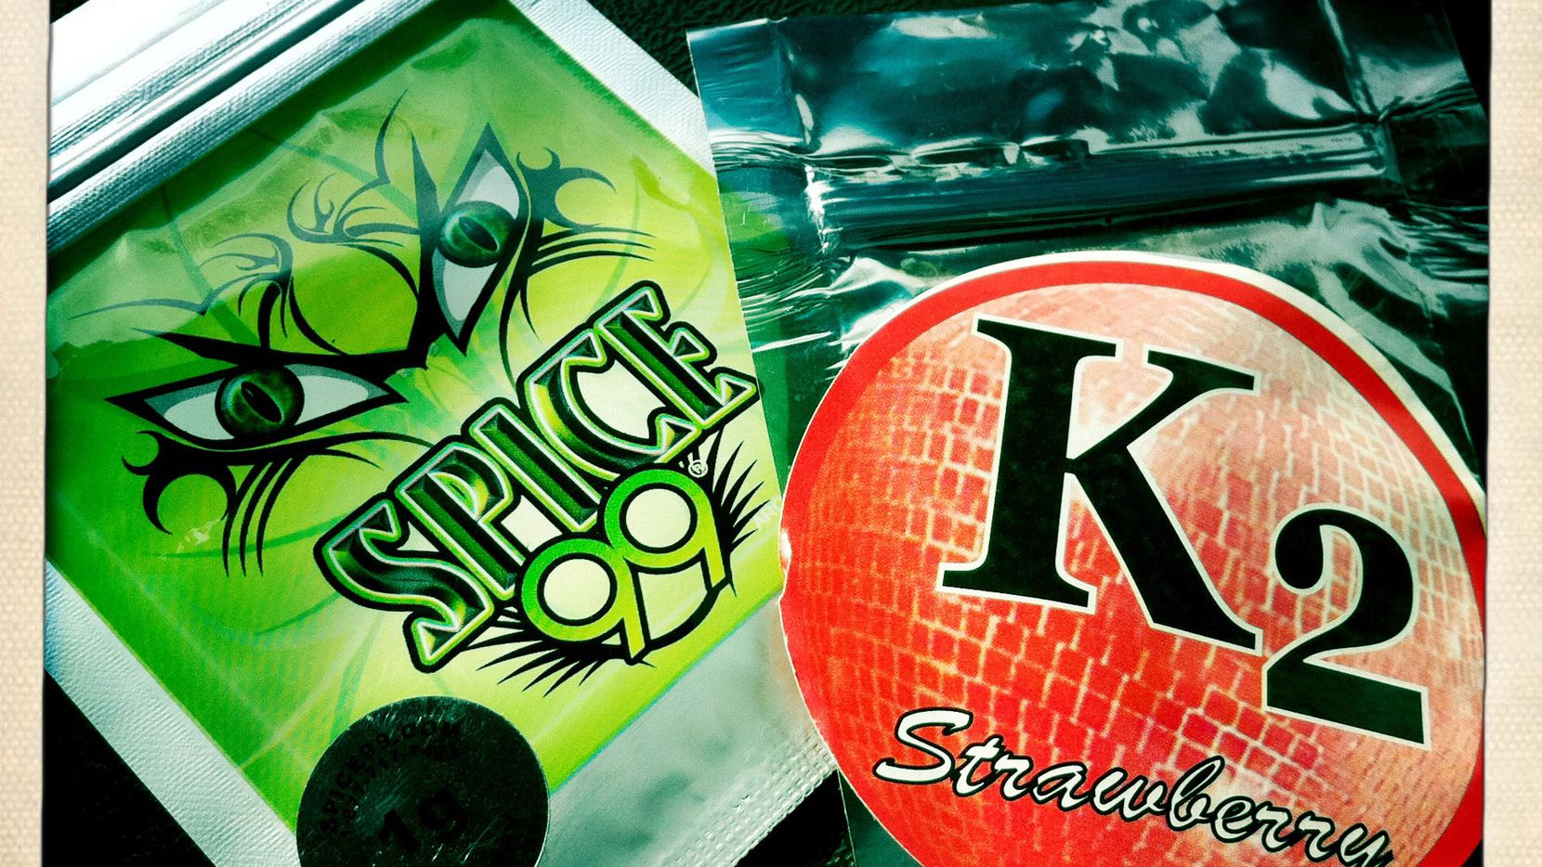
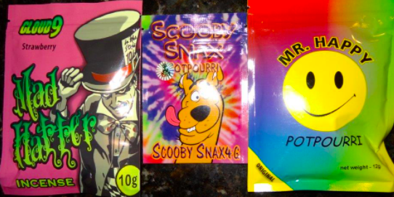
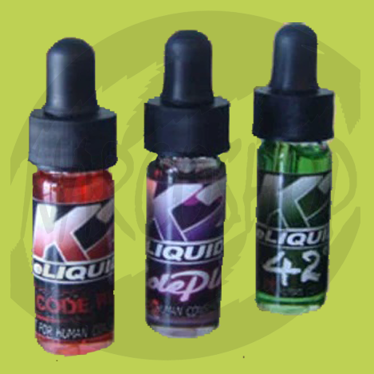

Slide 21
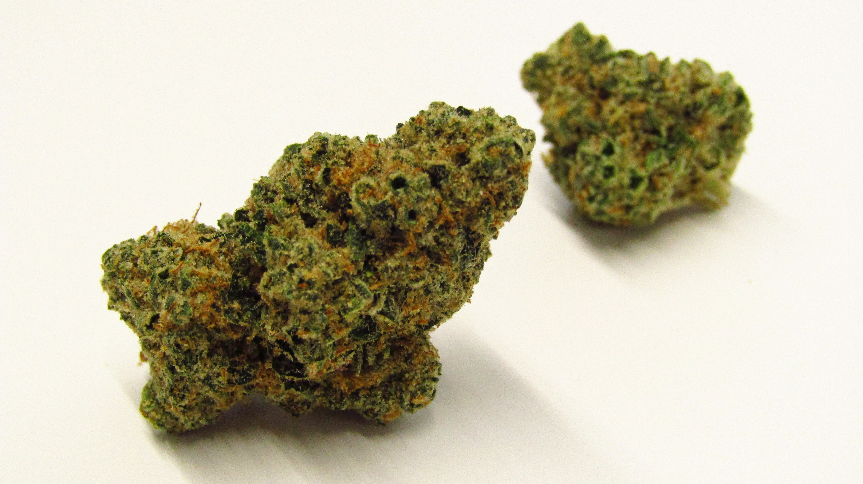
SCB: Concerns
The lack of quality control leads to batch-to-batch differences in SCB concentrations in different products
Spray the chemical mixture onto Marshmallow plant so there is a wide variation on concentration saturation
K2 or Spice products usually contain more than 1 structure/form of SCBs that can interact in unpredictable ways
3, 8, 44

Slide 22
SCB: Prevalence
Prevalence of lifetime SC use is between 0.2-4%
Mostly young, Caucasian males
Sold over the internet and head shops/bodegas
Reasons for use include
Cheap
Not detected on standard toxicology
Perceived as safe
Promises of similar or stronger “high” than cannabis
Targeted to children/young adults
4, 7, 9

Slide 23
SCB: Onset and duration
Onset of action varies from immediately, minutes or hours after use
Duration of action varies but can last hours
Effects can be similar to cannabis; however, unpredictable- individual SC compounds vary in potency, efficacy and duration of action
4

Slide 24
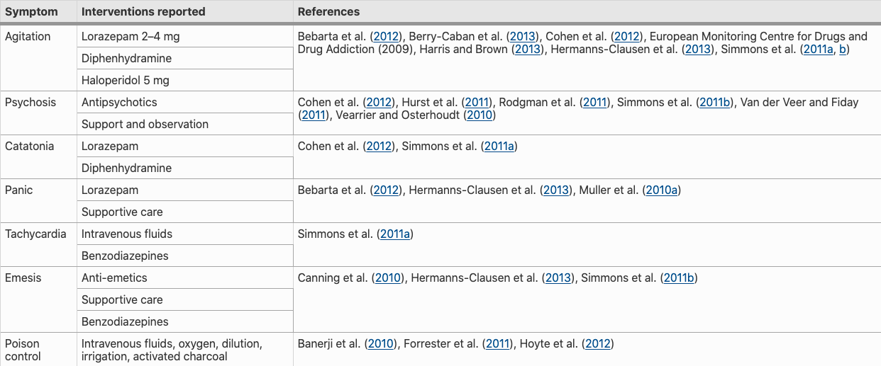
SCB: Adverse effects and treatment options
4
Notes:
No lit review on which antipsychotics are the most helpful. Depends on if there is an underlying condition (bipolar, schizophrenia, etc.) if they were used for acute agitation or persistent psychosis. However, there was a lit review in 2019 on clinical, psychopathological and therapeutic with synthetic cannabinoids.
Most of the studies have found that benzodiazepines are useful for agitation.
Of those that used neuroleptics the most common ones were olanzapine, clozapine, quetiapine, and aripiprazole. Haldol, risperidone and paliperidone were used in isolated cases.
Their use may also have a propensity to trigger a chronic psychotic disorder in vulnerable individuals with a history of psychosis.^{20,23,24,26,30,35,37,38} Some individuals may experience psychosis that persists for weeks after the acute intoxication.^{20,23,26,38}

Slide 25
SCB: Screening and testing
Not detected on typical toxicology
Can use gas chromatography (GC) or mass spectrometry (MS) for the detection of parent compounds and/or metabolites
JWH-018, JWH-122, AM-2201, CP-47.497, etc.
Not commercially available
In 2019, a team in the UK created a 5-minute saliva test for synthetic cannabinoids
4, 41-42
Notes:
JWH-018, most common
While there are no commercially available laboratory tests for the detection of synthetic cannabinoids, there are a number of laboratories that can detect synthetic cannabinoids. However, these tests cannot be performed on-site at most institutions. Thus, the results would not be immediately available and would be unlikely to inform clinical decision making.
Synthetic Cannabinoid Receptor Agonists Detection Using Fluorescence Spectral Fingerprinting

Slide 26
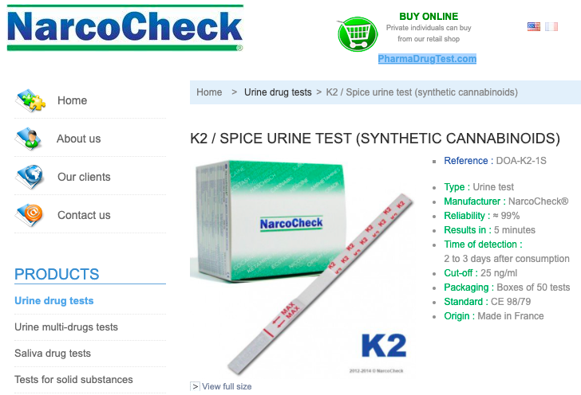
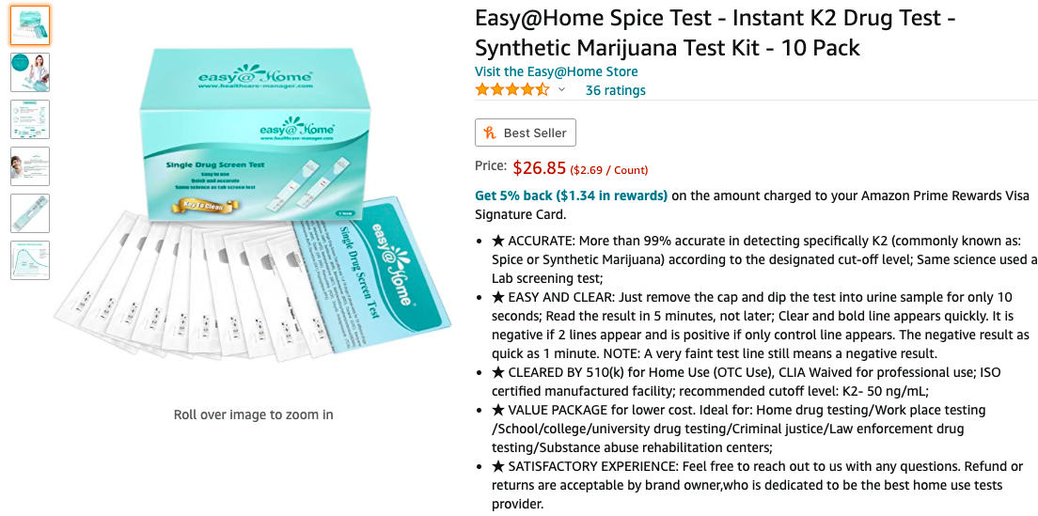
SCB: Currently…
Notes:
Still new and not well studied, not used in clinical care

Slide 27
SCB: Treatment
Studies have demonstrated that SC withdrawal is mediated by the CB1 receptor (like THC), suggesting that pharmacotherapies for cannabis use disorder may be effective in treating SCB withdrawal
Nabilone has been shown to specifically alleviate cannabis withdrawal-associated disruptions in sleep, appetite suppression, and irritability, hallmark features of SC withdrawal, suggesting that nabilone may also be a potential pharmacotherapy for treating SC withdrawal.
No current FDA-approved medications for cannabis UD; however, nabilone (a synthetic analogue of THC FDA-approved for chemotherapy-induced nausea) has shown promise in cannabis withdrawal and relapse by alleviating
Disruption of sleep
Appetite suppression
Irritability
38
Notes:
Treat co-occurring psychiatric symptoms

Slide 28
Case #2
ID: 30 M admitted to VUH for medically supervised withdrawal (MSW) from benzodiazepines and opiates
Consult: benzodiazepine and opioid withdrawal management
HPI: reports experimenting with benzodiazepines bought online (clonazolam and flubromazepam) daily for “a long time” for anxiety w/ hx of withdrawal seizures as well as online designer opioids (2-Methyl-AP-237) for mood and pain

Slide 29
Case #2
PPH: AUD, MDD; no inpatient admissions or outpatient care; denies SA; prescribed quetiapine, gabapentin, and sertraline
PMH: seizures, hx of vertebral fractures, chronic pain
SH: grad student, in a relationship, lives with fiancé, family supportive
Substance Hx: opioid and sedative use per HPI; AUD in remission; smokes ½ PPD; residential treatment programs in the past

Slide 30
Case #2
Recommendations: meets criteria for opioid use disorder (OUD); start Suboxone for cravings, continue CIWA w/ PRN Valium for benzo withdrawal/detox, recommend outpatient MOUD and MH provider
Medical course: completed MSW in CIWA without complications; did well with suboxone induction, provided with resources for MH and substance use tx; MOUD appointment scheduled

Slide 31
Synthetic benzodiazepines (SB)
Other names: legal benzodiazepines, designer benzodiazepines (DBZD), or research chemicals¹¹
Novel benzodiazepines include substances that were tested but not approved or illicitly manufactured substances that differ from the structure of existing benzodiazepines
Typically made and shopped from China, India

Slide 32
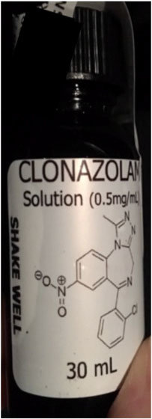
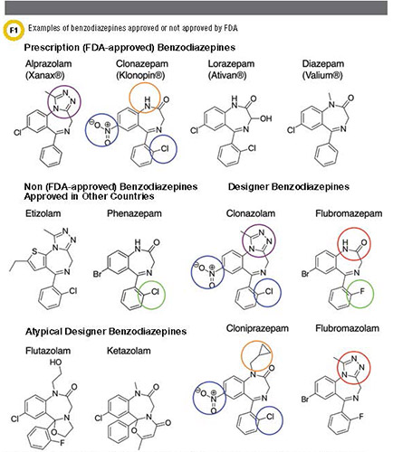
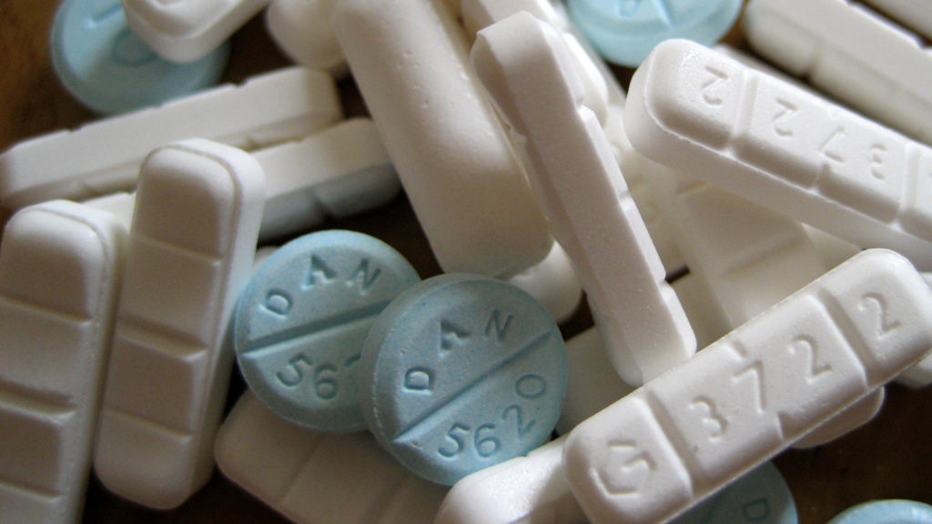

Slide 33
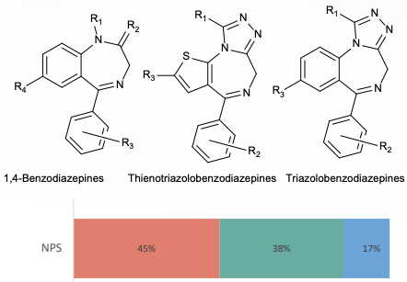
SB: Structural classification
2
Notes:
The UNODC EWA report 3 core structures
1,4-benzodiazepines (45%)- diclazepam
Thienotriazolodiazepines (17%)- etizolam
Triazolobenzodiazepines (38%) - clonazolam, flualprazolam and flubromazolam

Slide 34
SB: Formulation, mechanism of action and prevalence
Formulations include tablets, capsules, powders, blotters or liquids
MOA: Works on GABA-A receptors
Activation at the receptor site leads to an influx of intracellular chloride and promotes an inhibitory effect on the central nervous system.
Prevalence: unknown; however, more countries reporting DBZD and large crackdown missions
11-12, 14-15, 17

Slide 35
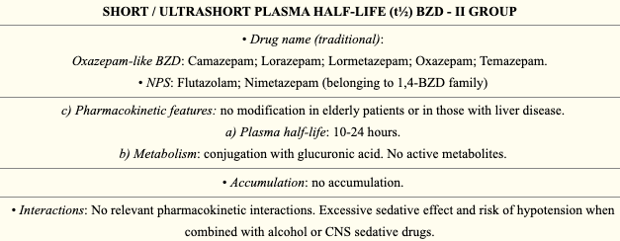
SB: Pharmacokinetics: Ultrashort ½ life
12

Slide 36
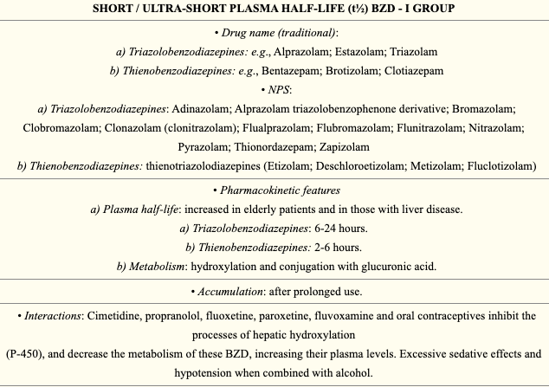
SB: Pharmacokinetics- Short ½ life
12
Notes:
CYP3A4

Slide 37
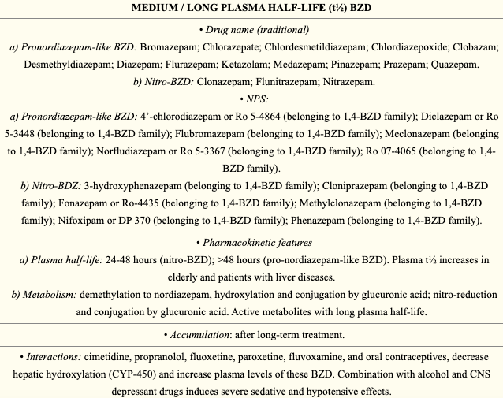
SB: Pharmacokinetics- Med ½ life
12
Notes:
Flubromazepam longest w/ halt life of 106 hours

Slide 38
SB: Concerns
Low price and easy access through the internet
Higher risk for unintentional overdose 2/2
High potency
No guarantee of composition and purification
Increasing reports of contamination with fentanyl
Little scientific data available on risks
16, 18, 21

Slide 39
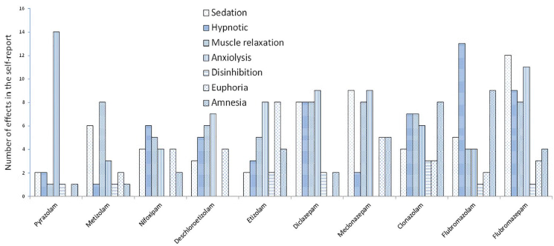
SB: Acute effects
19

Slide 40
SB: Adverse effects (acute)
Common adverse effects include somnolence, impaired balance, ataxia, impaired thinking, muscle weakness, confusion, slurred speech, blurred vision, amnesia, dizziness, delirium, AVH, respiratory depression and coma
Abrupt cessation can lead to anxiety, insomnia, restlessness, seizures that may be life-threatening
There are reports that AMS lasting several days
6, 22

Slide 41
SB: Adverse effects (chronic)
Extended use is associated with risk of impaired cognition, physiological and mental health sequelae consistent with traditional benzodiazepines
Dependence and tolerance have been documented
Compared with classical BZD, DBZD produce strong sedation and increase the risk of respiratory depression and death with concurrent use of CNS depressants
6, 19-20, 22

Slide 42
SB: Testing
Most DBZD can be detected by immunochemical assays in urine samples (sharing similar metabolites)
However
Some DBZD have atypical structures such as flutazolam and ketazolam
Blood/serum levels of DBZD can be too low to be detected by immunoassays
False negative confirmation by mass spectrometry 2/2 assays do not test for DBZD compounds
14, 23
Notes:
POC
However, when a preliminary positive sample that contains a non-FDA-approved BZD is analyzed for confirmation by mass spectrometry (MS), it will likely be negative, as many targeted BZD confirmation assays do not test for these compounds. This may lead to the incorrect interpretation of a false positive immunoassay-based BZD result.

Slide 43
SB: Treatment
In the light of limited research, recommend treating like typical benzodiazepine withdrawal
Important to:
consider extreme half life variations (ranging from a few hours to 100+ hours)
Anywhere from 2hr (Bentazepam, brotizolam) to 106 hours (Flubromazepam)
Assess for risk of acute withdrawal and determine ASAM LOC
Treat any co-occurring psychiatric conditions
Notes:
Outpatient with transition to long acting benzodiazepine (e.g. Valium) and slow taper vs inpatient admission for detox (using long acting benzodiazepines or phenobarbital)
Associated with anxiety disorders, ACEs and other substance use disorders

Slide 44
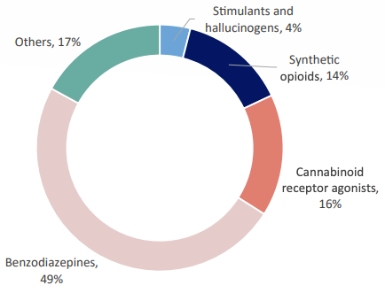
NPS associated with fatalities
2
Notes:
From United nations office on drug and crime early warning advisory
2020/21 post-mortem NPS case data (n=397), stimulants and hallucinogens accounted for 4% of the NPS detected in fatalities, followed by synthetic opioids (14%) and SCRAs (16%) with benzodiazepine-type NPS accounting for 49% of all cases. The remaining cases (17%) predominantly involved Kratom (Figure 6)

Slide 45
Case #3
ID: 31 M transferred to VUH for paralysis of bilateral lower extremity, rhabdomyolysis and acute hypoxic respiratory failure
Consult: assessment/management of substance use
HPI: (HD 2) limited d/t pt intubated and sedated; mother and fiancé report “polysubstance use”; recommend re-engagement once patient able to engage in meaningful interview

Slide 46
Case #3
(HD 13)- reconsulted for agitation recommendations in the context of infection and discontinuation of fentanyl; recommend PRN opioid agonist for pain and possible opioid withdrawal
(HD 17)- delirium resolving, pt intubated but able to engage in limited interview, endorses using kratom and tianeptine daily; recommend methadone for withdrawal/cravings

Slide 47
Case #3
Medical course: hospital course complicated by ventilator-associated pneumonia, pneumothorax and sacral osteomyelitis. Pt and family prefer abstinence treatment. Completed methadone taper and placed in skilled nursing facility
Recommendations: provided education re: MOUD and relapse prevention, naloxone prescription upon discharge and SUD tx resources

Slide 48
Kratom (KT)
Mitragyna speciosa
a tree native to Asian countries
Mitragynine- partial agonist of the mu/delta opioid receptors.
may interact w/ adrenergic and serotonergic receptors
7-hydroxymitragynine- mu-opioid agonist
30-fold more potent than mitragynine
Mitraphylline- acts both on mu/delta opiate receptors and NMDA receptor antagonist
24, 26
Notes:
Leaves contain…
Alkaloids mitragynine and 7-hydroxymitragynine have been identified to interact with the opioid receptors although the interaction is not entirely elucidated with some researchers indicating a full agonist activity with lower potency than morphine and others suggesting a partial agonist activity with higher potency than morphine
In addition, in vitro assays and animal studies indicate that mitragynine may also interact with several non-opioid receptors in the CNS including adrenergic and serotonergic receptors that may contribute to its antidepressant and mood-altering effects

Slide 49
Kratom (KT)
Sold over the internet and at smoke shops
Primarily marketed as an herbal medicine to treat a variety of ailments, “legal” high, and alternative to traditional opioids
Considered novel synthetic opioid (SO)/designer opioid
Kratom may be smoked, brewed, ingested as an extract or consumed as capsules
25
Notes:
(pain, mental health, opioid withdrawal symptoms)
Most commercially available powdered Kratom products in the US are recommended in doses of 2–6 g depending on the Mitragyna strain

Slide 50
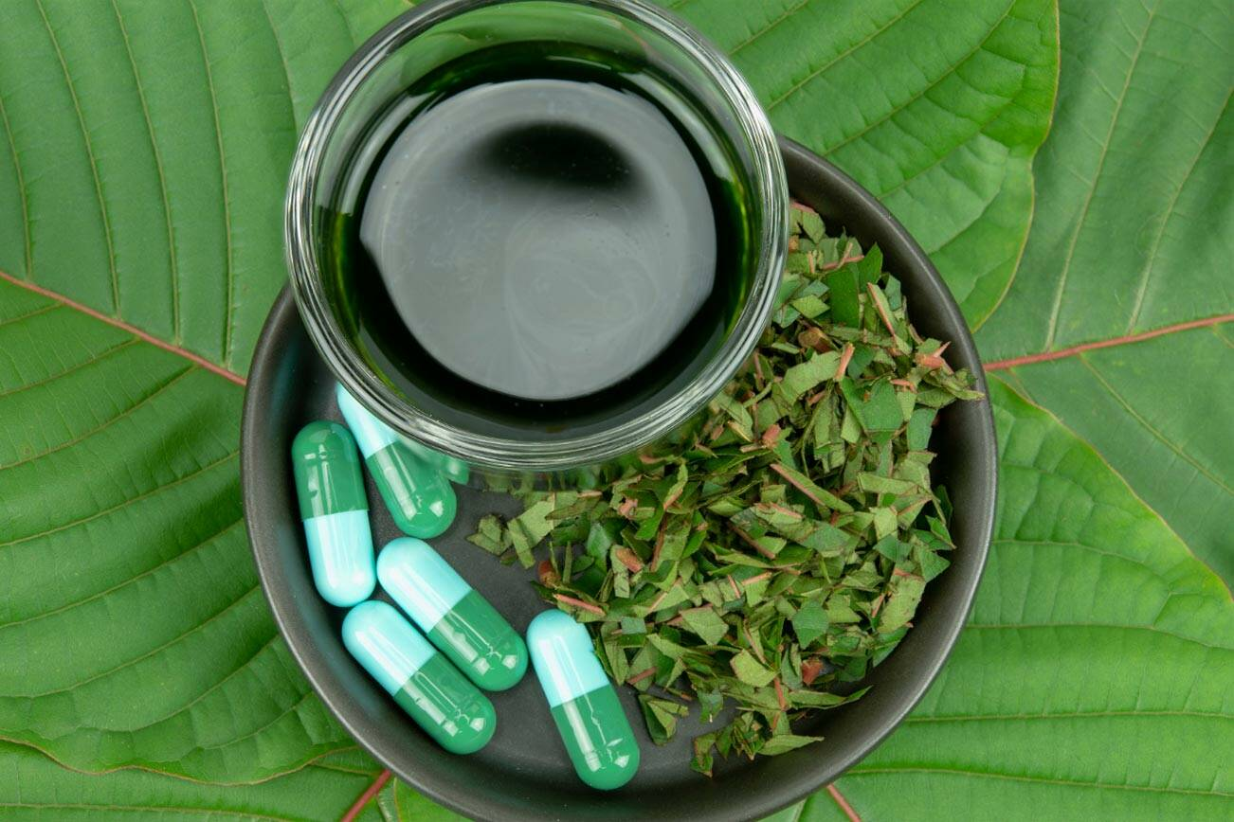
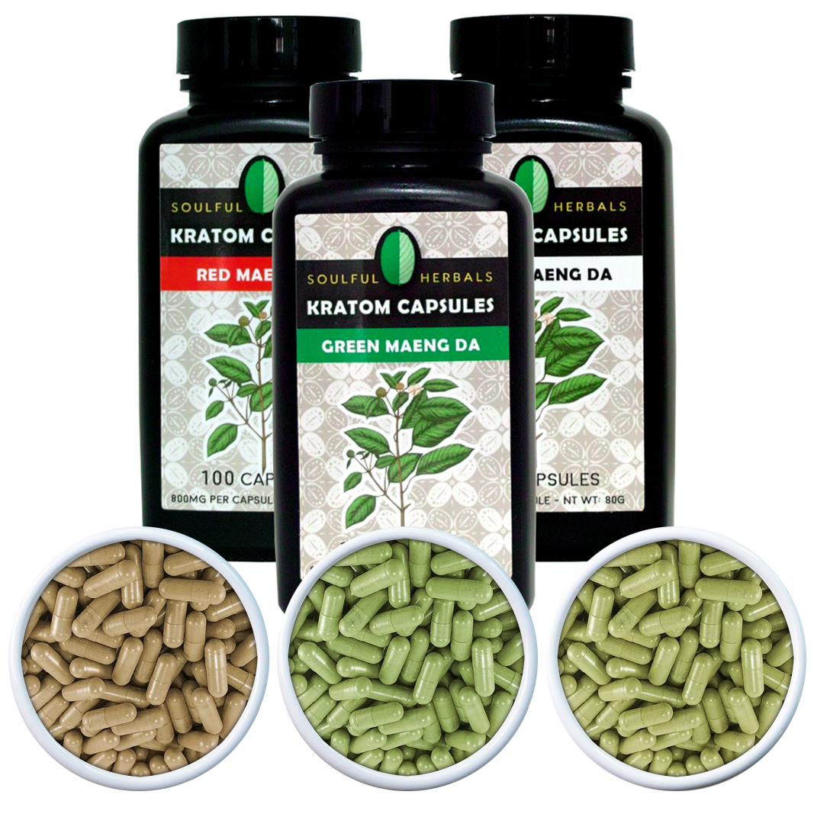
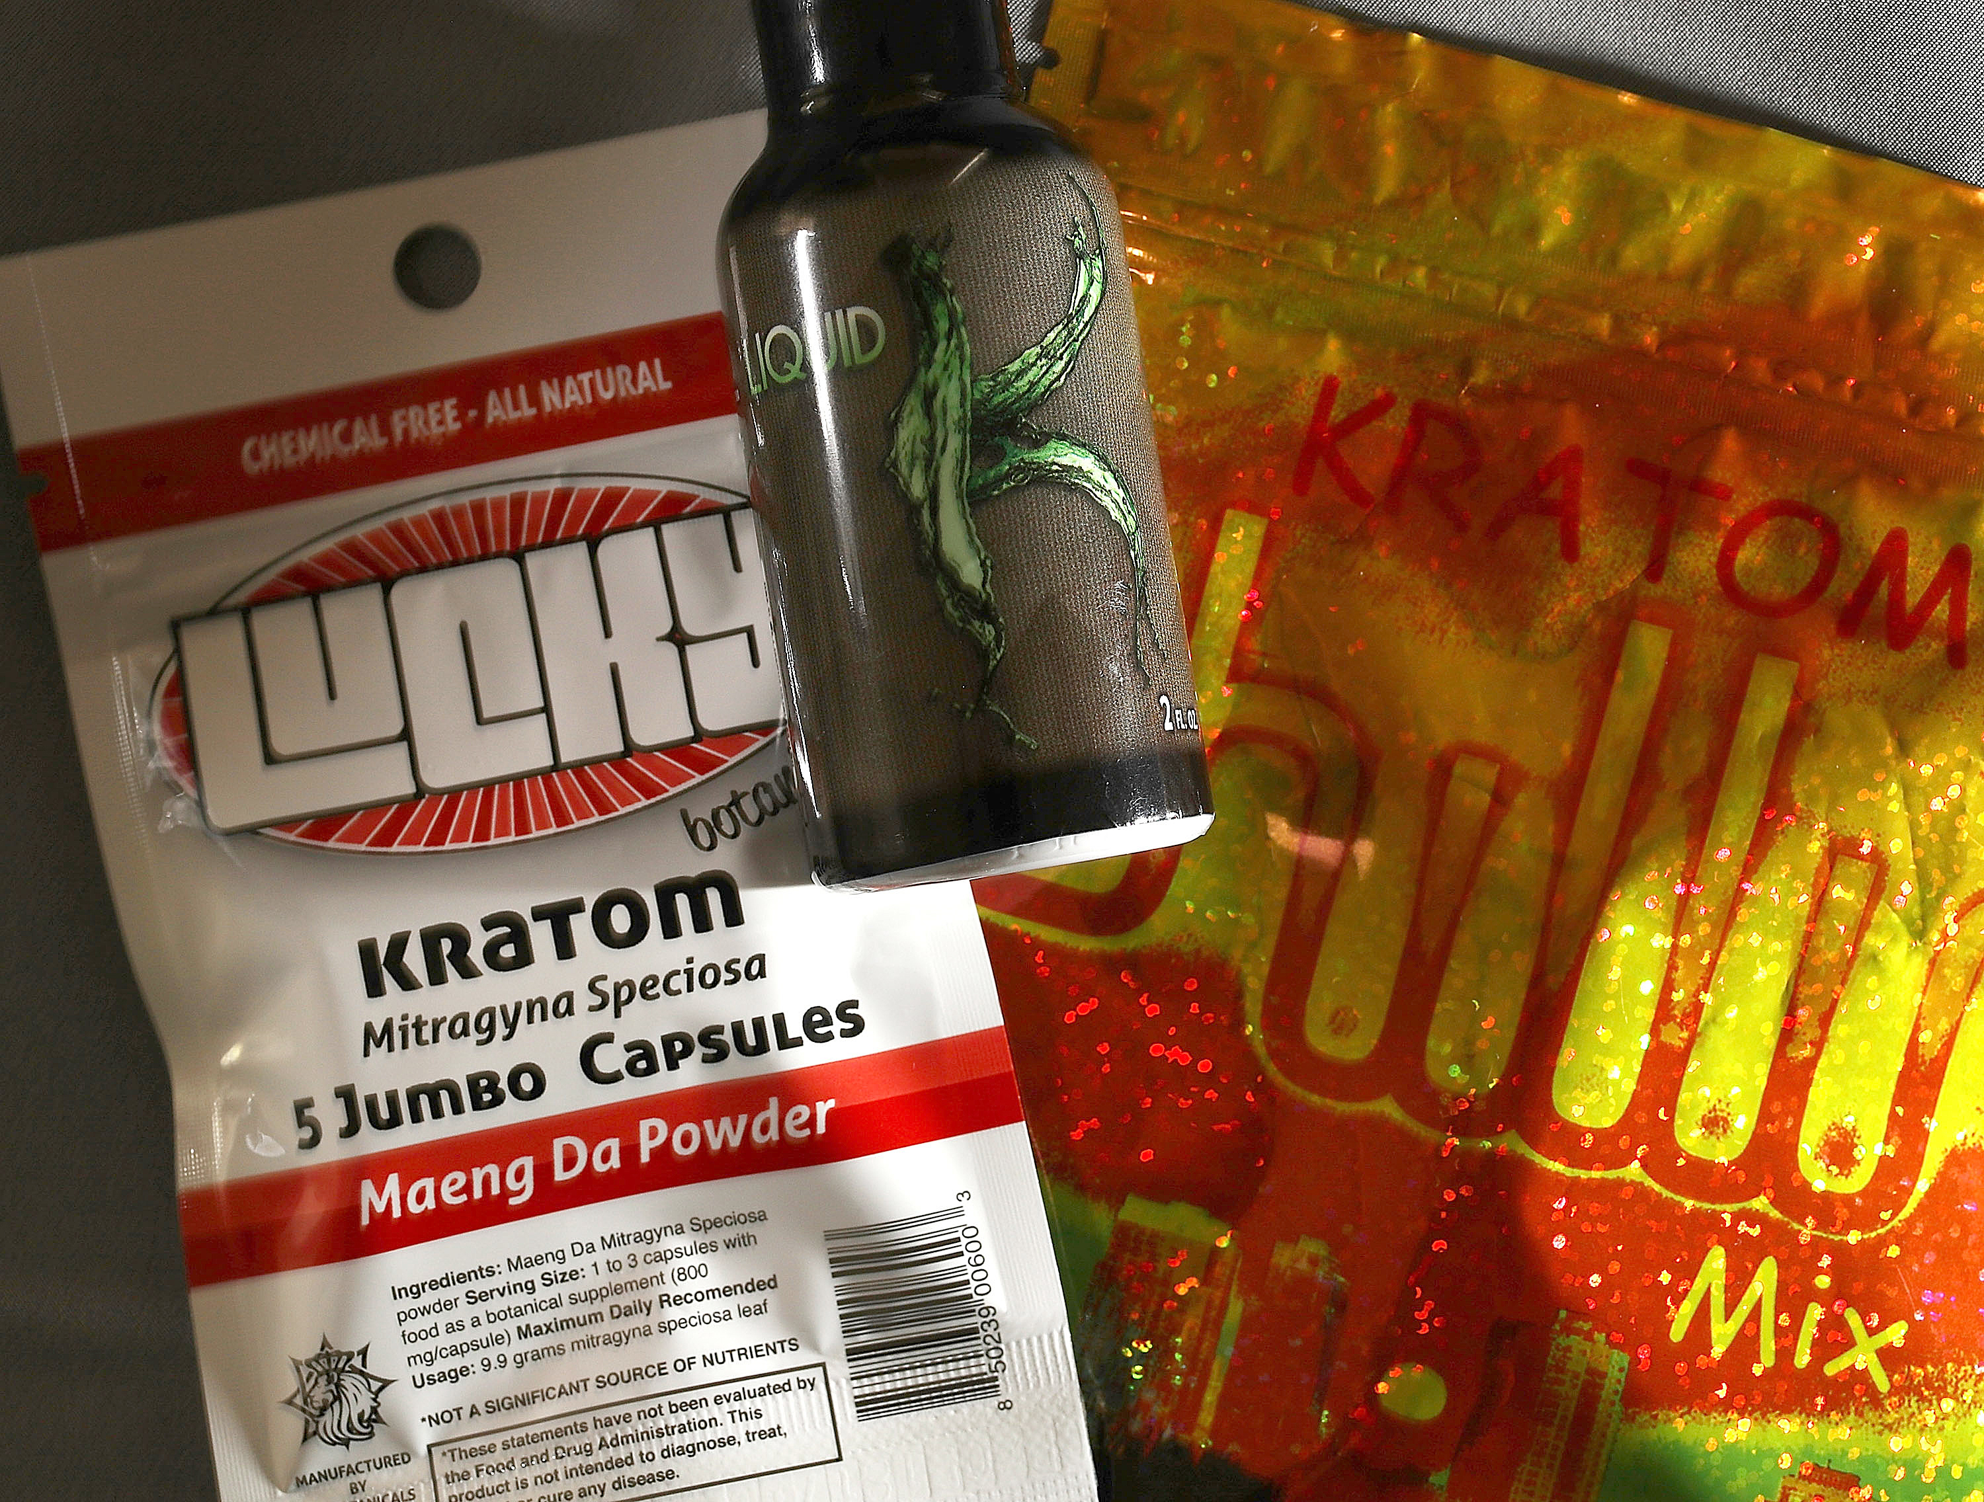

Slide 51
KT: Demographics & prevalence
Previous research has shown that Kratom users are
White non-Hispanic males
Ages 31 and 50 years old
In a relationship
Employed with an income of $35,000+
At least some college education
Students
Healthcare professionals
Prevalence: in 2021 use was 0.8%, life-time prevalence of 1.3%
26, 29
Notes:
From an anonymous online survey in the US in 2016 with a total of >8000 respondents showed that…

Slide 52
KT: Acute effects
Reports use for
Acute or chronic pain
Anxiety or depression
Opioid withdrawal
Increased energy
Users report either opiate-like sedation at higher dosages or cocaine-like stimulation at lower dosages
24, 26

Slide 53
KT: Adverse effects
Adverse effects include agitation/irritability, tachycardia, nausea, drowsiness/lethargy, vomiting, confusion, and HTN
Serious clinical effects include seizures, respiratory depression, coma, bradycardia, rhabdomyolysis, renal failure, cardiac arrest/asystole and hepatotoxicity
Dependence and opioid-like withdrawal symptoms with extended use
24, 26
Notes:
Hepatotoxicity associated with Kratom use is rare and appear to be associated with chronic or high consumption of the product
Case interacting with quetiapine… case further highlights the need for more investigation into Kratom–drug interactions, specifically involving CYP2D6 and CYP3A4.

Slide 54
KT: Testing
Not detected in standard toxicology (point of care)
Can use gas chromatography (GC) or mass spectrometry (MS) for the detection of mitragynine and its metabolites
However, this is expensive and uncommon (more seen with sports)
24, 26
Notes:
liquid chromatography-(tandem) mass spectrometry
Not common, expensive, more used for sports medicine

Slide 55
KT: Treatment
In-patient detoxification with buprenorphine or clonidine and a combination of oral dihydrocodeine and lofexidine
Case reports utilizing buprenorphine and methadone for long term treatment as MOUD
These have not been explored much due to the medico-legal hindrance from the classification of kratom as a nonopioid until recently. With kratom’s active constituents being declared opioid analogues, we are likely to see these agonist therapy modalities being used.
Contingency management
39-40, 43
Notes:
Currently, very few reports of buprenorphine- or methadone-assisted detoxification exist. These have not been explored much due to the medico-legal hindrance from the classification of kratom as a nonopioid until recently. With kratom’s active constituents being declared opioid analogues, we are likely to see these agonist therapy modalities being used.
There is also no evidence of how to handle longterm maintenance of sobriety.

Slide 56
Fentanyl and other designer opioids
Many of them are derivatives of therapeutically used drugs, namely fentanyl
Typically subdivided from base compound
4,5-epoxymorphinan ring (e.g. morphine)
phenylpiperidines (e.g. fentanyl)
diphenylheptylamines (e.g. methadone)
However, new synthetic opioids such as AH-7921, MT-45, and U-47700 with distinct structures
30-31
Notes:
Sold powders, nasal sprays, liquids, or in tablet forms

Slide 57
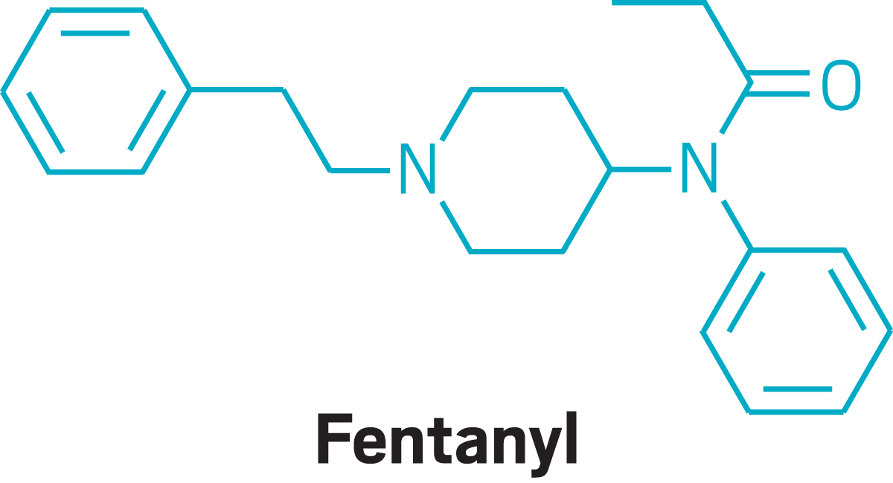
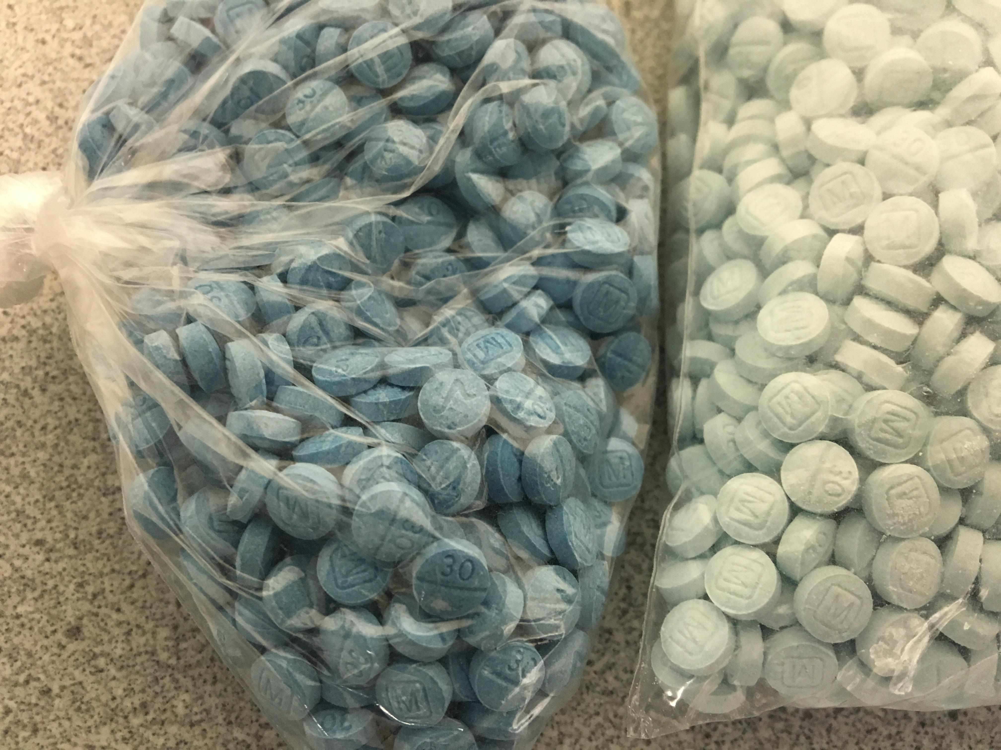
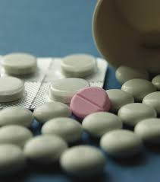

Slide 58
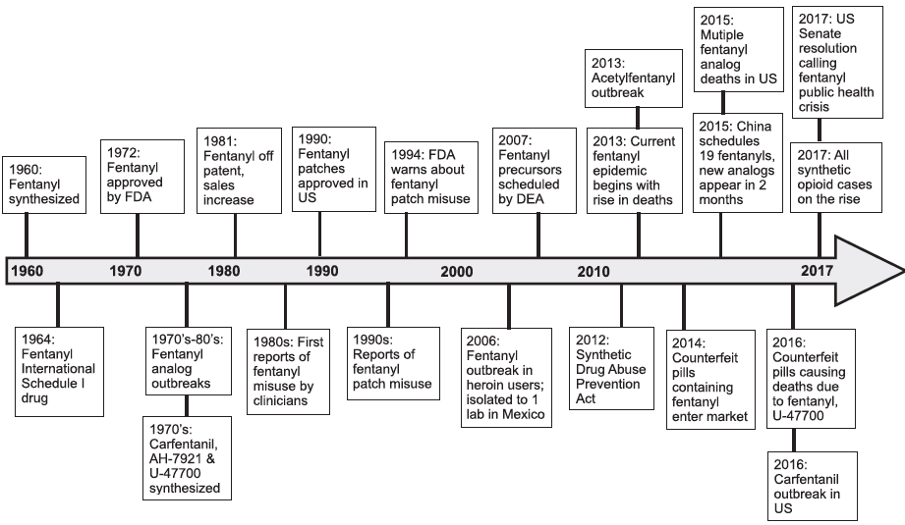
32
Notes:
Timeline of select synthetic opioid events in the US

Slide 59
Fentanyl: Mechanism of action
Full agonists at mu, delta and kappa opioid receptor subtypes, with selectivity for the mu opioid receptor
Many synthetic opioids are considerably more potent than traditional opioids
The potency of fentanyl: 50–100 times higher than morphine
Carfentanil: 10,000 times higher than morphine
34

Slide 60
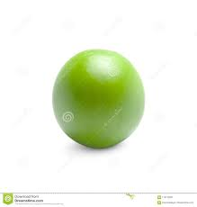
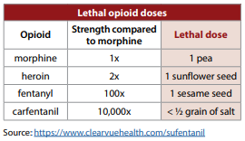
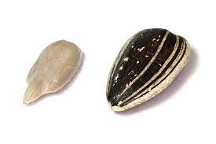
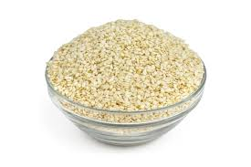
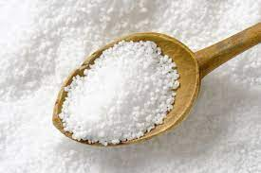

Slide 61
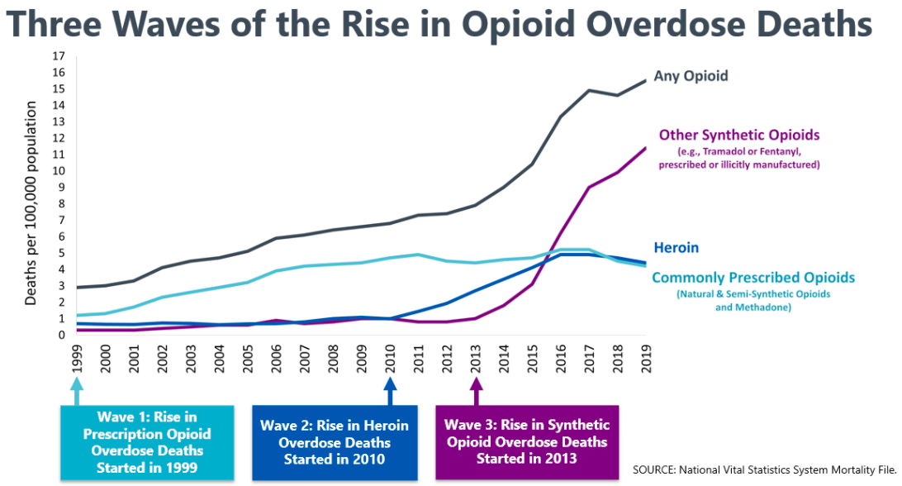
33
Notes:
Increased deaths associated with synthetics

Slide 62
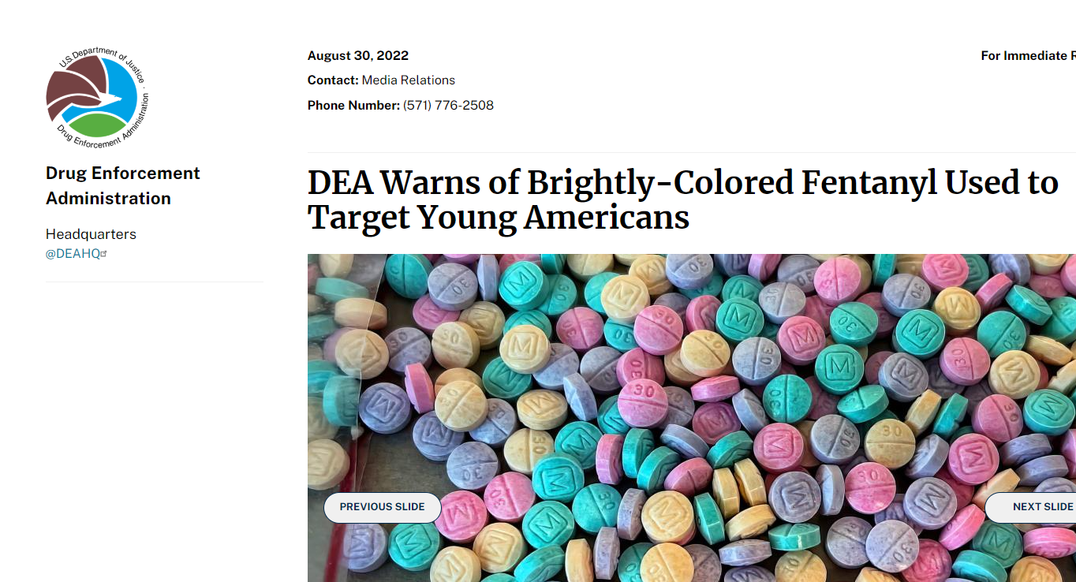
Fentanyl: In the media
45

Slide 63
Fentanyl: In the media
“WASHINGTON – The Drug Enforcement Administration is advising the public of an alarming emerging trend of colorful fentanyl available across the United States. In August 2022, DEA and our law enforcement partners seized brightly-colored fentanyl and fentanyl pills in 18 states. Dubbed “rainbow fentanyl” in the media, this trend appears to be a new method used by drug cartels to sell highly addictive and potentially deadly fentanyl made to look like candy to children and young people.
“Rainbow fentanyl—fentanyl pills and powder that come in a variety of bright colors, shapes, and sizes—is a deliberate effort by drug traffickers to drive addiction amongst kids and young adults,” said DEA Administrator Anne Milgram.
Brightly-colored fentanyl is being seized in multiple forms, including pills, powder, and blocks that resembles sidewalk chalk. Despite claims that certain colors may be more potent than others, there is no indication through DEA’s laboratory testing that this is the case. Every color, shape, and size of fentanyl should be considered extremely dangerous.”

Slide 64
Fentanyl: Concerns
Increasing rates of precipitated withdrawals with buprenorphine induction
Fentanyl highly lipophilic, rapidly transported across the blood brain barrier leading to rapid effects. High lipophilicity also causes fentanyl to be redistributed into adipocytes (fat), which may result in protracted excretion patterns--- precipitated withdrawal
Highly potent, thus requires more Narcan
Undetected on standard toxicology, thus can be overlooked
Cheap and most often sold as other substances
35-37

Slide 65
Fentanyl: Concerns
Fentanyl remains the deadliest drug threat facing this country.
According to the CDC, 107,622 Americans died of drug overdoses in 2021, with 66 percent of those deaths related to synthetic opioids like fentanyl.
Fentanyl available in the United States is primarily supplied by two criminal drug networks, the Sinaloa Cartel and the Jalisco New Generation Cartel (CJNG).
45

Slide 66
Fentanyl: Acute effects
Similar to opioids:
Analgesia
Anxiolysis
Euphoria
Drowsiness
Feelings of relaxation
Intoxication: reduced level of consciousness, respiratory depression and miosis
31-32

Slide 67
Fentanyl: Adverse effects
Mild: pruritus, nausea, vomiting, constipation, dizziness, dissociation, memory loss, motor impairment and sleep disturbance
Severe: respiratory depression, apnea, central nervous system depression, pulmonary edema, acute lung injury, diffuse alveolar hemorrhage, and rhabdomyolysis
31

Slide 68
Fentanyl: Testing
Not detected on typical toxicology
Can use gas chromatography (GC) or mass spectrometry (MS) for the detection of fentanyl and its metabolites
Specific enzyme-linked immunosorbent assays (ELISAs) are also available for MT-45, AH-7921, and U-47700
However, more manual processes and expensive
32
Notes:
However, does not test for newer synthetic opioids

Slide 69
Fentanyl: Treatment
Acute:
Protecting the airway and maintaining breathing and circulation
Naloxone (typically requiring higher doses)
Long term:
MOUD- buprenorphine, methadone, naltrexone
Naloxone script
Treat any co-occurring psychiatric conditions
Therapy/groups
32,36
Notes:
Narcan intranasal- 4 mg every 2-3 minutes. IV- 0.4 mg
Narcan- typically <0.1 mg for heroin, NSO range from 0.4 to 12 mg (mean dose higher than 3 mg). Other NSOs (MT-45, U-47700) typically respond to <2 mg of Narcan.
Overdose education
Carfentanyl- highest amount of Narcan at 18 mg, recommend monitoring for at least 24 hours
Overdose education and naloxone distribution: 25-45% reduction in deaths
Abstinence compared to MOUD: 90% relapse rates
Naltrexone (Vivitrol): shown to have same retention as Suboxone; however, lost a lot during induction time 2/2 need to be off all opioids 7-10 days
-works well for highly motivated patients (in residential settings or professionals)
-increased risk for OD with naltrexone 2/2 losing tolerance

Slide 70
Novel psychoactive substances: Summary
Novel psychoactive substances are becoming more prevalent over the past decade
Most NPS are not detected on standard toxicology, so remember to ask about synthetic substance use (especially if atypical presentation)
Provide education regarding risks, encourage safe cessation, screen for appropriate level of care, treat co-occurring psychiatric conditions and consult Addiction Psychiatry when needed

Slide 71
References
Bright, Stephen. "New and emerging drugs." Melbourne: Australian Drug Foundation (2013).
United Nations Office on Drug and Crime. Current NPS Threats: Volume IV [internet]. November 2021. Cited 22 December 2021. Available from: https://www.unodc.org/documents/scientific/NPS_threats_IV_web.pdf
Mills, Brooke, Andres Yepes, and Kenneth Nugent. "Synthetic cannabinoids." The American journal of the medical sciences 350.1 (2015): 59-62.
Spaderna, Max, Peter H. Addy, and Deepak Cyril D’Souza. "Spicing things up: synthetic cannabinoids." Psychopharmacology 228.4 (2013): 525-540.
Atwood BK, Huffman J, Straiker A, Mackie K (2010) JWH018, a common constituent of ‘Spice’ herbal blends, is a potent and efficacious cannabinoid CB receptor agonist. Br J Pharmacol 160:585–593
Tracy, Derek K., David M. Wood, and David Baumeister. "Novel psychoactive substances: types, mechanisms of action, and effects." Bmj 356 (2017).
Barratt MJ, Cakic V, Lenton S (2013) Patterns of synthetic cannabinoid use in Australia. Drug Alcohol Rev 32:141–146
Vardakou, Ioanna, Constantinos Pistos, and Ch Spiliopoulou. "Spice drugs as a new trend: mode of action, identification and legislation." Toxicology letters 197.3 (2010): 157-162.
Loeffler, George, Eileen Delaney, and Michael Hann. "International trends in spice use: prevalence, motivation for use, relationship to other substances, and perception of use and safety for synthetic cannabinoids." Brain research bulletin 126 (2016): 8-28.
Fantegrossi, William E., et al. "Distinct pharmacology and metabolism of K2 synthetic cannabinoids compared to Δ9-THC: mechanism underlying greater toxicity?" Life sciences 97.1 (2014): 45-54.
United Nations Office of Drug Control. UNOD. “Non-medical use of benzodiazepines: a growing threat to public health?” 2017.
Orsolini, Laura, et al. "‘New/Designer Benzodiazepines’: an analysis of the literature and psychonauts’ trip reports." Current neuropharmacology 18.9 (2020): 809-837.
Pope, Jeffrey D., et al. "Novel benzodiazepines (clonazolam and flubromazolam) identified in candy-like pills." Journal of Applied Laboratory Medicine 3.1 (2018): 48-55.
Moosmann, Bjoern, and Volker Auwärter. "Designer benzodiazepines: another class of new psychoactive substances." New psychoactive substances. Springer, Cham, 2018. 383-410.
Manchester, Kieran R., et al. "The emergence of new psychoactive substance (NPS) benzodiazepines: A review." Drug testing and analysis 10.1 (2018): 37-53.
Arens, Ann M., et al. "Adverse effects from counterfeit alprazolam tablets." JAMA internal medicine 176.10 (2016): 1554-1555.
European Monitoring Centre for Drugs and Drug Addiction. European Drug Report: Trends and Developments [internet]. 2020. Cited 22 December 2021. Available from: https://www.emcdda.europa.eu/system/files/publications/13236/TDAT20001ENN_web.pdf
Abouchedid, Rachelle, et al. "Assessment of the availability, cost, and motivations for use over time of the new psychoactive substances—benzodiazepines diclazepam, flubromazepam, and pyrazolam—in the UK." Journal of Medical Toxicology 14.2 (2018): 134-143.

Slide 72
El Balkhi, Souleiman, et al. "Designer benzodiazepines’ pharmacological effects and potencies: how to find the information." Journal of Psychopharmacology 34.9 (2020): 1021-1029.
Brunetti, Pietro, et al. "Designer Benzodiazepines: A Review of Toxicology and Public Health Risks." Pharmaceuticals 14.6 (2021): 560.
Beharry S and Gibbons S (2016) An overview of emerging and new psychoactive substances in the United Kingdom. Forensic Sci Int 267: 25–34.
Zawilska, Jolanta B., and Jakub Wojcieszak. "An expanding world of new psychoactive substances—designer benzodiazepines." Neurotoxicology 73 (2019): 8-16.
Marin MJ, van Wijk XMR. Designer benzodiazepines: New drugs challenge laboratories. Clinical and Forensic Toxicology News (Quarterly, AACC/CAP) June 2018:1-6.
Schifano, Fabrizio, et al. "Novel psychoactive substances of interest for psychiatry." World Psychiatry 14.1 (2015): 15-26.
Veltri, Charles, and Oliver Grundmann. "Current perspectives on the impact of Kratom use." Substance abuse and rehabilitation 10 (2019): 23.
Grundmann, Oliver. "Patterns of kratom use and health impact in the US—results from an online survey." Drug and alcohol dependence 176 (2017): 63-70.
Guddat, Sven, et al. "Mitragynine (Kratom)‐monitoring in sports drug testing." Drug testing and analysis 8.11-12 (2016): 1114-1118.
Eggleston, William, et al. "Kratom use and toxicities in the United States." Pharmacotherapy: The Journal of Human Pharmacology and Drug Therapy 39.7 (2019): 775-777.
Schimmel, Jonathan, et al. "Prevalence and description of kratom (Mitragyna speciosa) use in the United States: a cross‐sectional study." Addiction 116.1 (2021): 176-181.
Zawilska, Jolanta B. "An expanding world of novel psychoactive substances: opioids." Frontiers in psychiatry 8 (2017): 110.
Shafi, Abu, et al. "New psychoactive substances: a review and updates." Therapeutic advances in psychopharmacology 10 (2020): 2045125320967197.
Armenian, Patil, et al. "Fentanyl, fentanyl analogs and novel synthetic opioids: a comprehensive review." Neuropharmacology 134 (2018): 121-132.
Wide-ranging online data for epidemiologic research (WONDER). Atlanta, GA: CDC, National Center for Health Statistics; 2020. Available at http://wonder.cdc.gov.
Zawilska, Jolanta B. "An expanding world of novel psychoactive substances: opioids." Frontiers in psychiatry 8 (2017): 110.
Glasscott, Matthew W., et al. "Electrochemical sensors for the detection of fentanyl and its analogs: Foundations and recent advances." TrAC Trends in Analytical Chemistry (2020): 116037.
Salle, Sophie, et al. "Novel synthetic opioids: A review of the literature." Toxicologie Analytique et Clinique 31.4 (2019): 298-316.
Antoine, Denis, et al. "Method for successfully inducting individuals who use illicit fentanyl onto buprenorphine/naloxone." The American Journal on Addictions 30.1 (2021): 83-87.
Cooper, Ziva D. "Adverse effects of synthetic cannabinoids: management of acute toxicity and withdrawal." Current psychiatry reports 18.5 (2016): 52.
Kalin, Seth, Salaahuddin Dakhlalla, and Saurabh Bhardwaj. "Treatment for kratom abuse in a contingency-management-based MAT setting: A case series." Journal of Opioid Management 16.5 (2020): 391-394.
Abdullah, Bin, and Mohammad Farris Iman Leong. "Kratom dependence and treatment options: a comprehensive review of the literature." Current drug targets 21.15 (2020): 1566-1579.
Seely, Kathryn A., et al. "Spice drugs are more than harmless herbal blends: a review of the pharmacology and toxicology of synthetic cannabinoids." Progress in Neuro-psychopharmacology and biological psychiatry 39.2 (2012): 234-243.
May, Benedict, et al. "Synthetic cannabinoid receptor agonists detection using fluorescence spectral fingerprinting." Analytical chemistry 91.20 (2019): 12971-12979.
Stanciu, Cornel N., et al. "Kratom withdrawal: a systematic review with case series." Journal of psychoactive drugs 51.1 (2019): 12-18.
https://www.westword.com/marijuana/marshmallow-og-strain-review-14113992
https://www.dea.gov/press-releases/2022/08/30/dea-warns-brightly-colored-fentanyl-used-target-young-americans

