Slide 1

Tennessee Bureau of Investigation Trends in Law Enforcement Drug Seizures

Slide 2
Tennessee Bureau of Investigation Forensics Services/Crime Laboratory
Forensic Chemistry / Drugs

Slide 3


Slide 5
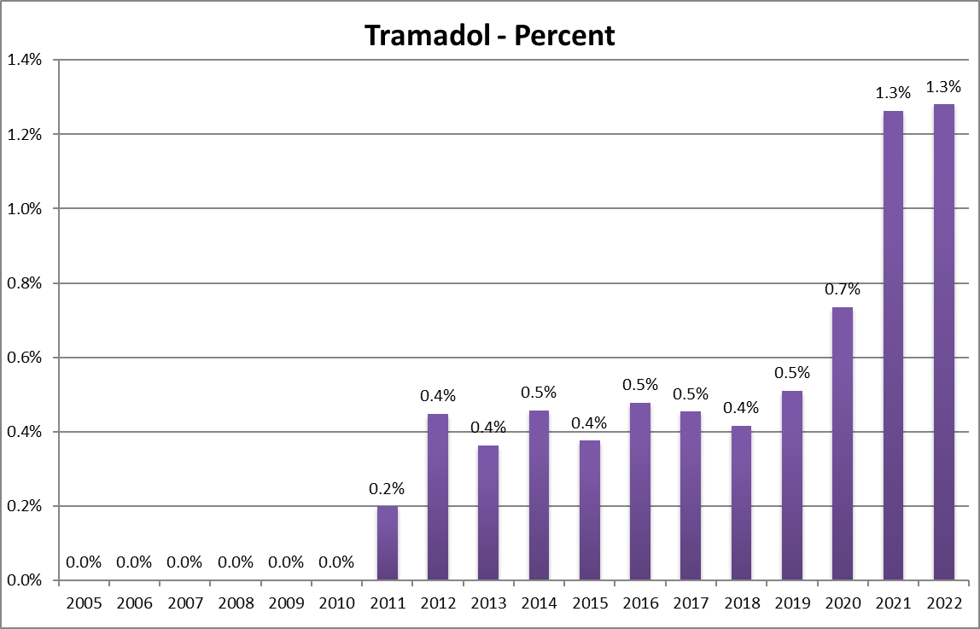

Slide 7
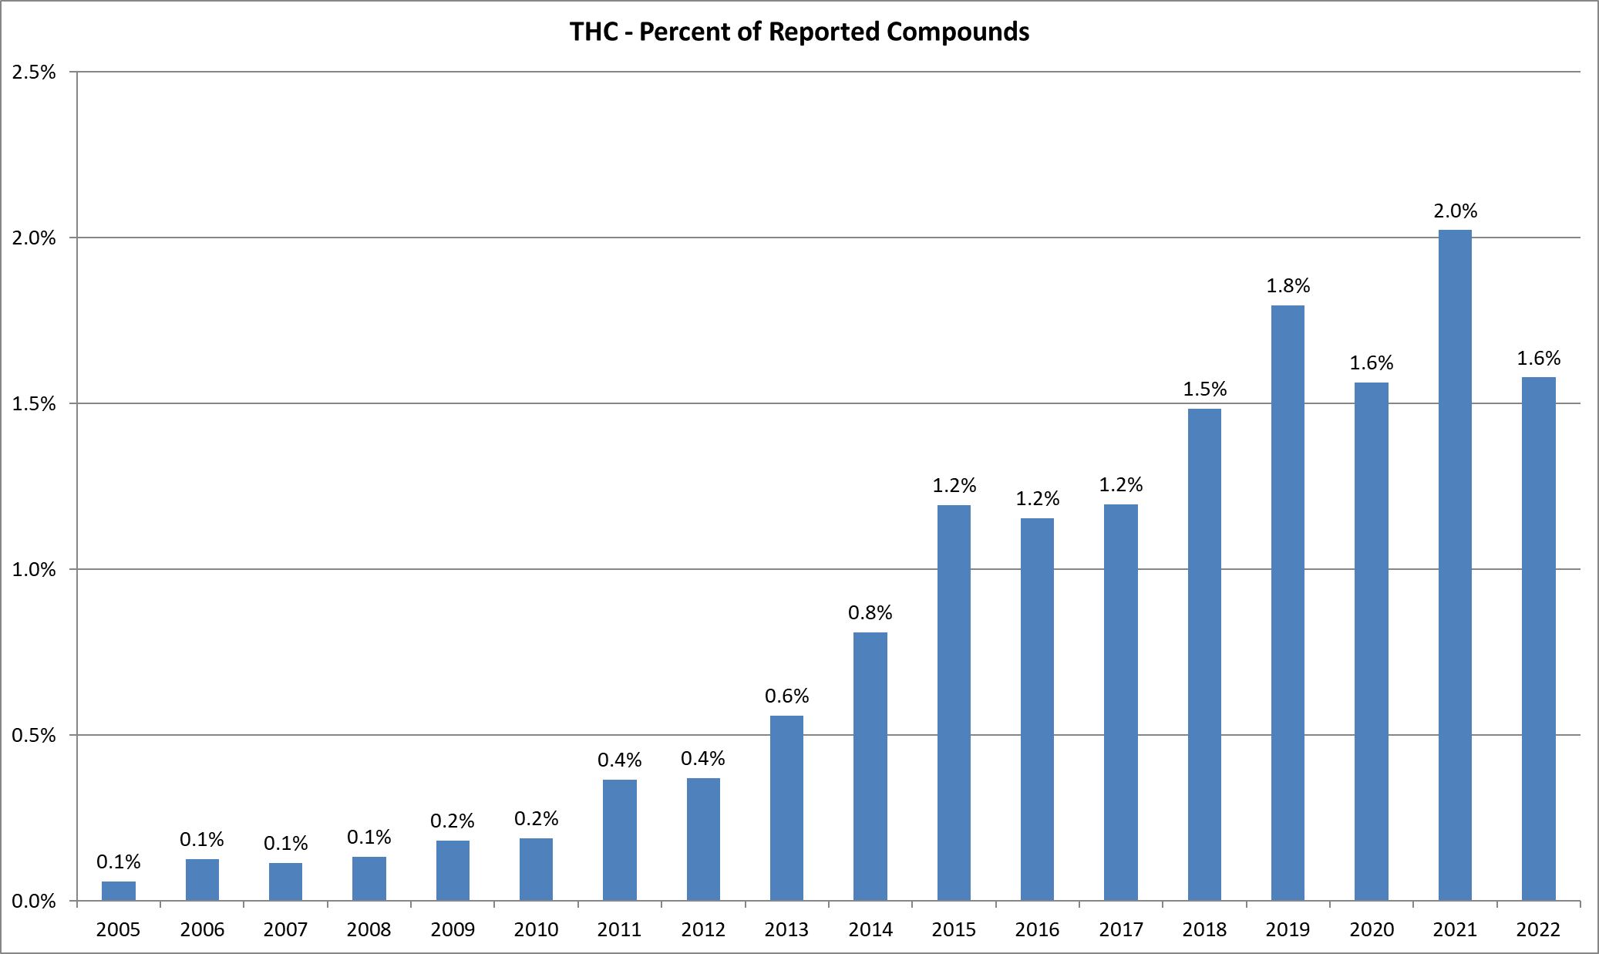

Slide 8
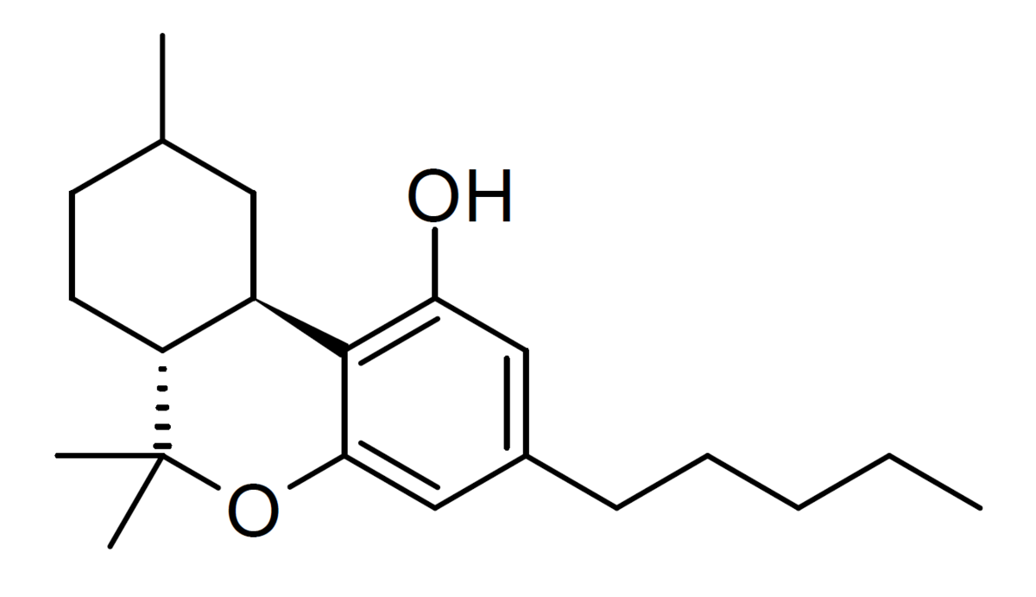
HHC - Hexahydrocannabinol

Slide 9
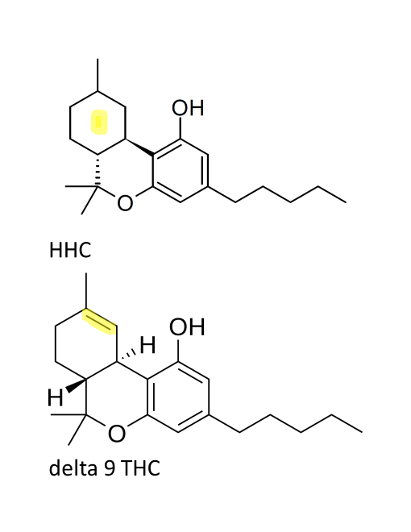
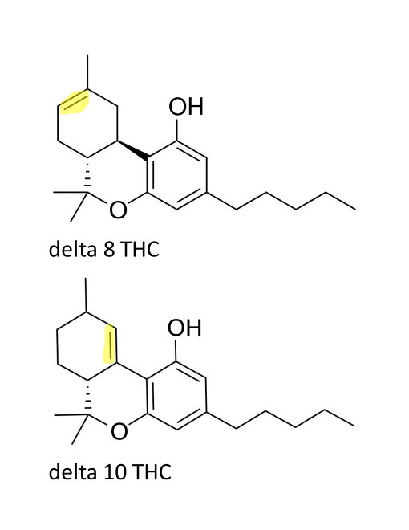

Slide 10
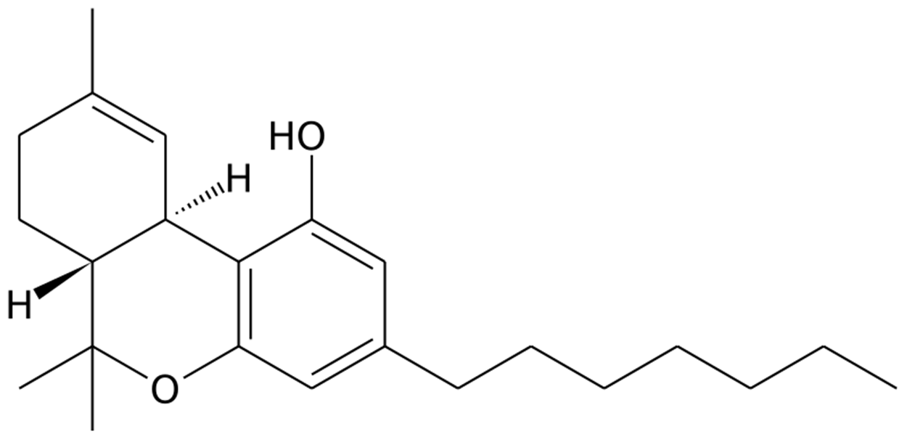
THCP – Tetrahydrocannabiphoral
30 times more potent than delta-9?

Slide 12
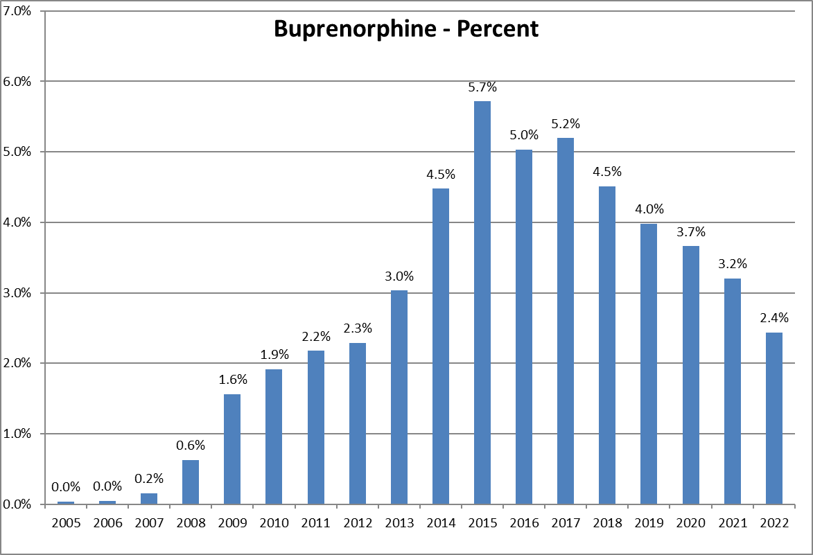

Slide 14
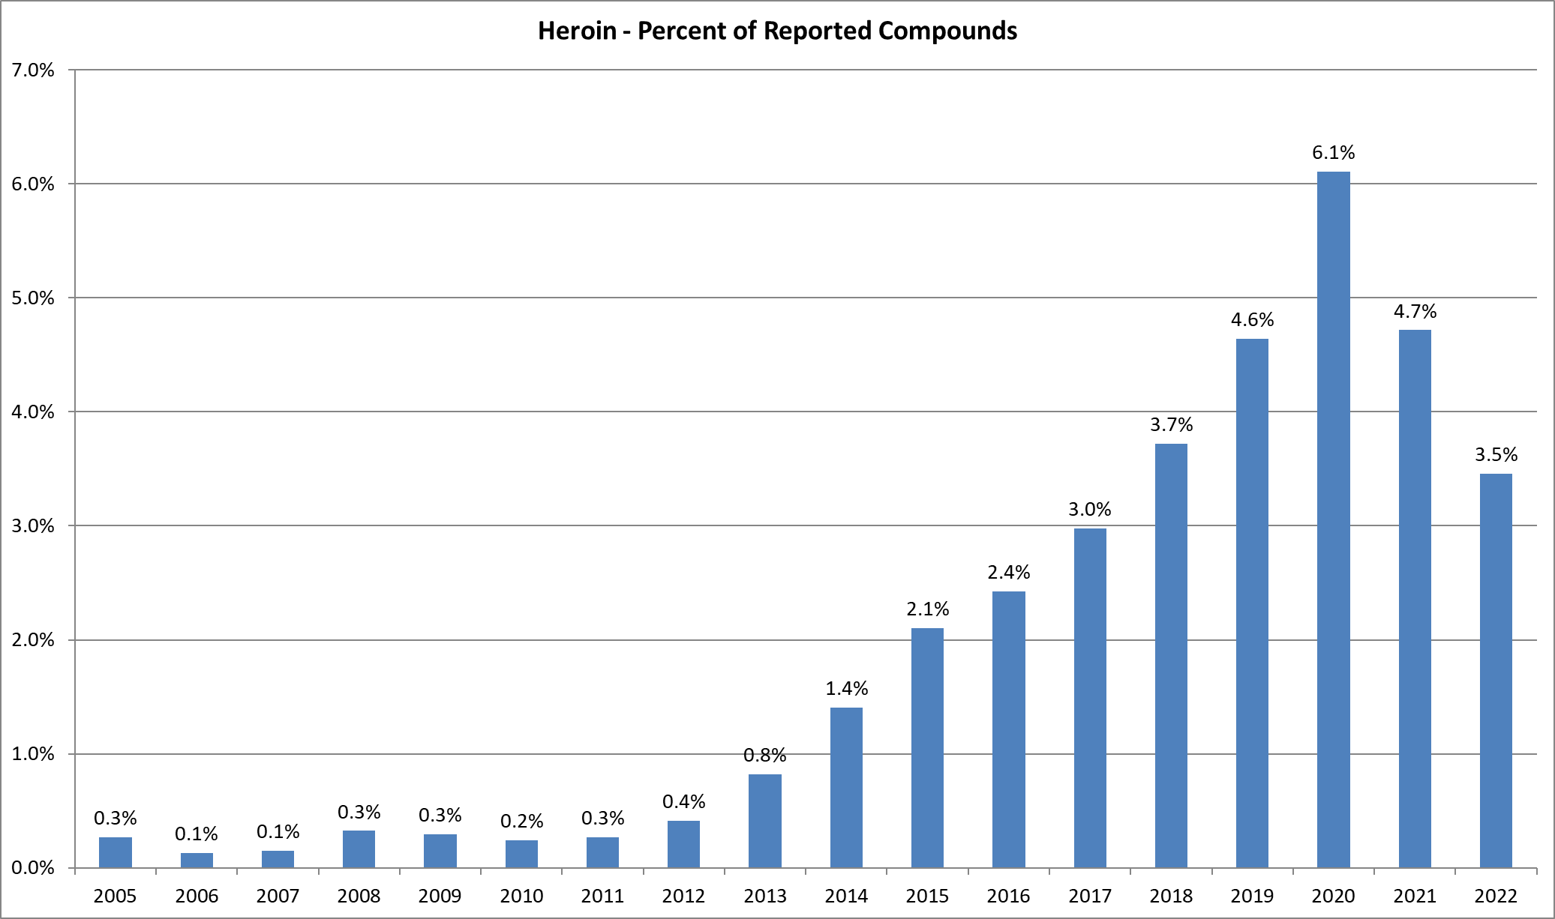

Slide 16
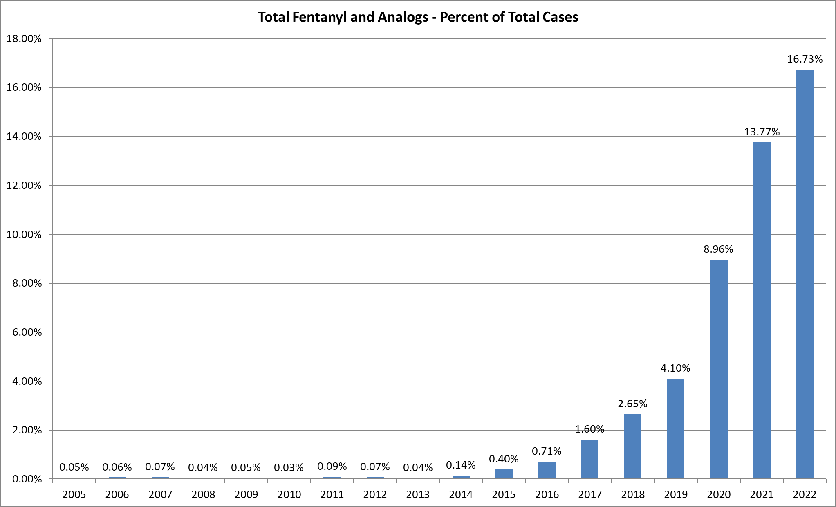

Slide 18
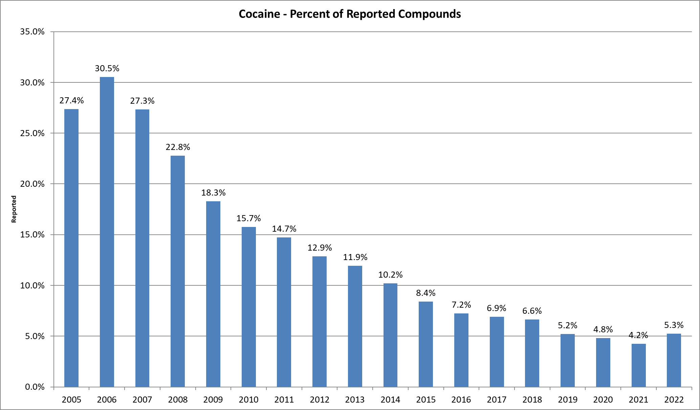

Slide 20
ANPP
(although schedule 2 on its own)
is a precursor in the
manufacturing process of fentanyl

Slide 22
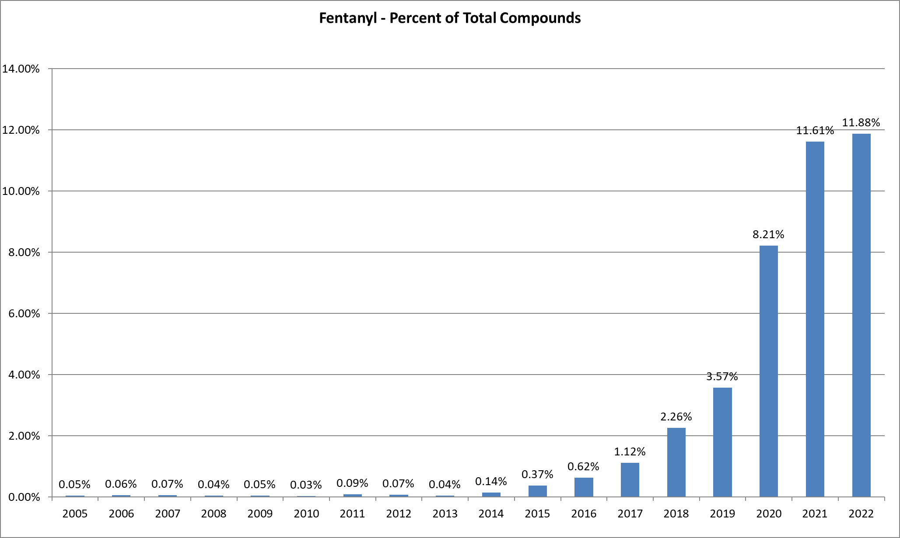

Slide 25
Approximately 93.45% (2,269 out of 2,428) of plant material is presumptively consistent with marijuana.
Approximately 6.55% (159 out of 2,428) of plant material is presumptively consistent with hemp.

Slide 26
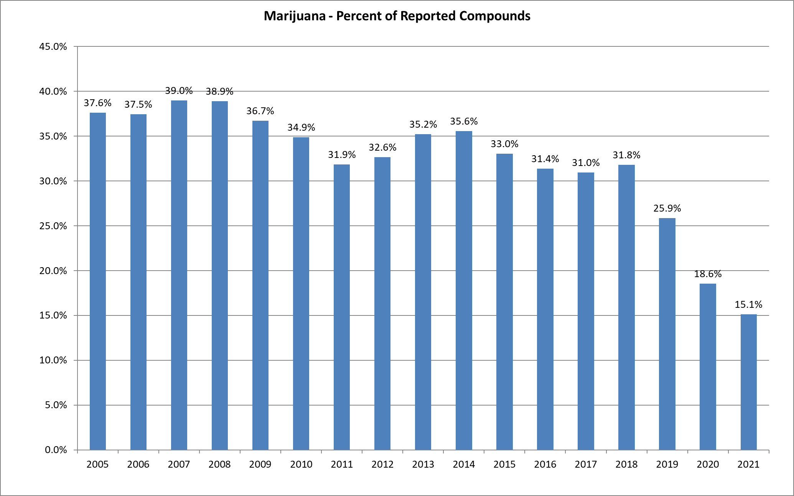

Slide 28
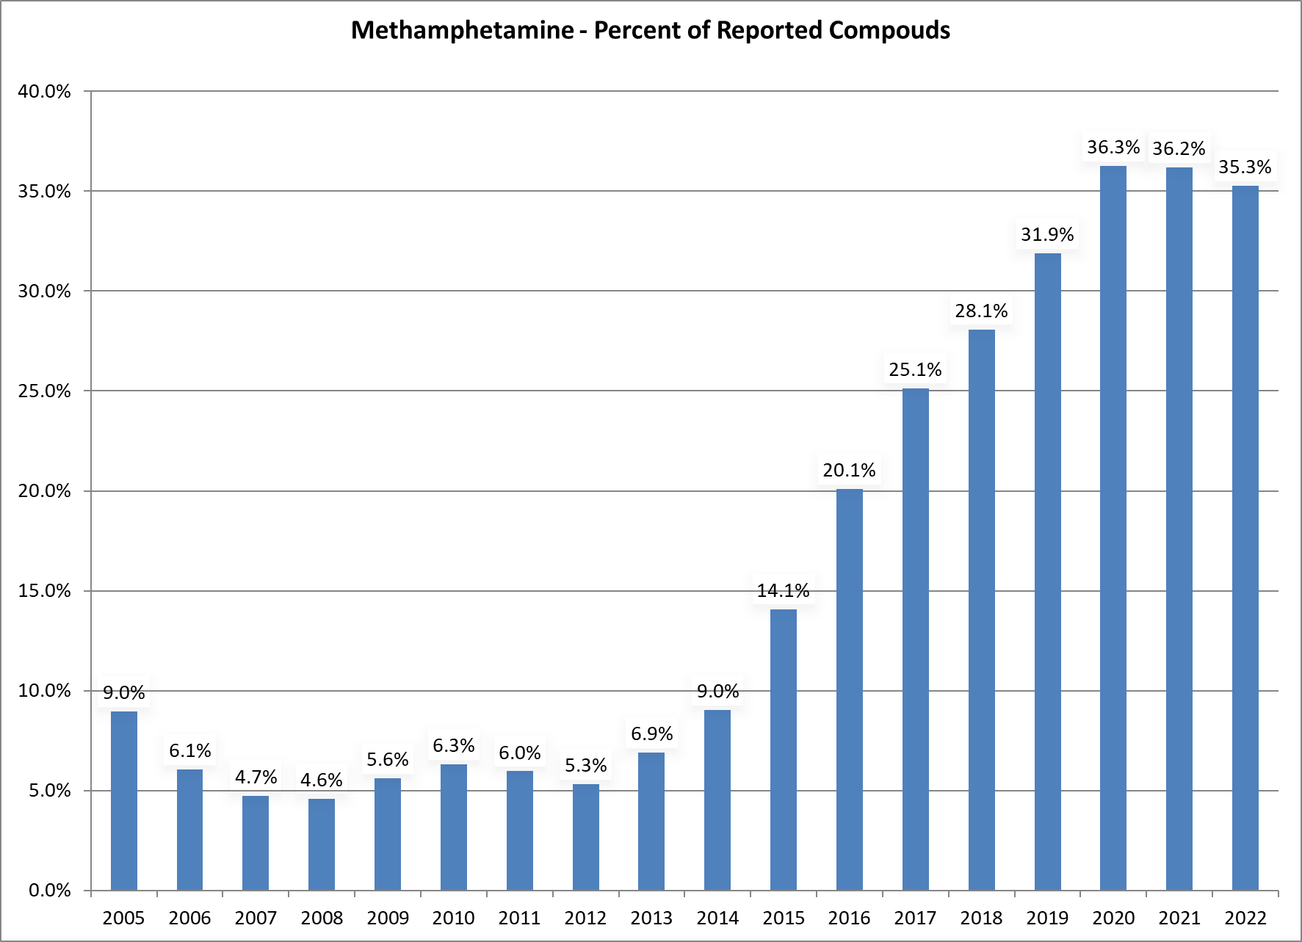

Slide 29
Drugs to watch Nitazenes
Metonitazene Isonitazene Pronitazene N-pyrrolidino Etonitazene Flunitazene

Slide 30
Drugs to watch Nitazenes
Nitazenes are potent synthetic opioids from a drug class known as benzimidazole-opioids. Recent studies show that the potency of nitazene compounds varies, with some being 1.5-40 times more potent than fentanyl.

Slide 31
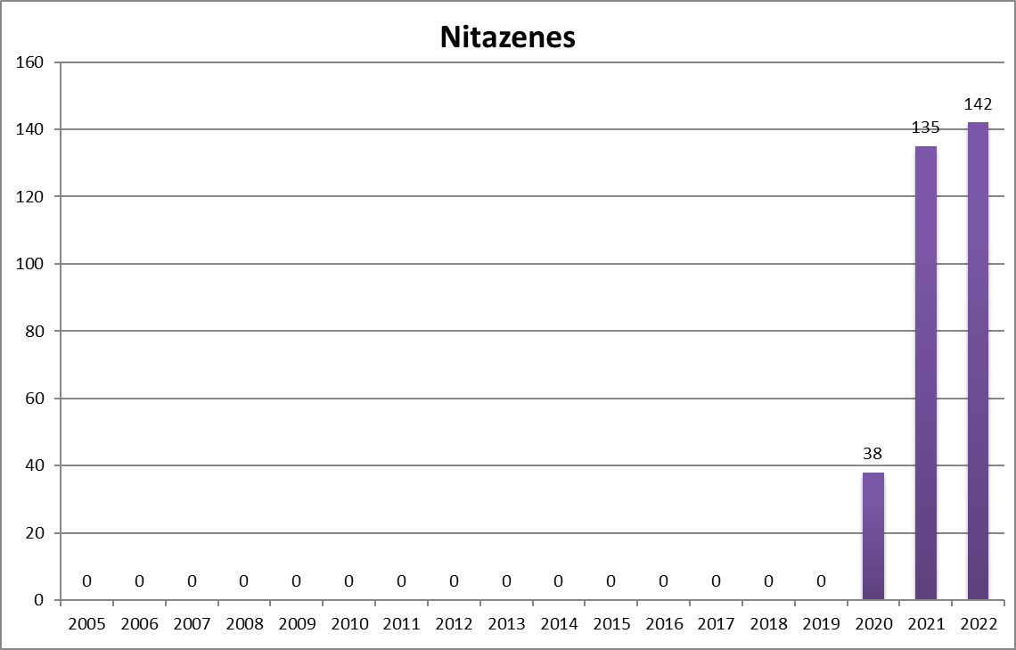

Slide 32
Drugs to watch Xylazine Xylazine, a non-opioid veterinary tranquilizer not approved for human use, has been linked to an increasing number of overdose deaths nationwide in the evolving drug addiction and overdose crisis. Studies show people exposed to xylazine often knowingly or unknowingly used it in combination with other drugs, particularly illicit fentanyl.

Slide 33
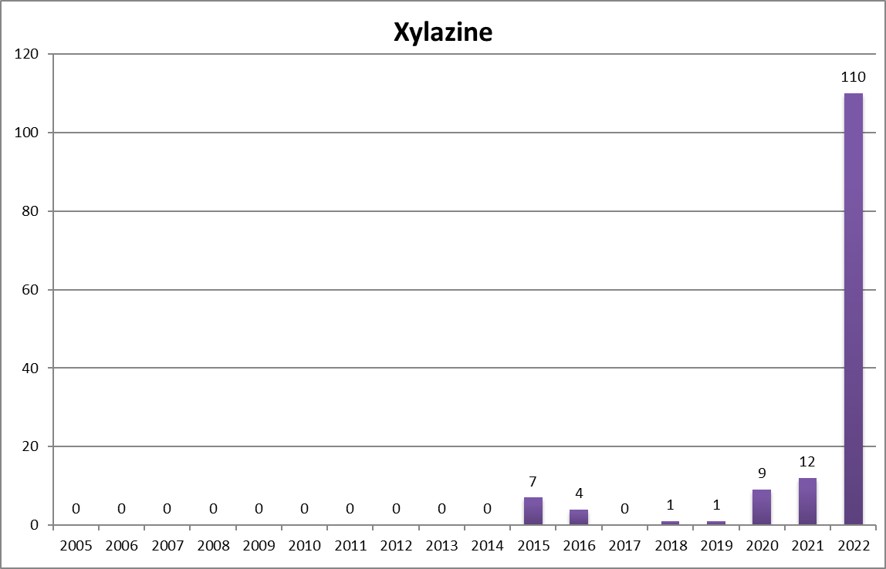

Slide 34

David B. Rausch
Director
Tennessee Bureau of Investigation
Office (615) 744-4367 / Cell (629) 395-0813
David.Rausch@tn.gov

