Slide 1
Please describe
A barrier you face to referring patients to MHOs

Slide 2
Intensive Referral to Mutual Help Organizations (MHOs)
David Marcovitz, MD
Mid-South Addiction Conference
October 23rd 2022

Slide 3
Learning objectives
Participants will be able to discuss the evidence in support of the effectiveness of Mutual Help Organizations (MHOs) like Alcoholics Anonymous/Narcotics Anonymous (AA/NA) and SMART Recovery as adjunctive treatment in patients with addictions
Participants will be able to address common patient reservations about attending MHOs
Participants will be able to make referrals to MHOs and know three methods to increase the effectiveness of these referrals
Notes:
Get at objectives by taking this from the angle of a patient in your clinic: what are your reservations about referring and what are the patient’s reservations about going → this gets obliquely at the evidence, the referral procedure and how to increase the effectiveness of your referrals.

Slide 4
Why do we care about MHOs?
Passage of ACA plus updates on parity laws will mean and additional 62.5 million people obtained mental health and/or substance use disorder benefits.
Professional addiction services remain inadequate to the needs to those with SUD
In the US, MHOs are the most frequently sought source of support for substance-related problems.
MHOs are free of charge and in the case of 12-Step groups, highly prevalent
www.drugabuse.gov/nidamed-medical-health-professionals/addiction_medicine_in_primary_care
Beronio et al http://aspe.hhs.gov/health/reports/2013/mental/rb_mental.pdf; SAMSHA, 2010. aaboston.org

Slide 5
Case
Ms. B is a 56 year old widowed woman with HTN and alcoholic hepatitis who presents after a fall and is found to have urosepsis. As she recovers from her infection, psych is consulted about her ongoing alcohol use at home. She admits to drinking at least 4-6 vodka drinks each night when she gets home from work.
What steps will you take to help this patient?

Slide 6
Case Continued
Further history, ?need for detoxification
Outpatient service options
Role of medications
Role of mutual help organizations?
What are your hesitations about discussing MHOs like AA/NA and SMART with this patient?
Notes:
Topics we will not discuss in detail
Does severity impact whether you will think of referring?

Slide 7
Learning objectives
Participants will be able to discuss the evidence in support of the effectiveness of Mutual Help Organizations (MHOs) like Alcoholics Anonymous/Narcotics Anonymous (AA/NA) and SMART Recovery as adjunctive treatment in patients with addictions
Participants will be able to address common patient reservations about attending MHOs
Participants will be able to make referrals to MHOs and know three methods to increase the effectiveness of these referrals
Notes:
Get at objectives by taking this from the angle of a patient in your clinic: what are your reservations about referring and what are the patient’s reservations about going → this gets obliquely at the evidence, the referral procedure and how to increase the effectiveness of your referrals.

Slide 8
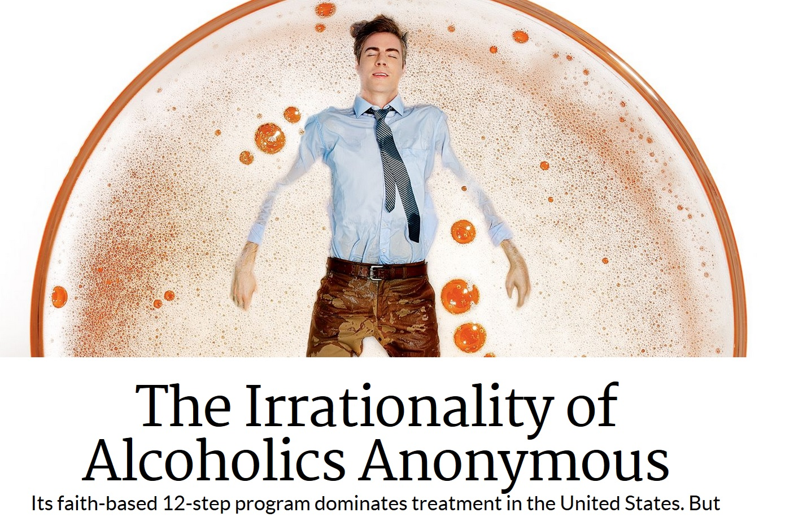
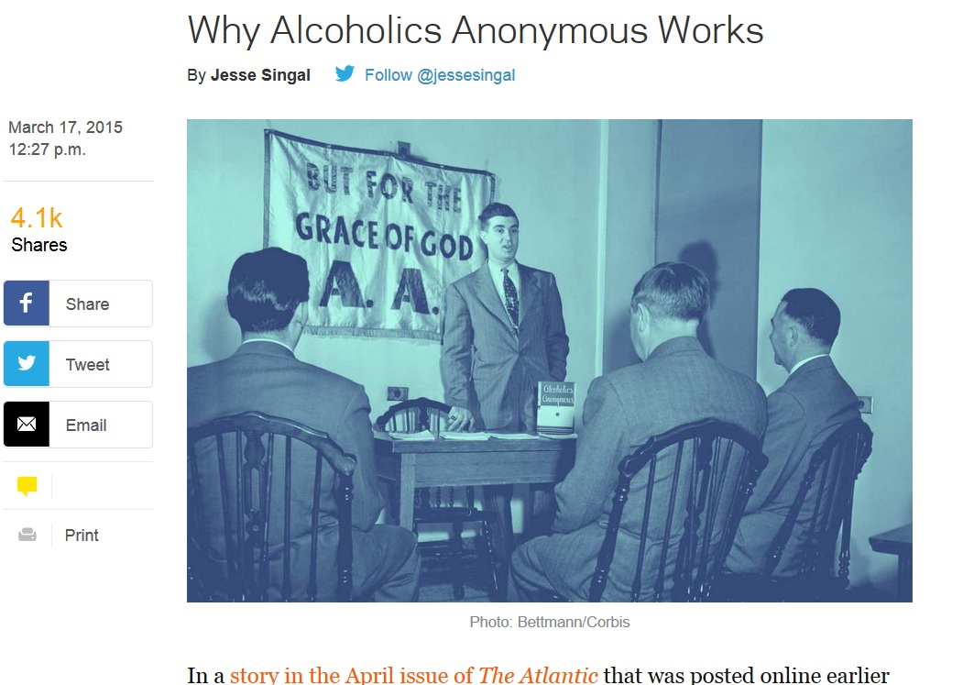

Slide 9
Evidence vs. Philosophy
Moderation and harm-reduction are different goals than abstinence.
Which is “better”?
It depends

Slide 10
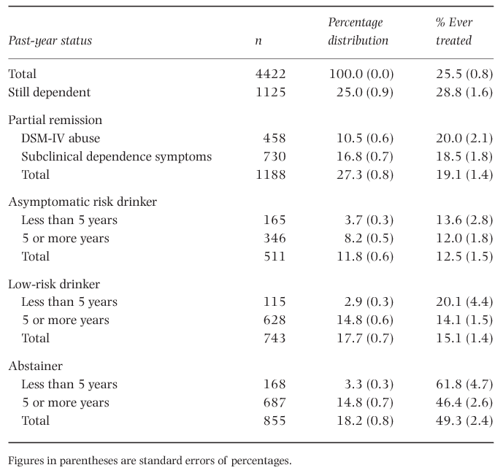
Pathways: Natural recovery?
Only 25% of persons with PPY alcohol dependence still dependent in past year
Of 35% in full remission, ~10% had professional tx
Severity of AUD more than level of consumption associated negatively with non-abstinent recovery (Tucker et al, 2020)
But consumption level maya matter (Moos, 2006)
Dawson, D. A., et al Addiction 2001-2002 using NESARC data
Notes:
Ted asked me basis for abstinence model.
We tell our patients “Our data suggests that” while AA says, “If you think you are one of us, half measures avail us nothing”;
A lot about alcohol; more prevalent still, also more gray areas given legalization etc. compared to opioids.

Slide 11
Lack of familiarity with evidence-base (or whether this is even an evidence-based treatment)
A variety of MHOs exist with differing amounts of evidence. These include: 12-Step Groups, Self-Management and Recovery Training (aka SMART Recovery), Moderation Management, Women for Sobriety, etc.
Key take home: 12-Step groups currently have the most evidence w/ >100 studies done looking at effectiveness of AA. Overall meta-analyses show a moderate beneficial effect of attending on par with professional treatment.
Kelly et al, 2020. Ferri et al, 2006., Timko et al, 2000.; Emrick et al, 1993.
Notes:
Mention AA, NA, MA, CA by name, behaviorally focused i.e. gambling, debt, sexual compulsions
(meant to be voluntary and unethical to deny access)

Slide 12
Updated Cochrane Review: 2020
Results: A total of 27 studies (21 RCTs/quasi-experiments, 5 nonrandomized and 1 purely economic study) containing 10,565 participants were included. AA/TSF interventions performed at least as well as established active comparison treatments (e.g. CBT) on all outcomes except for abstinence where it often outperformed other treatments. AA/TSF also demonstrated higher health care cost savings than other AUD treatments.
Kelly, J. F., Humphreys, K., & Ferri, M. (2020). Alcoholics Anonymous and other 12‐step programs for alcohol use disorder. Cochrane Database of Systematic Reviews, (3).
Notes:
Twelve studies (including three evaluations of effectiveness) were identified. Alcohol-related outcomes were the primary focus. Standardized assessment of nonalcohol substance use was infrequent. Information about behavioral addiction was restricted to limited prevalence data. Functional outcomes were rarely reported. Feasibility was largely indexed by attendance. Economic analysis has not been undertaken. Little is known about the variables that may influence treatment outcome, but attendance represents a potential candidate. Assessment and reporting of mental health status was poor. Although positive effects were found, the modest sample and diversity of methods prevent us from making conclusive remarks about efficacy. Further research is needed to understand the clinical and public health utility of SMART as a viable recovery support option. (PsycInfo Database Record (c) 2020 APA, all rights reserved)

Slide 13
AUD: Evidence Base for 12-Step Groups
Challenging to study 12-Steps? Various ways including RCT of “proxies” for attendance (like 12-Step Facilitation) versus prospective trials
Notes:
MATCH – Matching Alcohol Treatments to Client Heterogeneity – N=1726, 8 year multisite, two groups (inpatient and outpatient), NIAAA funded
People who had high network support for drinking had big effect at 3 years from AA; helps people change their social network
Moos and Moos,2006: Longer duration of AA attendance in years 1-3 predicted abstinence at year 16
IOM called for more research in 1990 because so influential, so many groups, so now we’ve moved over past 25 years from numerous high quality effectiveness trials and efficacy studies of TSF to moderators of how it works. This is on the national registry of evidence based practices on SAMSHA.

Slide 14
AUD: Evidence Base for 12-Step Groups
Best known RCT of TSF: NIAAA-funded Project MATCH: TSF condition compared with CBT or MET
Equal
Though more patients continuously abstinent at 1 and 3 years in TSF condition
*Patients in MET and CBT able to attend AA
McKellar, Stewart, & Humphrey, 2003; Tonigan et al 2003, Cooney et al 2003)

Slide 15
AUD: Prospective examples:
Moos and Moos, 2006: Long term prospective study, N=626, AA has similar outcomes w/ pro. tx at year 8, followed to year 16.
Ouimette, 1998: Large VA sample N=3,018; 12-Step MHO attendance alone resulted in greater abstinence at 1 year, less depression, compared to OP (combo best)
Humphreys and Moos, 2007: 12-Step compared to CBT; 1/3 more patients abstinent at 1 and 3 years compared to CBT; health care cost off-set of 8K per patient at 2 years
McKellar, Stewart, & Humphrey, 2003; Tonigan et al 2003, Cooney et al 2003)
Notes:
MATCH – Matching Alcohol Treatments to Client Heterogeneity – N=1726, 8 year multisite, two groups (inpatient and outpatient), NIAAA funded
People who had high network support for drinking had big effect at 3 years from AA; helps people change their social network
Moos and Moos,2006: Longer duration of AA attendance in years 1-3 predicted abstinence at year 16
IOM called for more research in 1990 because so influential, so many groups, so now we’ve moved over past 25 years from numerous high quality effectiveness trials and efficacy studies of TSF to moderators of how it works. This is on the national registry of evidence based practices on SAMSHA.

Slide 16
AUD: Evidence Base for 12-Step Groups
Also COMBINE Trial
Landmark study of various combinations of meds + “medical management” + BT for AUD
Medical Management + Placebo better than specialized BT
Added benefit of medical management partially mediated by strong rec to attend AA.
*Also true of “cocaine collaborative” trial
Anton et al, 2006. Weiss et al, 2008. *Crits-Cristoph, 1999.

Slide 17
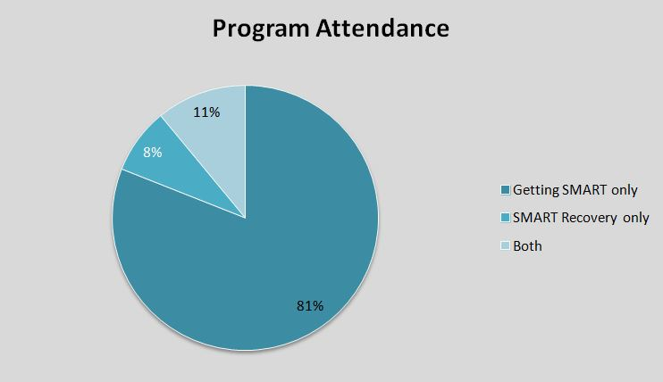
Evidence base for other MHOs
SMART Recovery – one small RCT N=189, 2 cross sectional survey studies
Meeting attendance increased percent days abstinent and decreased drinks per drinking day at 3 months
Australian quasi-experimental study of n=5764 ; SMART reduced rates of prison recidivism
Other groups – minimal if any data
Hester, 2013., Atkins & Hawdon, 2007; Li, Feifer, & Strohm, 2000, Bland 2016.

Slide 18
SMART Recovery
Although positive effects were found, the modest sample and diversity of methods prevent us from making conclusive remarks about efficacy. Further research is needed to understand the clinical and public health utility of SMART as a viable recovery support option.
Beck, A. K., Forbes, E., Baker, A. L., Kelly, P. J., Deane, F. P., Shakeshaft, A., ... & Kelly, J. F. (2017). Systematic review of SMART Recovery: Outcomes, process variables, and implications for research. Psychology of Addictive Behaviors, 31(1), 1.

Slide 19
What about OUD?

Slide 20
OUD: Evidence Base for 12-Step Groups
Cohort studies of outpatients receiving Suboxone that show association between mutual help attendance and:
Improved abstinence (Mintzer et al., 2007; Parran et al., 2010) or treatment retention (Marcovitz et al, 2016; Stein & Friedmann, 2005).
Monico et al., 2015 –300 opioid-dependent African American patients in Baltimore from RCT of standard versus intensive outpatient services for pts receiving BN
Attendance at N.A. associated with greater retention and abstinence at 6 months, dose dependent, though “requiring” N.A. did not yield better outcomes
Notes:
. Indeed, participants in one study with 5-year longitudinal outcomes included predominantly heroin users (77%), but did find similarly that attendance at A.A. and N.A. was associated with greater reported abstinence at follow up in a dose-dependent fashion, such that greater frequency of meeting attendance correlated with increased abstinence (Gossop, Stewart, & Marsden, 2008). In that cohort, 71% of subjects attending mutual-help (A.A or N.A.) reported 90-day abstinence in year 4-5 compared to 40% of patients not attending. In another study of emerging adults (age 18-25 years old) with opioid use problems, participants with opioid dependence (72.6% used heroin) who attended a 4 week, 12-Step based residential program prior to outpatient treatment had a 29% rate of continuous abstinence at 12 months. Although this rate of abstinence may seem low, emerging adults have been shown empirically to have significantly worse outcomes with outpatient buprenorphine treatment compared to older adults (Schuman-Olivier, Weiss, Hoeppner, Borodovsky, & Albanese, 2014) such that the authors are quick to underscore this rate represents a significant improvement over previously reported outcomes for outpatient treatment alone in this population (Schuman-Olivier, Greene, Bergman, & Kelly, 2014).
Multiple cohort studies of patients receiving outpatient BN therapy have noted an association between mutual help attendance and improved abstinence (Mintzer et al., 2007; Parran et al., 2010) or treatment retention (Marcovitz, McHugh, Volpe, Votaw, & Connery, 2016; Stein & Friedmann, 2005). Perhaps the most rigorous of these studies, a mixed-methods analysis of 300 opioid-dependent African American patients in Baltimore who participated in an RCT of standard versus intensive outpatient services for patients receiving BN, found that attendance at N.A. was associated with greater retention and abstinence at 6 months, with more frequent meeting attendance predicting greater abstinence, though “requiring” N.A. attendance did not yield better outcomes (Monico et al., 2015).

Slide 21
OUD: Evidence Base for 12-Step Groups
Longitudinal studies of OUD demonstrating association between A.A./N.A. attendance and improved self-reported abstinence:
Weiss et al, 2019 – Correlates of opioid abstinence in 42-month naturalistic follow up
Gossop, Stewart, & Marsden, 2008: n=142, 5 year follow up, 71% abstinent among those attending AA/NA, 40% among those not attending.
(Schuman-Olivier, Greene, Bergman, & Kelly, 2014)
Need for RCTs of TSF in OUD space
Notes:
First, complete abstinence rates for emerging adults with opioid dependence were substantially higher at 12 month follow-up (29%) than was expected given results from a prior study of emerging adults with opioid dependence enrolled in outpatient B/N maintenance treatment, which had only 17% 12-month retention (Schuman-Olivier et al., 2014)

Slide 22
Learning objectives
Participants will be able to discuss the evidence in support of the effectiveness of Mutual Help Organizations (MHOs) like Alcoholics Anonymous/Narcotics Anonymous (AA/NA) and SMART Recovery as adjunctive treatment in patients with addictions
Participants will be able to address common patient reservations about attending MHOs
Participants will be able to make referrals to MHOs and know three methods to increase the effectiveness of these referrals
Notes:
Get at objectives by taking this from the angle of a patient in your clinic: what are your reservations about referring and what are the patient’s reservations about going → this gets obliquely at the evidence, the referral procedure and how to increase the effectiveness of your referrals.

Slide 23
Common provider hesitations
Effectiveness: Lack of familiarity with evidence-base (or whether this is even an evidence-based treatment on par with others)
Lack of knowledge about what MHOs are and do
Concern patient will not be a good fit for MHOs (gender, socioeconomics, religious aspects) or that they will experience adverse effects
Lack of time to discuss MHOs as a provider.
Notes:
Who can tell me what they know about 12-Steps? What is a sponsor?

Slide 24
Lack of knowledge about what MHOs are and do
Overview of 12-Step groups (brief history, model, steps, sponsorship, meetings)
Founded in 1935 by Bill W. and Dr. Bob
Prevalence of AA (over 50K in US, >1.1 million members;>68K NA in world
Conception of addiction: allergy + obsession = powerlessness and need for abstinence, disease model.
AA, 1939, 2001.
Notes:
1800 meetings/week within 45 minute drive of MGH, 600 NA meetings, which goes against other groups; Cite aaboston.org

Slide 25
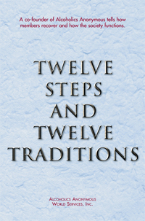
Notes:
Idea that you get power back, chapter “we agnostics”, hone in a 1-3, 4, 7 (positive psychology), 8, 10 (across the board), 11 (DBT, ACT), 12 (service)

Slide 26
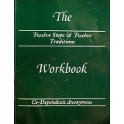

Slide 27
Lack of knowledge about what MHOs are and do
Overview of 12-Step groups continued
Discussion of 12-Steps and traditions
What are meetings like?
Beneath the surface: elements of CBT, slogans, role of sponsorship
Morganstern et al, 1997; Marcovitz et al, 2020.
Notes:
12-Step patients show better progress on cognitive behavioral coping then do patients in pro CBT training; Morganstern et al 1997 Journal of consulting and clinical psychology is best one (mediate effect of AA on outcome)
Take the action and the feeling will follow, easy does, first things first, one day at a time

Slide 28
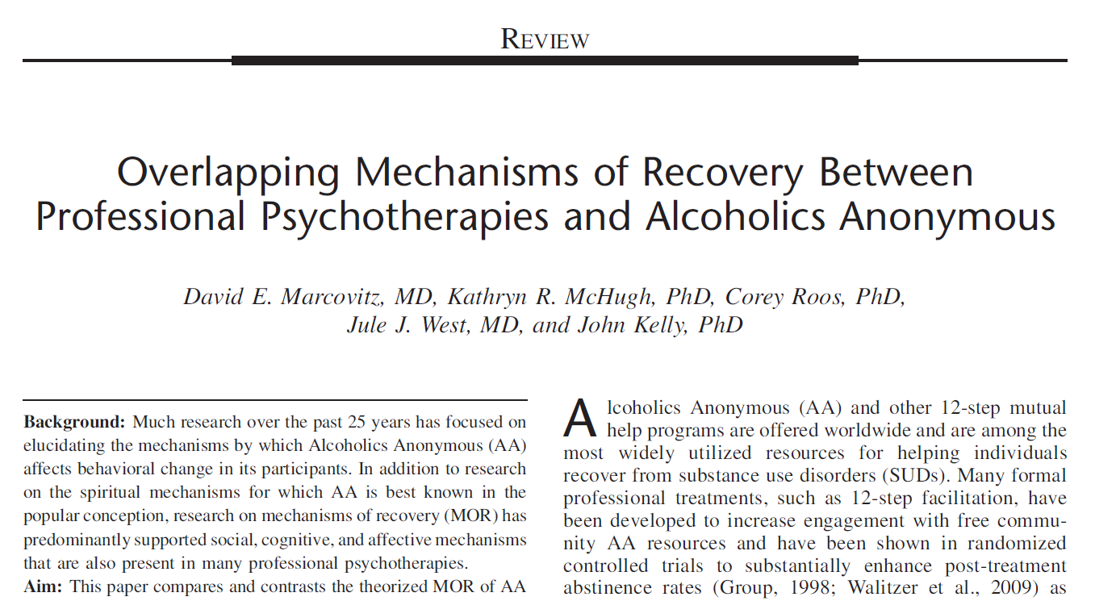
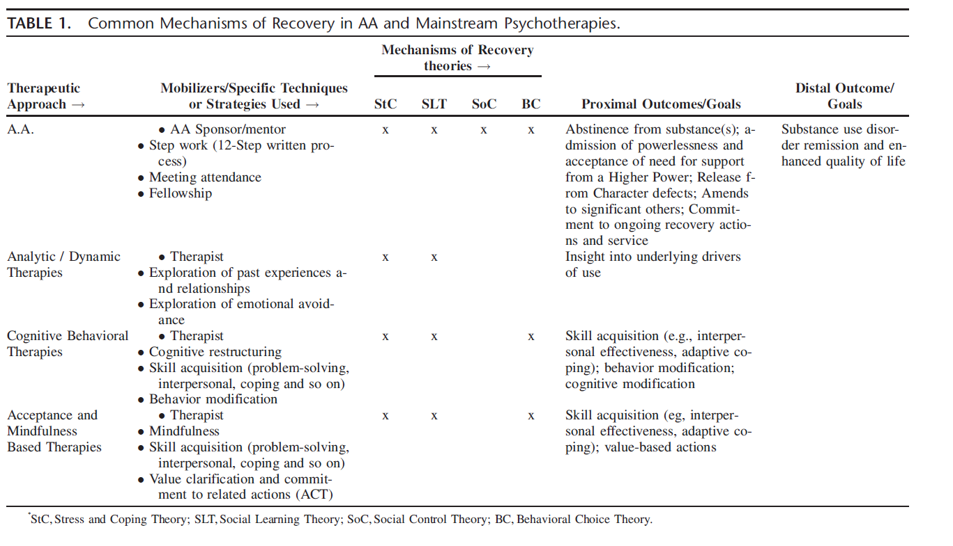
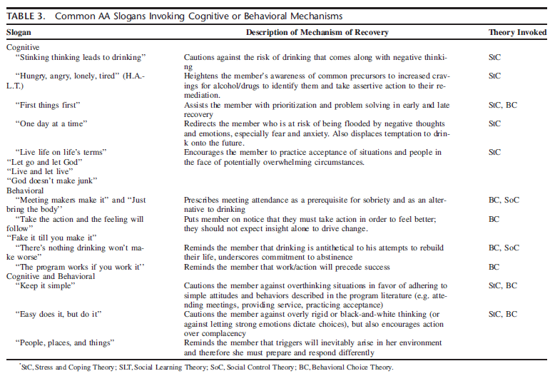

Slide 29
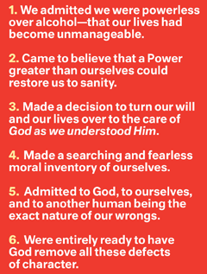
12-Step Analogs in Other Therapy Modalities
Admitting need for outside help (common to all therapies).
Making a decision to accept guidance from HP, which for many is represented by advice from sponsor and/or group
Various analogs of CBT, in particular, looking at various distortions in one’s self image and getting to the roots of these (i.e. core beliefs)
Psychodynamic analog: looking at patterns of behavior
Marcovitz et al, 2020

Slide 30
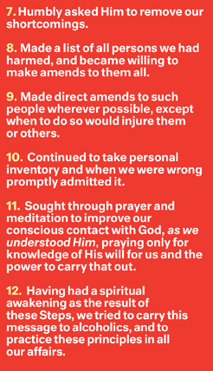
Created by DM 2015
Journaling and self-reflection common element of many types of CBT. Gratitude lists in Positive Psychology. (This also represents prominent “maintenance phase” in the Stages of Change model)
Analogs with mindfulness movement
Prescription for taking ongoing value-based actions is a core element of Acceptable and Commitment Therapy (ACT)

Slide 31
Lack of knowledge about what MHOs are and do
Overview of SMART recovery (brief history, model)
Off shoot of Rational Recovery in 1994
Addiction model: maladaptive behaviors with possible physiologic influences.
Self-empowerment in four areas 1) lifestyle balance 2) coping with urges 3) motivation to abstain and 4) problem solving
Evolves as science evolves
Kelly, J. & White, W. (2012)
Notes:
Off shoot of Rational Recovery, 1994.
most SMART participants were Caucasian (93.2%), 42.7% were female, and had a median age of approximately 50 years old. Slightly over half (53.5%) of those surveyed reported being SMART members for less than one year. Despite SMART having a secular orientation and providing an alternative to 12 step organizations, 60.7% of members reported believing in some kind of God
or Higher Power, and 85.2% reported attending AA or other 12-step organizations in addition to SMART
Although not a test of SMART Recovery as a mutual-help organization, a related study compared professionally led 12-step -and SMART-based intensive outpatient treatment programs for dually diagnosed patients (Brooks & Penn, 2003). Findings revealed SMART Recovery-based treatment was less effective at reducing alcohol use than the 12-step-based
treatment, but more effective at improving participants’ employment status and medical concerns. Several limitations were apparent in this study, however, including a high dropout rate and unequal treatment exposure across conditions. Also, as alluded to above, intensive outpatient treatment is not comparable to the context in which real world SMART Recovery groups are run, and this study sample was composed of dually diagnosed individuals who may not be representative of mostSMART Recovery members (Horvath & Yeterian, in press).

Slide 32
Differences from SMART Website:
SMART Recovery® teaches increasing self-reliance, rather than powerlessness.
SMART Recovery® meetings are discussion meetings in which individuals talk with one another, rather than to one another.
SMART Recovery® encourages attendance for months to years, but probably not a lifetime.
There are no sponsors in SMART Recovery®.
SMART Recovery® discourages use of labels such as "alcoholic" or "addict".
SMART Recovery® has a scientific foundation, not a spiritual one.

Slide 33
Lack of knowledge about what MHOs are and do
Over half of patients go to 12-Steps as well (61% believe in some sort of God)
53.5% SMART member less than one year
What are meetings like?
Kelly, J. & White, W. (2012)
Notes:
Off shoot of Rational Recovery, 1994.
most SMART participants were Caucasian (93.2%), 42.7% were female, and had a median age of approximately 50 years old. Slightly over half (53.5%) of those surveyed reported being SMART members for less than one year. Despite SMART having a secular orientation and providing an alternative to 12 step organizations, 60.7% of members reported believing in some kind of God
or Higher Power, and 85.2% reported attending AA or other 12-step organizations in addition to SMART
Although not a test of SMART Recovery as a mutual-help organization, a related study compared professionally led 12-step -and SMART-based intensive outpatient treatment programs for dually diagnosed patients (Brooks & Penn, 2003). Findings revealed SMART Recovery-based treatment was less effective at reducing alcohol use than the 12-step-based
treatment, but more effective at improving participants’ employment status and medical concerns. Several limitations were apparent in this study, however, including a high dropout rate and unequal treatment exposure across conditions. Also, as alluded to above, intensive outpatient treatment is not comparable to the context in which real world SMART Recovery groups are run, and this study sample was composed of dually diagnosed individuals who may not be representative of mostSMART Recovery members (Horvath & Yeterian, in press).

Slide 34
Created by DM 2015
Imparting Information
Mechanisms Common to All Groups
Pro-social
Altruism
Other MHOs
Catharsis
Universality
SMART
Universality
12-Steps
Imitative behavior
Instillation of Hope

Slide 35
Common provider hesitations
Effectiveness: Lack of familiarity with evidence-base (or whether this is even an evidence-based treatment on par with others)
Lack of knowledge about what MHOs are and do
Concern patient will not be a good fit for MHOs (age, gender, socioeconomics, religious aspects) or that they will experience adverse effects
Lack of time to discuss MHOs as a provider

Slide 36
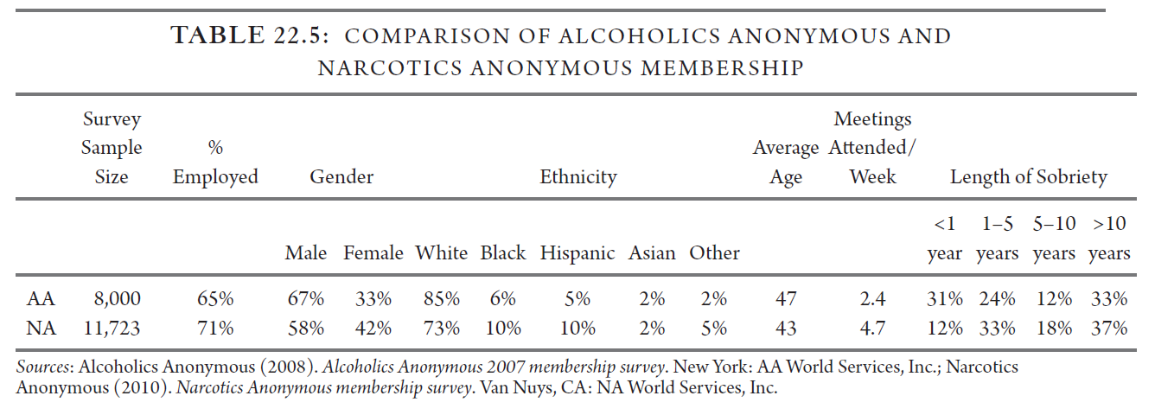
Concern patient will not be a good fit for MHOs
Demographics of 12-Steps and SMART
Specific socioeconomic hesitations discussed later in presentation
Brown et al 2002., Kelly and Hoeppner, 2013, Laudet, 2012.
Notes:
In training you might go to a few open meetings (project MATCH); could contact local treatment center to get a list or even ask your own patients
-All patients benefitted equally from TSF approach compared to RP (CBT) after SUD residential, but female subgroup did better with TSF (Brown)
-Women fewer in percent but get more involved, mechanism that they can cope with affect, men benefit from social risk prevention (these were zero for the opposite group)
-Specific meetings exist for young people, gays; significant percent of minorities as above

Slide 37
Objections based on age, gender and socioeconomic considerations
We reviewed slide earlier on age, gender and race
Existence of men’s meetings, women’s meetings, youth meetings, gay meetings
Mental illness? Consider DRA, multimodal approach.
Keep in mind variety of meetings and importance of fit (patient may consider neighborhood as proxy – “not elitist but pragmatic”
“Socioeconomic and cultural factors … over biochemistry”
Forman, 2002.
Notes:
Gender specific treatment can enhance treatment outcomes
Neighborhood also has implications for anonymity
AA may be better for some narcotics addicts than NA depending on neighborhoods etc., example of RN abusing pills; patient should try both, patient qualifies under Third Tradition either way

Slide 38
Objections to perception of religiosity
Kaskutas, 2003: N=587, baseline beliefs not predictive of abstinence at year 3
Attend less frequently and drop out rates higher, but those who stay benefit equally.
“Spiritual awakening,” “God as we understood Him”, “We agnostics” chapter; what is religion?
Half of original members agnostic or atheist
SMART versus 12 Steps → how to decide?
Tonnigan, Miller and Schermer, 2002; AA, 2001; Kelly and Moos, 2003; Winzelberg and Humpheys, 1999, Kaskutas, 2003.
Notes:
The personality change sufficient to bring about recovery from alcoholism has manifested itself among us in many different forms. They develop slowly over a period of time. They have tapped an unsuspected inner resource which they present identify with their own conception of a Power greater than themselves.
-PCP can prep for this language, passing basket, also can duck out 5 minutes early if holding hands in prayer would raise discomfort
-Recommend patients look up names of meetings; if focus is step study or 11th step, held Sunday morning, may be more religious.
-Take what works and leave the rest mentality
-”My message is that AA is a fellowship more than a spiritual program, and although the spiritual route is there for the taking, there is no required belief system other than one drunk helping another drunk. AA only offers suggestions, there are no rules” (PHS physician)

Slide 39
Objection: prior AA experiences
83% of individuals seeking alcohol treatment at a representative sample of programs had at least some prior AA involvement.
“I’m not that bad”: emphasize variety/variability in degree to which people in AA have encountered EtOH related problems
“Found it triggering”: remind them they have found triggers outside of meetings; assess for ambivalence; encourage inquiry.
Humphreys et al, Drug and Alcohol Dep, 1998.
Notes:
¼ to 1/3 of this 83% had positive experiences
Different impairment; concept of bottom and “bottom is when you stop digging”; give it a try and see if it fits, even if you try a few and decide it’s not for you, especially if they’ve had trouble on their own before, if they couldn’t cut back. also “play the tape through” when you get triggered

Slide 40
Objection: Medication stigma
AA’s policy supports sovereignty of physician-patient relationship: “No A.A. member should ‘play doctor’”
NA World Services
Bulletin #29 (1996) – Groups may limit sharing by those on ORT
PR Handbook (2006-07) & NA Pamphlet “NA Groups and Medication”(2007) - softer stance, acknowledges tapers, not NA role to judge, group variability (but still not ‘clean’)
White, 2011
Notes:
Different impairment; concept of bottom and “bottom is when you stop digging”; give it a try and see if it fits, even if you try a few and decide it’s not for you, especially if they’ve had trouble on their own before, if they couldn’t cut back.
also “play the tape through” when you get triggered

Slide 41
Common provider hesitations
Effectiveness: Lack of familiarity with evidence-base (or whether this is even an evidence-based treatment on par with others)
Lack of knowledge about what MHOs are and do
Concern patient will not be a good fit for MHOs (age, gender, socioeconomics, religious aspects) or that they will experience adverse effects
Lack of time to discuss MHOs as a provider

Slide 42
Lack of time to discuss MHOs as a provider
Active referral interventions delivered by a doctor or peer increased post-discharge attendance rates
DI group 48% versus 33% attended compared to non-intervention,
*Of those patients who were formerly 12-Step naïve, ALL had received an intervention but TWICE as many had received doctor intervention
30-45 minute intervention in this study
Manning, 2012.
Notes:
Manning study; as a doctor you’re a powerful person, in this study
Analogy of telling patient to pick up PDR and choose antidepressant is same as “call AA”
This touches on topic of increasing effectiveness of referrals

Slide 43
Case Continued
Ms. B is interested in your idea that she attend but has several reservations :
She believes in God but doesn’t subscribe to any organized religion, worries AA would be “too religious”
She went to a group once and didn’t relate to anyone there: “I’m not that bad”.
She also found some of their shares to be triggering and left wanting to drink more.
How might you respond to some of these concerns?
Notes:
There are gay meetings, women’s meetings, young person’s meetings, men’s

Slide 44
Provider reservations
+
Patient reservations
Concern referral won’t be effective
Notes:
What we’re really getting at.
Should you be directive or motivational in your approach?

Slide 45
Case Continued
You have spent 10-15 minutes discussing MHOs with Ms. B and addressing several of her reservations. She now says he is still ambivalent about attending but respects you as an expert and so she will go to at least a couple meetings.
How do you actually make the referral?
Notes:
Topics we will not discuss in detail

Slide 46
Learning objectives
Participants will be able to discuss the evidence in support of the effectiveness of Mutual Help Organizations (MHOs) like Alcoholics Anonymous/Narcotics Anonymous (AA/NA) and SMART Recovery as adjunctive treatment in patients with addictions
Participants will be able to address common patient reservations about attending MHOs
Participants will be able to make referrals to MHOs and know three methods to increase the effectiveness of these referrals
Notes:
Get at objectives by taking this from the angle of a patient in your clinic: what are your reservations about referring and what are the patient’s reservations about going → this gets obliquely at the evidence, the referral procedure and how to increase the effectiveness of your referrals.

Slide 47
Consider a sliding scale approach to MHO referral in inpatient setting:
More likely to emphasize:
(You are fairly compensated)
Patient has mild reservations / no experience / is open to MHOs
Patient has failed with professional treatment alone
Patient is not willing to engage in professional treatment
Less likely to emphasize:
(You have 3 discharges and an admission)
Patient adamant about prior negative experience with MHOs / prefers professional treatment only

Slide 48
Making an effective referral
For starters, should your approach be directive or motivational?
Walitzer, 2009 → directive approach (sometimes) more effective than MET
I favor a synthesis – always asking permission after hearing pros/cons
What to say? Prescribe they attend 3 meetings between now and next visit; 6 visits before making a decision
Also, start listening for someone who has something you want (potential sponsor)
Tell them a little about what to expect (how to identify, sharing optional, people may approach them but okay to exit early)
AA, 2007; NA, 2010. Walitzer et al 2009.
Notes:
Patients in directive condition attended more meetings, got more involved, and had a higher percentage days abstinent
Kahler: more time spent with 12-Step naïve is helpful, slightly different approach if experienced in 12-steps (but part of the beauty of the primary care setting is that many people are MHO-naïve)

Slide 49
Making an effective referral
You’ve already done 50% of intensive referral by discussing what various MHOs are (12-Steps, SMART).
Timko and DeBenedetti, 2007: gave lists of meetings and locations, encouraged/provided journal, linked to a peer, recommended sponsor
Outpatient: a peer if you have access, or a prior patient who is willing to be a contact (could build up a cadre)
Inpatient: ask if THEY know anybody who can plug them in
Sisson and Mallams,1981. Timko and DeBenedetti, 2007. Blondell, J Family Practice, 2001.
Notes:
Analogy that “Go to AA” is like saying go to the PDR and choose a medication
Patient in Timko and Debenedetti, 2007 were more likely to attend and more likely to be abstinent at 1 year

Slide 50
3 Bottom lines re: referral
In several studies, time spent discussing MHO referral has mediated effectiveness of intervention.
1-Spend time discussing MHOs with patients
Good evidence that intensive referral is more effective than basic referral
2-prescribing and following up attendance
3-linking to the community)
Don’t be discouraged if patients leave saying they won’t go. People will reflect. 49% NA / 33% AA referred by professional.
Walitzer, 2009.

Slide 51
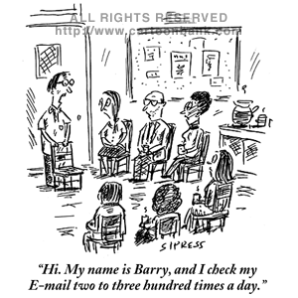
Role playing and Q&A
I am your patient, you are my PCP.
Let’s have fun
dmarcovitz@partners.org

Slide 52
Selected References
Beck, A. K., Forbes, E., Baker, A. L., Kelly, P. J., Deane, F. P., Shakeshaft, A., ... & Kelly, J. F. (2017). Systematic review of SMART Recovery: Outcomes, process variables, and implications for research. Psychology of Addictive Behaviors, 31(1), 1.
Blatch, C., O’Sullivan, K., Delaney, J. J., & Rathbone, D. (2016). Getting SMART, SMART Recovery© programs and reoffending. The Journal of Forensic Practice, 18(1), 3-16.
Crits-Christoph, P., Siqueland, L., Blaine, J., Frank, A., Luborsky, L., Onken, L. S., ... & Woody, G. E. (1999). Psychosocial treatments for cocaine dependence: National Institute on Drug Abuse collaborative cocaine treatment study. Archives of general psychiatry, 56(6), 493-502.
Emrick CD, Tonigan JS, Montgomery H, Little L. Alcoholics anonymous: what is currently known? In: McCrady BS, Miller WR, editors. Research on Alcoholics Anonymous: Opportunities and Alternatives. New Brunswick, NJ: Rutgers Center for Alcohol Studies; 1993. pp. 41–77.
Ferri M, et al. Alcoholics Anonymous and other 12-step programmes for alcohol dependence. Cochrane Database Syst Rev. 2006 Jul 19;(3):CD005032.
Forman, Robert, PhD. One AA Meeting Doesn’t Fit All: 6 Keys to Prescribing 12 Step Programs. Current Psychiatry. Volume 1, Number 10. October 2002
Kelly, J. & White, W. (2012) Broadening the base of addiction recovery mutual aid. Journal of Groups in Addiction & Recovery, 7(2-4), 82-101.
Kelly, John and Yeterian, Julie. Mutual Help Groups for Alcohol and Other Substance Use Disorders. Chapter in Addictions: A Comprehensive Guidebook McGrady and Epstein,, 2013
Kelly JF¹, Hoeppner BB. Does Alcoholics Anonymous work differently for men and women? A moderated multiple-mediation analysis in a large clinical sample. Drug Alcohol Depend. 2013 Jun.

Slide 53
References Continued
Manning V et al. Does active referral by a doctor or 12-Step peer improve 12-Step meeting attendance? Results from a pilot randomised control trial. Drug Alcohol Depend. 2012 Nov 1;126(1-2):131-7.
Marcovitz, D. E., McHugh, R. K., Roos, C., West, J. J., & Kelly, J. (2020). Overlapping mechanisms of recovery between professional psychotherapies and alcoholics anonymous. Journal of addiction medicine, 14(5), 367.
Moos, R. H., & Moos, B. S. (2006). Rates and predictors of relapse after natural and treated remission from alcohol use disorders. Addiction, 101(2), 212-222.
Project Match. Matching Alcoholism treatments to client heterogeneity. Project MATCH post-treatment drinkingoutcomes. J Studies Alcohol 1997;58(1): 7-29.
Tucker, J. A., Cheong, J., James, T. G., Jung, S., & Chandler, S. D. (2020). Preresolution drinking problem severity profiles associated with stable moderation outcomes of natural recovery attempts. Alcoholism: Clinical and Experimental Research, 44(3), 738-745.
Timko C¹, Long-term outcomes of alcohol use disorders: comparing untreated individuals with those inalcoholics anonymous and formal treatment. J Stud Alcohol. 2000 Jul;61(4):529-40.
Walitzer KS, Dermen KH, Barrick C. Facilitating involvement in Alcoholics Anonymous during out-patient treatment: a randomized clinical trial. Drug Alcohol Depend. 2011 Nov 1;118(2-3):194-201.
Weiss, R. D., O'malley, S. S., Hosking, J. D., LoCastro, J. S., Swift, R., & COMBINE Study Research Group. (2008). Do patients with alcohol dependence respond to placebo? Results from the COMBINE Study. Journal of studies on alcohol and drugs, 69(6), 878-884.
Weiss, R. D., Griffin, M. L., Marcovitz, D. E., Hilton, B. T., Fitzmaurice, G. M., McHugh, R. K., & Carroll, K. M. (2019). Correlates of opioid abstinence in a 42-month posttreatment naturalistic follow-up study of prescription opioid dependence. The Journal of clinical psychiatry, 80(2), 13469.

Slide 54
Supplementary Slides

