Slide 1
Rural Center of Excellence in
Recovery Housing
ERNIE FLETCHER,MD
Founder and Chief Medical Officer
fletchergroup.org
Notes:
Time: ..25

Slide 2
Who Are We?
The Fletcher Group Rural Center Of Excellence is supported by a HRSA grant to promote evidence-based recovery housing and services.
Notes:
We are here today on behalf of the Fletcher Group Rural Center Of Excellence which is funded by a grant from the Health Resources and Services Administration to promote evidence-based recovery housing and services.

Slide 3
Our Reach

Slide 4
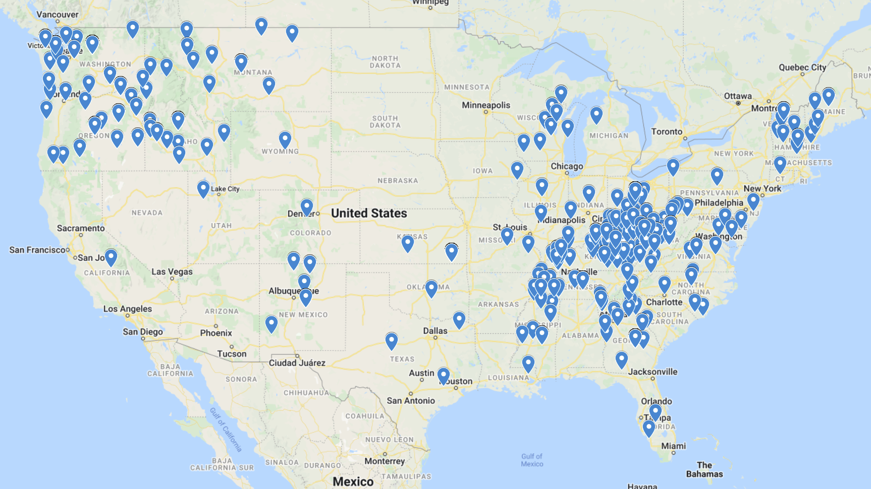
FGI RCOE – TA Locations in 44 States
Notes:
In December this number was 30 states.
The states without formal TA:
N & S Dakota
Nebraska
Nevada
Minnesota
Arizona
Observation: Areas where TA begins, is growing, much in part from TA recipient referrals, invitations to speak that lead to other activities. Organic.

Slide 5
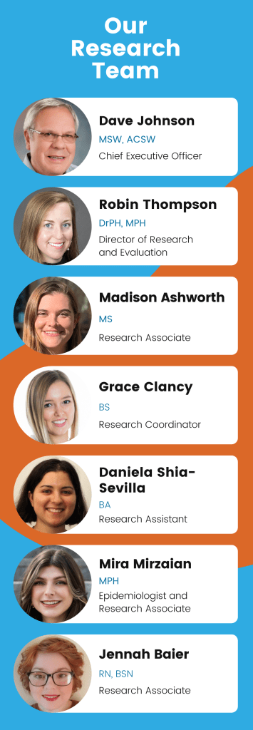
Research - Informs Policy and Practice
Research is imperative, particularly in an industry like recovery housing that’s been largely unregulated and under-studied.
Recovery Housing
Recovery Research Institute
HRSA COE on Recovery Housing
SAMHSA Office of Recovery Support
HUD Recovery Housing Program
What’s not Working

Slide 6
20.1 million adults with SUDs (8.4% of the adult population) ¹
Over 100,000 drug overdose deaths were reported from March 2020 to March 2021, a 36.1% increase over prior year.²
>100,000 annual alcohol-related deaths ³
553,742 homeless ⁴
The Problem
.
.
https://drugabusestatistics.org/alcohol-related-deaths/#:~:text=Miscellaneous%20Death%20Rates%20due%20to%20Alcoholic%20Consumption&text=95%2C000%20Americans%20die%20from%20alcohol,drinking%20too%20much%20over%20time.
https://www.cdc.gov/nchs/nvss/vsrr/drug-overdose-data.htm Centers for Disease Control and Prevention (CDC).
Alcohol and Public Health: Alcohol-Related Disease Impact (ARDI). Average for United States 2006–2010 Alcohol Attributable Deaths Due to Excessive Alcohol Use (between 2006 and 2010)
National Alliance to End Homelessness, State of Homelessness, January 2017 Point-in-Time count, the most recent national estimate of homelessness in United States https://endhomelessness.org/homelessness-in-america/homelessness-statistics/state-of-homelessness-report/
Notes:
Need to add the new references for new numbers.

Slide 7
What is the State of Affairs in SUD
Federal Efforts – Over $ 6 Billion
Slight Decrease in Overdoses 2018
Then…COVID-19

Slide 8
What is the State of Affairs in SUD
Expanded Stimulant Use
Multi-drug Use
Fentanyl

Slide 9
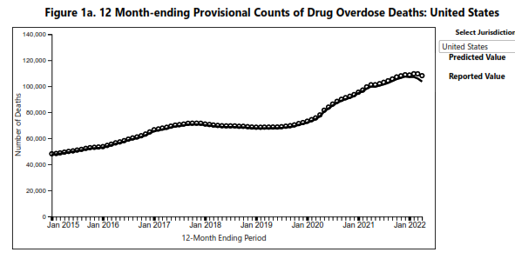
CDC Provisional Data Over 100,000 Drug Overdoses in 2021-2022

Slide 10
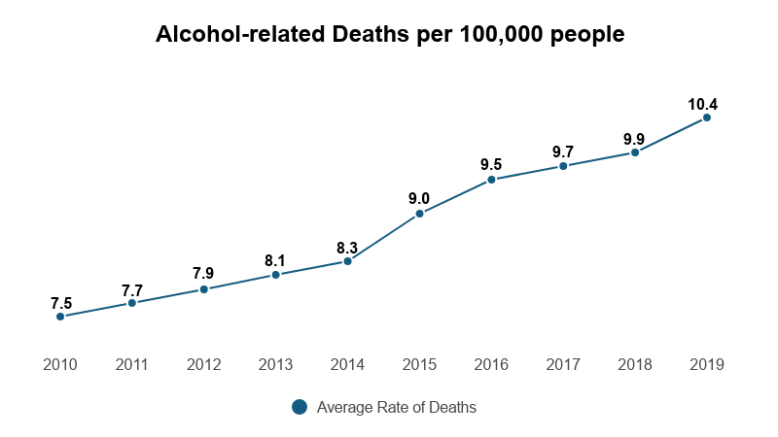
Alcohol Related Deaths Increasing

Slide 11
The Incarcerated
80% have used drugs – 60% have SUD
Only 20% have been treated
68% are re-incarcerated within 3 years
High risk of overdose on Reentry
Blacks incarcerated at 8-12 times the rate of whites
Notes:
More than 80% of incarcerated individuals report having used an illicit substance in their lifetime, and only 20% of those with OUD/SUD received treatment in prison.³ If an individual experiences recurrence, they are 68% more likely to be re-incarcerated within three years of release.⁴ Decreased drug tolerance due to reduced drug use during incarceration makes relapse more dangerous for those with OUD/SUD, and overdose likely.⁵ Two studies from the Washington State Department of Corrections (DOC) document the increased risks for individuals with OUD/SUD upon release from prison. A cohort study between 1999-2009 found that the leading cause of death among former prisoners was overdose; opioids were involved in 14.8% of all deaths and 58.6% of overdose deaths.⁶ Importantly, the time immediately following release is a critical window that is directly correlated to health outcomes and recidivism. Another Washington State DOC study from 1999-2003, found that former inmates were at 12.7 times greater risk of death in the two-week period following release than comparable Washington State residents of similar demographics (age, sex, and race).⁷ A study conducted among New York Department of Corrections found that “formerly incarcerated people in New York City (NYC) were eight times more likely to die of drug-related causes during the first two weeks after release than were non-incarcerated NYC residents in the same two-week period.”⁸ Other contributing factors to poor outcomes included decreased access to healthcare services for individuals with SUD, mental health disorders, and other co-morbidities during the post-release transition period.⁹ These studies point to the importance of establishing evidence informed policies and processes in addressing early release and re-entry during the COVID-19 pandemic.
FOOTNOTES:
3. Adam Chamberlain et al., "Illicit Substance Use after Release from Prison Among Formerly Incarcerated Primary Care Patients: A Cross-Sectional Study," Addiction Science and Clinical Practice 14, no. 1 (2019): 7.
4. Steven Belenko et al., "Treating Substance Use Disorders in the Criminal Justice System," Current Psychiatry Reports 15, no. 11 (2013): 1-11.
5. Clarissa S. Krinsky et al., "Drugs, Detention, and Death: A Study of the Mortality of Recently Released Prisoners," The American Journal of Forensic Medicine and Pathology 30, no. 1 (2009): 6-9.
6. Ingrid A. Binswanger et al., "Mortality After Prison Release: Opioid Overdose and Other Causes of Death, Risk Factors, and Time Trends from 1999 to 2009," Annals of Internal Medicine 159, no. 9 (2013): 592-600.
7. Ingrid A. Binswanger et al., "Release from Prison — A High Risk of Death for Former Inmates," The New England Journal of Medicine 356, no. 2 (2007): 157-65.
8. Sungwoo Lim et al., "Risks of Drug-Related Death, Suicide, and Homicide During the Immediate Post-Release Period Among People Released From New York City Jails, 2001–2005," American Journal of Epidemiology 175, no. 6 (2012): 519-26.
9. Joseph W. Frank et al., "Emergency Department Utilization Among Recently Released Prisoners: A Retrospective Cohort Study," BMC Emergency Medicine 13, no. 1 (2013): 16.

Slide 12
The Cost of Criminalizing Addiction
Supply and Demand
“They don’t rehabilitate you in prison, and they don’t make it easy for you to get a job. I truly believe they don’t make it easy because they want you back, and they want you back because that’s the new factory work in so many places now—the prison.” *
“If we reduced our prison population by 25 percent, that’s 20 billion dollars we could save.
* From the book, “Dopesick: Dealers, Doctors, and the Drug Company That Addicted America” by Beth Macy, 2018
Notes:
As that narrative of addicts as criminals further embedded itself into the national psyche, the public became indifferent to an alternative response that could have eased treatment barriers, he said. As an example he cited Portugal, which decriminalized all drugs, including cocaine and heroin, in 2001, adding housing, food, and job assistance—and now has the lowest drug-use rate in the European Union, along with significantly lowered rates of drug-related HIV and overdose deaths. In Portugal, the resources that were once devoted to prosecuting and imprisoning drug addicts were funneled into treatment instead.”.

Slide 13
SUD Treatment access remains low
Ensuring access treatment requires that services along a continuum of care are covered, affordable, and designed to meet the unique needs of the population
A MACPAC’s review of state Medicaid coverage for SUD treatment services shows that only 12 states pay for the full continuum of clinical services
The largest gaps in state clinical service coverage are for partial hospitalization and residential treatment.
These pitfalls are exacerbated by the lack of recovery housing
https://www.macpac.gov/wp-content/uploads/2018/06/Access-to-Substance-Use-Disorder-Treatment-in-Medicaid.pdf

Slide 14
What is a “Recovery Ecosystem?”
Notes:
Today we’ll be talking defining and explaining the benefits of what we call a “Recovery Ecosystem.”

Slide 15
ARC defines a Recovery Ecosystem as a linkage of:
Criminal justice
Public safety
Housing
Transportation
Education
Employers
Recovery communities
Peer support
Healthcare
Human services
Faith-based communities
Notes:
Ernie:
“One of our key partnerships is working with the Appalachian Regional Commission to build and strengthen economically resilient communities throughout the 13-state Appalachian region. ARC defines a Substance Abuse Recovery Ecosystem as a complex linkage of multiple sectors, including, but not limited to, recovery communities, peer support, healthcare, human services, faith-based communities, the criminal justice system, public safety, housing, transportation, education, and employers.
The goal of a Recovery Ecosystem is to help individuals in recovery access the support services and training they need to maintain their recovery and successfully obtain sustainable employment.
Resources of course vary by community as determined by the existing recovery infrastructure, the prevalence of stigma, funding, insurance coverage, employment opportunities, and the length of time and experience communities have been working to address the substance abuse crisis.

Slide 16
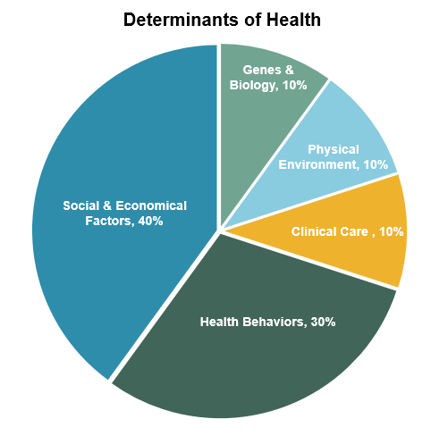
Holistic Support
Services Clinical care alone is only ten percent of the impact.
https://www.orpca.org/initiatives/social-determinants-of-health
Notes:
This is our WHY

Slide 17
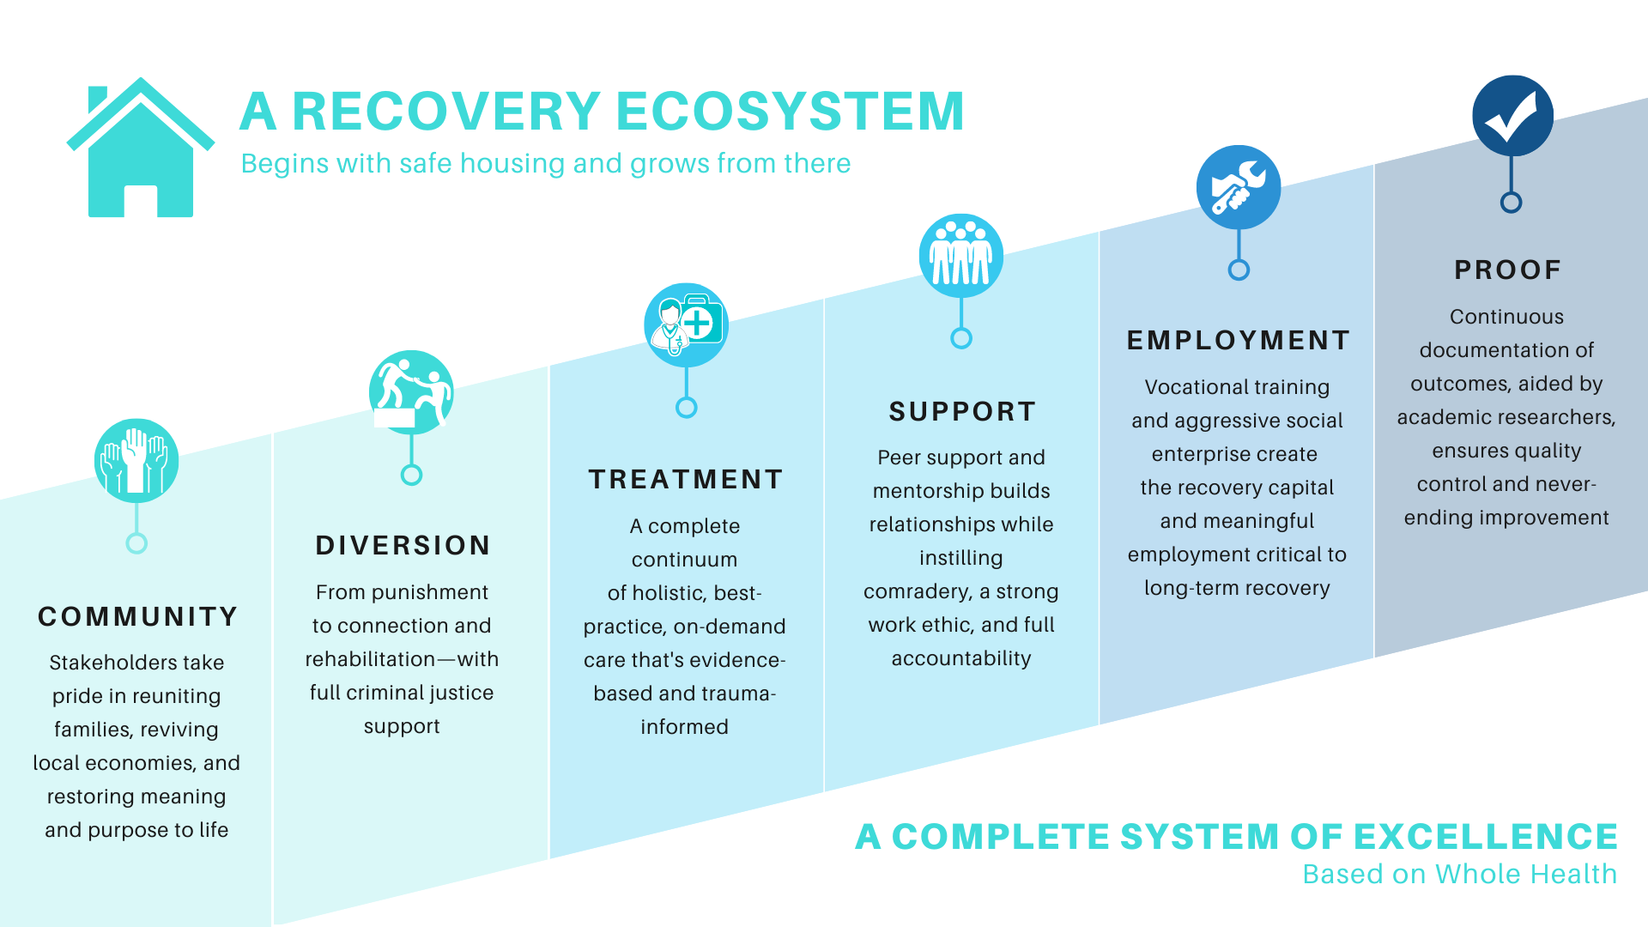
Recovery Ecosystem Index Map (norc.org)

Slide 18
Holistic Intervention
Recovery Capital
Employment
Housing
Community
Supports
Peer and
Social Support
Recovery
Recovery Housing
Workforce Development
(Social
Enterprises)
Clinical Services-MAT

Slide 19
A Recovery Ecosystem
Criminal Justice
Treatment Providers
Counselors
Community Support Groups
Self-directed
Referral Sources:
Case Management
Employment
Support
Peer Support
Life Skills
Development
Stable Housing
Health--physical and mental
Employment
Transportation
Education Support
Housing
Social Support
Building Recovery Capital

Slide 20
REI Technical Expert Panel Members
Robert Ashford (RecoveryLink)
Matt Boggs (Ryker Douglas)
Matt Brown (Addiction Recovery Care)
Anita Chandra (RAND)
Kimberly Dash (Education Development Center)
John Gale (University of New England School of Public Health)
Peter Gaumond (ONDCP)
Carolyn Hardin (National Association of Drug Court Professionals)
Christopher Hart (RecoveryLink)
Sierra Helfrich (CDC)
Patrick Hibbard (JEAP Training Institute at Oregon Social Learning Institute)
Pam Johnson (FAHE)
John Kelly (Recovery Research Institute, Harvard Medical School)
Ron Manderscheid (National Association for Rural Mental Health)
Robin Phillips (National Rural Transit Assistance Program)

Slide 21
Selecting Indicators for Index
The current list of indicators for inclusion in the index includes:
Category | Indicator
SUD Treatment | Number of substance use treatment facilities per capita
 | Number of providers licensed to administer buprenorphine per capita
 | Average distance to nearest MAT provider
 | Number of mental health providers per capita
Continuum of SUD Support | Number of recovery residences per capita
 | Average distance to nearest SSP
 | Is there a drug court?
 | Is there a drug free coalition?
 | Indicator of state policy environment
Social and Infrastructure | Percentage of households with 1 or more vehicles
 | Percentage of households spending 50% or more of their income on housing
 | Percentage of households with broadband
 | Number of social associations per capita

Slide 22
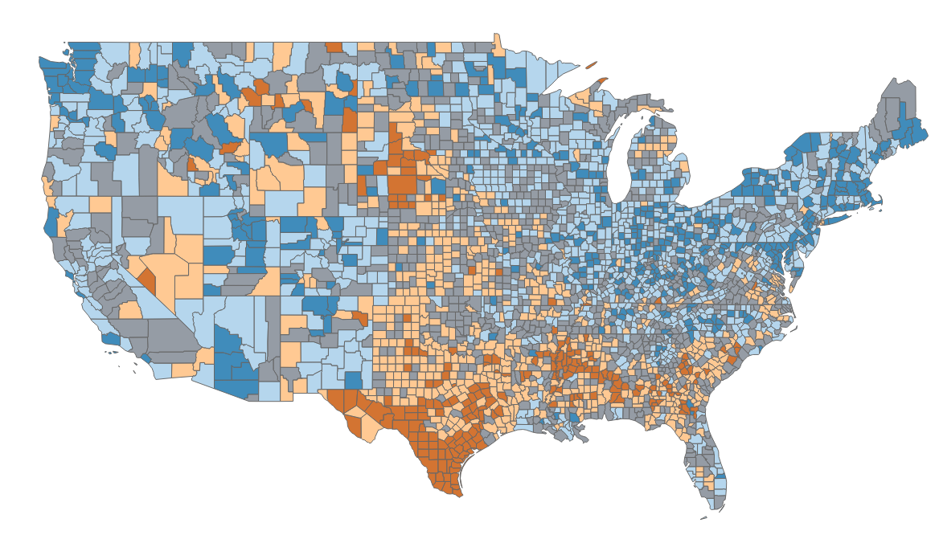
Overall Recovery Ecosystem Scores*
*Note: Not for dissemination, as scores are not final

Slide 23
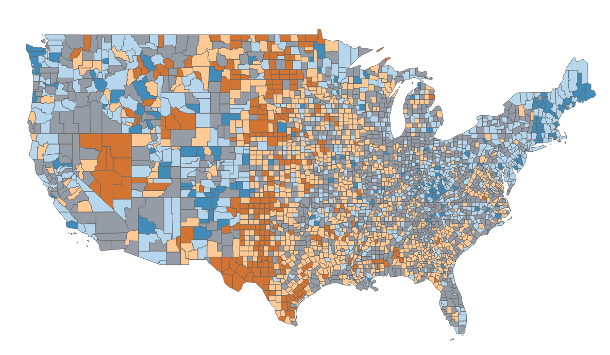
Substance Use Treatment Scores*
*Note: Not for dissemination, as scores are not final

Slide 24
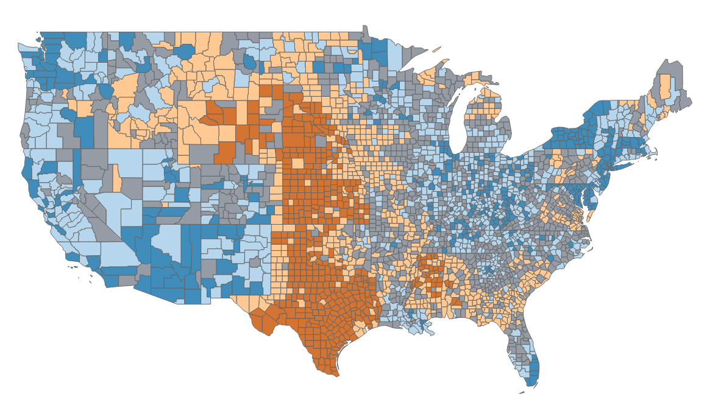
Continuum of SUD Support Scores*
*Note: Not for dissemination, as scores are not final

Slide 25
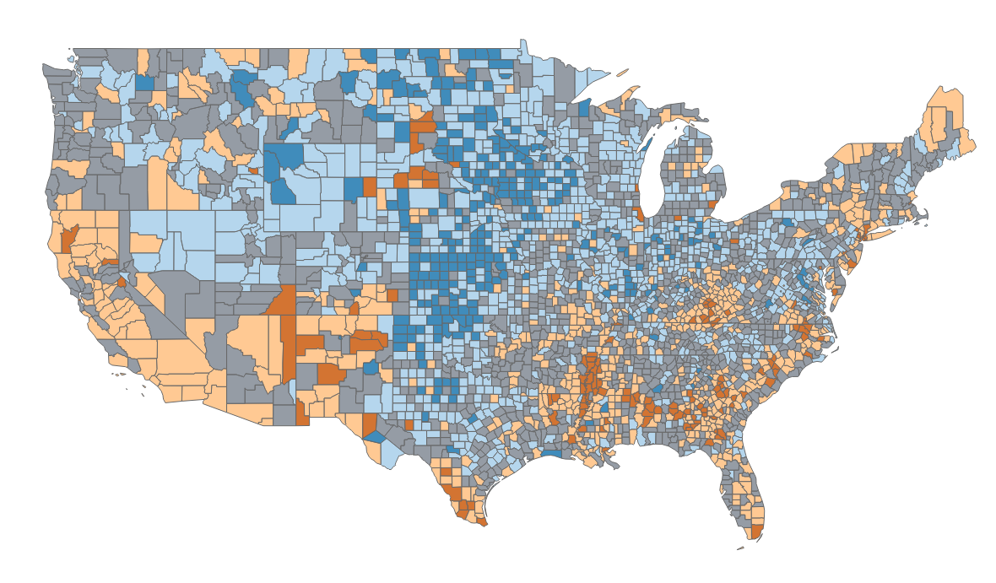
Social + Infrastructure Scores*
*Note: Not for dissemination, as scores are not final

Slide 26
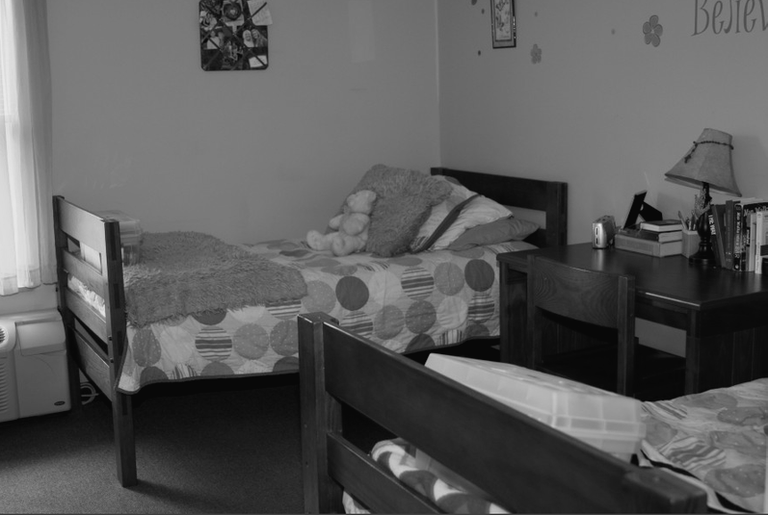
What is Recovery Housing?

Slide 27
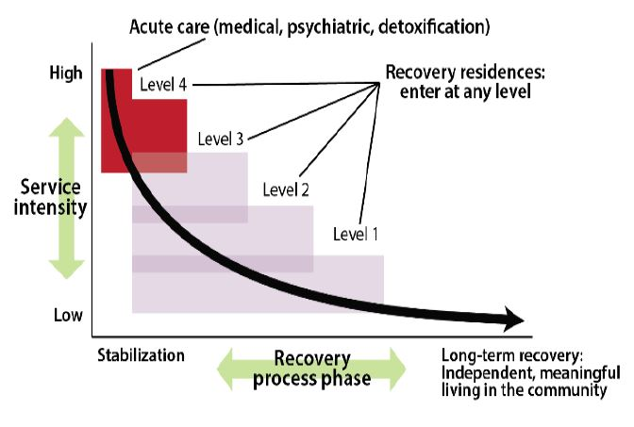
NARR Levels of Support
RECOVERY RESIDENCES IN THE CONTINUUM OF RECOVERY
Notes:
First, there is not a lot of research on evidence-based practices in RH and that is one of major goals that aligns with this core activity
Secondly, as we have already begun to realize, there is not a lot of help especially in rural areas in this “cottage industry” and our efforts include “boots on the ground” and working with local partners to bring educational resource defining what works and what doesn’t
Thirdly, there is little a large need for help to RH providers across the spectrum of evidence based practices, but even more basic, zoning, NIMBY, financing, bundling of creative resources. That is what our activities will be focused on.
Time: .25
To bolster this a large component of data collection and outcomes measurement will help us develop the industry standards of best practices.

Slide 28
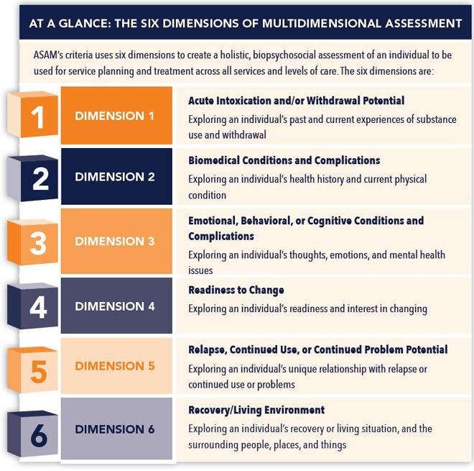
ASAM Criteria

Slide 29
Common Funding for Recovery Housing
Larger Operations – >25
HUD related grants for capital development
Reimbursement for clinical services
Partnership with DOC or Medicaid plans
Smaller Operations – <24
Landlord, LLC, or 501c3
Housing vouchers and private pay
Grant funding and donations

Slide 30
Oxford House
Social Recovery with Housing Supports
Overview Evidence
Democratically run, self-supporting and drug free home. The number of residents in a House may range from six to fifteen; there are houses for men, houses for women, and houses which accept women with children.
Oxford House has been evaluated in a two-year randomized, clinical trial which reported a significant reduction in substance use, increases in “self-control,” increases in employment, and reduced criminal justice involvement.
http://www.oxfordhouse.org/userfiles/file/purpose_and_structure.php
SAMHSA NREPP, “Intervention Summary: Oxford House Model,” https://nrepp.samhsa.gov/Legacy/ViewIntervention.aspx?id=223.

Slide 31
OUR
FACILITIES

Slide 32
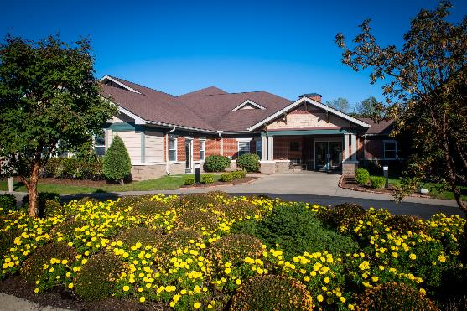
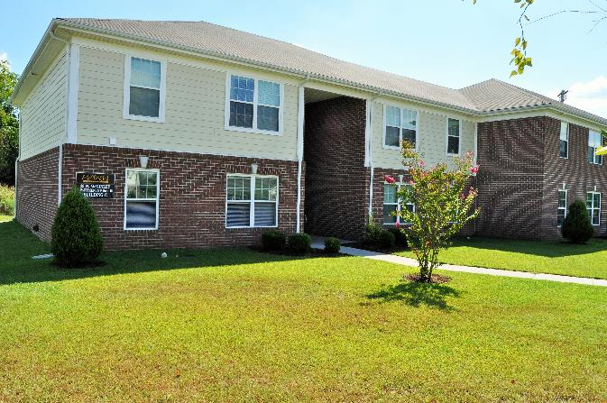
Women's Addiction Recovery Center in Henderson
28,757 county residents
The first recovery facility in the state of Kentucky
Frequently accepts residents from Tennessee
W.A.R.M.
Notes:
Time: ..75

Slide 33
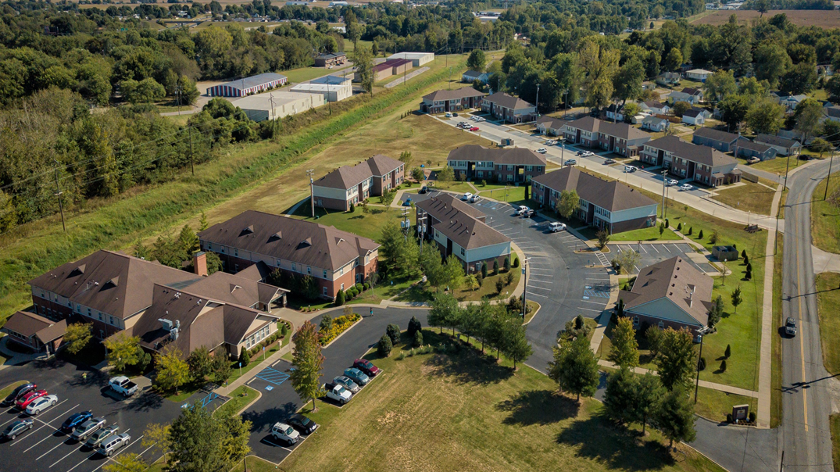
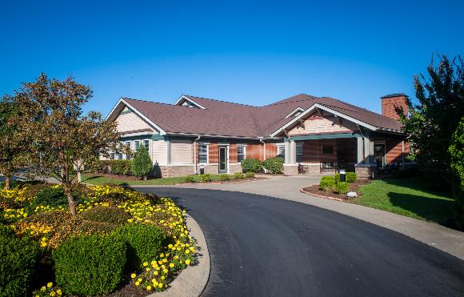
MISSION
Provide hope to homeless women suffering
from alcoholism and drug addiction.
Notes:
Time: ..75

Slide 34
WARM Residences II 32 units
Recovery Center
WARM Residences I 32 units
Community Center

Slide 35
LOW-INCOME HOUSING TAX CREDITS
A federal program
Administrated by states
Competitive process, but there may be set-asides
Each state’s annual credit allocation is approximately$2.50/person multiplied by the state’s population
Example: A 100-bed recovery residence would need approximately $1.1 million in credit allocation
LIHTC
BASICS
Notes:
Time: ..75

Slide 36
1
LIHTC
(OVER 10 YEARS)
$5,000,000
How Debt-Free Construction Works
2
HOME FUNDS
$250,000
How $5.9 million in construction costs were covered at the Regional Men's Recovery Center in Owensboro, Kentucky
3
AFFORDABLE HOUSING TRUST
$150,000
4
FEDERAL HOME BANK LOAN
$500,000

Slide 37
1
DEPARTMENT OF CORRECTIONS
$550,000
How Operational Day-To-Day Sustainability Works
2
HOUSING CHOICE VOUCHERS
$200,000
3
COMMUNITY DEVELOPMENT BLOCK GRANTS
How $1.3 million in annual day-to-day operating costs are covered at the Men's Addiction Recovery Center in Bowling Green, Kentucky
$300,000
4
FOOD STAMPS
(SNAP)
$150,000
5
LOCAL
$100,000

Slide 38
The Value
$30 per day…Liberty Place, Richmond, KY
8-9 months of recovery vs. 30 days in clinical model of inpatient
Adherence for 12 months approx. 50%
Better ROI

Slide 39
Our Recovery Ecosystem Experience
18 Recovery Kentucky residences
Created through unprecedented multi-agency teamwork and a willingness to think outside the box
“Community As Method” approach promotes active participation in peer-based group living
Remarkably effective in returning substance use victims to the community as productive members of society
Notes:
(Ernie general discussion of his experience with the Recovery Kentucky model and evidence-based Best Practices in dealing with the SUD epidemic.)
Ernie: II would now like to bring on Lori Baier, our Director of Employment Services, to discuss the employment piece of a Recovery Ecosystem and how we work with local employers to nurture the kind of personal, community, and economic development that can benefit your city.

Slide 40
SAMHSA RECOGNIZED
Evidence Based
Evidence-based model for Criminal Justice System Treatment and Recovery of Criminal Justice involved individuals with SUD.
Notes:
There are a number of efforts that exist without collaboration. Our effort is to bring to gather these efforts, especially around RH to find synergies within the silos.
Time: .3

Slide 42
Aligning Medical and Social Interventions
Housing access and retention
Bridging social and care gaps
Ensuring pathways to employment
Ensuring pathways to permanent housing

Slide 43
RHOAR – Recovery Hope Opportunity and Resiliance
Middlesboro, Kentucky – Cumberland Gap
Groundbreaking for $14 million recovery campus
Pregnant and Parenting Women
100 beds in Recovery Housing
IOP
Clinical Detox and Inpatient
Recovery Ecosystem in Rural Community
Notes:
(Ernie general discussion of his experience with the Recovery Kentucky model and evidence-based Best Practices in dealing with the SUD epidemic.)
Ernie: II would now like to bring on Lori Baier, our Director of Employment Services, to discuss the employment piece of a Recovery Ecosystem and how we work with local employers to nurture the kind of personal, community, and economic development that can benefit your city.

Slide 44
Value Based Payment
Certification vs. Credentialing of Recovery Houses
Collection of Outcome – Recovery Capital
Medicaid
Notes:
(Ernie general discussion of his experience with the Recovery Kentucky model and evidence-based Best Practices in dealing with the SUD epidemic.)
Ernie: II would now like to bring on Lori Baier, our Director of Employment Services, to discuss the employment piece of a Recovery Ecosystem and how we work with local employers to nurture the kind of personal, community, and economic development that can benefit your city.

Slide 45
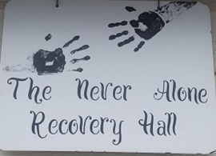
Scoobies House in Montana
An SOS (Safe Off the Streets) House sponsored by NARSS (Never Alone Recovery Support Services)
The only recovery house in Polson, Montana
“My kids motivate me. I have one more on the way so I need to figure this out. It’s time to do something different.”
– Nekota, 32, who began using drugs as a teenager, was jailed, did not benefit from previous treatment but is now thanks to the peer support model.

Slide 46
Summary
What we are doing is not working!
Recovery Housing is an important resource for individuals with SUD and experiencing homelessness, criminal justice involvement or other social challenges
Outcomes meet or exceed those of other programs and services addressing SUD
Cost of a 7-to-9 month stay in RH is equal to or less than other service models
To advance recovery housing sustainable funding models are needed with renewed public private partnerships

Slide 47
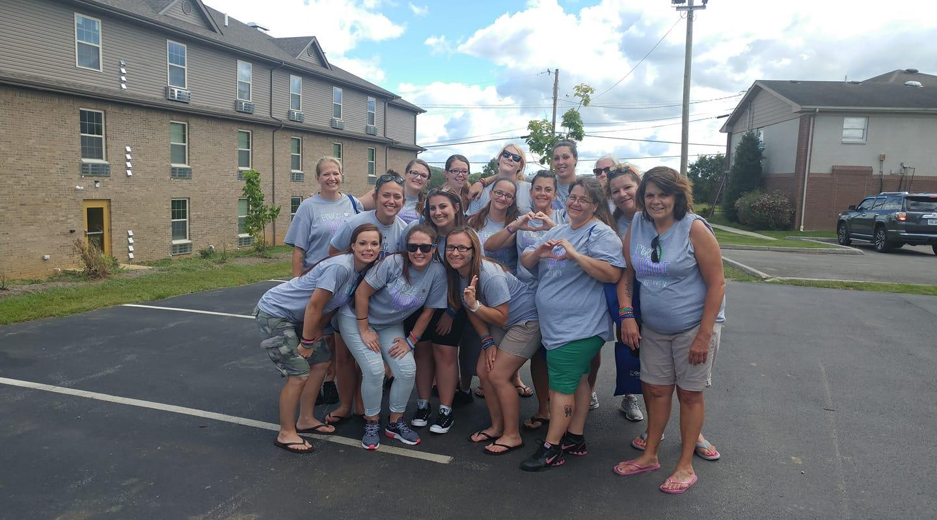
THANK YOU
This presentation is supported by the Health Resources and Services Administration (HRSA) of the U.S. Department of Health and Human Services (HHS) as part of an award totaling $17.1 million. The contents are those of the author(s) and do not necessarily represent the official views of, nor an endorsement, by HRSA, HHS or the U.S. Government

Slide 49
Contact Information
Fletcher Group, Inc.
601 Meyers Baker Rd #238
London, KY 40741
EMAIL ADDRESS
info@fletchergroup.org
PHONE NUMBER
(606) 657-4662

Slide 50
Dr. Ernie Fletcher
efletcher@fletchergroup.org
fletchergroup.org

