Slide 1
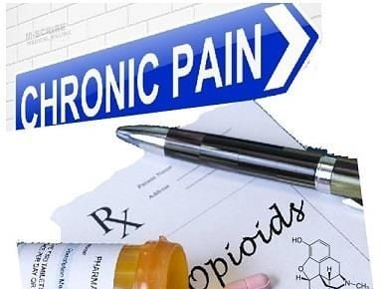
Pain and Opioid Use Disorder
Rebecca R. Donald, MD
Assistant Professor of Anesthesiology and Pain Medicine
Vanderbilt University Medical Center
Mid-South Addiction Conference
21 October 2022

Slide 2

WELCOME!
Notes:
Who is in the audience?

Slide 3
I have no disclosures to report

Slide 4
Learning Objectives
Describe the epidemiology of chronic pain
Describe the epidemiology of chronic pain among patients with Opioid Use Disorder (OUD)
Describe changing trends in opioid prescribing practices
Review treatment approaches for individuals with co-occurring pain and opioid use disorder

Slide 5
Chronic Pain Prevalence
MORE PEOPLE LIVE WITH CHRONIC PAIN THAN CANCER, HEART DISEASE, AND DIABETES, COMBINED
One of top presenting complaints
#1 reason people are out of work
$560 - $635 billion a year in direct medical cost, lost productivity, disability programs
Notes:
Chronic pain, one of the most common reasons adults seek medical care (1), is the number one reason people are out of work, has been linked to restrictions in mobility and daily activities (2,3), dependence on opioids (4), anxiety and depression (2), and poor perceived health or reduced quality of life (2,3).
$560 - $635 billion a year in direct medical cost, lost productivity, disability programs

Slide 6


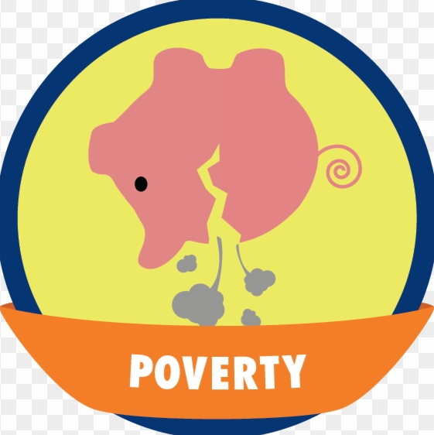

2016 National Health Interview Survey data
Chronic pain:
20.4% (50.0 million) of U.S. adults
High impact chronic pain:
8.0% of U.S. adults (19.6 million)
Higher prevalence:
Women
Older adults
Previously but not currently employed
Living in poverty
Less than high school education
Public health insurance
Rural residents
Lower Prevalence:
Bachelor’s degree or greater
Notes:
To estimate the prevalence of chronic pain and high-impact chronic pain in the United States, CDC analyzed the 2016 National Health Interview Survey (NHIS) data.
Basically they asked people two questions: “In the past six months, how often did you have pain?
The second question was “Over the past six months, how often did pain limit your life or work activities? “never, some days, most days, or every day?”
An estimated 20.4% (50.0 million) of U.S. adults had chronic pain (Chronic pain defined as pain on most days or every day in the past 6 months, as recommended by the International Association for the Study of Pain)
8.0% of U.S. adults (19.6 million) had high-impact chronic pain (defined as chronic pain that limited life or work activities on most days or every day during the past 6 months).
Higher prevalence of both chronic pain and high-impact chronic pain reported among women, older adults, previously but not currently employed adults, adults living in poverty, adults with less than a high school education, adults with public health insurance, and rural residents.
Dahlhamer J, Lucas J, Zelaya, C, et al. Prevalence of Chronic Pain and High-Impact Chronic Pain Among Adults — United States, 2016. MMWR Morb Mortal Wkly Rep 2018;67:1001–1006. DOI: http://dx.doi.org/10.15585/mmwr.mm6736a2external icon

Slide 7
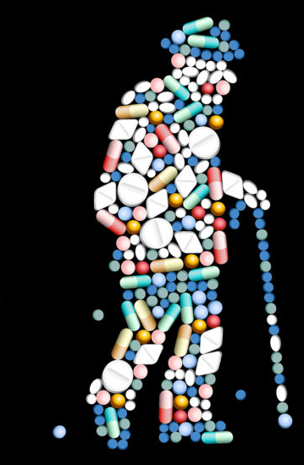
Chronic Pain and OUD in Older Patients
Prevalence of chronic pain increases with advancing age
Previous traumatic injuries
Age-related physiological changes in connective tissue
Nervous system degeneration
Arthritis from repetitive use and overuse
Consequences of end-stage chronic diseases (e.g. diabetes, cancer)
Rate of opioid prescribing for older adults is higher than for any other age group
OUD tends to be mis-identified or under-identified
Less responsibility to fulfill obligations outside of their homes
Overlap of symptoms common to older adults, including depression, delirium, dementia.
40%−50% of adults aged 50 and older who misuse prescription opioids obtain these medications through physicians
Potru S, Tang Y: Chronic Pain, Opioid Use Disorder, and Clinic Management Among Older Adults. Psychiatry Online 18 Aug 2021. https://doi.org/10.1176/appi.focus.20210002
Notes:
As you can imagine, the prevalence of chronic pain increases with advancing age. Etiologies include previous traumatic injuries, age-related physiological changes in connective tissue, nervous system degeneration, increasing arthritides from repetitive use and overuse, and consequences of end-stage chronic diseases such as diabetes, vascular disease, and various forms of cancer
Long-term chronic opioid use among older adults is often rationalized and, in fact, the rate of opioid prescribing for older adults is higher than for any other age group.
Challenges/Concerns with opioid use in older adults is that
OUD tends to be mis-identified or under-identified because many older adults may not need to go to work or fulfill other obligations outside of their homes, therefore the effects of usage may go unrecognized
Some symptoms of OUD may be similar to those of medical conditions common among older adults, including things such as depression, delirium, or dementia
Many patients with OUD have difficulty accepting a dx of OUD for fear of uncontrolled pain and stigma.
It has been shown that 40%−50% of adults age 50 and older who misuse prescription opioids obtain these medications through physicians and that older people are less likely to obtain them illicitly
Chronic Pain, Opioid Use Disorder, and Clinical Management Among Older Adults Sudheer Potru, D.O., and Yi-lang Tang, M.D., Ph.D. Published Online:18 Aug 2021https://doi.org/10.1176/appi.focus.20210002

Slide 8
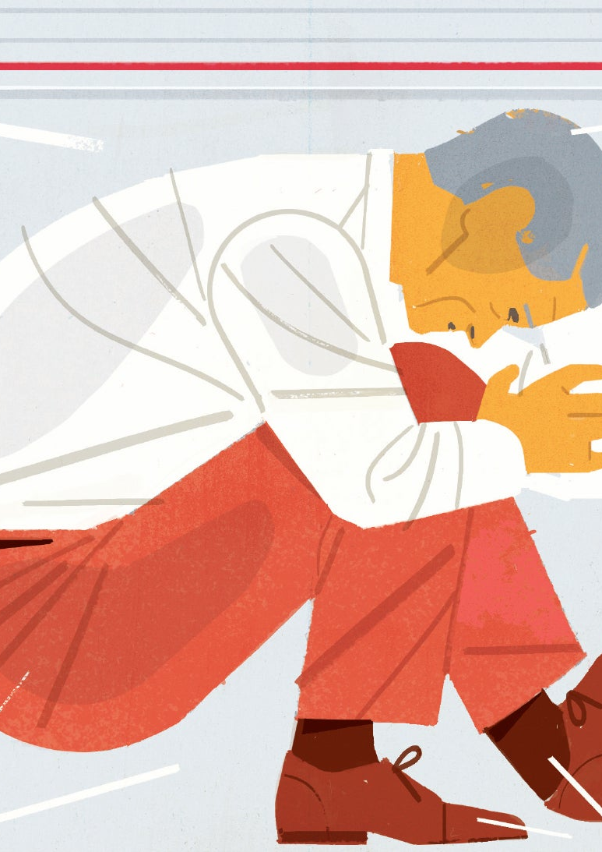
Chronic pain among patients with OUD
Time course is complex:
Chronic pain → prescription opioid use → OUD
OUD → Chronic pain (independent health condition or consequence of OUD)
Substance use is a risk factor for MVCs and violent crimes → injuries → chronic pain
Complicating issue: mental health problems often co-occur with OUD & Chronic pain
Patients with OUD:
11x more likely than general population to have a mood disorder
8x greater rates of anxiety disorders
Individuals with depression, schizophrenia, and bipolar disorder are significantly more likely to have chronic pain (OR 2.61, 1.21 and 2.17, respectively) relative to those without these psychiatric conditions
Hser YI, Mooney LJ, Saxon AJ, Miotto K, Bell DS, Huang D. Chronic pain among patients with opioid use disorder: Results from electronic health records data. J Subst Abuse Treat. 2017 Jun;77:26-30. doi: 10.1016/j.jsat.2017.03.006. Epub 2017 Mar 9. PMID: 28476267; PMCID: PMC5424616.
Notes:
A study by Hser et al aimed at determining the relationship between pain and OUD in patients with both conditions. This is a retrospective study based on the evaluation the electronic health records at a major academic institution. They evaluated the charts of 5307 patients with OUD
Among these 5307, 64.4% of patients with OUD had chronic pain
Among them, 61.8% had chronic pain before their first OUD dx
What they found is that the relationship between chronic pain and OUD and the time course between the two is complex.
Chronic pain may precede prescription opioid use (which makes sense, since pain can be a reason patients first start using opioids) OR chronic pain may develop after OUD, either as an independent health condition or as a consequence of OUD since substance use is a risk factor for car accidents and violent crime, which often lead to injuries that are associated with chronic pain.
Complicating the issue is that other physical health and mental health problems often co-occur with OUD and chronic pain. For example, OUD patients are up to 11 times more likely than the general population to have a mood disorder, and they have up to 8 times greater rates of anxiety disorders
What is more, Individuals with depression, schizophrenia, and bipolar disorder are significantly more likely to have chronic pain (Odds Ratio of 2.61, 1.21 and 2.17, respectively) relative to those without these psychiatric conditions. These patients with mental health problems or multiple pain problems often present with more physical and psychological distress, resulting in greater frequency of opioid prescribing in primary care practices.
Hser YI, Mooney LJ, Saxon AJ, Miotto K, Bell DS, Huang D. Chronic pain among patients with opioid use disorder: Results from electronic health records data. J Subst Abuse Treat. 2017 Jun;77:26-30. doi: 10.1016/j.jsat.2017.03.006. Epub 2017 Mar 9. PMID: 28476267; PMCID: PMC5424616.
2006-2015, the study assessed 5307 patients

Slide 9
Prevalence of comorbid chronic pain among patients with opioid use disorder (OUD) Hser YI, Mooney LJ, Saxon AJ, Miotto K, Bell DS, Huang D.
Purpose:
To examine the prevalence of comorbid chronic pain among patients with opioid use disorder (OUD)
Compare other comorbidities (substance use disorder, mental health disorders, health/disease conditions) among patients in four categories: no chronic pain (No Pain), OUD prior to pain (OUD First), OUD and pain at the same time (Same Time), or pain condition prior to OUD (Pain First).
Study conducted using electronic health record database of 5307 patients with OUD in a large healthcare system from 2006-2015
64.4% of patients with OUD had chronic pain
61.8% had chronic pain before their first OUD dx
The Pain First group had generally higher rates of co-occurring medical and psychological problems than did the OUD First group
Patients with mental health and multiple pain problems often present with more physical and psychological distress, resulting in greater frequency of opioid prescribing in primary care practices
Hser YI, Mooney LJ, Saxon AJ, Miotto K, Bell DS, Huang D. Chronic pain among patients with opioid use disorder: Results from electronic health records data. J Subst Abuse Treat. 2017 Jun;77:26-30. doi: 10.1016/j.jsat.2017.03.006. Epub 2017 Mar 9. PMID: 28476267; PMCID: PMC5424616.
Notes:
Purpose: To examine the prevalence of comorbid chronic pain among patients with opioid use disorder (OUD) and to compare other comorbidities (substance use disorder (SUD), mental health disorders, health/disease conditions) among patients in four categories: no chronic pain (No Pain), OUD prior to pain (OUD First), OUD and pain at the same time (Same Time), or pain condition prior to OUD (Pain First).
Study conducted using electronic health record database from 2006-2015 –limitation: data from records may not be as accurate as that collected for research purposes. Once healthcare system so cannot obtain info about patients’ dx outside of the healthcare system under study.
5307 patients with OUD in a large healthcare system
64.4% of patients with OUD had chronic pain
Among them, 61.8% had chronic pain before their first OUD dx
Pain First patients had the highest rates of mental disorder (81.7%), heart disease (72%), respiratory disease (68.4%), sleep disorder (41.8%), cancer (23.4%) and diabetes (19.3%). The Pain First group had generally higher rates of co-occurring medical problems than did the OUD First group. Part of the explanation for this phenomenon may be related to the age of the Pain First group; that group was older and thus more prone to medical illness. It may also be possible that the Pain First group had a longer duration of pain, which contributed to declining health status.
For the groups with chronic pain, major pain diagnoses included spinal pain, joint pain, general or unspecific chronic pain, osteoarthrosis, and migraine (see Table 2). The prevalence rates in all these diagnoses were significantly different among the three groups with chronic pain (p < .01), and these rates were higher among the Pain First group than among the OUD First or Same Time groups
The results show that the majority of patients with opioid use disorder developed this disorder following the presence of chronic pain. A plausible explanation for some of these cases, although not directly demonstrated by the data collected, is iatrogenic causation via use of opioid medication prescriptions for pain. As hypothesized, this group, as well as the OUD First group and Same Time group, had greater rates of co-occurring psychiatric and medical conditions compared to the No Pain group
Patients with mental health and multiple pain problems often present with more physical and psychological distress, resulting in greater frequency of opioid prescribing in primary care practices
Comorbid OUD and chronic pain complicates treatment decision-making, predicts poor outcomes, and increases healthcare costs

Slide 10
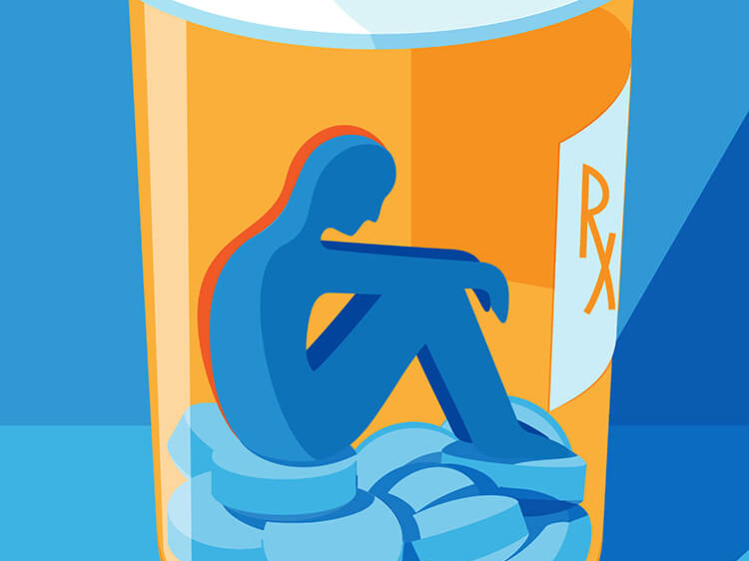
Between 21 and 29 percent of patients prescribed opioids for chronic pain misuse them.
Between 8 and 12 percent of people using an opioid for chronic pain develop an opioid use disorder.
About 80 percent of people who use heroin first misused prescription opioids.
https://www.drugabuse.gov/drug-topics/opioids/opioid-overdose-crisis
Notes:
What we do know is that, prescription opioids place people at risk for developing opioid use disorder.
To give you a few statistics
Between 21 and 29 percent of patients prescribed opioids for chronic pain misuse them.
Between 8 and 12 percent of people using an opioid for chronic pain develop an opioid use disorder.
About 80 percent of people who use heroin, now fentanyl, first misused prescription opioids.
Statistics from : https://www.drugabuse.gov/drug-topics/opioids/opioid-overdose-crisis

Slide 11
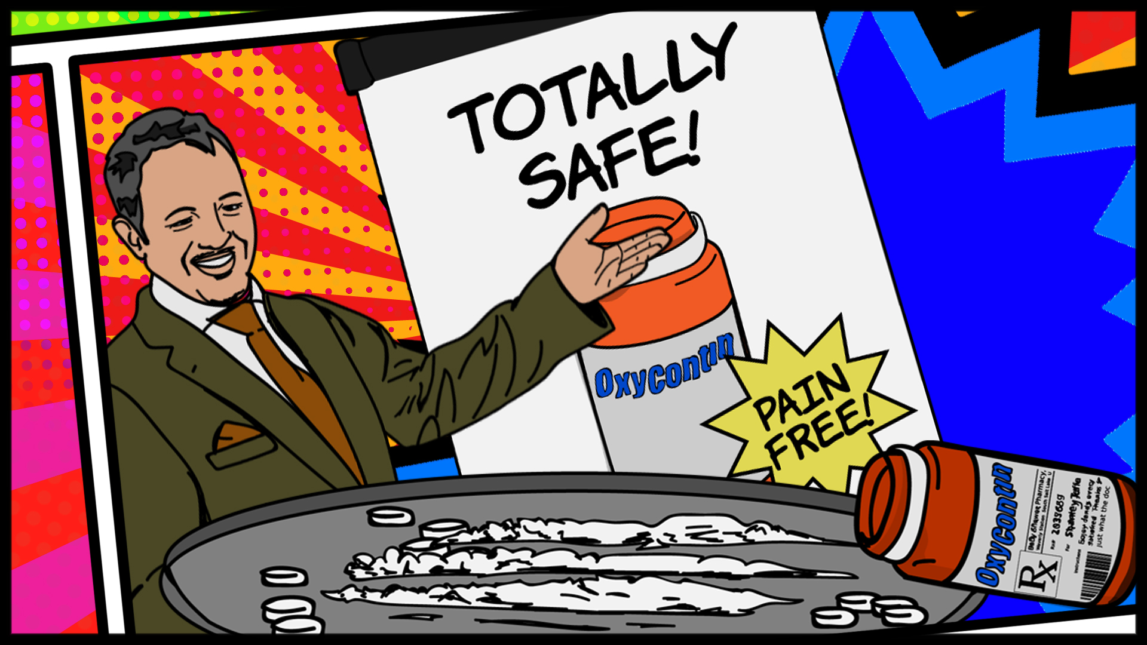
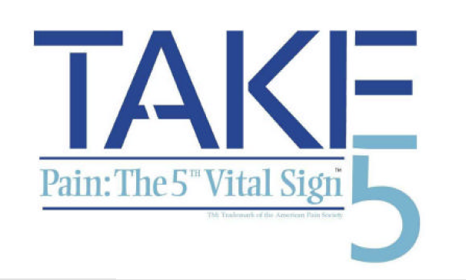
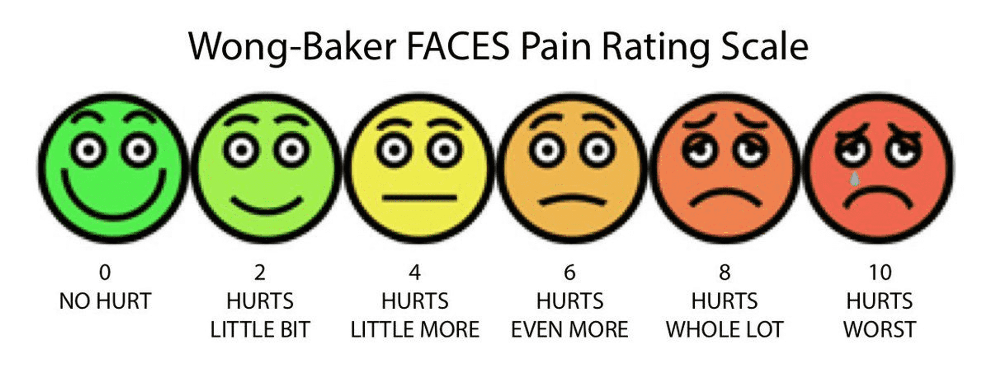
Notes:
It makes sense that we would see a lot of patients with chronic pain develop opioid use disorder because for many years we were told that opioids were very safe drugs with low risk of addiction. Accompanying that assertion was the emphasis placed on pain as the fifth vital sign.

Slide 12
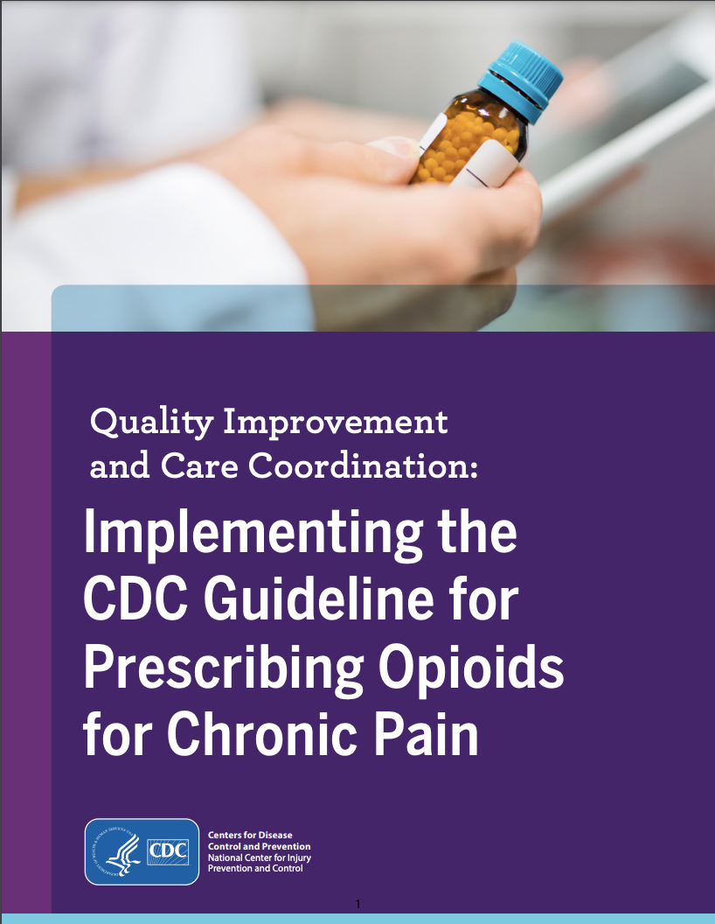
Notes:
But then we wised up a little bit and determined that opioids are not actually ideal for chronic pain conditions. Even before the CDC released their guidelines for prescribing opioids for chronic pain in 2016, the number of opioid prescriptions started dropping, but it fell significantly after these guidelines were published.
On the next slide is a map of the US that shows the Opioid dispensing rates. It’s going to play automatically and change color over time. The darker the color the more opioids that were dispensed. You will note that until about 2012-2013 the map gets darker, but then it starts to lighten up and become more yellow than red or orange.

Slide 13
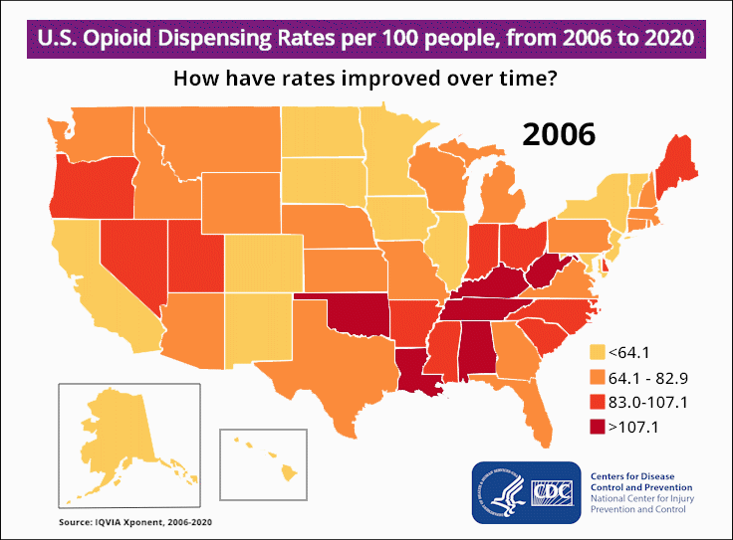
Notes:
In 2006 a total of almost 216 million (215,917,663) prescriptions were written, which is a dispensing rate of 72.4 per 100 persons.
The total number of prescriptions dispensed peaked in 2012 at more than 255 million and a dispensing rate of 81.3 prescriptions per 100 persons.
In 2020 that number dropped to around 142 million (142,816,781), which is a dispensing rate of 43.3 per 100 persons, so almost half of what it was in 2006
Despite this overall drop in prescribing from 2012-2020, dispensing rates continued to remain very high in certain areas across the country (these hot-spots are in darker red and are concentrated in the south).
https://www.cdc.gov/drugoverdose/rxrate-maps/index.html

Slide 14
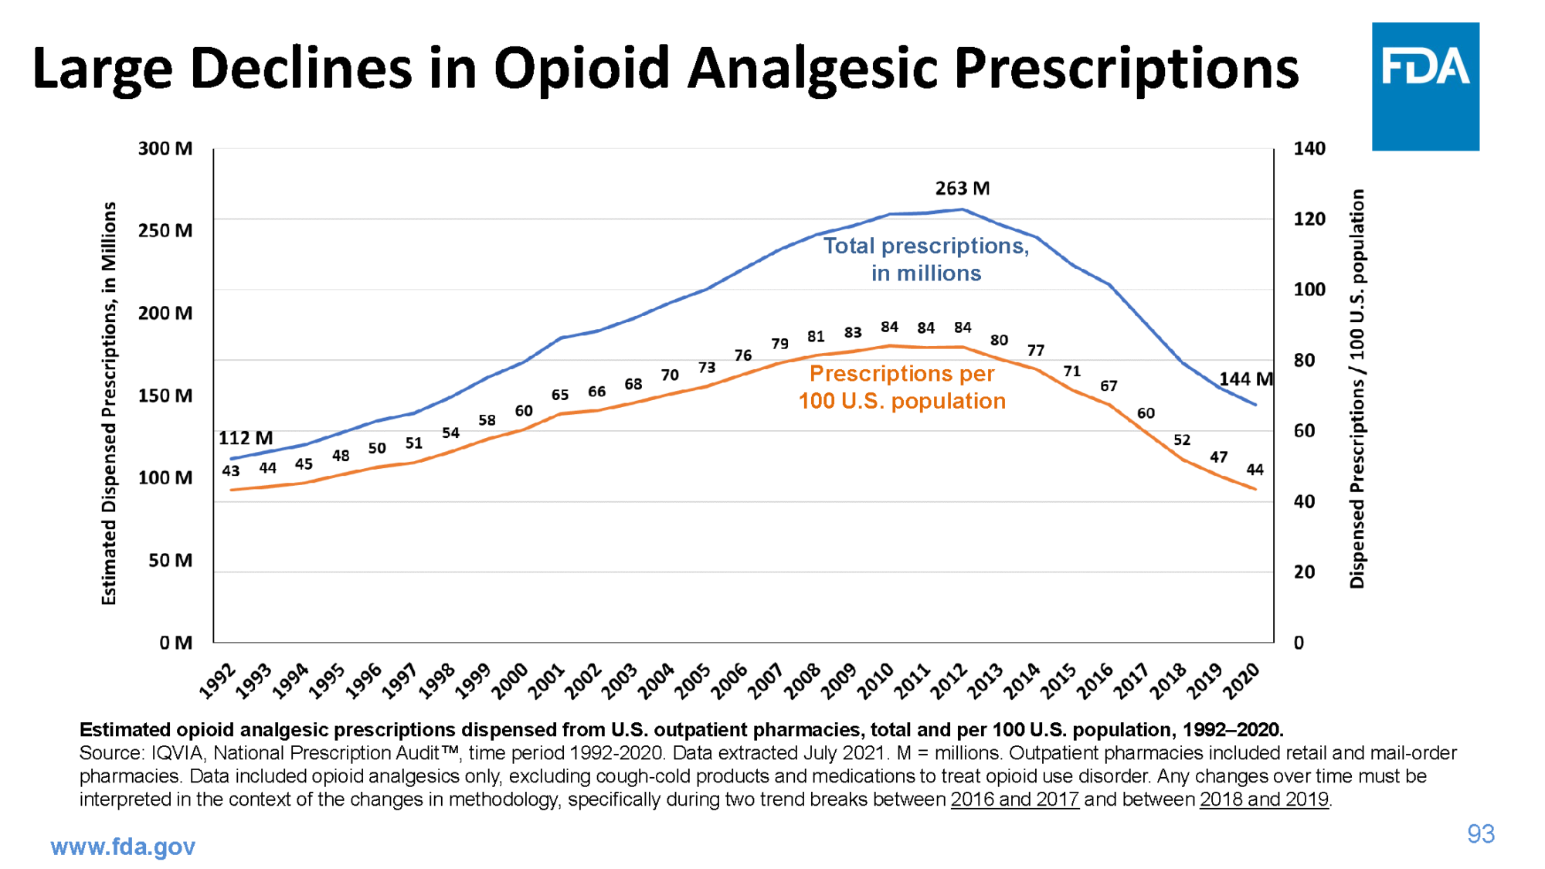
Notes:
https://thegarrisonproject.org/prescription-opioids-overdose/

Slide 15
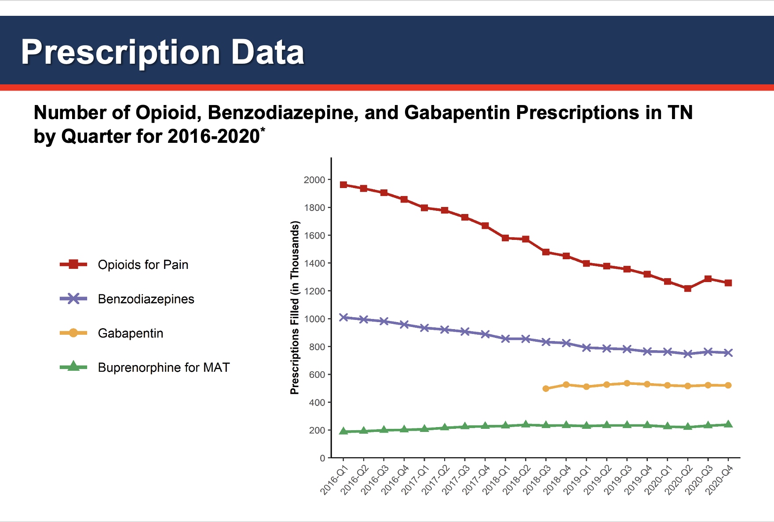

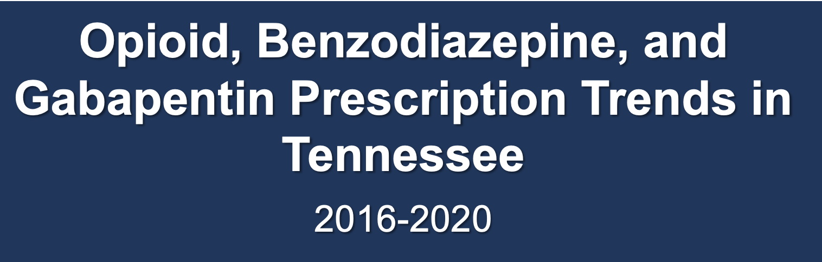
*Analysis conducted by the Office of Informatics and Analytics, TDH (last updated January 15, 2021). Limited to TN residents. Data Source: Controlled Substance Monitoring Database.
Notes:
Those were the national numbers, and now we’ll take a look at the prescribing rates in TN
The numbers of filled opioid prescriptions for pain and filled benzodiazepine prescriptions have continued to decline between 2016 and 2020

Slide 16
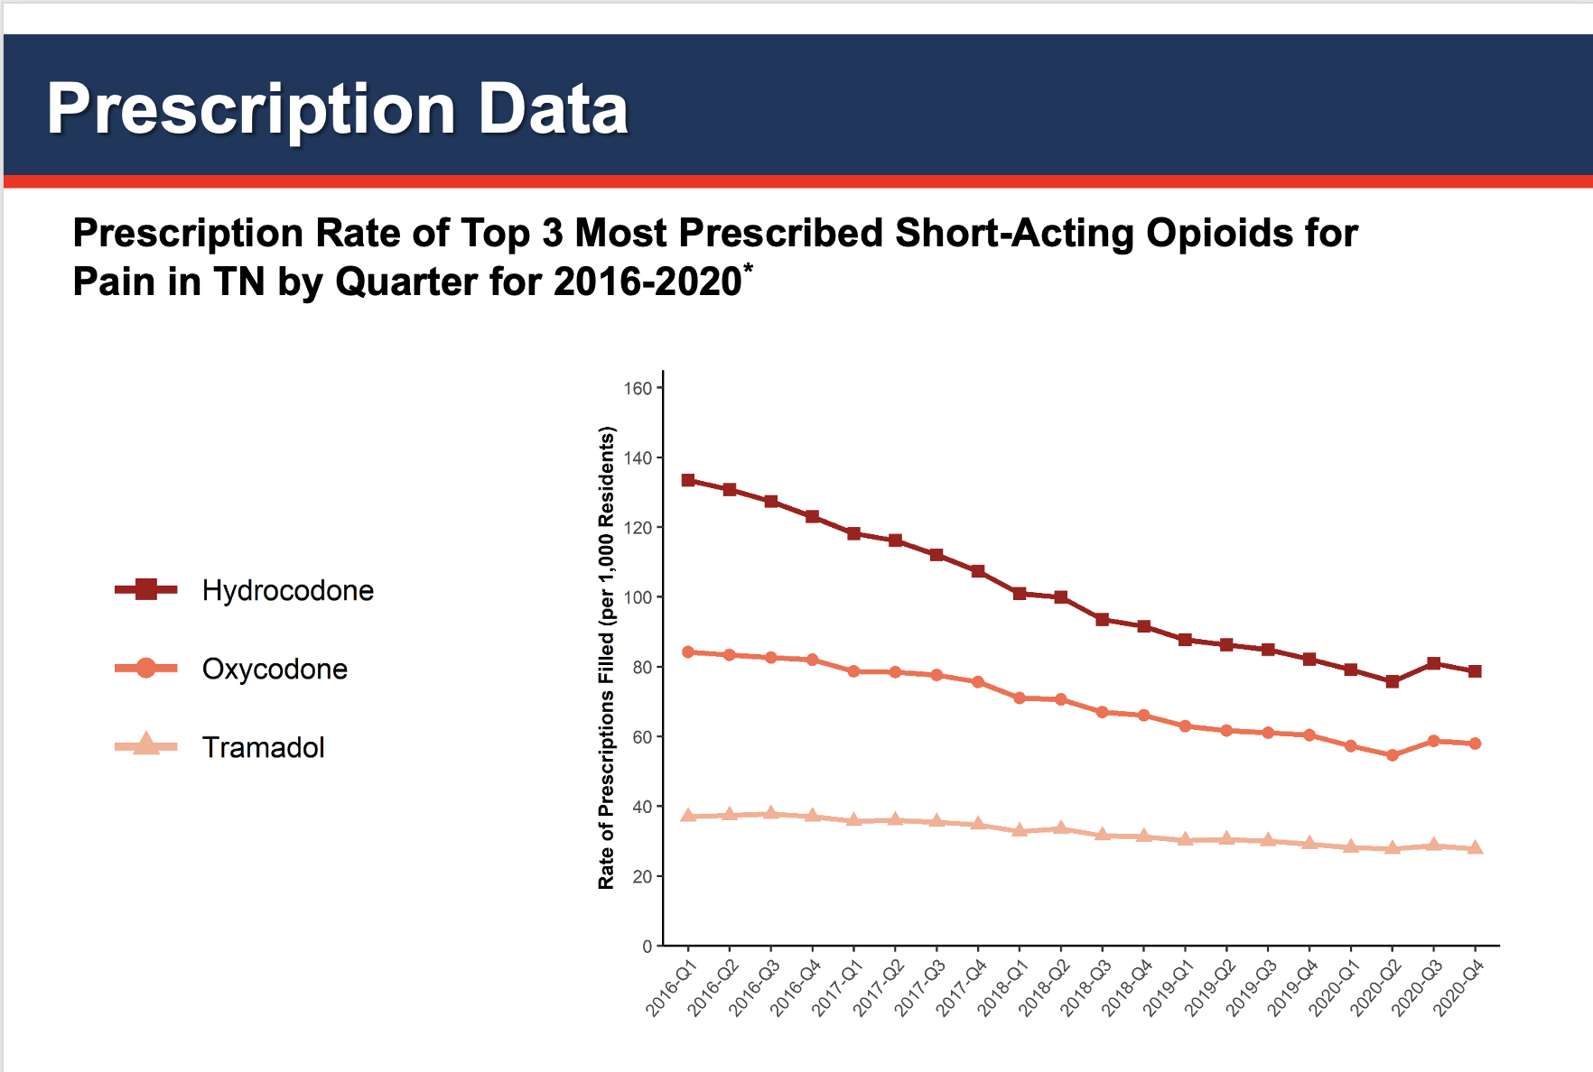
*Analysis conducted by the Office of Informatics and Analytics, TDH (last updated January 15, 2021). Limited to TN residents. Data Source: Controlled Substance Monitoring Database.
Notes:
Hydrocodone is consistently the most commonly prescribed short-acting opioid for pain
Each top prescribed opioid increased in rate from Q2 2020 to Q3 2020
https://www.tn.gov/health/health-program-areas/pdo/pdo/facts-figures.html

Slide 17
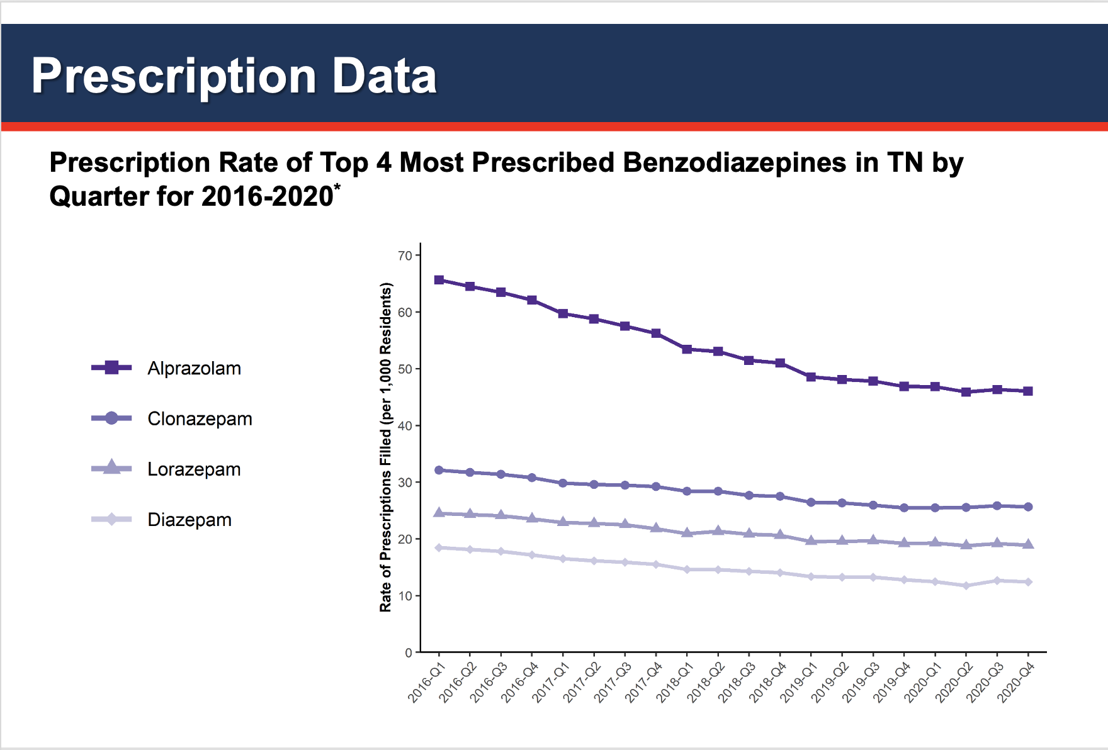
*Analysis conducted by the Office of Informatics and Analytics, TDH (last updated January 15, 2021). Limited to TN residents. Data Source: Controlled Substance Monitoring Database.
Notes:
Alprazolam is prescribed nearly 2 to 3 times the rate of the other benzodiazepines
The rate of filled Alprazolam prescriptions continued to decrease from 2016 to 2020
https://www.tn.gov/health/health-program-areas/pdo/pdo/facts-figures.html

Slide 18
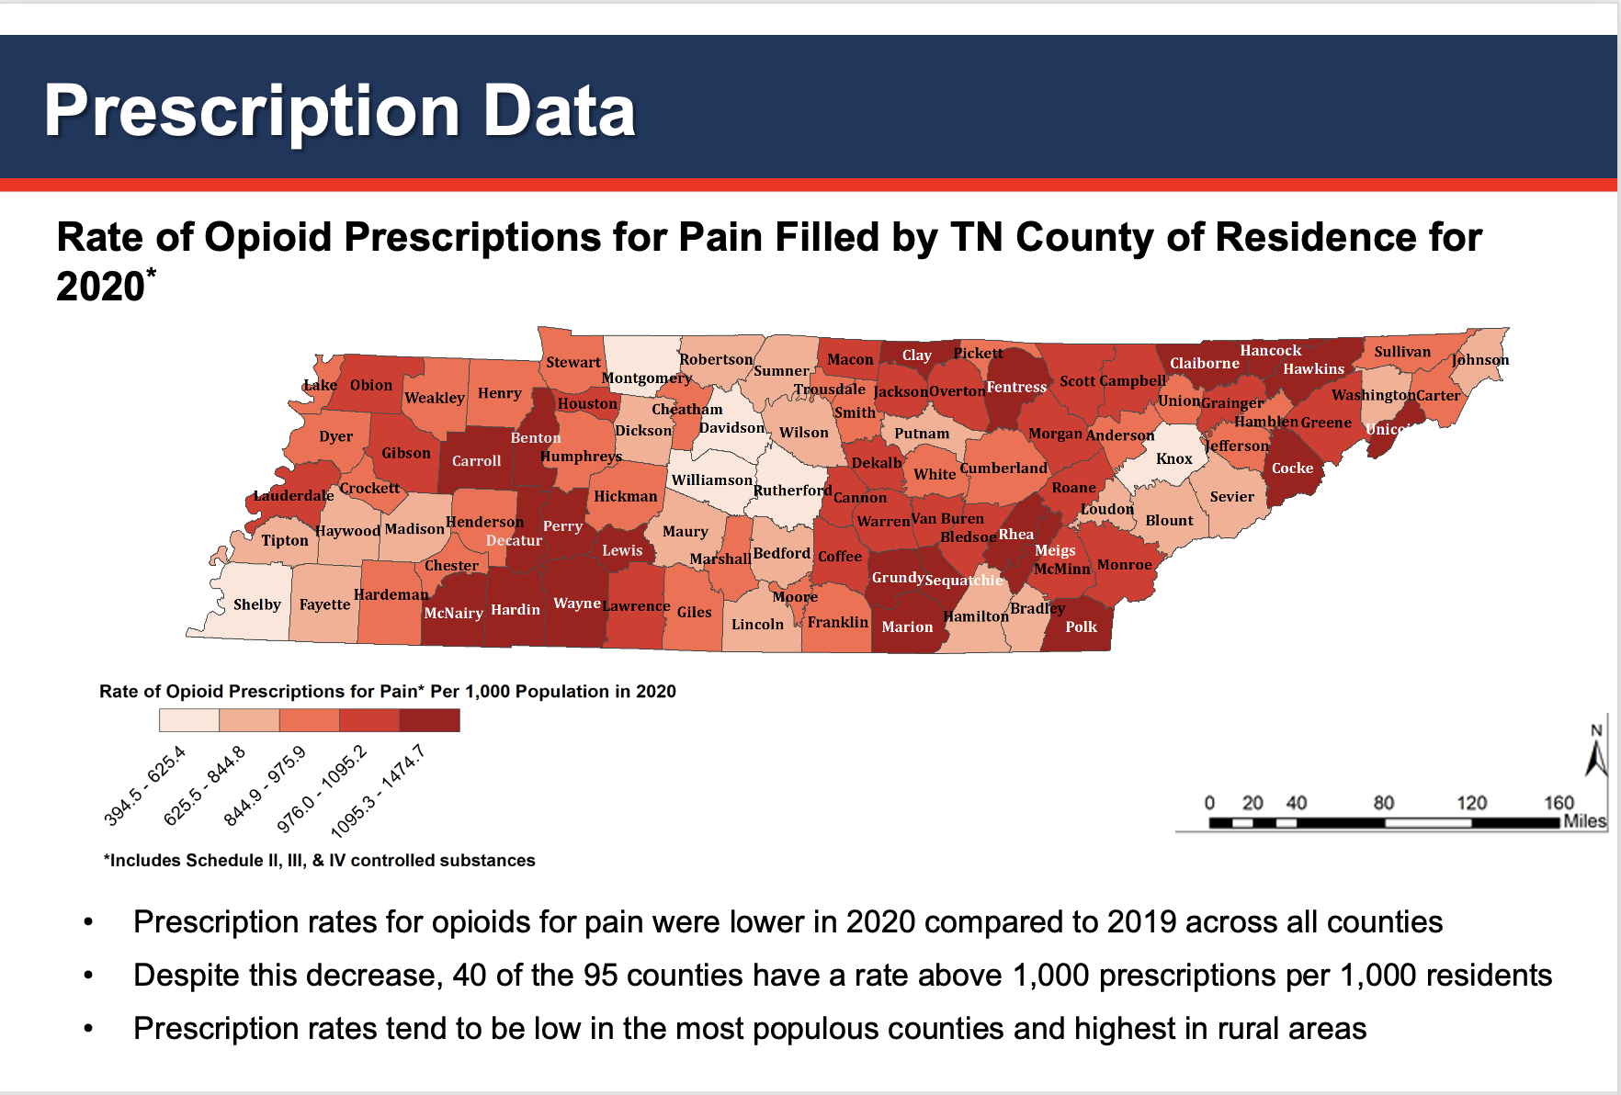
Notes:
https://www.tn.gov/health/health-program-areas/pdo/pdo/facts-figures.html

Slide 19
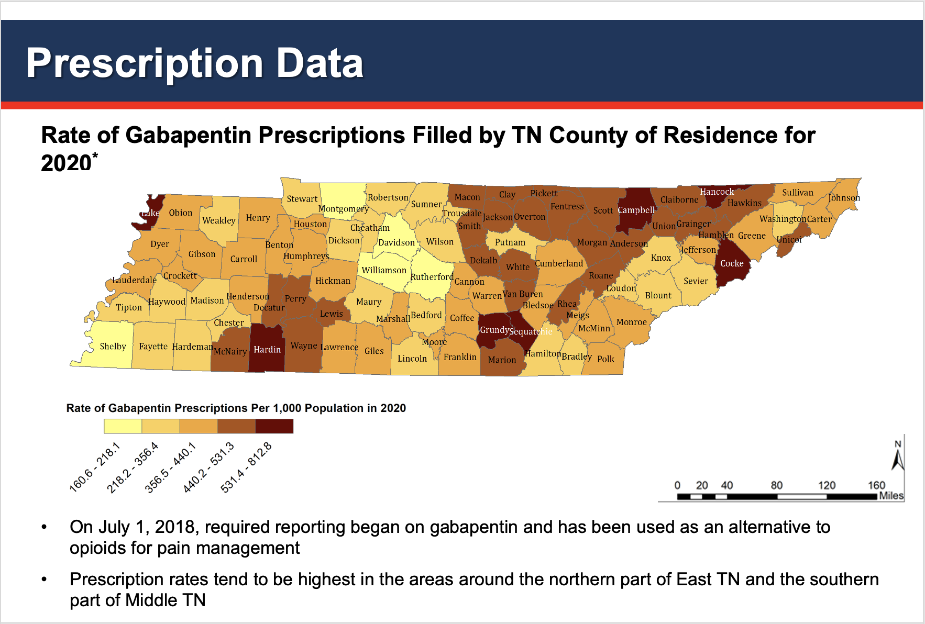
Notes:
https://www.tn.gov/health/health-program-areas/pdo/pdo/facts-figures.html

Slide 20
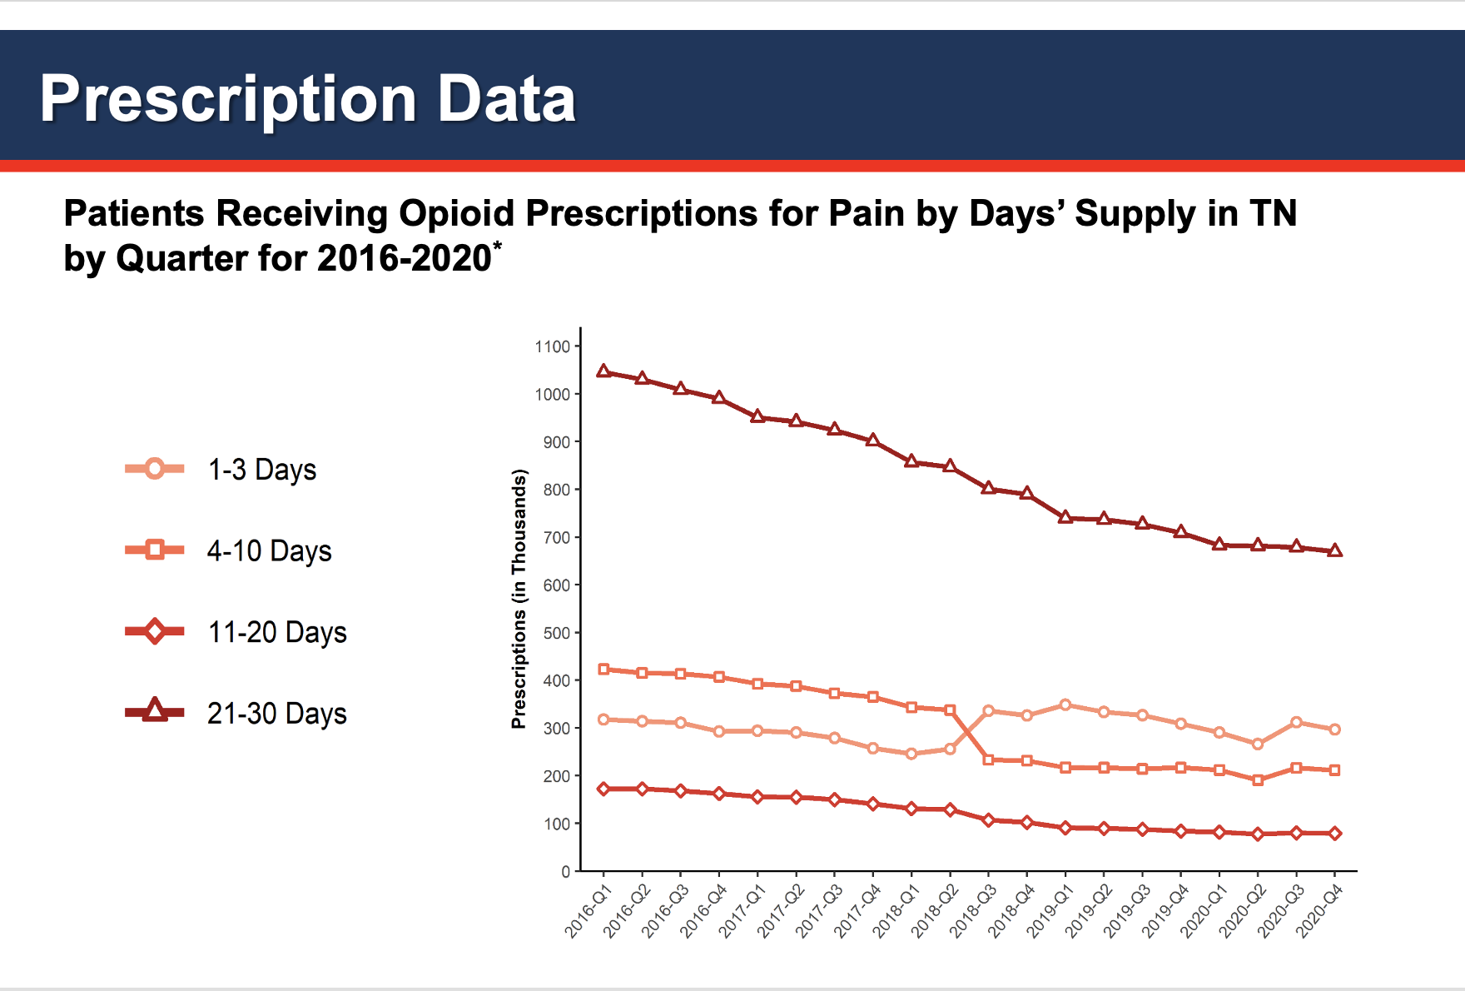
Notes:
The most common length of opioid prescription from 2016 to 2020 was 21-30 days
The least common length of opioid prescription from 2016 to 2020 was 11-20 days
https://www.tn.gov/health/health-program-areas/pdo/pdo/facts-figures.html

Slide 21
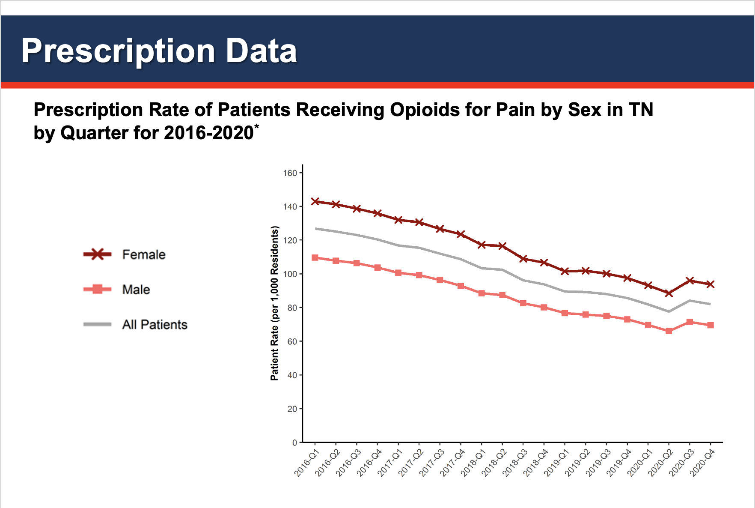
Notes:
Opioid prescriptions for pain were filled at a higher rate by females from 2016 to 2020
Both males and females had a decrease in the rate of patients receiving opioids for pain at roughly the same rate

Slide 22
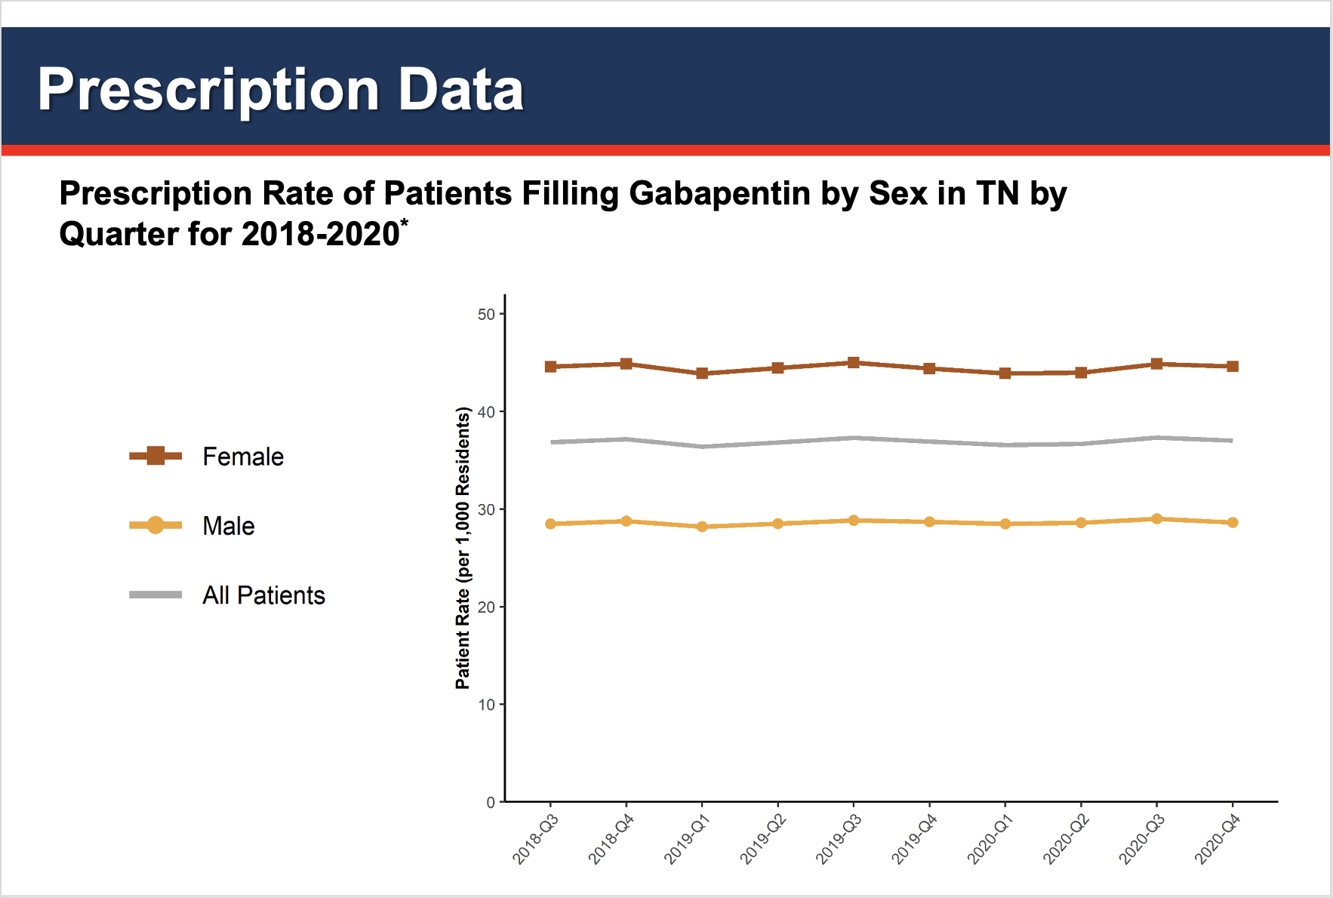
Notes:
Gabapentin prescriptions were filled at a higher rate by females from Q3 2018 to 2020
The rates for both males and females have held relatively steadily across this period

Slide 23
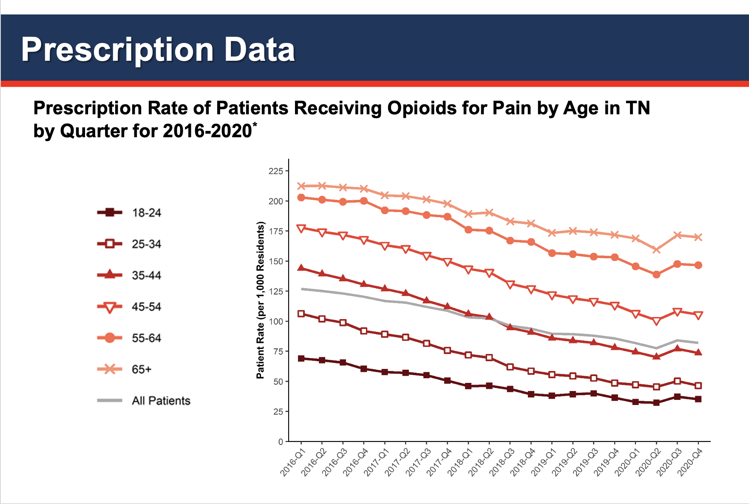
Notes:
Older age groups filled opioid prescriptions for pain at higher rates than younger age groups from 2016 to 2020
All age groups had a decrease in rates between 2016 to 2020, with age groups 25-54 having the sharpest rate decrease
All age groups had an increase in prescriptions between Q2 2020 and Q3 2020

Slide 24
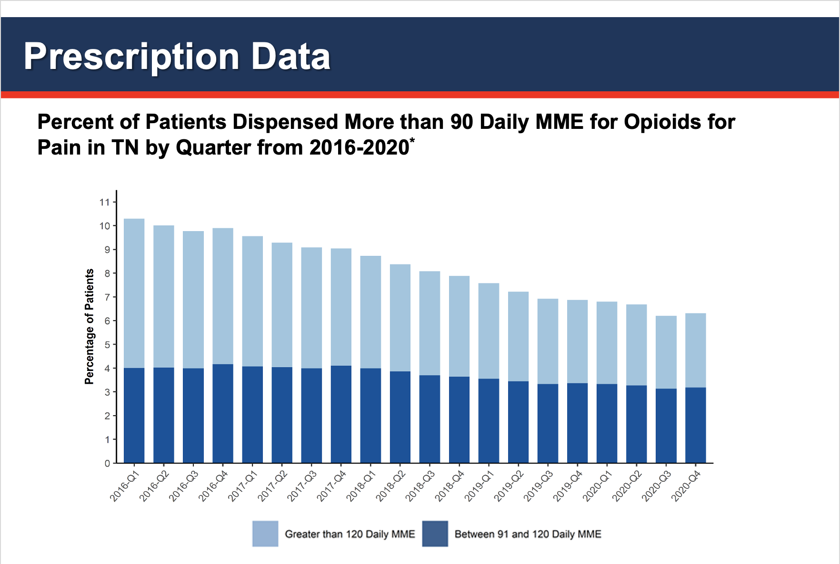
Notes:
The percentage of patients who received opioid prescriptions for pain that exceeded 90 daily MME per day continues to decline from 2016 to 2020
The percentage of patients receiving 91 to 120 daily MME has decreased

Slide 25
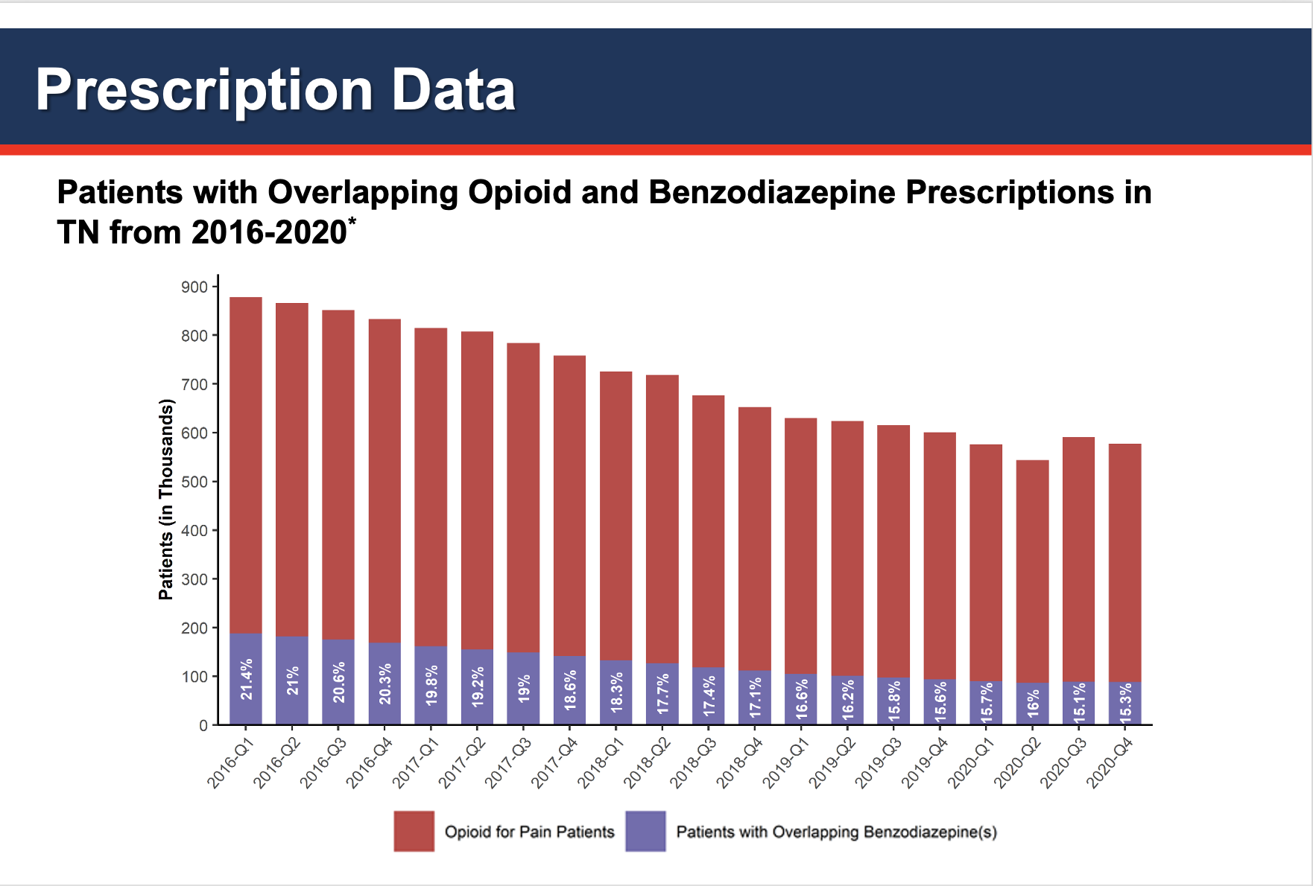
Notes:
The percentage of patients with an overlapping opioid and benzodiazepine prescription decreased from 2016 to 2020

Slide 26
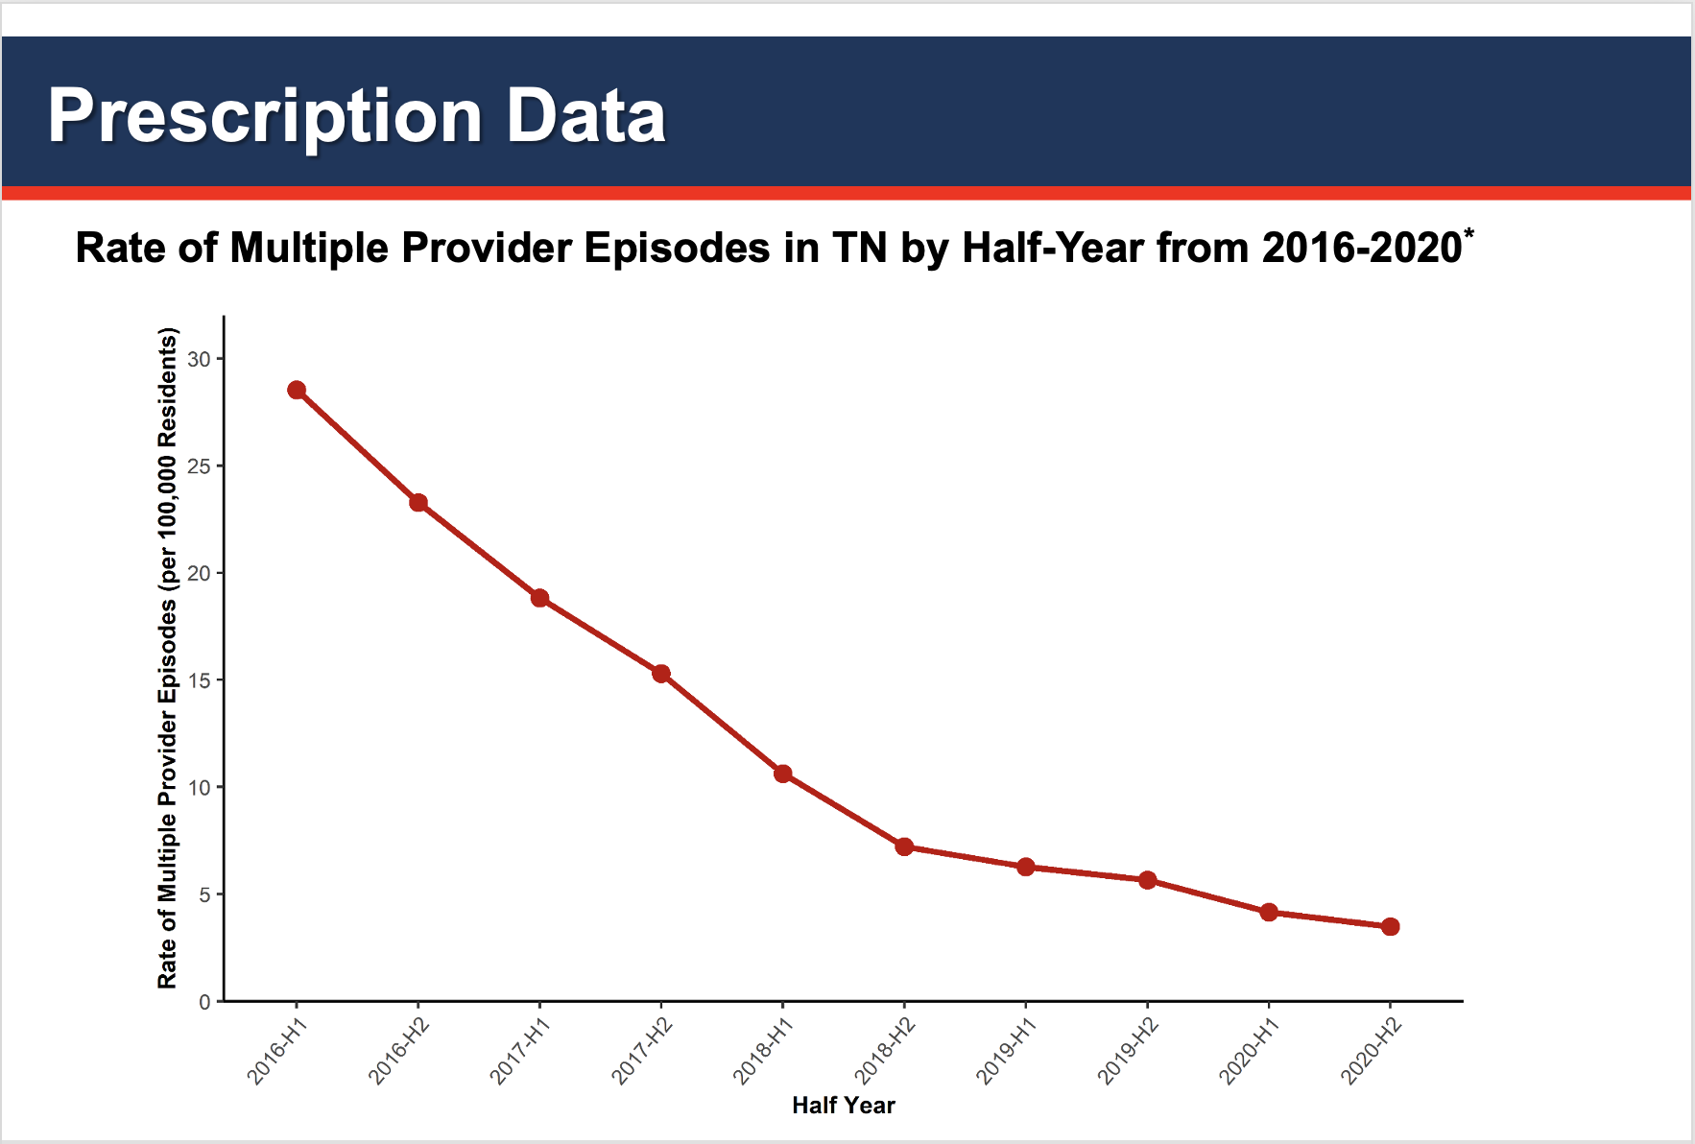
Notes:
A multiple provider episode² (MPE) occurs when a patient fills prescriptions from at least 5 prescribers and at least 5 dispensers in a 6 month period
The rate of MPEs in TN has rapidly declined over the last 5 years

Slide 27
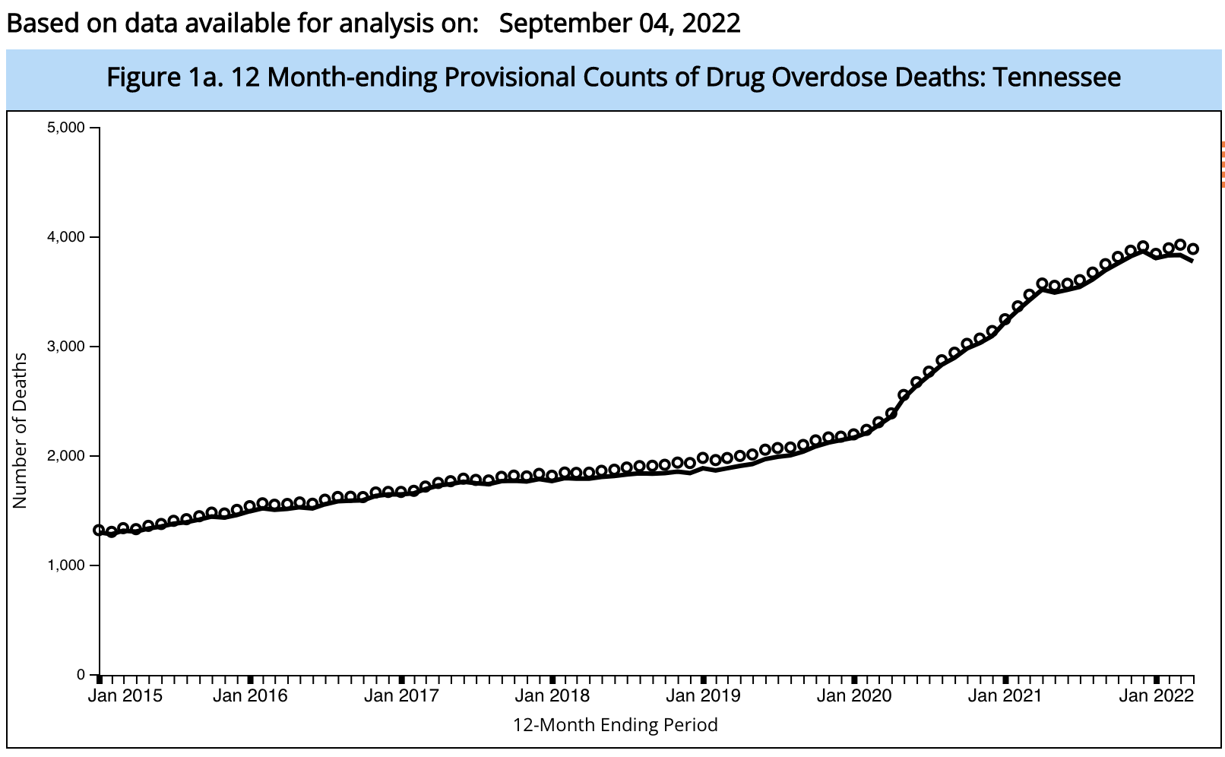
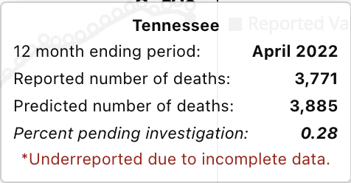
March 2020 Covid lockdown begins
Notes:
The problem is that despite declining opioid prescriptions people are dying at higher rates than ever.

Slide 28
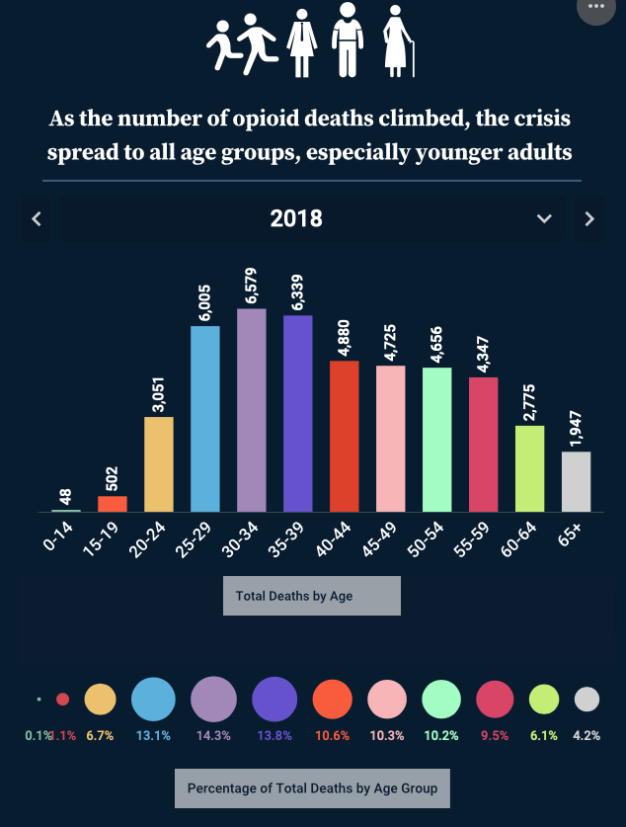

Notes:
In fact, while older adults receive more prescriptions for opioids, the highest death rate is among 30-39 year olds.

Slide 29
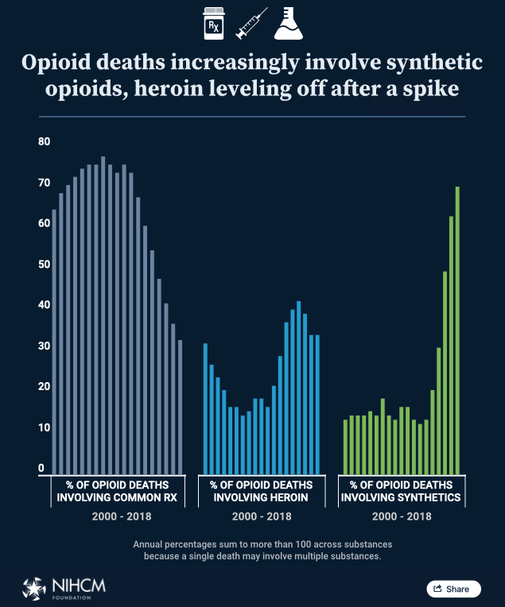
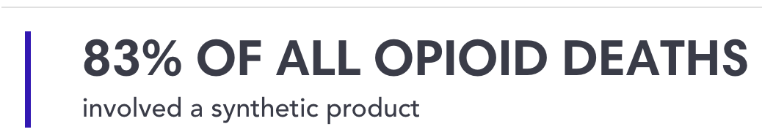
Notes:
So deaths are involving not only those who use or misuse opioids chronically but they are also involving young people who experiment with drugs for the first time.
83% OF ALL OPIOID DEATHS involved a synthetic product (https://nihcm.org/publications/visualizing-the-impact-of-the-opioid-overdose-crisis) July 28, 2022

Slide 30
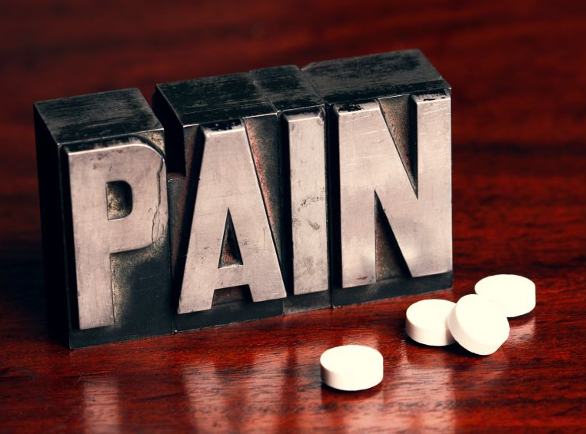
Notes:
I want to shift gears and talk about pain, why opioids for chronic pain are generally not a good idea for chronic pain, and how we treat patients with co-occurring pain and OUD.

Slide 31
But first…a primer on pain

Slide 32
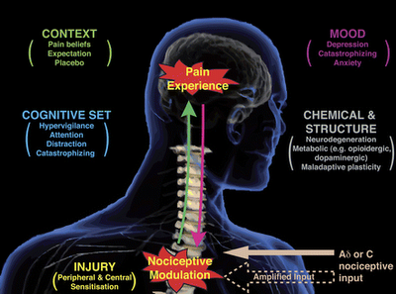
“An unpleasant sensory and emotional experience associated with, or resembling that associated with, actual or potential tissue damage.”
- revised definition by the International Association for the Study of Pain, 2020
Notes:
32
Gatchel et al., 2007: The Biopsychosocial Approach to Chronic Pain: Scientific Advances and Future Directions.

Slide 33


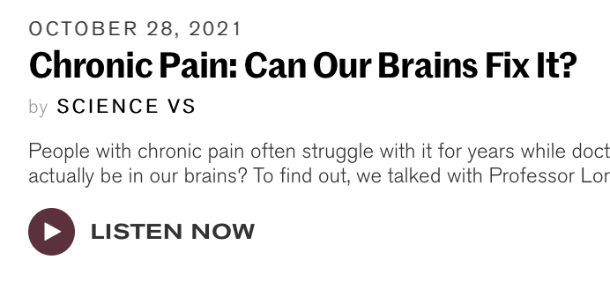
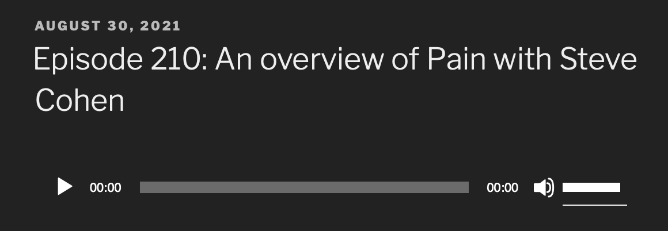
A Good Listen

Slide 34
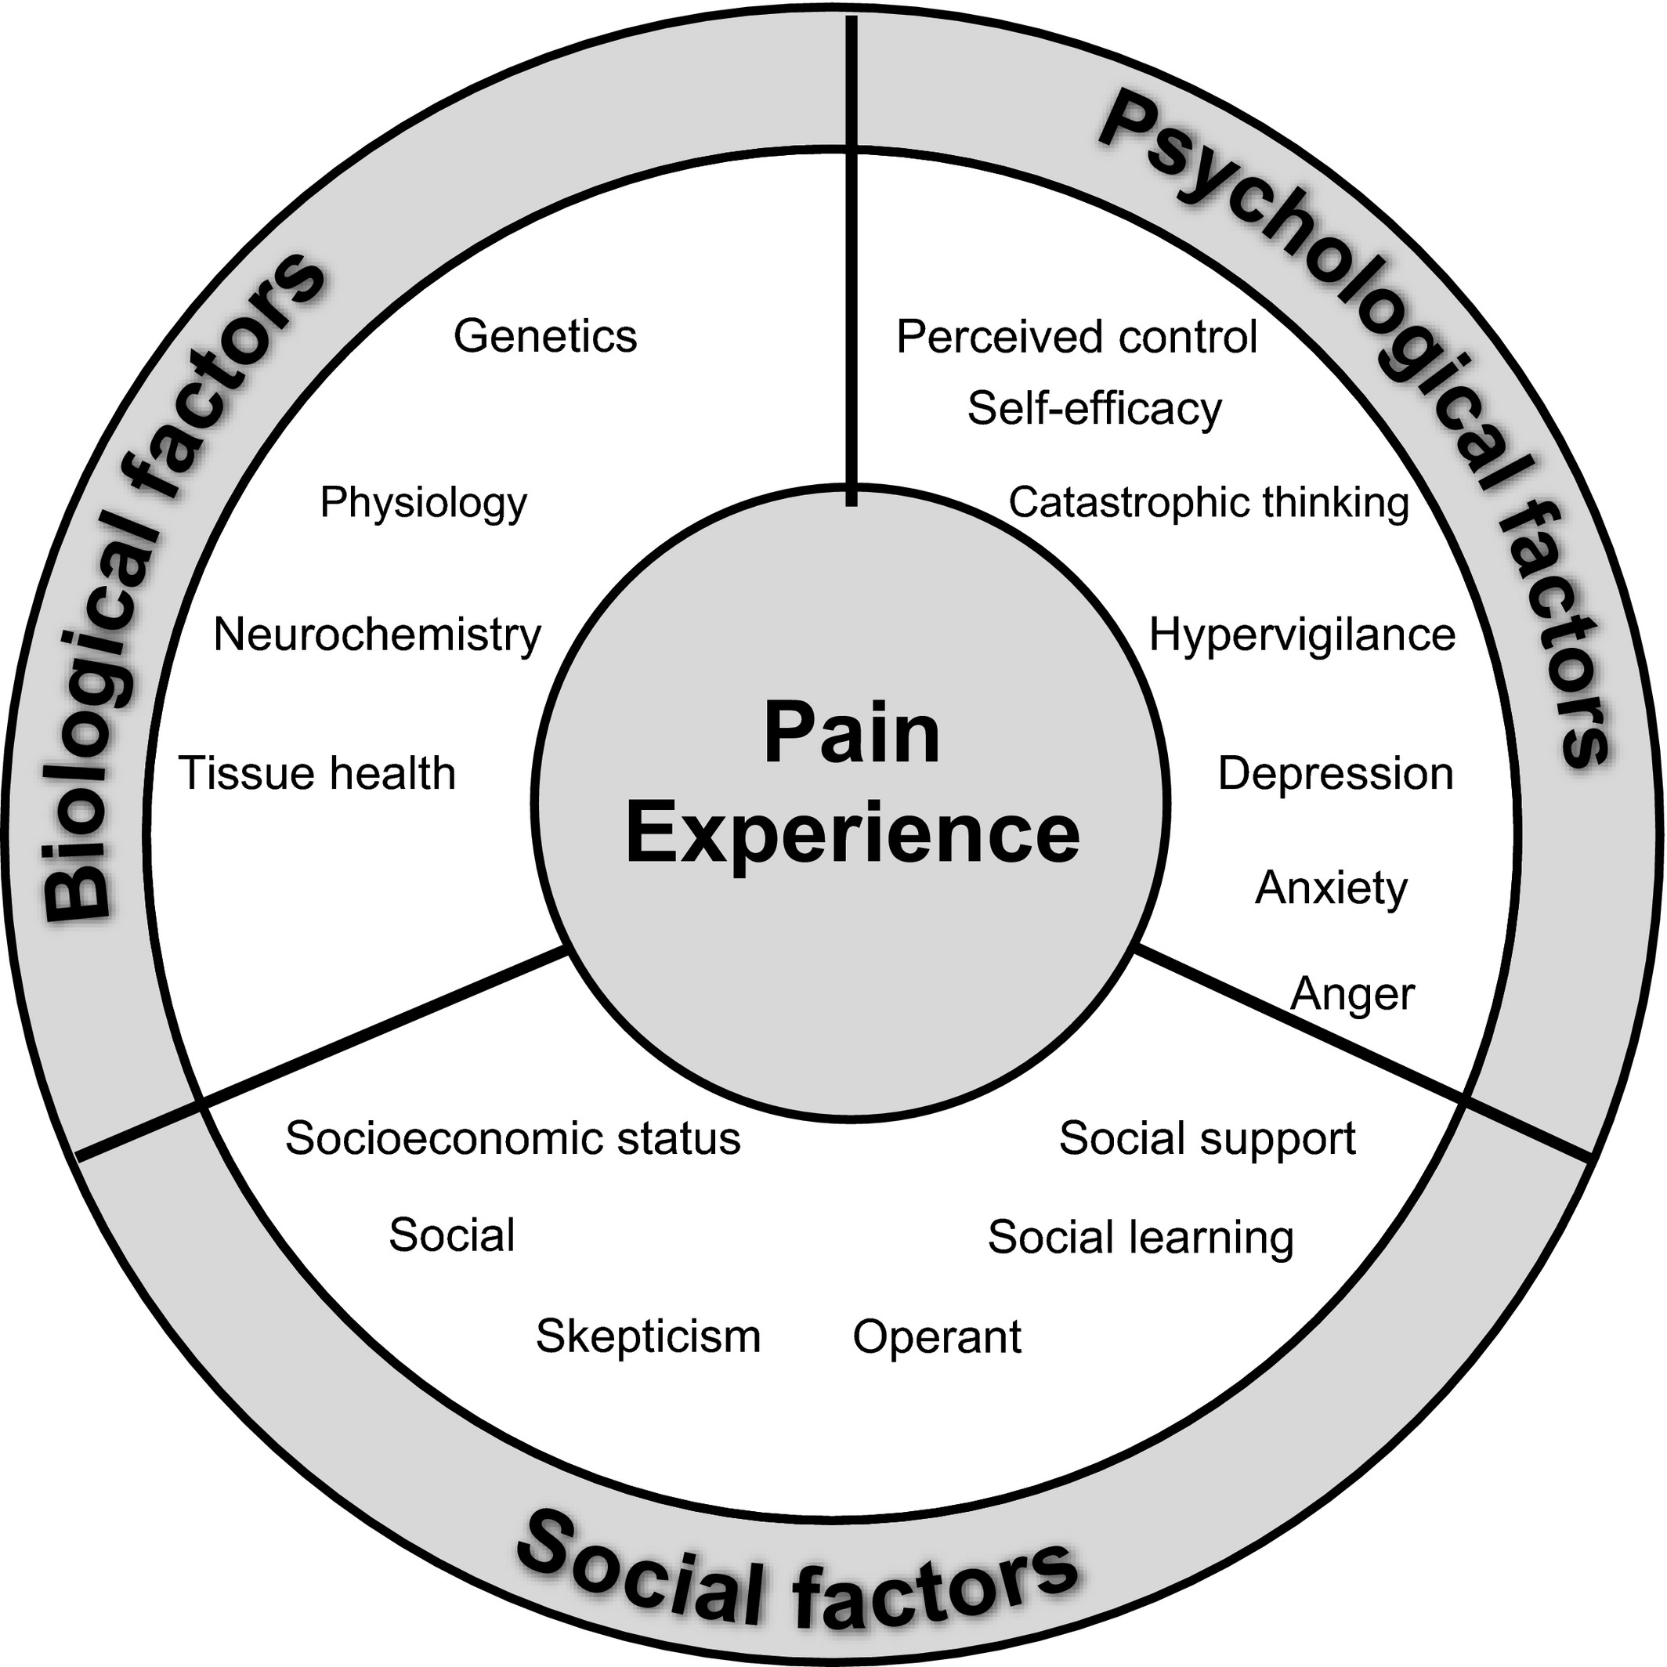
Biopsychosocial Model of Pain
Biologic: tissue damage causing pain
Psychological: pain can lead to psychological stress OR having psychological comorbidities, poor coping mechanisms, being a catastrophizer can increase one’s experience of pain.
Social: support networks impact the experience of pain – can be enabling or challenging

Slide 35

Ways of Categorizing Pain
Acuity: acute, chronic, acute on chronic
Major determinant of prognosis: the longer a patient has pain the harder it is to treat due to neuroplasticity and changes in the nervous system.

Slide 36
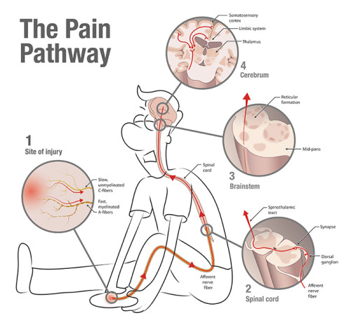
Acute pain
Pain evoked by a specific disease or injury
Associated with tissue damage & sympathetic nervous system activation
Serves a biological purpose & confers evolutionary survival
Self-limited

Slide 37
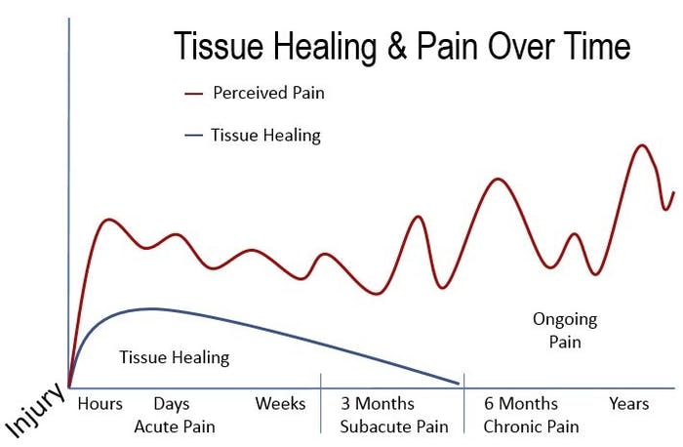
Chronic Pain
Pain that outlasts the normal time of healing
Generally considered pain lasting > 3 months
Chronic pain is pathological - serves no biological purpose

Slide 38
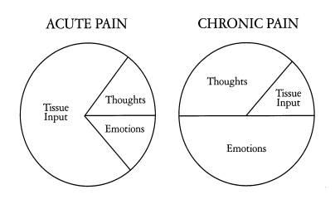

Slide 39
Treatment of Chronic Pain
Must address the multidimensional aspects of pain
Notes:
https://www.practicalpainmanagement.com/treatments/psychological/biopsychosocial-approach
https://www.google.com/url?sa=i&url=https%3A%2F%2Fonlinelibrary.wiley.com%2Fdoi%2F10.1111%2Fjabr.12125&psig=AOvVaw2IHyLbSLyjK-FUMuK_QDop&ust=1601601652987000&source=images&cd=vfe&ved=0CAIQjRxqFwoTCICl7dCckuwCFQAAAAAdAAAAABA4

Slide 40
What Patients Need
Cognitive restructuring/CBT
Coping skills training
Gentle Movement
Mindfulness
Trauma counseling
Social support
Functional rehabilitation
How many of these does insurance cover?

Slide 41
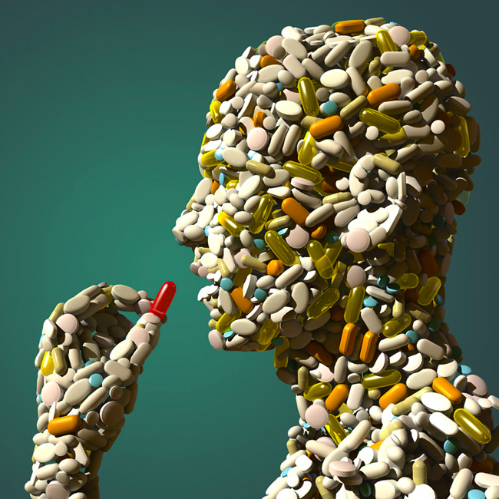
What We Can Offer: Multimodal Therapy
Medications
Interventions
Physical therapies
Cognitive strategies
No single category will solve the problem!
Same treatment for those with OUD as for those without OUD

Slide 42
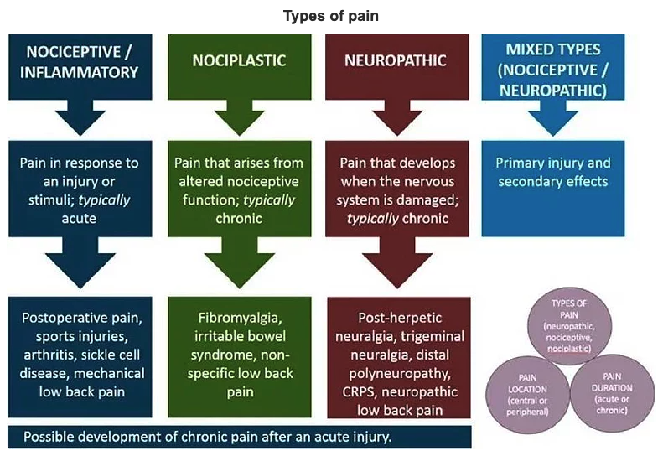
Let the Mechanism of Pain Guide Your Treatment
What type of Pain is it?
Allows us to determine most appropriate treatment options
Notes:
https://www.oohcpd.com/understanding-pain

Slide 43
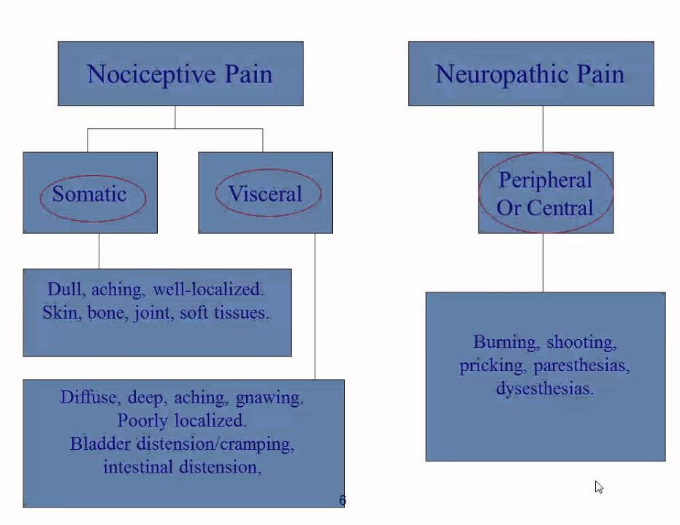
#1 Nociceptive pain:
results from activation of pain pathways due to tissue damage/injury
most common form of acute & chronic pain
e.g. post-surgical pain, arthritis, axial low back pain from degenerative conditions, etc.
Notes:
https://www.google.com/url?sa=i&url=https%3A%2F%2Fwww.youtube.com%2Fwatch%3Fv%3D7o7oDryem7U&psig=AOvVaw3qMCDYlsM46s9fRxxHbc-O&ust=1635967578153000&source=images&cd=vfe&ved=0CAsQjRxqFwoTCKDeqKq0-vMCFQAAAAAdAAAAABBT

Slide 44
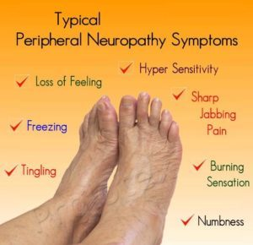
#2 Neuropathic pain:
Pain caused by damage/disease affecting the somatosensory system
E.g. diabetic neuropathy, post-herpetic neuralgia, chemotherapy-induced peripheral neuropathy, HIV-associated peripheral neuropathy
Typically associated with sensory abnormalities that may occur in the distribution of a nerve or a nerve root
some literature shows that for the same degree of ”severity” neuropathic pain is associated with greater decrements in quality of life than nociceptive pain
Prognosis: after nerve injury there is a higher chance of the development of chronic pain.
Notes:
https://www.google.com/url?sa=i&url=http%3A%2F%2Fwww.diabetesclinic.ca%2Fen%2Fprof%2F6comp%2Fpainful_neuropathy.htm&psig=AOvVaw3qMCDYlsM46s9fRxxHbc-O&ust=1635967578153000&source=images&cd=vfe&ved=0CAsQjRxqFwoTCKDeqKq0-vMCFQAAAAAdAAAAABBO

Slide 45
#3 Nociplastic pain:
Nociplastic
Arises from abnormal processing of pain signals without evidence of tissue damage or pathology involving the somatosensory system
Prominent affective/motivational components
Often have lots of other associated conditions such as multiple chemical sensitivity.
Diagnosis of exclusion
No biomarkers or identifiable pathology → makes treatment difficult
Due to disturbance in central pain processing
↑ excitability
↓ inhibition
Examples: fibromyalgia, TMJ dysfunction, non-specific low back pain

Slide 46
Treatment for Chronic Pain
RICE
NSAIDS
Acetaminophen
Muscle relaxants
Opioids
Gabapentinoids
Interventions
SNRIs / TCAs
Very Rarely

Slide 47
RICE
NSAIDS
Acetaminophen
Muscle relaxants
Opioids
Gabapentinoids
Interventions
SNRIs / TCAs
Very Rarely

Slide 48
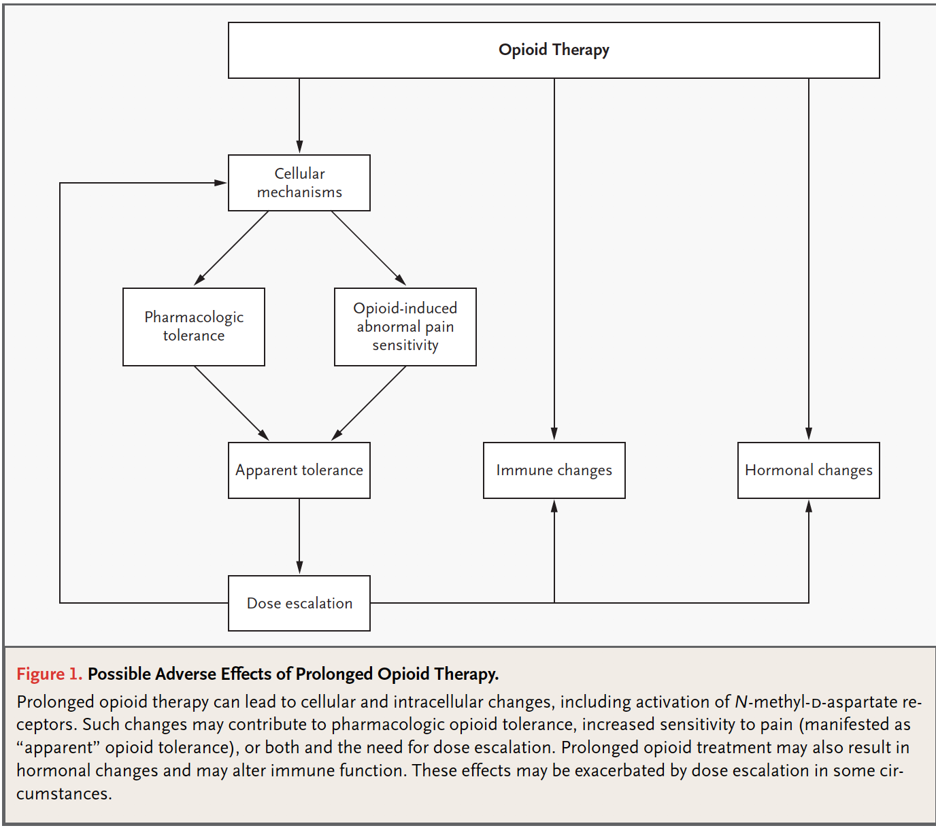
Notes:
Pharmacologic tolerance: the body needs more doses to achieve the same desired analgesic effect (with increasing doses comes increasing risk of side effects)
Opioid-induced abnormal sensitivity to pain: potentially irreversible changes in the dorsal horn of the spinal cord occur that leads to the development of sensitization such that things that once were not painful subsequently become painful. (so not just tolerance develops but sensitization develops too)
Hormonal changes: Opioids influence at least two major hormonal systems, the hypothalamic-pituitary-adrenal axis and the hypothalamic-pituitary-gonadal axis. Morphine has been reported to cause strong, progressive decline in plasma cortisol levels in adults. The main effect on the hypothalamic-pituitary-gonadal axis in adults is a decrease in luteinizing hormone, follicle-stimulating hormone, testosterone, and estrogen. This can results in decreased libido, aggression, amenorrhea, and galactorrhea.
Opioid induced immune modulation occurs through the neuroendocrine effects but also through a direct effect on the immune system. Opioids alter the development, differentiation, and function of immune cells in both the innate and adaptive immune systems. In fact, opioid-related receptors exist on immune cells making it more likely that opioids have a direct effect on the immune system.
In general these effects are dose related and prolonged exposure has a more profound effect than short-term exposure.

Slide 49
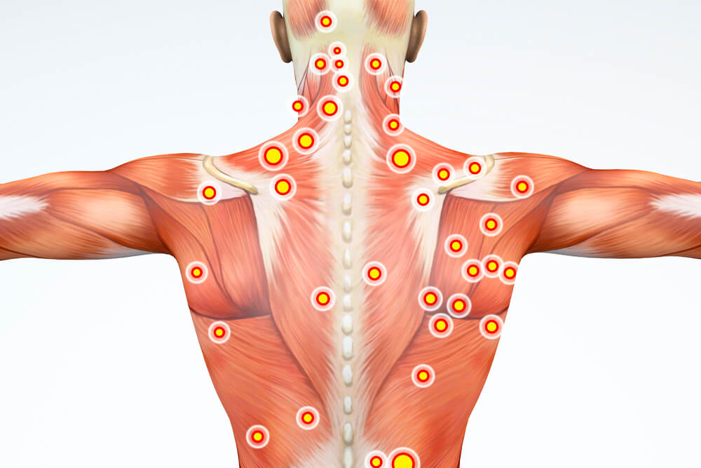

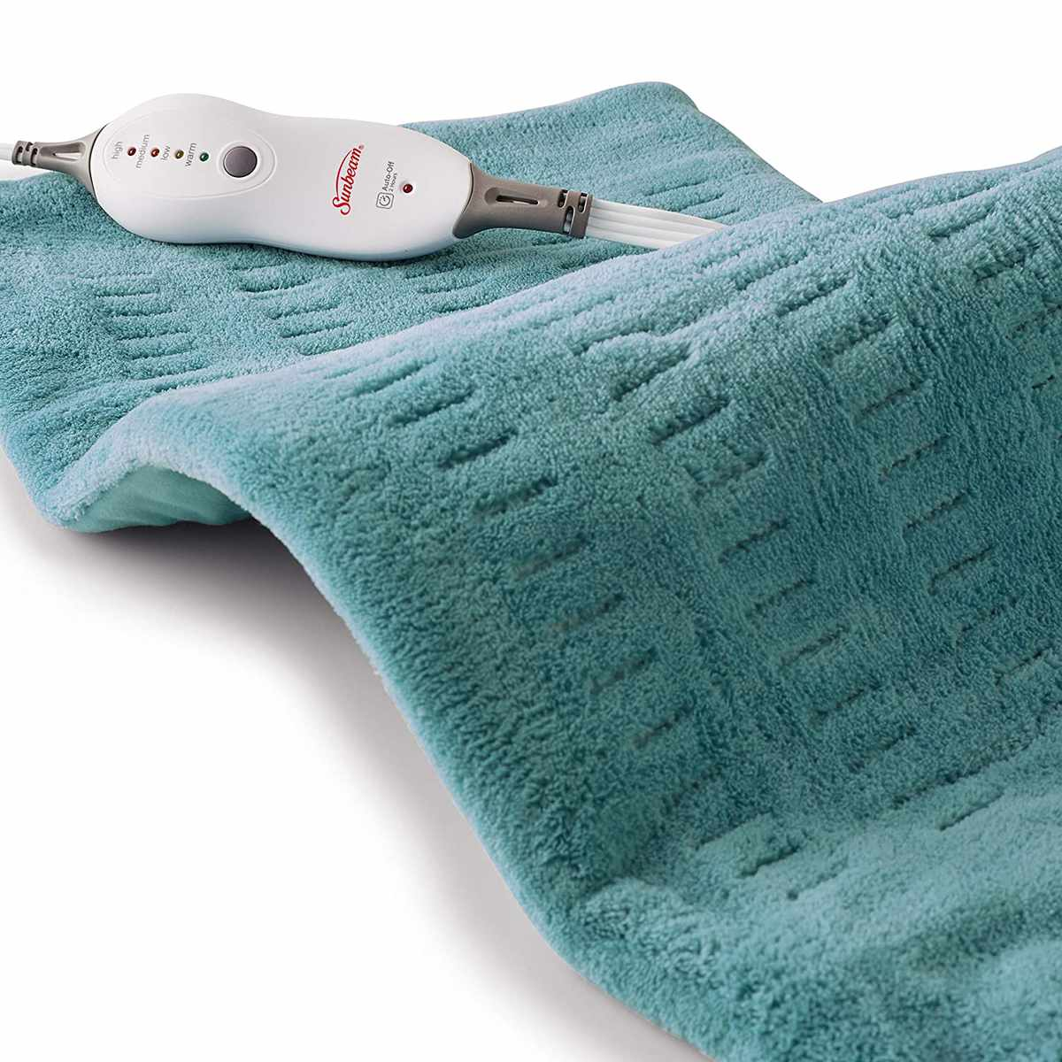

RICE
NSAIDS
Acetaminophen
Muscle relaxants
Opioids
Gabapentinoids
Interventions
SNRIs / TCAs
Very Rarely

Slide 50
RICE
NSAIDS
Acetaminophen
Muscle relaxants
Opioids
Gabapentinoids
Interventions
SNRIs / TCAs
Very Rarely
Ketorolac
Side effects limit use

Slide 51
RICE
NSAIDS
Acetaminophen
Muscle relaxants
Opioids
Gabapentinoids
Interventions
SNRIs / TCAs
Dosing:
No liver disease– 3g/day in divided doses
Chronic liver disease, no EtOH use-– 2g/day in divided doses
Chronic liver disease & EtOH use OR acute hepatitis– AVOID
**recommend avoiding in pts with untreated Hepatitis B or C
Renal disease– no adjustments
Very Rarely

Slide 52
RICE
NSAIDS
Acetaminophen
Muscle relaxants
Opioids
Gabapentinoids
Interventions
SNRIs / TCAs
FDA approved: “Tx of acute, painful, MSK conditions” (i.e. spasm)
Cyclobenzaprine (Flexeril) (TCA-like, watch for serotonin syndrome)
Methocarbamol (Robaxin)
Metaxalone (Skelaxin)
Carisoprodol (Soma) (metabolized to a barbiturate, highly addictive)
Chlorzoxazone (Paraflex)
Diazepam (Valium) (benzodiazepine)
Very Rarely
FDA Approved: spasticity (UMN dysfunction
Central agents
tizanidine, baclofen
Peripheral agents
dantrolene, Botox

Slide 53
RICE
NSAIDS
Acetaminophen
Muscle relaxants
Opioids
Gabapentinoids
Interventions
SNRIs / TCAs
Gabapentin (Neurontin), Pregabalin (Lyrica)
Membrane Stabilizers: Stop injured nerves from firing
Structurally derived from GABA but do not bind GABA receptor
Really great drugs for neuropathic pain
Very Rarely

Slide 54
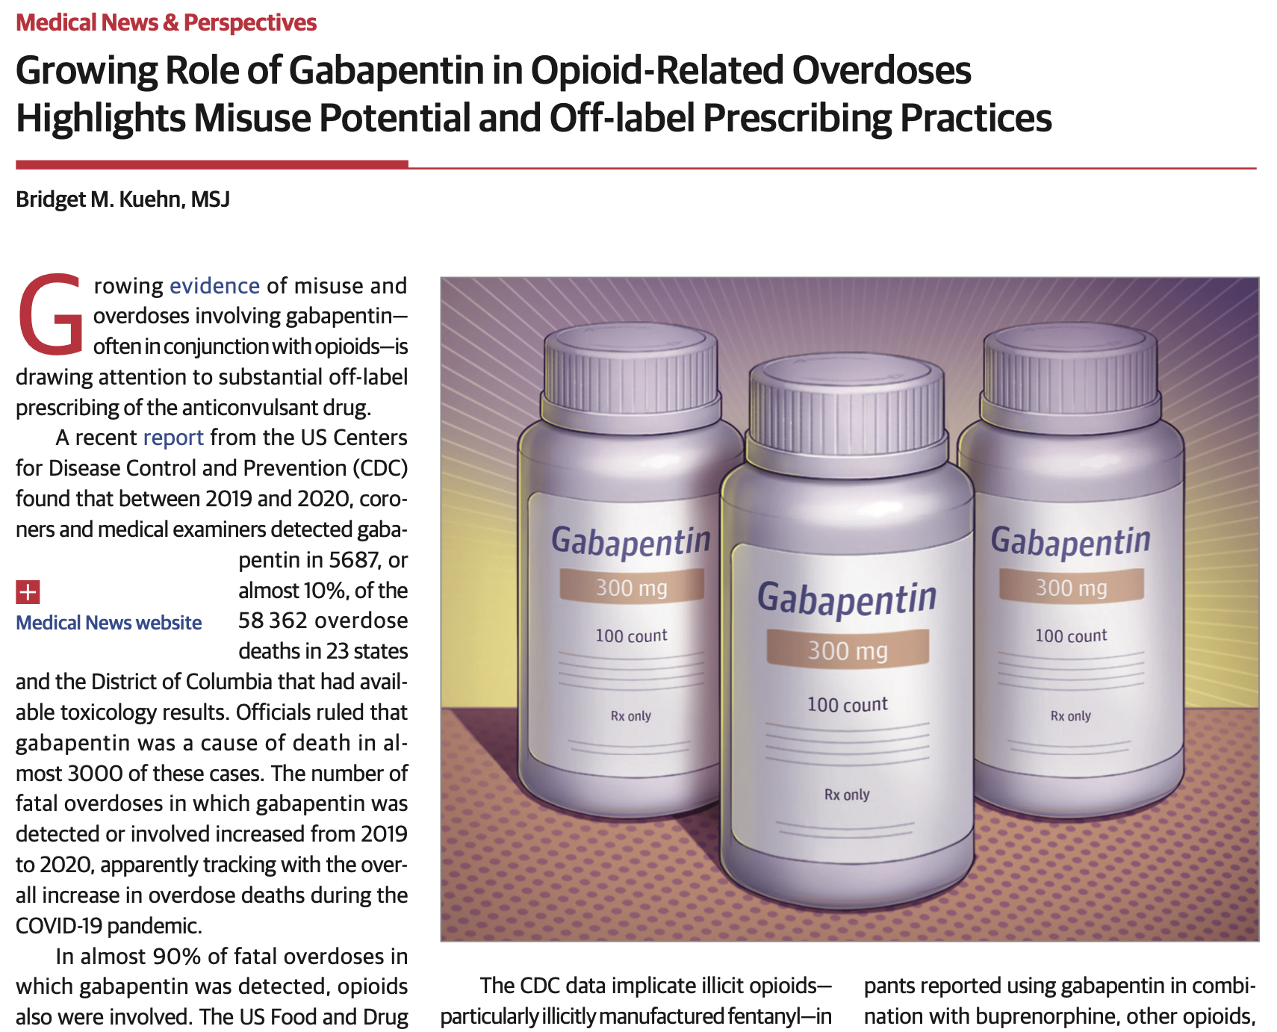
Notes:
Kuehn BM. Growing Role of Gabapentin in Opioid-Related Overdoses Highlights Misuse Potential and Off-label Prescribing Practices. JAMA. 2022 Oct 4;328(13):1283-1285. doi: 10.1001/jama.2022.13659. PMID: 36069924.

Slide 55
Between 2019 and 2020, gabapentin detected in 5687 (almost 10%) of the 58,362 overdose deaths in 23 states and DC
Gabapentin was a cause of death in ~3000 of these cases.
In almost 90% of fatal overdoses in which gabapentin was detected, opioids also were involved
2019 the FDA warned that gabapentin can cause severe breathing difficulties, especially when used with other central nervous system depressants (opioids, anxiety medications, or anti- depressants) or when used by older adults and people with respiratory risk factors
Kuehn BM. Growing Role of Gabapentin in Opioid-Related Overdoses Highlights Misuse Potential and Off-label Prescribing Practices. JAMA. 2022 Oct 4;328(13):1283-1285. doi: 10.1001/jama.2022.13659. PMID: 36069924.
Notes:
Kuehn BM. Growing Role of Gabapentin in Opioid-Related Overdoses Highlights Misuse Potential and Off-label Prescribing Practices. JAMA. 2022 Oct 4;328(13):1283-1285. doi: 10.1001/jama.2022.13659. PMID: 36069924.

Slide 56
Can produce euphoria and intoxication; can potentiate opioids effects
When used in combination with buprenorphine, other opioids, cocaine, and caffeine it can produce effects such as feeling drunk or “high,” muscle relaxation, sleep initiation, or pain relief.
Misuse by individuals with OUD is common.
In a survey of almost 13,000 people seeking treatment for opioid use, ~ 9% reported nonmedical use of gabapentin during the past month.
Rising popularity due to easy access and its low street costs
Kuehn BM. Growing Role of Gabapentin in Opioid-Related Overdoses Highlights Misuse Potential and Off-label Prescribing Practices. JAMA. 2022 Oct 4;328(13):1283-1285. doi: 10.1001/jama.2022.13659. PMID: 36069924.
Notes:
Kuehn BM. Growing Role of Gabapentin in Opioid-Related Overdoses Highlights Misuse Potential and Off-label Prescribing Practices. JAMA. 2022 Oct 4;328(13):1283-1285. doi: 10.1001/jama.2022.13659. PMID: 36069924.

Slide 57
RICE
NSAIDS
Acetaminophen
Muscle relaxants
Opioids
Gabapentinoids
Interventions
SNRIs / TCAs
SNRIs: duloxetine, venlafaxine, milnacipran
TCAs: Amitriptyline, Nortriptyline, Desipramine
Anticholinergic side effects
Sedation
Sexual dysfunction
Weight gain
Increased risk of suicidality in young people
Use cautiously in patients with co-occurring psychological problems who may be taking other psych meds
Risk of inducing mania in patients with BPAD
Very Rarely

Slide 58
RICE
NSAIDS
Acetaminophen
Muscle relaxants
Opioids
Gabapentinoids
Interventions
SNRIs / TCAs
Trigger point injections
Peripheral nerve blocks
Radiofrequency ablation for arthritis in neck and low back
Spinal Cord Stimulators, Peripheral Nerve Stimulators
Limitation: Insurance Status
Very Rarely

Slide 59
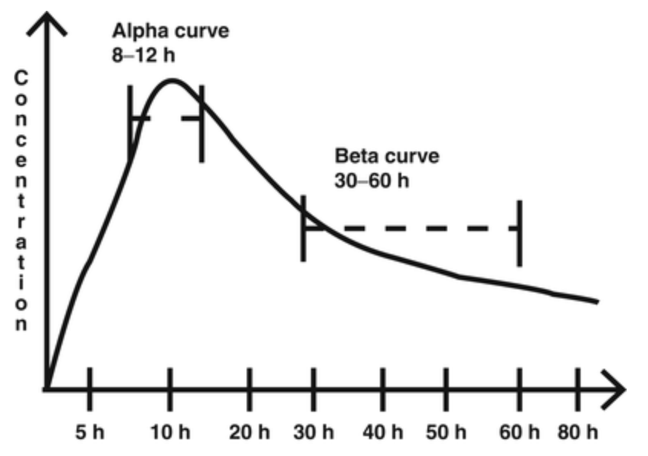
RICE
NSAIDS
Acetaminophen
Muscle relaxants
Opioids
Gabapentinoids
Interventions
SNRIs / TCAs
Methadone and Buprenorphine
Great pain medications
Analgesic benefit:
Methadone 8-12 hours
Buprenorphine 6-12 hours
Divide total daily dose in to BID or TID dosing to capitalize on analgesic benefit
Very Rarely
Notes:
Kuehn BM. Growing Role of Gabapentin in Opioid-Related Overdoses Highlights Misuse Potential and Off-label Prescribing Practices. JAMA. 2022 Oct 4;328(13):1283-1285. doi: 10.1001/jama.2022.13659. PMID: 36069924.
Khanna IK, Pillarisetti S. Buprenorphine - an attractive opioid with underutilized potential in treatment of chronic pain. J Pain Res. 2015 Dec 4;8:859-70. doi: 10.2147/JPR.S85951. PMID: 26672499; PMCID: PMC4675640.

Slide 60



RICE
NSAIDS
Acetaminophen
Muscle relaxants
Opioids
Gabapentinoids
Interventions
SNRIs / TCAs
Limited by potential side effects
Only if no liver dysfunction
High risk of misuse; overdose
Caution in pts with comorbid psych conditions
Must have insurance
Divide dose of methadone or buprenorphine

Slide 61

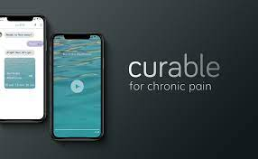
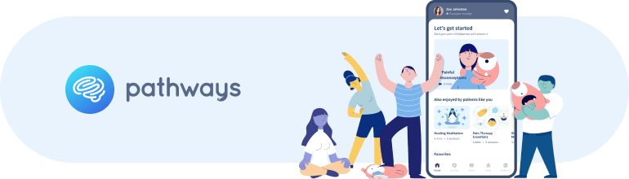
Smartphone Apps for Self-management of Chronic Pain
WebMAP Mobile: Web-based management of adolescent pain
Rated as high-quality and promising for adolescents with chronic pain. One of few mobile apps tested in RCT
Pathways and Curable for Chronic Pain: Rated as two of the highest quality chronic pain self-management mobile apps for adults in systematic reviews

Slide 62
TLC

Slide 63
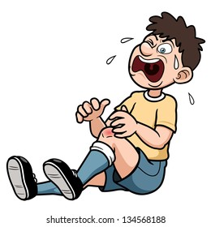
Acute pain in patients with OUD
Appropriate to treat with opioids if indicated (surgery, identifiable pathology)
If applicable, continue methadone or buprenorphine (divided doses)
Honest conversation with patients
Optimize multimodals
Use lowest dose of opioids for the shortest period possible.
If on methadone or buprenorphine may need higher doses of opioid than an opioid-naïve person.

Slide 64
References
Ballantyne JC, Mao J: Opioid Therapy for Chronic Pain. NEJM 2003; 349: 1943-53.
Dahlhamer J, Lucas J, Zelaya, C, et al. Prevalence of Chronic Pain and High-Impact Chronic Pain Among Adults — United States, 2016. MMWR Morb Mortal Wkly Rep 2018;67:1001–1006. DOI: http://dx.doi.org/10.15585/mmwr.mm6736a2external icon
Hser YI, Mooney LJ, Saxon AJ, Miotto K, Bell DS, Huang D. Chronic pain among patients with opioid use disorder: Results from electronic health records data. Journal of substance abuse treatment. 2017;77:26-30. doi:10.1016/j.jsat.2017.03.006
Khanna IK, Pillarisetti S. Buprenorphine - an attractive opioid with underutilized potential in treatment of chronic pain. J Pain Res. 2015 Dec 4;8:859-70. doi: 10.2147/JPR.S85951. PMID: 26672499; PMCID: PMC4675640.
Kuehn BM. Growing Role of Gabapentin in Opioid-Related Overdoses Highlights Misuse Potential and Off-label Prescribing Practices. JAMA. 2022 Oct 4;328(13):1283-1285. doi: 10.1001/jama.2022.13659. PMID: 36069924.
Latif ZH, Skjærvø I, Solli KK, Tanum L. Chronic Pain Among Patients With an Opioid Use Disorder. The American journal on addictions. 2021;30(4):366-375. doi:10.1111/ajad.13153
Grichnik KP, Ferrante FM: The difference between acute and chronic pain. Mt Sinai J Med. 1991 May;58(3):217-20.
Jongen JL, Hans G, Benzon HT, Huygen F, Hartrick CT: Neuropathic pain and pharmacological treatment. Pain Pract 2014; 14: 283-95.
Melzack R: From the gate to the neuromatrix. Pain 1999; Supplement 6: S121-S126.
Potru S, Tang Y: Chronic Pain, Opioid Use Disorder, and Clinic Management Among Older Adults. Psychiatry Online 18 Aug 2021. https://doi.org/10.1176/appi.focus.20210002
Sullivan MD, Howe CQ: Opioid therapy for chronic pain in the United States: promises and perils. Pain 2013; 154 Suppl 1: S94-100.
Vallejo R, Barkin RL, Wang VC: Pharmacology of opioids in the treatment of chronic pain syndromes. Pain Physician 2011; 14: E343-60.
Woolf CJ: Central sensitization: implications for the diagnosis and treatment of pain. Pain 2011; 152: S2-15.

