Slide 1
Recovery Services & Recovery Housing in Tennessee
2022 Mid-South Addiction Conference
October 21, 2022
Vanderbilt University Medical Center

Slide 2
Key Contacts:
Susan O. Binns, LADAC, NCAC2, CPRS NARR Board/ TNARR President
sbinns@bellsouth.net
(615) 351-7991
www.tnarr.org
Garrison Nuckols, Program Coordinator/Winston Place
garrisonnuckols@winstonplace.org
(615)308-4953
www.winstonplace.org

Slide 3
The Long-term Recovery Curve

Slide 4
What do people in early recovery need?

Slide 5
What do people need for long-term recovery. Who is responsible?
Connection, community and social model that fosters accountability
The social model of addiction recovery has been seen in 12-step communities where mutual self-help is promoted as a way to remain abstinent. Generally, people struggling with alcoholism or addiction often lack social support and, in the absence of that support from a social network, their addiction can lead to the unraveling of their lives, and sometimes homelessness. Long ago, people recognized that alcoholics and addicts struggling with recovery needed more social support and the guidance provided by shared experiences.

Slide 6
Federal Funding and Recommendation Providers
National Institute - nida.nih.gov
- National Institute on Drug Abuse. NIDA is the lead federal agency supporting scientific research on drug use and addiction.
SAMHSA - www.samhsa.gov
-The Substance Abuse and Mental Health Services Administration is the agency within the U.S. Department of Health and Human Services that leads public health efforts to advance the behavioral health of the nation.

Slide 7
State Funding and Recommendation Providers
TN Department of Mental Health & Substance Abuse Services
-www.tn.gov/behavioral-health
Housing and Urban Development (HUD) - www.hud.gov - varies by state
Housing First - www.endhomelessness.org
The Fair Housing Act (FHA) - www.justice.gov/crt/fair-housing-act-1
Federal Disabilities ACT – www.dol.gov
Insurance/Licenser

Slide 8
Examples of Housing After Interventional Care in Tennessee
TN Department of Corrections approved Houses (TDOC)
- based on incarceration
State Licensed - Authoritarian
Flop Houses - No accountability: mission or money
Certified Recovery Residences - As recognized by the SAFE bill
Notes:
How was the standard developed?
2010
Weekly conference calls with thought leaders
Pre-existing and emerging organizations submitted standards
2011
May - Thought leaders from 15 states and national recovery organizations met in Atlanta to develop consensus and the first draft of the standard
Weekly conference calls further refined
September – Final draft published
2014
NARR Standards Committee begins review process, preparation for version 2.0

Slide 9
Legislation Passed 2021 Stopping Addiction and Fostering Excellence (SAFE ACT)
33-2-1402. List of approved recovery residence organizations
(a) The department of mental health and substance abuse services shall establish and maintain on its website a list of organizations.
(b) A recovery residence that is not recognized or certified by an organization or funded by a state or federal department or agency is required to display in a prominent place within the recovery residence, a sign at least eleven inches (11”) in height and seventeen inches (17”) in width stating:
- NOTICE: THIS IS A RECOVERY RESIDENCE THAT IS DESIGNED TO ASSIST MEN AND/OR WOMEN WHO DO NOT REQUIRE MORE STRUCTURED TREATMENT ENVIRONMENTS TO RECOVER FROM SUBSTANCE ABUSE DISORDER; HOWEVER, THIS RESIDENCE MAY NOT COMPLY WITH NATIONAL OR STATE STANDARDS.

Slide 10
Thank God for Volunteers and Non-Profits in Tennessee
Currently no certified recovery services or recovery housing receive impactful federal or state aid in Tennessee unless licensed (i.e., Treatment Center, inpatient detox, Halfway house etc.)
Recovery residences and peer led recovery services are left to fend for themselves

Slide 11
National Certification
narronline.org
NARR’s mission is to support persons in
recovery from addiction by improving their access to quality recovery residences through standards, support services, placement, education, research and advocacy.
11
Notes:
The main point is that NARR’s mission statement ties directly to the ROSC mission
Read the NARR mission

Slide 12
Certification in Tennessee
www.tnarr.org
TN-ARR is Tennessee’s established housing resource for “Recovery Residences.” We provide a network of experienced, reliable, and accountable places of hope and responsibility for those who seek long-term recovery.
We serve as an educational resource and conduit to Tennessee’s proven long-term housing options where experience, safety, sobriety and accountability are primary.
An abstance free environment is essential to long-term recovery. Living among others, whose healthy goals and habits are shared.
TN-ARR is a peer driven not-for-profit organization 12
Notes:
In turn, MASH’s mission supports NARR and ROSC
Recite or ask a participant to read the mission statement
You have opportunities to get in on the ground floor of an evolving organization through volunteering and learning about other’s programs through Standards reviews…

Slide 13
Recovery is Enhanced in an Environment Where:
Recovery is viewed positively
People are welcomed instead of indoctrinated, where there is a sense of belonging, hope, connectedness, purpose
Residents are taught to practice recovery principles in every life/living situation that arises in the home
“Ask vs. Tell/ Requests vs. Demands”
Owners, Operators, and Peer Staff manage the environment not the people

Slide 14
Recovery Residences . . . Because . . .
Recovery is a process, and continued engagement in support systems is the most researched and proven marker of sustained recovery after treatment
The drop-off in support following structured, insurance eligible services is often the crucial phase between sustained recovery and costly relapse
Recovery based living environments combine resident autonomy with structured and safe integration of recovery supports around community reintegration

Slide 15
“Social model is the dichotomy of medical clinical and incarceration.”
Social Model theorists have varied definitions of what this means.
Most agree on the following as a definition of recovery:
Life Long, Life Changing, Life Transforming

Slide 16
Language Matters in a Recovery Residence
Recovery housing is the non-clinical component of recovery residences
Recovery residences (RR) are one type of recovery support service. RRs adhere to the social model and provide a family-like living environment free from alcohol and illicit drug use, centered on peer support and connections that promote sustained recovery from substance use (Society for Community Research and Action, 2013). They are often called by various names: sober homes, sober livings, recovery homes, recovery residences and Oxford Houses™.

Slide 17
Remove the Stigma

Slide 18
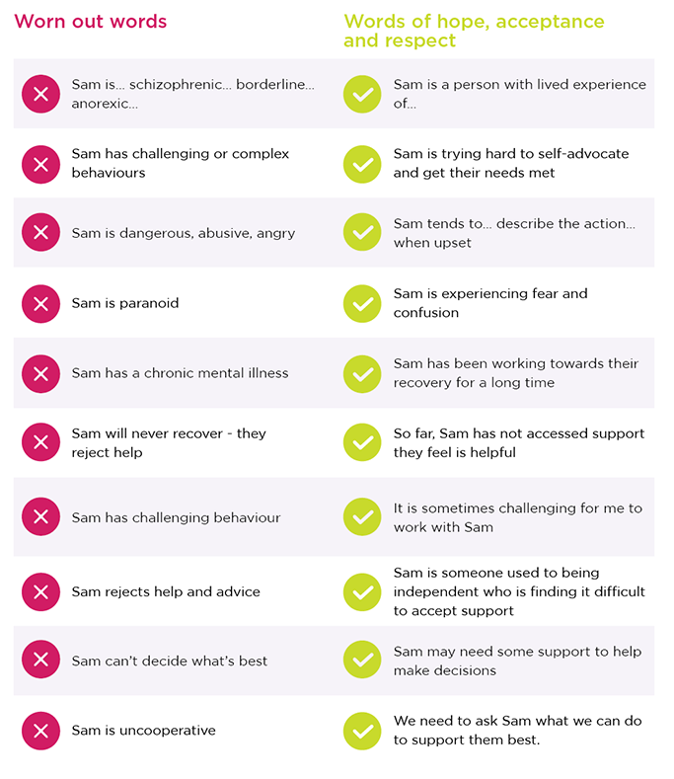
Practical Application

