Slide 1
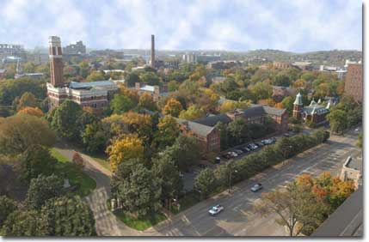
VANDERBILT UNIVERSITY MEDICAL CENTER
VA TENNESSEE VALLEY HEALTH SYSTEM
GERIATRIC PSYCHIATRY FELLOWSHIP
TRAINING PROGRAM

Slide 2
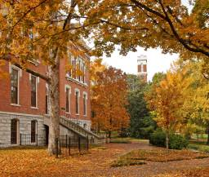
Overview
Vanderbilt University
VU School of Medicine
VU Medical Center
VU Psychiatry Department
VA TVHS Hospitals
Geriatric Psychiatry Fellowship
Living in Nashville

Slide 3
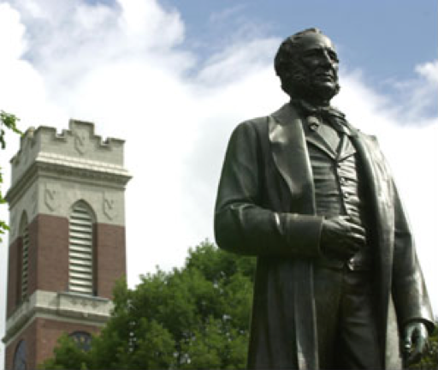
Founded 1873
Students:
6,800 undergraduate
5,900 graduate
10 schools, Top 20 in US News & World Report
4,700 fulltime faculty

Slide 4
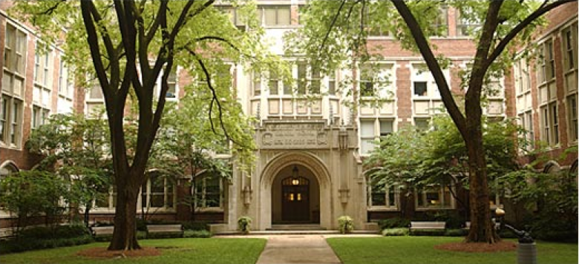
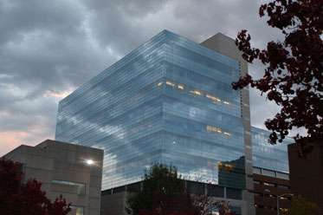
Students:
444 MD, 99 MD/PhD
548 PhD
29 MSCI
Ranks #14 in US News & World Report
Top 10 in NIH funding (Over $300 Million)
2,800 fulltime faculty

Slide 5
VUMC
> 97 ACGME accredited programs
Approx. 984 residents and fellows
Orientation: 300+ new house staff
VUMC: $2.9 billion annual enterprise

Slide 6
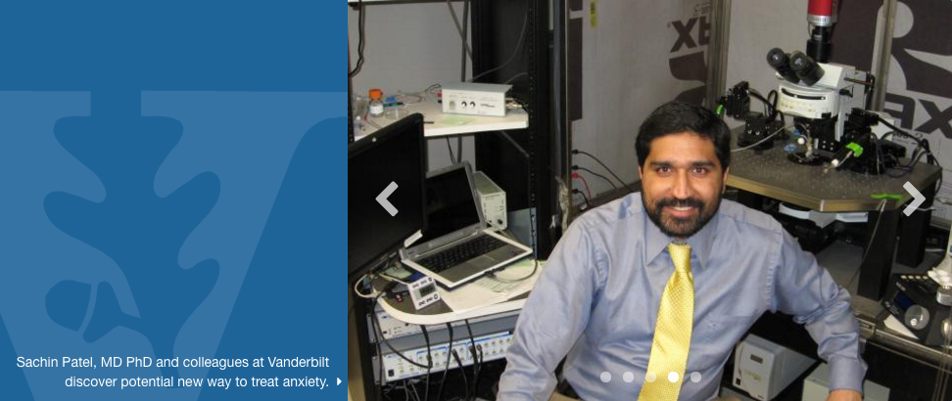
VU Department of Psychiatry and Behavioral Sciences
Founded in 1947
Current Faculty:
98 fulltime, 50 secondary, 77 voluntary

Slide 7
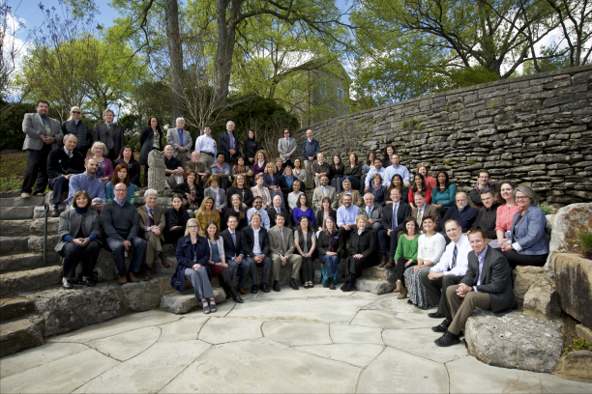
VU Department of Psychiatry
Growth since 2006:
New faculty
97 new faculty members
8 tenure-track faculty
6 tenured faculty
New space for laboratory research
New training opportunities (Fellowships, K-awards)
Renovation of VPH (3,500 discharges; >85% occupancy)
Recent addition of inpatient unit on third floor
Outpatient clinics (>60,000 outpatient visits)
Faculty Retreat 2016

Slide 8
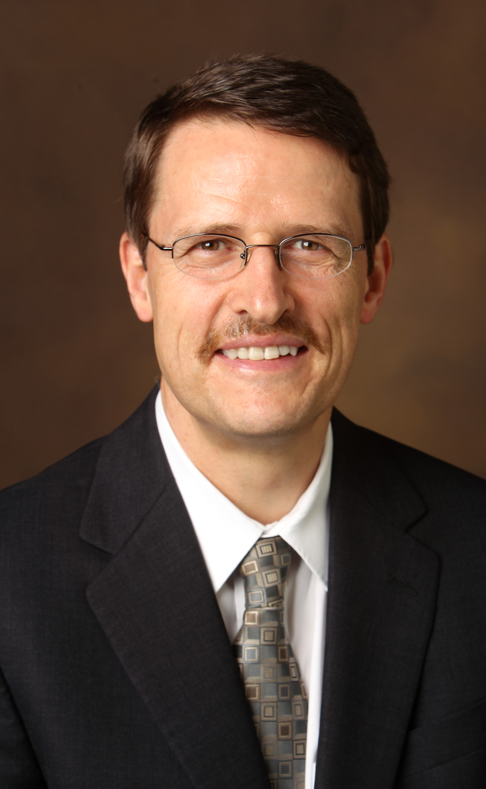
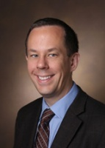
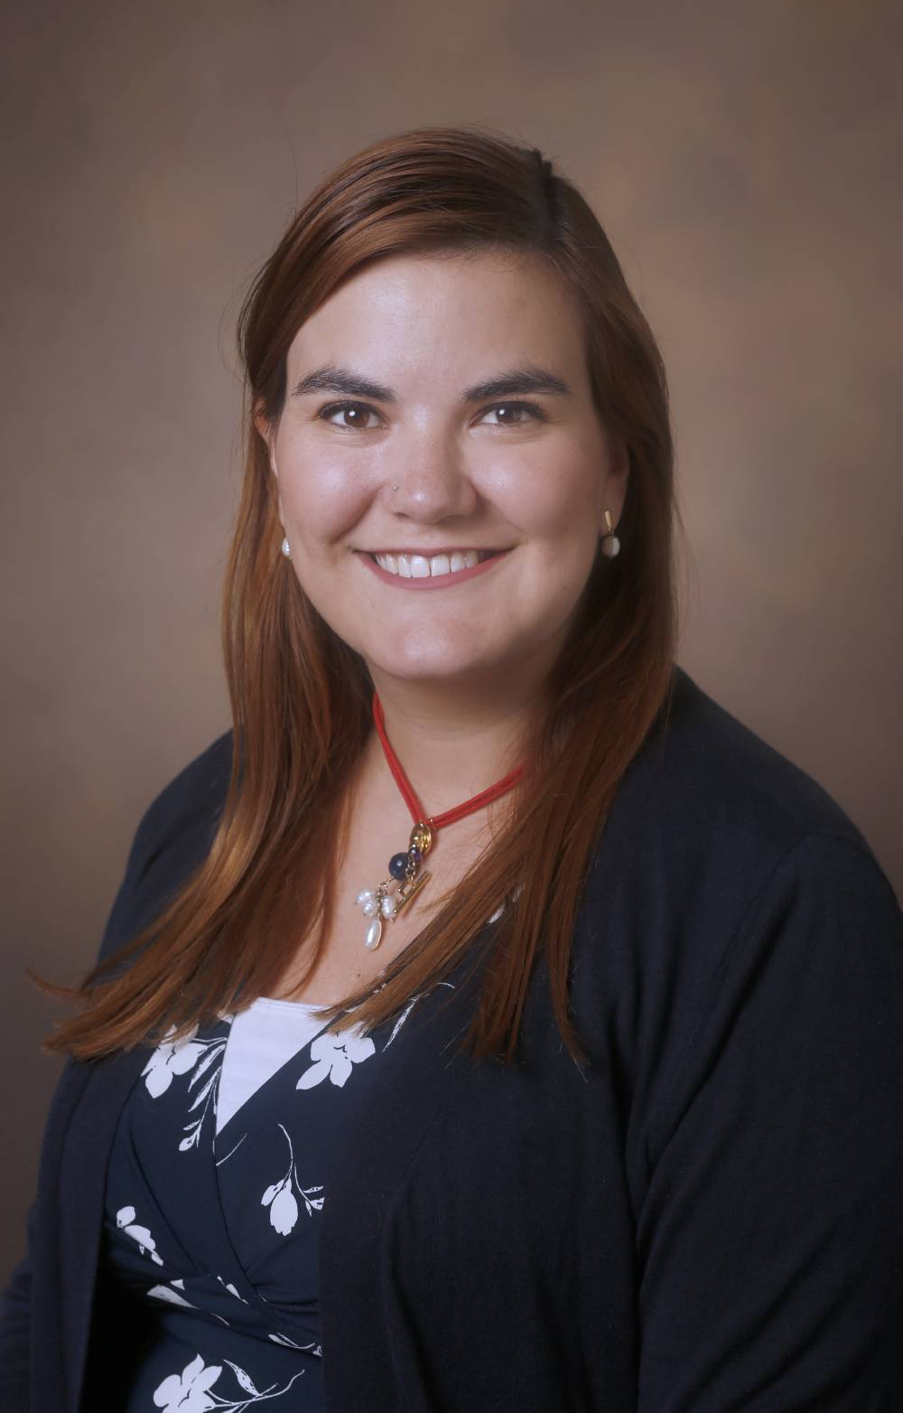
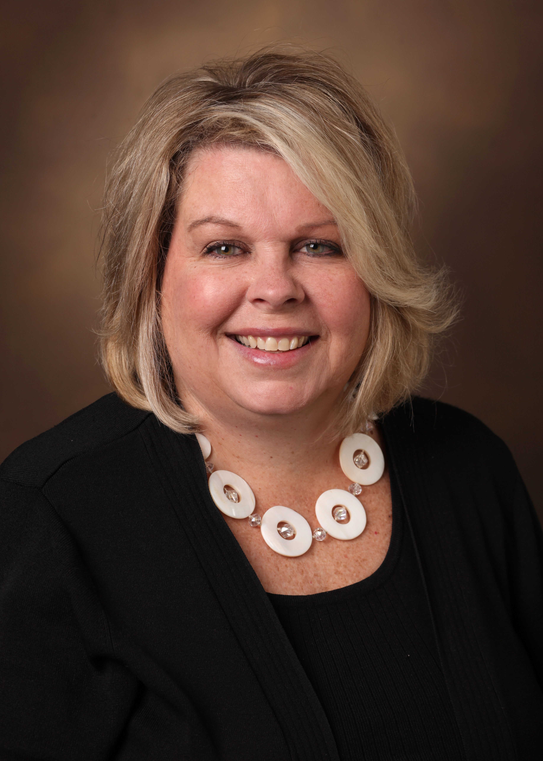
Leadership & Training Staff
Stephan Heckers, MD, MSc.
Chair of Psychiatry
Warren Taylor, MD
Director, Geriatric Psychiatry Division
Training Director, Geriatric Psychiatry Fellowship
Patricia Serrano, MD
Assistant Training Director,
Geriatric Psychiatry Fellowship
Shana Scanlin
Program Manager
Elizabeth Wilson
Associate Program Manager

Slide 9
Division Faculty
Paul Newhouse, MD
William Petrie, MD
Lili Sepassi, MD
Harry Gwirtsman, MD
Suzi Azzazy, MD
Shagufta Jabeen, MD

Slide 10
Geriatric Psychiatry Fellowship Overall Program Goals
Our goal is to train the next generation of leaders in clinical and academic geriatric psychiatry.
The Geriatric Psychiatry Fellowship Program has been designed to enable fellows to be able to:
Provide patient care that is compassionate, appropriate, and effective for the promotion of health and the management of psychiatric problems related to aging;
Apply knowledge in the biomedical, clinical, epidemiological sciences and social-behavioral sciences to their care of patients;
Pursue an career focused on clinical care, research or teaching, health care leadership, and as a scholarly practitioner.

Slide 11
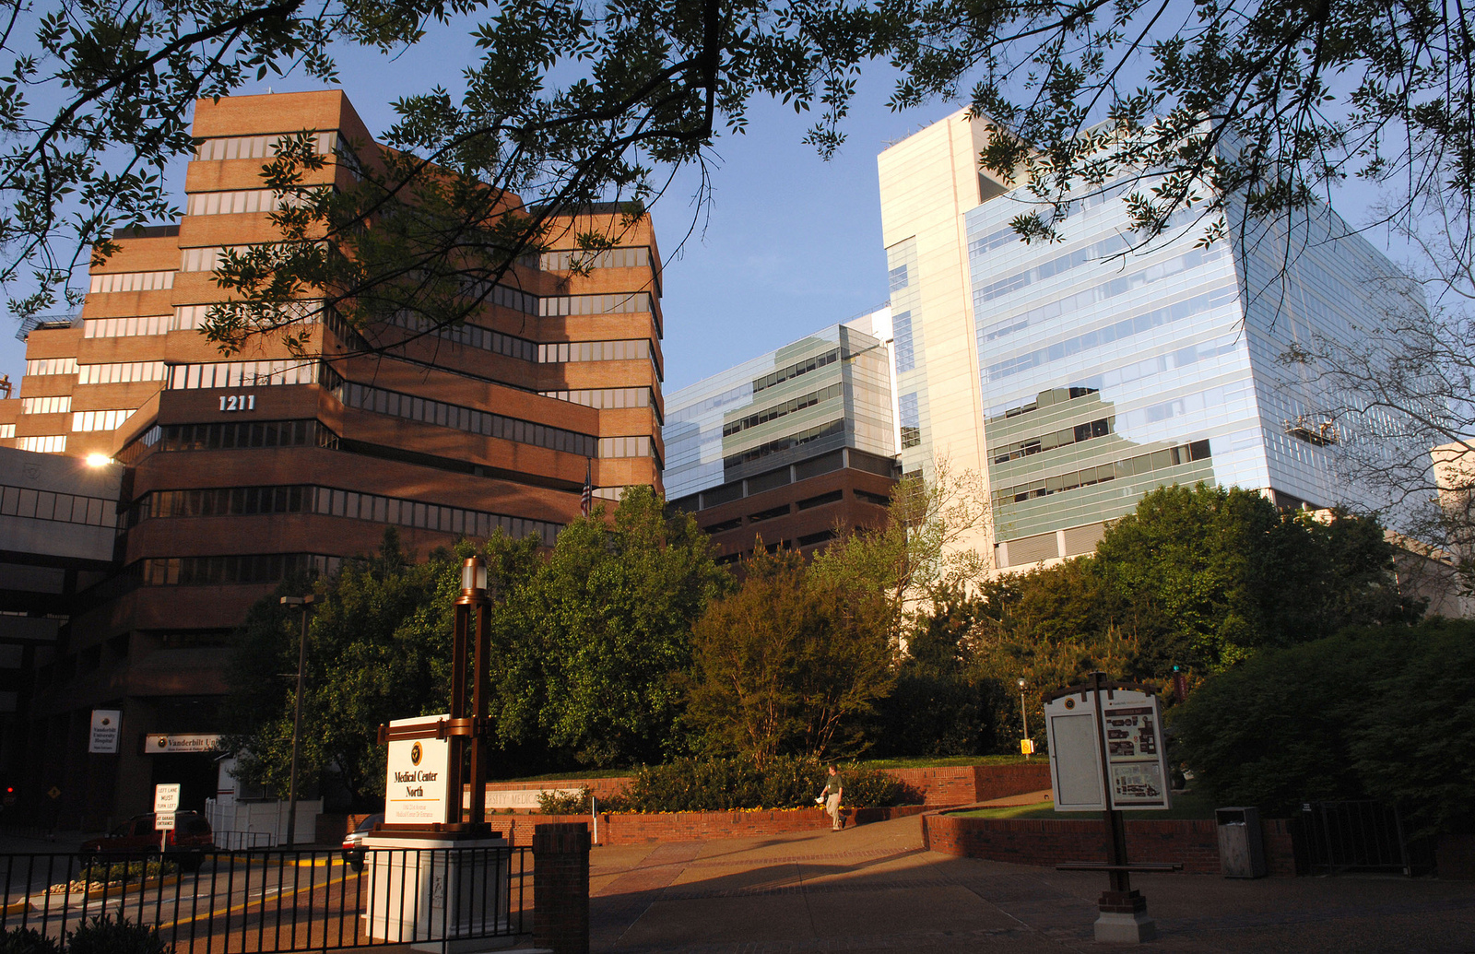
Vanderbilt Medical Center ~656-bed Hospital~
Vanderbilt University Medical Center (VUMC) is a leader in medical education, research, and patient care throughout the Southeast and the nation over the course of its 134-year history. A tertiary referral center for physicians and patients throughout the region, Vanderbilt University Hospital (VUH) and The Vanderbilt Clinic (TVC) consistently rank among the premier health care facilities in the United States.

Slide 12
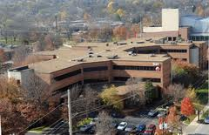
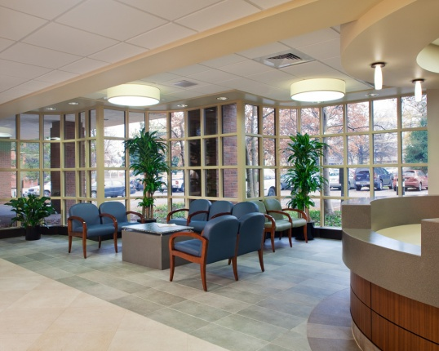
Vanderbilt Psychiatric Hospital ~88 + bed Hospital~
Vanderbilt Behavioral Health (VBH) offers individualized patient care through a wide array of connected services that provide each patient with the right psychiatric treatments for his or her needs. We serve patients from Nashville and the Southeast with emotional problems, depression, mood and personality disorders, anxiety and other problems.

Slide 13
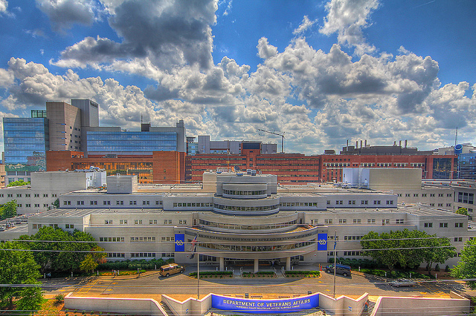
Tennessee Valley VA Healthcare System VA – Nashville
The Nashville campus offers primary, secondary and tertiary care to veterans living in middle Tennessee and Kentucky. TVHS is affiliated with Vanderbilt University School of Medicine and Meharry Medical College, with active residency programs in all major medical and surgical specialties and sub-specialties. In addition, the Nashville campus supports a vigorous research program of over $26 million annually.

Slide 14
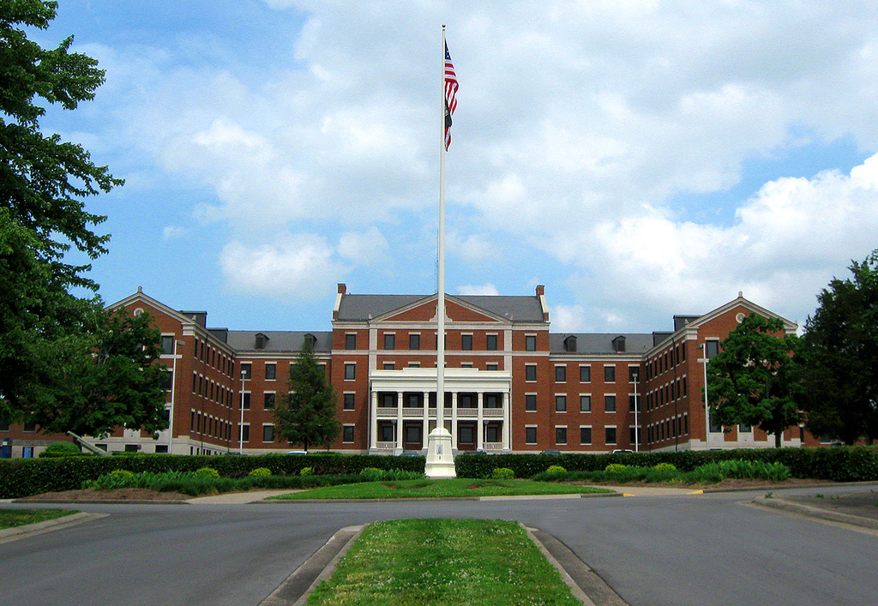
Tennessee Valley VA Healthcare System Alvin York Medical Ctr. Murfreesboro, TN
The Alvin C. York Campus of the VA Tennessee Valley Healthcare System (TVHS) provides primary care and subspecialty medical, surgical, and psychiatric services to veterans. The campus provides long-term rehabilitation and nursing home care, and serves as a VISN 9 resource for the long-term inpatient care of psychiatric patients.

Slide 15
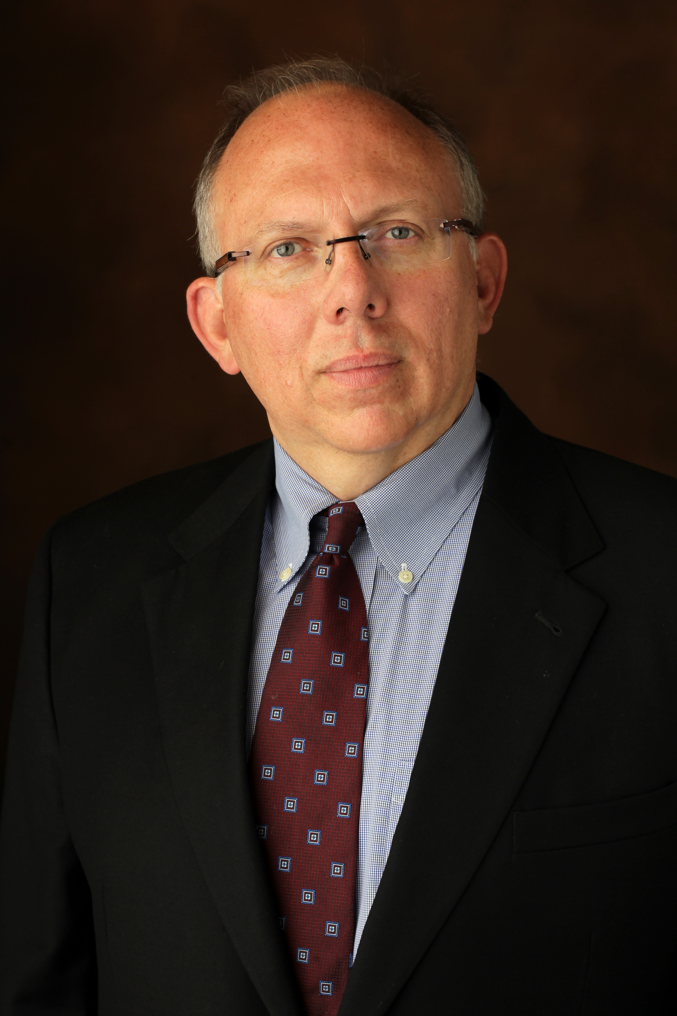
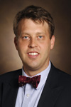
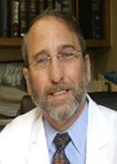
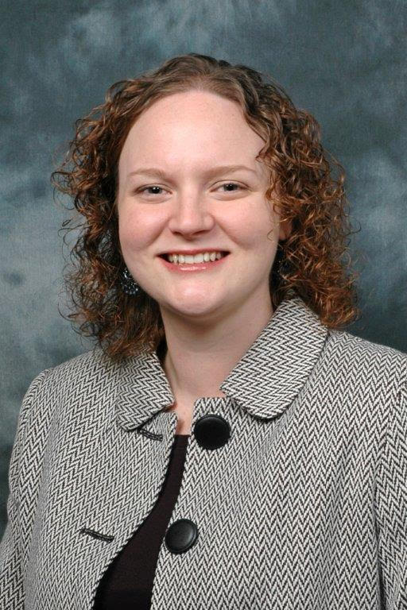
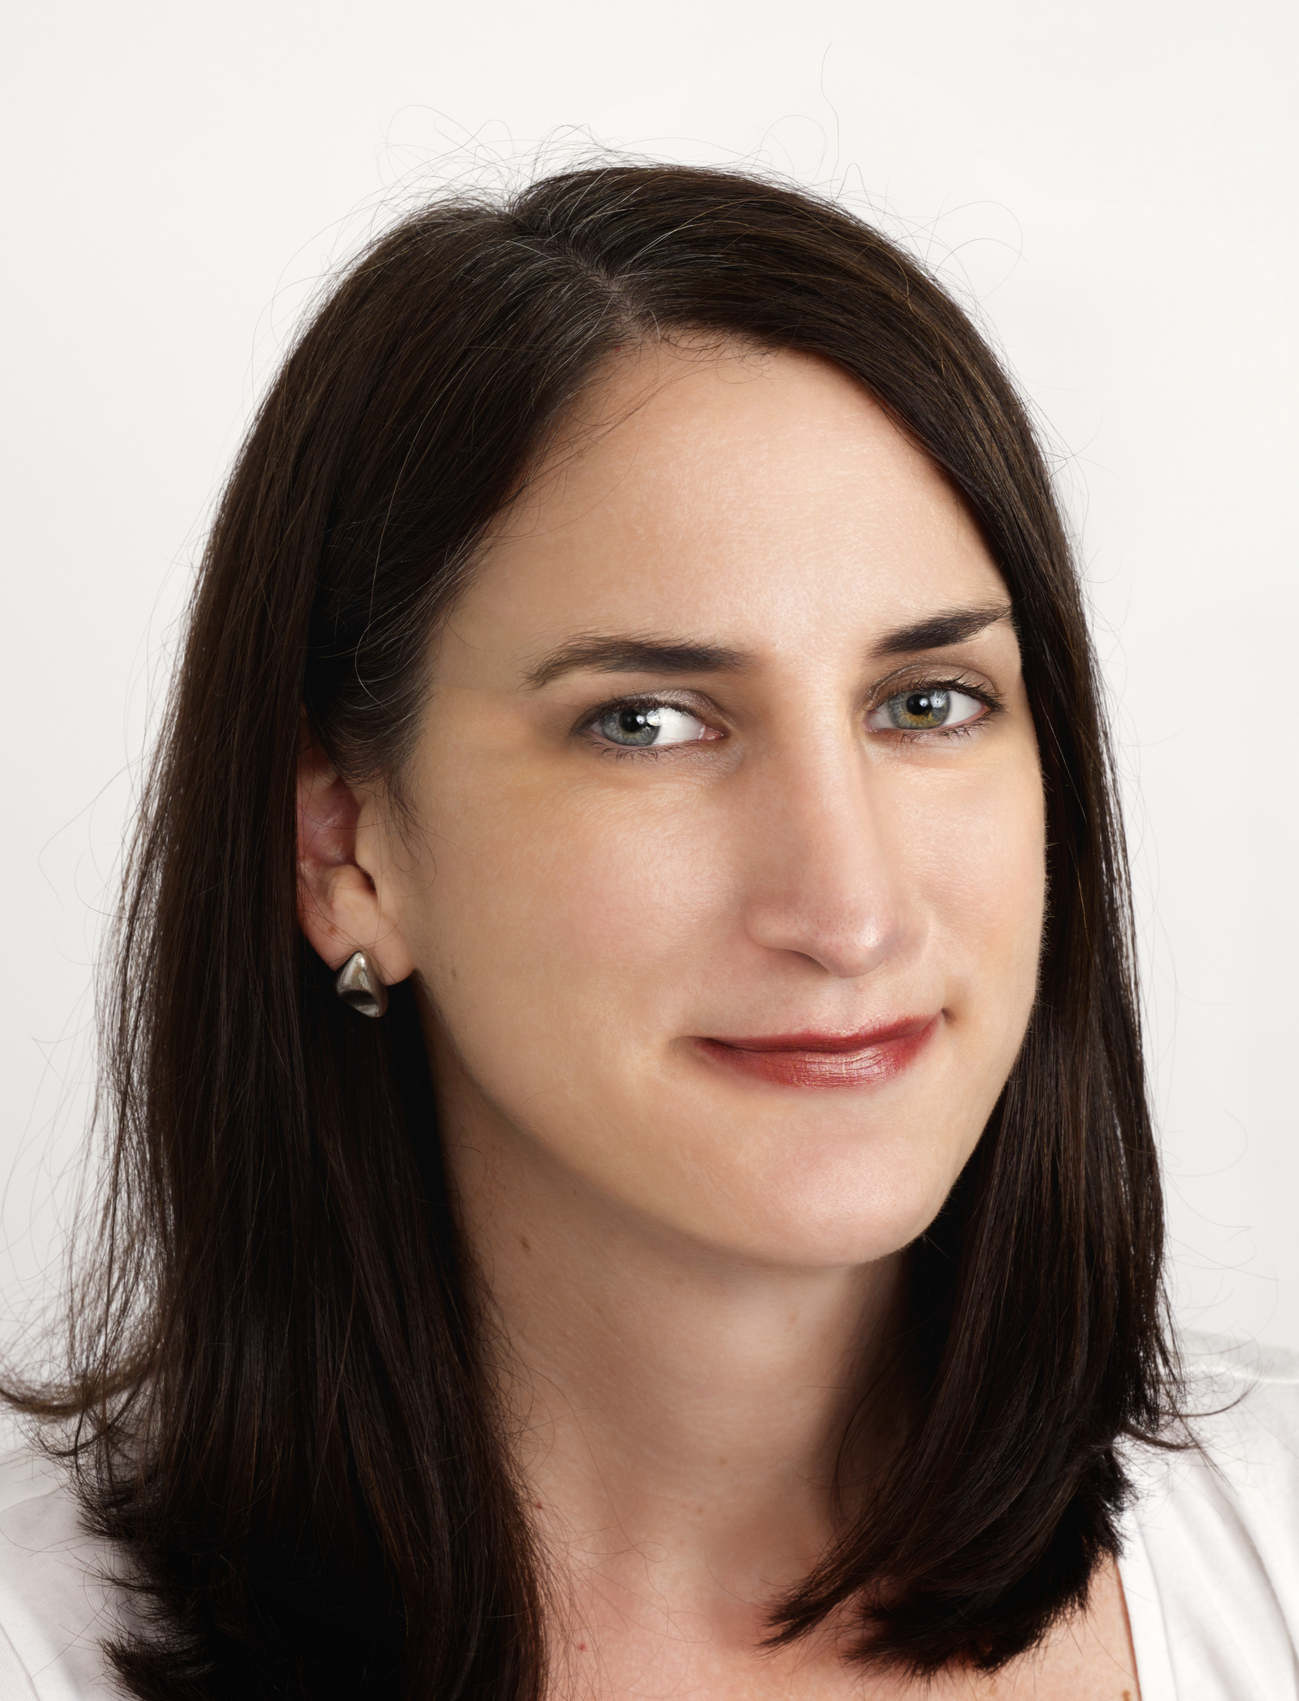
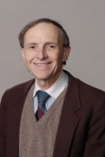
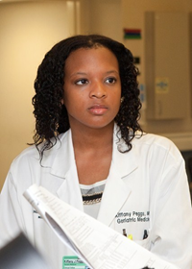
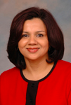
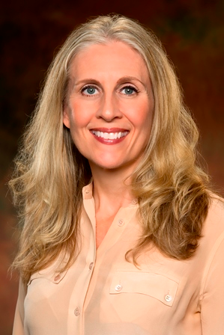
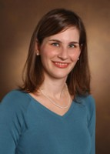
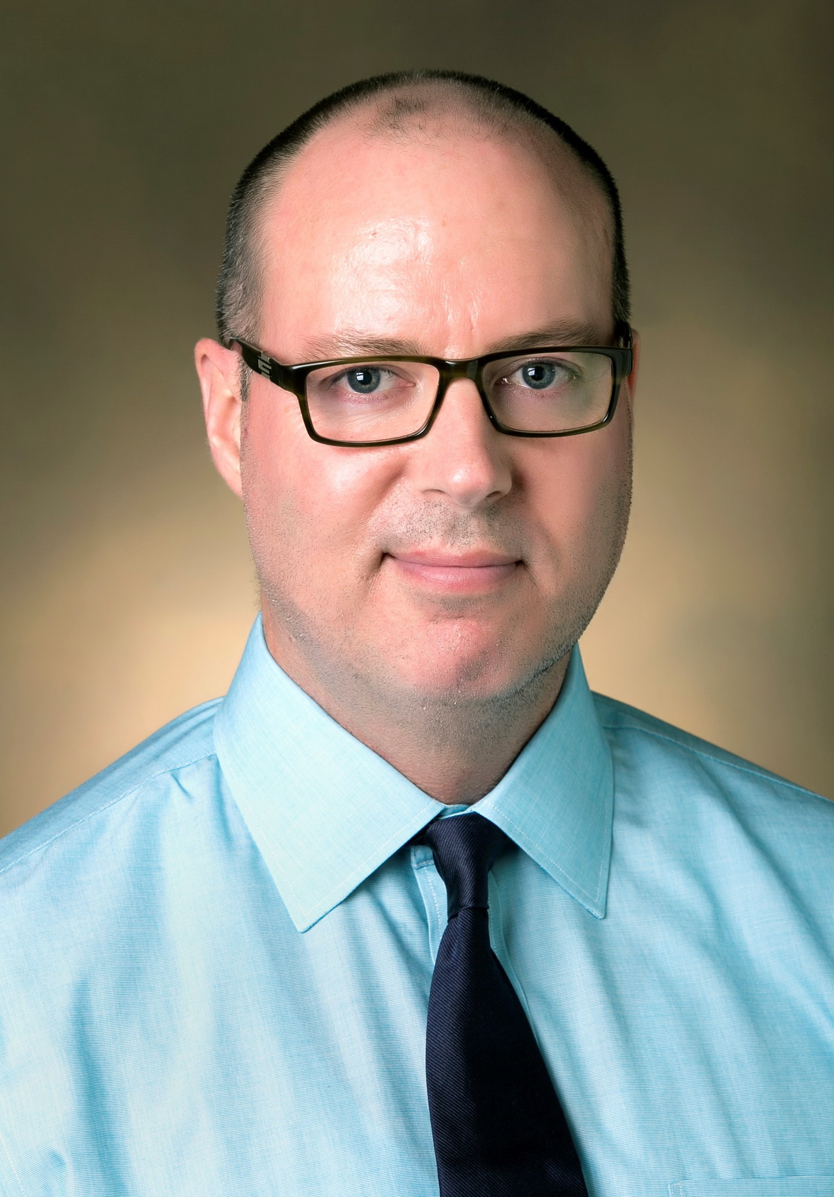
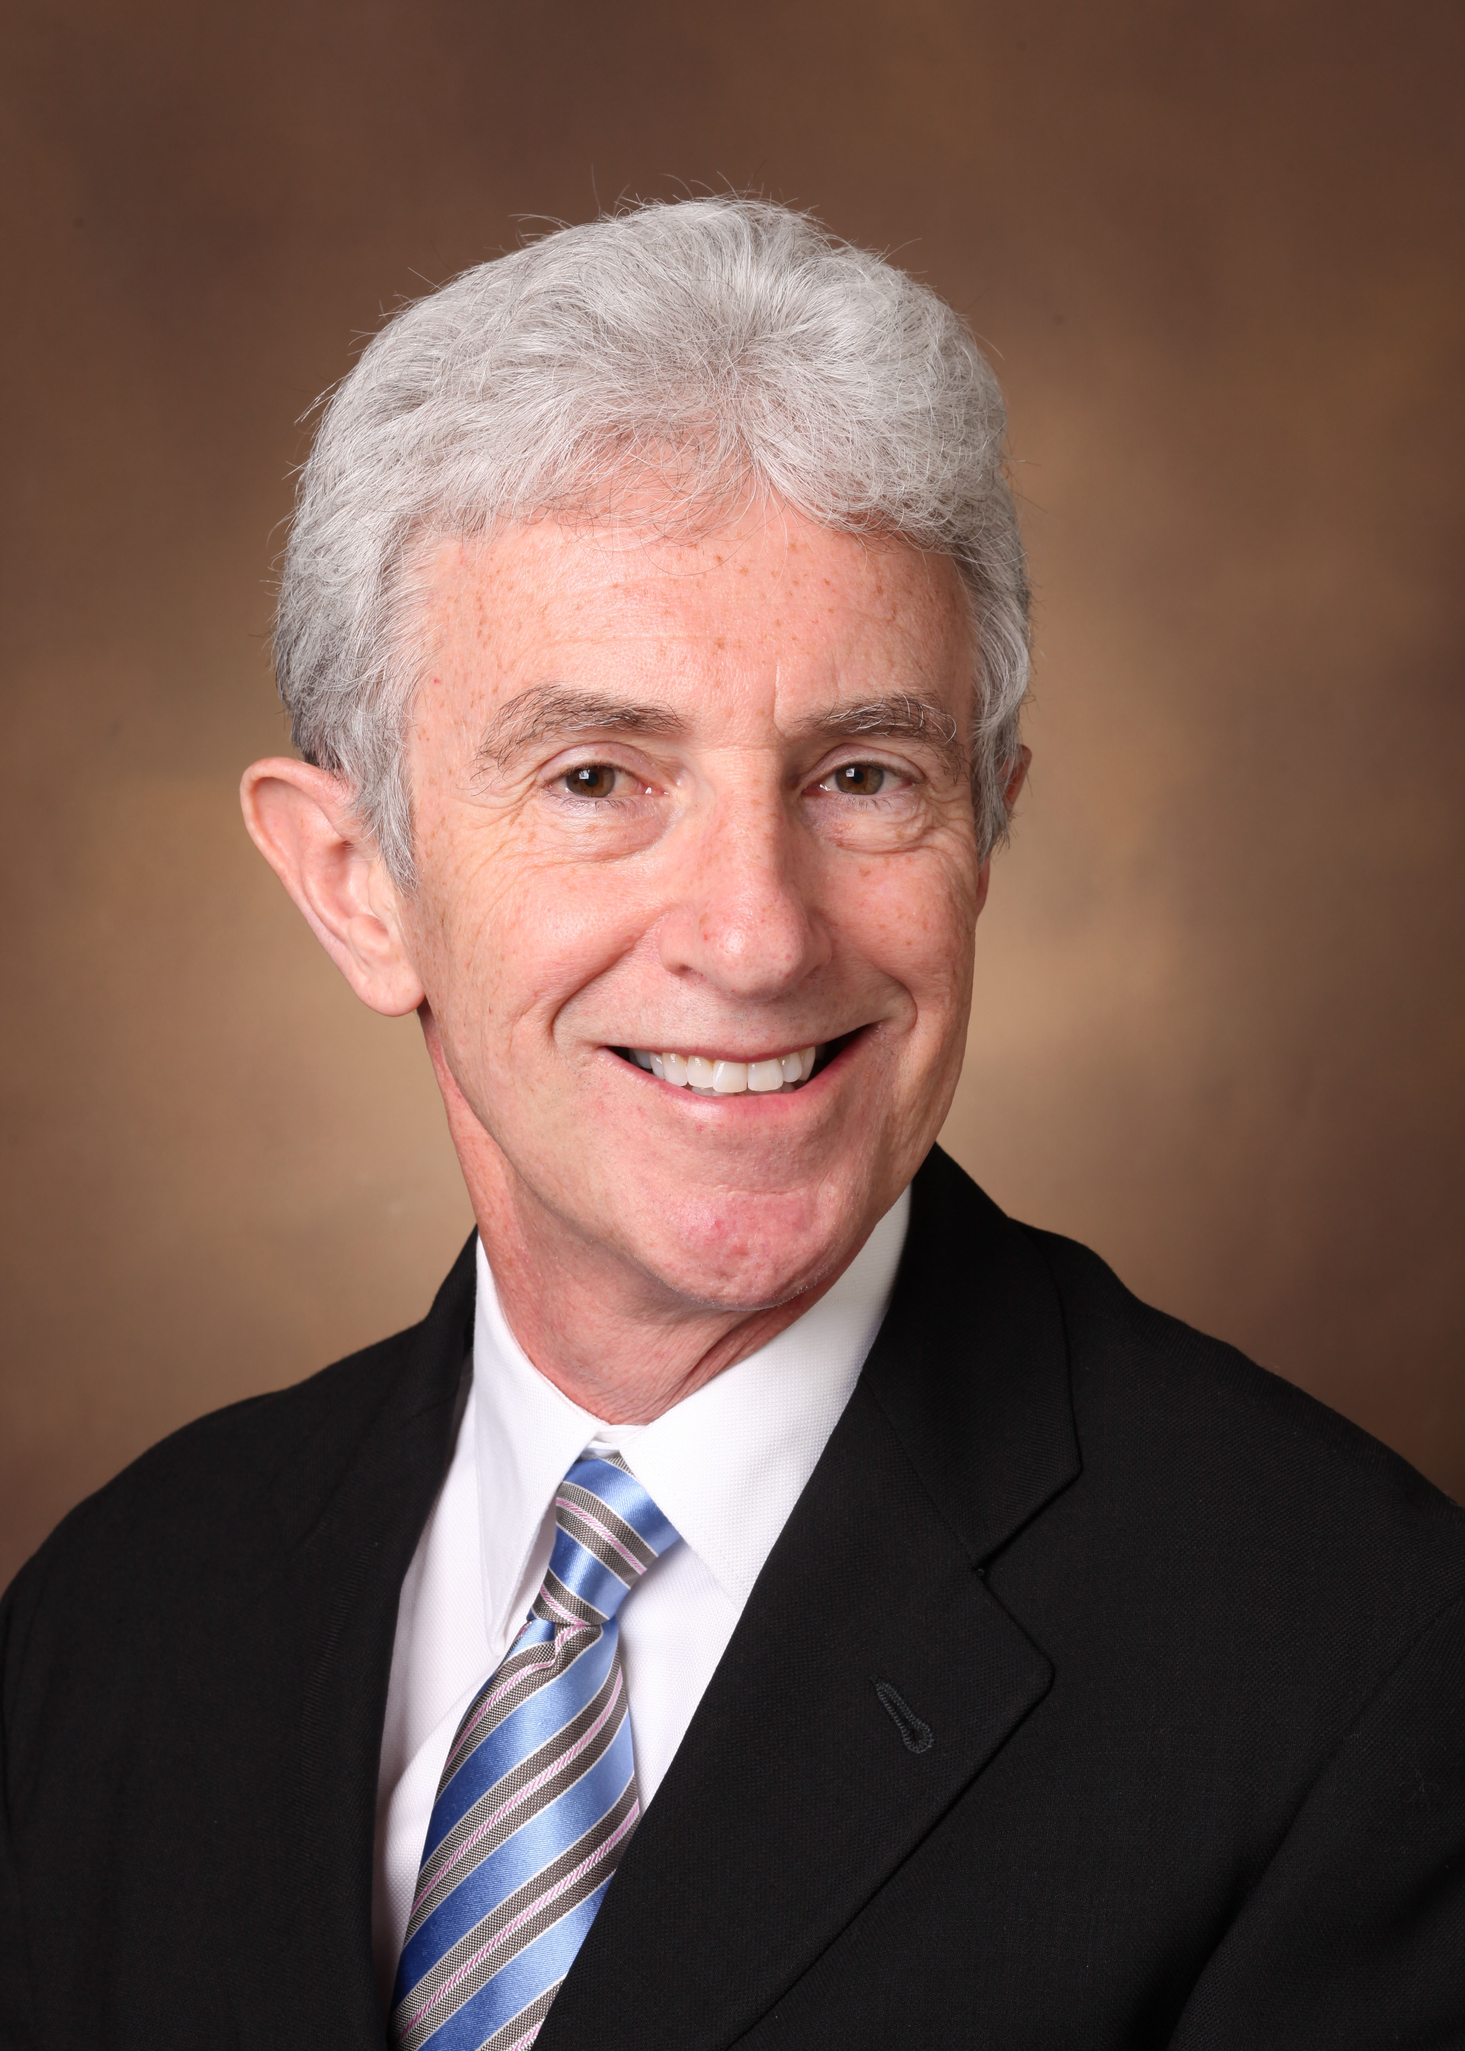
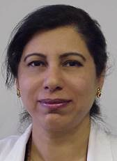
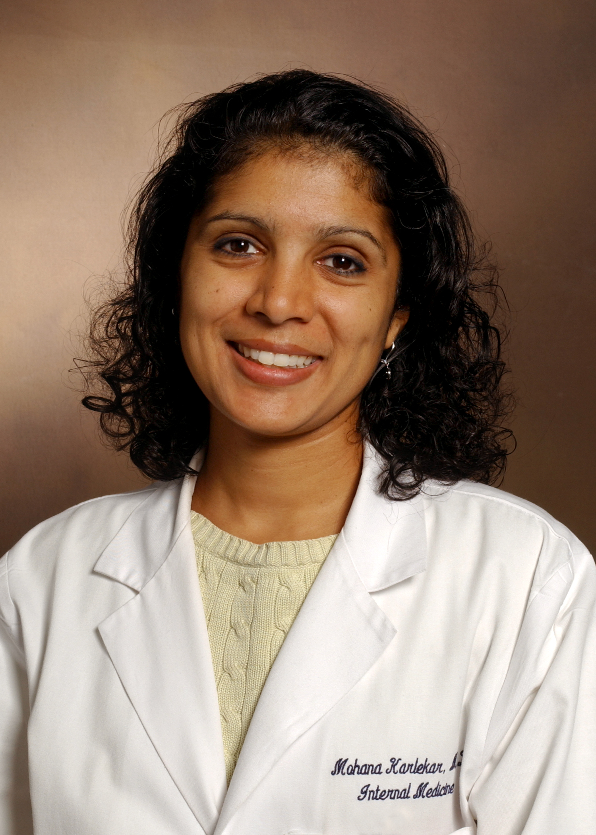
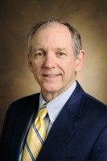

Slide 16
Major Inpatient Rotations
Inpatient Geropsychiatry
Inpatient Geriatric Psychiatry Consultation
TVHS-VA Geriatric Extended Care (Long-Term Care Consultation)
Palliative Care
Geriatric Medicine

Slide 17
Major Outpatient Rotations
Geropsychiatry Clinics – Village at Vanderbilt
Memory Disorder Clinic
Cognitive Neurology
Geriatric Mood Disorders
Continuity Clinic
Veterans Affairs Medical Center
Single Provider Clinic (Nashville)
Multidisciplinary Clinic (Murfreesboro)
Brain Stimulation Service

Slide 18
First 6 months of Training
Fellow 1
Fellow 2
Monday | Tuesday | Wednesday | Thursday | Friday
Memory & Aging Clinic (Newhouse) | Late-Life Depression Clinic (Taylor) | Elective | Dementia Clinic (MU-VA) | Geriatric Hospital Consultation (Nashville VA)
Lunch Break |  | Geriatric Didactics |  | Psychiatry Grand Rounds
Cognitive Neurology Clinic (Petrie) | Geriatric Continuity Clinic | VA Geropsych Clinic (Gwirtsman) | Geropsy Clinic (MU-VA)
Monday | Tuesday | Wednesday | Thursday | Friday
VBH Inpatient Geropsych | VBH Inpatient Geropsych | VBH Inpatient Geropsych | VBH Inpatient Geropsych ECT / TMS | VBH Inpatient Geropsych
Lunch Break |  | Geriatric Didactics |  | Psychiatry Grand Rounds
 | Geriatric Continuity Clinic | VA Geropsych Clinic (Gwirtsman)
Geriatric Medicine and Palliative Care during this half of the year

Slide 19
Second 6 months of Training
Fellow 1
Fellow 2
Monday | Tuesday | Wednesday | Thursday | Friday
VBH Inpatient Geropsych | VBH Inpatient Geropsych | VBH Inpatient Geropsych | VBH Inpatient Geropsych ECT / TMS | VBH Inpatient Geropsych
Lunch Break |  | Geriatric Didactics |  | Psychiatry Grand Rounds
 | Geriatric Continuity Clinic | VA Geropsych Clinic (Gwirtsman)
Monday | Tuesday | Wednesday | Thursday | Friday
Memory & Aging Clinic (Newhouse) | Late-Life Depression Clinic (Taylor) | Elective | Dementia Clinic (MU-VA) | Geriatric Hospital Consultation (Nashville VA)
Lunch Break |  | Geriatric Didactics |  | Psychiatry Grand Rounds
Cognitive Neurology Clinic (Petrie) | Geriatric Continuity Clinic | VA Geropsych Clinic (Gwirtsman) | Geropsy Clinic (MU-VA)
Geriatric Medicine and Palliative Care during this half of the year

Slide 20
Geriatric Seminar/Didactics Series
1-hour afternoon session per week
Protected time
Sessions are open to the entire department
Schedule and suggested readings will be posted on the following website
https://www.vumc.org/psychiatry-geriatric-fellowship/seminars-and-didactics

Slide 21
Biology and Psychology of Aging
Epidemiology of Aging
Theories of Biological Aging
Organ System Changes in Aging
Drug Metabolism in Aging
Structural and Functional Brain Changes in Aging
Cognitive Changes that Occur with Normal Aging
Age‐Related Neurodegenerative Disorders
Changes in Emotion and Emotional Functioning with Aging
Preserving Brain Health and Aging
Stress, Resilience, and Aging
Motor and Gait Changes in Aging

Slide 22
Assessment of Pathology in Aging
Major and Minor Depression in Aging
Bipolar Disorder
Anxiety and Anxiety Disorders in Geriatrics
Schizophrenia and Other Psychotic Disorders
Alzheimer’s disease; Frontotemporal dementia
Lewy‐Body dementia; Parkinson’s disease
Stroke and Cerebrovascular dementia
Somatic Therapies in Geriatric Psychiatry (ECT; DBS; TMS)
Polypharmacy Issues in Geriatrics
Addictions and Substance Abuse in Geriatric Psychiatry (Alcohol abuse, Opiates, Marijuana )
Ethical Treatment in Aging Issues
Special Issues in Long‐Term Care
End of Life Issues (Palliative Care; Hospice; Assisted Suicide/”Death with Dignity”
Capacity Assessment and Guardianship in Geriatric Psychiatry

Slide 23
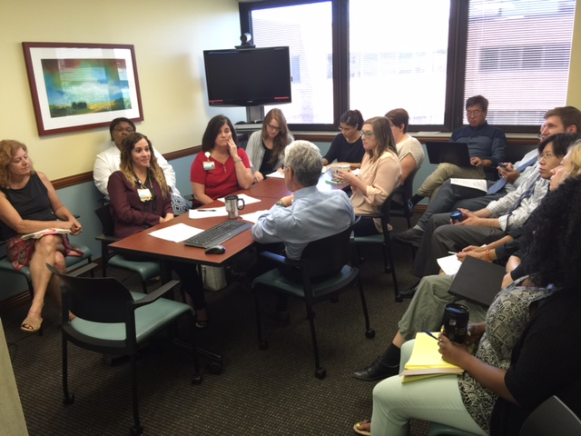
Clinical Research Methodology
Neuroimaging in Psychiatry
Statistics / Research Design
Genetics and Psychiatry
New Drug Development
Psychiatric Epidemiology

Slide 24
Additional Seminars
PsychoRadiology Conference
Review of clinical MRI scans with neuroradiologist
Replaces geriatric didactic that week
Geriatric Psychiatry Case Conference
In this conference, fellows will be responsible for selecting a patient to present along with pertinent questions and relevant journal articles for discussion. A faculty member will be designated as the leader for this case conference and will serve as a mentor for the fellow presenting.

Slide 25
Additional Seminars
Psychiatry Grand Rounds
This weekly presentation is centered around a formal research-oriented presentation by a visiting speaker or member of the faculty, or by a major clinical service of the Department of Psychiatry focusing on clinical management of particularly difficult problems. Geriatric Psychiatry has at least two presentations each year.
Geriatric Psychiatry Grand Rounds Case Conference
Deep discussion of a clinical issue in geriatric psychiatry
Faculty present review of clinical presentation, neurobiology and treatment
Fellows present case (about 10min)
Hollender Endowed Lecture
Endowed grand rounds, focusing on geriatric psychiatry researchers / topics

Slide 26
Elective Seminars & Case Conferences
Geriatric Medicine Core Curriculum (weekly)
Geriatrics and Gerontology Interest Group Grand Rounds (biweekly)
Biomedical Ethics Case Conference (monthly)
Palliative Care Journal Club (monthly)

Slide 27
Teaching Opportunities
Teaching of Vanderbilt 2nd, 3rd and 4th year medical students and visiting students/residents
Opportunities to teach first- and second-year General Psychiatry residents
Some first-year residents will rotate through inpatient service
Teaching opportunities within the community
Other opportunities, as identified

Slide 28
Geriatric Psychiatry Research at Vanderbilt: Center for Cognitive Medicine https://medschool.vanderbilt.edu/ccm/
Cognitive Aging Program (Newhouse): Multiple projects with a focus on brain cholinergic pharmacology
Estrogen/Menopause studies (Newhouse):
Brain structure and function in postmenopausal women with subjective cognitive impairment.
Alzheimer’s Disease Studies (Newhouse):
Phase 3 clinical trials: monoclonal antibodies, behavioral agents, etc.

Slide 29
Geriatric Psychiatry Research at Vanderbilt: Center for Cognitive Medicine
Geriatric Depression Research Program (Taylor):
Multiple projects focusing on late-life depression, brain structure, and treatment outcomes.
Integration of brain aging measures and effect on outcomes
Longitudinal study of predictors of depression recurrence (upcoming)

Slide 30
VA Tennessee Valley Geriatric Research Education and Clinical Center (GRECC)
Education: Disease Prevention, Pharmacoepidemiology, Quality Improvement/Patient Safety, Ethnogeriatrics.
Research: Cancer prevention; Late life cognitive impairment; critical illness-associated cognitive impairment; quality and safety of care; and drug utilization.
Clinical Care: Clinical demonstration and best practice projects.
Quality Scholars Program: Two year funded research program for clinical research in aging

Slide 31
We are wired …
Electronic Medical Record: Epic (or E-Star)
Research Database: RedCap is a secure, web-based application designed to support data capture for research.
Personalized Medicine/Genetics: BioVU is the Vanderbilt DNA Databank, a resource for exploration of genetic variation, disease susceptibility, and pharmacogenetics.
The Synthetic Derivative (SD): The SD contains all clinical information in the EHR but is stripped of personal identifiers
Eskind Electronic Library
And many more…

Slide 32
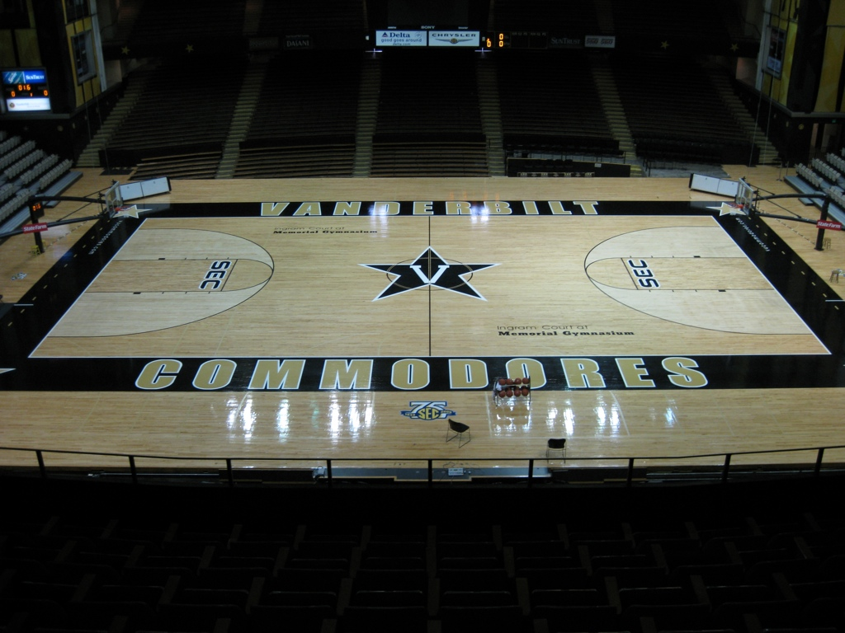
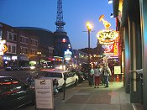
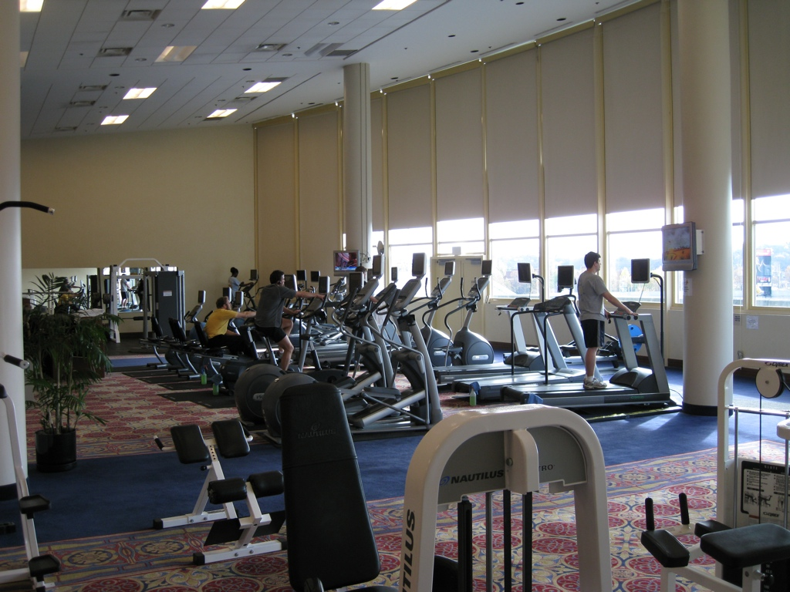
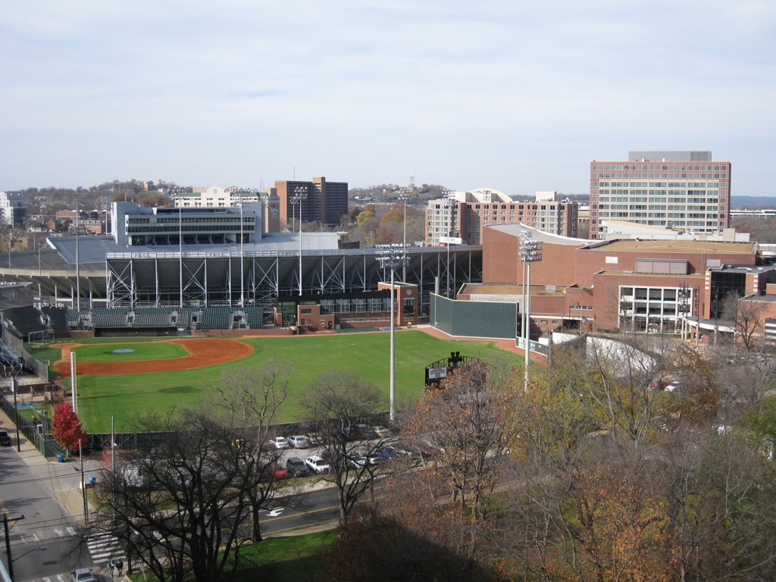
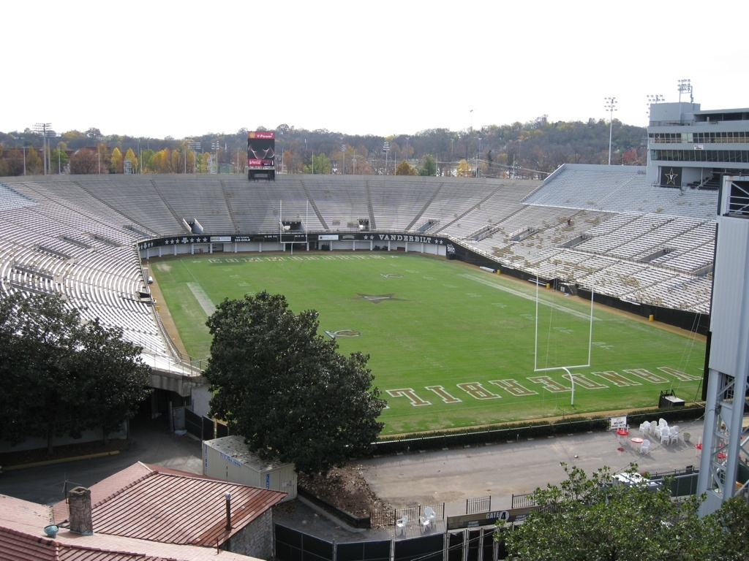

Slide 33
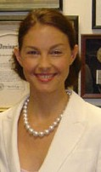
Your neighbors in Nashville …

Slide 34
Summary
Opportunity to develop skills in all aspects of Geriatric Psychiatry
Collegial and dynamic department
Outstanding (top 10) academic medical center with substantial growth in geriatric medicine, psychiatry, and neuroscience
Opportunity to interface with strong Medical School, Department of Psychiatry and Geriatric Medicine
Great city for activities outside of work
WELCOME TO VANDERBILT!

