Slide 1
Case Documentation
Surgical Areas

Slide 2
Meet Your Facilitator

Slide 3
Module 1: CDUI and Features | CDUI and Features
Lesson 1 | Case Documentation User Interface (CDUI)
Lesson 2 | CDUI Features
Module 2: Supply Source Configuration and Management | CDUI and Features
Lesson 1 | Supply Source Configuration
Lesson 2 | Changes Made
Lesson 3 | Supplies
Lesson 4 | Implant Log

Slide 4
Training Structure & Flow
Each functionality covered today will follow the following 4-step process:
Content
Q & A
Demos
Exercises
Notes:
Each functionality covered today will follow the following 4-step process:
Watch the facilitator’s lead to follow the steps of how the functionality works to accomplish the scenario.
Utilize the scripted example to facilitate a self-guided exercise.
Collective recap of the scripted scenario focusing on:
Key Takeaways
Challenges
Q & A

Slide 5
What’s in the Name?
Tecsys
Epic
POU
CDUI
Software Company
Electronic Medical Record Software Application
Point Of Use Management System – Module being implemented
Case Documentation User Interface

Slide 6
CDUI and Features
1
Case Documentation User Interface (CDUI)
CDUI Features

Slide 7
Case Documentation User Interface
CDUI and Features

Slide 8
Case Documentation User Interface (CDUI)
Locate CDUI within Epic.
Visualize how Tecsys embeds with the EMR.
Observe how CDUI works in the OR.
Cancel a case that has been opened in CDUI.

Slide 9
Document in Tecsys
Stock
Less time spent case picking.
Avoid using recalled and expired products.
Prevent case delays and cancellations.
Case Picking
Real-time updates to picking lists.
Case Management
Less errors and less waste.
Easier putaway experience.
Notes:
Script:

Slide 10





Epic Embedded Resource
Clinical Documentation (Notes)
Material Usage Capture
User Identification
Select the Case
Replenishment Demand
CDUI
Case / Patient Consumption
Notes:
Script:
Let’s discuss how Tecsys fits within the existing EMR.
Users will start the documentation for cases in the Tecsys application that is embedded in Epic.
Users will log into Epic, select the case, and once in the case, they will see a CDUI tab that’s been added.
The CDUI tab is where users will document both supplies and implants.
The system will update Epic automatically upon case validation, and inventory will be decremented properly so that replenishment can occur.
The user can still make changes in the CDUI process after validation that will update in EPIC as long as that case is still open and active.
Once that case is closed in Epic, users can no longer make any changes in CDUI that will pass through.

Slide 11
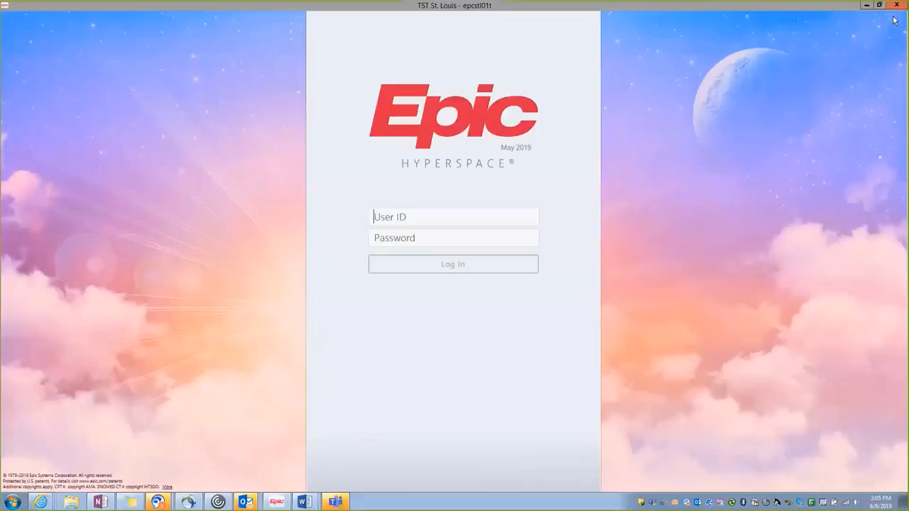
Epic Integration
The clinical user interface embedded inside Epic
Notes:
Script:
Here is a demonstration of how CDUI looks in Epic.
Although this is a video of CDUI for the OR, we will be reviewing the CDUI screen for surgical areas in more detail in the slides that follow.

Slide 12
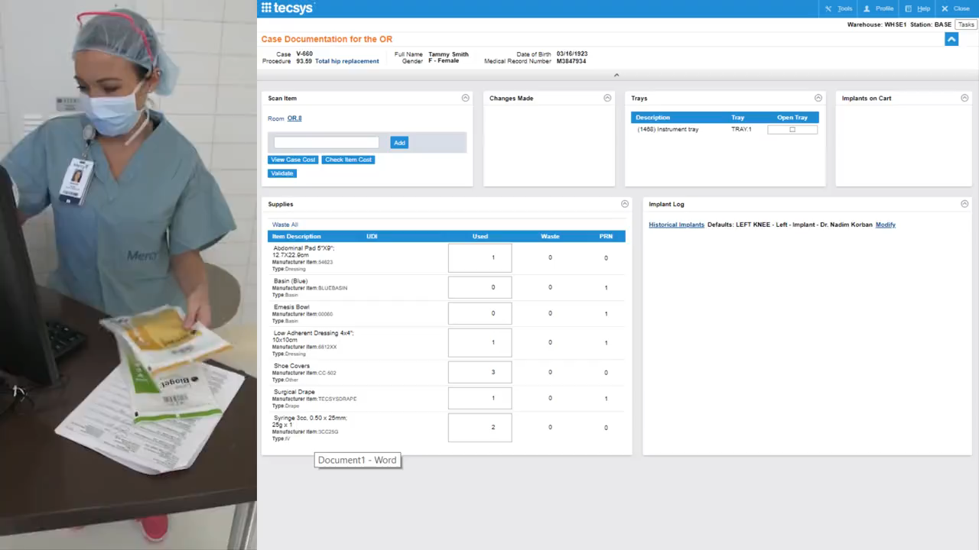
CDUI in the OR
Notes:
Script:
This video shows the CDUI in action in the OR.
As a note, this is a previous version of the software and modifications have been made.
Here, the circulating nurse is scanning in the barcode of the item being consumed during the case. This will add the item into the supplies section.
As you can see, the changes made section will update with the most recent items being scanned at the top.
Here you can see she will scan in implants, and they will appear on the Implants Log.
If an item has gone to waste, the user can document that in the Supplies section and choose a waste reason. They can also document it within the Implant Log.
We will walk through how to do this in more detail in the following modules.

Slide 13
Notes:
Script:
Does anyone have any questions?

Slide 14
CDUI Features
CDUI and Features

Slide 15
CDUI Features
Add items by scanning, typing, or searching.
Validate transfer of items used into Epic.
Track an item using the search.
Locate an item using the search.

Slide 16
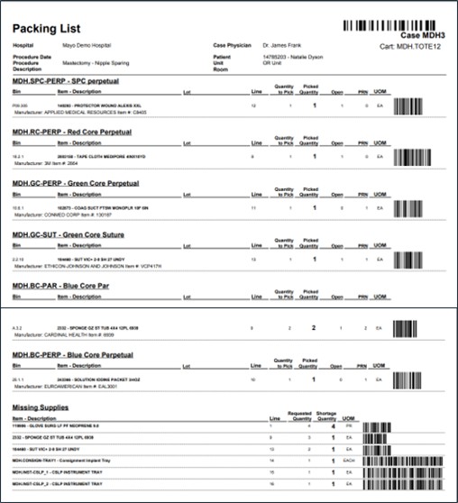
Packing List
Current DPC document
Includes items picked, substituted, or missing
Item allocation
Occurs through case planning function
Performed by Supply Chain
Prior to case picking
Substitution
Occurs before or during picking
Barcodes
Use for documentation if needed
Notes:
Script:
Once the user goes into Tecsys, they will see a new form that will arrive with their case cart.
This is called a packing list and will detail all items picked, subbed, or are missing for the case.
A user will still receive their current DPC document since it also includes any specific notes they would need for the case.
The packing list shows what was picked, substituted, or missing for the case.
Items are allocated to the case through a planning function that is performed by Supply Chain prior to case picking.
The system supports the ability to perform substitution before or during picking which will be reflected in the document.
A packing list prints upon case picking completion to list out what was picked and what is missing.
Barcodes from the packing list can be used to document as needed.

Slide 17
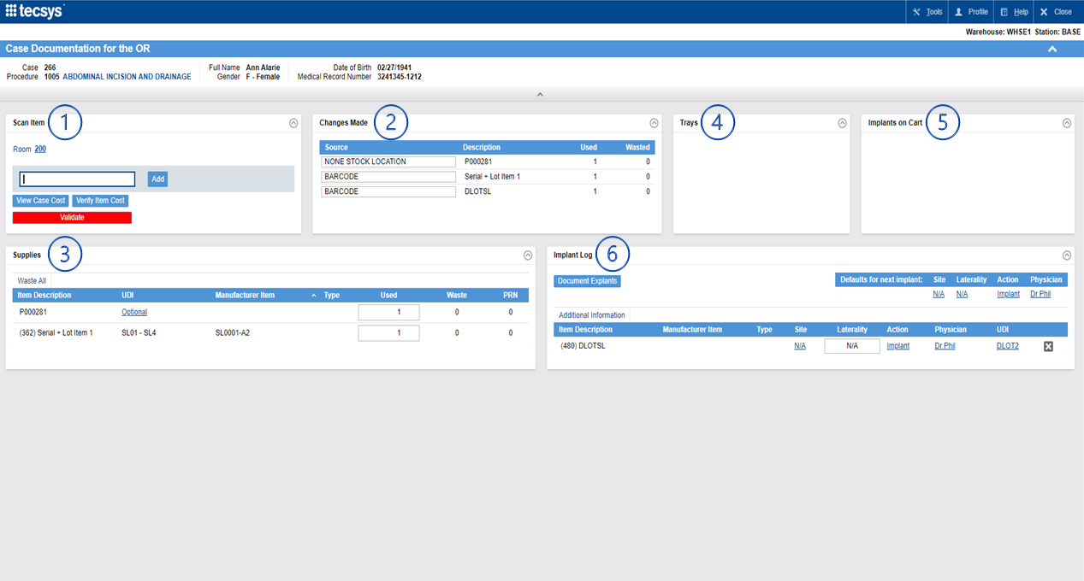
CDUI for the OR
Notes:
Script:
Let’s go over a brief overview of CDUI for the OR.
There are 6 windows in CDUI: Scan Item, Changes Made, Supplies, Trays, Implants on Cart, and Implant log.
The Scan Item section is where items will be populated when a user scans them into the system.
It can also be manually searched and is where a user would Add on an Item or Add an Item on the Fly, if no item number is listed in the system.
The Changes Made section is where a user will see all used or wasted items.
It will also show the Source Location that the system assumed the items were pulled from. This can be updated as needed.
The Supplies section shows all used supplies and can be updated at any time. Any change to this area will be shown in the Changes Made section.
The Trays section shows instrument trays, loaner trays as well as implant trays, which can be virtually opened, and the implants used will be documented inside CDUI.
The Implants on Cart section will display all the picked implants prior to the procedure starting, based off the preference card.
If the items are used, they will be moved to the implant log for documentation. If they aren't used, then once the case has been validated, they will be returned to inventory.
Implant Log is where all documented implants will be shown. Any additions or changes will also be reflected in the Changes Made section.

Slide 18
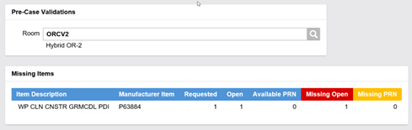
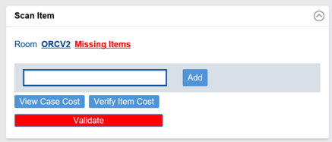
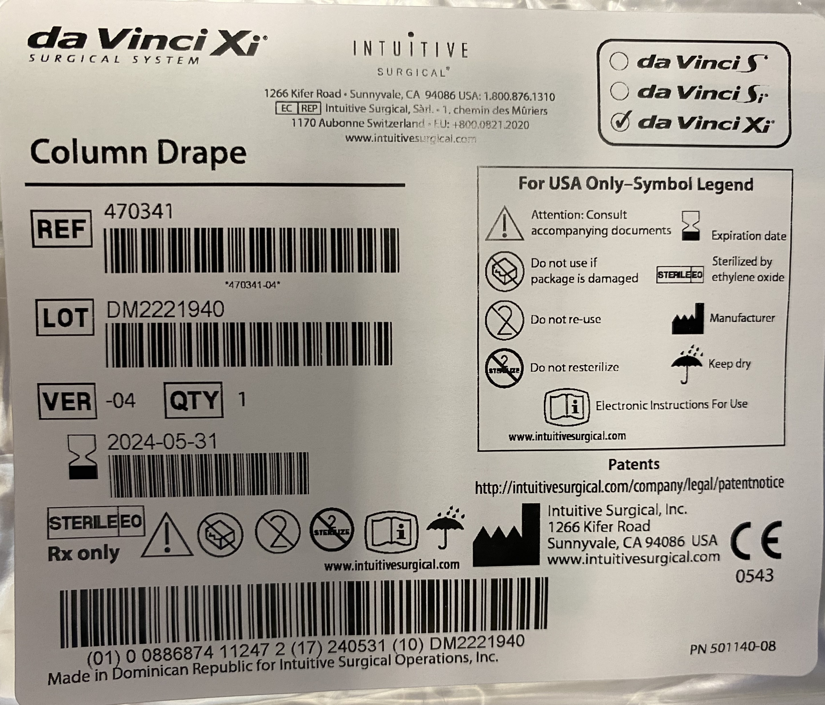
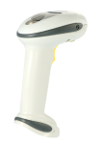
Scan Items Section
Add items by scanning, typing, or searching
Add On the Fly items
Ability to View Case Cost and Verify Item Cost
Validate to transfer item usage information to Epic
Confirm accurate Room number is listed
Notes:
Script:
Next, let’s talk about how to scan items into the system.
The Scan Item area is where a user can add an item onto a case.
Note that the room number is listed in this section. It's important to look at this and ensure it is accurate.
If not, the user can select into it, search for, and select the correct room.
Users can either scan the item in, type it in, or if needed, users can manually search for an item in in the database.
Users can also Add Items on the Fly. These are items that aren't in the system, and we will go over how to document those.
If an item doesn't have a barcode or users scan it and the barcode's not working, users can go search and see if it is in the item database.

Slide 19
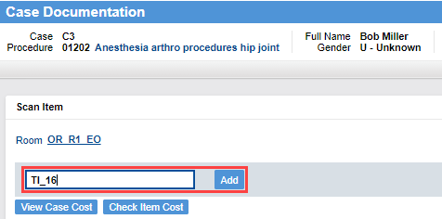
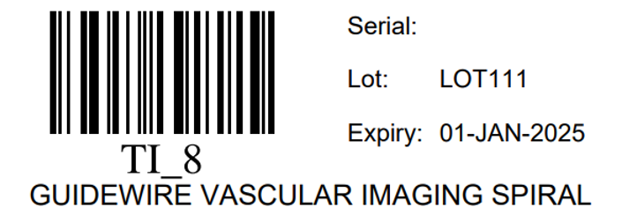
Tracked Items Case Documentation
Lot and serial tracked
Documented by their Tracked Item (TI) label or ID
Damaged label requires manual entry “TI_” followed by the ID number
Special label with a tracking ID
Notes:
Script:
Let’s discuss Tracked Items Case Documentation.
First, what is a tracked item?
A tracked item is an item that has a Tecsys generated barcode that is tracked down to the specific SKU (lot and serial).
As a note, currently, tracked items are only used for bulk buys.
When they are scanned into inventory, their UDI information is captured, a tracked item (TI) number is generated, and it is printed onto the barcode label which is affixed to the packaging.
The glue on the label is not strong and the label can be pulled off should the item need to be returned to the vendor for a credit.
When the user has a tracked item to document, they can scan the Tracked item barcode instead of the barcode on the packaging.
When it's scanned in, all pertinent UDI is also documented on the case.
Remember, tracked Items must always be documented by their Tracked Item (TI) label or ID.
If a label is damaged and unreadable the user will need to manual enter “TI_” followed by the ID number for documentation.

Slide 20
Terminology
On the Fly Item
Add-On Item
An item that is scanned or manually keyed into CDUI that does not exist in the item master (no Workday item number)
An item that is scanned or manually keyed into CDUI and that is already part of the item master
Notes:
Script:
Let’s go over some basic terminology a user will need to know.
An On-the-Fly item is an item that is scanned into CDUI that does not exist in the Tecsys Item Master. We don’t have a number for it, and it is not set up in Tecsys.
An Add-On item is an item that is in the Tecsys system, but it wasn't part of the original case pick.

Slide 21
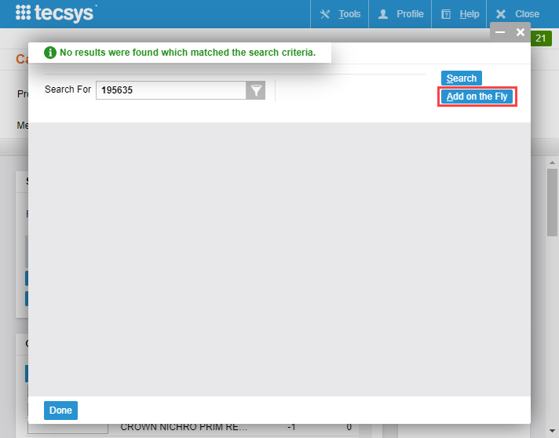

Add on the Fly
Notes:
Script:
We are going to talk about how to Add on the Fly now with detail.
Again, an Add on the Fly item is an item that does not exist in the Item Master.
To add an Item on the Fly, a user would scan an item and select Add.
A pop-up window will come up and a user would then select the Add on the Fly button.

Slide 22
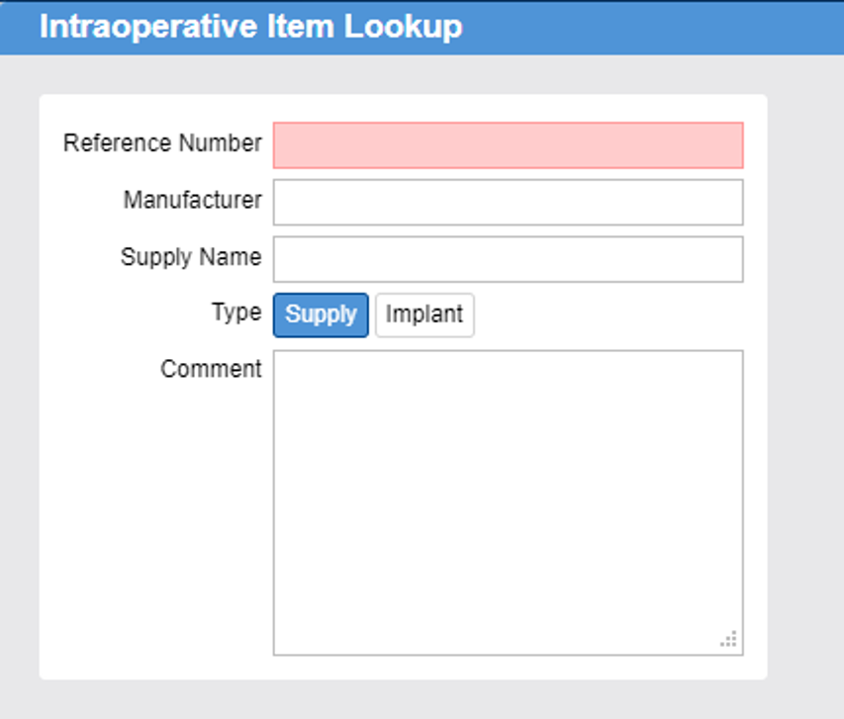
Add an Item on the Fly
Supply
Enter Reference Number, Manufacturer, and Supply Name.
Select the Type as Supply.
Include any comments, such as lot, expiry or serial number, if applicable.
Items added on the fly are then created in the Tecsys Item Master:
Reference # is stored as the Item number
Supply Name is stored as Description 1
Manufacturer is stored as Description 2
Comment is stored in Item Annotations table
1
2
3
Notes:
Script:
Once a user accesses the Add an Item on the Fly pop-up window, there are a few things a user must enter.
A user must enter the reference number from the packaging of the product.
Although the system may not require the manufacturer and supply name, it is important to add it.
The user will then select whether it's a supply or an implant item.
Documenting items that get added on the fly will then create a record in Tecsys that can be reviewed to determine if it should be added to the item file.
That's also why it's important to include the Manufacturer and Supply Name when documenting.

Slide 23
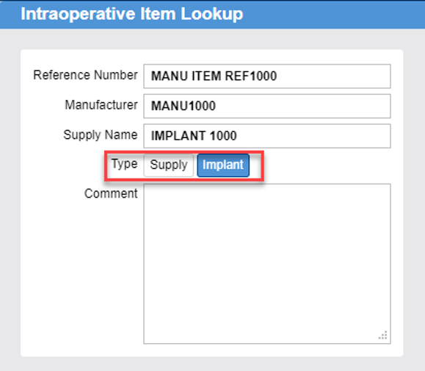
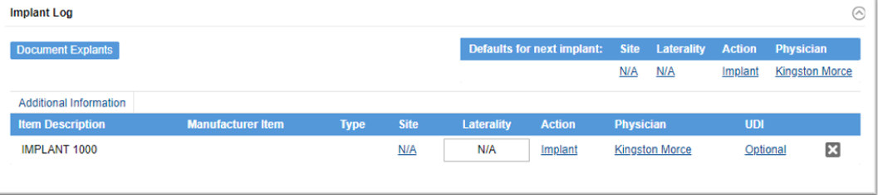
Add an Item on the Fly
Implant
Enter Reference Number, Manufacturer, and Supply Name.
Select the Type as Implant.
Include comments for extra information (required).
Implant is added to the Implant Log where the UDI information can be captured.
“Add on the Fly” is the same as “One Time” supply process in Epic.
1
2
3
Notes:
Script:
There is a difference when it comes to adding an item on the fly that is an implant.
If the item that the user is adding on the fly is an implant, a user must select Implant when they are adding it.
If they select Supply, it's not going to show up as an implant.
They're not going to be able to document as an implant and they're not going to be able to document the UDI. It won't ask for the UDI information, and it won't require it.
Once it has been categorized as an implant, the item is going to then populate in the implant log.
In the implant log, it is required that the UDI information be documented during the case.

Slide 24
Scan Items
Learn how scan items to add to a supply case.
Add On a Supply
Add on the Fly Item
Notes:
Script:
Let’s walk through how to scan items to be added to a case within the system.
First, we’re going to demo how to Add On a Supply item.
Second, we’re going to demo how to Add an Item on the Fly.
To add an item,
First, a user would launch the Tecsys CDUI resource through the embedded CDUI button in Epic. Users can also access the CDUI resource directly through the Case Documentation activity on the Tecsys Home screen.
Scan the item’s barcode, search for the item in the search field of the Scan Item pop-up window, or Search for an item using the item Name, Description, Manufacturer Item Number, or Workday Number.
Select the Add button to add the item to the case Supplies list. The item now appears as a Used item in the Supplies pop-up window.
Once an item is listed in the Supplies window, you can increment the ‘Used’ quantity as desired by scanning the item’s barcode again, or by selecting the plus sign (+) button on the items in the Used section.
You can decrement the number used, if necessary, by selecting the minus sign (-) button.
Next, let’s add an item on the fly,
Navigate to Case Inventory Manager on the Home page and select Case Documentation.
Identify a case you would like to add an item to. Select Open. The case will open.
Enter the item name in the search field in the Scan Item window. Select the Add button.
Because this item is not recognized in the system, a warning message appears. The Intraoperative Item Lookup pop-up window displays. Select Add on the Fly.
Enter the item information available, such as the item Reference Number (Manufacturer), Manufacturer, Supply Name, Type, and Comment.
Select Done.
The non-stock item now appears in the Supplies pop-up window and the source shows as the default Non-Stock Item Location in the Changes Made pop-up window.

Slide 25
Scan Items
Learn how to search for and add an item to a supply case.
Add on a Supply
Add on Fly Item
Notes:
Script:
Now that we have walked through the demos, it is your turn to try these steps for yourself! Use these two QRG’s to walk through the process to completion.

Slide 26
Notes:
Script:
Are there any questions?

Slide 27
Supply Source Configuration and Management
2
Supply Source Configuration
Changes Made
Supplies
Implant Log
Tissue

Slide 28
Supply Source Configuration
Supply Source Configuration and Management

Slide 29
Supply Source Configuration
Explain the supply source configuration depletion paths.
Classify when to use each type of waste reason.

Slide 30
Supply Source Depletion Path
Clinician picks item
Supply Source Depletion Path defines the expected location for the item
Inventory is decremented from the expected picked location
Notes:
Script:
The first topic of this lesson is Supply Source Depletion Paths.
It is incredibly important for each of you to learn and understand what they are, how they are set up, and how they are used.
A Supply Source Depletion Path is built for each procedure room.
It is used to define the most probable location an item is taken from when pulled during a procedure. This helps with ensuring the item is replenished properly and to the correct inventory location.
In other words, when a user picks an item, the system automatically determines the path to manage inventory at the expected location.
Let’s briefly discuss how the paths are created.
Your organization worked to create your Supply Source Depletion Paths based on input from each department.
However, there could be updates that need to be made.
As we go through this course, we will discuss how a user can help improve these Supply Source Depletion Paths.
We will also discuss how to override a Supply Source Depletion Path in the Changes Made section.
The reason why a user will need to know how to do this, is in the case that an item was ever pulled from a different location than what was noted in CDUI.
If picked elsewhere, a user can update the source in the changes made section for proper decrementation of inventory.

Slide 31
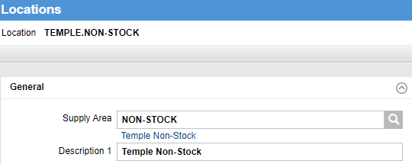
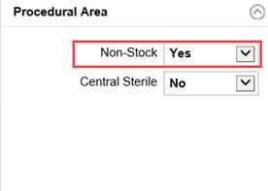
Non-Stock Location
Virtual location
Items set up in Workday
Repository for On-the-Fly items
Items documented in CDUI but have no Workday Item numbers (non-catalog items or specials)
Items are not stocked in an inventory location
Notes:
Script:
Next, let’s talk about Non-Stock Locations.
First, what does it mean?
A Non-Stock Location is a virtual supply location.
One Non-Stock Location is set up for every hospital. So, each facility has one.
And second, why do we need one?
This virtual supply location allows the hospital to keep records of items that are not part of any item master or stock in the Tecsys system.
To explain further, this virtual location is used for two things:
One, to keep track of items that are set up in Workday, but not stocked in an Inventory Location.
Two, to keep a repository for On-the-Fly items to be placed. These are items documented in CDUI but have no Workday Item numbers. Also known as non catalog items or specials.
These items will be marked as Non-Stock.
If the add-on item scanned shows a source location of non-stock, contact Supply Chain for further review of the item.

Slide 32
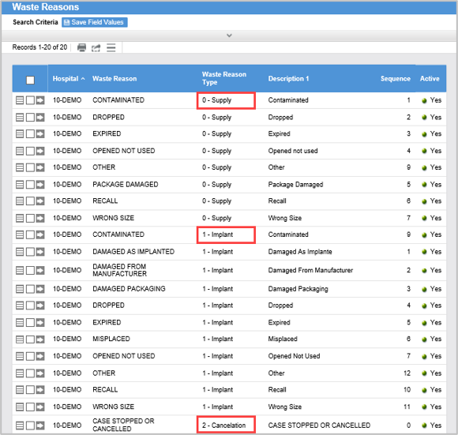
Waste Reasons
Waste Reason Types
Supply
Implant
Cancellation
Must match Epic Waste Reasons
When a waste reason is used, it will update the inventory to ensure an accurate inventory adjustment.
Notes:
Script:
Next, let’s talk about Waste Reasons.
Different waste reasons have been configured already within the system.
In the Tecsys system, we have set up 3 types of reasons for an item to be wasted.
These are, Supply, Implant, and Cancellation.
Again, the reasons are configured already, and they do have to match an Epic Waste Reason.
During the case, while a user is documenting, they’ll be able to go in to Tecsys and select exactly why they are wasting an item.
Providing a reason for why an item is being wasted and ensuring the waste reason matches with Epic helps keep inventory data accurate and current.
This is just a brief overview of the subject; we will go over each of the steps to perform a waste in the next couple lessons.

Slide 33
Notes:
Script:
Does anyone have any questions?

Slide 34
Changes Made
Supply Source Configuration and Management

Slide 35
Changes Made
Update a supply source location.

Slide 36
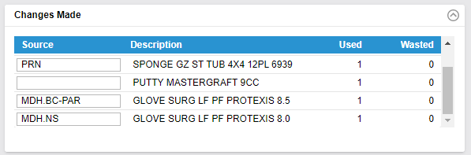
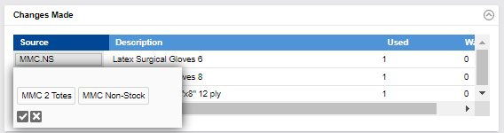
Changes Made
Users can see a list of all changes made to the documentation
Notify someone if you notice an error in the source location.
The list follows the depletion path and assumes it knows where the product was pulled from.
Review and ensure the information is correct for proper replenishment to occur.
Notes:
Script:
Let’s talk about how to make changes to the documentation of an item
The source of items can be modified for add-on items if it doesn’t reflect where the product was pulled from when first scanned in.
A user can do this by double selecting the Source of an item.
A pop-up window will appear with all other Locations in the Room Depletion Path.
Select the correct one and select the checkmark icon.​
As a note, the source will not be specified for items having only 1 location​.
This process is the same when logging changes made for wasted and used items.
If a user notices an error in the Source Location, they should notify someone of the item, room, and the location that is missing.
This way they can update the Room Depletion Path.
If the product was pulled from a location other than the one closest to the room, the source needs to be verified and updated as needed.
The source location could even be outside of their department.
Next, we’re going to walk through a demo and exercise to show you how this is done.

Slide 37
Change Source Location
Learn how to change a supply course location.
Edit the source location of an Item.
Notes:
Script:
Let’s walk through a demo of how to edit the source location of an item.
First, navigate to an item that requires a change.
Double select in the Source section for the item. A list of the other available source locations appears in the pop-up window.
Select the correct source location.
Then, select the checkmark icon to make the change.
The item source is now updated in the Changes Made pop-up window.

Slide 38
Change Source Location
Learn how to change a supply course location.
Change Source Location
Notes:
Script:
Now that we have walked through the demo, it’s your turn to try! Use this QRG to walk through the process to completion.

Slide 39
Notes:
Script:
Are there any questions about this lesson?

Slide 40
Supplies
Supply Source Configuration and Management

Slide 41
Supplies
Identify the status of a supply.
Waste a supply.
Apply when to use each type of waste reason.

Slide 42
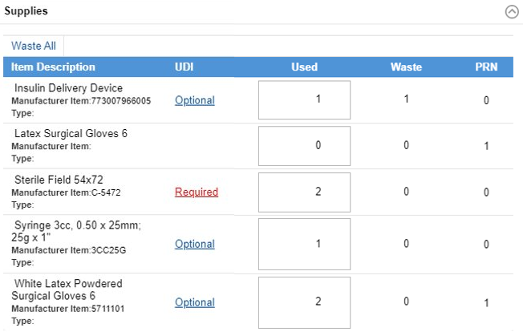
Supplies
Supplies picked onto the cart are listed and reflected on the packing slip.
Items marked as open on the preference card are marked as used.
As needed or hold items are marked as PRN.
Notes:
Script:
Let’s talk about what a clinician will experience within the system when it comes to Supplies.
Once the items for a case has been picked, the items listed in the Supplies window should match what was seen on the packing slip.
In this window, a user can also see the items picked as PRN.
When a user documents a supply item as used, the quantity will go from PRN status to used.
Unused PRNs will be returned through post-operative procedures.
Required and Optional identifiers are determined by factors like location Item, planning group, and depleting path.
If UDI is required and it was not captured when the item was scanned into the procedure, it will show as "Required" in red.
For this reason, there is an opportunity to capture the required UDI (Unique Device Identifier) within the Supplies window.
Items can also be wasted in this window.
Next, we are going to discuss how to waste different types of items.

Slide 43
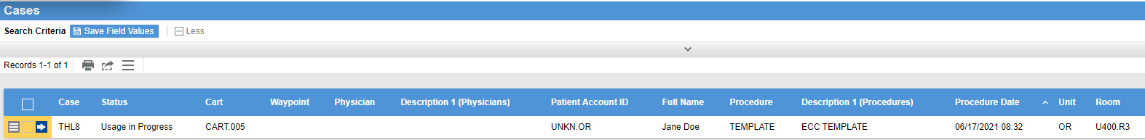
Canceling a Case Already Opened in CDUI
Case Status: Usage in Progress
Notes:
Script:
Let’s discuss canceling a case that has been opened in CDUI.
As a note, this screenshot is what supply chain staff see in the system.
A user cannot manually cancel the case record when it has already been opened in CDUI.
A cancellation in Epic would generate a cancellation message which would not update the case record if the status is passed “Picking in Progress.”
At this point, the Case Status is “Usage in Progress.”
If a cancellation has occurred in Epic, the case has already been picked, and the case was opened in CDUI, the circulator must document what was opened and wasted, and then move all unopened items back to PRN status in the system.
Returning items to the PRN status is necessary so they can be included in the verification and putaway process.

Slide 44

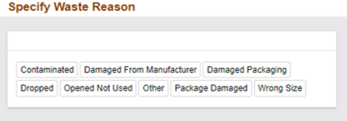
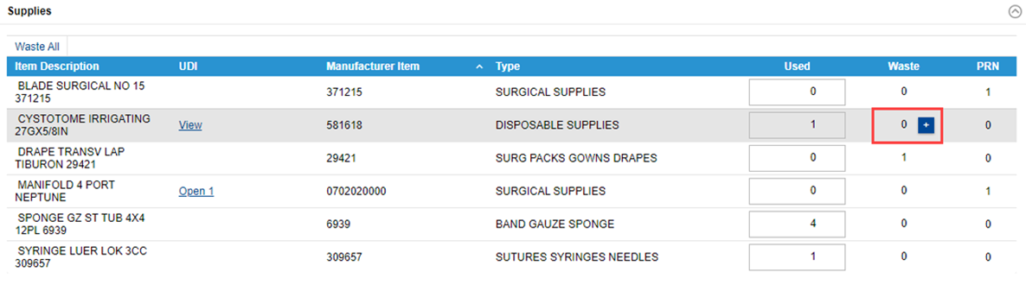
Waste Supplies
Select the “+” icon next to the number in the waste column.
To waste all supplies listed, select Waste All.
Specify the waste reason.
Notes:
Script:
Again, supplies can be wasted. Let’s discuss how to waste a supply item that has been added to a case.
To do this, a user would first navigate to the waste column of a certain item and hover above it.
There is a plus and minus button where the item can be wasted.
Once an item has been wasted, the Specify Waste Reasons pop-up window will appear.
Select the appropriate reason for wasting the item.
Examples for waste reasons could be, Contaminated, Wrong Size, Damaged Packaging, and more.
The changes that a user has made to the Supplies for a case will be noted in the Changes Made section of CDUI.
Users can also select the Waste All button. Selecting Waste All will waste every item in the Supplies list.
The Waste All button is used if it is known that the case has been canceled, or the procedure ends up not being performed.
Wasting an Implant occurs in the Implant Log which we will talk about in a little bit.

Slide 45
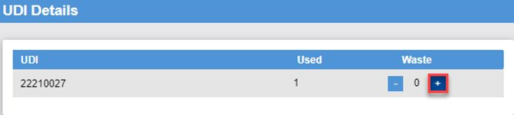
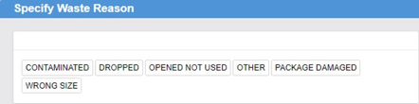
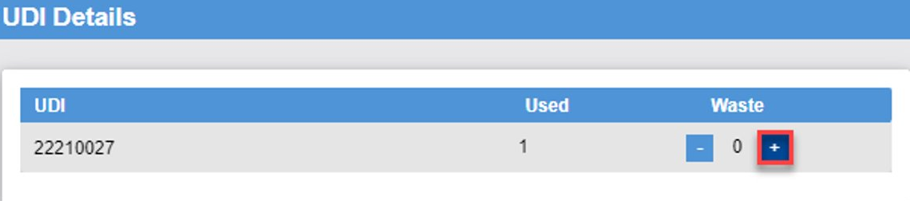
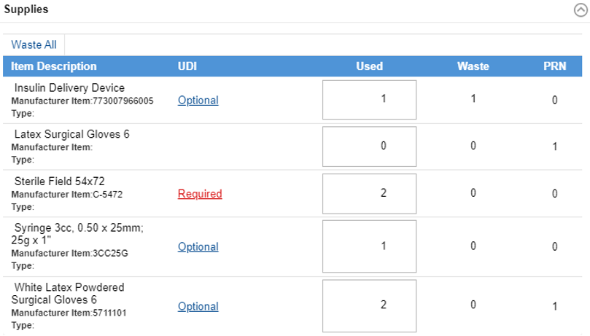
Waste Reasons - Supply
Notes:
Script:
Let’s break down the process of wasting a supply item even further in this next slide.
There are different ways to document the waste reason items.
A user would first go in to CDUI and select the item they would like to waste.
If there is an item that is required to have UDI information, the process will be different.
The user will need to first capture the UDI information and then enter the waste reason.
If it is just optional, then the user can waste an item by selecting the plus sign button.
When item is wasted, a pop-up window will appear to request the user to specify the waste reason.
It’s set up to match what's in EPIC so if an implant must be wasted in CDUI, it goes into the Implant Log.

Slide 46
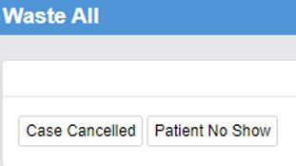
Waste Reasons - Cancellation
If a case is canceled and room and supplies have already been opened, select Waste All.
Choose the reason.
Notes:
Script:
Let’s walk through how to waste an item for a case that has been canceled.
An example of a cancellation would be a situation such as, opening every single item that came through for a case and sitting there waiting for the patient, only for the patient to not show up or have the case be canceled.
Once a patient is categorized as a no show or a case cancellation, a clinician can select Waste All to waste all the items in the case at once.
In the pop-up window select Case Canceled or Patient No Show depending on the reason for Waste All.

Slide 47
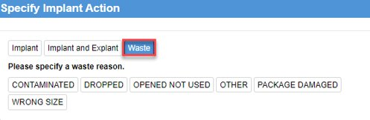
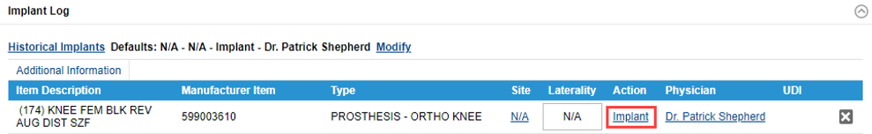
Waste Reasons - Implant
If an implant must be wasted, select Implant under the Action column.
A Specify Implant Action pop-up displays to select Waste and choose the waste reason.
Notes:
Script:
Finally, let’s discuss how to waste an implant.
To waste an implant in CDUI, the user would first go to the implant log within their Case.
Next, they would select Implant under the Action column of an Item.
In the Specify Implant Action box, the user would select Waste and then they would select their waste reason from there.

Slide 48
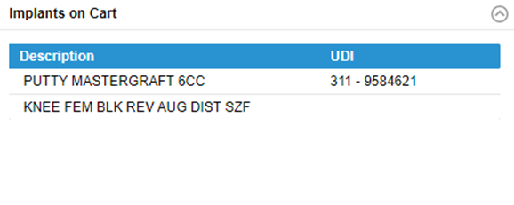
Implants on Cart
Implants are not currently picked in advance, so this should be empty.
Implants are not marked as used until they are documented.
It is possible to include tissue*, if picked prior to the case (not in scope).
Notes:
Script:
Let’s talk about another log, Implants on Cart.
Implants on Cart is a log of all the implants that were placed on the cart during case pick.
This cart provides the circulator with visibility to larger or boxed implants that have been picked for the case.
This will include tissues and implants.
Once a user scans the tissue to document its usage, it will disappear from the Implants on Cart Log and re-appear on the Implant Log.

Slide 49
Waste a Supply
Learn how to waste a supply item in CDUI.
Waste an item
Provide a waste reason
Notes:
Script:
Let’s walk through how to waste a supply in CDUI.
1. First, to document supply Waste, use the Waste section of the supplies window.
2. To increment the Waste quantity, select the plus sign (+) button in the Waste section. The Waste quantity will be incremented, and the Used quantity will be decremented accordingly.
3. The Specify Waste Reason pop-up window will appear. Select the appropriate Waste Reason.
To Undo Waste Documentation
1. You can undo Waste documentation using the minus sign (-) button.
2. The Waste Removal pop-up window will appear. Select the (X) Delete button next to the Waste documentation you wish to undo.
3. Select Done. The Waste quantity will be decremented, and the Used quantity will be incremented accordingly.

Slide 50
Waste a Supply
Learn how to waste a supply item in CDUI.
Waste a Supply
Notes:
Script:
Now that we have walked through the demo, it’s your turn to try! Use this QRG to walk through the process to completion.

Slide 51
Notes:
Script:
Are there any questions about this lesson?

Slide 52
Implant Log
Supply Source Configuration and Management

Slide 53
Implant Log
Document an implant log.
Match site and laterality in Epic.
Identify recalled and expired supplies.

Slide 54
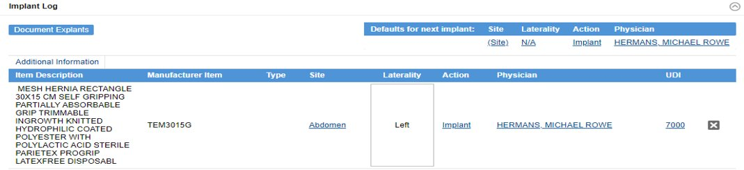
Implant Log
List of implants (and any tissue if used) used during the case.
Circulator can specify:
  Site, Laterality, and Physician
  Action: Implant, Implant and Explant, Waste
  UDI (lot and/or serial information)
Also used to document explants.*
*Explants should only be documented in CDUI if the Implant was also documented there.
Anything implanted directly into Epic prior to CDUI should also be explanted in Epic.
Notes:
Script:
Let’s get familiar with the Implant Log.
In the Implant Log there's a list of all the implants used during the case.
This log gives the user the ability to document certain things such as, Site, Laterality, and they can also select the Physician that implanted the item.
The log can be used to:
Track UDI information.
Document various Actions or Waste items once they are used.
Explants can be documented as well.
As a note, explants will only be available for that patient if the procedure was documented in Tecsys CDUI.

Slide 55
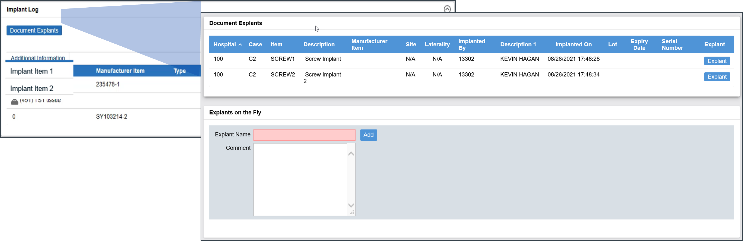
Document Explants
      Lists all implants for this patient.
      If implants were documented in Tecsys, they will populate under the Implant Log.
      Select which to explant in the Document Explants page.
      Note: You can not log an explant from a procedure that was not done within Tecsys.
Notes:
Script:
Next, let’s talk through how to document an explant.
For a real-life example, imagine that a patient comes in who needs a screw put in.
Then, six months from now they come back for another procedure to take that screw out.
A user would then document that screw as an explant in CDUI.
As another reminder, explants will only be available for that patient if they have had a procedure done within the Tecsys system.
If the implant was documented prior to Tecsys, then the explant should occur directly in Epic.
If the patient was not documented prior to Tecsys, look inside Epic to see if they were documented there. If it was, document the explant in Epic.
Otherwise, use Explants on the Fly inside the Document Explants page.

Slide 56
Document Tissue
Tissue will be managed as an Implant for replenishment purposes.
However, continue to use the existing tissue documentation process.
Notes:
Script:
Tissue will be documented as an Implant within Tecsys.
As a note, clinicians will continue to use the documentation process that is already being used.

Slide 57
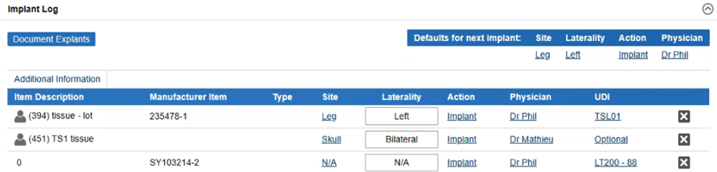

Defaults for Next Implants
Used to default implant information for the procedure
Implants added will have the implant default values but this information can be changed for any implant
Notes:
Script:
Again, users can document explants in the Implant Log as well.
When a user selects the Document Explants button, it will then pull up any implant that has been done on that patient so that they have the ability to explant it.
If it is not on the list of implants, a user can then create one and create an Explant on the fly for documentation.

Slide 58
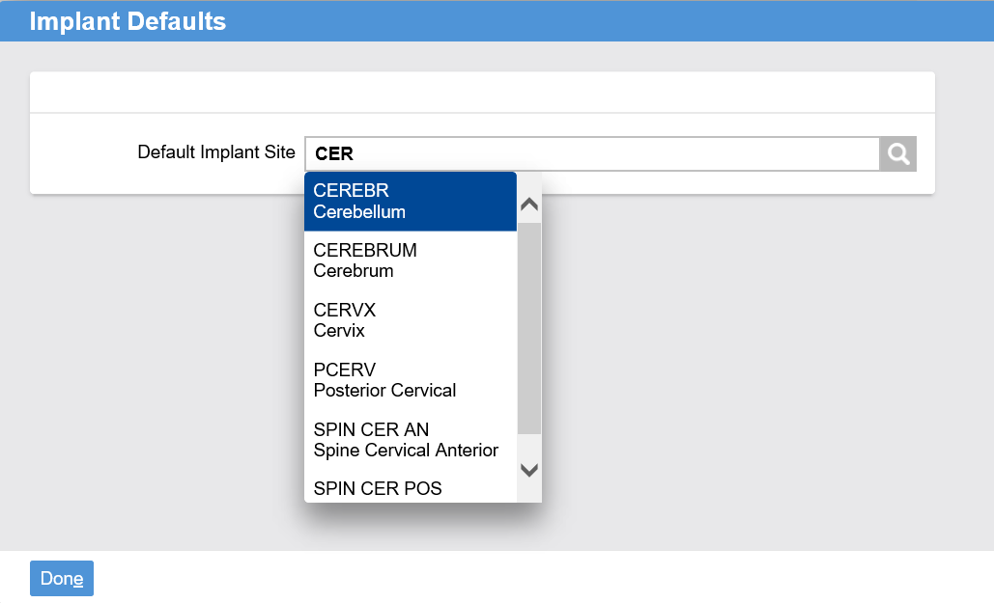
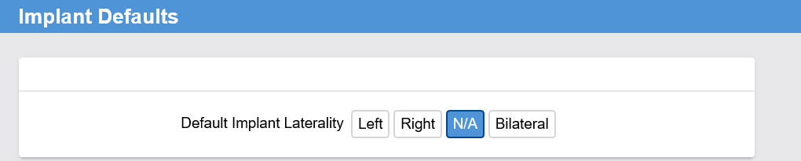
Site & Laterality
Notes:
Script:
During the implant, a user can select the site and laterality of the implant.
When selecting the Site of the implant, the user will see a list of body sites built in the system that can be chosen from.
As a benefit, Tecsys has a prediction functionality when 3 or more characters are entered.
The Site and Laterality that are chosen must match what is in Epic.

Slide 59
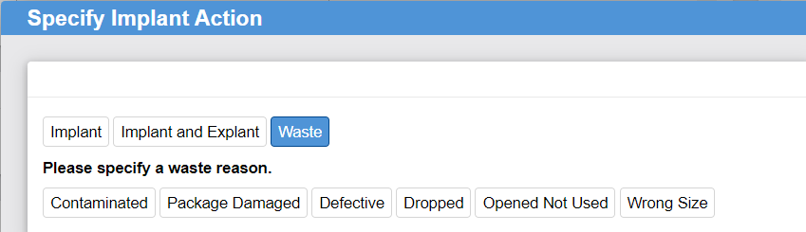
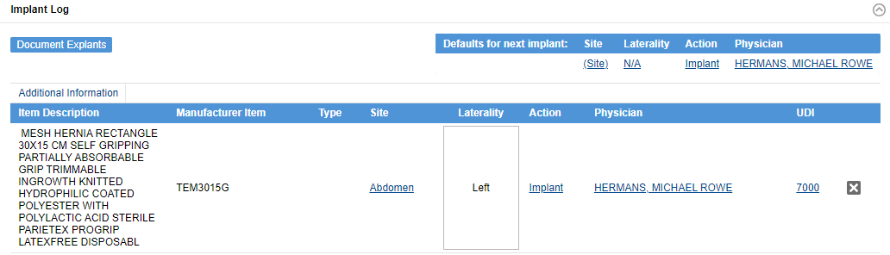
Implant Log - Waste
The type or Implant Action must match Epic Waste Reasons.
If an implant was captured by mistake and must be placed back in inventory, selecting the X will reverse the usage.
  This will not waste the implant.
Notes:
Script:
A user can also waste an implant within the Implant Log.
Any action that is made must match Epic Waste Reasons.
If a clinician were to capture an implant that was a mistake and not actually used, they can select the X button to the far right of the item and it will delete the record without wasting the implant.

Slide 60
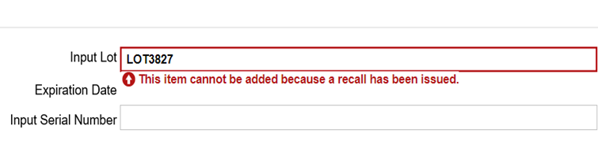
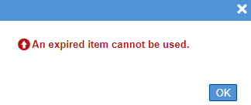
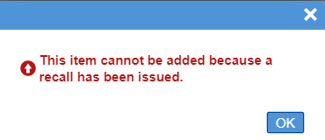
Recalled and Expired Items
If an item is recalled or is expired
an alert can be created.
The alert will notify users of its status and the system will not allow the item to be used.
Notes:
Script:
Understanding how to manage recalled and expired items is important for Tecsys users.
In Tecsys, a user can set up a recall for an item that has been recalled and make it active.
If an item is recalled that has a lot and serial number that has been captured in Tecsys, an alert can be created which will cause the following pop-up notification to notify users of it’s recalled status. The system will not allow for it to be used in a case.
If a user tried to go and scan the item onto a case, it's going to alert users that the item cannot be used.
If the organization gets information back that it’s no longer in recall, the recall can be inactivated.
If a UDI item that’s expired is being captured in Tecsys expires, the following pop-up notification will occur. Again, the system will not allow for the item to be used in a case.

Slide 61
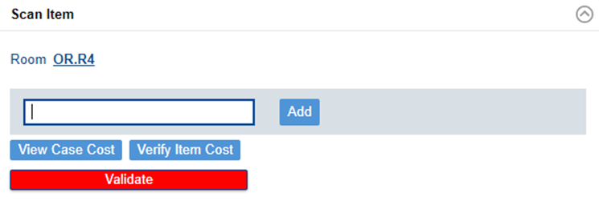
Validate
Only cases that have been fully completed should go through the validation process.
Select the validate button in the scan item section.
Verify for any missing information.
Transfer the usage information to Epic.
The case status will change to “Usage Complete.”
Notes:
Script:
Once the procedure has been completed, select the validate button in the scan item section.
As a note, be sure to not validate a case prior to the case’s completion.
This will check the case for missing information and will transfer case data back to Epic.
Once the case is validated, the status of the case will change to “Usage Complete”.
If a user accidentally selects validate mid-case, the user can continue adding information to this case until the case is signed off in the EMR.
The documentation is only transmitted to the EMR once the case has been validated.
Edits can still be made in Tecsys and will be sent to Epic only while the case is still open in Epic.

Slide 62
Document an Implant
Learn how to document an implant in the implant log.
Document an implant
Check site and laterality
Waste an implant
Return an implant to inventory
Validate an implant
Notes:
Script:
Now, let’s walk through how to document an implant.
First, scan the implant.
Select the Implant Log section.
Locate the implant you would like to document.
Enter any required information about the implant such as Site, Laterality, Action, Physician, or UDI by selecting the hyperlink for each documentation needed and entering the necessary information in the pop-up window. As a note, some information will default into the Implant Log fields, such as the Action “Implant”, as well as the case Physician name. This can be changed on each line as necessary. Settings can be updated prior to documenting implants in order to prefill fields as appropriate.
Select Done. The implant will now appear in the Implant Log.

Slide 63
Document an Implant
Learn how to document an implant in the implant log.
Document an Implant
Notes:
Script:
Now that we have walked through the demo, it’s your turn to try! Use this QRG to walk through the process to completion.

Slide 64
Notes:
Script:
Does anyone have any questions?

Slide 65
Case Documentation User Interface (CDUI)
Supply Source Configuration
CDUI Features
Changes Made
Supplies
Implant Log
Notes:
Script:
As we wrap up this course, let’s summarize what we covered.
In module 1, we covered the Case Documentation User Interface and how integrates with Epic. We also learned the various features of the CDUI like adding items or adding items on the fly.
In module 2, we talked about Supply Source Configuration and how depletion paths work and can be managed. We also learned how to make changes to an item and manage supplies by canceling cases and wasting items. Finally, we learned about the Implant Log and how to document explants.

Slide 66
Next Steps/Takeaways
Now it is your turn to try it for yourself. Over the next few days, you should try to complete the following on the test site:
Locate CDUI within Epic.
Add items by scanning, typing, or searching.
Locate an item using the search.
Waste an item.
Document an implant log.
Identify recalled and expired supplies.
Notes:
Script:
So, what comes next? Over the next few days, try to complete the following processes on the test site.

Slide 67
Add support resources here.
Notes:
Script:
Here are a list of support resources that you will be able to access to support you in your use of the platform.

