Slide 1
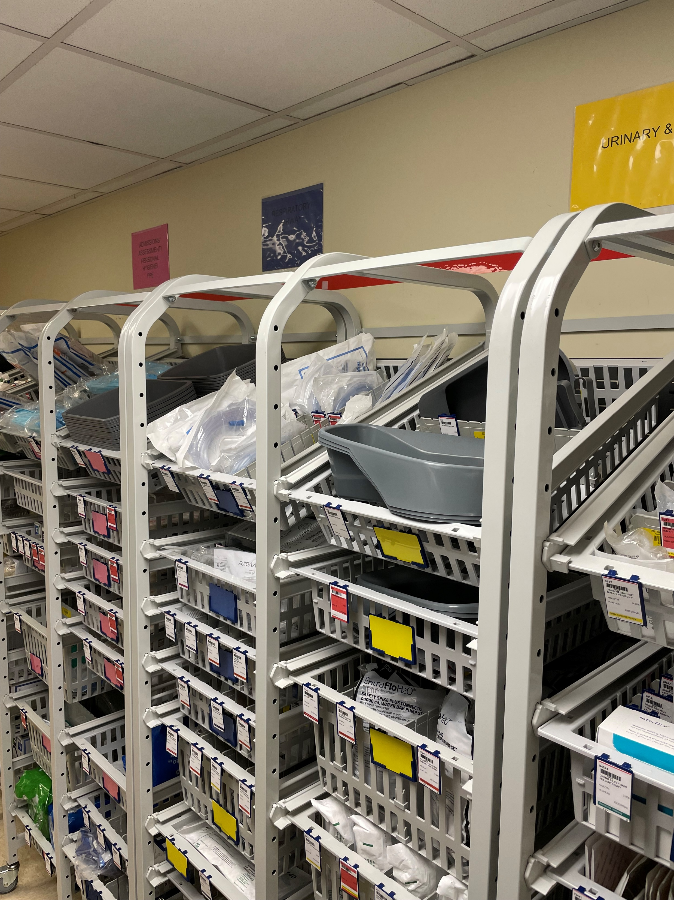
Two-Bin Kanban:
Supply Management
Inpatient Staff

Slide 2
Objectives
Understanding of the purpose of the Tecsys Two-Bin Kanban system
Understand what is changing from the current state
Understand the two-Phase change process
Understand the nurse's role in the new processes
Understanding how to escalate unit-specific issues/questions

Slide 3
What is Tecsys Point of Use
A supply scanning system used to track patient supplies in the department
Tecsys Point of Use system enables you to ensure you have the right supplies, in the right place, at the right time.

Slide 4
Why are we changing?
Improved integration of systems
*Replacing our current system, Optiflex
*Part of a bigger project called Workday
*This project will help create more integration between many of our systems, including eStar, in late 2022
Improved communication regarding supply needs
*Future state will include automatic notification to the service center of supply needs in department
*Current state – call service center for immediate needs
Improved insight into PAR levels that need to be adjusted
*Par levels are split into two equal parts – primary & secondary bins
*Movement of white/ primary tag indicates half-way through PAR inventory
Improved time/process steps to locate needed supplies when out of stock
*Future state – Smartboard panel will allow you to quickly and easily search nearby locations for supplies

Slide 5
Rollout Process
Phase 1
Includes installation of hardware only
Phase 2
Includes software go-live
Bins, Static Kanban Boards, and Tags
Requires a manual process for moving tags from bins to Kanban board as supplies run out
Tag movement initiates the replenishment process
Still requires staff to call for critically low supplies
Software go live will include:
RFID boards* that will automatically notify the service center of supply need
Scanning of some chargeable items
Training plans and rollout timelines to be communicated soon
*RFID boards delayed until 2023 due to global supply chain issues

Slide 6
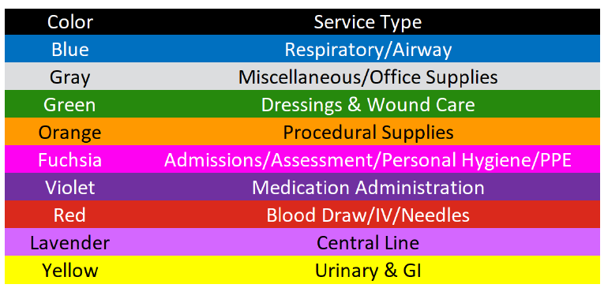
Color Families
Supplies are organized into colored categories
Standardized across the Hospital!

Slide 7
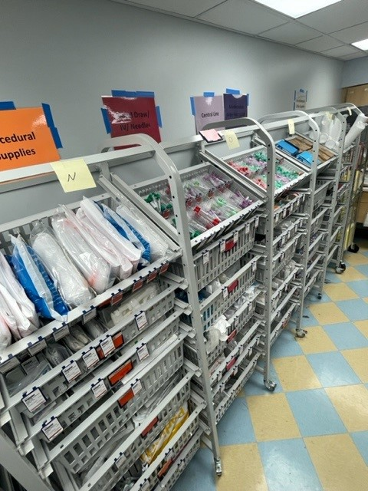
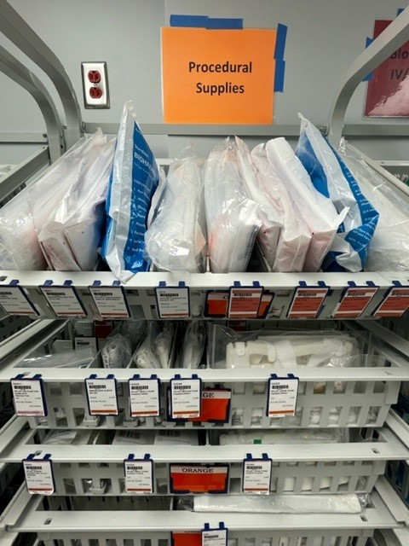
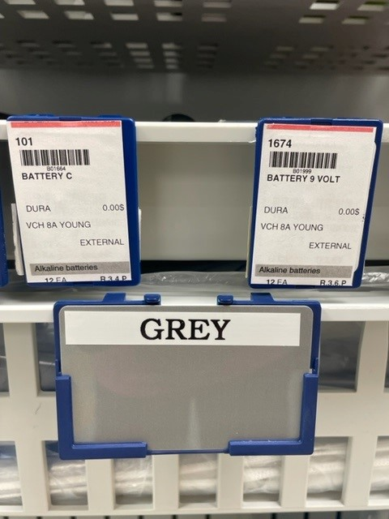
Corresponding Wall Signs,
Bins, & Tags
Wall signs/color families correspond to Bin labels
Bin labels/color families correspond to bin tags

Slide 8
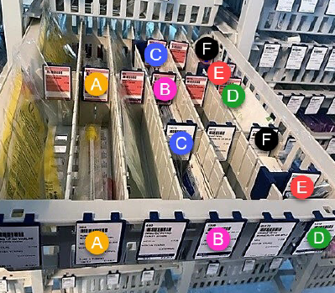
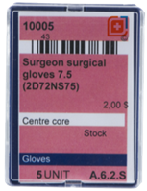
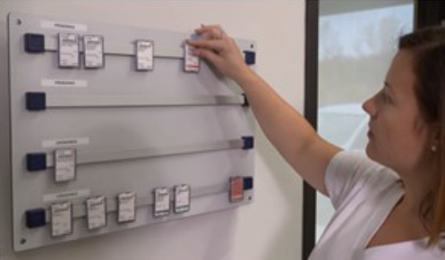
Phase 1 Rollout: Key Points
Each Supply has Primary bins (White tags) and Secondary bins (Red tags)
Take supplies from Primary Bin first
Move white tag to Kanban board when primary bin runs out
Take supplies from Secondary Bin last
Move Red tag to Kanban board when secondary bin runs out
Note: supplies may be organized with
all primary bins in front of all secondary
bins.

Slide 9
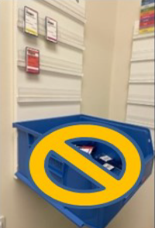
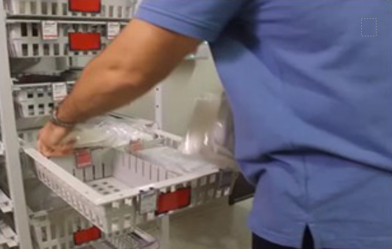
Phase 1 Rollout: Key Points
Do NOT move bins around.
Instead, escalate to unit leadership any requests/concerns.
Blue Bins are for Service Center staff only – do not place tags in bins
Continue to call service center for supplies needed immediately

Slide 10
Go-Live Date & Next Steps
Phase 1 Go-Live date: ENTER DATE
Next Steps:
Review Education Flyer here
Know who your unit point people are
Enter names of identified staff/leaders
Visit other units already live (implementation schedule here)
Look for future communication regarding software training (Fall ‘22)
Tecsys Implementation Website: https://vumc.org/pou

Slide 11
Questions?

Slide 12
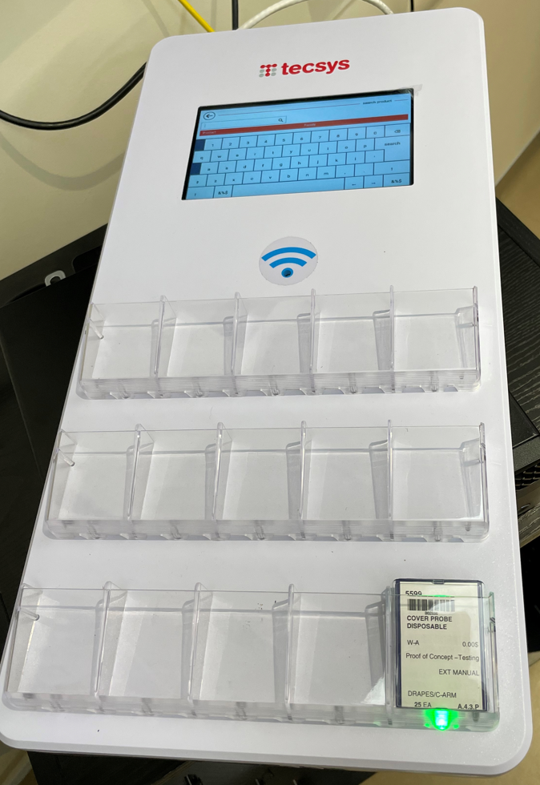
Appendix: Phase 2
Coming Fall 2022
Tecsys Software Go-Live
Identification of Tecsys Super Users
Online training in Learning Exchange for staff
Installation of RFID Smartboards*
RFID tags immediately send replenishment request
Include a smart panel to search nearby locations for product
Future state video here
*RFID boards delayed until 2023 due to global supply chain issues

