Slide 1
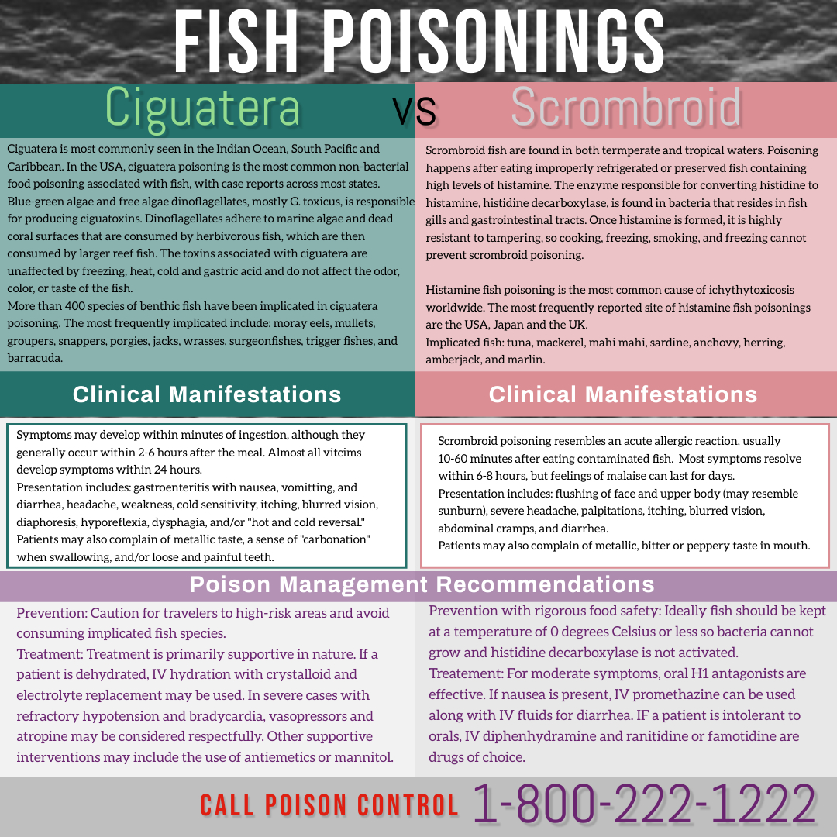
References:
Clin Rev Allerg Immunol (2016): 54-64-69
CDC Traveler’s Health information, poisonings from marine toxins

