Slide 1
PMI HealthIT Overview: LIS Perspective
Leonard Bloom MPH, SCT(ASCP)CM

Slide 2
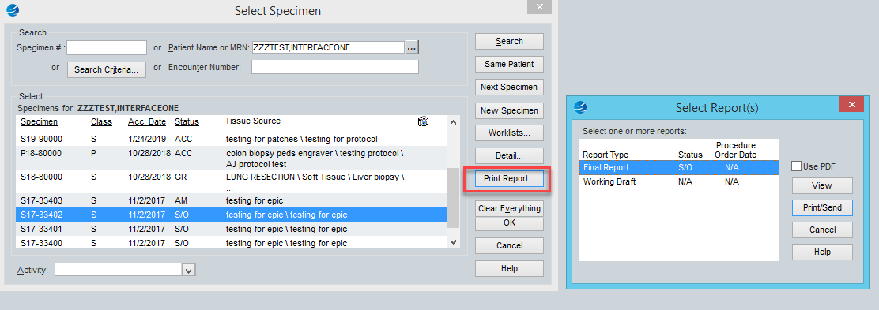
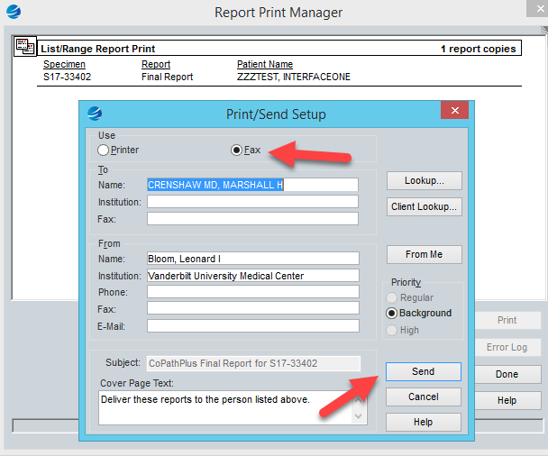
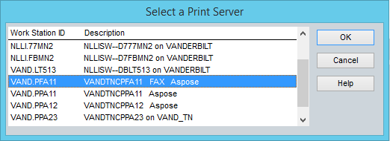
Top 10 Things to Know for Daily Work
Local Number:
Long Distance:
#10 - How to send an ad hoc fax out of Copath

Slide 3
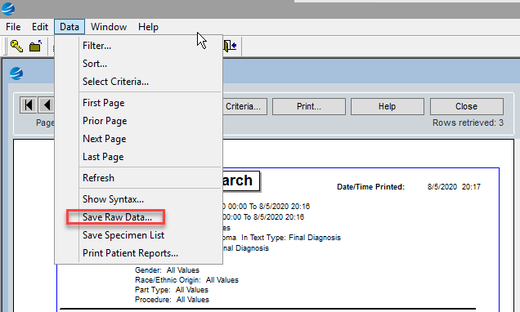
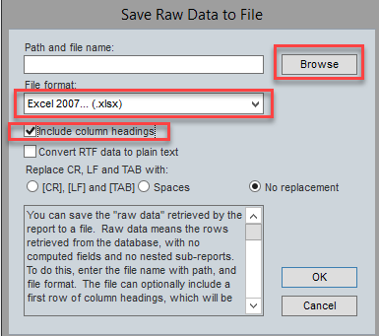
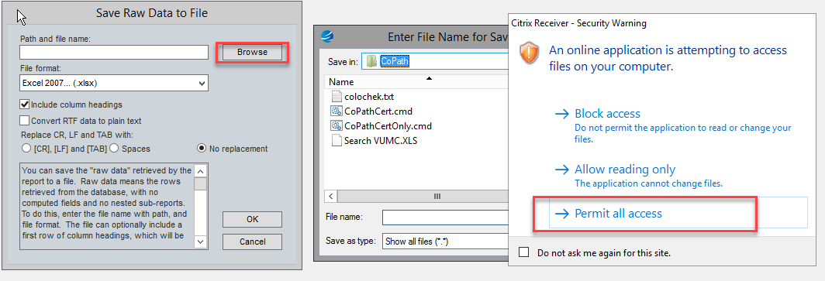
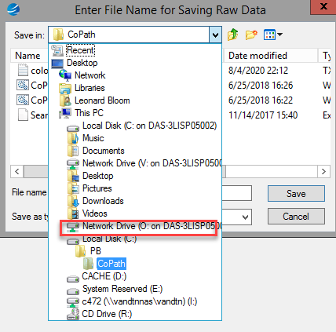
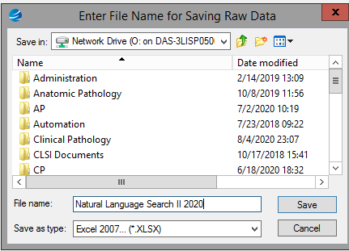
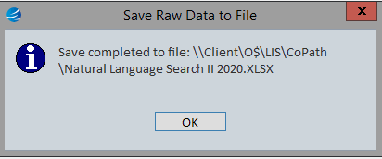
Top 10 Things to Know for Daily Work
#9 - How to save an infomaker report

Slide 4
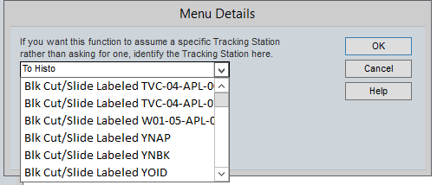
Top 10 Things to Know for Daily Work
#8 - How to customize specimen tracking

Slide 5
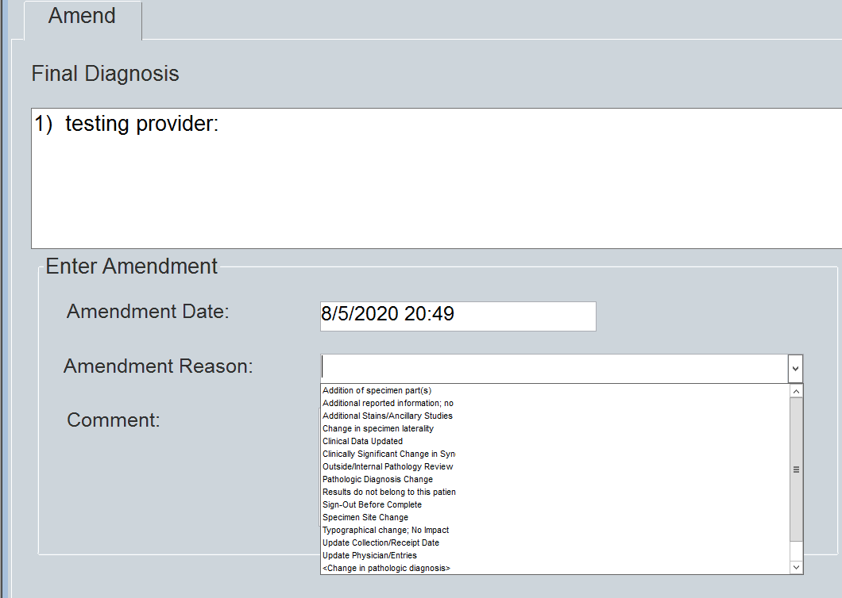
Top 10 Things to Know for Daily Work
Once you create a corrected report, you cannot undo it, you can only edit it
#7 – How to create and edit a corrected report

Slide 6
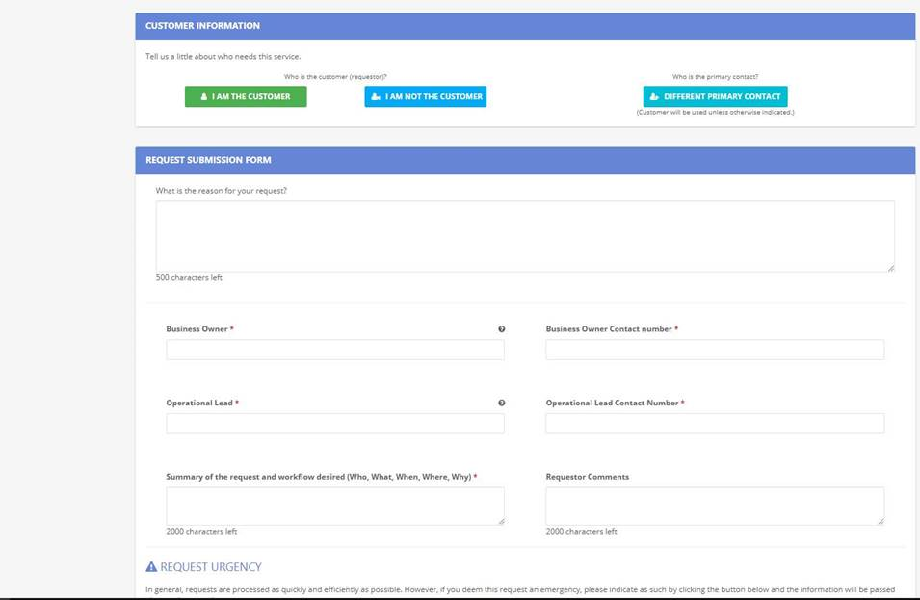
Top 10 Things to Know for Daily Work
#6 – How to submit a Pegasus Request for LIS

Slide 7
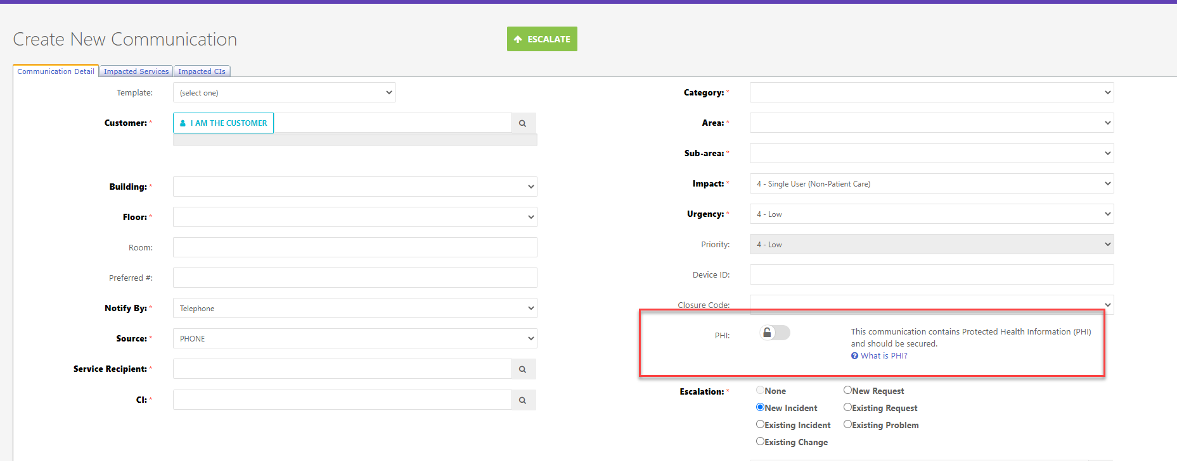
Top 10 Things to Know for Daily Work
#6 – How to submit a Pegasus Request for LIS

Slide 8
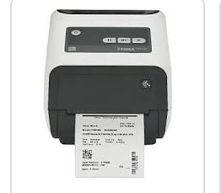
Top 10 Things to Know for Daily Work
How do you power cycle a Zebra printer without restoring to factory default:
Power off: Press and hold down the power button located on the top of the printer for 3-4 secs, release button when all LED lights go dark.
Power on: Press and hold down the power button for 2-3 secs, release button when you see all the LED lights flash on
https://www.youtube.com/watch?v=e8J99iLzCaU
#5 – How to perform routine maintenance on your zebra printers

Slide 9
Top 10 Things to Know for Daily Work
#4 – Do not choose a CSN (Encounter) with missing location or patient type

Slide 10
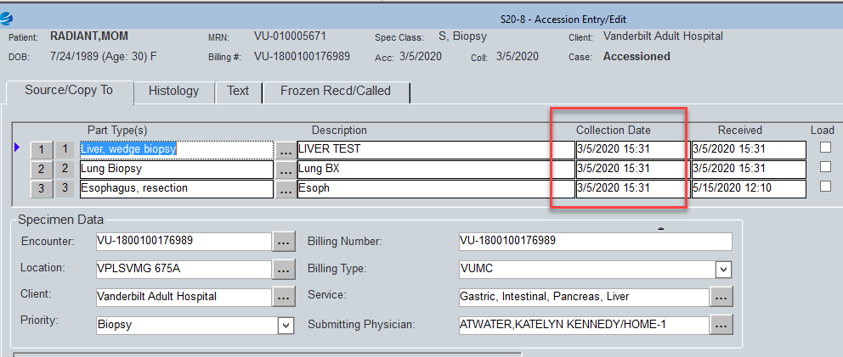
Top 10 Things to Know for Daily Work
DOS in accession window must be modified by staff
DOS in billing window must be modified by pathology billing because it will require an ICD code. Please contact pathology billing when you have completed your accession window change.
Log into Millennium Charge Viewer in Millennium to absorb charges (if patient bill)
#3 – How to correct a wrong DOS before case is signed out

Slide 11
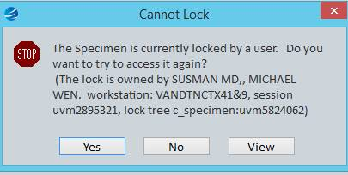
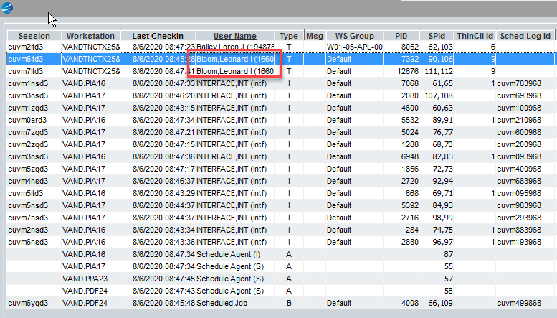
Top 10 Things to Know for Daily Work
#2 - How to prevent & resolve a locked case

Slide 12
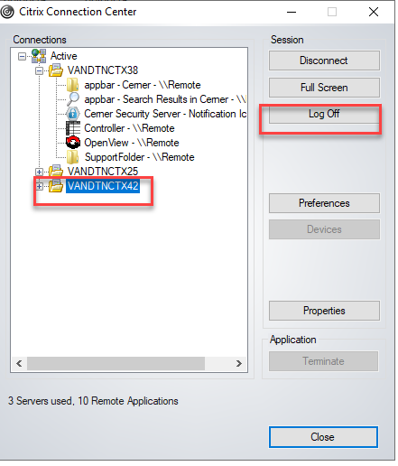
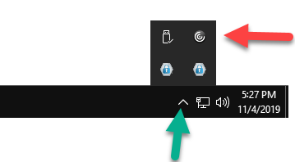
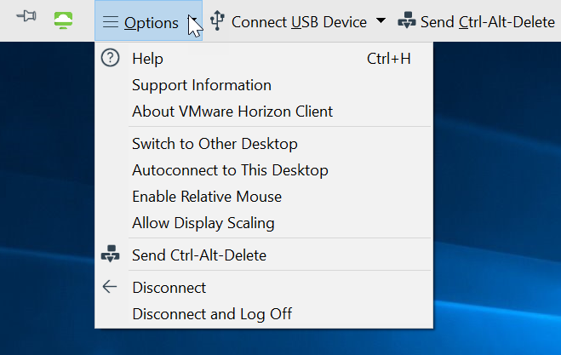
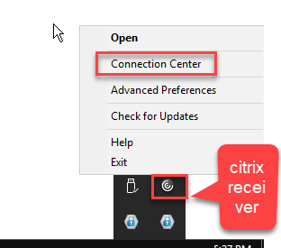
Top 10 Things to Know for Daily Work
VDI
Citrix
#1 – How to resolve word crashes

Slide 13
Top 10 Things to Know for Daily Work
LIS ENHANCEMENT REQUEST FORM FOR CLINICAL LAB
LIS ENHANCEMENT REQUEST FORM FOR ANATOMIC PATHOLOGY (AP)
LIS QUESTION REQUEST
LIS MAINTENANCE- APPLICATION SECURITY INACTIVATE REQUEST MILLENNIUM COPATH SOFT
LIS MAINTENANCE- APPLICATION SECURITY ADD REQUEST MILLENNIUM COPATH
LIS MAINTENANCE- STAIN ADD MODIFY REQUEST
LIS MAINTENANCE- VERIFY PROVIDER IN LAB INFORMATION SYSTEMS
LIS MAINTENANCE- CERNER FAX DISTRIBUTIONS FOR CLIENTS ADD_MODIFY_INACTIVATE
LIS MAINTENANCE- APPLICATION SECURITY ADD REQUEST SOFTBANK
LIS MAINTENANCE- STAIN INACTIVATION REQUEST
LIS MAINTENANCE- ICD10 IMPORT FILE FOR COPATH
LIS MAINTENANCE- ICD10 IMPORT FILE FOR MILLENNIUM
LIS MAINTENANCE- ICD10 IMPORT FILE FOR SOFTBANK
LIS MAINTENANCE- INSTRUMENT SERIAL NUMBER UPDATE
LIS MAINTENANCE- APPLICATION SECURITY ADD REQUEST_VPLS STARPANEL DATABASE
LIS MAINTENANCE- APPLICATION SECURITY NATURAL LANGUAGE SEARCH REQUEST FOR COPATH
LIS MAINTENANCE- BILLING CODE EAP_CPT MODIFICATION IN MILLENNIUM
LIS MAINTENANCE- MERGE-PATIENT AND ENCOUNTER MERGE
LIS MAINTENANCE- VPLS CERNER NEW CLIENT SETUP FOR CLIENT BILL CLIENTS
LIS MAINTENANCE- VPLS CERNER CLIENT INFORMATION MODIFICATION
LIS MAINTENANCE- CPT ANNUAL UPDATES
LIS MAINTENANCE- WORD PROCESSING TEMPLATE (WPT) ADD_MODIFY_INACTIVATE FOR MILLENNIUM
LIS MAINTENANCE- BLOOD GAS REPLACEMENT REQUEST (RT AND CORE LAB USE ONLY)
Take Home Message: Please report any unusual occurrences

Slide 14
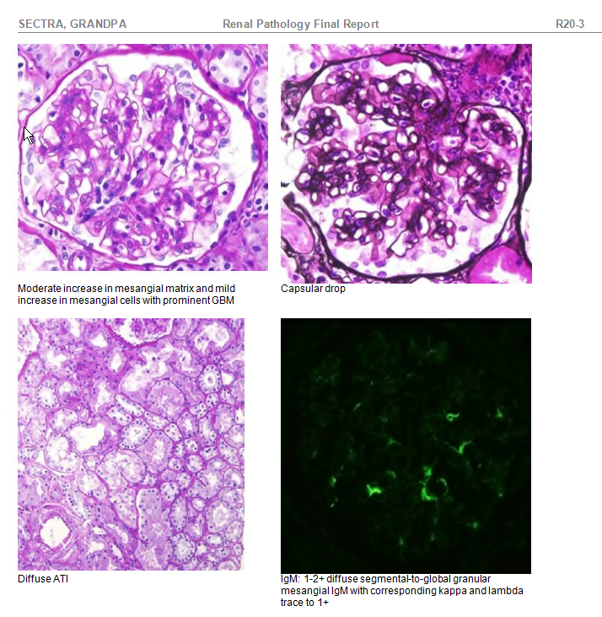
Top 10 Things to Know for Daily Work
Copath upgrade: Late Fall/Early 2021: New text editor, remove MS Word
Picsplus: approx. 1 Month: scan requisitions, images; display images on reports
Add-on Specimen class: Billing items > 30 days
Upcoming Events

