Slide 1
Haiku

Slide 2
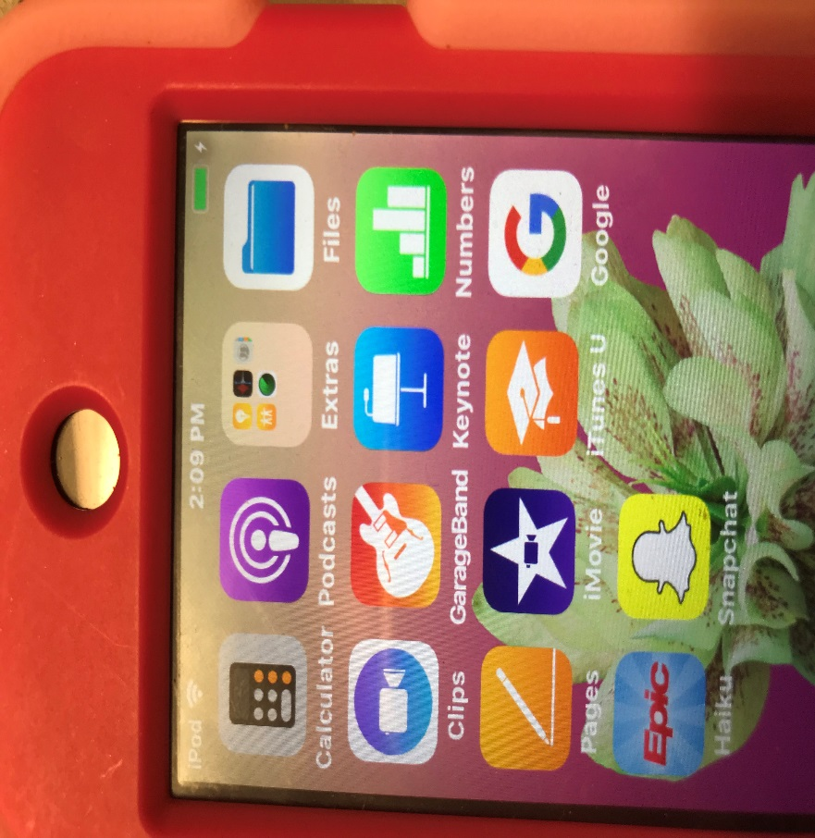
Haiku
A photo can be taken with staff’s I-pod or
I-phone with the Haiku app

Slide 3
Sign in using your Vanderbilt log-on

Slide 4
Your patient list will pop up

Slide 5
After you click on your patient, in the upper left corner is a picture of the patient or where one could be, click the picture

Slide 6
Click on top Icon which reads ”Capture Clinical Media”

Slide 7
You will then take your picture. If you want to keep this picture, click on “Use Photo”

Slide 8
Don’t forget to save it!

