Slide 1
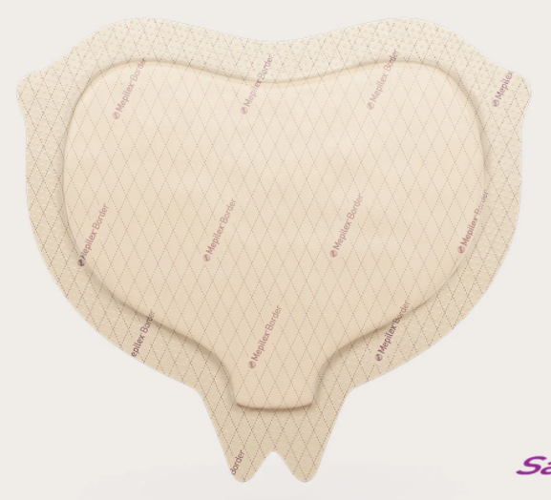
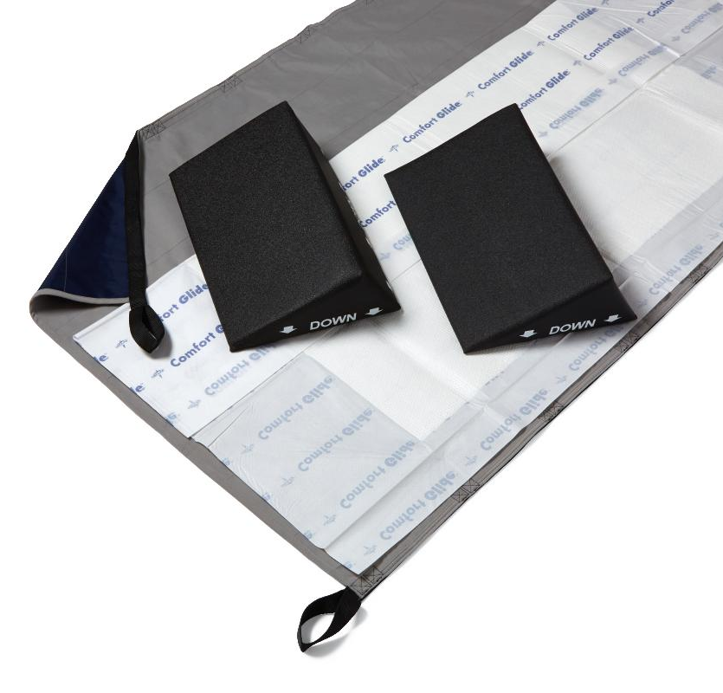
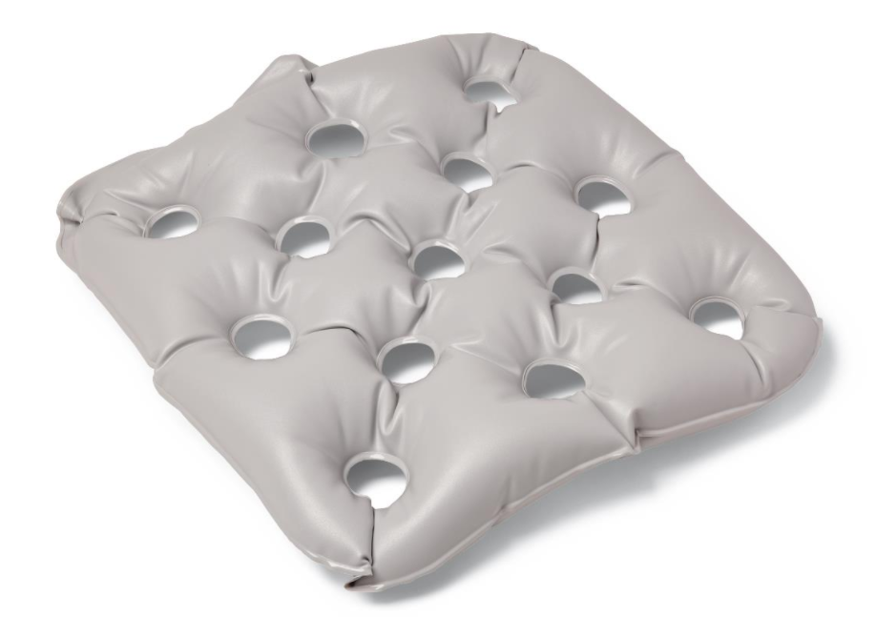
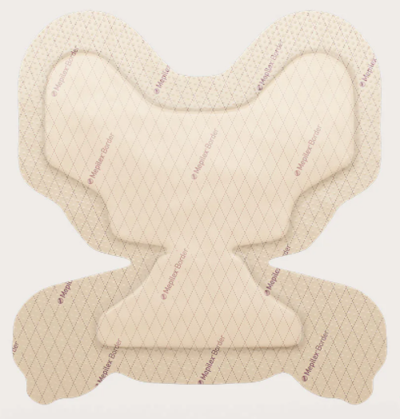
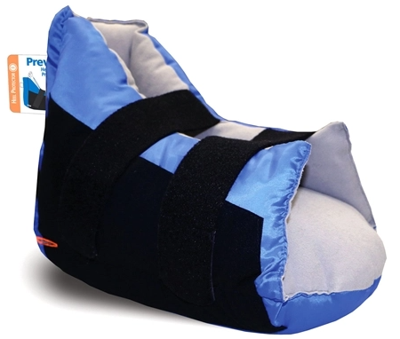
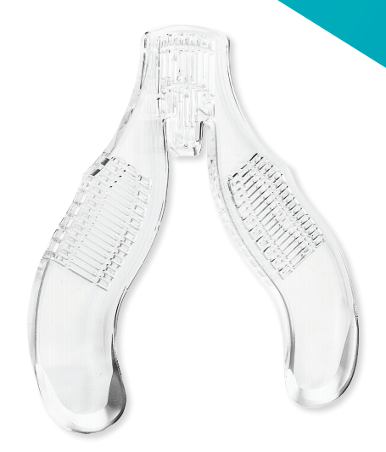
Pressure Injury Prevention Items Vanderbilt University Adult Hospital (VUAH)
https://www.vumc.org/pip/resources
Sacral Mepilex #84549
Utilize anywhere on body.
Don’t use if consistently incontinent.
Does NOT take the place of turning!
Medline Comfort Glid Repositioning Sheets and Wedges
Standard: #112080 and #112084
Bariatric: #119381 and #119382
Reduces shear/ friction during bed mobility.
Helps to offload sacral/ ischial areas for prevention.
Mepilex Flex #84931
Utilize anywhere on body.
Great under devices!
Medline Chair Cushion
Standard #84931
Bariatric #89576
Should be used for at risk patient in chair.
Does NOT take the place of repositioning your patient while in chair!
Mepilex Heel #137351
Utilize anywhere on body.
Use WITH offloading boots.
Does NOT take the place of floating heels!
Prevalon Offloading Boot #23615
Use WITH Mepilex Heel.
Does NOT take the place of floating heels!
Ensure heel is in “pocket” every time you move patient.
Protecta-Gel
Available per request from Respiratory Therapy.
Utilize under CPAP/ BiPAP or other devices.
For the bridge of nose/ face area.

