Slide 1

Pressure Injury
Champion Training
2021

Slide 2
Topics
Overview of process change
Pressure Injury (PI) definition
Risk assessment
Prevention
Staging/Challenges
Moisture Associated Skin Damage (MASD)
Measurement of Pressure Injuries
Documentation
Using HAIKU

Slide 3
Objectives
As a result of this course, VUAH RNs will be able to:
Accurately identify and stage pressure injuries according to NPIAP guidelines
Perform the responsibilities of the Skin Champion role in accordance with VUMC policies

Slide 4
Process Changes
Unit pressure injury champions (established 2019)
Champions will serve as a second set of eyes to assess the suspected pressure injury of each patient:
    When a pressure injury is initially identified on admission
    When a pressure injury is identified during the hospital stay
    When a pressure injury has been assessed as declining/deteriorating
    When a patient with a known pressure injury is discharged
Champions will co-sign the documentation in Epic
Pressure injury measurements
Photographing pressure injuries SOP (discussed later in presentation)

Slide 5
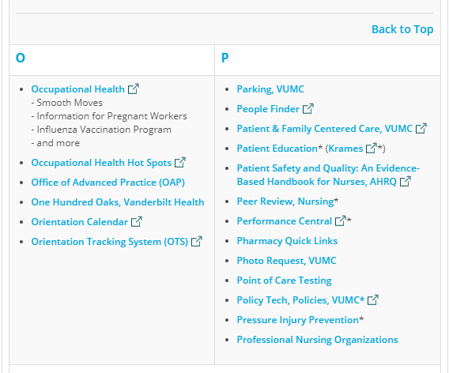
Pressure Injury Prevention (PIP) Website
www.vumc.org/pip
Nursing at Vanderbilt→ Employee Resources →Quick Links → Pressure Injury Prevention
Includes resources, guidelines, meeting minutes
www.vumc.org/pip

Slide 6
Definition

Slide 7
PI Definition
A pressure injury is localized damage to the skin and/or underlying soft tissue usually over a bony prominence or related to a medical or other device. The injury can present as intact skin or an open ulcer and may be painful. The injury occurs as a result of intense and/or prolonged pressure or pressure in combination with shear.
The tolerance of soft tissue for pressure and shear may also be affected by:
  Microclimate
  Nutrition
  Perfusion
  Co-morbidities
  Condition of the soft tissue
Re-defined by the NPUAP during the 2016 Staging Consensus Conference
Notes:
Redefined by the National Pressure Ulcer Advisory Panel (NPUAP) in 2016. Terminology changed from pressure ulcer to injury. The terms "decubitus" and "bedsore" are outdated

Slide 8
Risk Assessment

Slide 9
Braden Risk Assessment Scale
Sensory perception – Ability to respond meaningfully to pressure-related discomfort
Moisture – Degree to which skin is exposed to moisture
Activity- Degree of physical activity
Mobility – Ability to change and control body position
Nutrition – Usual food intake pattern
Friction & Shear
Notes:
Friction = Rubbing. Shear is mechanical force parallel to the tissue. Friction may contribute to the development of PI’s because of the SHEAR it creates.

Slide 10
Braden Scale
VUH at risk score = 18 or less
If patient has existing PI they should be considered “at risk” regardless of Braden
Interventions to reduce PI risk target the Braden sub-scores (see PIP TIP sheet)
Sub-score definitions and suggestions for intervention items are also found in e-Star sidebar
Assess risk on admission, q shift, AND any with any significant change in patient condition (surgery, decline, etc.)

Slide 11
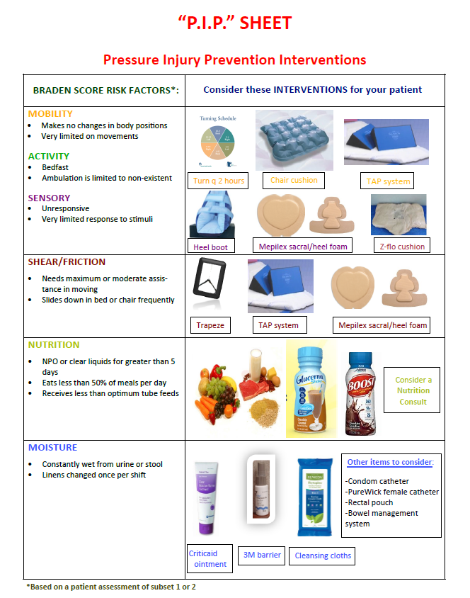
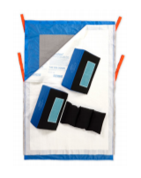
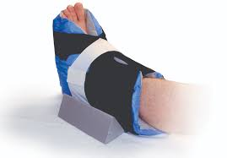
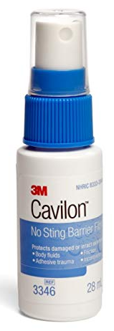

Slide 12
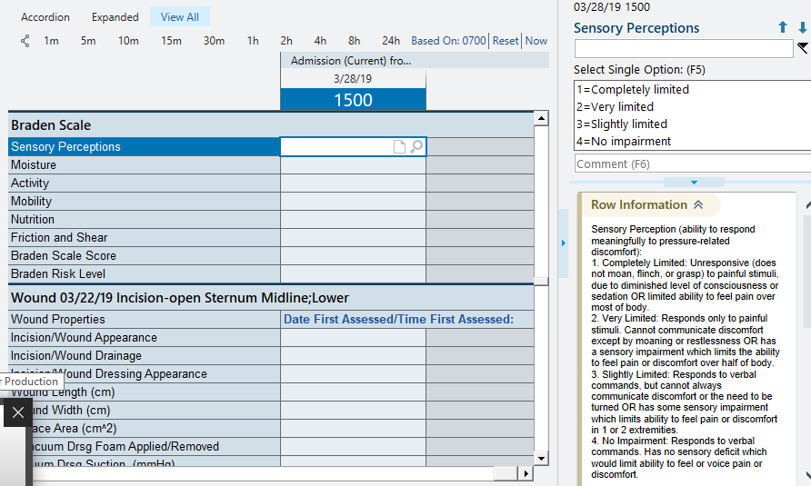
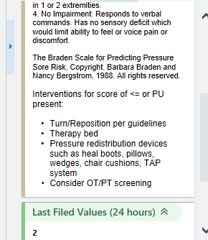
e-Star Braden row info

Slide 13
Assessment
  Starts with a THOROUGH SKIN ASSESSMENT
  Head to toe, front & back!
  Remove dressings
  Pay close attention to bony prominences + devices
  May be more subtle in dark pigmented skin
  Combine with history to help determine etiology
  Look and FEEL (for temperature change, bogginess or induration)
  Good lighting is important
  When a LDA is started there should be an associated assessment (not just “dressing in place”)
Notes:
With a PI you would EXPECT some degree of immobility (or recent history of); Similarly with moisture you would expect incontinence (or history of).

Slide 14
Why is it important to recognize PI’s present on admission (POA)?

Slide 15
Prevention
Always the goal!

Slide 16
VUH Pressure Injury Prevention & Treatment Guidelines
Roadmap
Initiated on all patients determined to be at risk and/or who have a pressure injury
Provides specific dressing selection based on stage
Interventions listed in left-hand (prevention) column should also be implemented for any PI
Orders for wound care/dressing changes by provider, WOC Nurse, or Complex Wound would supersede guidelines
Most important intervention is to RELIEVE/OFFLOAD PRESSURE!

Slide 17
When to Consult
Stage 1 or 2:
No consult needed unless deterioration noted despite offloading and use of treatment guidelines
DTI:
Consult Simple Wound
Stage 3, 4, Unstageable:
Notify Team. Request consult to Complex Wound (Provider must consult)

Slide 18
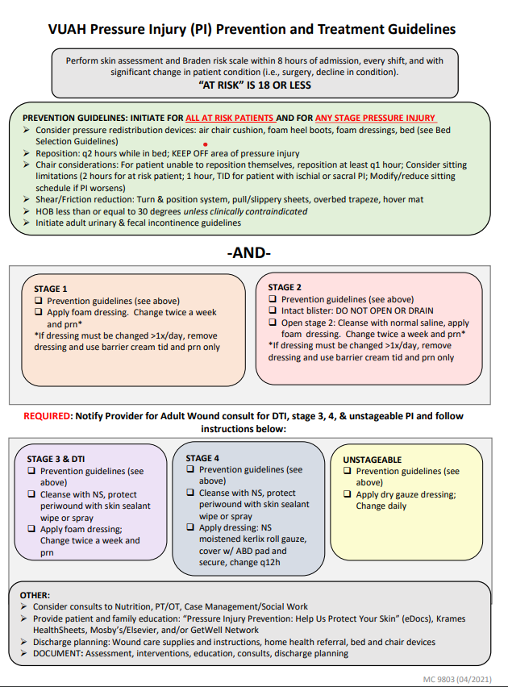
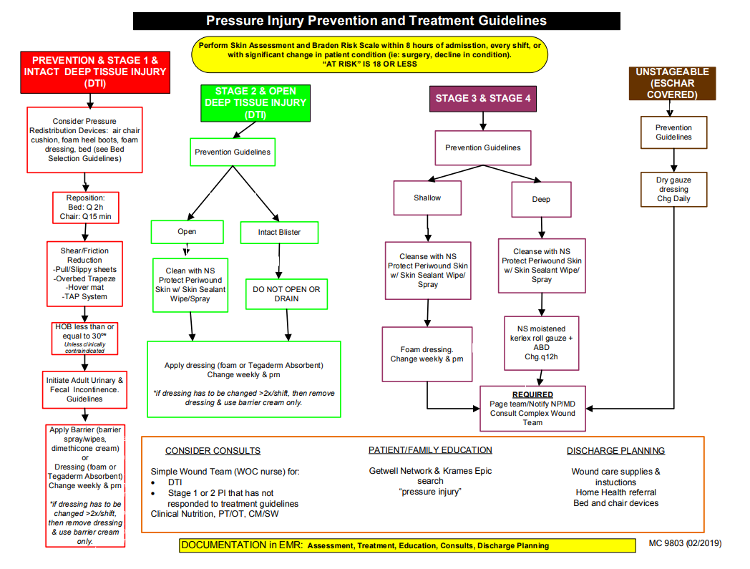
Updated Version "New Look"
Previous Version

Slide 19
CONSULTS
New process
Adult Ostomy/Fistula/Tube
Adult Wound
Complex Wound Team currently triaging all wound consults
Must be entered by provider

Slide 20
Prevention
Must make prevention a PRIORITY
As skin champions, look around your unit for opportunities for improvement:
Are heels being offloaded?
How can routine turning be improved? (Buddy system, other ideas?)
Share resources/knowledge with your colleagues

Slide 21
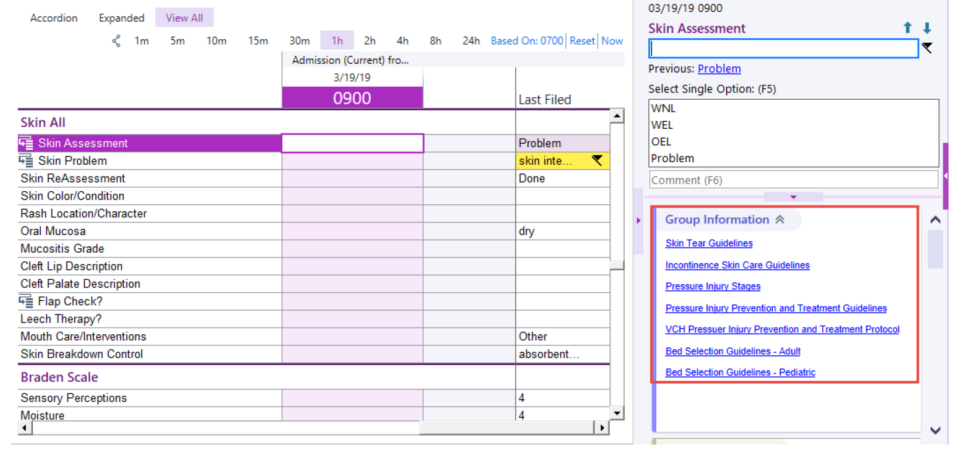
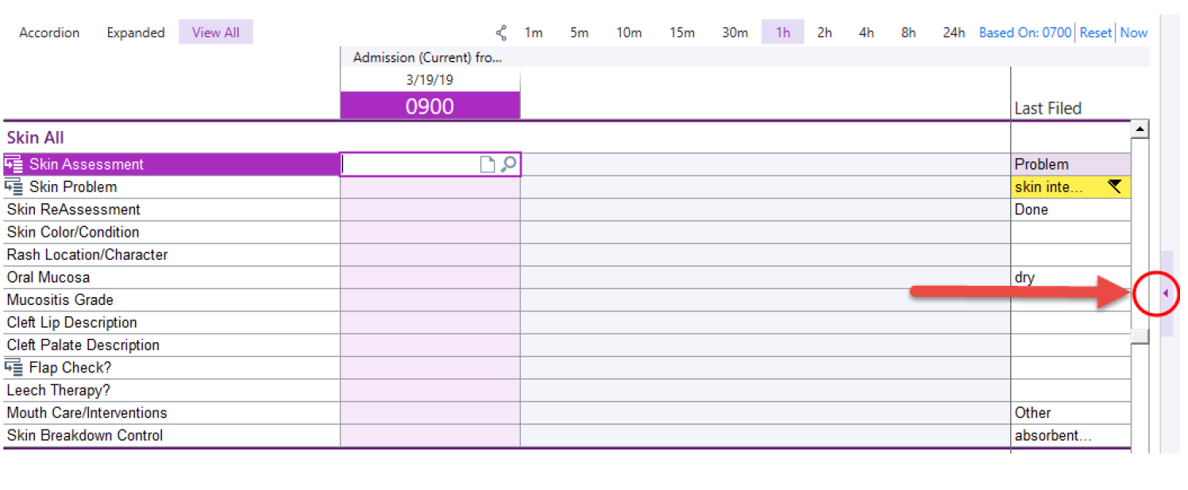
eStar Resources: Click to expand to access links

Slide 22
Scenario
Patient is a 68-year-old female with past medical history of DM 2, liver failure, prior CVA with residual right-sided weakness who presents to Vanderbilt from an outside hospital with concern for sepsis secondary to UTI versus pneumonia. Started on broad spectrum abx. Hospital course complicated by acute anemia and poor oral intake.
Nurse to nurse report:
Pt follows commands but is weak. Requires 1 assist for meaningful repositioning and has some difficulty keeping positioned to the side with pillows, so the nurse ordered a TAP system. She has orders to get up to chair BID.
Foley catheter, recently started lactulose. Edematous w/weepy legs
Braden = 13
Has a left buttock PI that is POA. The nurse staged it as a “2” but isn’t sure if this is correct

Slide 23
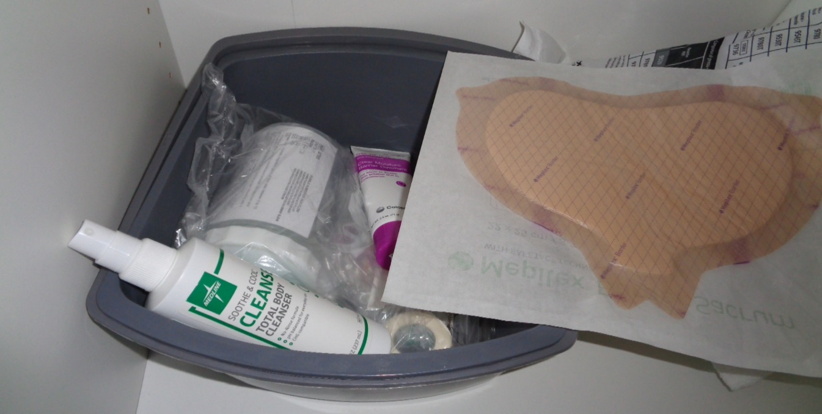
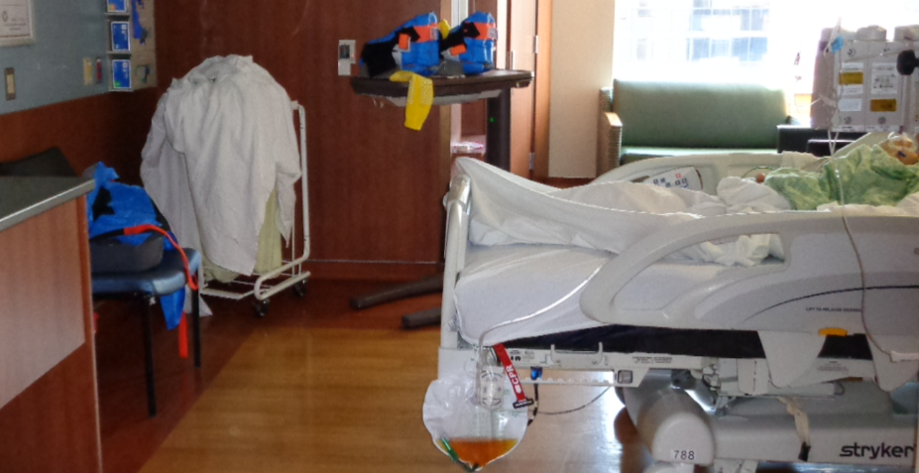
You walk in the room and this is what you notice:

Slide 24
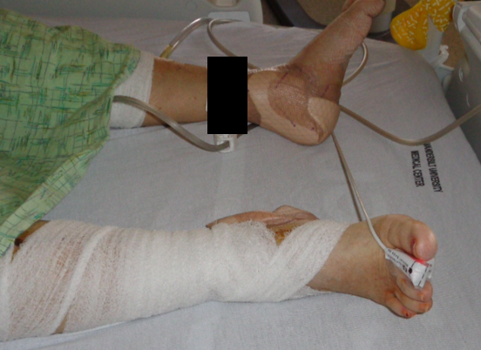
You remove the covers
Let’s stop and talk about what you have noticed. The good, the bad, and the ugly!
What could be done to improve prevention interventions?

Slide 25
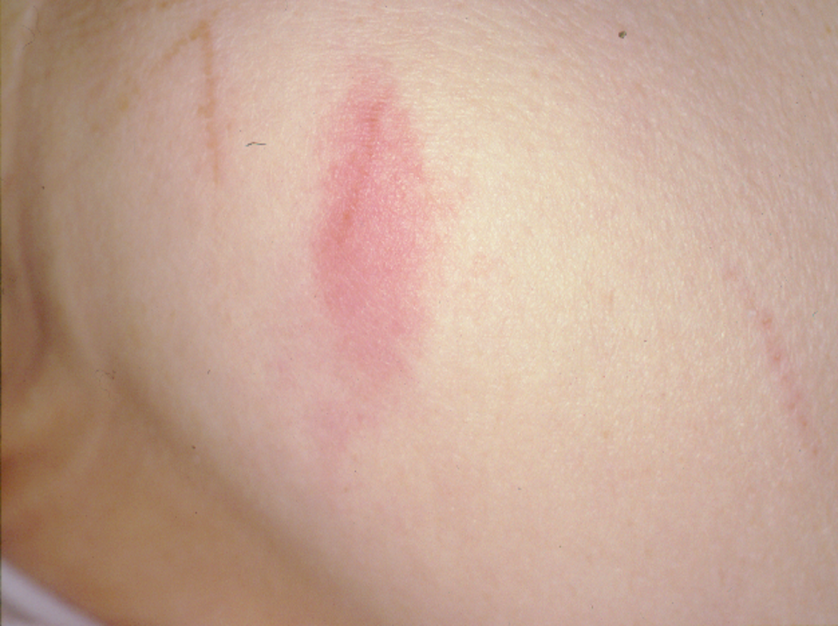
You assess the buttock wound
What stage is this?
How would you describe it in your notes?

Slide 26
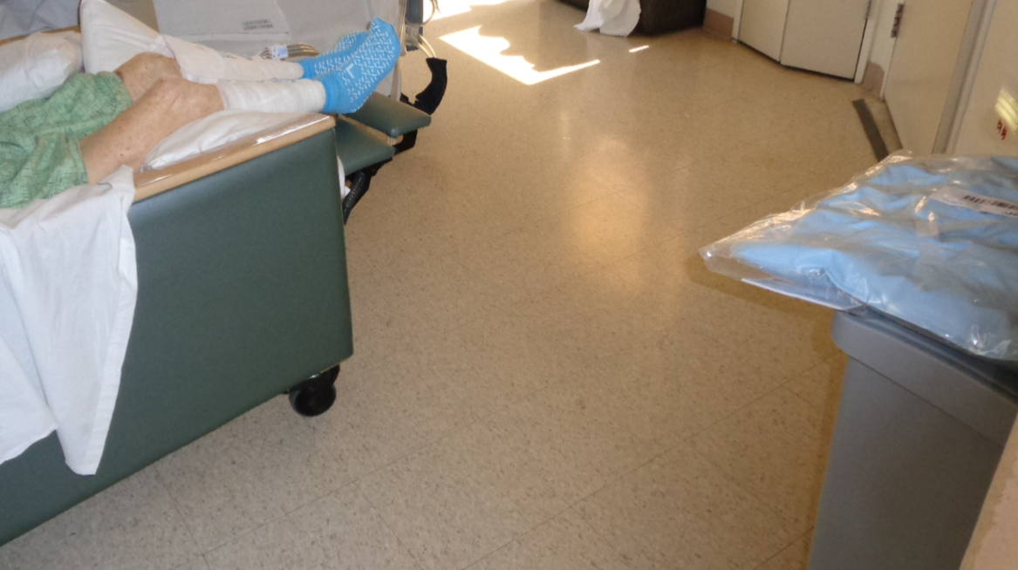
Later that afternoon you return.
The patient is now up to the chair.
What’s wrong in this photo?

Slide 27
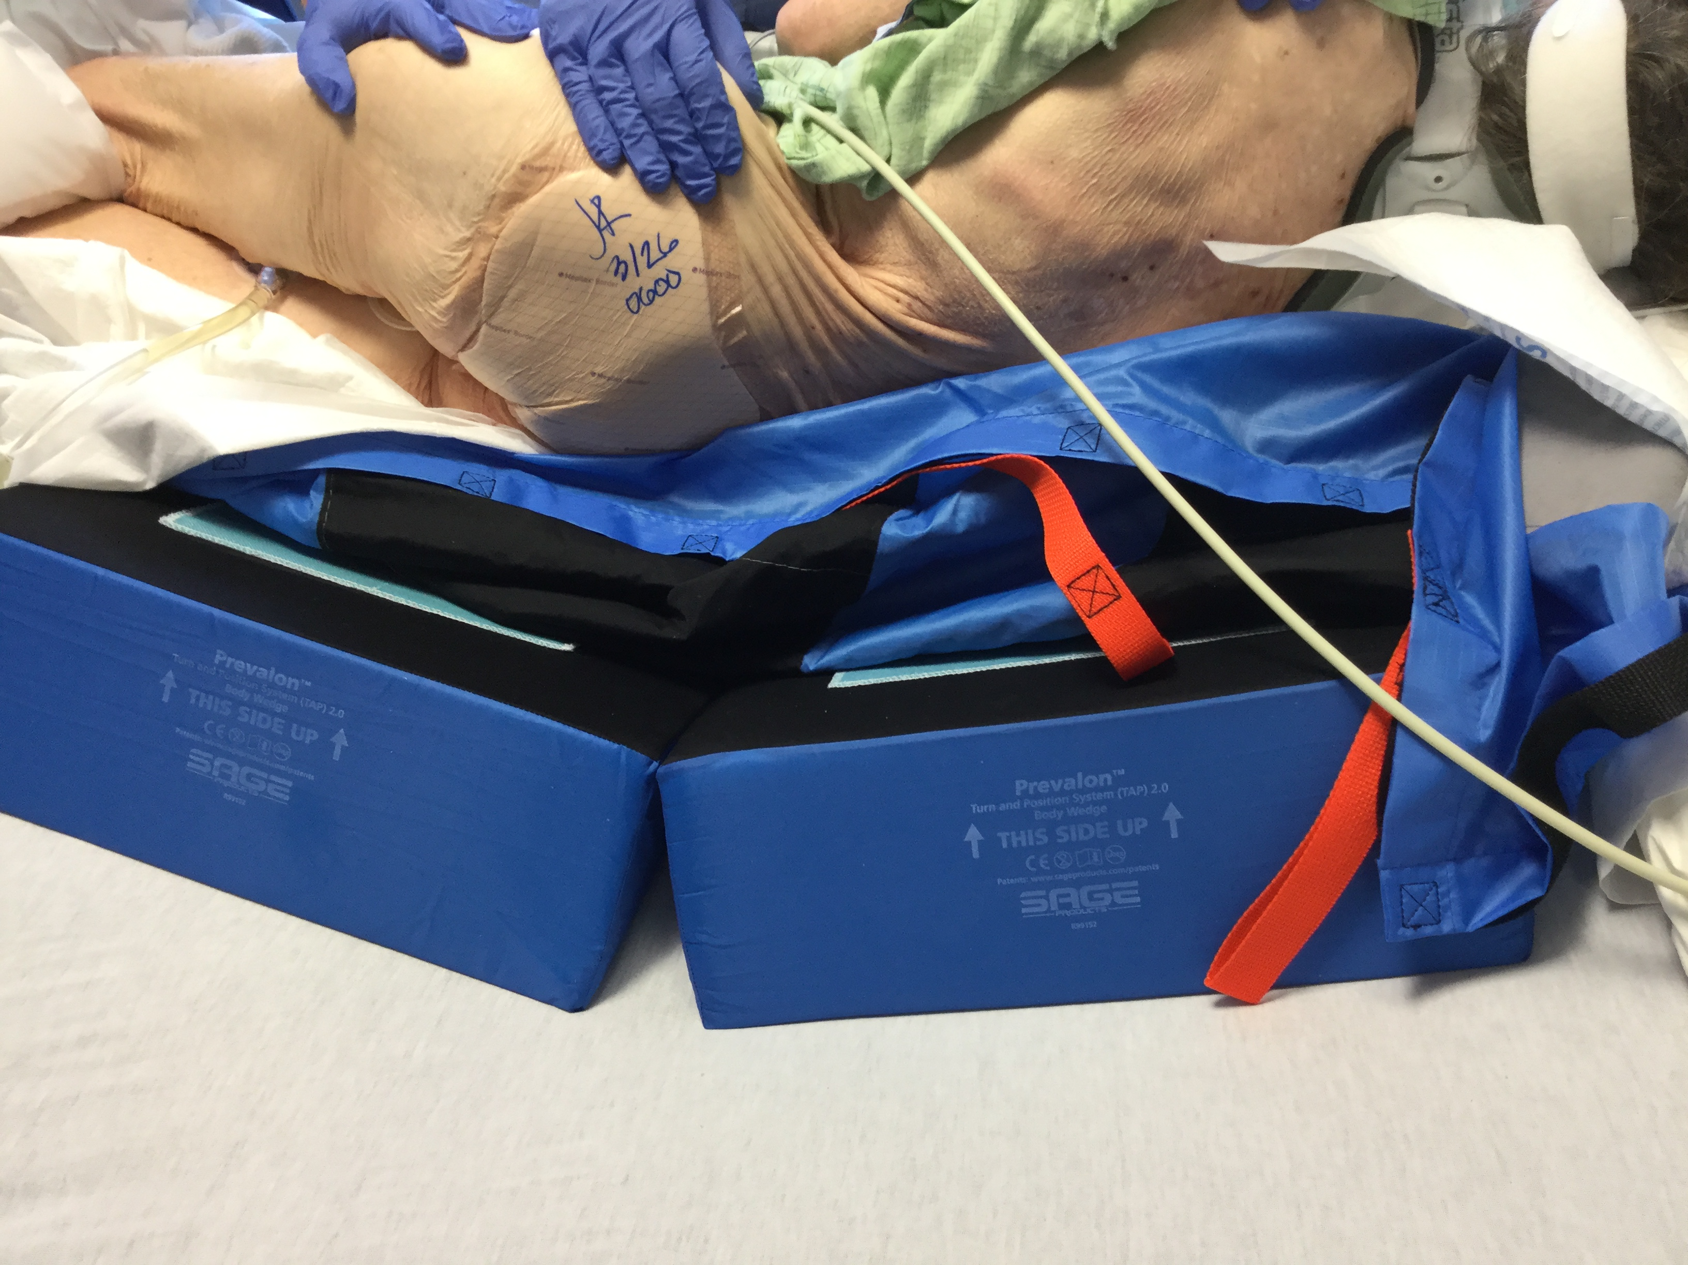
You assist them back to bed and turn them to the right side with wedges
What is wrong with this picture?

Slide 28
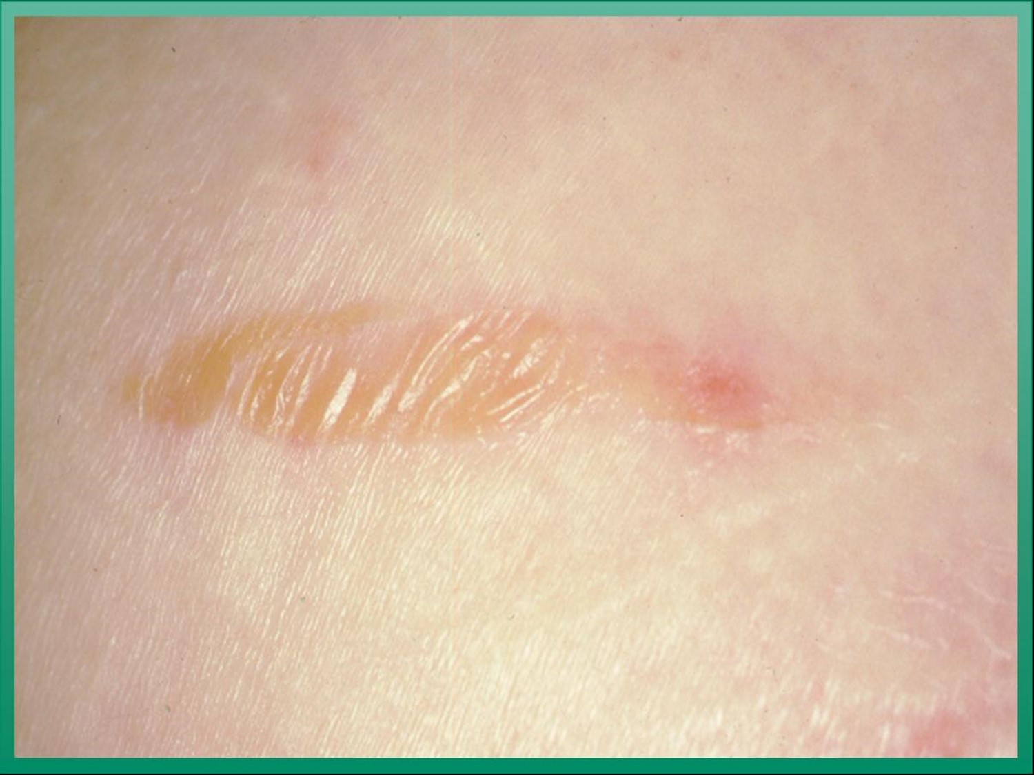
Three days later the nurse approaches you with concern that the PI is “worse”.
Initial assessment
Follow-up assessment
Is it better or worse now? Why or why not? What would you stage it now?

Slide 29
Staging & Challenges

Slide 30
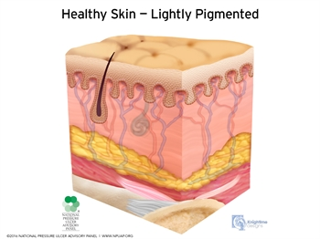
PI Stages
Stage 1
Stage 2
Stage 3
Stage 4
Unstageable
Deep tissue injury (DTI) or Deep tissue pressure injury (DTPI)
Mucosal
NPIAP Staging Definitions available at: https://cdn.ymaws.com/npiap.com/resource/resmgr/online_store/npiap_pressure_injury_stages.pdf
Notes:
Another change in 2016: roman numerals used in staging are now Arabic numerals
Often at bony prominences but not always!! Don’t forget about medical devices

Slide 31
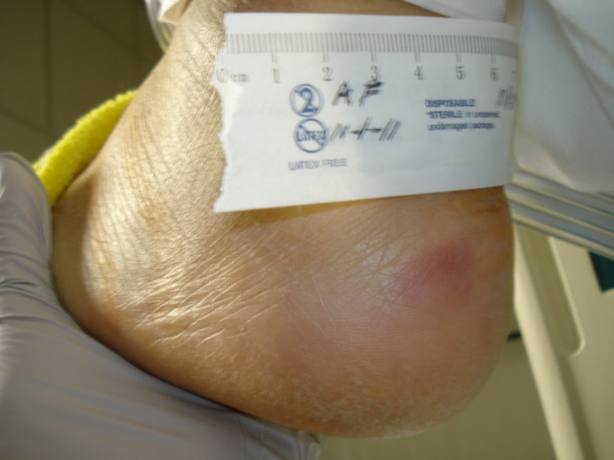

Stage 1:
Non-blanchable erythema
Intact skin with localized area of non-blanchable erythema,
May appear differently in darkly pigmented skin.
Blanchable erythema or changes in sensation, temperature, or firmness may precede visual changes

Slide 32
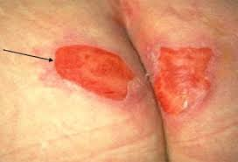
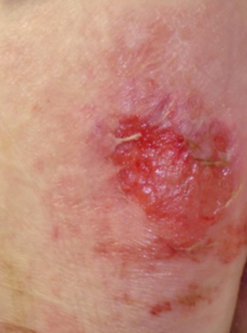
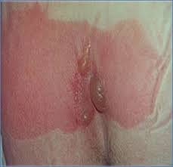
Stage 2:
Partial thickness skin loss
Partial-thickness loss
Viable, pink or red, moist or intact or ruptured serum-filled blister
Adipose (fat) is not visible and deeper tissues are not visible

Slide 33
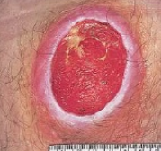
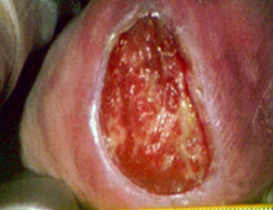
Stage 3:
Full-thickness skin loss
Full-thickness loss
Adipose (fat) is visible
Granulation tissue (beefy red), slough and/or eschar may be visible. Depth varies by anatomical location
Undermining and tunneling may occur

Slide 34
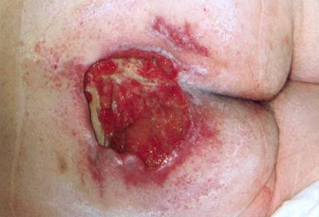
Stage 4:
Full- thickness skin and tissue loss
Full-thickness skin and tissue loss
Exposed or directly palpable fascia, muscle, tendon, ligament, cartilage or bone
Slough and/or eschar may be visible
Undermining and/or tunneling often occur
Depth varies by anatomical location

Slide 35
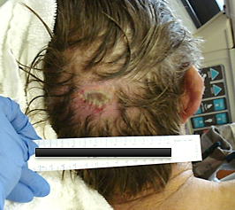
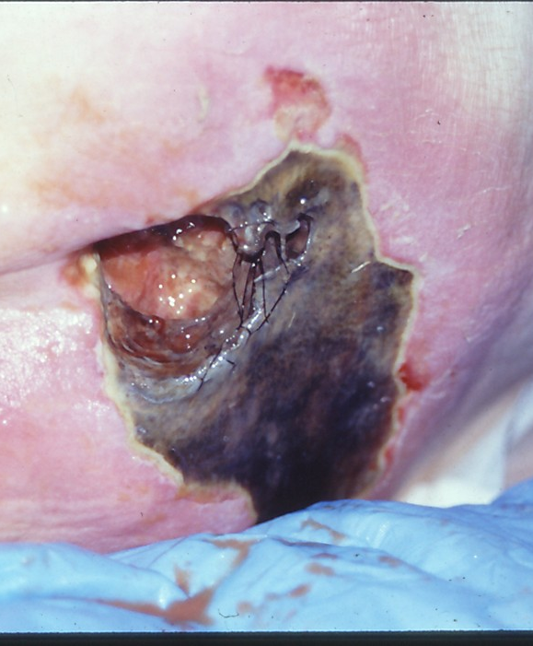
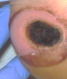
Unstageable:
Obscured full-thickness skin and tissue loss
Full-thickness skin and tissue loss
Extent of tissue damage cannot be confirmed because it is covered by slough or eschar
If slough or eschar is removed, a Stage 3 or Stage 4 pressure injury will be revealed.

Slide 36
DTI:
Deep Tissue
Injury
Intact or non-intact skin
Non-blanchable deep red, maroon, purple discoloration or blood-filled blister.
Results from intense and/or prolonged pressure and shear forces at the bone-muscle interface.
May evolve rapidly to reveal the actual extent of tissue injury or may resolve without tissue loss.
DTI’s usually change/evolve. If a DTI evolves, re-stage it once extent of injury is clear or if it becomes unstageable.

Slide 37
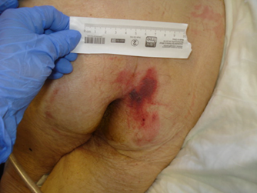
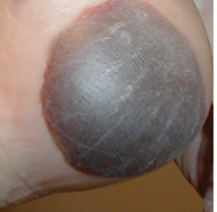
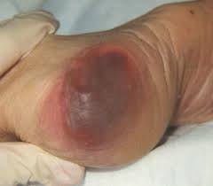
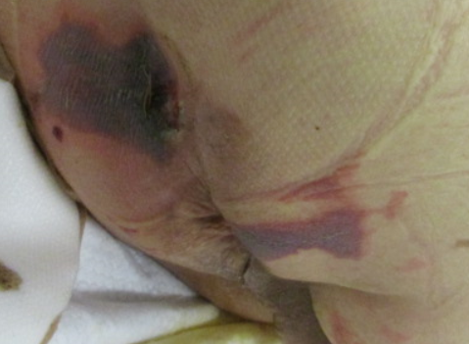
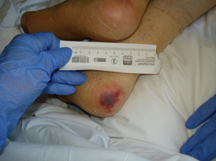
Deep Tissue Injury (DTI) examples

Slide 38
DTI: Is it just a bruise???
Can be mistaken for a bruise, skin tear, ischemia
Consider the history (Trauma? Falls? Long OR case?)
“Patient found down” = be prepared to find pressure injuries that often present as a DTI
Sometimes DTI’s are not visible until 24-72 hours AFTER the precipitating event
DTI’s “may evolve rapidly to reveal the actual extent of tissue injury, or may resolve without tissue loss”.
The topical treatment/dressing sometimes changes as the injury evolves but most important intervention is to keep the pressure off!

Slide 39
DTI Evolution (Day 1, 3, and 10)
Notes:
NOT NECESSARILY DECLINING OR DETERIORATING!!!

Slide 40
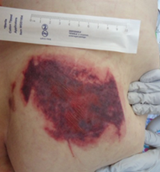
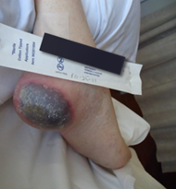
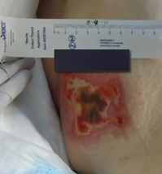
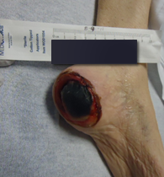
DTI Evolution (~ 2 weeks)
Now considered unstageable

Slide 41
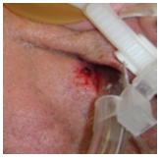
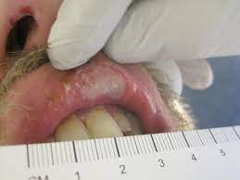
Mucosal
Found on mucous membranes with a history of a medical device in use at the location of the injury.
Due to the anatomy of the tissue these ulcers cannot be staged.

Slide 42
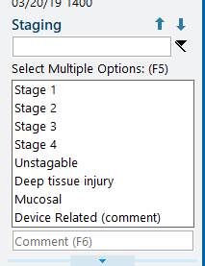
Device related PI
This describes an etiology
Results from the use of devices
Generally conforms to the pattern or shape of the device.
Staged using the staging system
Also click “device related” and indicate the device in comments

Slide 43
Thought Process for Staging
Where is the breakdown? Over a bony area? Under a device?
Is the skin intact or not intact? If not intact, is the injury shallow? (stage 2) or deeper? (stage 3+)
What color? Purple = DTI
Can you see any fat (stage 3), muscle/bone/tendon (stage 4)?
Is there black/yellow/brown tissue obscuring the wound base? (Unstageable)
Is the injury on the mucosa (i.e. lip, etc)? (Mucosal)

Slide 44
What we DON’T stage
Skin tears
Moisture Associated Skin Damage (MASD)
Diabetic foot ulcers
Arterial/Venous ulcers
Abrasions
**A “Wound” LDA should be opened for these types of wounds which does not have a staging row.

Slide 45
Staging Challenges
Even WOC Nurses have difficulty with identification and staging!
More difficult with dark pigmented skin
Assess for variations in sensation, temperature, firmness, color
After flap/graft repair the PI is then considered a surgical wound

Slide 46
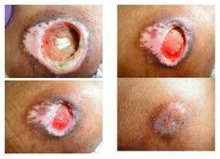
Do Not Reverse Stage
        Stage 4 does not become a stage 3, 2, then 1 as it heals
        As a PI heals it is staged according to the maximum anatomic depth (i.e. “healing stage 4”)
        Difficult in chronic wounds: a healing stage 4 can be shallow/small!
        Chronic wound- ask patient if they know stage or “do you know if there was ever bone exposed?”
        When you aren’t sure, stage according to your current assessment

Slide 47
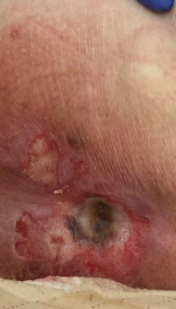
How would you stage and describe the following PI’s?

Slide 48
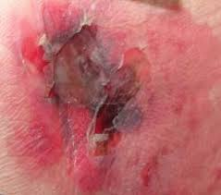
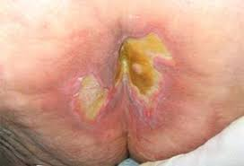

Slide 49
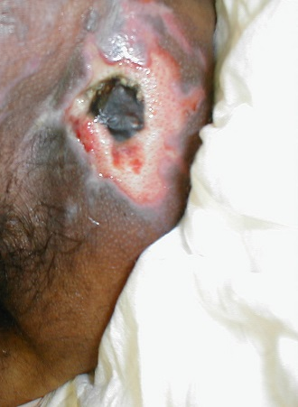

Slide 50
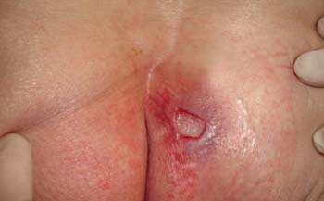
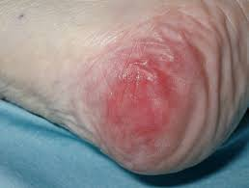
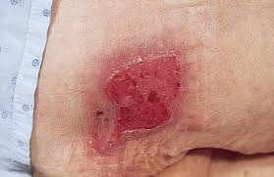

Slide 51
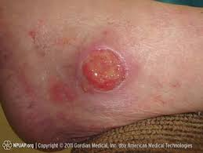


Slide 52


Initially documented as a “skin tear”… is it?
Notice larger area of darker discoloration
How would you stage?
Next photo is 7 days later. How would you stage now?

Slide 53
Moisture Associated Skin Damage (MASD)

Slide 54
Moisture Associated Skin Damage (MASD)
Caused by prolonged exposure to various sources of moisture
Use this category to document redness or breakdown caused by MOISTURE
Four sub-categories
        Incontinence (IAD)
        Skin folds (Intertriginous)
        Periwound
        Peristomal
Notes:
We will focus on IAD today

Slide 55
It’s not always a pressure injury!
IAD is often mistakenly labeled, and can sometimes co-exist
Can be difficult to distinguish between IAD, stage 1, and stage 2 PI’s
IAD puts patient at higher risk for PI: There is a link!
      IAD + immobility = significantly increased likelihood of developing full thickness sacral PI (Gray, M. and Karen, K. 2018)
      Patients with fecal incontinence or dual incontinence more likely to develop IAD versus urinary incontinence alone
It’s not always the sacrum!

Slide 56

Pressure versus IAD
Table 1: Differentiation of IAD Versus Stage I and II Pressure Ulcers from
Black JM, Gray M, Bliss DZ, et al. MASD Part 2: Incontinence-Associated Dermatitis and Intertriginous Dermatitis: A Consensus. Journal of Wound, Ostomy & Continence Nursing. 2011;38(4):359-370.

Slide 57
What am I looking at?
(It’s not always easy to tell)

Slide 58

The challenge
Put your detective hat on
Couple the assessment with the patient history
Make best determination based on history and assessment

Slide 59


Sometimes a moisture problem is easy to identify

Slide 60



Sometimes it’s more difficult: Pressure/Moisture combination?

Slide 61


Is it pressure?

Slide 62


Is it pressure?

Slide 63


Is it pressure?

Slide 64

Challenge in identification
Patient in recliner for several days at home, son unable to move her
Dark purple consistent with DTI but widespread area
Suspected combo of pressure AND moisture

Slide 65

Challenge in identification
Evolution process
Overall area is smaller, but pressure related areas are becoming more clear/defined

Slide 66
Documentation

Slide 67
Documentation
Document what you see and where you see it
Be as descriptive as possible
Identify if skin is intact versus open
Try to “paint a picture” with the documentation
A wound cannot be described with only one word
Must use free text/comment section to augment the choices in the EMR

Slide 68
What does this PI look like?
Initial assessment of a pressure injury states:
“Unstageable, Healing, Dressing in place”
  What color is the wound?
  Difficult to use “healing” on initial assessment unless clinician knows what wound looked like previously
  Must be more descriptive using flowsheet options under wound appearance

Slide 69

Wound Appearance options
Multi-select but use Comment (free text) to provide better description!

Slide 70
Using HAIKU
Taking photos

Slide 71
NEW! Photographing Pressure Injuries SOP
Photographs should be taken:
Within 24 hours of admission for POA
On initial discovery for hospital acquired injury
Weekly on Wednesday ("Wound Wednesday)
On day of discharge
Effective September 2020
Outlines process for photographing pressure injuries
Describes steps for using Haiku
Has example photos to show correct/incorrect methods

Slide 72

General Guidelines
Reminder: Photograph supports (but does not replace) good assessment
“Visual management scale” i.e. measuring guide is necessary for reference
Patient identification label: Date, initials, MRN #
Place ID/measuring guide near the wound and position so that it reads head-to-toe
Label photo with injury location

Slide 73

Example photo
Patient’s head

Slide 74


Using HAIKU
Login
Select the patient

Slide 75


Click the circle in the upper left corner with the silhouette or picture of the patient
Click Capture Clinical Media

Slide 76


Take the picture
If you want to keep it, click “Use Photo” or retake
ADD DESCRIPTION (i.e. sacrum, left heel, etc.)
Don’t forget to SAVE!

Slide 77


Find Photos in the Chart
Click on the Chart review button, then the “Media Tab”

Slide 78



Questions:
What body part(s) am I looking at?
Which way is up?
Must be able to identify what body part is being photographed! Enter location under description after taking photo before saving.

Slide 79
Measurement of Pressure Injuries

Slide 80
Measurement of Pressure Injuries
All pressure injuries should be measured by the staff nurse
Measurements need to be taken upon admission, discharge, on a weekly basis "Wound Wednesdays" and if any concern for deterioration.
Remember: Staff nurses will need guidance from their PI Champion on how to measure
Measurements are considered an essential element of PI documentation and are required as part of the policy

Slide 81
How to measure a pressure injury
Length x width x depth in centimeters
Head to toe orientation
Longest length from head to toe (12:00 – 6:00)
Widest width from side to side perpendicular to length (9:00 – 3:00)
Obtain depth by inserting a cotton-tipped applicator into the wound bed at the greatest depth and place a mark (or your thumb and index finger) at the level of the skin
Document measurements including depth in flowsheet

Slide 82

Wound measurement

Slide 83

Tunneling & Undermining
Seen in full thickness wounds (stage 3, 4, unstageable)
Tunneling: narrow channel or tract extending from the base of the wound
Undermining: area that extends under the skin along the edge of the wound. Often caused by shear.
Measured in cm using a clock face direction

Slide 84

Tunneling & Undermining

Slide 85
Co-signing the LDA
Both NURSE and SKIN CHAMPION have separate responsibilities
Auditing for compliance
Must achieve 100% compliance

Slide 86

NURSE responsibility
  Find their skin champion when they find a new pressure injury on admission or during hospital stay
  Find skin champion if they have questions or concerns
  NURSE starts the LDA
    Highlight stage/assessment data from the LDA rows
    Right Click; Select Request Cosign
    Identify user (Skin Champion) that will need to co-sign
    Click Accept

Slide 87

NURSE responsibility (cont.)
Nurse must send documentation in a timely manner; Co-sign MUST be done within 12 hours of starting the LDA
When a PI LDA is started, a worklist task will populate the Brain reminding the nurse that s/he will need to request a co-signer

Slide 88
SKIN CHAMPION responsibility
Identify
- Identify yourself as the skin champion in huddle at the beginning of the shift
Serve
- Serve as “2nd set of eyes” for staff nurse
Assist
- Assist nurse with staging and measurements
Co-sign
- CO-SIGN the request during the shift when PI was first assessed; must be co-signed within 12 hours of LDA start

Slide 89
SKIN CHAMPION workflow
2 methods available to
complete the requested co-sign
Directly from the flowsheet for whom the co-sign was requested; click Cosign Report
From the Patient List by wrenching in the Cosign Report on the report toolbar

Slide 90
Patient List

Slide 91

Directly from the flowsheet
Go directly to flowsheet in patient’s chart
Click Cosign Report
Click Needs Cosign
IMPORTANT! You cannot co-sign until you have been requested to do so

Slide 92
Summary of Process Change
Be a resource for your unit!
SECOND SET OF EYES of PI on admission/first identified, if deteriorating, and upon discharge
Assist with identification/staging as needed
Co-sign EMR
Assist RN with photo and measurements as needed
Assist with recommendations for prevention/interventions as needed

Slide 93
CONTACT INFO
WOC Nurse Team
Pressure Injury Preventionist
Triage pager: (615) 835-0481
Voicemail: (615) 322-6633
Lance Mailloux
Lance.p.mailloux@vumc.org

Slide 94
QUESTIONS???

