Slide 1
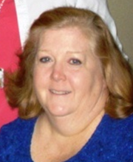
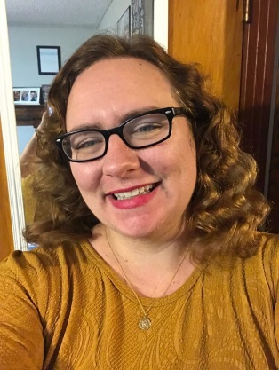
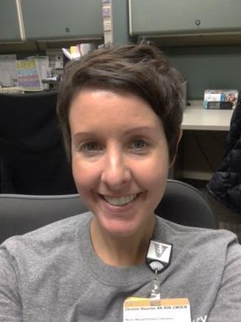
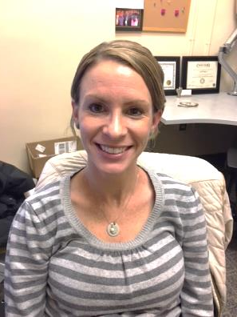
Wound, Ostomy, & Continence (WOC) Nurses
Sheree Lee (Manager), Martha Davidson, Candi Haggard, Marilyn Hargrove,
Shannon Lynch (VCH), Catherine Magee (VCH), Christine Reuscher, Britney Swor, Bonnie Thompson

Slide 2
Objectives
Pressure Injury (PI) Definition
Risk Assessment
Prevention
Documentation
Moisture Associated Skin Damage
Resources

Slide 3
Simple Wound/Ostomy Role | VUH Inpatient 615-835-0491 | VUH Outpatient 615-835-9829 | VCH 615-317-1680
Wound/Skin | Simple wounds PI stage 1/2/DTI PI prevention Prevalence surveys | No Wound clinic | Simple wounds High risk patients All PI’s Other skin issues Prevalence surveys
Ostomy | Pre-op teaching Stoma site marking Post-op teaching Pouching problems/skin issues
Tubes, Fistulas | Recommendations for management, containment, and/or skin care
Response time is 24 hours Monday-Friday
from time of consult (0800-1630)
WOC Nurse not available weekends and holidays
Notes:
Emphasize that VCH WOC Nurses should be consulted for any actual or suspected PI.

Slide 4
What is a pressure injury?

Slide 5
Pressure Injury
A pressure injury is localized damage to the skin and/or underlying soft tissue usually over a bony prominence or related to a medical or other device. The injury can present as intact skin or an open ulcer and may be painful. The injury occurs as a result of intense and/or prolonged pressure or pressure in combination with shear.
The tolerance of soft tissue for pressure and shear may also be affected by microclimate, nutrition, perfusion, co-morbidities and condition of the soft tissue.
Re-defined by the NPUAP during the 2016 Staging Consensus Conference.
Notes:
Redefined by the National Pressure Ulcer Advisory Panel (NPUAP) in 2016. Terminology changed from pressure ulcer to injury. The terms "decubitus" and "bedsore" are outdated.

Slide 6
QUICK Case Study

Slide 7
Case Study
24 y/o male
Admitted 1/28/17 for surgical consideration
Crohn’s disease with 2 month hx of worsening symptoms
Criteria met for moderate malnutrition
Surgery 2/3; OR time ~5hrs
Admission Braden= 20
Braden never less than 19
Wound discovered on 2/8; Braden= 21
Notes:
Good example of how PI’s can happen outside of ICU’s
This patient’s Braden was never less than 19
But he was malnourished (Crohn’s), went to surgery, didn’t want to get out of bed

Slide 8
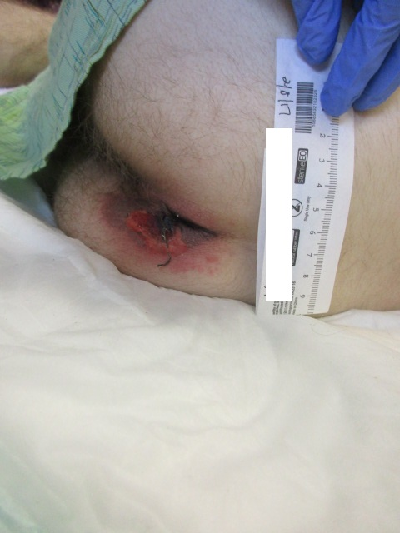
Deep Tissue Pressure Injury (DTI)
Notes:
Evolving DTI

Slide 9
Why is it important to recognize pressure injuries present on admission (POA)?

Slide 10
The Impact
Patient QUALITY OF LIFE
2008 Centers for Medicare & Medicaid Services (CMS) – stopped reimbursement for hospital acquired PI’s
Considered a “NEVER EVENT”
Patient care cost per PI $20,900-$151,700
60,000 patients die every year as a direct result of PI’s
Increased length of stay and readmission rates
Notes:
Statistics per the NPIAP Fact Sheet
No other preventable event occurs as frequently as pressure injuries

Slide 11
Why is this important to nursing?
Pressure injuries (PI’s) are often considered a reflection of NURSING QUALITY
PI’s and falls are the 2 most nursing sensitive quality indicators
Nursing has greatest impact on PREVENTION
YOU have the ability and responsibility to prevent harm to your patient

Slide 12
Braden Risk Assessment Scale

Slide 13
Braden Scale (Adults)
Sensory Perception
Moisture
Activity= Degree of physical activity
Mobility= Ability to change/control position
Nutrition= Usual intake pattern
Friction & Shear
VUH at Risk Score = 18 or less

Slide 14
Braden QD Scale (Children)
Mobility
Sensory
Friction & Shear
Nutrition
Tissue Perfusion & Oxygenation
Number of Medical Devices
Repositionability/Skin Protection (devices)
VCH at Risk Score = 13 or higher

Slide 15
Friction & Shear- what’s the difference?
Shear: The force exerted parallel to the tissue. One layer of tissue slides over another deforming adipose and muscle tissue and disrupting blood flow (NPUAP/NDNQI)
Friction: "The resistance that one surface or object encounters when moving over another" (Oxford Dictionary). Does not alone cause a PI but rather is a risk factor due to the SHEAR it creates

Slide 16
Our Goal:
PREVENTION

Slide 17
Pressure Injury Prevention & Treatment Guidelines
VUH (Adult) and VCH (Children)
Roadmap
Outlines interventions for prevention and treatment
Implement when a patient is at risk and/or whenever a pressure injury is identified
Links to this document available directly from eStar, eDocs, VUMC Nursing webpage

Slide 18
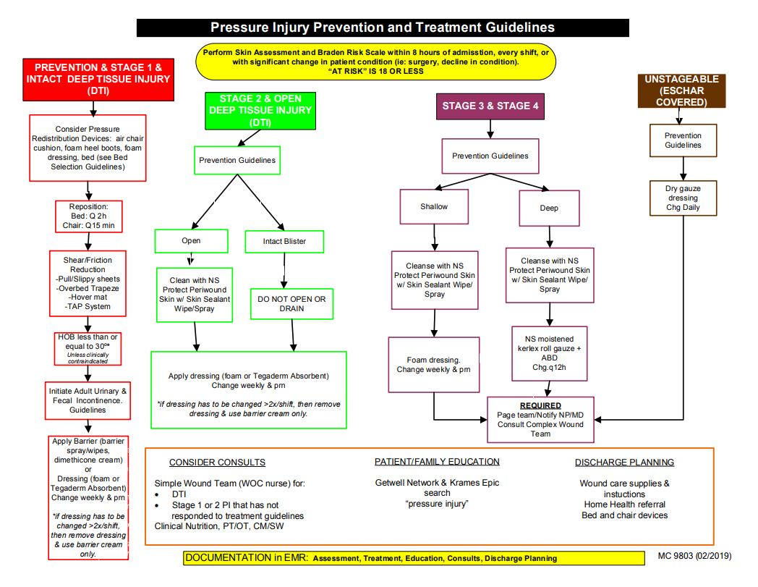
Notes:
Adult prevention and treatment guidelines

Slide 19
Notes:
VCH Prevention and Treatment- note that Simple Wound consult for all PI’s is required

Slide 20
FIRST: Thorough Skin Assessment
Head to toe, front & back!
Assess under devices
Remove dressings
Pay close attention to bony prominences
May be more subtle in dark skinned patients
Look and FEEL
Good lighting is important!
Notes:
It starts with a thorough SKIN ASSESSMENT. You have to turn the patient over! Remove dressings.

Slide 21
NEXT: Proactive Prevention
Implement prevention interventions
TURN/REPOSITION Q2h
Don't forget about the chair
Manage moisture/Protect from incontinence
OFFLOAD HEELS!!!
Be proactive, not reactive!
Notes:
Increased pressure in chair- use a seat cushion and if patient can’t shift weight or reposition themselves, need to reposition hourly.
Limit time in chair to 2 hours at a time. 1 hour or less if patient has a sacral or buttock PI
Heels are #2 location for PI

Slide 22
Pressure Injury Staging
Stage 1
Stage 2
Stage 3
Stage 4
Unstageable
Deep tissue injury (DTI)
Mucosal
Often at bony prominences but not always! Don’t forget about medical devices!
Notes:
Another change in 2016: roman numerals used in staging are now Arabic numerals
Mucosal ulcers not staged like traditional ulcers since mucosa does not have the same layers as skin

Slide 23
Stage 1: Non blanchable erythema
Intact skin w/localized non-blanchable erythema
May appear differently in darkly pigmented skin

Slide 24
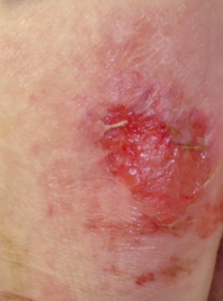
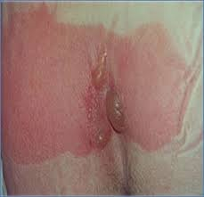
Stage 2: Partial thickness wound/ intact serum filled blister
Partial-thickness loss
Viable, pink or red, moist or intact or ruptured serum-filled blister
Adipose (fat) is not visible and deeper tissues are not visible

Slide 25
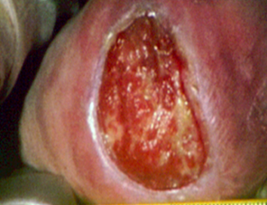
Stage 3: Full thickness with adipose (fat) visible
Full-thickness loss
Adipose (fat) is visible
Granulation tissue (beefy red), slough and/or eschar may be visible. Depth varies by anatomical location
Undermining and tunneling may occur

Slide 26
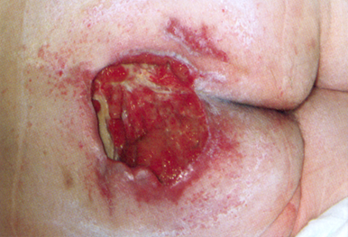
Stage 4: Full thickness with exposed bone/tendon/muscle
Full-thickness skin and tissue loss with exposed or directly palpable fascia, muscle, tendon, ligament, cartilage or bone in the ulcer. Slough and/or eschar may be visible. Epibole (rolled edges), undermining and/or tunneling often occur. Depth varies by anatomical location

Slide 27
Unstageable: Obscured full thickness skin and tissue loss
Full thickness skin and tissue loss obscured by slough or eschar
PI’s on occiput often go un-noticed! Use close inspection on assessment: flashlight can be helpful
When you see yellow/brown/black tissue: THINK PRESSURE!

Slide 28
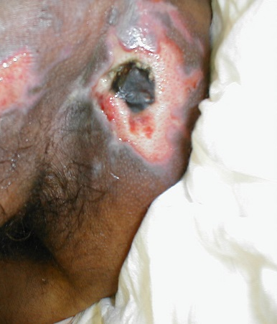
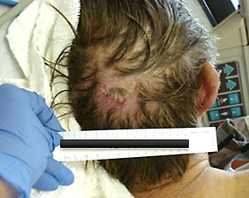
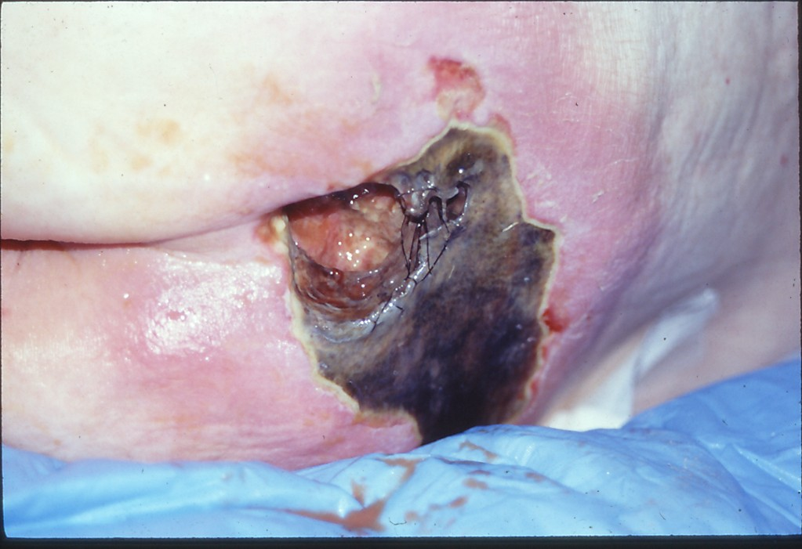
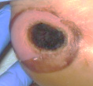
Unstageable

Slide 29
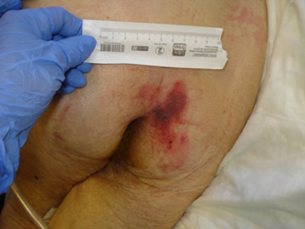
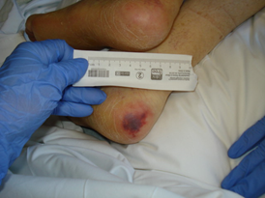
Deep Tissue Injury
Persistent non-blanchable deep red, maroon or purple discoloration or blood filled blister/bulla
Intact or non-intact skin
Results from intense and/or prolonged pressure and shear forces at the bone-muscle interface.
May evolve rapidly to reveal the actual extent of tissue injury, or may resolve without tissue loss.

Slide 30
DTI Evolution
Patient found down at home
DTI heel and right buttock
“Found down at home”= Bruised areas may likely be pressure.
Photos taken about 2 weeks apart

Slide 31
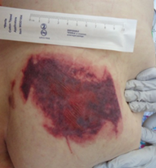
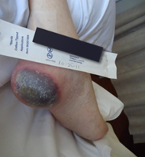
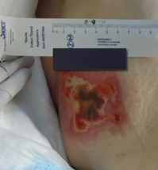
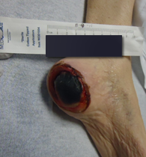
DTI Evolution

Slide 32
Pressure? It’s not always easy to tell
Put your “investigator hat” on
Couple the assessment with the patient history
Even more difficult in patients with dark pigmented skin
Remember skin does not need to be broken to be a pressure injury
Deep tissue pressure injury can look like a bruise
Notes:
Combine with patient history- is the patient bed/chair bound? Are they continent? Do they have diabetes, paraplegia, etc? History of a pressure injury? (that area is more susceptible to repeat breakdown)

Slide 33
Reminder: We DON’T stage
Skin tears
Moisture Associated Skin Damage (MASD)
Diabetic foot ulcers
Arterial/Venous ulcers
Abrasions
Notes:
We only stage PRESSURE INJURIES

Slide 34
Documentation
Resources &

Slide 35
Documentation
Document what you see and where
Be as descriptive as possible
Identify if skin is intact versus open
A good description is better than a bad guess at staging
Make best determination based on history and assessment
Even WOC Nurses have difficulty with identification and staging at times!
Notes:
Identification and staging isn’t easy!

Slide 36
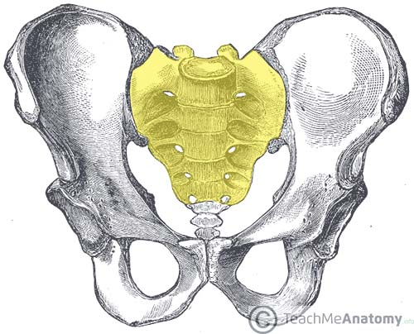
It's not always a sacral wound!
Sacrum
Coccyx
Ischium
Gluteal region
Gluteal cleft (natal cleft)
Gluteal folds (left and right)
Posterior thighs
Notes:
These are each very separate locations. Clear and adequate documentation is key. Specific location of breakdown can help figure out etiology. Example: redness in the gluteal cleft down into the perineum would be indicative of moisture, not pressure.

Slide 37
NEW PROCESS! (Adult Only)
Unit Pressure Injury Champions (CSL’s, RSL’s, others)
Required: Find a Champion to serve as a 2nd set of eyes to assess actual/suspected pressure injury
Send initial documentation to the Champion for co-signature
Notes:
New process at VUH only.
Champions have received special training… they wear a Skin Champion badge ribbon.
They will serve as a 2nd set of eyes to help identify and stage an actual or suspected PI.
You will learn how to send your initial documentation for co-signature.

Slide 38
To Do!
Get familiar with the PI Prevention and Treatment Guidelines and basic staging
VUH (Adult):
Identify your unit Skin Champions
Find your Skin Champion to help validate/stage the pressure injury on admission or when 1st discovered, or if you have questions

Slide 39
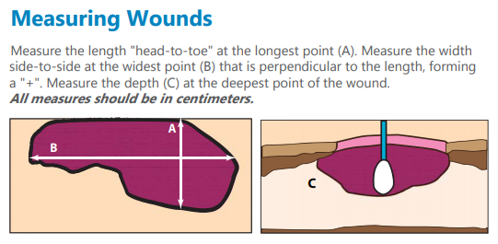
Pressure injury measurements
Measured by the staff nurse
On admission, weekly on Wednesday, upon discharge and if any concern for deterioration
Length x width x depth in centimeters
Ask Skin Champion for assistance

Slide 40
Documentation
Present on Admission (POA): Asking if PI was POA to the HOSPITAL, not your unit
Only choose one location for each LDA entry. i.e. Bilateral heel PI’s would be 2 separate LDA’s under left and right

Slide 41
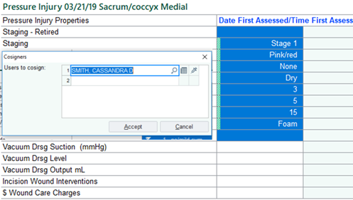
Requesting a co-signature
Highlight INITIAL ASSESSMENT within the PI LDA
Right click and select “Request Cosign”
Type in name of Skin Champion that assessed the PI with you

Slide 42
What is another type of skin damage that can look like pressure?

Slide 43
Moisture Associated Skin Damage (MASD)
Caused by prolonged exposure to various sources of moisture
Incontinence (IAD)
Skin Folds (Intertriginous)
Periwound
Peristomal
Notes:
MASD is an umbrella term that includes 4 types. We will focus on IAD today.

Slide 44
It’s not always a pressure injury!
Can be difficult to distinguish between IAD and early/shallow pressure injuries
IAD and pressure can co-exist
Assessment of IAD
Bright red, shiny, erosion, +/- satellite lesions, burning/itching
Look at pattern of injury/breakdown in perineum, gluteal cleft
Couple with history
IAD significantly increases risk for hospital acquired pressure injury
Notes:
Assessment of IAD: signs of inflammation, bright red, shiny, erosion, satellite lesions, burning/itching
"Hyperpigmentation" (darker skin) : can be a sign of a moisture issue
Again, history is important. You wouldn't expect a continent patient to have IAD. BUT patients sometimes do not want to admit that they are incontinent, or may not know what incontinent means.
MASD/IAD is documented as such. There is a specific LDA category for this.

Slide 45
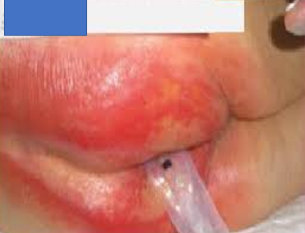
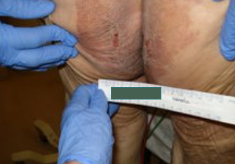
Incontinence Associated Dermatitis (IAD)
Notes:
Photo on left: Linear “crack” in gluteal cleft often seen. Notice pattern of moisture damage down gluteal cleft.
Bottom right: note dry, scaly , hyperpigmented skin- likely chronic moisture.

Slide 46
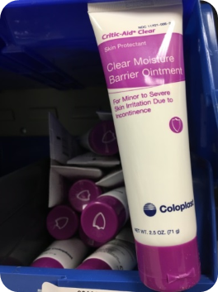
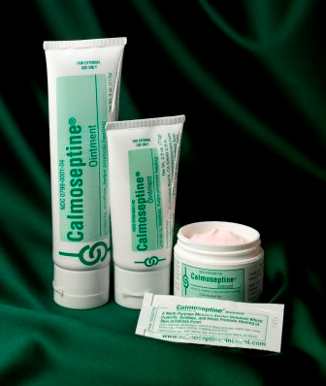
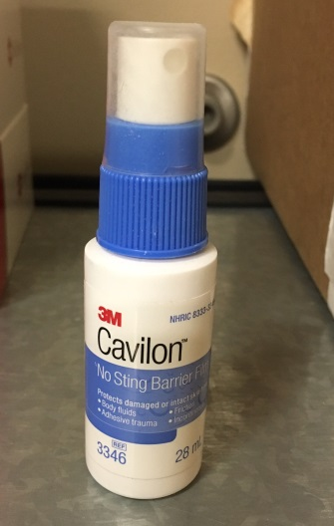
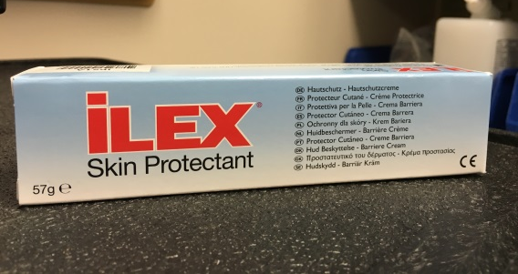
Protection from Incontinence
Perineal wipes (barrier cloths)
Critic-Aid ointment
Calmoseptine
Ilex
3M no-sting barrier spray
Notes:
"Go to" options are the barrier cloths and Critic-Aid ointment.
Ilex works really well on severe IAD (raw/bleeding)

Slide 47
What if your patient refuses to be turned?
ASK Why
EDUCATE why repositioning is important
ESCALATE to shift leader/ provider
DOCUMENT refusal and interventions
Notes:
It’s not ok to let a patient continually refuse turning. We have a flyer available that shows progression of actual pressure injuries as a tactic to reinforce the “WHY”.

Slide 48
Strategies to improve engagement with repositioning
AVOID:
Is it alright to reposition you?
Do you want to be turned now?
INSTEAD:
It is time for you to be repositioned. Can I get anything for you before we start?
It is good that you are comfortable, but you are at very high risk to develop a pressure injury. I want to make sure that doesn’t happen
This is the time we agreed upon. Prolonged pressure causes pressure injuries an it is my job to keep you SAFE.

Slide 49
VUMC Guidelines
Pressure Injury Prevention & Treatment
Incontinence Management
Bed Selection
Skin Tears
Notes:
Each of these guidelines helps you determine what to do
PIP Tx guideline also includes dressing selection

Slide 50
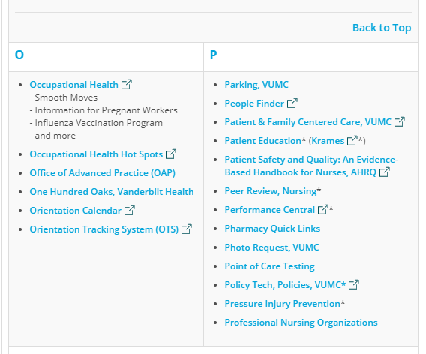
NEW! Pressure Injury Prevention (PIP) Website
Available from the VUMC Nursing Resources page
Vanderbilt Nursing--- Employee Resources --- Go to “P” section --- Pressure Injury Prevention
Resources, guidelines, meeting minutes

Slide 51
VUMC Resources
Patient Care E-Docs
mc.vanderbilt.edu → Resources Directory
Nursing at Vanderbilt → Employee Resources
PolicyTech
Pressure Injury Prevention and Treatment- Adult
Pressure Injury Prevention and Treatment- Peds
Fecal Incontinence and Bowel Management
Mosby’s Nursing Skills
Krames Patient Education

Slide 52
REMEMBER!
ASSESS your patient
UTILIZE your skin champions
TURN & REPOSITION your patient & FLOAT HEELS
MANAGE MOISTURE
DOCUMENT your findings and interventions
YOU can prevent pressure injuries!

Slide 53
More information
VUMC website: https://www.vumc.org/pip
NDNQI Pressure Injury Training 7.0- online module with great information on staging, prevalence
http://learning2.pressganey.com/ndnqi/copyright/2019/468913158456/story_html5.html
National Pressure Injury Advisory Panel (NPIAP)- up-to-date information on staging, educational resources
https://npiap.com/page/FreeMaterials

Slide 54
QUESTIONS???

