Slide 1
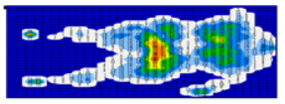
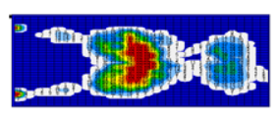
Pressure Injury (PI) Prevention and Sitting
In sitting positions, the pressure is higher than in lying postures.
The risk of pressure injury is greatly increased during sitting periods.
Pressure map in supine position
Pressure map in sitting position

Slide 2
All patients with ‘chair’ orders
AND
Have a sacral or ischial pressure injury
OR
Are at risk for a pressure injury
GENERAL GUIDELINES:
Apply Mepilex foam
Use chair air cushion under patient. Do not use donuts.
Maintain proper alignment; recline with legs elevated if possible or ensure feet are well supported on the floor.
Assess skin after each period of sitting to evaluate.
For a patient with an ischial pressure injury, avoid seating in a fully erect posture in chair.
REPOSITIONING:
If patient is unable to reposition themself or can reposition but won’t because of pain, dementia, etc: assist with repositioning at least q1h.
If patient is able to reposition themselves: encourage q15 minute pressure shifts.
CONSIDER SITTING LIMITATIONS:
2 hours for at risk patient
1hour TID for patient with ischial or sacral pressure injury.
Sitting time can be increased or decreased based on improvement or deterioration of the pressure injury.

Slide 3
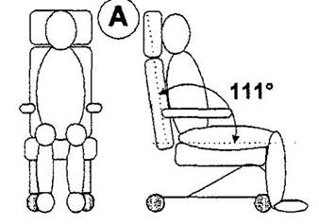
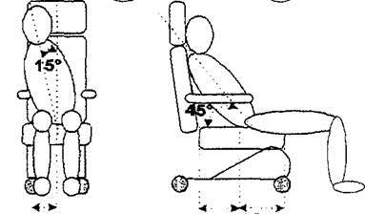
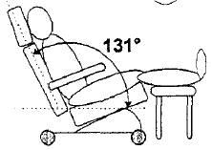
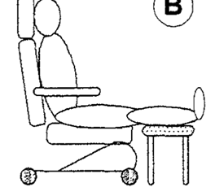
YES
NO
If chair does not recline, sit patient upright with feet on the ground.
Maintain proper position and alignment in chair.
Slouched or slid-down postures create significant increases in pressure.
YES
NO
If chair reclines, lean patient back and elevate legs on a rest.
Preferred chair position if patient has an ischial pi.
Do not sit patient upright with feet elevated

Slide 4
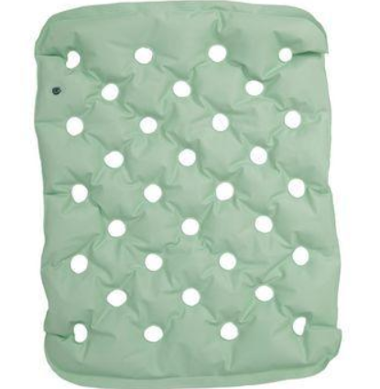
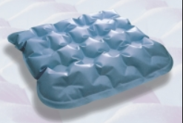
Standard cushion PMM 1782
Bariatric cushion PMM 89576

