Slide 1
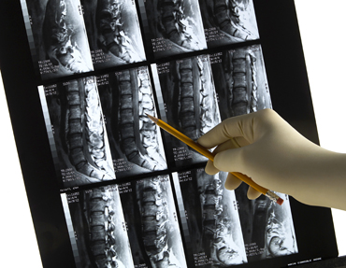
Diagnostic Modalities in Spine
Cyrus Wong, M.D.
Department of Neurological Surgery
Vanderbilt University Medical Center

Slide 2
Plain Xray
Historically used to diagnose all types of pathology related to the spine
It relies on ionizing radiation to provide images
The more dense an object the brighter the image
That is why bone appears “white” on plain x-rays

Slide 3
Xray Cont.
Used to help with localization in the operating room
Allows to evaluate alignment
Provides information with regards to stability
Provides information about hardware placement

Slide 4
Cervical Spine Xray
AP
LAT

Slide 5
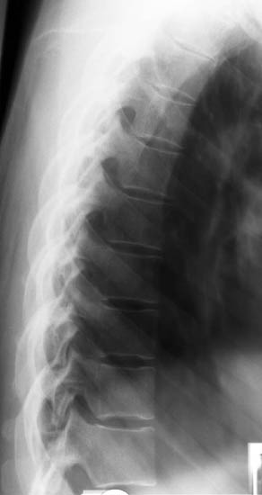
Thoracic Spine Xray
Lat
AP

Slide 6
Lumbar Spine Xray
AP
LAT

Slide 7
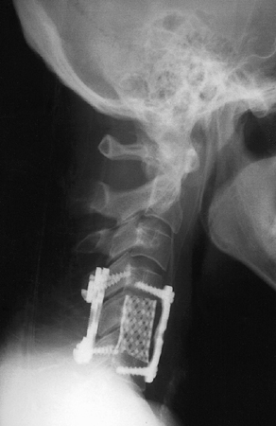
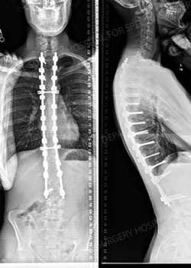
Examples of Fusion

Slide 8
CT Scans
A computed tomography (CT) scan uses x-rays to make detailed pictures of the spine
It has the ability to reconstitute the images in the axial, sagittal and coronal plane
It gives higher resolution pictures when compared to plain x-ray
Excellent modality to evaluate fractures (spine trauma)
Gives more information about soft tissue when compared to plan x-ray but not as sensitive as MRI
Less time consuming than MRI

Slide 9
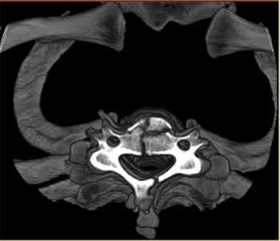
Cervical Spine
Sagittal CT
Axial CT showing fracture

Slide 10
C-Spine Cont.
Coronal
Sagittal

Slide 11
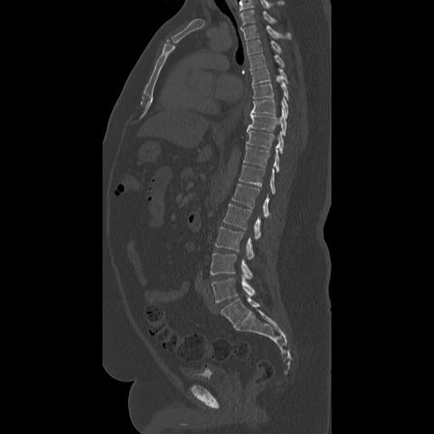
Lumbar and Thoracic CT
Axial
Sagittal

Slide 12
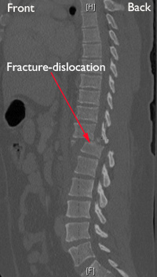
Thoracolumbar Fractures
Compression Fracture
Fracture Disslocation

Slide 13
MRI
Uses a magnetic field and pulses of radio wave energy to make images
Excellent image quality for soft tissue when compared to plain xray and CT
The study of choice to evaluate soft tissue such as intervertebral disk, thecal sac, ligaments, joints and spinal cord
Contrasted study is widely used in the detection of tumors

Slide 14
MRI Cont.
Various sequences give different information
T1 sequence
“Anatomic image”
Fat (bone Marrow) and Subacute blood (>48 hrs. old) appear bright (white)
CSF and bone appear dark
Most pathology appears dark but can enhance with contrast

Slide 15
MRI Cont.
T2 Sequence
Used to evaluate pathology
Most pathology appears bright (white)
Edema and CSF appear bright
Bone and Fat appear dark
Healthy Intervertebral disk appear bright

Slide 16
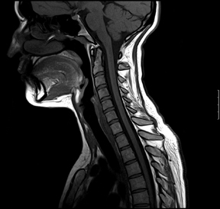
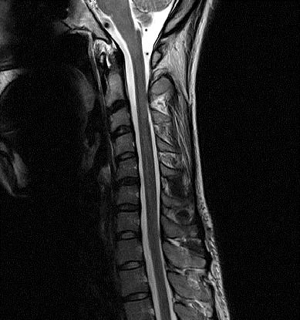
C-Spine MRI
Sagittal T1
Axial T2
Sagittal T2

Slide 17
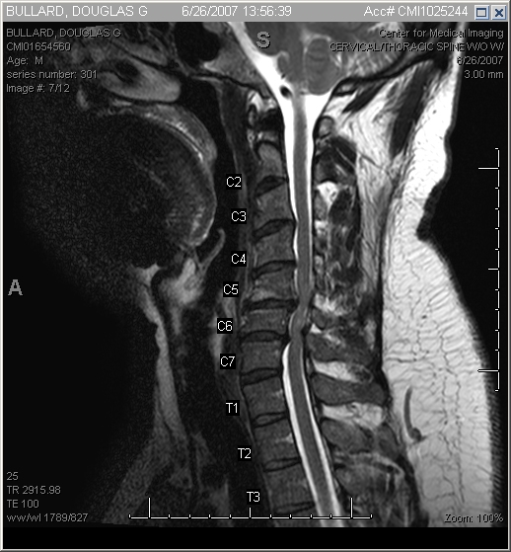
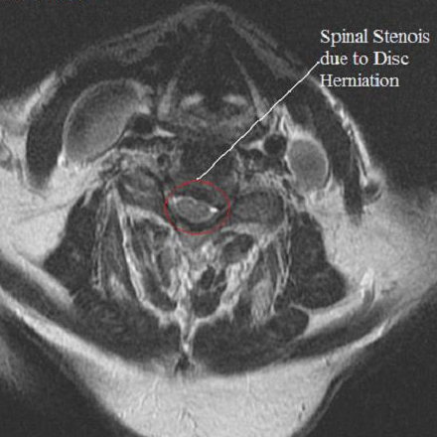
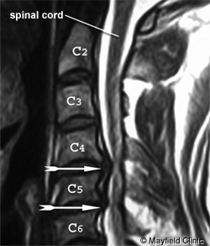
Cervical Stenosis
Axial T2
Sagittal T2

Slide 18
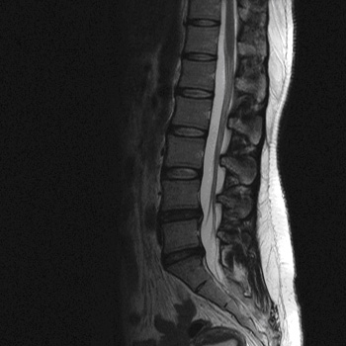
Lumbar MRI
Sagittal T2
Axial T2

Slide 19
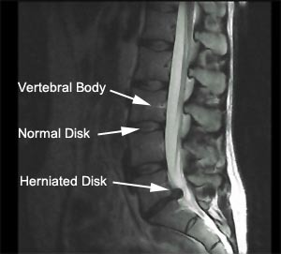
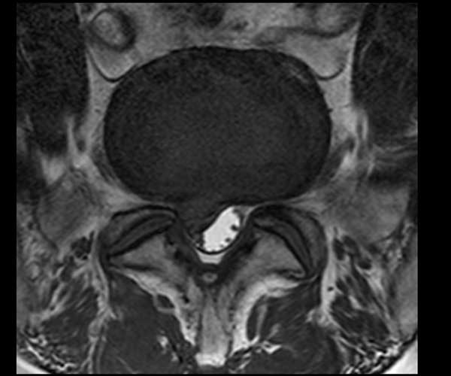
Herniated Lumbar Disc
Sagittal T2
Axial T2

Slide 20
EMG and Nerve Conduction Studies
Studies used to help localize the site of compression
Help delineate radiculopathy from neuropathy, myopathy or myelopathy
Highly operator dependent
Not recommended for use in the acute setting
NCV useful in assessing entrapment neuropathies

