Slide 1
Linking ORCID iD to Web of Science account
**Make sure you are logged onto VUMC network/VPN before proceeding**

Slide 2
Overview
Sign-in or Register to Web of Science (WOS) https://www.webofscience.com
Make sure you are logged onto VUMC network/VPN
Search > Researcher- Search by your first and last name; You can filter by Institution
Do not discount records that do not have Vanderbilt listed as top institution, you may still have publications included in that record
Select all records containing any publications by you and select Merge
At this point you will be asked for contact info and to review your publications; When reviewing select all publications that are NOT your publications to REMOVE from the record
Once you’ve reviewed and submitted your merged/corrected records, WOS will review (could take 3-5 days) and will then allow you to claim your single record “Claim my record”
Link your ORCID iD:
Edit My Researcher Profile (under Profile dropdown menu) to get to Profile Settings
ORCID Syncing- Link ORCID account and allow for automatic syncing
For step-by-step guidance see following slides or view a short instructional video

Slide 3
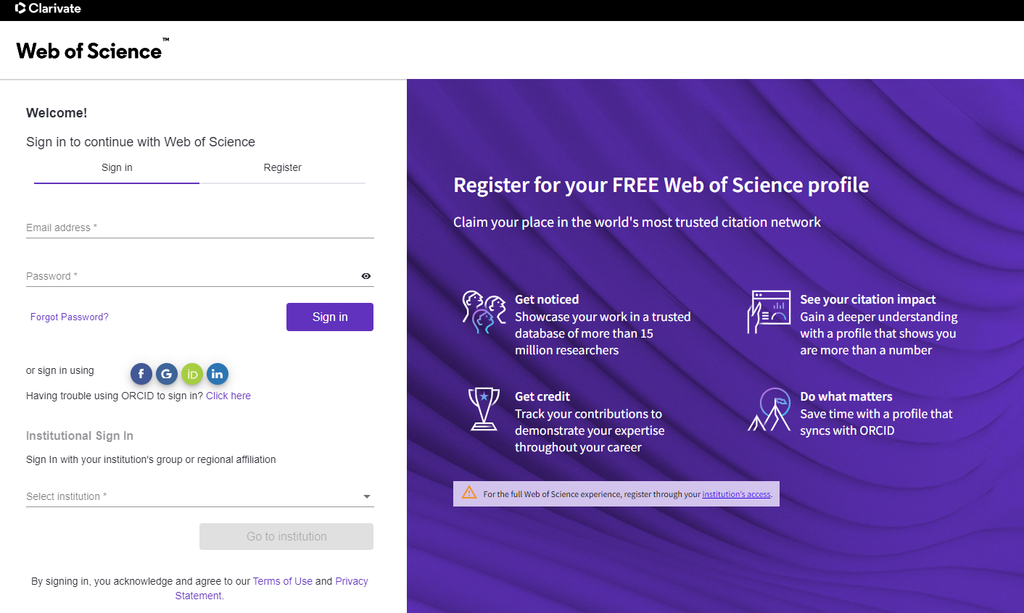
Sign-in or Register for Web of Science (WOS): https://www.webofscience.com

Slide 4
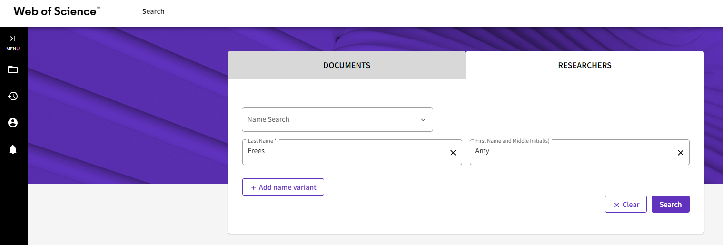
Search > Researchers: Insert your first and last name and search for all records associated with your name

Slide 5
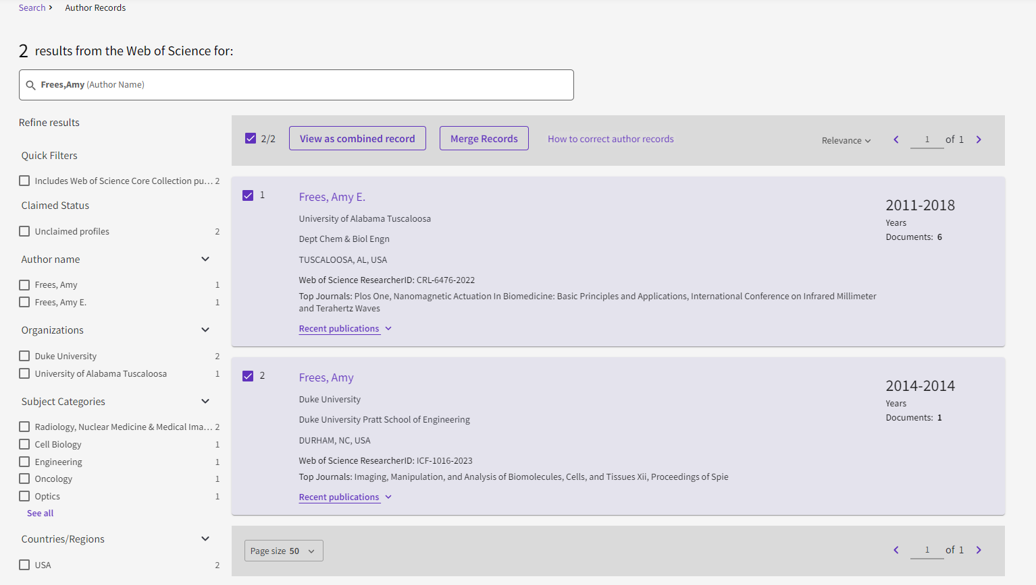
Select all your records and select “Merge Records

Slide 6
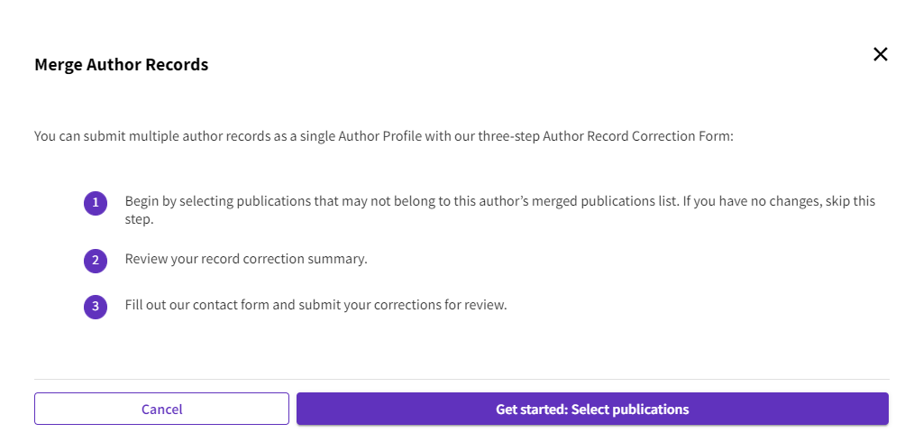
Merging author records allows you to claim all your publications and put under one WOS record Follow the steps as prompted to submit your merge/corrections for review

Slide 7
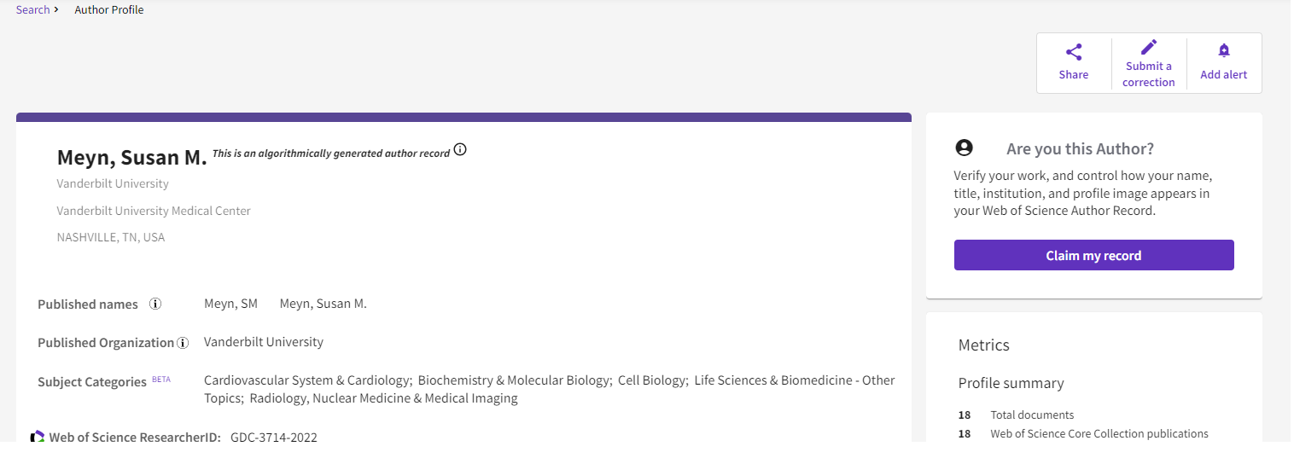
Once records are merged (this could take 3-5 days), or if the initial search only yields one record, select the author profile and select “Claim my record”

Slide 8
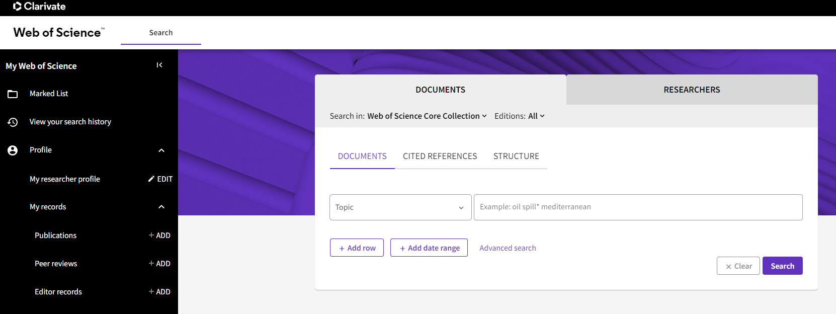
Link your ORCID iD to WOS profile In the menu on the left of the page, select EDIT “My researcher profile”

Slide 9
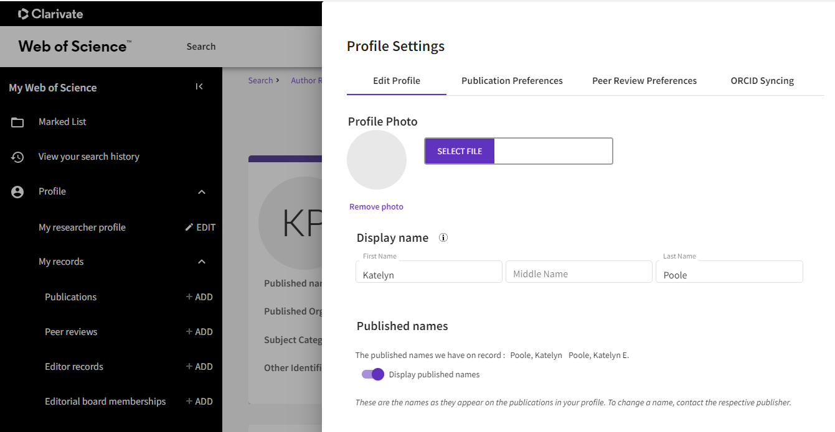
Under your profile settings select “ORCID Syncing”

Slide 10
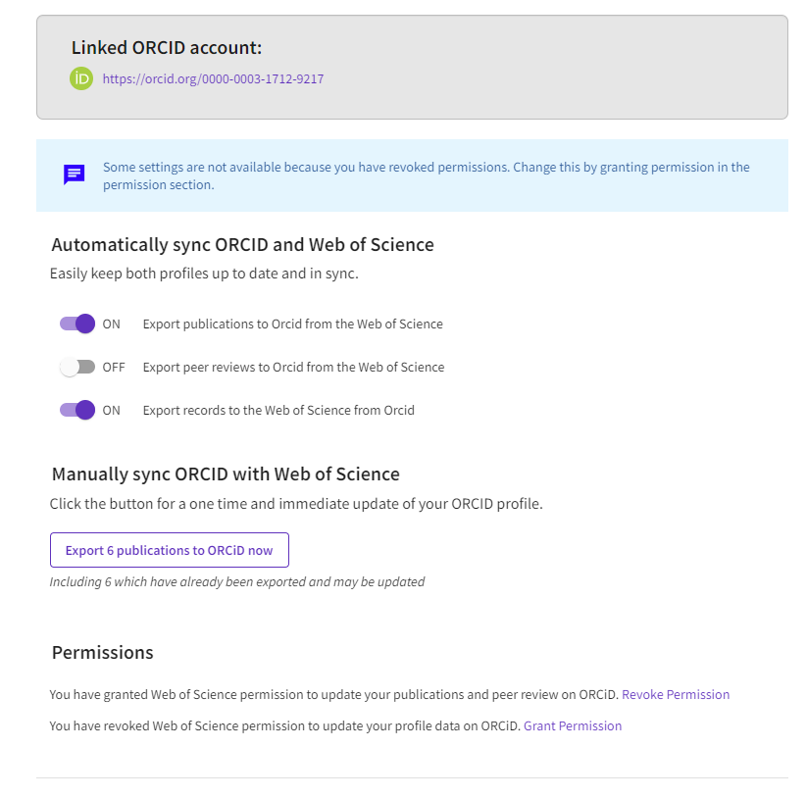
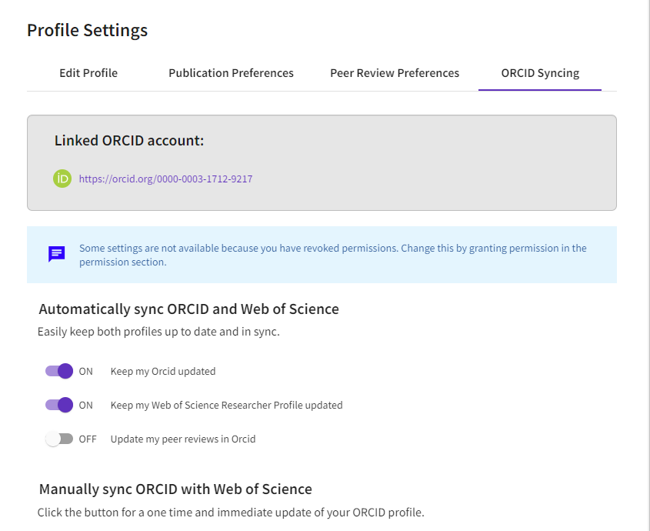
Link your ORCID account to your WOS profile and “Save & Close” You may see some variation on the following options for syncing your ORCiD and WOS publication records

Slide 11
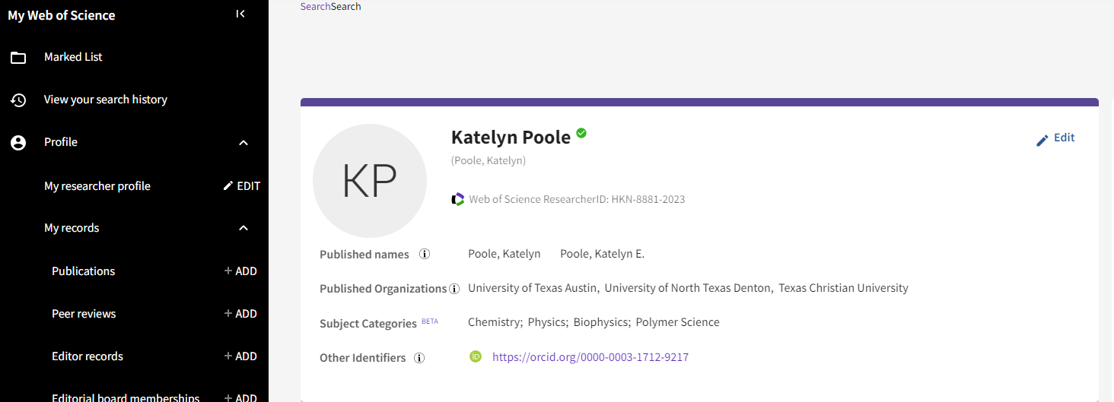
If linked correctly, you should now see your ORCID iD under “Other Identifiers” on your WOS Profile

Slide 12
If you have any questions, please reach out to Katelyn Poole, katelyn.poole@vumc.org

