Slide 1
Shared Resources Funding: Grants for equipment, salary, and research
VU Grant Submission
Hilda McMackin, PhD
Office of Research Development and Support (VU)
VUMC Grant Submission
Amy Martinez, PhD
Office of Research (VUMC)
NIH S10 Equipment Grant
Rob Carnahan, PhD
Vanderbilt Vaccine Center (VUMC)
NIH S10 vs. NSF MRI Equipment Grant
Jenny Schafer, PhD
Cell Imaging Shared Resource (VU)
NCI R50 Research Specialist Award
Josh Bauer, PhD
High-Throughput Screening Facility (VU)
VICTR
Lesa Black, PhD
VICTR (VUMC)

Slide 2
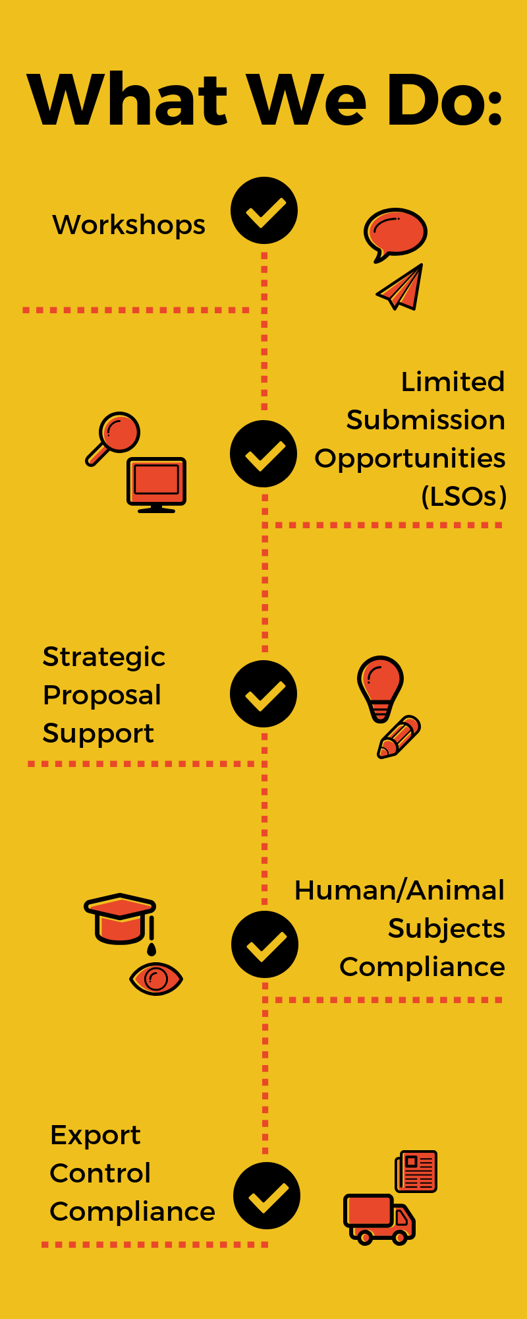
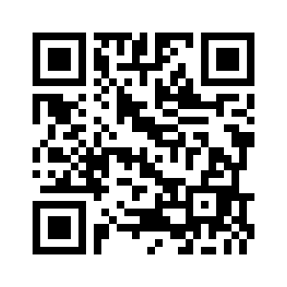
Office of Research Development and Support
Ask Us If You Want To…
Open your phone camera & zoom in on QR code to join the LSO Announcements Listserv
Attend a workshop or event to learn about federal sponsors and best practices to get funding
Apply to be the institutional nominee for a limited submission opportunity
Get proposal development support for large-scale or strategic federal funding opportunities
Find information or ask questions about conducting research with human or animal subjects
Get advice regarding export compliance with international collaborations

Slide 3
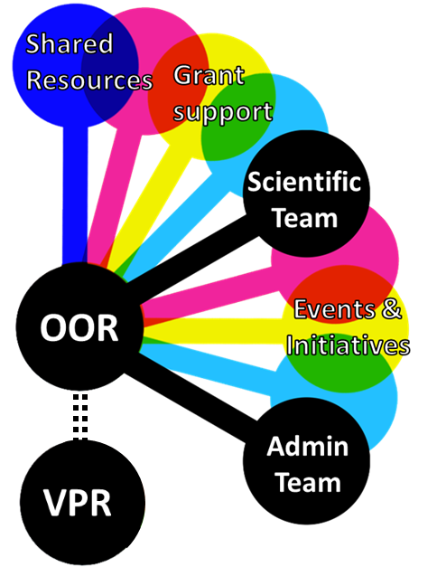
VUMC Office of Research: enabling discovery across the SOM
Amy Martinez, PhD
Program Officer
Hub for All Things Research
“Go-to” point of contact for internal and external research community
Coordinate with VU and VUMC offices to support research activities
Notes:
Good afternoon everyone, I’m Amy Martinez, Program Officer in the VUMC Office of Research. What I want to do in my few minutes is to share a very high level overview of what the Office of Research does, and go into a bit more depth on the grants and funding resources that we offer. I’ve titled this slide “enabling discovery across the SOM”, because we many of the services and resources we provide are available to all investigators across the school of medicine. For everything else, we partner with VU offices such as the Vice Provost for Research and Dean of Basic Sciences to serve all investigators.
We serve as a point of contact for all things research, and work with both scientific and administrative teams to help get things done.
Many of you likely work with us in our capacity of overseeing and supporting shared resources and supporting iLab and CORES systems.
Beyond that, we also sponsor a range of Research Events & Initiatives, such as lectures, retreats, and awards programs

Slide 4
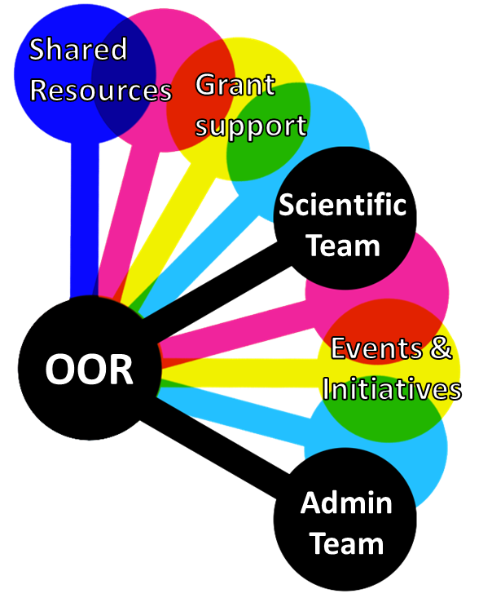
VUMC Office of Research: enabling discovery across the SOM
Amy Martinez, PhD
Program Officer
Grants & Funding Resources
Identify Opportunities
Advertise grants & awards
Support Submissions
Coordinate S10 grant process
Manage Limited Submission grants
Maintain grant-ready text
Prepare letters of support
Work with CFR to assist in development
Notes:
To hone in on the grants and funding resources that we provide, I’ve categorized what we do into two main buckets- identifying opportunities and supporting submissions.

Slide 5
Robert Carnahan
Director, Vanderbilt Antibody and Protein Resource (2007-2017)
Director of Research, Crowe Lab / Vanderbilt Vaccine Center (2017-current)
S10 Shared Instrumentation Strategies
Points to clearly and repeatedly address
Is facility qualified: technically, administratively, etc.
Make justification quantitative. Must tie it directly to a need. This thread(s) should go across all or most user projects
User Projects
Specific to requested need. How will this instrument address a need. Not just a summary of their cool research.
Short with more than minimum number. Sometimes grouped them (ex Epithelial Biology Center)
User profile
Diverse: Centers/Departments, stage of career, research area
High impact and funding but young investigators too
Broad user base = lower financial risk

Slide 6
NIH Shared Instrumentation Grant (SIG) vs.
NSF Major Research Instrumentation (MRI)
NIH S10 |  | NSF MRI
New equipment, upgrade | Allowable Costs | New equipment, upgrade
Multiple instruments, software, clinical, infrastructure | Not allowed | Multiple instruments, software, clinical, infrastructure
SIG = $50K - $600K SIFAR = $50K - $750K HEI = $600K - $2M | Funds | Track 1 (acquisition) = $100K - $1M Track 2 (development)= $1M - $4M
Only with VU/VUMC funds | Salary allowed | Only for Track 2
75% NIH grantees | Major/Minor Users/Co-PIs | any
May 31, 2018 | Deadline | January 2019
Not required | Institutional Commitment | 30% of total project cost
$70M, 109 awards | Total Awarded | $75M, 150 awards
FY17 = 109/353 (31%) | Percent Awarded | FY18 = 145/850 (17%)
No | Limited Opportunity Submission | Yes
Not expected | Education | Education/Outreach

Slide 7
NCI Research Specialist Award (R50)- est 2016
Purpose: Designed to encourage the development of stable research career opportunities for exceptional scientists who want to continue to pursue research within the context of an existing NCI-funded cancer research program, but not serve as independent investigators.
What: Is specifically for core/shared resource support scientists working on NCI-funded projects (≥50% effort) (including- U, P, K, R grants): supports salary and travel- 5yrs
Advantages:
Many NCI-funded projects (LOS help)
Expertise and specialty in an area (eg, HCI, FGS, etc.)
How involved were/are you in the projects- (intellectual input- grants, publications, etc.)
How will you continue to support NCI projects
How will you continue your career development
Application: RFA- Nov, Application due mid Jan
Joshua Bauer

Slide 8
Vanderbilt Institute for clinical and translational research (Victr) funding program
Pilot funding for clinical and translational hypothesis driven projects that involve human subjects, tissue, cell lines and/or information (e.g. medical records), and have application to human health
Access to the Clinical Research Center for Industry, NIH and foundation funded studies
VUMC, VU and MMC faculty, medical students and fellows are eligible to apply
Available resources include labs, cores, supplies, studios, biostat, recruitment support, and more
Learn more at https://starbrite.app.vumc.org/funding
615-322-8629 victr.resource.request@vumc.org

