Slide 1

Metrics of Success
for
Susan Meyn
Director, Research Resources & Strategy
VUMC Office of Research

Slide 2



Slide 3


Slide 4
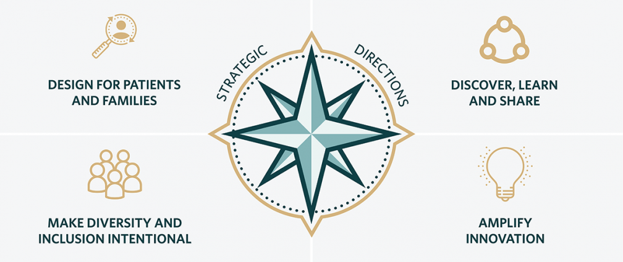
www.vumc.org/strategy/strategic-directions
www.vumc.org/strategy/

Slide 5
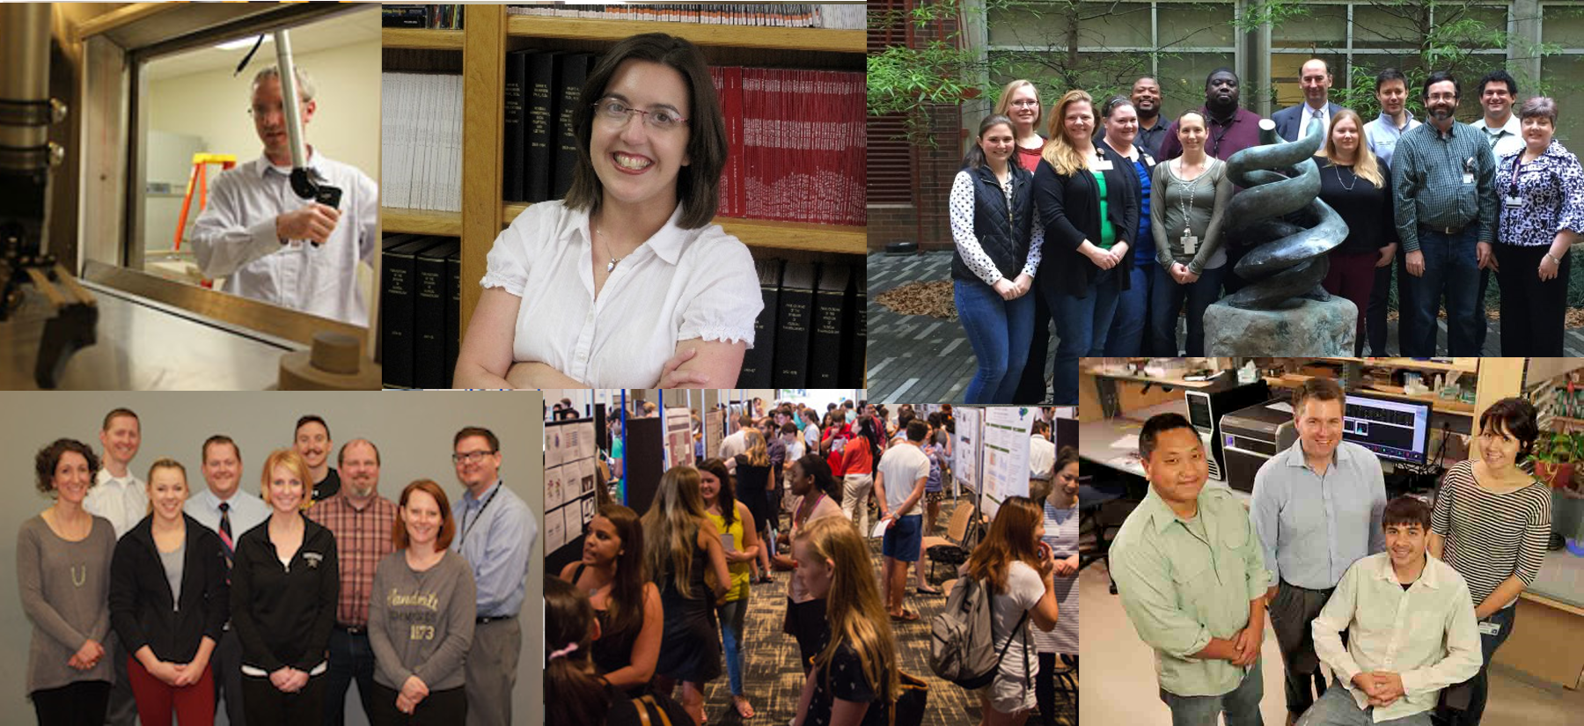
Metrics align, connect our people to our mission

Slide 6
Metrics align, connect our people to our mission
Should be:
Measurable
Analyzable
Meaningful
Motivational
Strategic

Slide 7
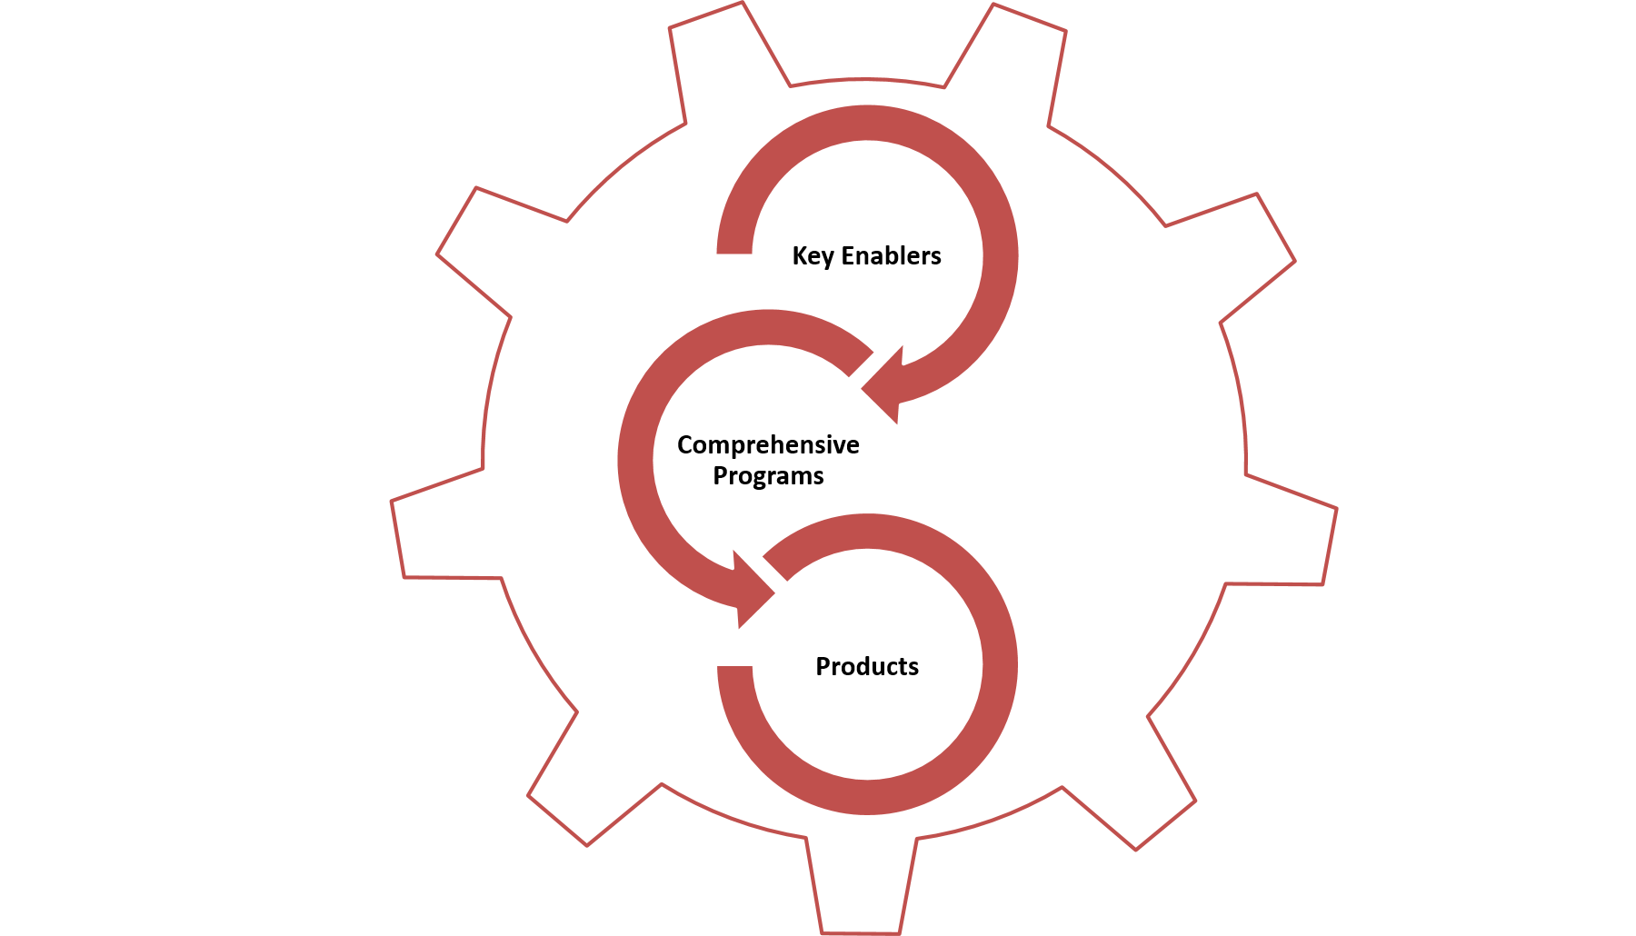
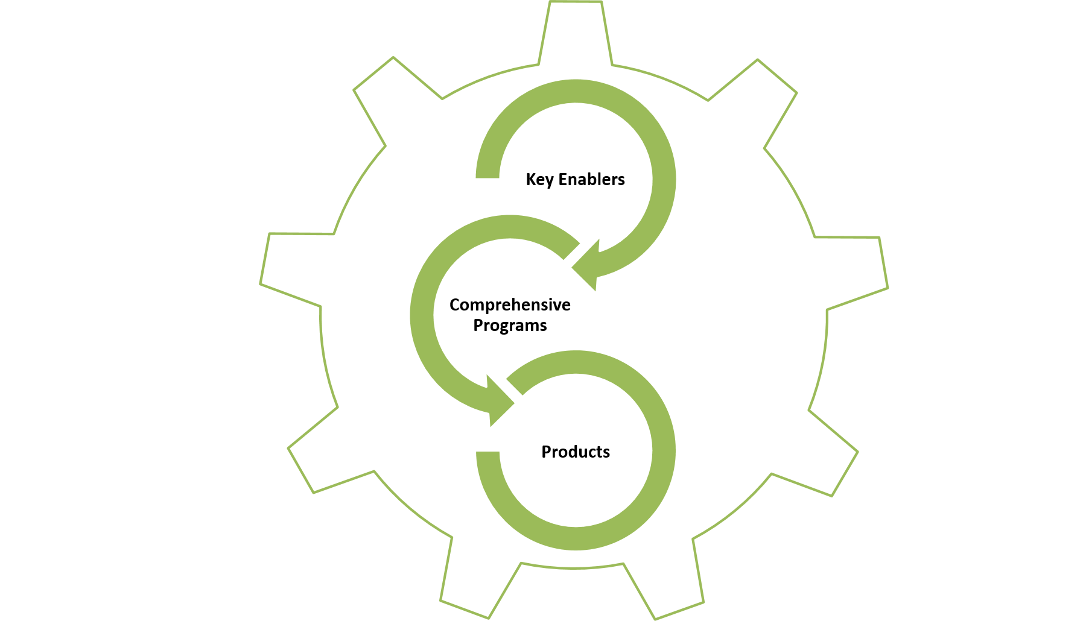
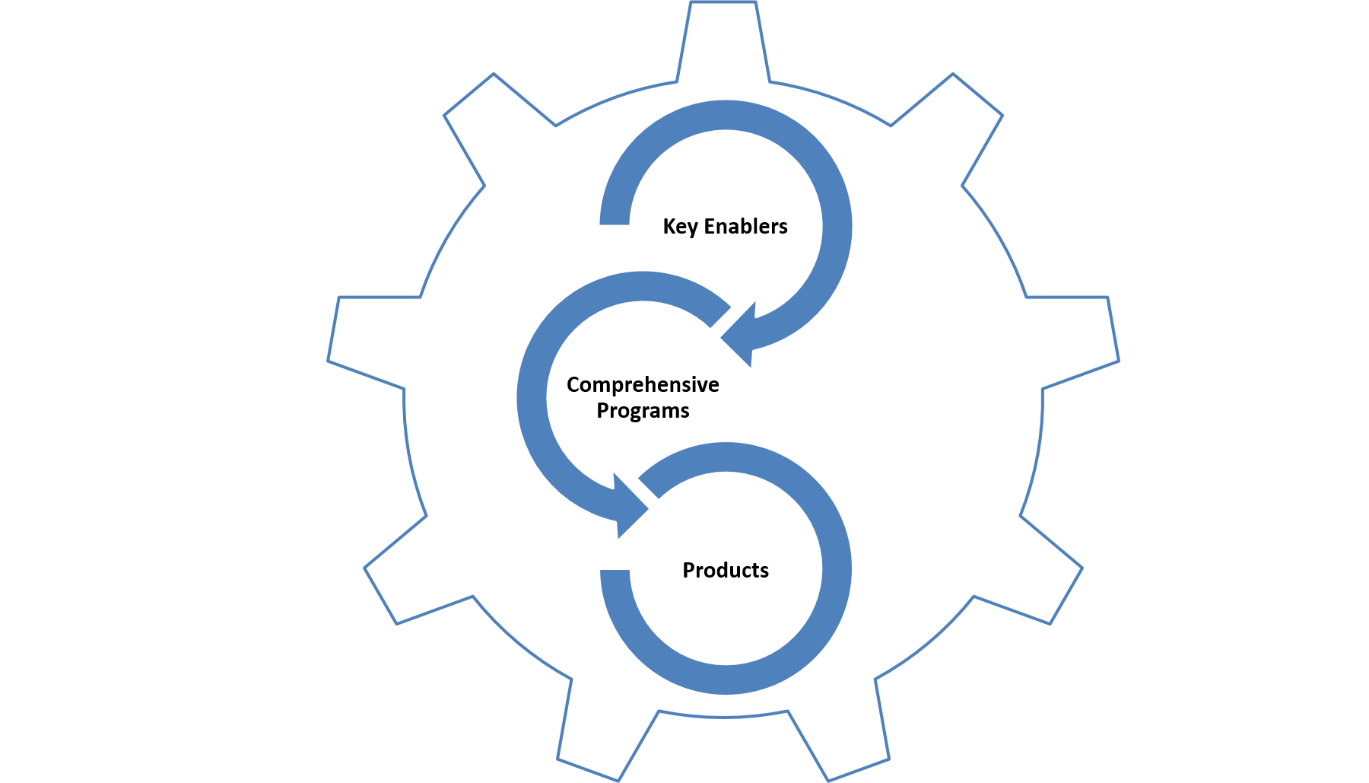
Metrics can drive, amplify impact
Criteria for investment
Comprehensive programs
Discoveries
Key enablers

Slide 8
Why develop a metrics program do for your core?
Develop or refine strategic plans
Monitor progress to goals
Plan for future technology development
Justify new or continued institutional investments, or grant funding
Enable a mission-driven culture
Retain great people

Slide 9


Slide 10

Define important values
Outcomes
For core, research community, professional, scientific & economic
Transformation
Change in practice, policy, paradigms
Connections
Reaching across disciplines, sectors, research-discovery continuum
Mission
Align core values with institutional strategic directions
BLEND IMAGES - COLIN ANDERSON VIA GETTY IMAGES grabbed from https://www.huffingtonpost.com/clara-tsao/5-augmented-reality-start_b_4674953.html

Slide 11

Identify specific milestones
Professional Development
For staff, managers and directors
Scientific Impact
Grant funding, publications, IP, collaborations
Resource stewardship
Budgets, cost recovery and revenue, ongoing technology development
Customer access & satisfaction
Outreach, training, service standards, continuous improvement, feedback mechanisms

Slide 12


Slide 13

How to get started?
Core self assessment
Assemble information, observations, data already available.
Gather feedback from team members, leaders and customers
Determine focus areas
What do you want to change, grow or improve?
Define metrics
Ideally can be consistently measured with minimal additional process
Report out
Tailor to purpose, i.e. show impact; grant budget justification; requesting institutional investment; or manage change.

Slide 16
Example Report Out: VUMC Cores
$345M
$52M
VUMC core billing
~54
VUMC cores
Ranked 10th
1-of-10 NIH$ spent in
VUMC cores
School of Medicine
NIH funding
Notes:
NIH funding from most recent reported year FY17
Core billing from FY18 total
Adjusting the $52M:
$4M in external for-profit business
$1M in scholarship redemption
75% of billing is to federal projects
Assume federal is almost all NIH

Slide 17
Example Report Out: VUMC Cores
$3-4M to for-profit companies
$1M scholarship redemption
75% to Federal funding
$345M
$52M
VUMC core billing
~54
VUMC cores
Ranked 10th
Consistent over the last 11 years
1-of-10 NIH$ spent in
VUMC cores
School of Medicine
NIH funding
Notes:
NIH funding from most recent reported year FY17
Core billing from FY18 total
Adjusting the $52M:
$4M in external for-profit business
$1M in scholarship redemption
75% of billing is to federal projects
Assume federal is almost all NIH

Slide 18
Example Report Out: VUMC Cores
$3-4M to for-profit companies
What this tells about VUMC cores:
As sponsored project funding has grown, cores have scaled to meet research needs
Cores are:
Integral to successful conduct of federally funded research
Efficient/economic way to spend federal dollars
Consistent performers in providing service and recovering cost
$1M scholarship redemption
75% to Federal funding
$52M
VUMC core billing
~54
VUMC cores
Ratio consistent over the last 11 years
1-of-10 NIH$ spent in
VUMC cores
Notes:
NIH funding from most recent reported year FY17
Core billing from FY18 total
Adjusting the $52M:
$4M in external for-profit business
$1M in scholarship redemption
75% of billing is to federal projects
Assume federal is almost all NIH

Slide 19




Acknowledgements
Vanderbilt core facilities
VUMC
Association of Biomolecular Resource Facilities (ABRF) & regional chapters:

