Slide 1
iLab Training for VUMC Departments & Users of VUMC Core Groups
VUMC Office of Research

Slide 2
VUMC C.O.R.E.S. to iLab Transition Core List
To view a full list of VUMC core groups that have transitioned to iLab, visit the Office of Research website:
https://www.vumc.org/oor/vumc-cores-ilab-solutions-transition

Slide 3
Core Users
All users will need to register
Registration instructions available on the Office of Research website
Once registered, all VUMC and VU users will access the application using their VUNet ID and ePassword
Notes:
NOTE: Webform located on the OOR site. Existing users can request additional roles by submitting a request on a webform.

Slide 4
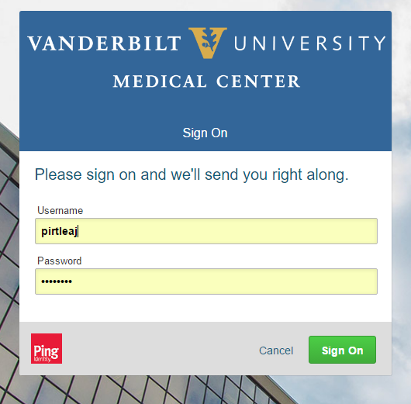
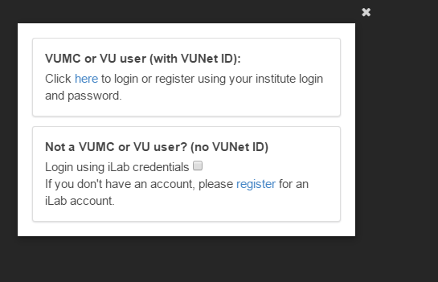
Registration Tips
Step 1:
VUMC or VU User (with VUNet ID)
Step 2:
Enter your VUNet ID and ePassword
If you have not yet registered, the system will ask you to select your PI’s name.

Slide 5
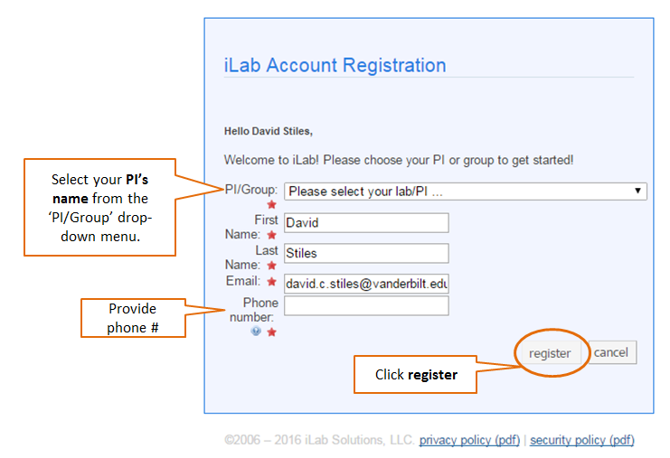
Registration Tips
If your PI is not listed select AAA Default (VUMC) Lab
Department Administrators – Select the Admin (VUMC) Lab
If you work with multiple PIs, email VUMCcores@vumc.org.
Step 3:
Select your PI Name and provide requested information.
VU Students mentored by VUMC Faculty – Select the default lab.

Slide 6
Core Users: Customer Payment Notes:
VUMC users will pay with a cost center
Cost centers are added by Department
PIs or Lab Managers grant access to activated cost centers to other lab staff members (i.e., resource users)
VUMC users will also have the ability to pay with a “scholarship fund” and “VICTR vouchers”.

Slide 7
Adding a VUMC Center Number Demo
Department Administrators
iLab Demo

Slide 8
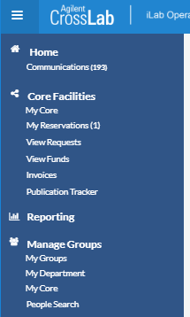
Adding a Center Number
Select My Department
Select My Departments
iLab Demo

Slide 9
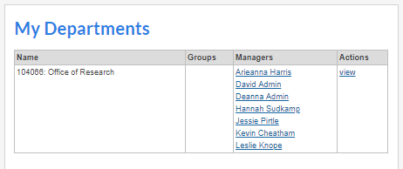
Adding a Center Number
Select View
There may be two department modules displayed.
Edit the module that begins with the department code to activate billing numbers for use in VUMC core groups.
The module that begins with ‘VUMC’ is used to manage billing numbers used in VU core groups.
iLab Dem

Slide 10
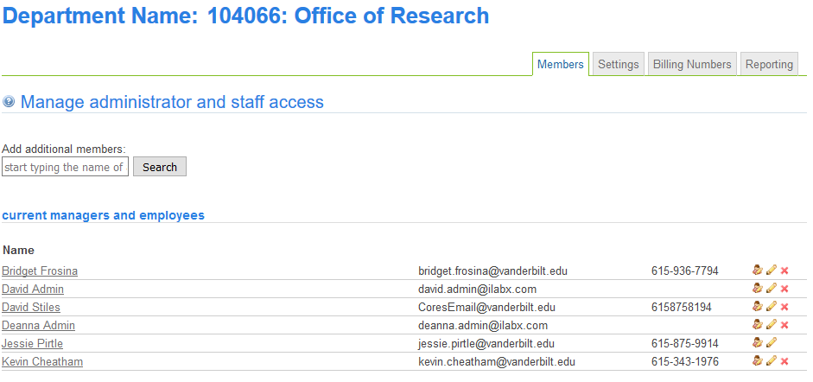
Adding a Center Number
Select Billing Numbers
iLab Demo

Slide 11
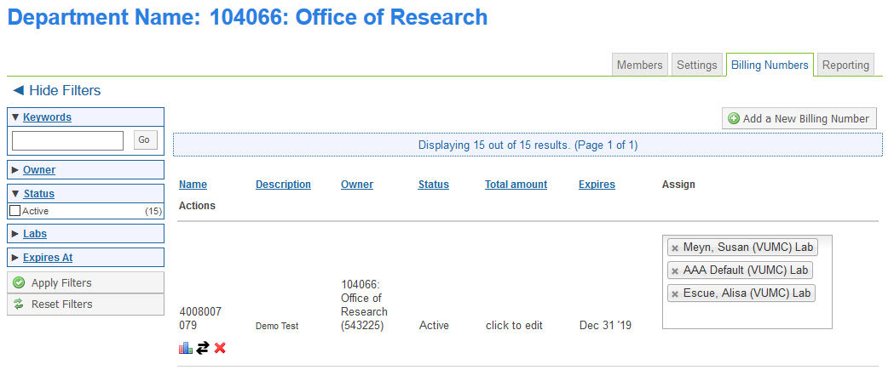
Adding a Center Number
Select Add a New Billing Number
iLab Demo

Slide 12
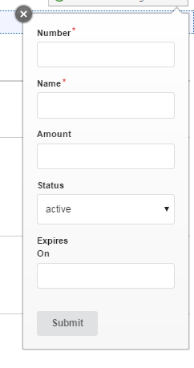
Adding a Center Number
Enter the Center Number
Enter the Center Number Name
Optional: Enter a spending limit amount.
Recommendation: leave blank
Optional: Enter the Center Number Expiration Date
Select Submit
iLab Demo

Slide 13
Adding a Center Number
Enter the
VUMC PI Lab Group Name
iLab allows multiple PIs to be added to a cost center.
iLab Demo

Slide 14
Assigning Lab Member Access
PIs
Lab Managers
iLab Demo

Slide 15
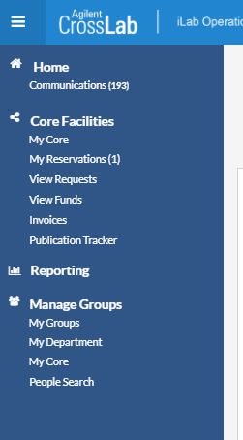
Assigning Lab Member Access
Select My Groups
Select
My Groups
iLab Demo

Slide 16
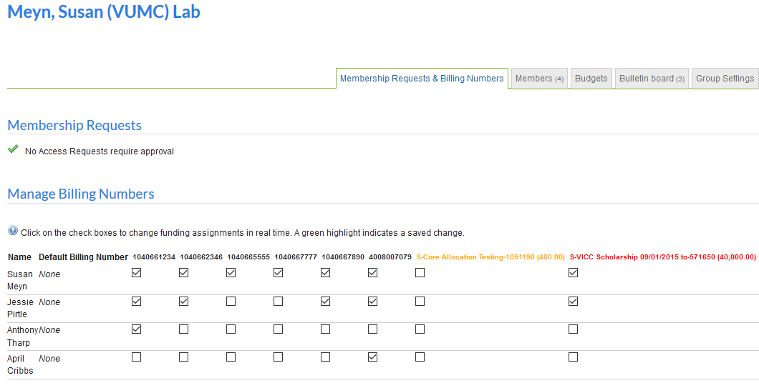
Assigning Lab Member Access
Select “Membership Requests & Billing Numbers”
iLab Demo

Slide 17
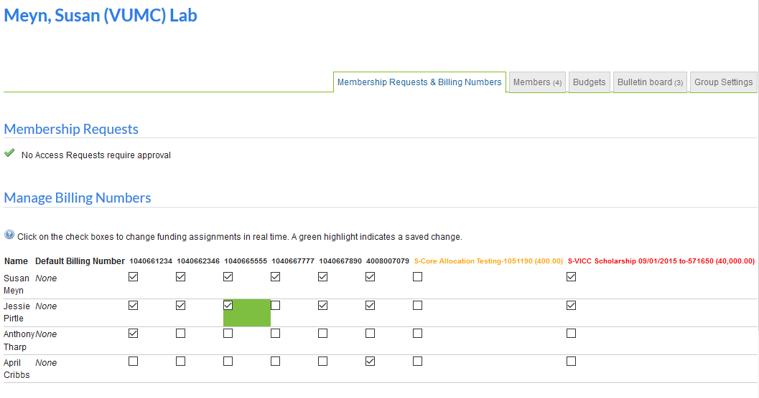
Assigning Lab Member Access
Check the box by the VUMC Center Number and User you want to grant access to.
iLab Demo

Slide 18
Project Workflow Demo
Request a Project
iLab Demo

Slide 19
Project Workflow Demo
iLab Demo
Select the Core
Click: Core Facilities

Slide 20
Project Workflow Demo
iLab Demo
Select the Core
Select the Name of Core

Slide 21
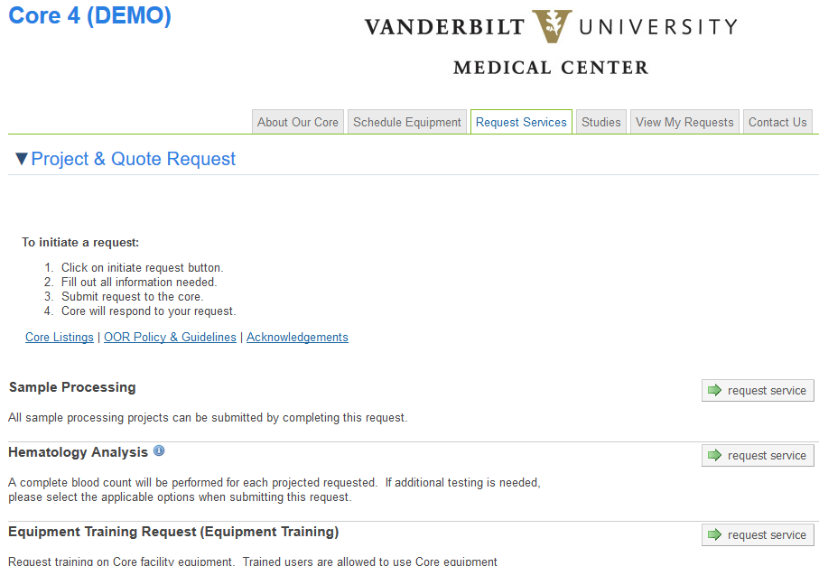
Project Workflow Demo
Request a Project
Select “Request Service”
iLab Demo

Slide 22
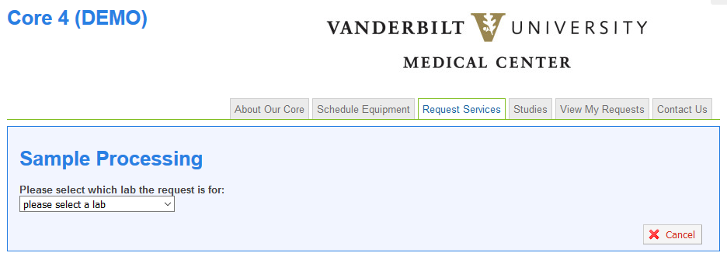
Project Workflow Demo
Request a Project
Select your lab’s name (PI) in the “lab” field.
Don’t see your PI’s name?
iLab Demo

Slide 23
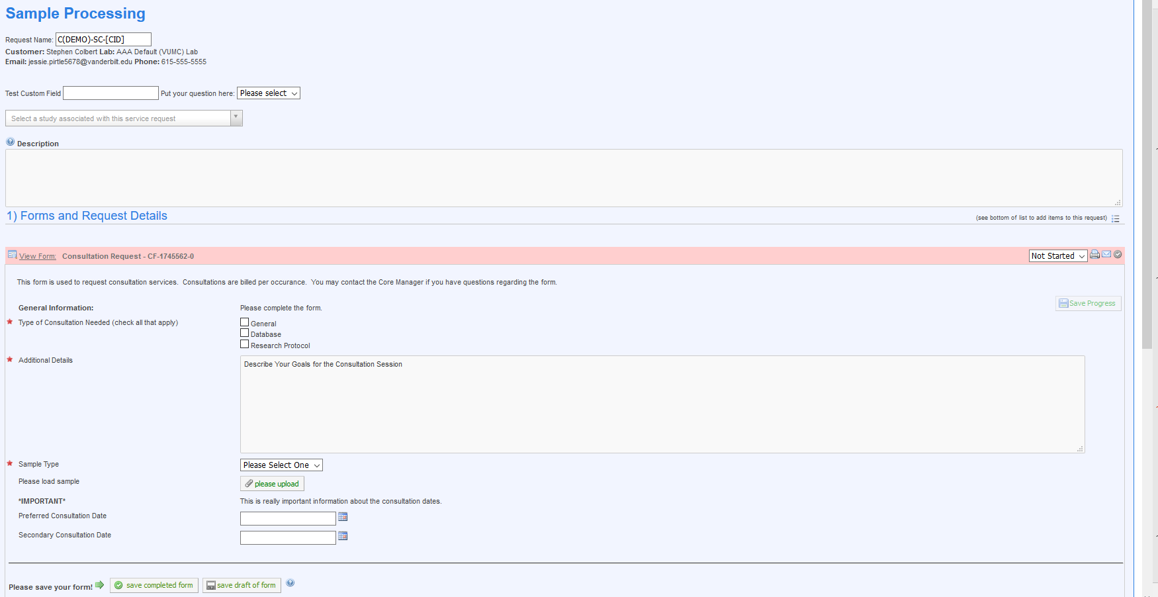
Project Workflow Demo
Request a Project
Complete the custom form.

Slide 24
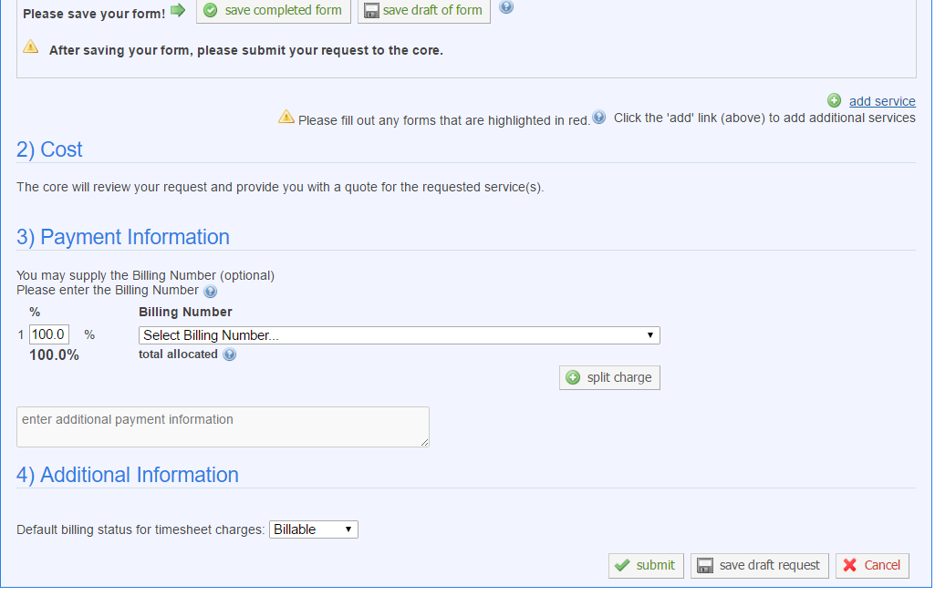
Select the user’s billing number.
Select submit request to core to continue.
Contact your Department Administrator if you need a Billing Number activated.
iLab Demo
Notes:
NOTE: For those of you that use scholarship funds (known as center funds in iLab), you will need to select “Center Fund” from the drop down menu to display a list of your available center funds.

Slide 25
Project Workflow Demo
Request a Project
The View All Requests tab will display.
You will be able to see all of your Service or Project Requests for this core by reviewing the View My Requests tab.
iLab Demo
Notes:
Note: This will only show service or project requests and you will need to view another tab to see pending reservations.

Slide 26
Reservation Workflow Demo
Request a Reservation
iLab Demo

Slide 27
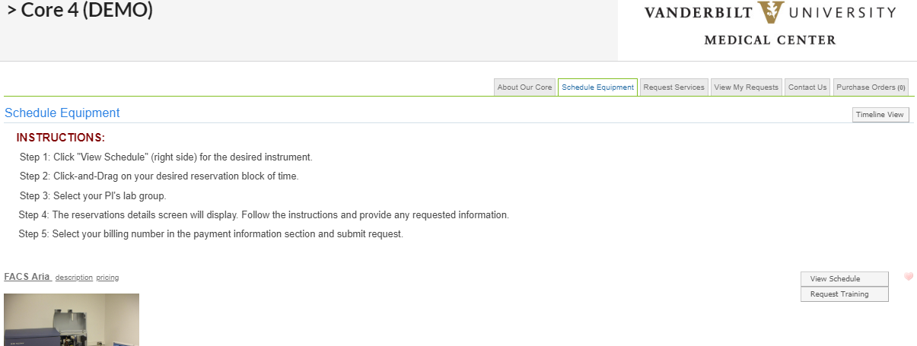
Reservation Workflow Demo
Select Schedule Equipment
Select View Schedule
iLab Demo
Notes:
Please note the “Reservation” tab can have various names. It can be called “Schedule Equipment”, “Schedule Services”, etc. Each core may have a slightly different name based on the services they may offer.

Slide 28
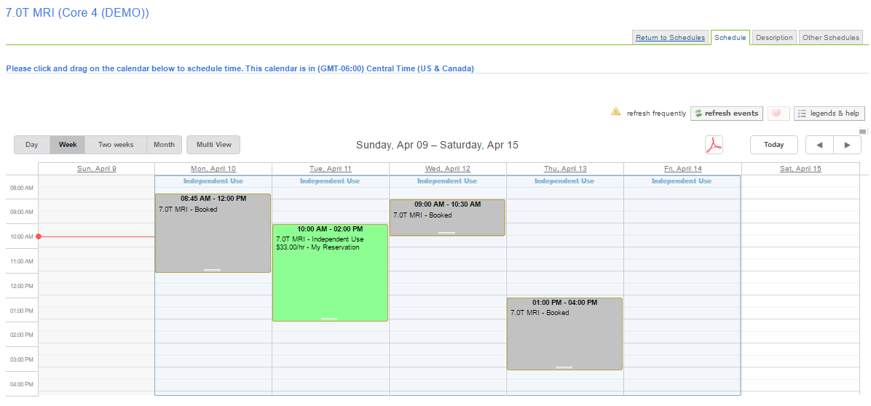
Reservation Workflow Demo
Select the Date/Time by dragging your cursor over the calendar.
iLab Demo
Notes:
Note: If the user has more than one (1) lab, they will need to select which lab they would like to make the request for.

Slide 29
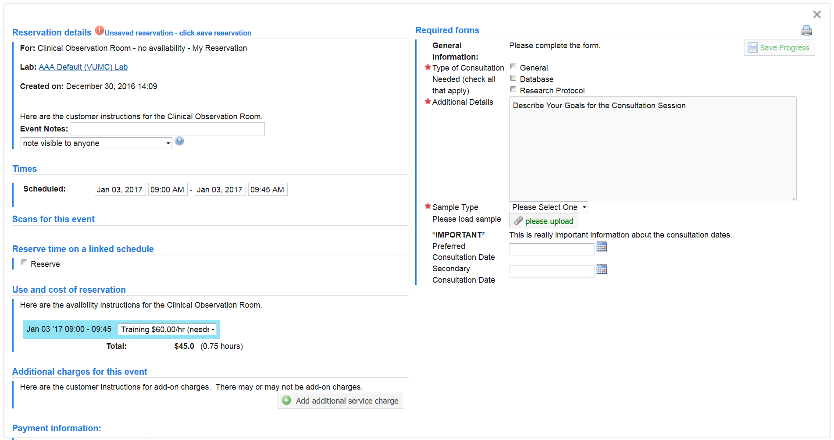
Reservation Workflow Demo
Complete Form
TIMES: Verify Date/Time USE & COST: Verify usage type (trained/ assisted use) if applicable
iLab Demo

Slide 30
Reservation Workflow Demo
Select Billing Number
Select Save Reservation
Contact your Department Administrator if you need a Billing Number activated.
iLab Demo

Slide 31
Reservation Workflow Demo
Reservation will appear on the calendar stating Pending Approval.
You will be able to see all of your Reservations for this core by reviewing the schedule.
iLab Demo
Notes:
NOTE: If core requires approval, it will be pending here. Not all reservations will require core approval.

Slide 32
VA Fund Selection Demo

Slide 33
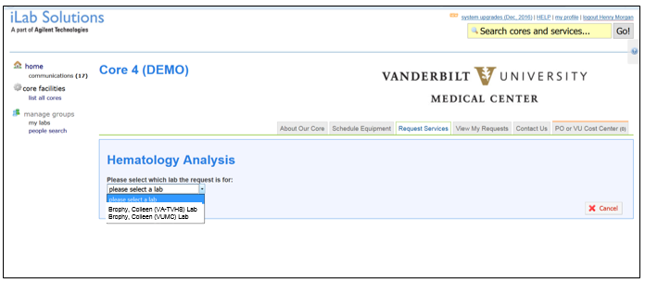
VA Fund Selection Demo
Select the
(VA-TVHS) Lab Group
PIs with VA Funding will have a separate VA Lab

Slide 34
VA Fund Selection Demo
Select the Standing PO
The Office of Research will manage the VA POs in collaboration with Mike Walsh at the VA.
Select your existing 999999####.
Email VUMCcores@vumc.org if you do not see your VA billing number.
Notes:
The iLab system does not allow us to centrally manage the encumbrance against the standing PO. Therefore, your lab will need to monitor the group’s spending with the VA fund number and ensure the lab does not overspend the amount awarded by the VA.

Slide 35
Scholarship Selection Demo
iLab Demo

Slide 36
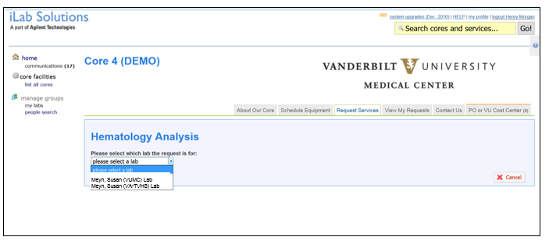
Scholarship Selection Demo
1
Select the VUMC Lab
Select the (VUMC) Lab
iLab Demo
Notes:
Note: If you only have one (1) lab, this will be your default.

Slide 37
Scholarship Selection Demo
Select Scholarships
Select the Scholarship fund number.
Once scholarships are added, the PI will receive an email notification.
If you do not see your scholarship fund, confirm you have been given access to the fund number by your PI or Lab Manager.
iLab Demo

Slide 38
Summary of Lab Groups
VUMC Labs
VUMC Cost Centers
Scholarships
VA Labs
Vouchers
VA Billing Number (999999####)

Slide 39
Lab groups available for VUMC Faculty
Smith, John (VUMC) Lab
Smith, John (VA) Lab
Fund Type:
Select this lab when you want to make core purchases/ reservations using your VUMC cost centers.
Select this lab when you want to make core purchases/ reservations using your scholarship or voucher funds.
VUMC Cost Centers
VUMC Cost Centers are activated by the department administrator.
Access to VUMC Cost Centers
The PI has automatic access to the VUMC cost center once activated by the department.
The PI or Lab Manager will need to grant access for specific users to specific cost centers via the PI’s fund grid.
Vouchers & Scholarships
Vouchers & Scholarships funds are activated in iLab via an outside process.
Access to Voucher & Scholarship Funds
The PI will have automatic access to these funds once activated
The PI or Lab Manager will need to grant access for specific users to specific cost centers via the PI’s fund grid.
Fund Type:
Select this lab when you want to make core purchases/ reservations using your VA Funds (99999XXXX)
VA Funds (999999xxxx)
VA funds are considered external funds.
VA funds are added as a ‘Standing PO’ number to each VUMC core facility that will be used.
The VA fund must be added for each individual lab member at each core facility.
Activating VA Funds
Contact the Office of Research to activate VA funds for each of the lab members.
NOTE: This is a manual process, and we will activate upon request. Please provide the VUMC core name and the name of the lab member.
Access to VA Funds
Once the VA fund has been added to the requested core site as a “Standing PO’, the user will have access to the fund.

Slide 40
Invoices

Slide 41
Invoice Demo
Select Invoices
iLab Demo

Slide 42
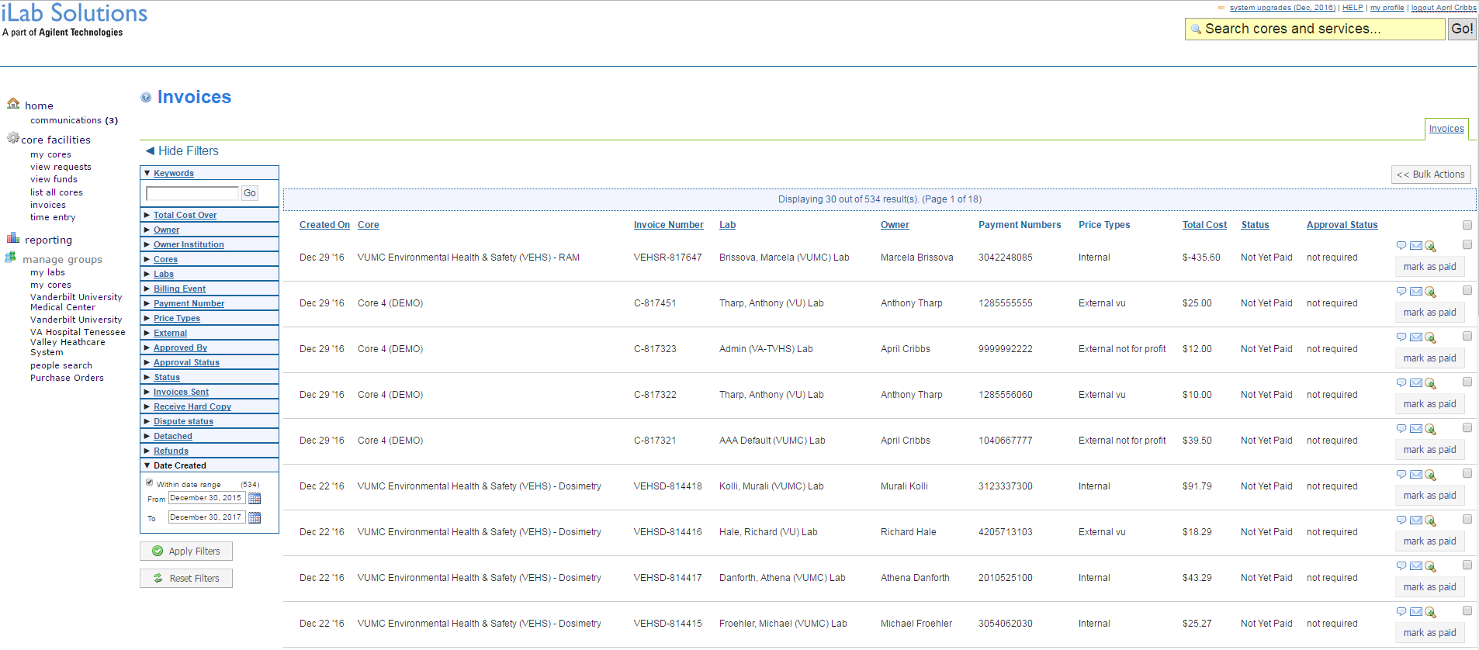
Invoice Demo
Optional: Filter to the invoice you are wanting to review
Select the magnifying glass to view the invoice.
iLab Demo

Slide 43
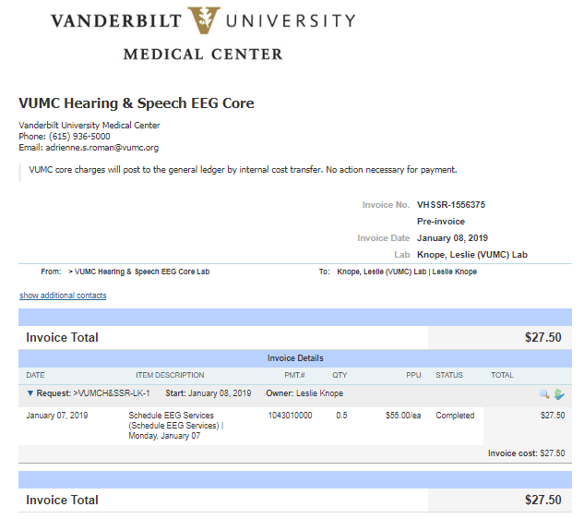
Invoice Demo
Pre-Invoice Status
Click the $ Icon to see the billing number
iLab Demo
Notes:
Note: Review where you see the payment # information.

Slide 44
Invoice Demo
To update the charges to a different billing number, select the check box for each charge in the payment list.
Using the Billing Number drop-down menu, select a new billing number.
Select Save
iLab Demo
Notes:
Note: Every month you will be able to review the pre-invoices on the 1st working day of the month. You will be able to make changes to the payment information at that time.

Slide 45
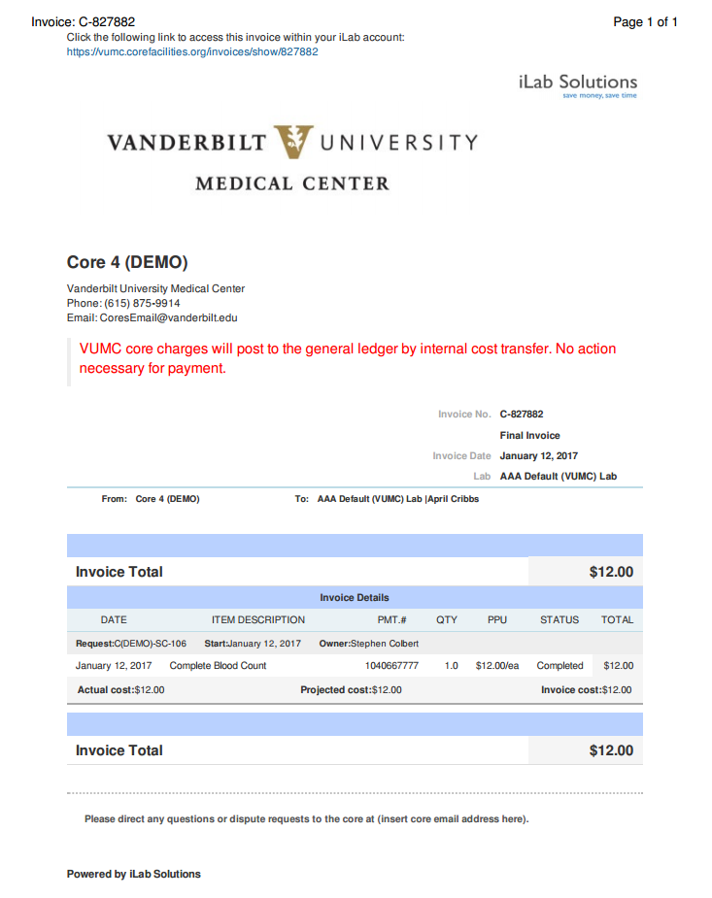
Final Invoice
If invoice status states “Final”, please contact the core for any refunds.
Final Invoice Status
iLab Demo
Notes:
Note: You cannot do a refund until the invoice is in a “Final Invoice” status. Once the invoice is in the “Final Invoice” status, you are unable to update the distribution of charges at this time.

Slide 46
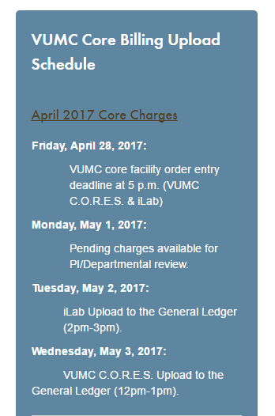
Pre-Invoices are generally available between noon and 1pm on the 1st Business Day.
Final invoices are generated around noon on the 2nd Business Day.
Users have roughly 24 hours to review the pre-invoice reports.
TIP: Use the reporting module to view completed charges that will be included on that month’s invoices.
Billing numbers can also be updated on orders in the ‘completed’ state.

Slide 47
Reporting Demo

Slide 48
Reporting Training
Select Reporting

Slide 49
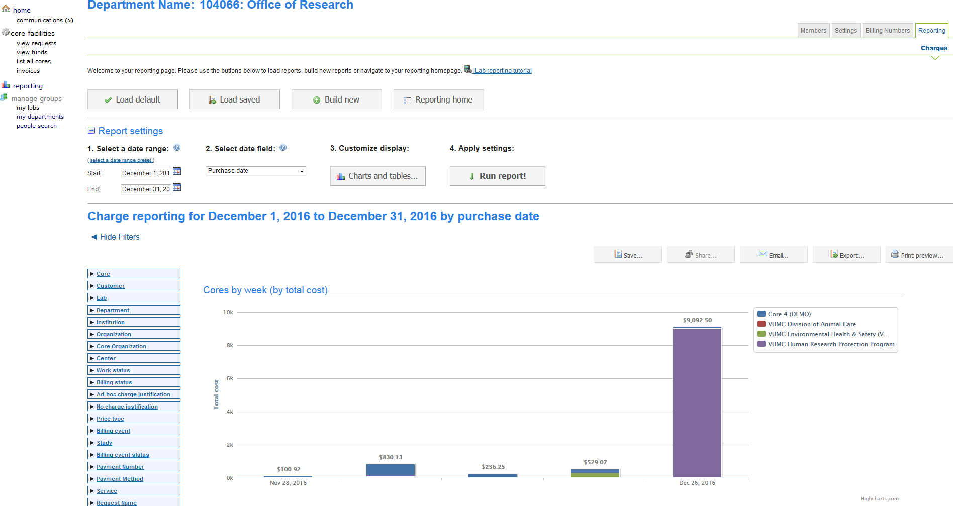
Reporting Demo
Watch the iLab Reporting Tutorial
Notes:
Review: 1) Load Default, 2) Run Report, 3) Filters, 4) Exporting Reports, 5) Customizable Report, 6) Save a Report

Slide 50
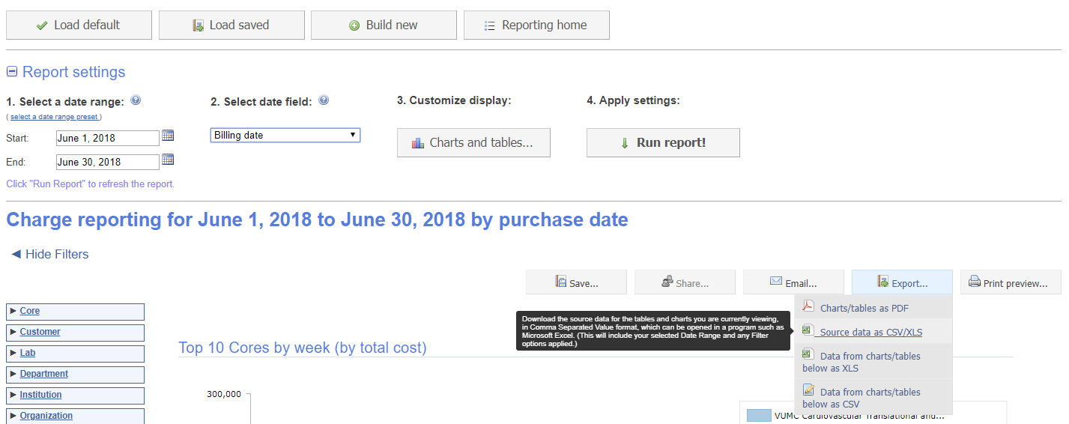
Reporting Demo
Reporting: Ledger Reconciliation
Export a csv file of all charges invoiced during the date range:
If the Billing Status column references “Billing_initialized”, then the charges on that line have been completed for billing by the core.
If the Invoice Number column references an invoice number, then the charges on that line have been invoiced.
The invoice number should display on the general ledger reports.

Slide 51
User Support
VUMC Department User Training Sessions
Dept. Admins, PIs & Lab Managers
Online User Guides and FAQs

Slide 52
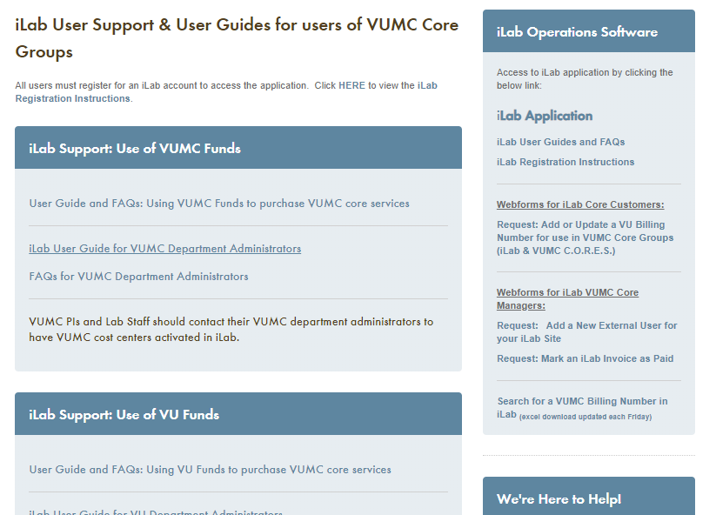
Office of Research Website:
Link to iLab Operations Application
Registration Instructions
User Guides
FAQs
https://www.vumc.org/oor/ilab-user-support-user-guides-users-vumc-core-groups

Slide 53
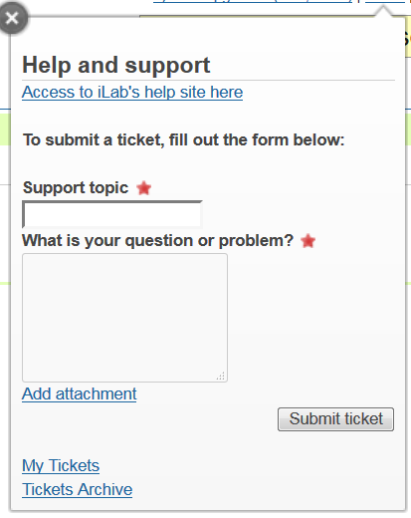
iLab Support
Select HELP
Complete the questionnaire and select Submit Ticket
Notes:
You can “Add Attachments” and view Archived Tickets.

Slide 54
We’re Here to Help
iLab/VUMC C.O.R.E.S Office Hours:
10:00am to 11:00am on Thursdays
Reservations required.
VUMC Office of Research Support Email Address:
VUMCcores@vumc.org
Or, contact the core manager!
Our support team can assist with any questions related to the
access to VUMC core group services
available in the iLab or VUMC C.O.R.E.S. applications.

Slide 55
Questions?
VUMC Core Questions:
VUMC Office of Research
VUMCcores@vumc.org
VUMC Core List:
https://www.vumc.org/oor/full-listing-vanderbilt-research-cores-and-shared-resources
VU Core Questions:
VU Office of Contracts and Grant Accounting
CoresVU@Vanderbilt.edu
VU Core List:
https://www.vanderbilt.edu/cores/cores-facilities.php

