Slide 1
Central IT Groups at VUMC
VUMC IT
Infrastructure
Enterprise Administrative Applications
Enterprise Cybersecurity
IT Security
IT Risk Management
Health IT
Clinical Applications
Revenue Cycle Applications

Slide 2
All About VUMC IT
Colleen Egan, Associate Director VUMC IT

Slide 3
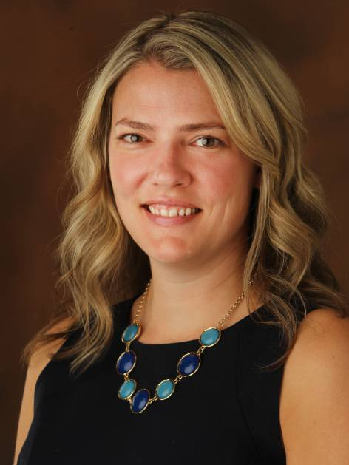
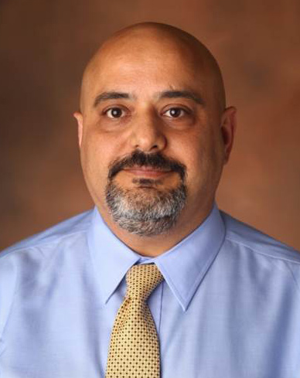
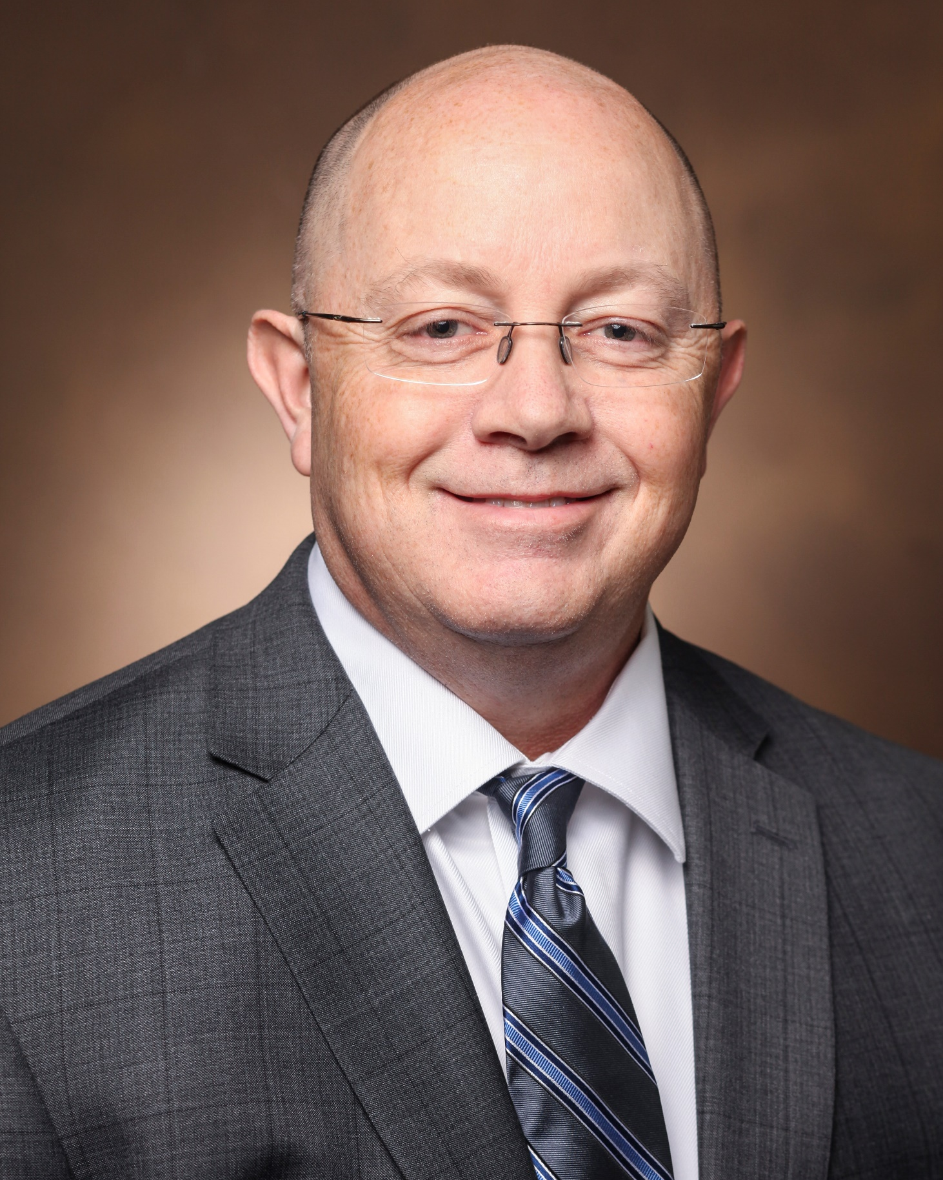
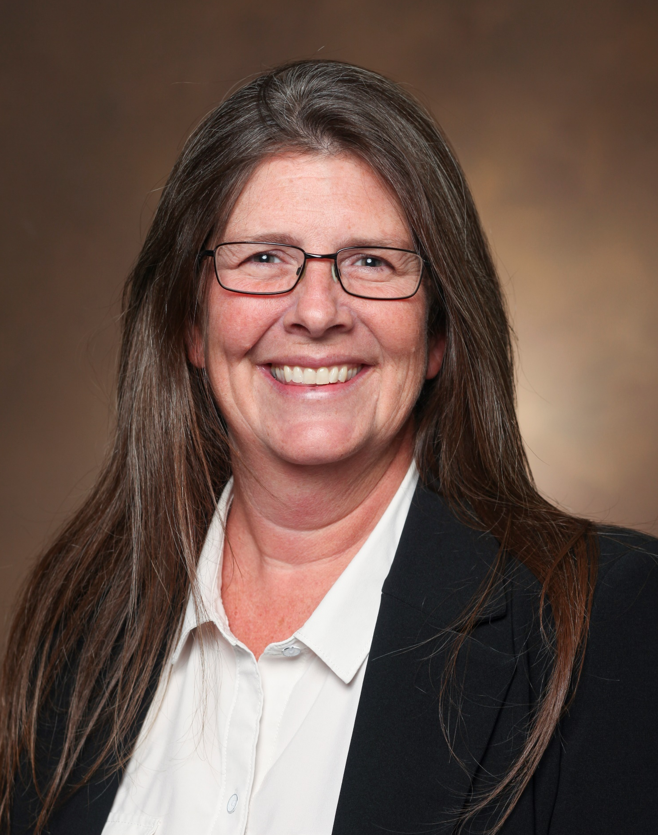
~$91M operating budget
272 Total FTEs
Sarah Hagovsky
CIO, VUMC IT
Esfandiar Zafar
IT Operations
Jason Williamson
Enterprise Product Management
Cheryl Warner
Program Management Office
Trish Zoller
Business Operations

Slide 4
VUMC IT Services
cx
End User Services
Help Desk
Audio Visual Services
Voice & Data Network Services
$
Identity Management
Enterprise Product Management
Business Intelligence
Data Center Services
Hosting Services
Cloud Services
IT Service Management
Program Management Office
Business Operations
Notes:
FTEs – 262 occupied; 272 budgeted, $91M opex
Data Centers – 3, consolidating to 2
Hosting Servers – primarily MS shop with Windows Server OS (~1300), Linux (~330), Oracle WebLogic (~100)
Hosting Storage – Block Storage (~1,168 TB), NAS Storage (~2,608 TB), Storage Backup (10,152 TB), File share Storage (~2,000 TB) = ~16 PB of data
Cloud Services – O365, Box
IDM – 21k active ee accounts, 12k active non-ee accounts, 3200 pw changes
End User Services – Physical machines (~20,000), Virtual machines (~15,000)
Help Desks – NTT (~13k calls/month), CAST (~4k calls/month)

Slide 5
Strategic Focus for VUMC IT
Position for Aggressive Growth
1
Reinforce the Foundation
2
Develop our Team
3

Slide 6
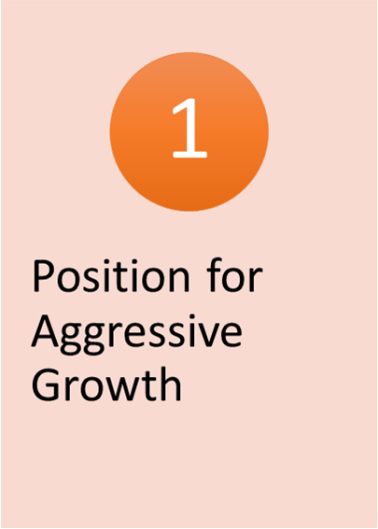
Pressure from market forces:
Demand for VUMC services
Population growth in middle Tennessee
Aging and increasing health complexities of populations we serve
Industry consolidation
How VUMC is meeting these challenges:
Grow our footprint and strengthen our brand
Expand high-margin service lines
Locate right type of care in right location
Execute on smart and strategic growth
VUMC IT role:
Support this rapid expansion with agility and scalability
Confirm strategies across all of our IT services
Understand our resource capacity, costs and demand
Use governance to ensure alignment
Notes:
Smart & strategic growth:
High-growth areas first (suburbs and exurbs)
Alleviating stress on our EDs through urgent and walk-in care clinics
Funnel complex care and lower acuity to appropriate places
Acquisition vs. new build where it makes sense

Slide 7
Vendor Consolidation
ERP

Slide 8
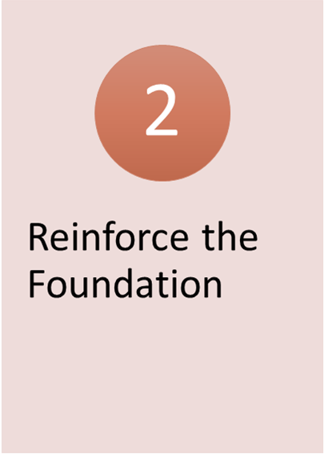
Infrastructure, security and IT operational excellence continue to be priority
Service catalog
Product catalog
Cost modeling
Key metrics
TMO projects will continue over next 5 years including:
Email separation
Network core and wireless separation
Identity management system replacement
Directory services separation
Voice reparation
ERP replacement

Slide 9
Balanced Hosting Approach
Notes:
Continue to execute Cloud-ready/Cloud-enabled approaches in our data centers – move to the appropriate balance on on-prem and cloud environments to reduce risk and improve flexibility/scalability

Slide 10
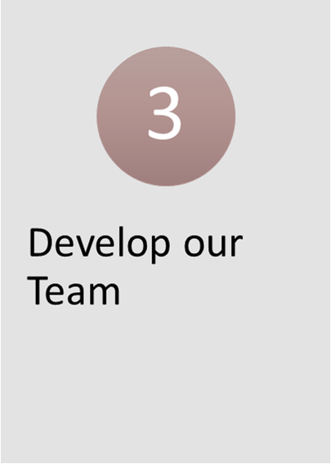
Lots of opportunities to learn new platforms, new technologies, new management techniques
Training, training, training
Retooling individuals and teams
Stretch assignments with opportunities to gain broader experience in new areas
Leadership development

Slide 11
How to Connect to IT
HELP DESK
615.343.HELP (3-4357)
REQUEST TICKET
https://pegasus.mc.vanderbilt.edu/ess/Submit
WEB
www.vumc.org/it
EMAIL
ITConnect@vumc.org

Slide 12
Appendix

Slide 13
Responsible for:
Applications
Security patches
System updates
Drivers for CWS and AWS
Supports:
App Store
Workspace ONE
Print hosting (clinical and non-clinical)
End User Services
20K physical machines
15K virtual machines
Current project initiatives include:
Windows 10 Upgrade
Imprivata Implementation (CWS badge tap solution)
Epic SU implementation support
Notes:
Also known as Desktop Engineering, the End User Services team integrates applications, security patches, system updates, and drivers for physical and virtual clinical work stations (CWS), as well as administrative work stations (AWS)
Windows print hosting

Slide 14
2 Help Desks:
NTT Help Desk (Tier 1)
Enterprise and administrative products/services (Laptops, Office 365, Skype for Business, etc.)
CAST Help Desk (Tiers 1 & 2)
Clinical applications (eStar, Cerner, etc.)
NTT team:
Field technicians can resolve on-site issues
Pool of resources for special projects
Help Desk
NTT Help Desk: 13K calls/month
CAST Help Desk: 4K calls/month
Current project initiatives include:
Windows 10 Upgrade
WorkspaceOne deployment
Notes:
VUMC IT provides two Help Desks for VUMC:
NTT provides Tier 1 help desk support for enterprise and administrative products and services, as well as field technicians to resolve issues where users reside
NTT also provides a project pool that VUMC IT and departments can leverage to support special, long- or short-duration project initiatives
Clinical Application Support Team (CAST) provides Tier 1 and Tier 2 help desk support for clinical systems

Slide 15
Vanderbilt Audiovisual Services and Technology (VAST)
Video conferencing
Digital signage
Audiovisual
Telehealth
EPIC/ZOOM/My Health at Vanderbilt Direct-to-Patient
EPIC/ZOOM Provider-to-Provider
Telehealth technology administration and support (e.g., cameras, scopes, carts)
Audio Visual Services
644 Video calls
199 conference recordings
473 Jabber accounts
254 ZOOM accounts
27 digital media players deployed in VHVI Murfreesboro, TMO, VISE, CVICU, IMPH, Hearing and Speech and others
364 meeting, collaboration, conference rooms
Current projects and initiatives
Life Cycle of Video Conference and video recording infrastructure
Supporting existing and new Telehealth initiatives to include Tele neurology for Lebanon
Deployment of new Digital signs for PRB and upgrades for VHVI Murfreesboro
Renovation/deployment of AV technology in multiple locations including 3401, Grassmere, MCN, and others

Slide 16
Voice and Data Network Services
Administration, support and maintenance of the data network
Administration, support and maintenance of the voice network
Highly available voice and data networks with physically redundant components in data centers and patient care facilities.
Voice and Data Network Services
Wired network: ~1,500 switches providing roughly 70,000 ports
Wireless network: >3,500 access points
Voice network: >30,000 phone lines and ~5,000,000 minutes of call volume monthly
Current Strategic Initiatives:
Continued development and deployment of the Cisco ACI software defined networking architecture in the data centers
Implementation of Cisco PCCE for Care Connections and other ACD/IVR related services
Continued development and deployment of the Trusted Wireless Health architecture throughout the Medical Center

Slide 17
Manages access to digital resources through provisioning and management of VUMC IDs
Identity Management
Total active employee accounts: 21,747
Total active non-employee accounts: 11,812
Total VUMC monthly password changes: 4000 - 5000
Total VUNetID for Life accounts: 119,327
Current project initiatives include:
VUMC PING Single Sign On Consolidation
Identity Management System Replacement
Notes:
The Identity Management team manages access to digital resources through the provisioning of VUMC IDs for staff, faculty, and other affiliated individuals.
This virtual identity allows users to log into network resources and access applications that have been configured to use VUMC IDs for authentication.

Slide 18
Core enterprise solutions (Office 365, Box, etc.)
Administrative application development (Peoplesoft HR and Financials, McCormack & Dodge General Ledger)
$
Enterprise Product Management
McCormack & Dodge GL is 40+ year-old mainframe application!
Following separation from VU, VUMC provided ERP services to VU for 2+ years
Current project initiatives include:
Disaster Recovery and risk mitigation for legacy infrastructure and operating systems
FTP to sFTP migrations from Tivoli to Stonebranch
Upgrade GL to support FY 2020 activities
Notes:
The VUMC Enterprise Product Management team supports core enterprise solutions including Microsoft Office 365 as well as Box.
This team also supports our Administrative Application Development including our legacy ERP solutions Peoplesoft HR and Financials, and the McCormack & Dodge General Ledger

Slide 19
Technical support for Business Objects and Tableau end users
Data warehouse and ETL solutions for non-clinical applications (general ledger, DMS, supply chain, medical giving and others)
Business Objects Universe development
Supports:
Upgrade of Tableau environment
Upgrade of Business Objects environment
Business Intelligence
~3500 Bus Objects Application users
~3000 Tableau Application users
Current project initiatives include:
Data integration of non-clinical applications
Data warehouse changes for application upgrades
New Business Objects universe development for existing and new applications
Notes:
Also known as Desktop Engineering, the End User Services team integrates applications, security patches, system updates, and drivers for physical and virtual clinical work stations (CWS), as well as administrative work stations (AWS)
Windows print hosting

Slide 20
Operational management for facilities housing mission-critical IT systems
Power, cooling, racks, room-level space planning, maintenance, environmental status monitoring, engineering, and security and access control
IT Operations Center (ITOC)
Crisis management
Emergency response management
Disaster recovery
Data Center Services
3 main data centers:
Vanderbilt University Hospital (VUH) Data Center (DC1)
vXchange (DC2)
TierPoint (DC3)
Current project initiatives include:
Vacating vXchange (DC2) and consolidating DR to TierPoint (DC3)
Notes:
VUMC IT Facilities Management is accountable for providing operational management for facilities housing mission critical IT systems
Responsible for oversight of VUMC’s data center facilities including power, cooling, racks, room-level space planning, maintenance, environmental status monitoring, engineering, and security and access control
IT Operations Center (ITOC) is responsible for supporting crisis management, emergency response management, and disaster recovery

Slide 21
VUMC IT Hosting Team
Server and storage administration of virtual and physical server environments
Database Administration team:
Installation, configuration, backup and monitoring functions for VUMC’s production databases
Hosting Services
VUMC IT primarily hosts Microsoft server operating systems (~1,300), but provides some Linux (~215) and Oracle WebLogic (~100) support as well
DBA host 250 instances of SQL Server and 225 instances of Oracle databases
VUMC IT currently supports ~16 Petabytes of storage!
Current project initiatives include:
SQL 2008 upgrades
Windows Server 03/08 upgrades
Redhat 6 and Oracle WebLogic upgrades
Physical server virtualization with full encryption
Notes:
The VUMC IT Hosting Team provides server and storage administration of our virtual and physical server environments.
The Database Administration team is responsible for the installation, configuration, backup, and monitoring functions for VUMC’s production databases

Slide 22
Responsible for:
Microsoft Azure & Amazon Web Services
Microsoft Office 365 Platform
Box
Supports:
Microsoft Office 365 Licensing
Box Sync, Box Edit, Box Mobile Clients
Cloud Services
29K Microsoft Licenses
14K Box Users
Current project initiatives include:
Enterprise Cloud Architecture Framework
Intune Application Protection Assessment
Intune Assessment to support Paperless Clinics

Slide 23
How VUMC IT plans, designs, delivers, operates and controls IT services:
Change management
Incident management
Knowledge management
Root cause analysis and remediation
Request fulfillment
Management of Pegasus system for tickets
Service Management
Current Project Initiatives Include:
PHI in Pegasus
Change Management Upgrade

Slide 24
Cross-functional team includes:
Formal Project Management Services from project approval to implementation
Workflow analysis, business requirement documentation, scope definition
Relationship management between VUMC IT and business units
Governance navigation and escalation for service failure or high-priority requests
Program Management Office
Enables productivity of entire VUMC workforce
Supports 15 distinct administrative groups, plus Research, IT, and general VUMC population
Current project initiatives include:
Approximately 80 active projects
Average of 85 infrastructure technology requests
139 Closed projects YTD

Slide 25
Administration support
Procurement and vendor management
Purchasing (RFP/RFI)
Contracts review
Vendor relationships
Finance and accounting
Capacity management
Communications
Human resources
Business Operations

