Slide 1

First Annual Update
Notes:
The Brock Center launched with a philanthropic gift by the Brock Family in May 2022.

Slide 2
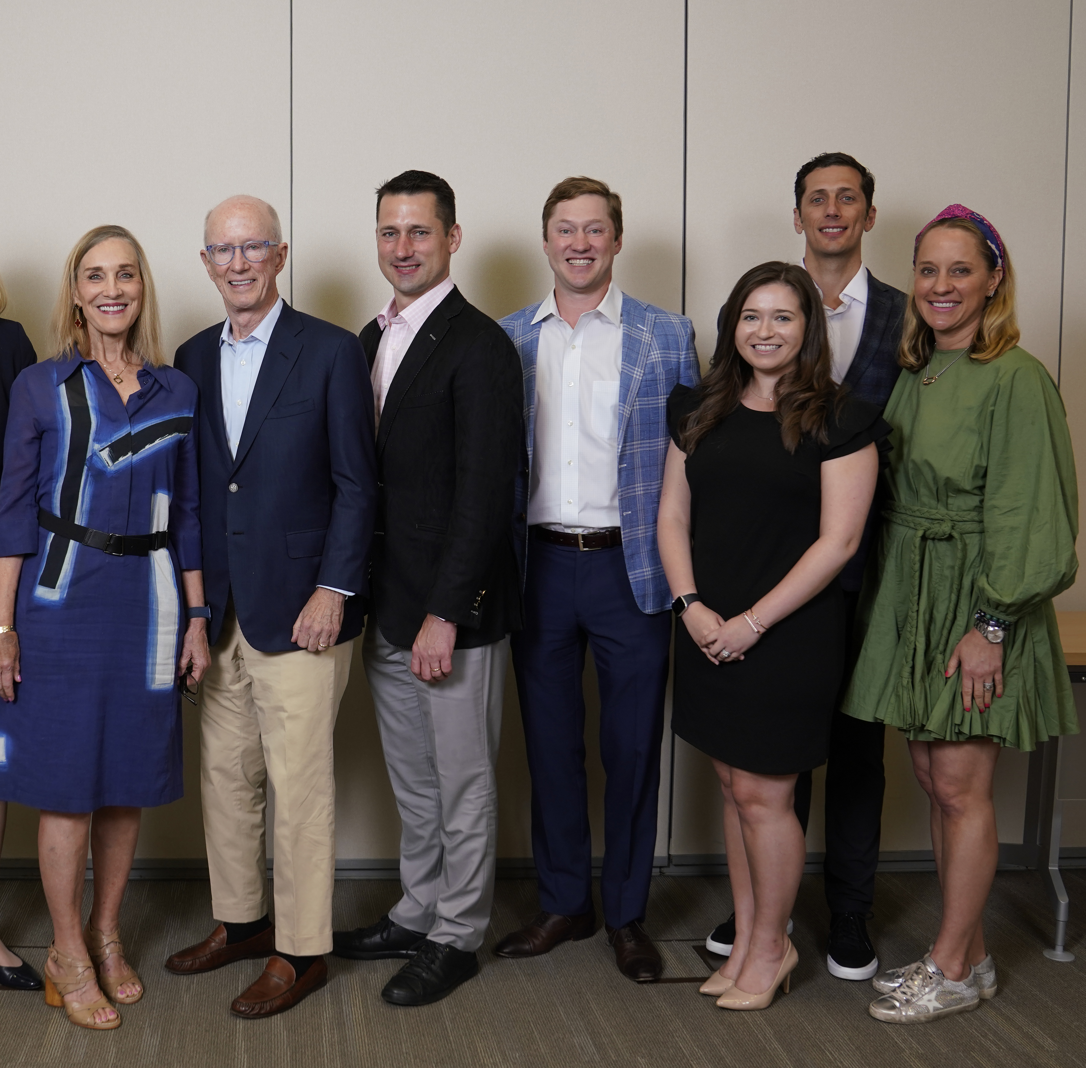
Established with $10M Gift from the Brock Family
From left: Mary Brock, John Brock III, John Brock IV, Major Brock,
Morgan Brock, Adam Dixon, Rebecca Brock Dixon
May 2022
Notes:
1. The Brock Family Center for Applied Innovation was announced May 31, 2022 with a $10 million gift from John F. Brock III and his wife Mary, and their three adult children Rebecca Brock Dixon, John F. Brock IV, and Major Brock.
The Brock Center is a catalyst and a collaboration center, leading and coordinating the evaluation and development of new ideas and start up companies. The Brock Family Center collaborates openly with internal VUMC discovery, innovation and business groups, and external innovation and business groups, including, very much so, our family and friends at VU. When we say Join The Family! , it means that we take action to develop the relationships and collaborations between groups necessary to make translation and commercialization opportunities reach their highest potential. Education, recognition, and development of an entrepreneurship culture at VUMC is a complementary second important objective.

Slide 3
Vision
Strategy
To accelerate the translation of VUMC discoveries and know-how to the public domain through commercialization and industry partnerships.
Engage Vanderbilt Community
Catalyze innovation formulation
Enable sustainable glidepath to commercialization

Slide 4
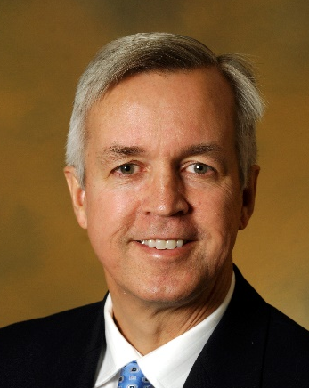
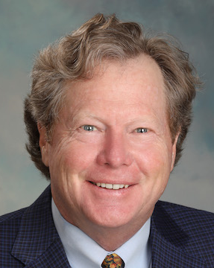
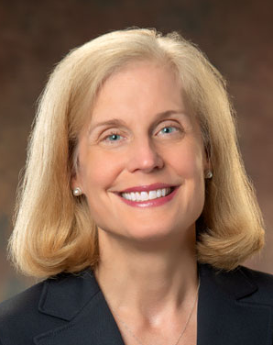
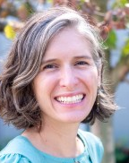
Leadership team
Ken Holroyd, MD, MBA
Co-Leader (Lead)
Vice President Tech Transfer Medical Director, CTTC
Jon Duane, MBA
Co-Leader
Emeritus Partner, McKinsey & Co.
Jennifer Pietenpol, PhD
Co-Leader
Chief Scientific and Strategy Officer, VUMC
Russelle Bradbury, MSW
Program Manager
Notes:
Leadership of the Brock Family Center is Jennifer Pietenpol, CSSO; Ken Holroyd, a pulmonologist and anesthesiologist who is Medical Director of the Center for Technology Transfer and Commercialization with 17 years experience at VUMC, serving on the Boards of innovation public-private partnerships, digital health, medical device, biopharmaceutical, and non-profit organizations, all on behalf of Vanderbilt, and a former COO of a NASDAQ biopharmaceutical company; and Jon Duane, who is Executive Chairman of Nashville Biosciences, and a former Senior Partner of McKinsey and Company, where he developed their life sciences practice including pharmaceuticals, medical devices, diagnostics and health services; and Russelle Bradbury, who is Program Manager, joining in January 2023 as Brock Family Center employee number one, with a background in non-profit, grant and program management.

Slide 5
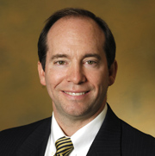
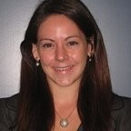

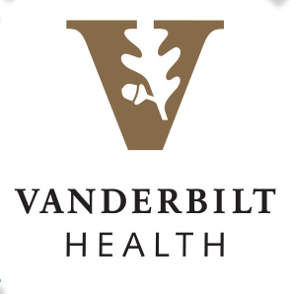
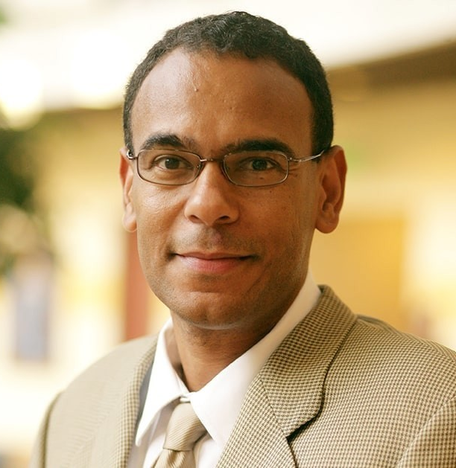
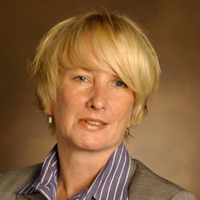
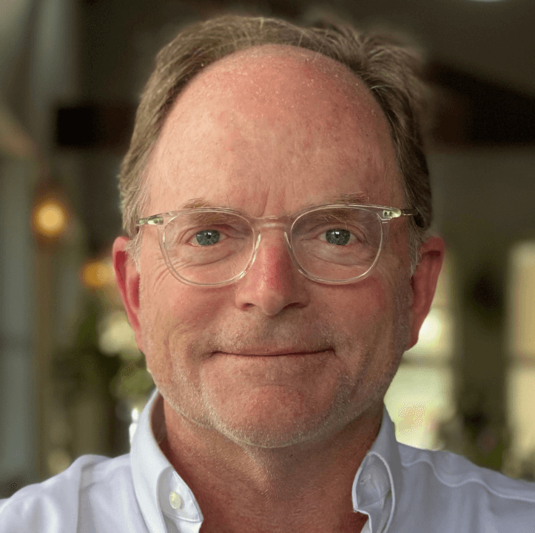
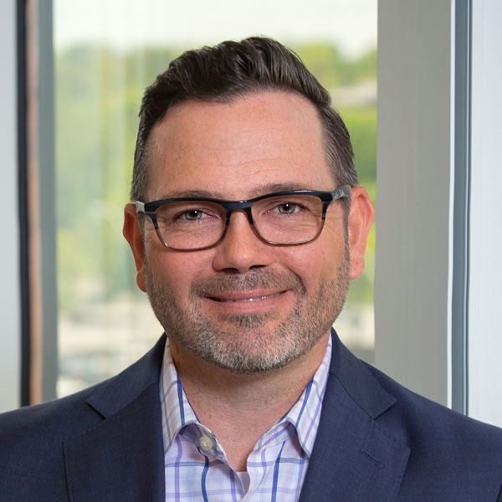
Brock Family Center Partners
VENTURE CAPITAL
INVESTMENT BANKS
Alan Bentley, Assistant Vice Chancellor
Center for Technology Transfer & Commercialization
Brock Family
Center
Collaborative Ecosystem
Olivia Bryant, Senior Vice President
Vanderbilt Health Professional Solutions
David Owens, Executive Director
The Wond’ry
Laura Beth Brown, Senior Vice President
Vanderbilt Health Services
INNOVATION STUDIOS
EXECUTIVE STAFFING FIRMS
John Lehman, Adjunct Professor of Management
Owen Graduate School of Management
Brent McDonald, Senior Vice President
Vanderbilt Health Affiliated Network
Notes:
Our ecosystem includes all of the internal groups interested in new health and medical technology and business innovation: the Center for Technology Transfer and Commercialization, serving both VUMC and VU, has the greatest overlap in mission, and there is also very significant overlap of mission and interests with Health Professional Solutions, Vanderbilt Health Services, Population Health, the Wond'ry, and the Owen Graduate School of Management, in addition to our faculty members, departments, institutes, and centers at VUMC and VU. Externally, the Brock Family Center partners with venture capital firms and investment banks, innovation studios and executives staffing firms to provide the necessary resources for assessment, incubation, development and acceleration of new businesses.

Slide 6

Engagement
58 Vanderbilt entrepreneurs:
17 financial and staff partners
32 internal Vanderbilt projects
5 external projects
School of Medicine
Faculty
Staff
Residents
College of Arts & Sciences
School of Engineering
Notes:
Currently, by the numbers, the Brock Family Center has 23 active internal projects, collaborating in the evaluation and development pf start up ideas, assisting with fundraising, and in one case selling an internal business unit. The internal projects are brought forward by a total of 35 faculty, staff and residents are 3 external projects currently, two of which relate to digital health. The Brock Family Center is actively planning to significantly increase outreach and development of relationships in the digital health areas in particular, to increase the number of external projects. External projects could include developing proof of concept and product development in partnership with VUMC internal IT and data capabilities, as is done similarly by organizations such as Cedars-Sinai Ventures, Mayo Clinic Ventures, and University of Pittsburgh Medical Center Enterprises (UPMC Enterprises). The Brock Family Center can consider funding these co-development opportunities, as it is planning to do with the nference project. Now let's consider 3 of the 23 current active internal projects.

Slide 7
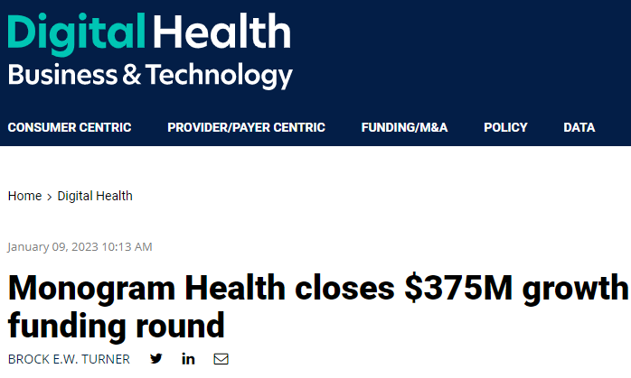
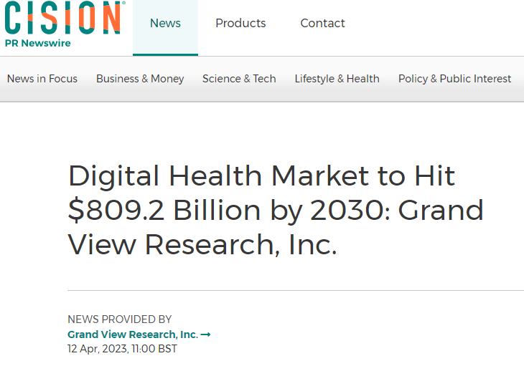
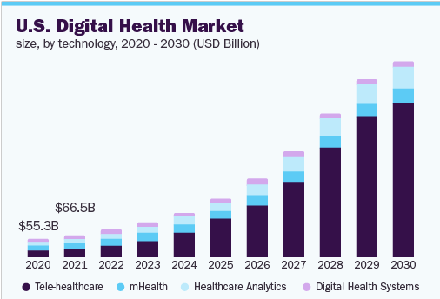
Digital Health Focus

Slide 8


Education, recognition and culture
SEMINAR SERIES
COMING FALL 2023:
Inaugural Brock Family Center INNOVATOR OF THE YEAR
Notes:
The second important goal is building an entrepreneurial culture, including through education, and recognition. Susan Eagle, a serial entrepreneur having founded three successful medical device companies with VU partners, was the first speaker for a new educational speaker series, From Concept to Commercialization: Translational and Entrepreneurial Journeys. The speaker series is jointly sponsored by the Brock Family Center and by CTTC. About eight talks a year are scheduled, largely drawing from external experts and the 80 or so VUMC and VU faculty members who have already been involved in starting at least once company. Selection of a first annual Innovator Award, to be awarded in the fall of 2023.

