Slide 1
Spatial immunophenotyping using the phenocycler platform
Lejla Pasic, MLI
Research Assistant III
Innovative Translational Research (ITR) Shared Resource

Slide 2
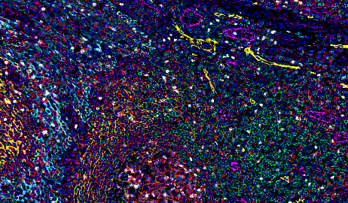
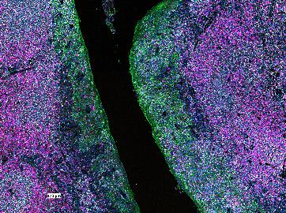
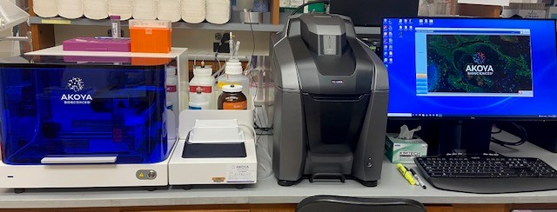
PHENOCYCLER SYSTEM
(Akoya Biosciences)
Formerly known as the CODEX Platform: CO-Detection by indEXing

Slide 3
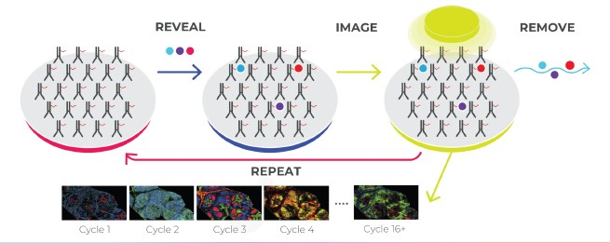
Codex Technology
CODEX ANTIBODIES
CODEX REPORTERS
CODEX
ANTIBODY PANEL
TISSUE
STAIN
Oligonucleotide (barcode) conjugated antibodies for building antibody panels
Fluorophore conjugated oligonucleotides for visualization of CODEX antibodies
REVEAL
IMAGE
REMOVE .
REPEAT
CYCLE :
1 2 3 4 16+
https://www.akoyabio.com/intro-to-codex/

Slide 4
Completed Antibody Panels
14-antibody panel on fresh frozen human HNSCC
14-antibody panel on FFPE RCC and tonsil
24-antibody panel on FFPE breast tissue
Antibodies labeled in black were provided off-the shelf from Akoya Biosciences, pre-conjugated to barcodes.
Arrows indicate antibodies that were newly added to each panel. Over time, we learn which antibodies work together in each cycle, so that we can plan more complex panels in the future.
Antibodies with a purple label were custom conjugated to a barcode in-house.
CD45
CD3
CD4
CD8
CD19
CD69
CD104
HLA-DR
PD-1 (CD279)
Cytokeratin
Ki67
CD31
CD38
CD11c
CD45
CD4
CD8
HLA-DR
Cytokeratin
Ki67
CD11c
CD31
CD19
CD69
CD104
PD-1 (CD279)
CD38
CD3
CD45
CD4
CD8
HLA-DR
Cytokeratin
Ki67
CD11c
CD31
CD20
CD68
CD107a
Podoplanin
TFAM
CD3e
CD45
CD3e
CD4
CD8
CD20
CD68
TFAM
HLA-DR
Podoplanin
Cytokeratin
Ki67
CD31
CD107a
CD11c
CD45
CD4
CD8
HLA-DR
Cytokeratin
Ki67
CD11c
PD-L1
CD20
CD68
CD107a
FOXP3
Granzyme B
CD163
CD45
PD-L1
CD4
CD8
CD20
CD68
Granzyme B
HLA-DR
FOXP3
Cytokeratin
Ki67
CD163
CD107a
CD11c
HLA-A
CD56
CD45RO
GATA3
ER
Keratin8/18
Keratin5
HER2
PR
AR

Slide 5
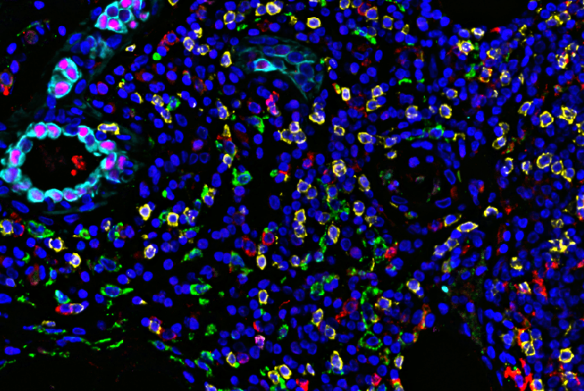
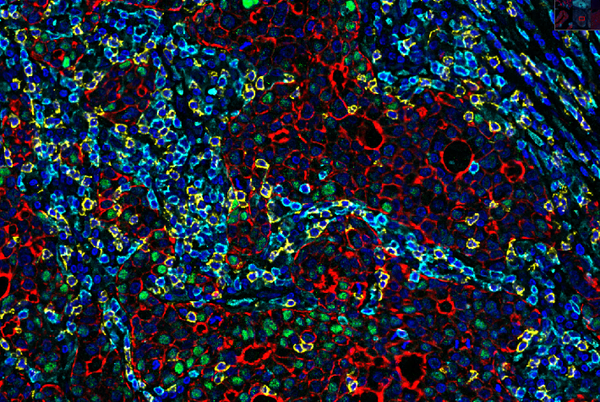
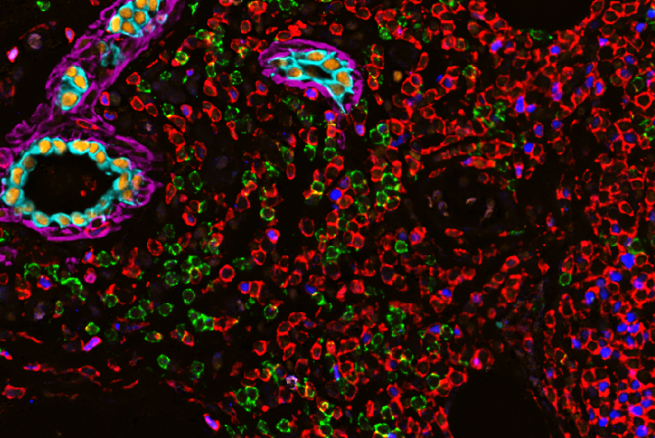
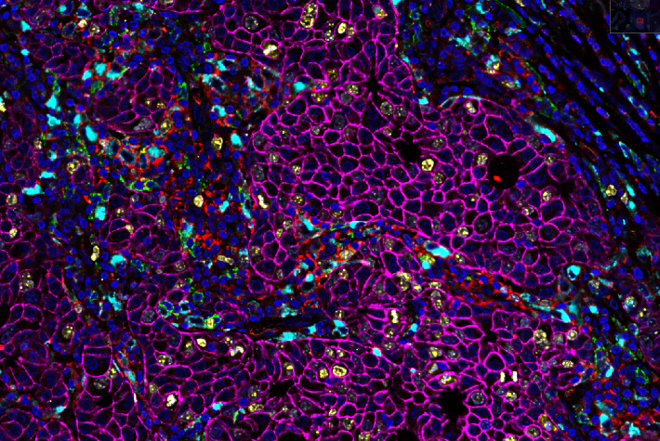
Example Images
DAPI Pan-Cytokeratin
AR CD8 CD4
DAPI CD11c ERα CD163 CD8 Pan-Cytokeratin
High-Grade Breast Cancer, AR+ HER2+
DCIS, ER+, with immune infiltrate
DAPI PD-L1 HER2
CD20 Ki67 CD68
FOXP3 CD4 Keratin5
Keratin8/18 CD20 GATA3

Slide 6
ITR/IPSR CODEX Services
Panel design and antibody selection
Protocol Development and optimization
Training and consulation
Custom conjugation and validation
Tissue staining
CODEX runs (not offered as a walk-up service)
Data analysis available soon
Immunophenotyping Shared Resource 2021
Notes:
A typical 14 marker panel with four coverslips (using pre-conjugated antibodies) ~ $17,000

Slide 7
Questions?
Project-related questions:
Kim Dahlman, Ph.D., ITR Scientific Director kim.dahlman@vumc.org
Questions about pathology and data analysis:
Paula Gonzales-Ericsson, MD, Sr. Staff Scientist paula.i.gonzalez.ericsson@vumc.org
Visit our website at: https://www.vumc.org/itr-shared-resource/welcome Click the link to submit a project request: https://redcap.link/ITRIntake
Funding support:
The CODEX instrument is supported by 1S10OD030338-01. Past and ongoing projects are supported by the Breast Cancer SPORE program, NCI 2P50CA098131-11, and by the Cancer Center Support Grant (CCSG) NCI 5P30CA068485-21.

