Slide 1
Core Managers Meeting
September 19, 2023

Slide 2
Agenda
01
iLab Monthy Invoicing Schedule
02
iLab Fund Management
03
New External Customer Information Survey
04
Workday Townhalls
05
Workday Reports

Slide 3
iLab Monthly Close Schedule
We will continue the new monthly iLab closing schedule.
Action | Day | September
Core Billing Entry Deadline | Day Before Last Business Day (4 p.m.) | Thursday, Sept. 28
Create Pre-Invoices | Last Business Day | Friday, Sept. 29
Create Final Invoices & Send files to Workday | First Business Day | Monday, Oct. 2
Unfortunately, we cannot accept late billing events.
Notes:
Workday invoice dates impact the external revenue accounting.
Additional processing time allows for troubleshooting.
We cannot accept late billing events.
We encourage cores to enter charges throughout the month when possible.
Waiting until the last day may not give you enough time to resolve billing issues.

Slide 4
Grant Worktags
iLab Fund Management
Step 1: Grant Worktag created in Workday
(Office of Sponsored Programs | Peer Request)
Step 2: Nightly import of all active grant worktags and PI Assignment
(End Date = Workday Award Line End Date +120 days)
Step 3: Grant worktag displays in PI’s VUMC Lab Group
PI or Lab Manager assigns access to lab members
Grace period prevents interruption of access to grant funding as the grant moves from one award line to the next each year.
Other Worktags
Step 1: Worktag created in Workday
(Do not contact OSP for non-Grant worktags)
Step 2: Nightly import of all active gift, program, or cost centers.
Step 3: PI or Department Administrator must claim gift, program, or cost center into PI Lab Group
PI or Lab Manager assigns access to lab members
OSP does not create records for gifts, programs, or cost centers. These worktag types do not have end dates or PI assignments in Workday. Please do not contact OSP for assistance regarding these worktags in iLab
https://www.vumc.org/oor/vumc-ilab-application

Slide 5
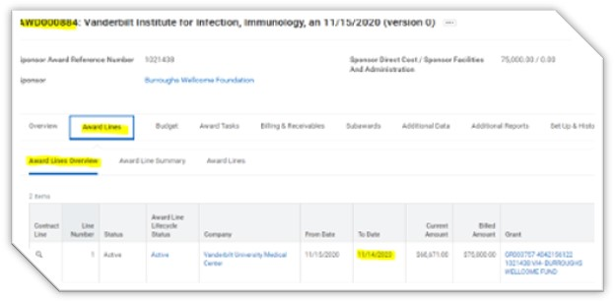
Grant Worktags: Customer Support
Fund Management
Dept of Finance Guidance: Workday & Grant Worktags:
If the award line’s end date or PI is not correct in Workday, reach out to your assigned OSP representative for assistance in updating Workday. Please allow 14 days for OSP to process your request. The current delay is due to a large backlog of needed changes. Generally, OSP has recommended that departments proactively submit the PEER request for the financial setup of the award if the investigator plans to begin spending before the award is executed.
View the grant’s end date by selecting the ‘Award Line’ tab within the grant record:
Verify the grant you are trying to use has a current end date listed in Workday Award Line field. Grant worktags are available in iLab for 120 days after the award line’s end date.
View the grant’s PI by selecting the ‘Roles’ tab within the grant record:
Verify the correct PI is assigned to the grant under the ‘Principal Investigator (Grant)’ assignable role .

Slide 6
External Customers
External Customer Management Guide has been updated with best practices, details on the research core service agreement, and an overview of external customer workflow.
New: External Customer Survey:
https://redcap.vanderbilt.edu/surveys/?s=MCK4W898MPAYTDPJ
https://www.vumc.org/oor/vumc-ilab-application

Slide 7
Workday Help
Workday Training Hub
Research Town Halls
https://www.vumc.org/myworkday/training-hub

Slide 8
Workday Reports
Department Transaction Detail
What:
Report for reviewing transaction level GL detail.
Prompts:
Use the Organization field to run on the core cost center.
Select Expense & Revenue in the Leder Account Type
Why:
Helpful for reviewing all labor, non-labor, and revenue on the core’s cost center.
Notes:
Report includes hyperlinks to expense details (i.e., supplier invoices, expense reports).
Export feature is available to view in other formats (i.e., excel or pdf)

Slide 9
Department Transaction Detail
Workday Reports

Slide 10
Workday Reports
Department Transaction Summary
What:
Report for transaction review - data summarized by ledger account.
Prompts:
Use the Organization field to run on the core cost center.
Select Expense & Revenue in the Leder Account Type
Why:
Helpful for expenses and revenue in a summary review.
Notes:
Click hyperlinks within the report to drill down to the transactional data.
Export feature is available to view in other formats (i.e., excel or pdf)

Slide 11
Department Transaction Summary
Workday Reports

Slide 12
Workday Reports
Invoice Payment Status for My Organizations
What:
Report intended to track the payment status of customer invoices.
Prompts:
Use the Organization field to run on the core cost center.
To view paid invoices only, use Payment Status field to filter to paid and fully paid.
Why:
To view payment status & payment details of core invoices.
Notes:
This report only displays payment status for invoices created after the Workday transition.
All invoices created in legacy systems are considered conversion data and have limited functionality in the workday customer module.

Slide 13
Invoice Payment Status for My Organizations
Workday Reports

Slide 14
Department Finance Reports
Workday Reports

Slide 15
Question and Answe﻿r...

Slide 16
Thank You!

Slide 17
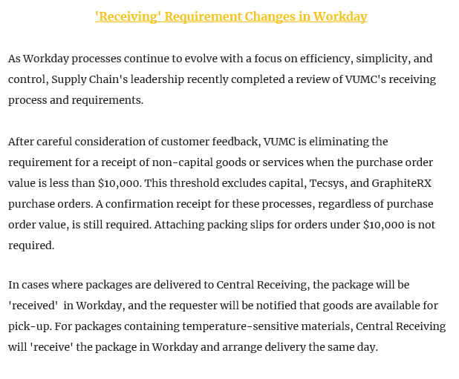
Workday “Receiving’ Requirement
Workday

