Slide 1
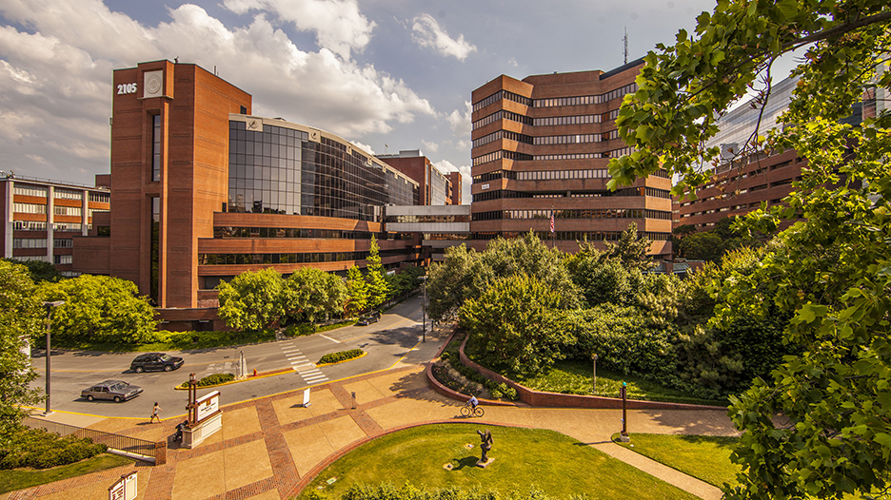
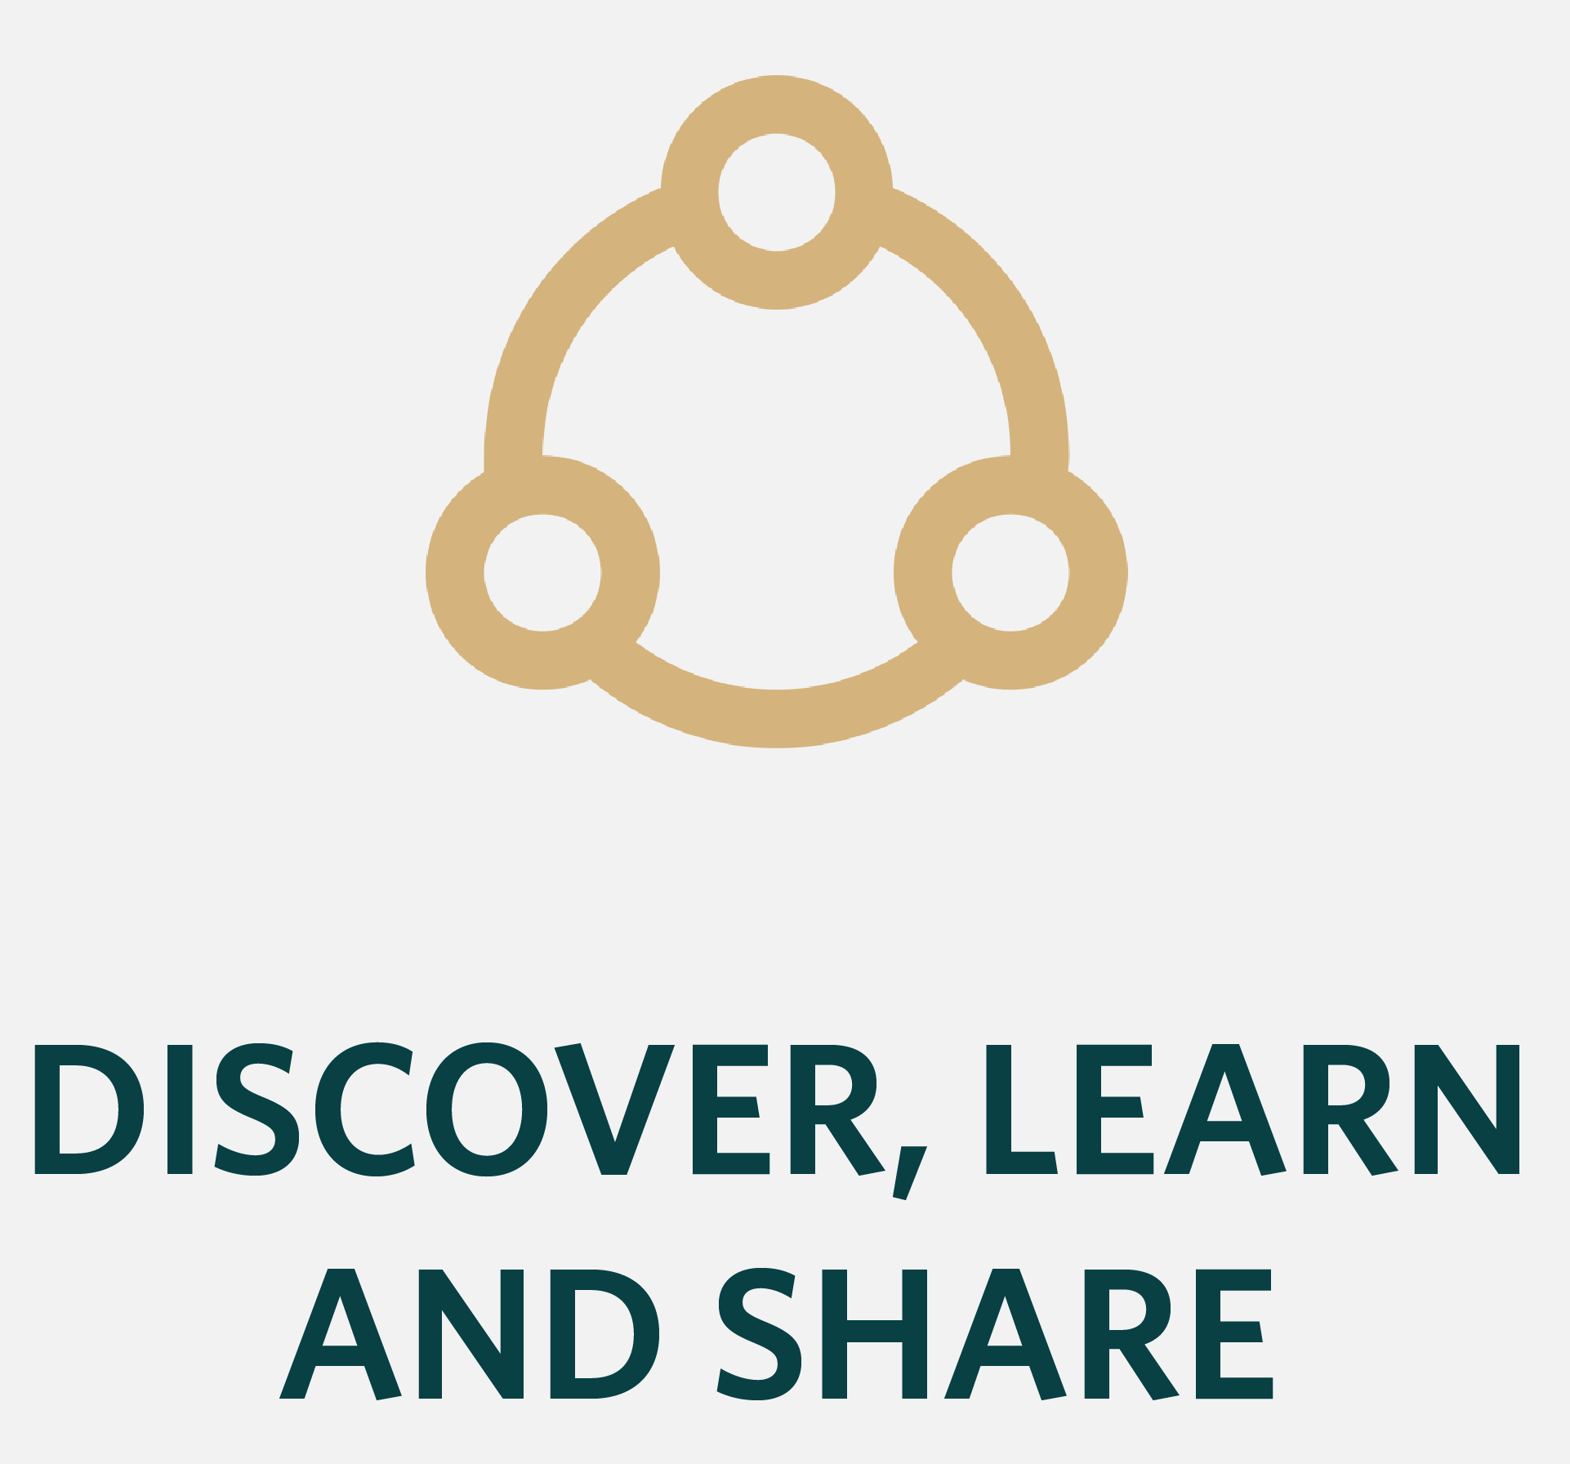


VUMC Core Managers Meeting
April 6, 2021

Slide 2
Agenda
Data Management SOP
Rate Change Communication & Publishing Price Lists
iLab User Group Meeting

Slide 3

VUMC Cores: Data Management
April 6, 2021

Slide 4
VUMC Policy

Slide 5
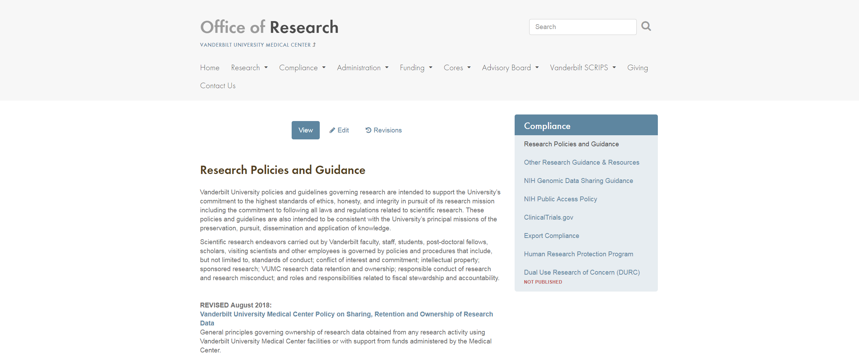
VUMC Institutional Policy Sharing, Retention and Ownership of Research Data
www.vumc.org/oor/research-policies-and-guidance

Slide 6
Policy Summary – Key Points
VUMC owns original, primary Research Data (as defined in the Policy and any referenced polices)
Ownership is consistent with separate Policy on Technology and Literary and Artistic Works (located in Faculty Manual) and specific data ownership requirements as agreed between VUMC and a Sponsor
PI is responsible for records management, understanding sponsor requirements on sharing, storing, copying or transferring data

Slide 7
Definition of Research Data
Includes data resulting from “…original observations and activities of a study and are necessary for reconstruction and evaluation of the report of the study…”
Research data examples added to provide guidance for investigators in looking at aggregate research data and determining what data is necessary to “confidently” reconstruct a project
Based on definition of research data per Federal Regulations

Slide 8
7-year Retention Period
7-year retention timeframe begins after the last date of:
Publication
Final financial close-out of a sponsored research award
Submission of the final project report to sponsor
Different, longer retention requirements specified by statute, sponsor agency regulations, or sponsor agreement should apply.
Caveat: records should be kept as long as may be required to protect any patents resulting from the work

Slide 9
Research Data Transfer, Destruction, and Disputes
PIs leaving VUMC may request copies of their research data via written request to and approval from the appropriate EVPR or designee(s)
Research data remain in PI’s primary department unless otherwise agreed to or required otherwise by funding sponsor or law
The appropriate EVPR or designee(s) will appoint steward of research data
Decisions to destroy early must be approved by the appropriate EVPR
Disputes are directed to the appropriate EVPR, with option to appeal to the CEO

Slide 10
SOP for Managing Data Retention Requirements in Core Facilities

Slide 11
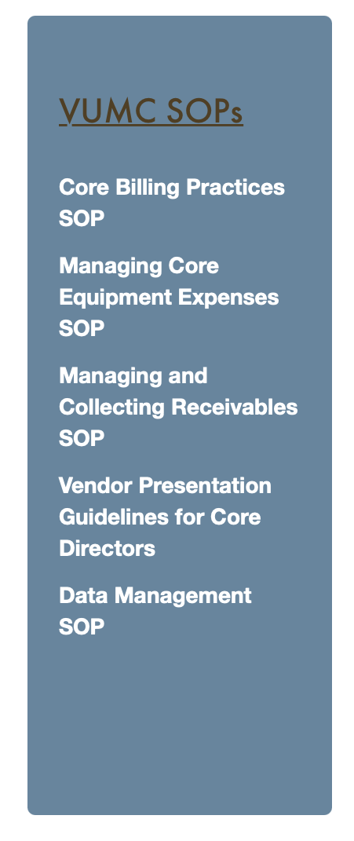
Core SOP for Managing Data Retention
SOP outlines best practices for Cores that may provide data management and storage services to PIs
Cores are not required to provide data management and storage services, and PIs may also “opt-out” of such Core services
PI is responsible for meeting data retention requirements per VUMC policy
Each Core should:
Review the SOP for Managing Data Retention Requirements in Core Facilities
Define original, primary research data or derivatives (core-specific)
Draft Core policy and SOP for data management
Submit draft to OOR for review with FY2022 rate documentation
https://www.vumc.org/oor/vumc-core-administration

Slide 12
Core SOP for Managing Data Retention: Required Elements
Establish and consistently adhere to a minimum operational data retention period
Defined as the timeframe immediately following collection of data necessary for processing and releasing results to the PI
Core SOP should also include as applicable:
Other data storage options provided by the Core
Estimated costs of storage options that may be charged back to the PI
Restrictions for types of data to be stored by the Core (e.g. no PHI)
Information about alternative storage options if available, e.g. public repositories
Make SOP readily available to PIs, especially at the initiation of a project

Slide 13
Core SOP for Managing Data Retention: Required Elements
Cores may opt to offer data storage and management services for all, part or none of the required data retention time frame
If offering data storage and management services, SOP should address the following:
Process for ensuring data safety
Communication plan including process for PI to affirmatively confirm understanding for delivery and eventual destruction of data
Additional considerations may include HIPAA or other PPI, export compliance, confidentiality or non-disclosure agreements, patent protection and IP standards as applicable

Slide 14

Website coming soon: Rigor, Reproducibilty & Transparency
VUMC principles for Cores
Policies and SOPs
Resources

Slide 15
Rate Change Communication
As rates are changed, the core should notify users of the rate change and provide the updated rates.
Copy Jessie Pirtle and Susan Meyn on the rate change notification email.
The Office of Research will keep on file in the event of a core audit.
Published Price Lists: All internal core customers should easily be able to view or request current core service rates.
Reminder: All pricing in iLab can be set to ‘visible’ to allow users to view current rates. Contact VUMCcores@vumc.org to adjust your iLab site settings.

Slide 16
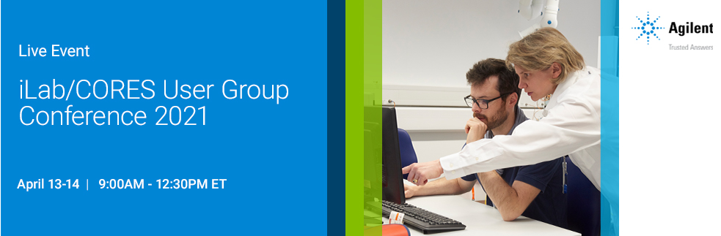

The virtual conference will feature presentations and discussions focused on new feature updates, best practices, and tips and tricks to help you make the most of your iLab sites. To register or to view the schedule of sessions, please click HERE.
April 13-14 | 8:00AM – 11:30AM CT
Notes:
There is no cost to attend this year’s user group meeting.
Email was distributed with registration links.

