Slide 1

Foreign Talent Recruitment Programs Department Town Hall
Susan Meyn
Amy Martinez
VUMC Office of Research
August 19, 2024

Slide 2
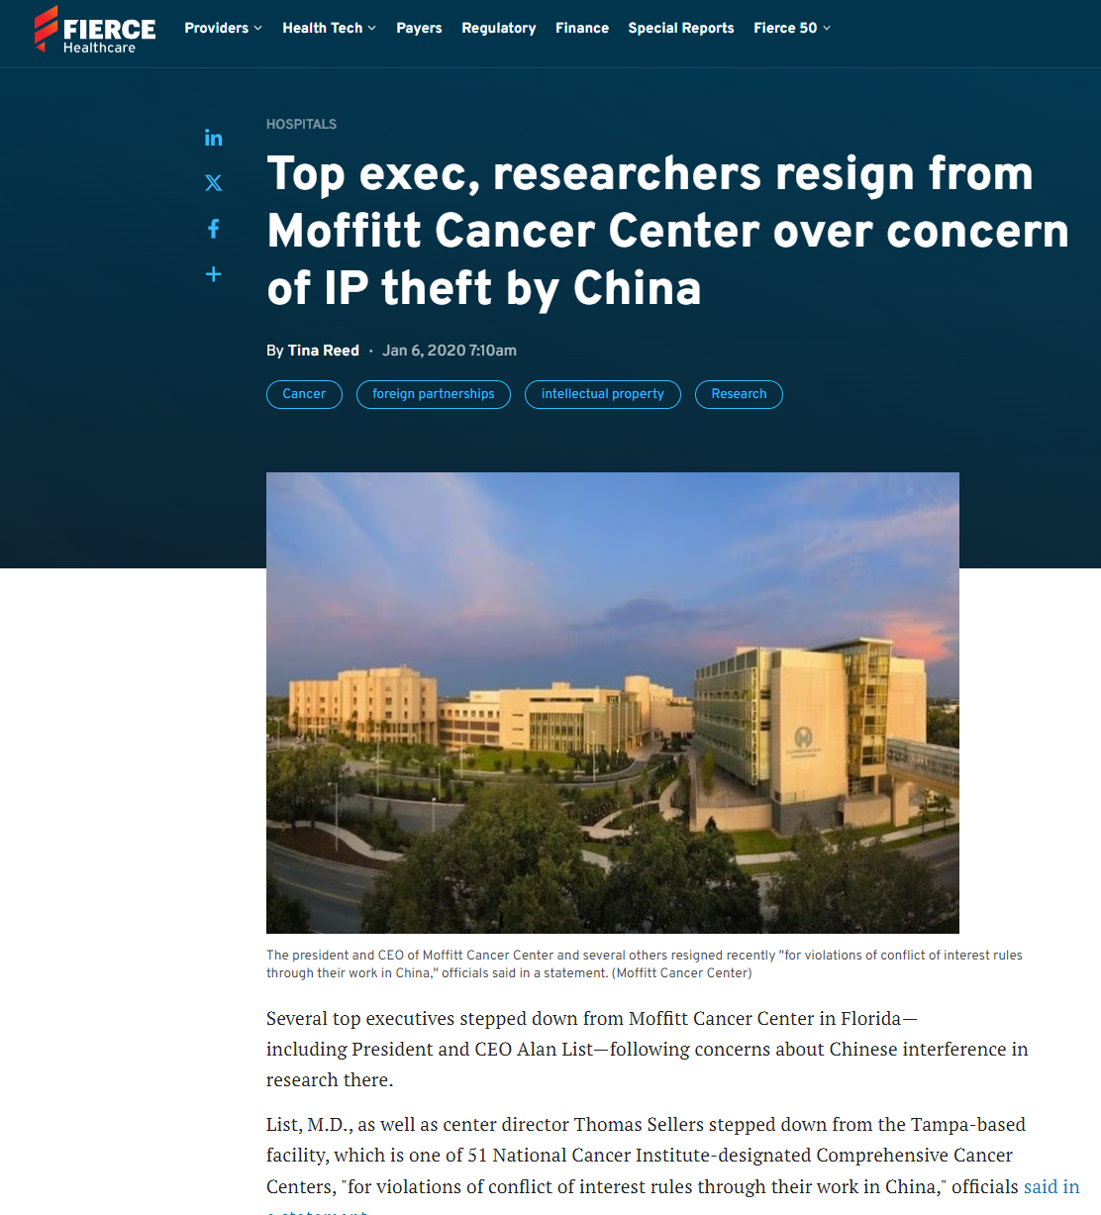
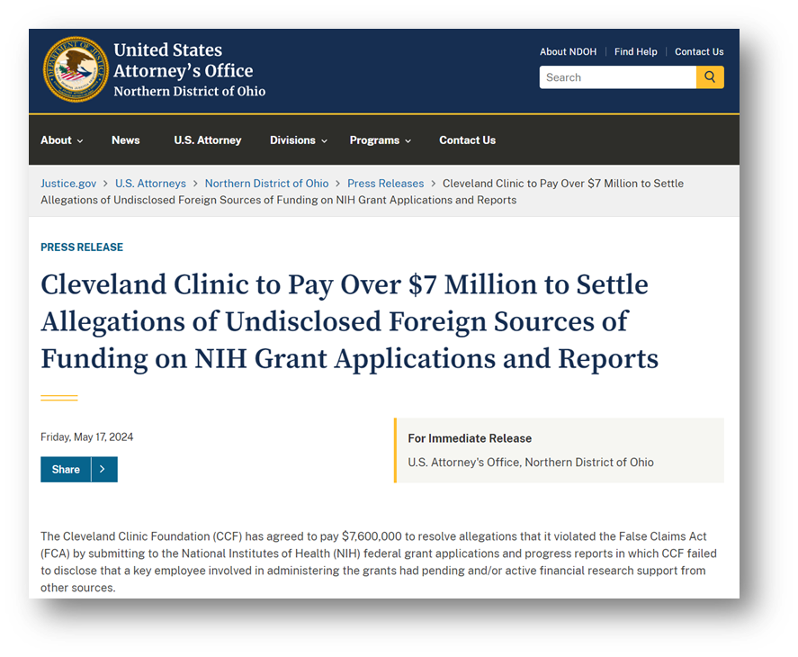
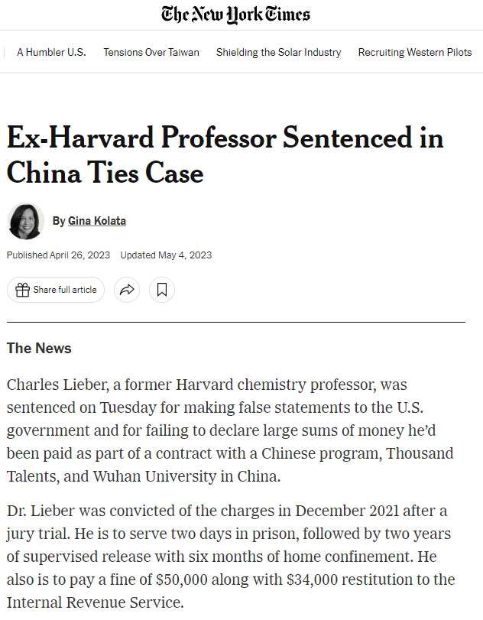
In the News:

Slide 3
Federal Research Security
Compliance Regimes
National Security Presidential Memo 33 (NSPM-33)
Malign Foreign Talent Programs
Dual Use Research of Concern
(DURC)
Pathogens w/ Enhanced Pandemic Potential
(PEPP)
CHIPS and Science Act
Notes:
Creating Helpful Incentives to Produce Semiconductors (CHIPS)

Slide 4
New Research Security Regulations: A Timeline
- OSTP Policy on Use of Common Disclosure Forms
OSTP
Draft
Guidelines for Research
NSPM-33
- OSTP Definition and Guidelines on Foreign Talent Recruitment Programs
NSTC
Research Security Subcommittee Established
Implementation
Guidance
Research
Security
Final
Security Programs
-RSP Elements
-Persistent Identifiers
Program
Common
Standard Requirements
Disclosure
Forms
May Jan.
2019 2021
Jan. 2022
August 2022
March 2023
June 2023
Nov. 2023
Jan. 2024
Feb. 2024
May July
2024 2024
NSPM-33
CHIPS and Science Act
Draft Common Disclosure Forms
DoD Risk Review Policy and Matrix – Countering Unwanted Foreign
- Federal
NSF
Implements the Common Forms via SciENcv
Disclosure
Research Security Program Requirement (RSP)
Research
Security
Training
Modules
- Updated
Pre- and Post-Award Disclosure Table
Influence
Adapted from NSPM-33 workshop
NCURA annual meeting, Aug. 2024

Slide 5
What is a foreign talent recruitment program?
White House Office of Science and Technology Policy - Definition
A foreign talent recruitment program is any program, position, or activity that includes:
compensation in the form of cash
in-kind compensation, including research funding
promised future compensation
complimentary foreign travel
things of non de minimis value
honorific titles
career advancement opportunities
or other types of remuneration or consideration directly provided to an individual whether directly or indirectly stated in the arrangement, contract, or other documentation at issue; whether or not directly sponsored by the foreign country or by a foreign country at any level (national, provincial, or local); or their designee; or an entity based in, funded by, or affiliated with a foreign country
https://www.whitehouse.gov/wp-content/uploads/2024/02/OSTP-Foreign-Talent-Recruitment-Program-Guidelines.pdf

Slide 6
Current Priority: New Disclosure Requirements
Malign Foreign Talent Recruitment Programs
Foreign Talent Recruitment Programs
International Collaboration Activities
FEDERAL REQUIREMENT
All institutions receiving federal funds are required to have a policy addressing malign foreign talent programs by 8/9/24 (VUMC adopted 7/16/24).
Department of Defense (DOD): All fundamental research projects will be reviewed by DOD for potential foreign influence
National Science Foundation (NSF): All senior/key study personnel must:
provide additional disclosures at application
certify that they are not a party to a malign foreign talent recruitment program
NEW: NIH funding decision matrix and guidance
https://nexus.od.nih.gov/all/2024/08/15/new-decision-matrix-further-clarifies-nih-processes-for-handling-allegations-of-foreign-interference/
https://grants.nih.gov/policy/foreign-interference.htm
Permissible
Prohibited
May be permissible
with disclosure
Notes:
Department of Defense (DOD) now requires all fundamental research projects selected for award by DOD to go through a review for potential conflicts of interest and conflicts of commitment arising from foreign influence
https://media.defense.gov/2023/Jun/29/2003251160/-1/-1/1/COUNTERING-UNWANTED-INFLUENCE-IN-DEPARTMENT-FUNDED-RESEARCH-AT-INSTITUTIONS-OF-HIGHER-EDUCATION.PDF
National Science Foundation (NSF) will require all individuals designated as senior/key personnel to provide additional information and disclosures within proposal applications. Senior/key personnel will now need to certify that they are not a party to a malign foreign talent recruitment program.
https://www.nsf.gov/bfa/dias/policy/nstc_disclosure.jsp

Slide 7
Policy
Any VUMC employed faculty, staff, and trainees defined as “Covered Individuals” by a U.S. federal funding agency who are engaged in U.S. federally funded activities are required to disclose participation in, or application to, programs or projects sponsored or supported by foreign governments, instrumentalities, or entities associated directly or indirectly with a foreign government (including affiliations, appointments, and other support). Such Covered Individuals are prohibited from participating in a Malign Foreign Talent Recruitment Program as defined here per guidance issued from the Office of Science Technology Policy (OSTP) and in accordance with both the National Security Presidential Memorandum-33 (“NSPM-33”) and the Creating Helpful Incentives to Produce Semiconductors (CHIPS) & Science Act of 2022 (H.R.4346 Sections 10631-10632).
Participation in any form of Foreign Talent Recruitment Program by Covered Individuals is subject to institutional review and must be disclosed via the appropriate VUMC COI disclosure systems at least annually. For federal grant applications, investigators and senior/key personnel will be required to disclose any Foreign Talent Recruitment Program participation at the time of submission. The PI will be required to certify that they do not participate in any Malign Foreign Talent Recruitment Program per funding agency requirements, prior to an award.

Slide 8
Policy Definitions
Covered Individual
Any VUMC faculty, staff or trainee who is funded by a federal award and contributes in a substantive, meaningful way to the scientific development or execution of a research and development project proposed to be carried out with a research and development award from a Federal research agency; and who is designated as a covered individual by the Federal research agency concerned.
Foreign Talent Recruitment Program
Any program, position, or activity involving any country outside the U.S. that includes compensation of any type whether or not directly sponsored by the foreign country or by a foreign country at any level (national, provincial, or local); or their designee; or an entity based in, funded by, or affiliated with a foreign country.
Malign Foreign Talent Recruitment Program
Any program, position, or activity that meets the criteria for type 1 or type 2 activities.

Slide 9
Policy Definitions
Malign Foreign Talent Recruitment Program - Type 1:
Participation in a Foreign Talent Recruitment Program where compensation or remuneration from any foreign country outside the U.S. is provided to the Covered Individual in exchange for any of the following:
Unauthorized transfer of intellectual property, materials, data products, or other nonpublic information
Recruiting trainees or researchers to enroll in such program, position, or activity;
Establishing a laboratory or company, accepting a faculty position, or undertaking any other employment or appointment
Being unable to terminate the Program contract or agreement
Being limited in the capacity to carry out U.S. federal research award
Requirement to:
engage in work that overlaps or duplicates a federal research award;
obtain research funding from the foreign government’s entities;
omit acknowledgement of the U.S. home institution and/or the federal funding agency;
not disclose participation in the program, position, or activity
Having a conflict of interest or conflict of commitment contrary to a federal research award

Slide 10
Policy Definitions
Malign Foreign Talent Recruitment Program – Type 2:
Where a Covered Individual is sponsored or supported by a foreign country of concern or an entity based in a foreign country of concern (whether or not directly sponsored by the foreign country of concern).
Foreign countries of concern currently include:
The People's Republic of China;
The Democratic People's Republic of Korea (North Korea);
The Russian Federation;
The Islamic Republic of Iran; or
An academic institution or foreign talent recruitment program on the list developed under §1286 of the John S. McCain National Defense Authorization Act for Fiscal Year 2019 (10 U.S.C. 4001 note; Public Law 115–232).

Slide 11
Policy Definitions
Acceptable international collaboration activities
A Malign Foreign Talent Recruitment Program does not include typical academic activities, so long as the activity is not funded, organized, or managed directly or indirectly by an academic institution or a foreign talent recruitment program as defined in policy.
Some examples include:
Making scholarly presentations and publishing written material
Participating in international conferences, research projects and programs that involve open and reciprocal exchange
Advising a foreign student enrolled at an institution of higher education
Involvement in national or international academies or professional societies
Taking a sabbatical, serving as a visiting scholar, etc.
Receiving prestigious awards

Slide 12



Implementation
VUMC policy approved on July 16, 2024
Disclosures, certifications per federal funding agency requirements
Leverage existing infrastructure
Town Hall
Department Chairs
Center/Institute Directors
Central Business Officers
Faculty and Staff COI
PEER
COEUS
Training
Continue to monitor for updates

Slide 13



How do I disclose foreign support/participation in FTRPs to VUMC?
Disclose all foreign support during the Conflict of Interest disclosures process
Submit a new disclosure annually and immediately upon any changes in support
All disclosures of foreign support undergo institutional review to determine if a management plan is needed.
Not sure whether or how to report your activity? Get in touch!
s.meyn@vumc.org
amy.f.martinez@vumc.org

Slide 14
Faculty system – COI questions
Do you receive financial support or other resources of any type related to your professional duties or expertise as a Vanderbilt faculty member from a foreign entity, foreign institution, or their agents (anyone acting on their behalf), not including funds paid directly to Vanderbilt University or Vanderbilt University Medical Center to support your research or other activities?
Do you receive any support from a foreign entity, foreign institution, or their agents (anyone acting on their behalf), not including collaborative project agreements through Vanderbilt University or Vanderbilt University Medical Center?
Are any members of your research program supported in any way by a foreign entity, foreign institution, or their agents (anyone acting on their behalf), not including members whose funding is paid to Vanderbilt University or Vanderbilt University Medical Center?

Slide 15
Staff system – COI questions
Do you receive financial support or other resources of any type related to your professional duties or expertise as a VUMC workforce member from a foreign entity, foreign institution, or their agents (anyone acting on their behalf), not including funds paid directly to Vanderbilt University or Vanderbilt University Medical Center to support your research or other activities?
If yes, please describe the financial support or other resources you receive and provide the name(s) of the foreign entity or foreign institution
Do you receive any support from a foreign entity, foreign institution, or their agents (anyone acting on their behalf), not including collaborative project agreements through Vanderbilt University or Vanderbilt University Medical Center?
If yes, please describe the support you receive and provide the name(s) of the foreign entity or institution.

Slide 16




When do I disclose foreign support/participation in FTRPs to Sponsors?
During application process as part of the Biosketch and Other Support
Now: Agency Specific
Future: Common Forms
During the annual RPPR process
Via immediate notification/ communication outside of JIT or a RPPR as undisclosed Other Support
Prior to the award/ during the negotiation phase (JIT in Other Support)
Contact OSP for guidance

Slide 17








How do I disclose foreign support/participation in FTRPs to Sponsors?
Requires disclosure of all positions and scientific appointments, both foreign and domestic, whether or not renumeration is received or position is full-time, part-time, or voluntary
Requires disclosure of any updates to positions, appointments, and resources listed in application and/or Other Support
Application
Process
RPPR
Requires disclosure of all resources made available to a researcher in support of / or related to his/her research endeavors, regardless of whether they have monetary value
Requires disclosure of any instances of discovery when a PI or KP failed to disclose Other Support information outside of Just-in-Time or the RPPR, as applicable
JIT /
Other Support
Undisclosed Other Support
*Specific requirements are subject to change pending funding agency policies!
Contact OSP for guidance

Slide 18
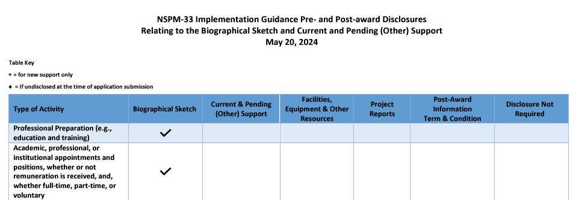
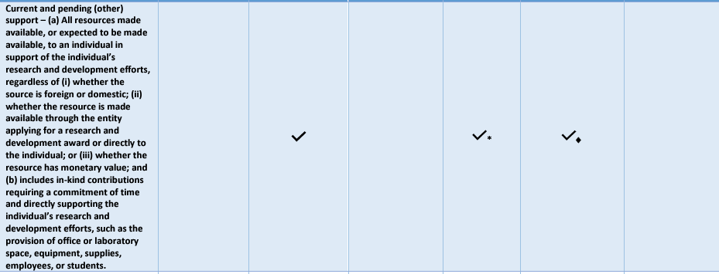
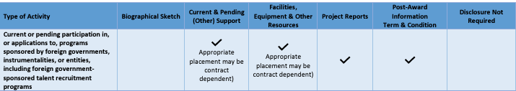
Federal Agency Common Forms
NSF maintains Biosketch and Current & Pending Support forms to help standardize reporting across agencies
Table clarifies where each type of support should be disclosed
Adopted by NIH: NOT-OD-24-163
Effective May 25, 2025
Will also require “Biosketch Supplement” (Personal statement, contributions to science, and honors)
Will require ORCID as the persistent ID
Will require use of SciENcv
Foreign appointment/ FTRP
Any foreign support, regardless of $ value
FTRP
https://www.nsf.gov/bfa/dias/policy/nstc_disclosure.jsp
Contact OSP for guidance

Slide 19
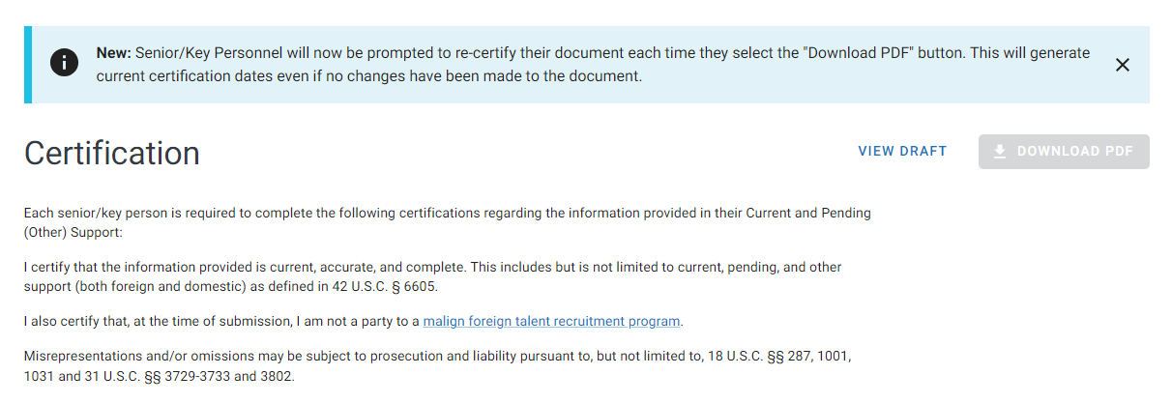
Federal Agency Common Forms
Certification required on both Biosketch & Current/Pending Support forms in SciENcv
Current/Pending Support
Biosketch
Contact OSP for guidance
https://www.ncbi.nlm.nih.gov/sciencv/

Slide 20
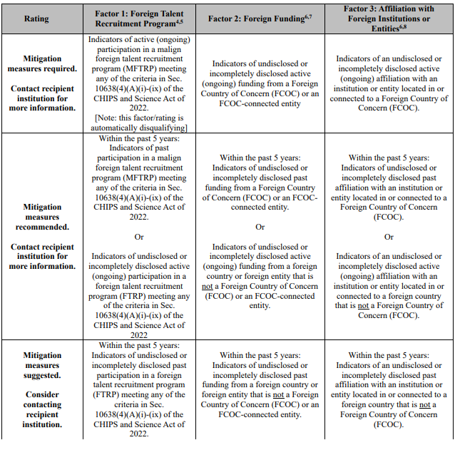

NEW
Decision Matrix
For reviewing grant applications, ongoing awards for signs of potential foreign interference, appropriately mitigating risk
Mitigation may be required, recommended, or suggested
If none of these conditions apply, mitigation not needed

Slide 21
Additional guidance and resources from NIH
NIH recipients are barred from using Federal funds to engage in certain activities with certain foreign entities (NIH GPS 4.1.37).
All other proposed engagements with foreign entities that may meet the criteria for a foreign component should be discussed with NIH staff as part of the foreign component prior approval process (NIH GPS 8.1.2)
https://www.nih.gov/about-nih/who-we-are/nih-director/statements/nih-supports-our-valued-asian-american-asian-immigrant-asian-research-colleagues
https://grants.nih.gov/policy/foreign-interference/requirements-for-disclosure
https://nexus.od.nih.gov/all/2024/08/15/new-decision-matrix-further-clarifies-nih-processes-for-handling-allegations-of-foreign-interference/
https://grants.nih.gov/policy/foreign-interference.htm
https://grants.nih.gov/sites/default/files/NIH Decision Matrix for Assessing Potential Foreign Interference for Covered Individuals or Senior 7 26 24 clean.pdf

Slide 22





REMEMBER:
VUMC requires all designated PIs to individually submit a PI Assurance in PEER as part of the application process. This serves as attestation that:
That the application is true, complete, and accurate to the best of their knowledge
That the PI accepts responsibility for the scientific conduct of the project and will fulfill all reporting requirements
That false, fictitious, or fraudulent statements or claims may subject them to criminal, civil, or administrative penalties
That the PI will observe all sponsor and VUMC policies – Including FTRP policies

Slide 23
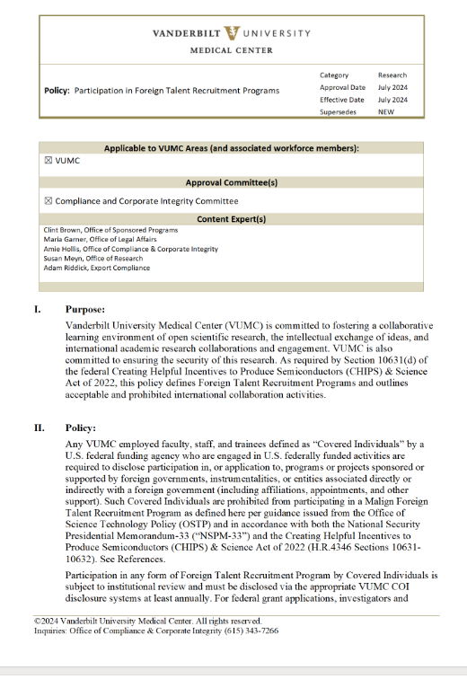
VUMC Policy, Malign Foreign Talent Recruitment Programs
Duty to disclose foreign support, direct or indirect
Institutional review of any foreign talent recruitment program participation
Bright-line prohibition on participation in Malign Foreign Talent Programs
VUMC’s policy fully aligns to federal requirements and is consistent with peer direction.
https://vanderbilt.policytech.com/docview/?docid=39911

Slide 24
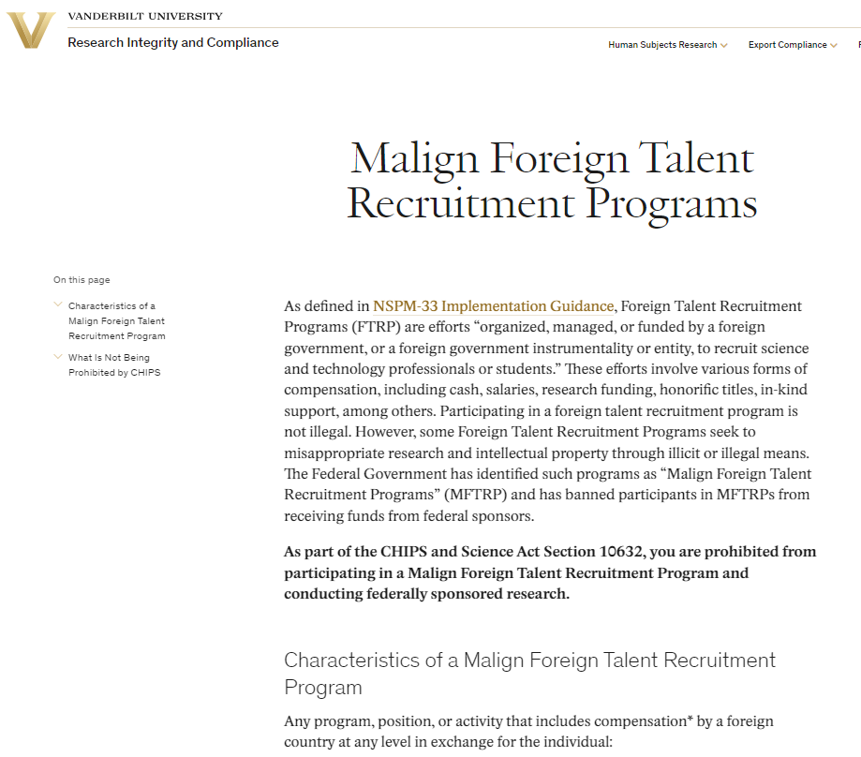
Vanderbilt University Policy – FYI
https://www.vanderbilt.edu/researchintegrityandcompliance/research-security/malign-foreign-talent-recruitment-programs/

Slide 25
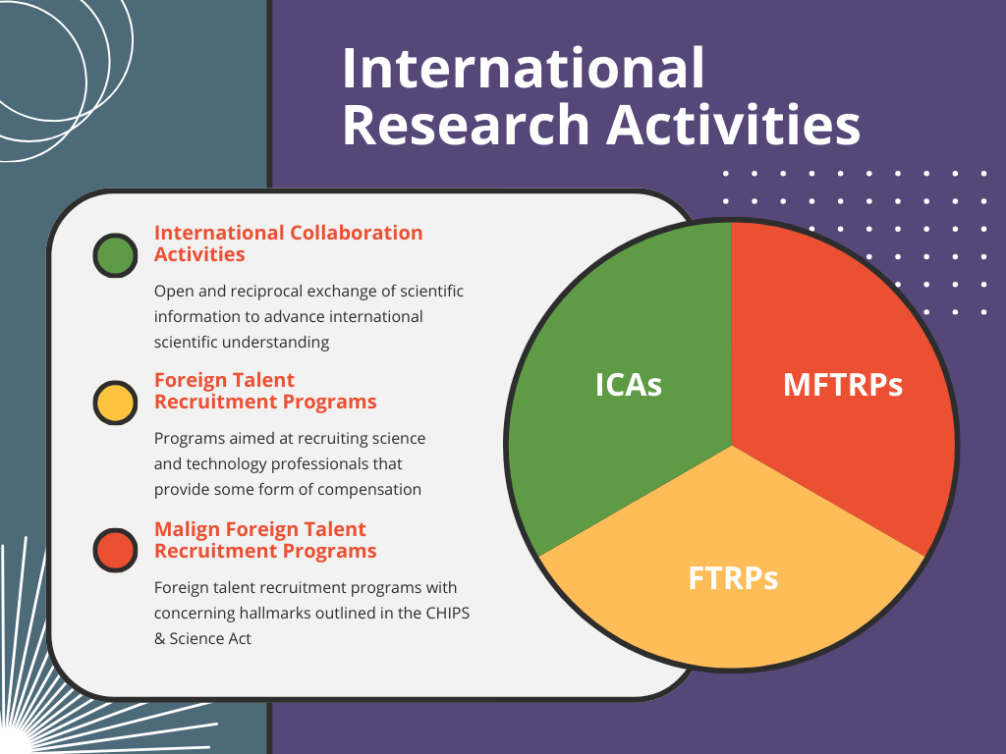
Resources
Office of Research https://www.vumc.org/oor/FTRPs
Links to
VUMC policy
Federal funding agency requirements
Federal policies and directives
Training materials – coming soon
Contact us with additional training opportunities
Notes:
DOD
https://media.defense.gov/2023/Jun/29/2003251160/-1/-1/1/COUNTERING-UNWANTED-INFLUENCE-IN-DEPARTMENT-FUNDED-RESEARCH-AT-INSTITUTIONS-OF-HIGHER-EDUCATION.PDF
NSF
https://www.nsf.gov/bfa/dias/policy/nstc_disclosure.jsp

Slide 26

Questions?

