Slide 1
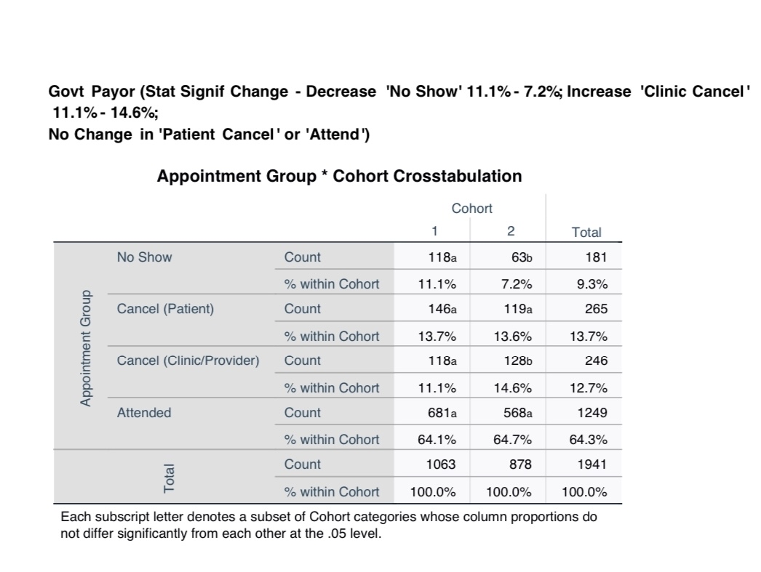
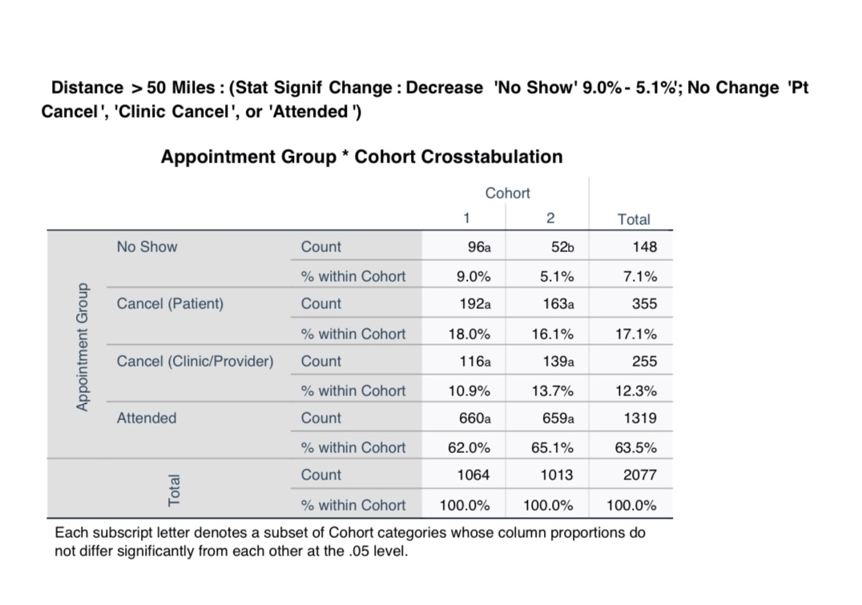
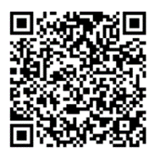
Reducing No-Shows
for Pediatric Cardiology Appointments
at Pediatric Heart Institute/DOT5
“Failure by patients to keep scheduled appointments is an important obstacle to the provision of effective healthcare. By missing their appointment, individuals deprive themselves of professional services, disrupt client-care-provider relationships, reduce the opportunity for other patients to receive timely care and indirectly contribute to rising health care costs”(Marchari et al, 1992).
Santosh Handa, BSN, RN
BACKGROUND: Missed appointments in pediatric heart patient population negatively impacts health and function as adults
Missed appointments represent wasted resources
METHODS: Pre-post quantitative design. Appointments were grouped as either missed or attended appointments with subcategories .
Selected predictors for missed appointments included:
Age provider
Gender day/time
Race/ethnicity MHAV enrollment
diagnosis distance traveled(zipcode)
Insurance type
The A Priori strategy implemented was reminder phone calls to parent/care givers
LIMITATIONS: Only the first appointment for each patient was included in the study. Data unable to show if patient additional appointments for patient ,rescheduled visit, and if was seen eventually or no-showed multiple times
FINDINGS: Pre/post phone calls significantly reduced no-show appointments for those with government insurance, and those living >50 miles from the clinic
CONCLUSION: Reminder phone calls can improve attendance
Government Payor
Cohort Crosstabulation Cohort
Distance > 50 Miles
Cohort Crosstabulation Cohort
P<..5
P<..5
PHI appointments for 3 months | Pre (Cohort 1) | Post (Cohort 2)
Total Patients scheduled | 2969 | 2772
No-show/No Call | 234/ 7.9 % | 149/ 5.4 %
Patient cancelled | 469/ 15.8% | 453/16.3%
Patients attended | 1942/65.4% | 1812 /65.4%
Scan to
contact me
or request references
Notes:
Source for quote 6. Macharia, W. M., Leon, G., Rowe, B. H., Stephenson, B. J., & Haynes, R. B. (1992). An overview of interventions to improve compliance with appointment keeping for medical services. Jama, 267(13), 1813-1817.
Unable to show true no-show percentage and impact on schedule for patient no-shows multiple times
Cohort 2 does not show the true picture because if a patient cancelled and later attended their appointment it could not be reflected in the data, only the first appointment for each patient could be counted.
-Only able to count 1st appt for each patient
-Only able to count patients appointment with one Provider (MD, NP), but a very large # of patients have echos, ekg and appts for other test ordered and many pre/post op patients see more than one provider.
Unable to show if patient was eventually seen

