Slide 1
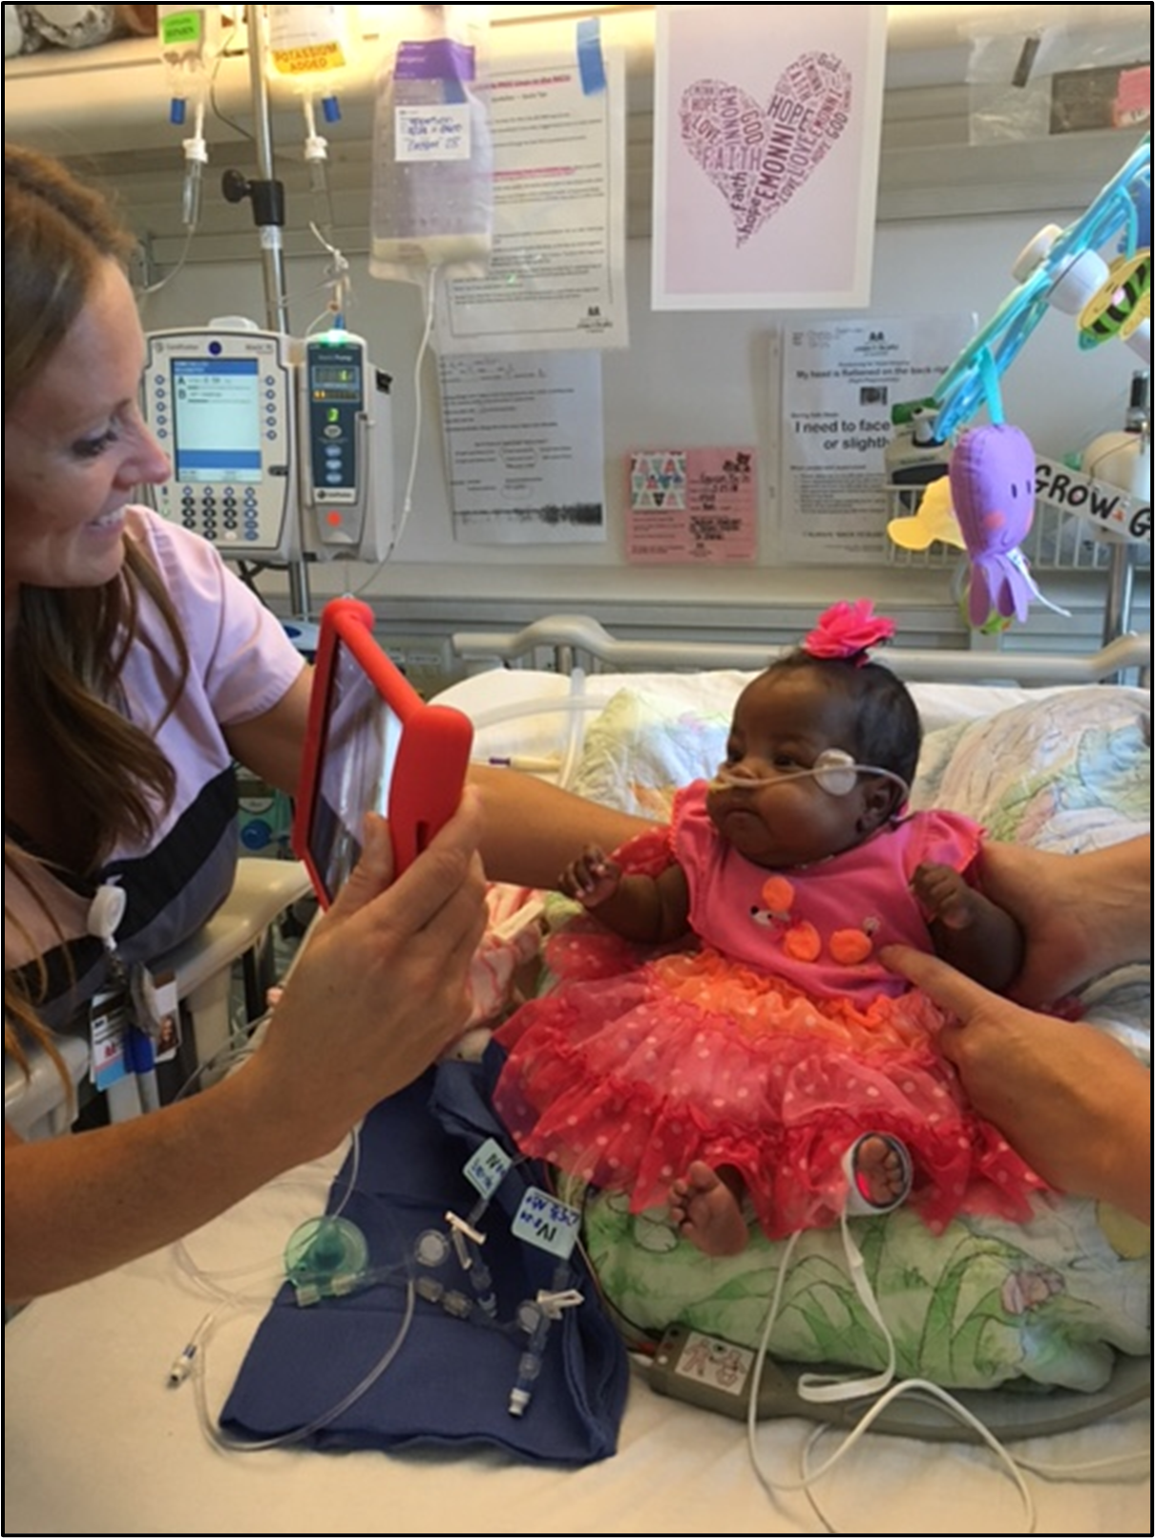
Impact of the Novel Coronavirus Pandemic on NICU Length of Stay
Within the first month of using video technology-based strategies, length of stay decreased by an average of 15 days.
Stephanie Abbu, DNP, RN, CNML
Monroe Carell Jr. Children’s Hospital at Vanderbilt
INTRODUCTION
In response to the COVID-19 pandemic, many neonatal intensive care units, or NICUs, have restricted access by limiting visitors to only parents – some only one parent and still others not even allowing parents. In comparison to the same timeframe in 2019, our NICU length of stay (LOS) increased by an average 18.7 days. An assessment was conducted to identify possible reasons for this increase. Although the patient population, number of admissions, and clinical care provided had remained relatively consistent, during the coronavirus pandemic parental presence decreased.
INTERVENTION / RESULTS
Finding ways to support parents and family members when in-person visitation is limited is imperative.
The use of tablets were implemented to increase communication with the healthcare team and allow parents to see their infant when they could not be physically present.
Tablets implemented
↓15 days
IMPLICATIONS FOR PRACTICE
Finding ways to support parents and family members when in-person visitation is limited is imperative. Future efforts will focus on increasing web-based videoconferencing and psychosocial support while at home, in addition to increased support when parents are present at the bedside to meet our team goal to reunite NICU infants with their parents at home as quickly as possible.

