Slide 1
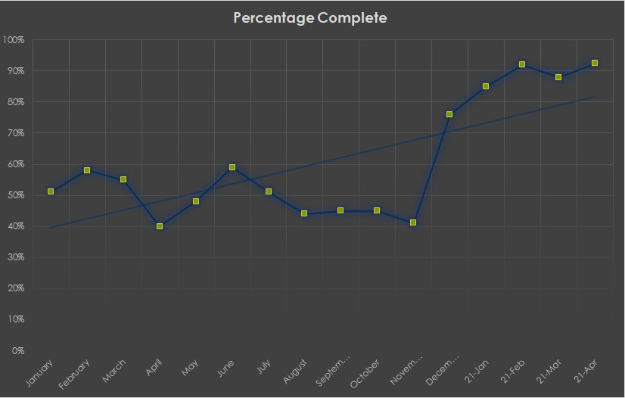
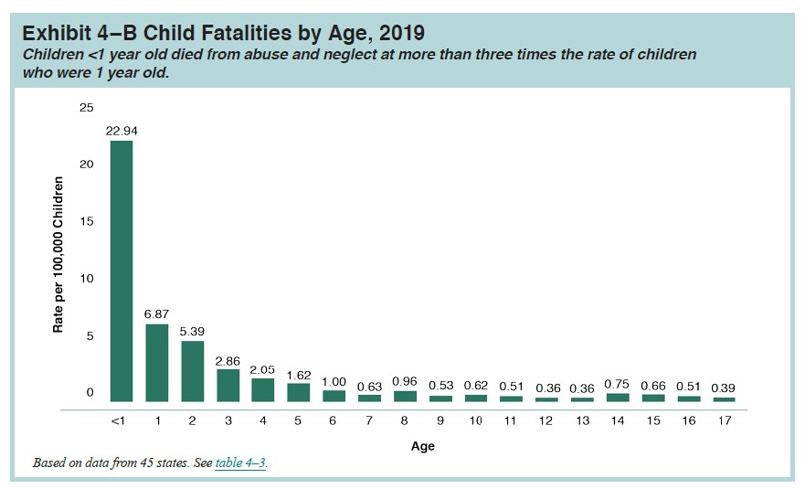
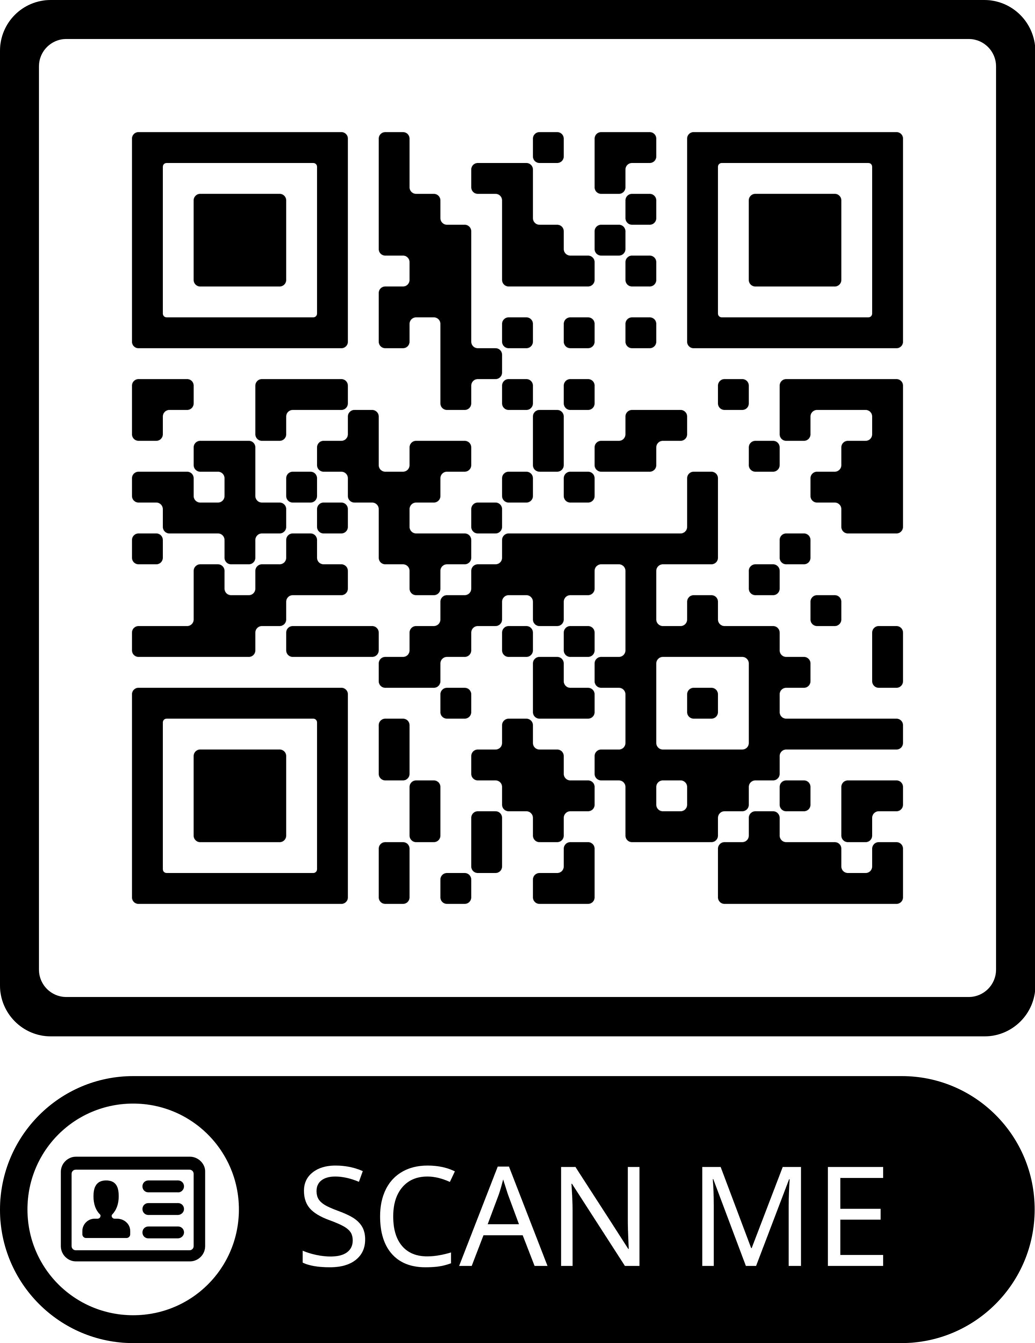
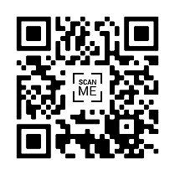
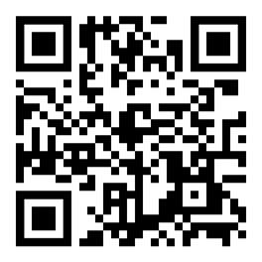
Child Safety Screen Assessment
Goal: Early recognition of findings that warrant additional investigation to determine if a patient less than 12 months of age is at risk for abuse.
The Child Safety Screen is an additional assessment tool that promotes a multidisciplinary approach for early detection and intervention of child
Implementing a reminder pop-up for the nurse increased
CLINICAL IMPLICATIONS
Implementing this screening tool aids in earlier identification of abuse and earlier involvement of social work/ CARE team.
Provides an objective screening tool to improved standardized care in non- accidental trauma care.
Future- Qualitative study
Future- Research pre and post implementation of the screen
Jodie Pickett BSN, RN, CCRN Kate Copeland, MSN, RN NEA-BC
BACKGROUND: Children less than 1 year of age are at greatest risk for abuse and abuse fatalities. Research shows there are a high number of non accidental trauma victims that had a recent previous medical visit where no abuse was recognized. This identifies a gap in care.
maltreatment.
compliance from a monthly average of 49% to 88%
This screening tool could be edited to implement on other high
risk patient populations, such as elderly patients.
Nearly half of all child maltreatment fatalities in 2019 were in children less than 1 year of age.
34.3% of child maltreatment fatalities in 2019 had 1 or more contacts with child protective services
(Children's Bureau, 2021).
RN Triage View
Contact Info
Example Case: 6 week old infant with a chief complaint of apnea- Positive screening due to BRUE. Patient was found to have a skull fracture
and bleed.
SCAN FOR OUR REFERENCES

