Slide 1
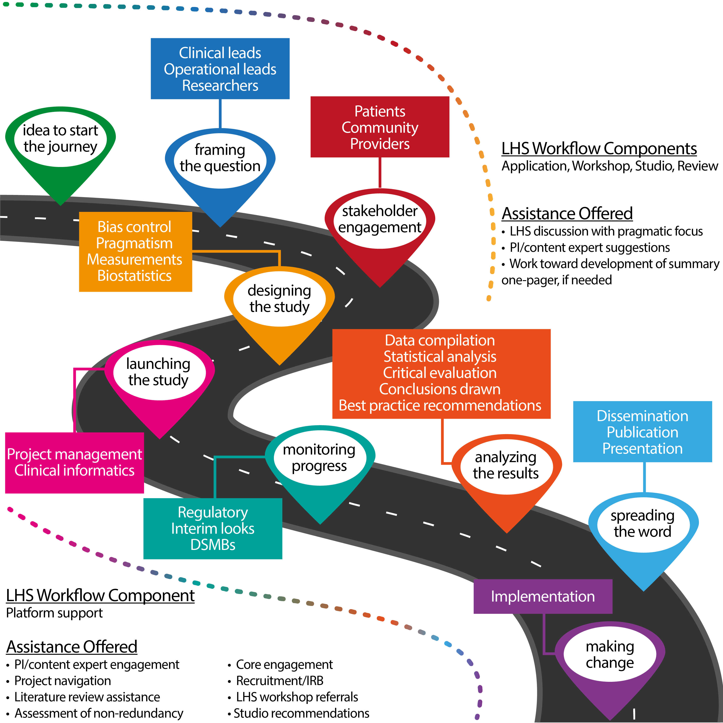
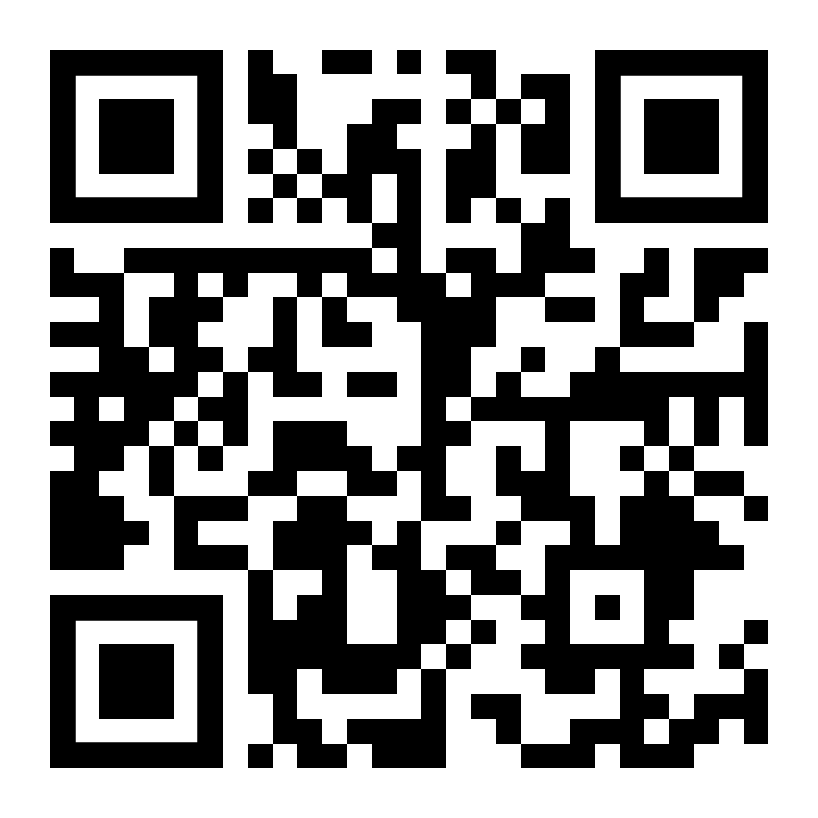
Learning Healthcare: Managing the Partnerships, Pathways, and Projects in Pragmatic Trials
Cheryl Gatto, PhD¹, Mary Lynn Dear, PhD¹, Reagan Buie, MHA¹, Estefania Gibson¹, William Hiser¹, Todd Rice, MD, MSc², Christopher Lindsell, PhD^{1,3}, Jill Pulley, MBA^{1,2}, Bob Dittus, MD, MPH^{4,5} and Gordon Bernard, MD^{1,2} for the Vanderbilt Learning Healthcare System Investigators
¹Vanderbilt Institute for Clinical and Translational Research, Vanderbilt University Medical Center, ²Department of Allergy/Pulmonary and Critical Care Medicine, Vanderbilt University Medical Center, ³Department of Biostatistics, Vanderbilt University Medical Center, ⁴Division of General Internal Medicine and Public Health, Vanderbilt University Medical Center, ⁵VA Tennessee Valley Healthcare System Geriatric Research, Education and Clinical Center
PURPOSE
LHS PROJECT NAVIGATION
LHS RESEARCH QUESTIONS
At VUMC, our Learning Healthcare System (LHS) focuses on bringing clinical research and clinical operations together as collaborative partners. Evidence generated through carefully designed, rigorous study informs recommendations for best practices. At the same time, critical issues that arise in the delivery of patient care generate pressing questions to pursue. The LHS Research Support Platform provides technical, procedural, and human infrastructure for organizing and supporting individual LHS projects to successful execution. We work with clinical, operations, research, and statistical experts to create the frontline team that drives the investigation, while leveraging our experience to facilitate the design, implementation and analysis of prospective, randomized, controlled, pragmatic clinical trials embedded within the context of routine care delivery. We promote the adoption of a healthcare culture that centers on learning from what we do and doing what we learn.
ACKNOWLEGEMENTS
The LHS Platform has been supported by countless people across the Vanderbilt University Medical Center and beyond. We thank our leadership, Steering Committee, and LHS Workshop teams for their enduring service and support. The VICTR LHS Platform is supported by CTSA award No. UL1TR002243 from NCATS. Its contents are solely the responsibility of the authors and do not necessarily represent official views of the National Center for Advancing Translational Sciences or the National Institutes of Health.
CONTACT INFORMATION
To learn more,
visit our StarBrite
page:

