Slide 1
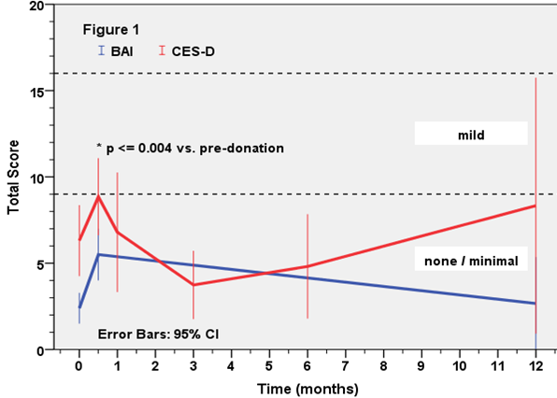
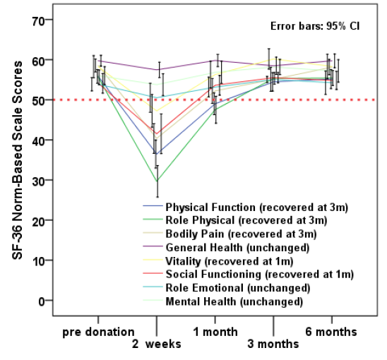
Health-Related Quality of Life in Living Organ Donors:
Research Project Development and Process Improvement
Cassandra Bruns, DNP, APRN, FNP-BC • Anthony Dreher, MPA • Scott Rega, MS • Irene Feurer, PhD • Deonna Moore, PhD, MSN, ACNP
Background
Survey Distribution Schedule
Health-related quality of life (HRQOL) describes how an individual’s health impacts their quality of life.
Benefits of living donation: decreased wait time, better recipient outcomes, allograft longevity.
Vanderbilt has a long history of assessing longitudinal, patient-reported outcomes among solid organ transplant candidates and recipients, but we currently have no longitudinal process for collecting living donor data.
Past research indicates long-term quality of life after donation is equal to or better than the general population, but there is still a lot to be learned about the affects of donation on mental and physical HRQOL.
Survey Instrument (# items) | Pre | 3 D Post | 2 W Post | 1 M Post | 3 M Post | 6 M Post | Ann Post
SF-36® (36) | X |  | X | X | X | X | X
Numerical Pain Scale (1) | X | X | X | X | X | X | X
PROMIS Anxiety (8) | X |  | X | X | X | X | X
CES-D Depression Scale (20) | X |  | X | X | X | X | X
EQ-5D Health Survey (6) | X |  | X | X | X | X | X
Healthcare Process Survey (16) | X |  |  |  |  |  | X
Project Development
Current & Future Aims
Transition from paper to electronic survey administration – prompted by grant funding
Completion of three IRB amendments to include liver donors, update electronic survey instrumentation, eConsent, establish rolling enrollment, obtain approval for recruitment materials and email survey invitations, and establish a process for distributing witnessed consents to participants
Longitudinal REDCap database development and testing – pre- and post-donation enrollment
Discussion with living donor coordinators
This was very much an iterative process!
To evaluate the short and long-term effects of living kidney and liver donation on HRQOL.
Help influence practice changes and provide us with data to monitor for adverse effects of newly implemented practice changes.
Improve willingness of the general population to participate in living donation.
Expand the project to assess the impact of COVID-19 on longitudinal mental and physical HRQOL (ASTS funding).
Photo from United Network for Organ Sharing
Past VUMC Research
Lessons Learned
Longitudinal data from 50 kidney donors spanning 1 year
At 2 weeks post-donation, patients reported an increase in depression and anxiety, however, these reductions were short-lived and participant anxiety and depression returned to baseline at about 1 month.
HRQOL declines initially after donation with participants reporting a reduction in 5 of the 8 HRQOL domains.
Pain, activity level, and HRQOL returned to pre-donation baseline approximately 1-3 months post-donation.
Patience and persistence are key to your success!
Don’t be afraid to reach out for help or consult your colleagues for their advice and expertise.
Don’t sweat the IRB process. It can be time consuming but use it as a learning experience.
Look at the projects being done in your practice area. There may be ways you can help refine a project or put your own twist on it.
Office of Disease Prevention and Health Promotion. Health-related quality of life and well-being. https://www.healthypeople.gov/2020/about/foundation-health-measures/Health-Related-Quality-of-Life-and-Well-Being. Published October 8, 2020.
Vanderbilt Health. Living kidney donor transplant. https://www.vanderbilthealth.com/program/living-kidney-donor-transplant. Published date unknown.
de Groot IB, Stiggelbout AM, van der Boog PJM, et al. Reduced quality of life in living kidney donors: Association with fatigue, societal participation and pre-donation variables. Transpl Int. 2012;25(9):967-975.
Glotzer OS, Singh TP, Conti DJ, Siparsky NF. Long-term quality of life after living kidney donation. Transplant Proc. 2013;45(9):3225-3228.
Gross CR, Messersmith EE, Hong BA, et al. Health-related quality of life in kidney donors from the last five decades: Results from the RELIVE Study. Am J Transplant. 2013;13(11):2924-2934.
Moore D, Dageforde LA, Feurer I, Moore DE. Mental health-related quality of life, depression and anxiety in living kidney donors. Poster presented at: ASTS; 2016.
Dageforde LA, Feurer I, Moore DM. Longitudinal health-related quality of life, pain and activity in living kidney donors. Presented at: ASTS; 2014.
Notes:
Background
- Four dimensions of HRQOL: physical, mental, emotional, and social.
- The first living kidney transplant in the US was performed in 1945 at Brigham and Women’s Hospital in Boston. A man by the name of Ronald Herrick donated a kidney to his identical twin brother Richard. The first living liver transplant in the US was performed in 1989 at the University of Chicago Medical Center.
- Recent organ shortages have led to an increased utilization of living organ donors to help fill the void.
- Since the start of Vanderbilt’s living kidney donor program in 1970, more than 1,750 living kidney donor transplants have been performed.
- Established in 2019, the living liver program has performed 5 living liver transplants.
Past VUMC Research
- Longitudinal data collected from 50 living kidney donors between July 2012 and August 2013. Highlight the fact that living donor HRQOL research at VUMC has only been on living kidney donors and not living liver.
- Explain the SF-36 and mention the 8 domains that it measures as well as that it is a validated measure of HRQOL.
- List the 5 domains that were reduced following donation (physical function, role physical, bodily pain, vitality, social functioning)
Project Development
- Briefly discuss how surveys were distributed either by mail or in-person at an office visit
- Grant funding (mention Heather) allowed for the study team to purchase iPads for electronic survey administration which prompted the transition from paper to electronic format
- Discuss what went into the IRB amendments, explain the process for submitting an amendment
- Explain what went into the REDCap database development and testing – also briefly describe the rolling enrollment process and how participants can either be brought into the study before or after donation
- Discussion with living donor coordinators – allowed us to refine out process and make revisions based on what they felt would work best for the participants
- Explain iterative process diagram

