Slide 1
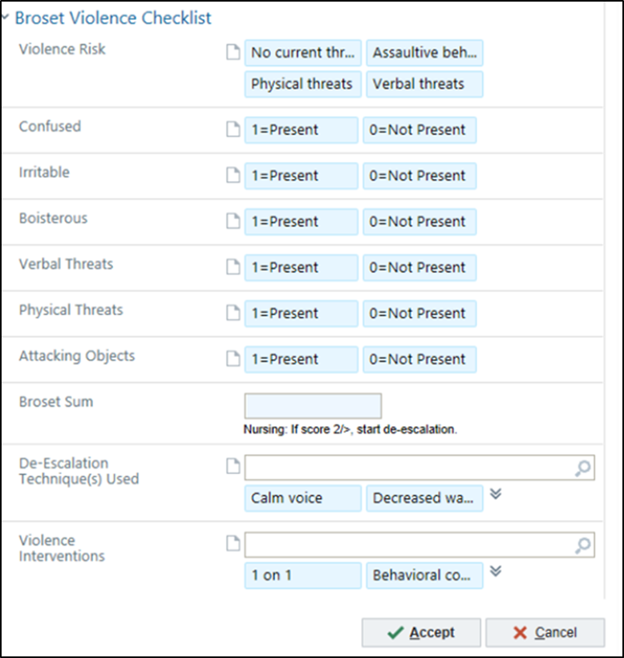
Management of Aggression in Behavioral Health Patients
Broset Violence Checklist provides a standardized approach to scoring and treating aggression
AUTHORS:
- Bethan Hughett, RN, BSN, CPEN
- Kate Copeland, MSN, RN, NEA-BC
BACKGROUND:
National and local trends show an increase in patients with behavioral health problems.
Patients with a chief complaint of aggression make up approximately 20-40 of our acute ED visits each month.
INTERVENTION:
Broset Violence Checklist (BVC) was chosen to help measure aggression and predict violence.
BVC implemented in the Pediatric ED in September 2018.
Score-based interventions implemented, both pharmacological and non-pharmacological.
INTERVENTION cont:
Pharmacological- medications based on the score given to the patients developed and added to ordering system.
Non-pharmacological- most successful were My Health Passport (MHP) and Safe Activity Bags.
RESULTS:
The use of BVC has resulted in a 50% decrease in our use of violent restrains as compared to baseline data.
Seen a shift in our team culture with a greater understanding of the needs of this patient population.
LESSIONS LEARNED:
Individualize education and coaching
Education and training requires MD involvement and understanding
Pharmacological inventions are needed but must be paired with non-pharmacological interventions.
Family understanding and partnership is optimal.

